Slide 1
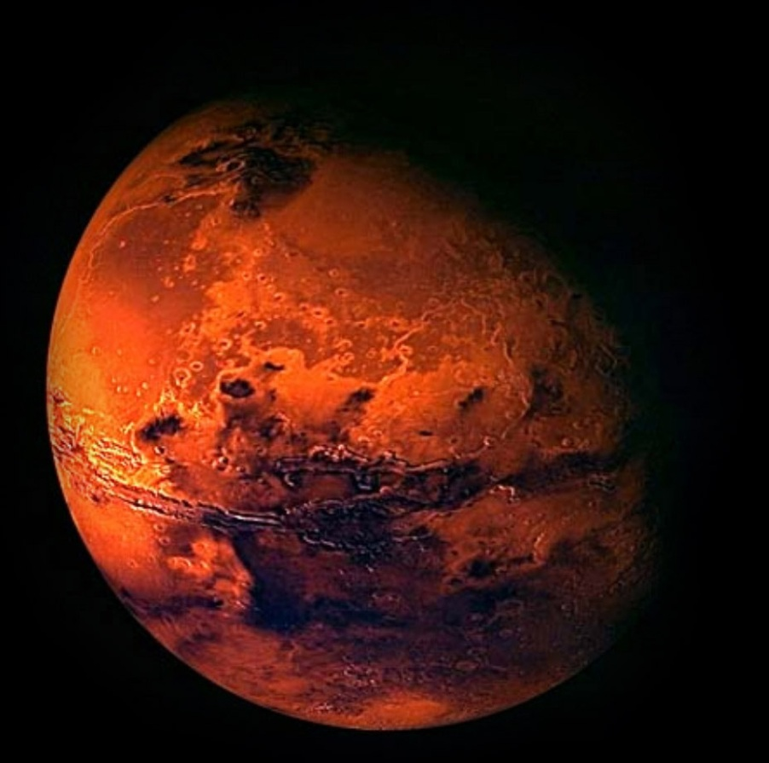
Physics 4A Project #2 – To Mars!
Richard The

Slide 2
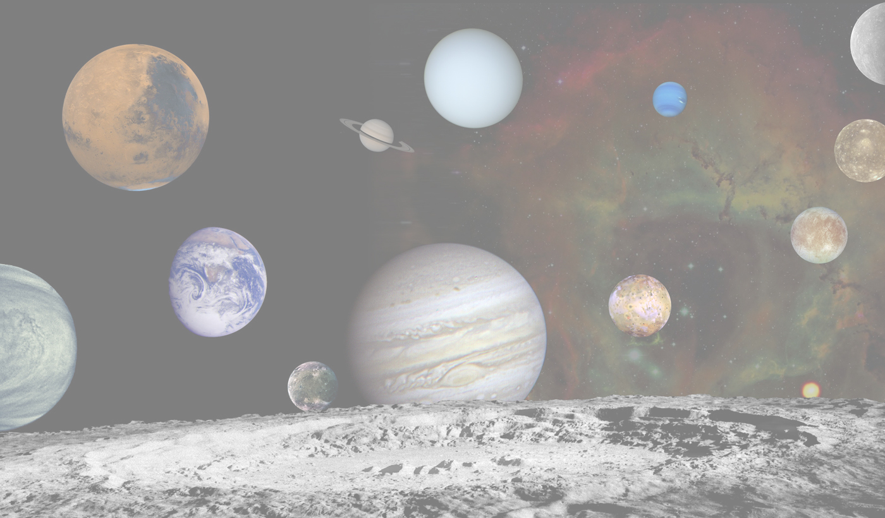
Setting Up the Solar System
Defined the properties of the planets & moons
Getting them to orbit correctly
Selecting a launch date
With a launch date we set the start positions of the planets by using data from JPL horizon (http://www.jpl.nasa.gov/)
Converted the data to polar coordinates to create an angle corresponding to each planets (and moons) start point.
With this the planets where then updated to start at the corresponding starting angles and given distance so they mimic their positions on the given date.

Slide 3

Setting Up the Launch
Calculated the acceleration due to the rockets thrust from its changing mass and changing velocity.
Determined the angle at which the space craft launched/rotates from.
Incorporation of air drag
Found equations to determine the variables of air drag.
Calculated the cross-sectional area of the Atlas V rocket to be that or a circle with a diameter 3.81 meters.
Found the coefficient of drag to be 0.4, the coefficient of streamline model rockets (http://library.thinkquest.org/10568/aerodynamics/forces.html)
Shut off the pressure equation at 44,300 meters so we would not get imaginary numbers.

Slide 4

Formulas
$Fthrust=Isp∙g∙\frac{∆m}{∆t}$
$Vorbit= \sqrt{\frac{G∙M}{R}}$
Acceleration from a rocket :
$a=\frac{Fthrust}{m}∙(directional vector)$

Slide 5
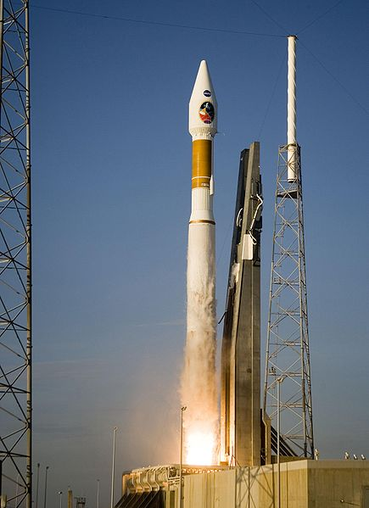
Atlas V-541

Slide 6
Atlas V-541 (stage 1)
CCB (Common Core Booster)
F_{thrust} = 4,152 kN
m_{total} = 307,000 kg
m_{fuel} = 284,450 kg
Burn Rate = 1,360.9 kg/s
t_{burn} = 253 seconds
I_{sp} = 311 seconds
Aerojets (4)
F_{thrust} = 1,270 kN
m_{total} = 40,820 kg
m_{propellant} = 36,820 kg
Burn Rate = 529 kg/s
I_{sp} = 245 seconds

Slide 7
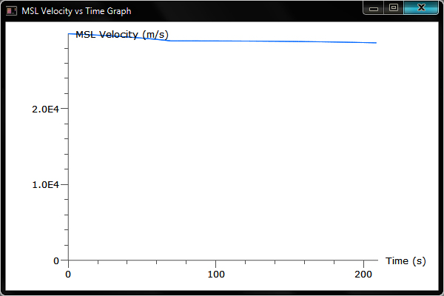
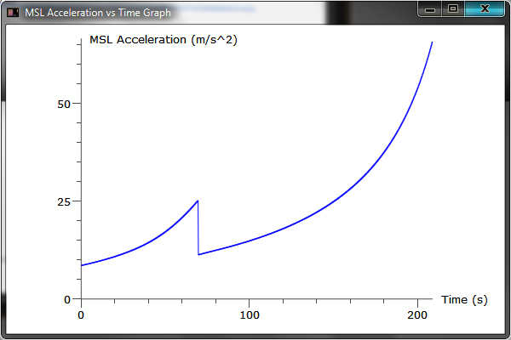
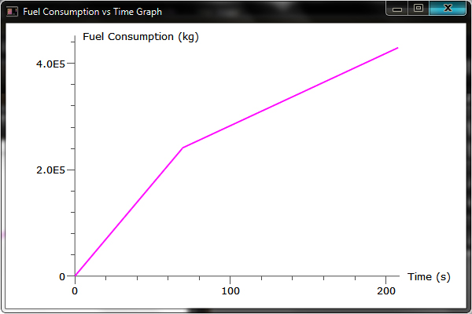
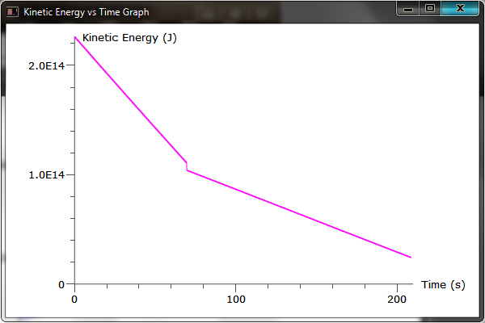
Atlas V-541 (stage 1)

Slide 8
Atlas V-541 (stage 2)
Centaur
F_{thrust} = 99.2 kN
m_{total} = 18,710 kg
m_{fuel} = 16,805 kg
Burn Rate = 22.42 kg/s
t_{burn} = 738 seconds
I_{sp} = 451 seconds

Slide 9
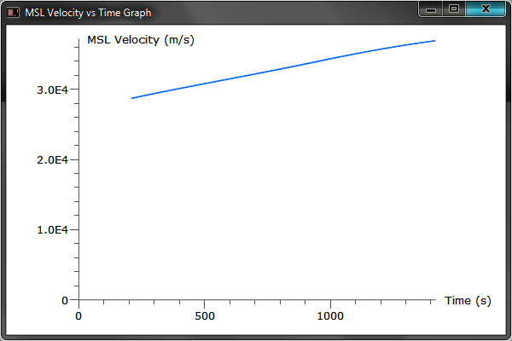
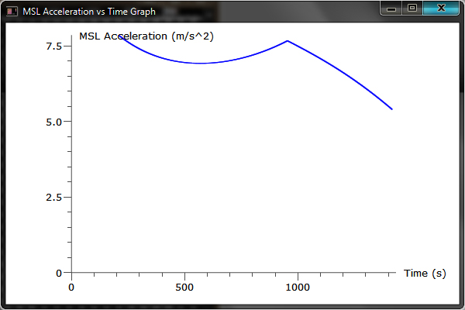
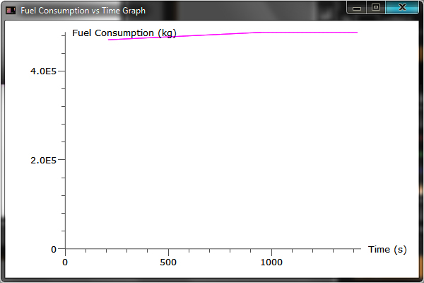
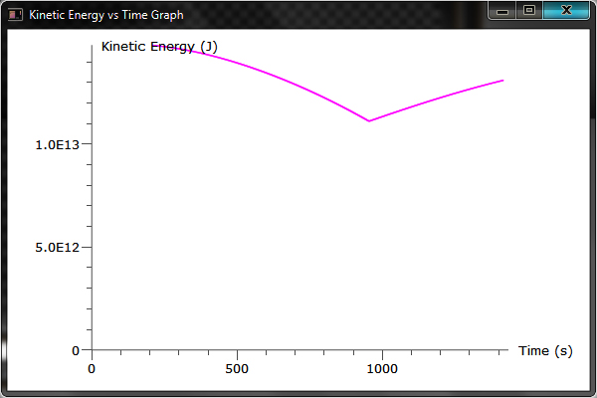
Atlas V-541 (stage 2)

Slide 10
Atlas V-541 (stage 3)
Space Maneuvering Thruster (NK-43)
v_{ex} = 3,248 m/s
F_{thrust} = 1,753.8 kN
I_{sp} = 331 seconds
m_{dry} = 1,235 Kg
Payload
mass = 3,000 kg
1,000kg “Curiosity” + accessories & landing craft
Total Fuel Used = 478,650 kg

Slide 11
NK-43
NK-33 and NK-43 are rocket engines designed and built in the late 1960s and early 1970s by the Kuznetsov Design Bureau. They were intended for the ill-fated Soviet N-1 rocket moon shot. The NK-33 engine achieves the highest thrust-to-weight ratio of any Earth-launchable rocket engine, whilst achieving a very high specific impulse. NK-33 is by many measures the highest performance LOX/Kerosene rocket engine ever created.
http://en.wikipedia.org/wiki/NK-33

Slide 12
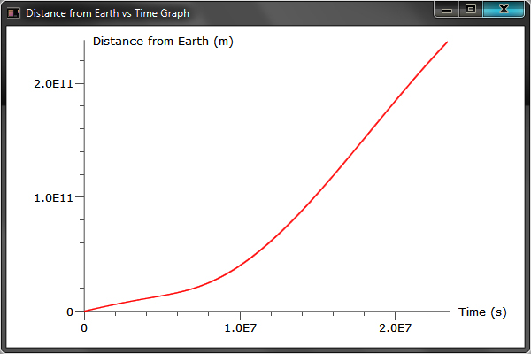
Distance from the Earth

Slide 13
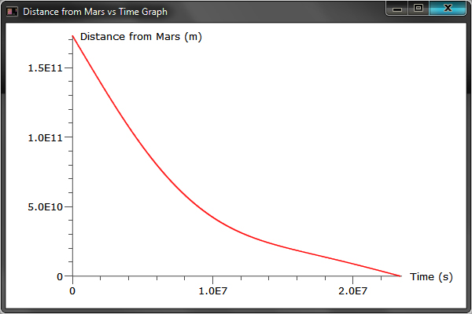
Distance from Mars

Slide 14
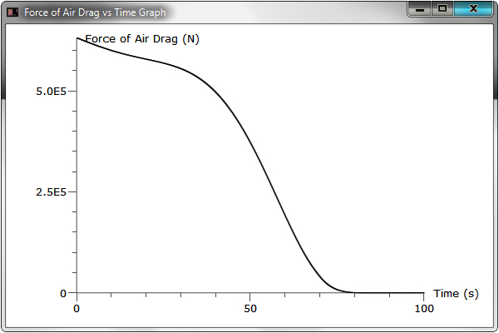
Air Drag (Earth)

Slide 15
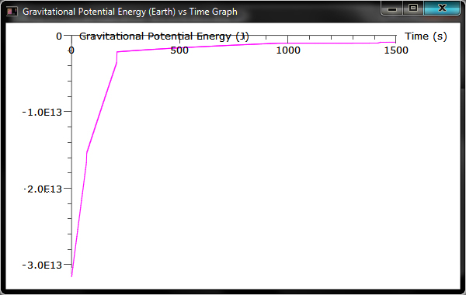
Gravitational Potential Energy (Earth)

Slide 16
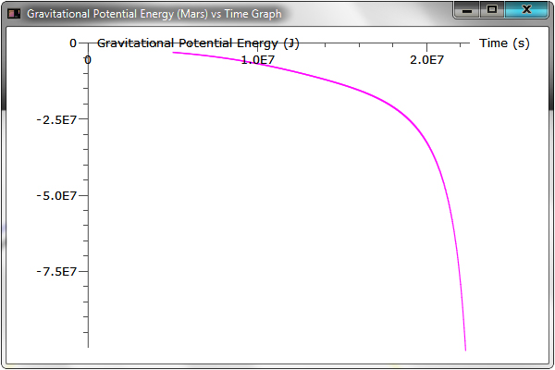
Gravitational Potential Energy (Mars)

Slide 17
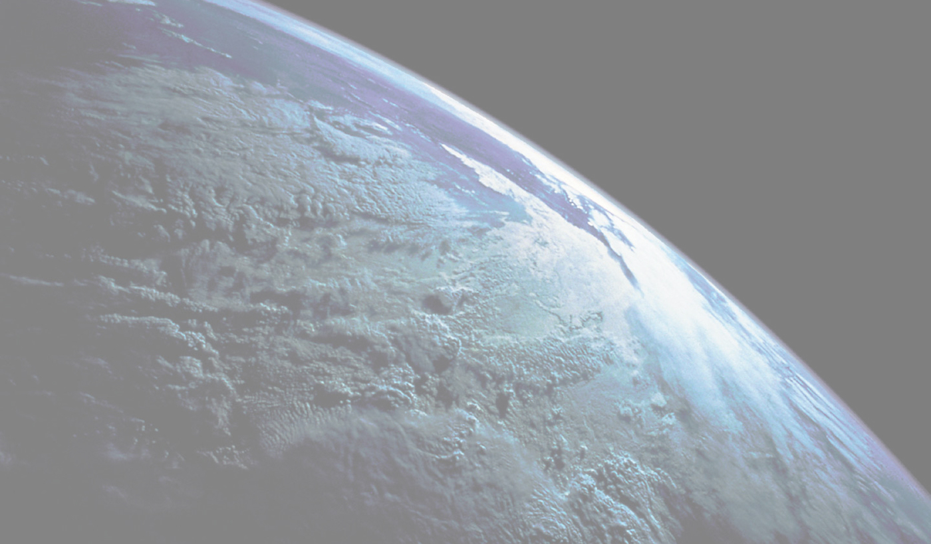
Resources
http://www.jpl.nasa.gov/
http://www.spacelaunchreport.com/atlas5.html
http://library.thinkquest.org/10568/aerodynamics/forces.html
http://www.astronautix.com

