Slide 1
Agent S: An Open Agentic Framework that Uses Computers Like a Human
CVPR 2024
Saaket Agashe, Jiuzhou Han, Shuyu Gan, Jiachen Yang, Ang Li, Xin Eric Wang
Simular Research
Presenter: Bo-Yu Chen

Slide 2
Introduction

Slide 3
Introduction
Autonomous Graphical User Interface (GUI) agents offer the promise of solving very specific and highly varied user queries such as data entry, scheduling, and document creation for individual users, and streamlining operations in commercial settings in the most general way: through direct UI interaction using the mouse and keyboard. Moreover, by eliminating the need for constant manual interaction, these agents not only boost efficiency but also improve accessibility, empowering individuals with disabilities to interact with technology in new, transformative ways.
Recent advancements in Multimodal Large Language Models (MLLMs), such as GPT-4o (OpenAI, 2023) and Claude (Anthropic, 2024), have laid the foundation for the development of GUI agents for human-centred interactive systems like desktop OS (Xie et al., 2024; Bonatti et al., 2024).
Notes:
自動化 GUI Agents 提供了一種解決各種特定且多樣化使用者需求的可能性——例如，為個人使用者處理資料輸入、排程和創建文件，並在商業環境中優化操作。而這些代理能夠以最通用的方式來執行任務：透過滑鼠和鍵盤直接與使用者介面互動。此外，透過消除不斷的手動操作需求，這些代理不僅能提升效率，還能改善無障礙性，使身心障礙者能夠以全新的方式與科技互動，帶來變革性的影響。
近年來，多模態大型語言模型（MLLMs）的進步，例如 GPT-4o（OpenAI，2023）和 Claude（Anthropic，2024），為 GUI 代理的發展奠定了基礎，使其能夠應用於以人為中心的互動系統，如桌面作業系統（Xie 等，2024；Bonatti 等，2024）。

Slide 4
Challenge
However, automating computer tasks presents significant challenges.
First, the vast range of constantly evolving applications and websites requires the agent to possess specialized and up-to-date domain knowledge and the ability to learn from open-world experience.
Second, complex desktop tasks often involve long-horizon, multi-step planning with interdependent actions that must be executed in a specific sequence.
Third, GUI agents must navigate dynamic, non-uniform interfaces, processing large volumes of visual and textual information while operating within a vast action space. This involves distinguishing between relevant and irrelevant elements, accurately interpreting graphical cues, and responding to visual feedback during task execution.
Notes:
然而，自動化電腦任務面臨重大挑戰。首先，不斷發展的應用程式和網站範圍廣泛，要求agent具備專業且最新的領域知識，並能夠從開放世界的經驗中學習。其次，複雜的桌面任務通常涉及長期、多步驟的規劃，其中各個動作相互依賴，必須按照特定順序執行。第三個，GUI agent 需要在動態且不統一的介面中運作，處理大量的視覺和文本資訊，同時在廣泛的操作空間內執行任務。這涉及區分相關與無關的元素，準確解讀圖形提示，並在任務執行過程中對視覺反饋做出適當反應。

Slide 5
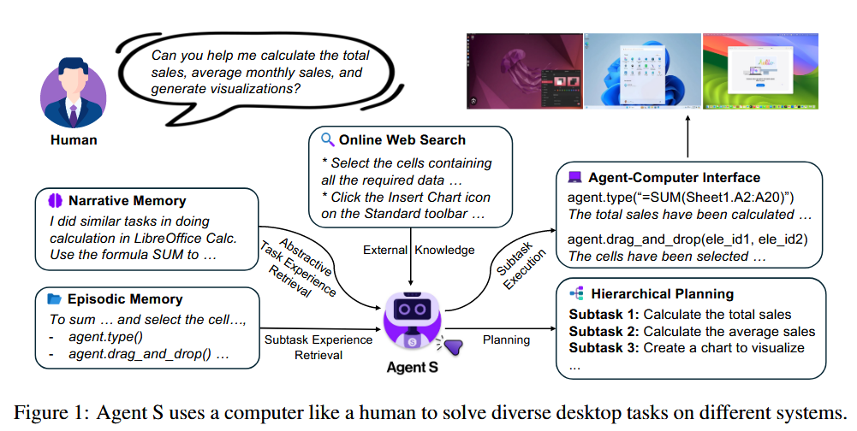
Introduction
In this paper, we present Agent S, a new agentic framework that tackles these challenges towards the goal of using computers like a human. First, to enhance the GUI agent’s capabilities in solving diverse, long-horizon desktop tasks with specific domain knowledge, we propose an Experience Augmented Hierarchical Planning method. This approach leverages Online Web Knowledge and past experiences stored in Narrative Memory to decompose the complex, long-horizon task into a structured plan of manageable subtasks (see Figure 1).
Notes:
在本文中，作者介紹了 Agent S，一個全新的 agentic framework ，旨在解決上一頁提到的挑戰，目標是像人類一樣使用電腦。首先，為了增強 GUI Agent 在解決多樣且長期的桌面任務時，具備特定領域知識的能力，作者提出了一種 Hierarchical Planning method。這種方法利用 Online Web Knowledge 和儲存在 past experiences stored in Narrative Memory ，將複雜且長期的任務分解為一個結構化的、可管理的子任務計劃（見圖 1）。

Slide 6
Introduction
We introduce a specific language centric Agent-Computer Interface (ACI) (Lieberman & Selker, 2003) as an abstraction layer to improve grounding, safety, and efficiency for MLLM-based GUI agents.
The ACI defines an interaction paradigm by (1) a dual-input strategy using visual input for understanding environmental changes together with an image-augmented accessibility tree for precise element grounding; (2) a bounded action space of language-based primitives (e.g., click(element id)) that are conducive to MLLM common-sense reasoning and generate environment transitions at the right temporal resolution for the agent to observe immediate and task-relevant environment feedback.
Notes:
我們介紹了一個特定的以語言為中心的 Agent-Computer Interface (ACI)作為一個抽象層，旨在提高 MLLM 基礎的 GUI 代理的基礎元素定位、安全性和效率。
ACI 定義了一種互動範式，具體包括：（1）dual-input strategy ，使用視覺輸入來理解環境變化，並結合 image-augmented accessibility tree 來進行精確的元素定位；（2）一個限制性的動作空間，其中包含一些基本的操作（例如，click(element id)）。這樣的設計有助於 MLLM 更好地進行常識推理，並且能夠在正確的時間點做出反應，讓代理可以根據環境變化快速回應並獲取與任務相關的即時反饋

Slide 7
Introduction
Our approach shows a remarkable improvement in the overall performance of Agent S on the OSWorld benchmark (OpenAI, 2023) (from 11.21% to 20.58%, with a relative improvement of 83.6%), establishing the new state-of-the-art results.
We also evaluate our Agent S on a concurrent work WindowsAgentArena (Bonatti et al., 2024), where we observe a performance improvement from 13.3% to 18.2% on an equivalent setup without any explicit adaptation. The improvement demonstrates the broad generalizability of Agent S to different operating systems. We detail the component-wise improvements introduced by the proposed strategies through ablation studies and present a comprehensive error analysis of our Agent S framework.
Notes:
作者的方法顯示 Agent S 在 OSWorld benchmark（OpenAI，2023）上的整體性能有顯著提升（從 11.21% 提升至 20.58%，相對改善達 83.6%），創下了新的 state-of-the-art。
我們還在同期的工作 WindowsAgentArena（Bonatti 等，2024）上對 Agent S 進行了評估，結果顯示，在相同設置下，性能從 13.3% 提升至 18.2%。這一改進顯示了 Agent S 在不同操作系統中的廣泛泛化能力。作者通過ablation studies詳細說明了所提出策略的組件性改進，並對 Agent S 框架 進行了全面的錯誤分析。

Slide 8
Related Works

Slide 9
MLLM Agents
The advent of Multimodal Large Language Models (MLLMs) has led to a host of works that utilize them as a reasoning backbone in Agentic Systems (Sumers et al., 2024). These Agents augment LLMs with Memory, Structured Planning (Wang et al., 2023; Shinn et al., 2023; Weng et al., 2023), Tool Use (Schick et al., 2023; Shen et al., 2023; Patil et al., 2023) and the ability to Act in external environments Park et al. (2023).
These agents have shown promise in domains ranging from embodied simulators (Liang et al., 2023; Song et al., 2023) to video games (Wu et al., 2023; Wang et al., 2024) and scientific research (Bran et al., 2023). For Software Engineering (Hong et al., 2024; Qian et al., 2024) in particular, Yang et al. (2024) proposed an Agent-Computer Interface (Lieberman & Selker, 2003) for MLLM agents to understand and act more efficiently and reliably. Our work extends and integrates these individual modules into a new MLLM agent framework for computer control.
Notes:
多模態大型語言模型（MLLMs）的出現促成了許多研究，這些研究將它們作為推理核心應用於 Agentic Systems 這些 Agent 通過結合記憶、結構化規劃、工具使用以及在外部環境中執行行動的能力（Park 等，2023）來增強 LLM 的能力。
這些代理在多個領域顯示出潛力，從 embodied simulators（Liang 等，2023；Song 等，2023）到 video games （Wu 等，2023；Wang 等，2024）以及 scientific research （Bran 等，2023）。特別是在 Software Engineering （Hong 等，2024；Qian 等，2024）領域，Yang 等（2024）提出了 Agent-Computer Interface（Lieberman & Selker, 2003），使得 MLLM 代理能夠更高效且可靠地理解和執行操作。我們的研究將這些模組擴展並整合為一個全新的 MLLM agent framework ，用於電腦控制。

Slide 10
GUI Agents
Early research concentrated on web navigation tasks, utilizing MLLMs to interact with web interfaces (Gur et al., 2024; He et al., 2024; Kim et al., 2023; Shaw et al., 2023; Putta et al., 2024). Recently, the focus has shifted to OS-level environments, leading to the development of benchmarks and frameworks such as OSWorld Xie et al. (2024) and WindowsAgentArena for desktop control, and DiGIRL (Bai et al., 2024) and AndroidWorld (Rawles et al., 2024) for mobile environments.
Methodologically, earlier GUI agents employed behavioral cloning with reinforcement learning (Humphreys et al., 2022), in-context trajectory examples (Zheng et al., 2024b), state-dependent offline experience (Fu et al., 2024b), and reusable skill generation (Wang et al., 2024). Our work contributes unique modules such as experience-augmented hierarchical planning and ACI for GUI control, integrated with a novel continual memory update framework.
Notes:
早期?的研究集中於 web navigation 任務，利用 MLLMs 與網頁介面進行互動（Gur 等，2024；He 等，2024；Kim 等，2023；Shaw 等，2023；Putta 等，2024）。最近，研究重心已轉向操作系統層級的環境，並開發了像 OSWorld（Xie 等，2024）和 WindowsAgentArena 這樣的基準測試和框架，用於桌面控制，還有 DiGIRL（Bai 等，2024）和 AndroidWorld（Rawles 等，2024）用於行動裝置環境。
在方法上，早期的 GUI 代理使用了 基於強化學習的 behavioral cloning （Humphreys 等，2022）、in-context trajectory examples （Zheng 等，2024b）、state-dependent offline experience （Fu 等，2024b）和reusable skill generation （Wang 等，2024）。作者的研究貢獻了獨特的模組，如 experience-augmented hierarchical planning 和 ACI，並將其與創新的 continual memory update framework 整合，用於 GUI 控制。

Slide 11
Retrieval-Augmented Generation (RAG) for AI Agents
RAG (Fan et al., 2024) improves the reliability of MLLM inference by augmenting the input with reliable and up-to-date external knowledge. Similarly, MLLM agents benefit from retrieving task exemplars (Kim et al., 2024), state-aware guidelines (Fu et al., 2024a), and past experiences (Kagaya et al., 2024). Our use of experience for augmentation differs in three ways: 1) our hierarchical planning leverages both full task experience and subtask experience; 2) the full task experience is summarized into an abstractive textual reward for subtask planning; 3) the subtask experience is assessed and annotated by a self-evaluator before being stored in memory.
Notes:
RAG（Fan 等，2024）通過將 reliable and up-to-date external 的外部知識增強輸入，提升了 MLLM 推理的可靠性。同樣，MLLM 代理也能從 retrieving task exemplars 、state-aware guidelines 和 past experiences 中受益。
作者在experience for augmentation的使用方面有三個不同之處：
作者的hierarchical planning同時利用了完整的任務經驗和子任務經驗；
完整的任務經驗被總結為一個abstractive textual reward ，用於子任務規劃；
子任務經驗在存儲到記憶之前，會由self-evaluator進行評估和註釋。

Slide 12
Method

Slide 13
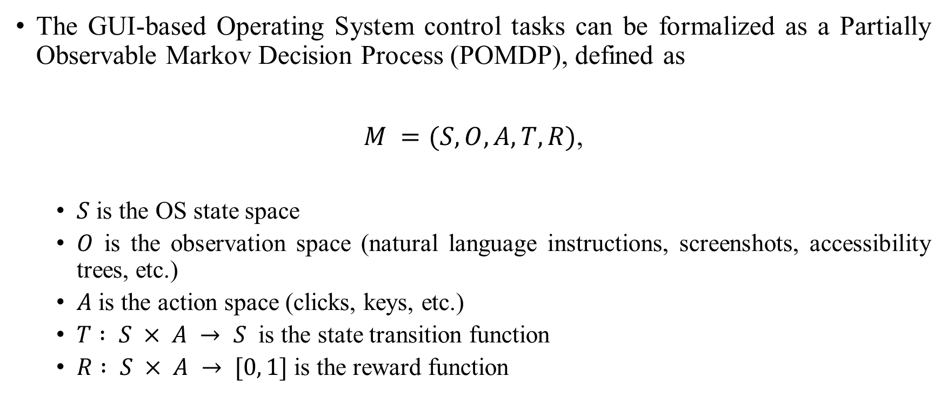
AGENT S
The GUI-based Operating System control tasks can be formalized as a Partially Observable Markov Decision Process (POMDP), defined as
$M =(S,O,A,T,R)$,
$S$ is the OS state space
$O$ is the observation space (natural language instructions, screenshots, accessibility trees, etc.)
$A$ is the action space (clicks, keys, etc.)
$T : S × A → S$ is the state transition function
$R : S × A → [0, 1]$is the reward function
Notes:
符號 → 表示一個 映射（mapping） GUI-based 使用者介面的作業系統控制任務可以形式化為 Observable Markov Decision Process定義為： S 是作業系統的 狀態空間（State Space）。 OOO 是 觀察空間（Observation Space），包括自然語言指令、螢幕截圖、可及性樹等。 AAA 是 行動空間（Action Space），例如點擊（clicks）、鍵盤輸入（keys）等。 T:S×A→ST : S \times A \rightarrow ST:S×A→S 是 狀態轉移函數（State Transition Function），描述每一個狀態和行動對應的下一個狀態。 R:S×A→[0,1]R : S \times A \rightarrow [0, 1]R:S×A→[0,1] 是 獎勳函數（Reward Function），將每一對狀態和行動映射到一個 [0, 1] 範圍內的值，表示該行動的效果。

Slide 14
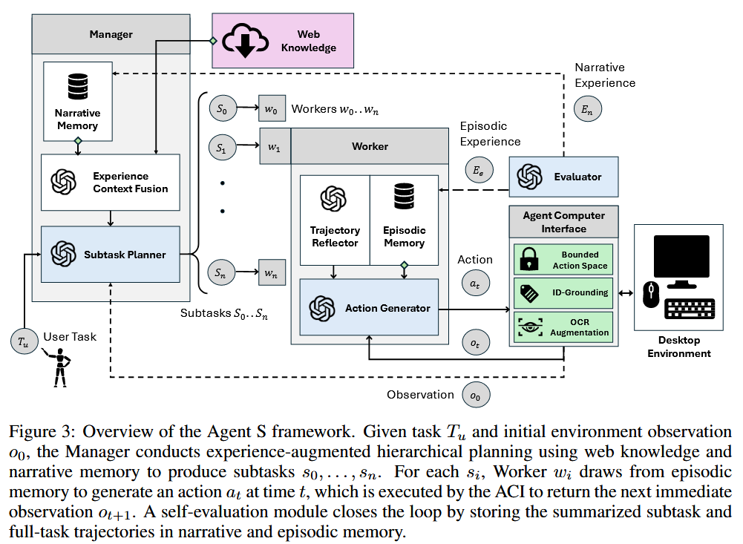
Experience-augmented hierarchical planning
Continual update of narrative and episodic memory
Agent-computer interface for precise perception and action on GUIs.
Notes:
用戶提供任務 TuT_uTu​。 管理者基於任務和初始環境觀察進行層次規劃，生成子任務 S0,S1,…,SnS_0, S_1, \dots, S_nS0​,S1​,…,Sn​。 每個子任務交由工作者執行，並從情節記憶中檢索經驗。 根據當前狀況生成並執行行動。 自我評估模組評估並更新敘述記憶和情節記憶。 循環進行，直到完成所有任務。

Slide 15
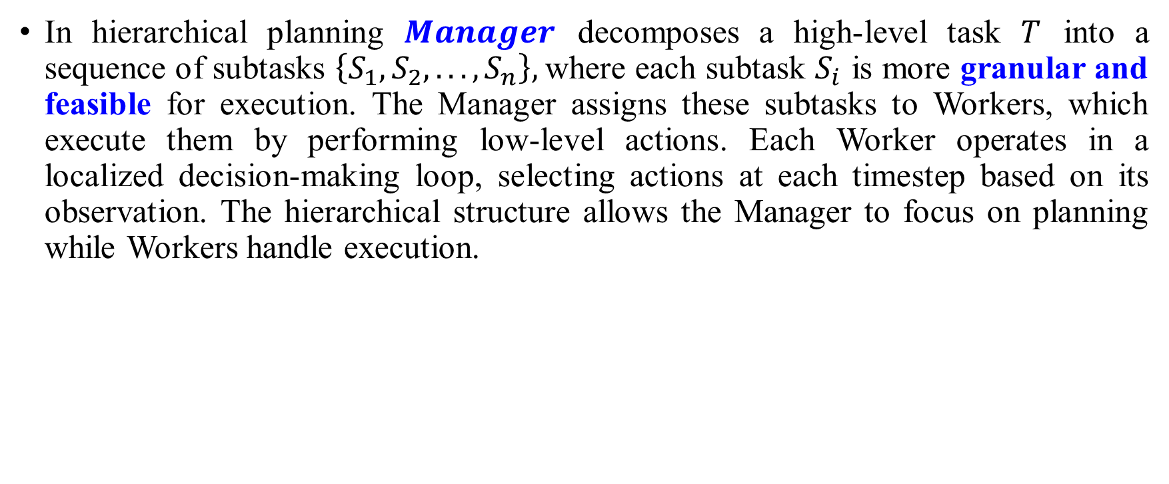
Experience-Augmented Hierarchical Planning
In hierarchical planning $Manager$ decomposes a high-level task $T$ into a sequence of subtasks $\left\{S_{1}, S_{2}, . . . , S_{n}\right\},$where each subtask $S_{i}$ is more granular and feasible for execution. The Manager assigns these subtasks to Workers, which execute them by performing low-level actions. Each Worker operates in a localized decision-making loop, selecting actions at each timestep based on its observation. The hierarchical structure allows the Manager to focus on planning while Workers handle execution.
Notes:
在hierarchical planning中，Manager 將高層次的任務 T 分解為一系列子任務 {S1,S2,…,Sn}，其中每個子任務 Si​ 都是更具體且可執行的。Manager 將這些子任務分配給 Workers，由 Workers 執行這些子任務，並通過執行低層次的操作來完成。每個 Worker 在一個局部的決策迴圈中運作，根據其觀察在每個timestep選擇行動。這種層次結構使得 Manager 可以專注於規劃，而 Workers 負責具體的執行。

Slide 16
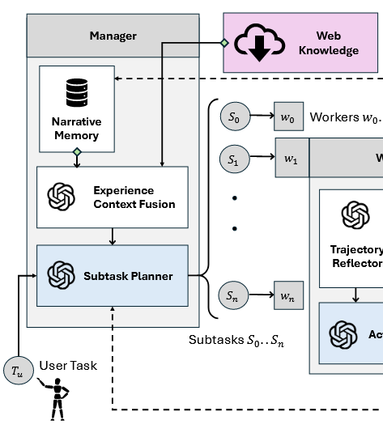

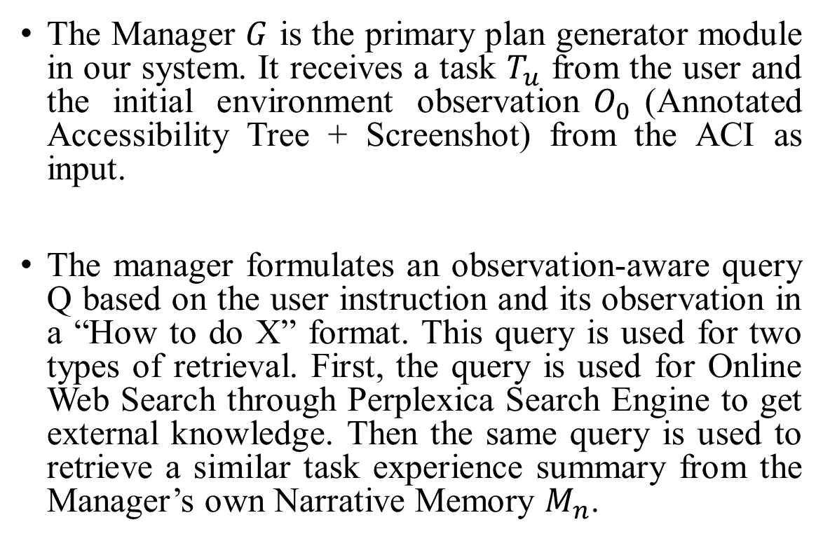
Manager: Fusing External Knowledge and Internal Experience for Planning
The Manager $G$ is the primary plan generator module in our system. It receives a task $T_{u}$ from the user and the initial environment observation$O_{0}$(Annotated Accessibility Tree + Screenshot) from the ACI as input.
The manager formulates an observation-aware query Q based on the user instruction and its observation in a “How to do X” format. This query is used for two types of retrieval. First, the query is used for Online Web Search through Perplexica Search Engine to get external knowledge. Then the same query is used to retrieve a similar task experience summary from the Manager’s own Narrative Memory $M_{n}$.
Notes:
Manager G 是系統中的主要plan generator module 。它接收來自用戶的任務 Tu​ 和來自 ACI 的初始環境觀察 O0（包括註解過的可及性樹和截圖）作為輸入。
管理者根據用戶指令和其觀察生成一個觀察感知查詢 Q，以 "如何做 X" 的格式來表達。這個查詢被用於兩種類型的檢索。首先，該查詢會通過 Perplexica 搜索引擎 進行線上網絡搜索，以獲取外部知識。然後，這個查詢也會用來從 Manager 自身的 敘述記憶 Mn​ 中檢索類似任務的經驗總結。
The retrieval is based on the similarity of the query embedding.

Slide 17

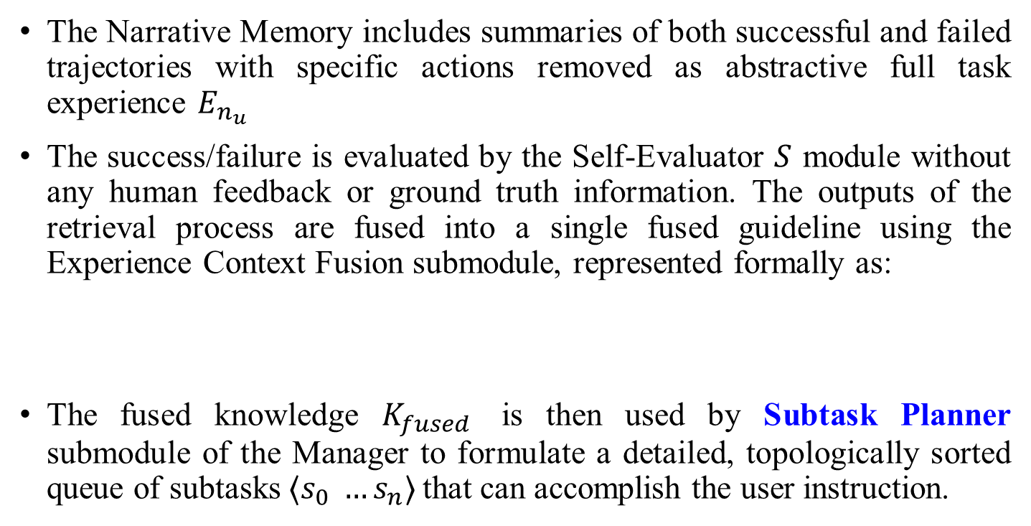
Manager: Fusing External Knowledge and Internal Experience for Planning
The Narrative Memory includes summaries of both successful and failed trajectories with specific actions removed as abstractive full task experience $E_{n_{u}}$
The success/failure is evaluated by the Self-Evaluator $S$ module without any human feedback or ground truth information. The outputs of the retrieval process are fused into a single fused guideline using the Experience Context Fusion submodule, represented formally as:
The fused knowledge $K_{fused}$ is then used by Subtask Planner submodule of the Manager to formulate a detailed, topologically sorted queue of subtasks $⟨s_{0} …s_{n}⟩$that can accomplish the user instruction.
Notes:
Narrative Memory 包括成功和失敗的軌跡摘要，其中去除了具體行動，作為抽象的完整任務 Enu​​。成功或失敗的評估由 自我評估器（Self-Evaluator, S） 模組進行，且不依賴任何人工反饋或真實標準信息。
檢索過程的輸出會通過 Experience Context Fusion 融合成一個單一的綜合指引，並形式化表示為：
融合後的知識 Kfused 隨後被 Manager 的 子任務規劃子模塊（Subtask Planner） 使用，用來制定一個詳細的、拓撲排序過的 subtasks queue $⟨s_{0} …s_{n}⟩$，這些子任務將幫助完成用戶的指令。

Slide 18
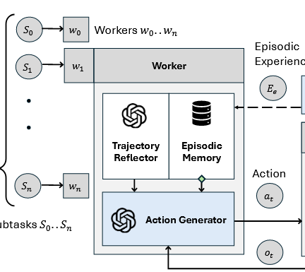
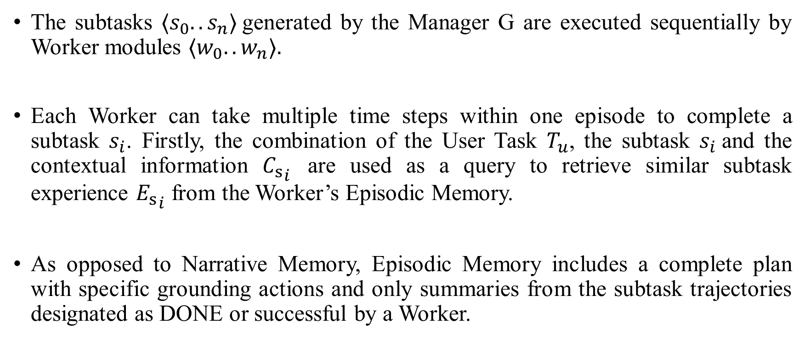
Worker: Learning From Subtask Experience and Trajectory Reflection
The subtasks $⟨s_{0}..s_{n}⟩$generated by the Manager G are executed sequentially by Worker modules $⟨w_{0}..w_{n}⟩.$
Each Worker can take multiple time steps within one episode to complete a subtask $s_{i}$. Firstly, the combination of the User Task $T_{u}$, the subtask $s_{i}$and the contextual information ${C_{s}}_{i}$ are used as a query to retrieve similar subtask experience ${E_{s}}_{i}$ from the Worker’s Episodic Memory.
As opposed to Narrative Memory, Episodic Memory includes a complete plan with specific grounding actions and only summaries from the subtask trajectories designated as DONE or successful by a Worker.
Notes:
The Episodic Memory is indexed by the concatenation of the task query, the subtask, and the contextual information $⟨Q, s_{i}, C_{s_{i}}⟩$

Slide 19

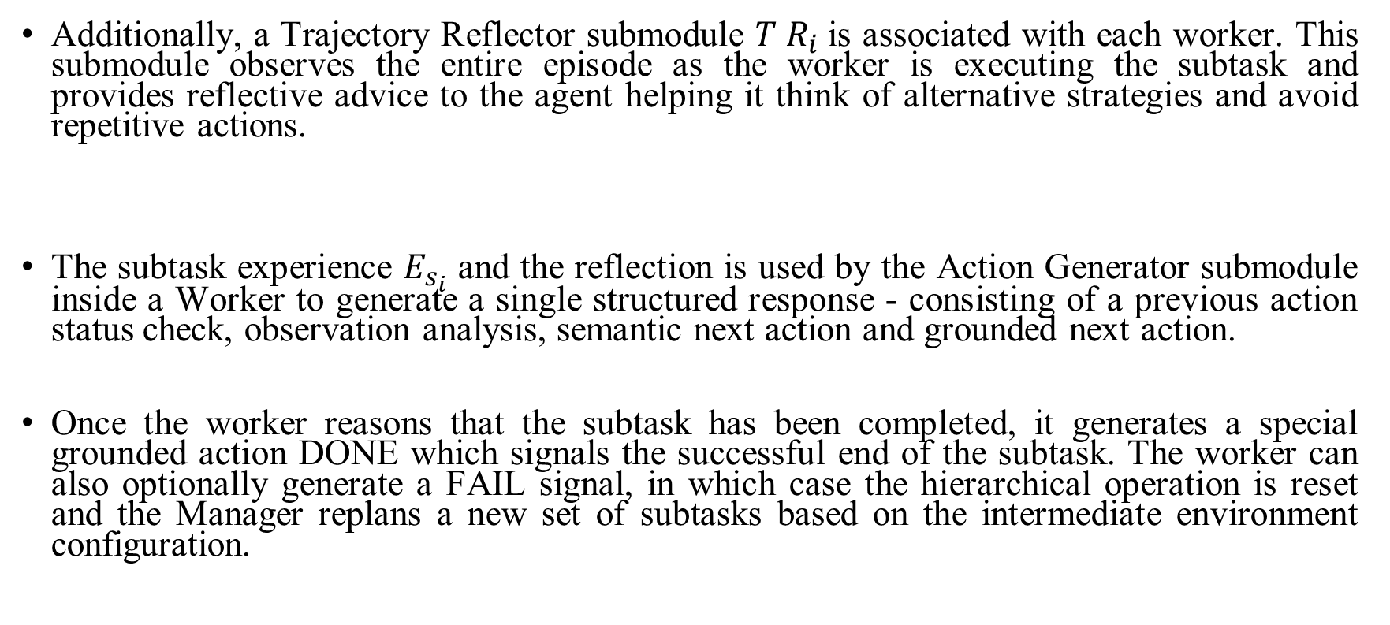
Worker: Learning From Subtask Experience and Trajectory Reflection
Additionally, a Trajectory Reflector submodule $T R_{i}$is associated with each worker. This submodule observes the entire episode as the worker is executing the subtask and provides reflective advice to the agent helping it think of alternative strategies and avoid repetitive actions.
The subtask experience $E_{s_{i}}$ and the reflection is used by the Action Generator submodule inside a Worker to generate a single structured response - consisting of a previous action status check, observation analysis, semantic next action and grounded next action.
Once the worker reasons that the subtask has been completed, it generates a special grounded action DONE which signals the successful end of the subtask. The worker can also optionally generate a FAIL signal, in which case the hierarchical operation is reset and the Manager replans a new set of subtasks based on the intermediate environment configuration.

Slide 20
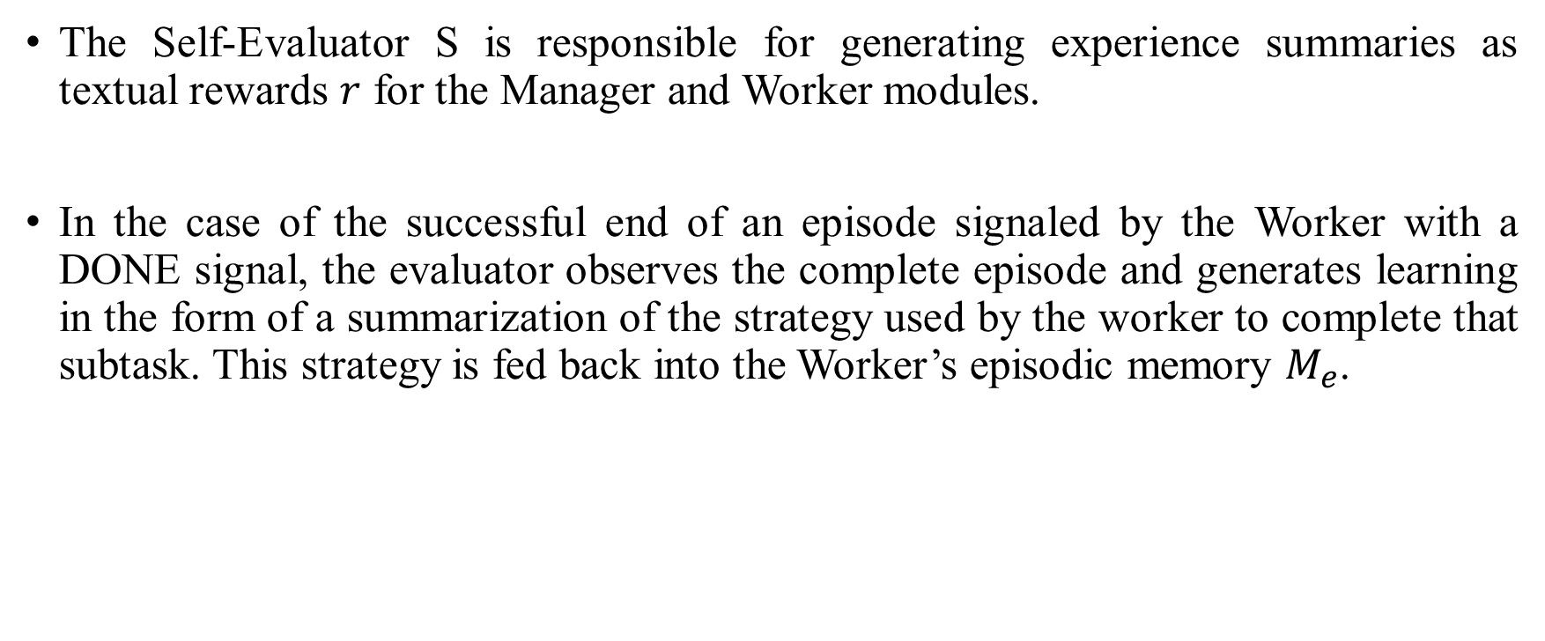
Self-Evaluator: Summarizing Experiences as Textual Rewards
The Self-Evaluator S is responsible for generating experience summaries as textual rewards $r$ for the Manager and Worker modules.
In the case of the successful end of an episode signaled by the Worker with a DONE signal, the evaluator observes the complete episode and generates learning in the form of a summarization of the strategy used by the worker to complete that subtask. This strategy is fed back into the Worker’s episodic memory $M_{e}$.

Slide 21
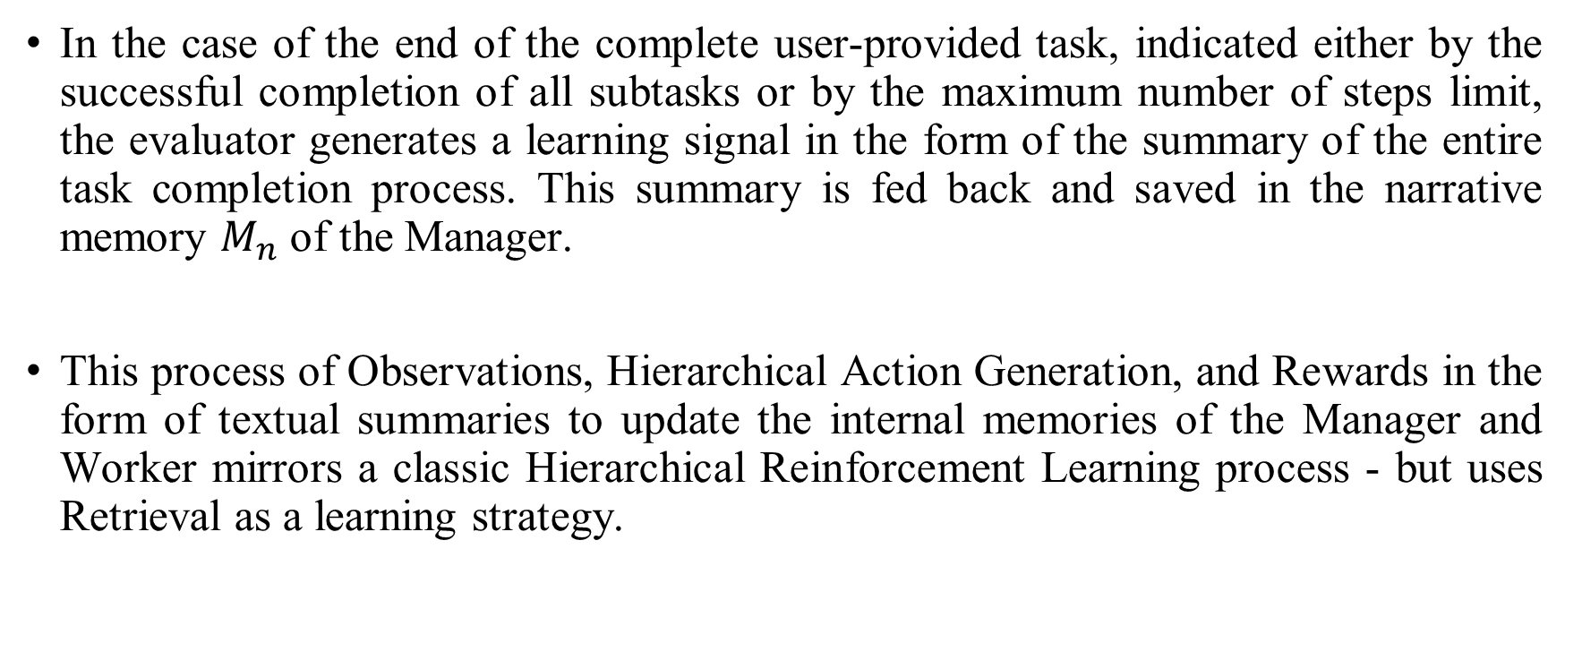
Self-Evaluator: Summarizing Experiences as Textual Rewards
In the case of the end of the complete user-provided task, indicated either by the successful completion of all subtasks or by the maximum number of steps limit, the evaluator generates a learning signal in the form of the summary of the entire task completion process. This summary is fed back and saved in the narrative memory $M_{n}$ of the Manager.
This process of Observations, Hierarchical Action Generation, and Rewards in the form of textual summaries to update the internal memories of the Manager and Worker mirrors a classic Hierarchical Reinforcement Learning process - but uses Retrieval as a learning strategy.

Slide 22
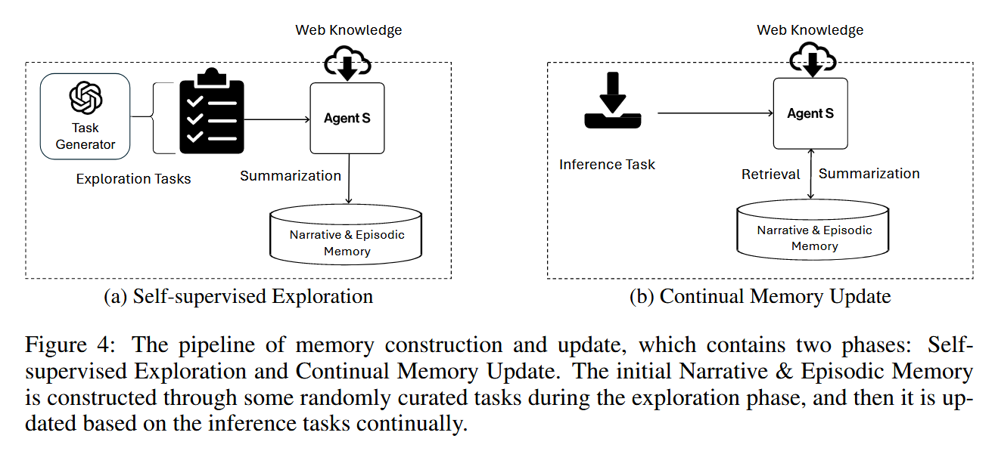

Initial Memory Construction via Self-supervised Exploration
To bootstrap Narrative $M_{n}$ and Episodic Memories $M_{e}$, Agent S conducts self-supervised exploration on a set of synthetically generated tasks
we run Agent S on these tasks by only taking web knowledge $K_{web}$ and collect the full task (Narrative Experience $E_{n}$) and subtask experiences (Episodic Experience $E_{e}$) for the narrative and episodic memories

Slide 23

Continual Memory Update
As our Agent S interacts with new tasks, it continually updates the Narrative Memory $M_{n}$ and Episodic Memory $M_{e}$ , as illustrated in Figure 8. Thus even after the initial exploration is completed, the agent continues to learn as it encounters and attempts newer, more novel tasks. This process enables our agent to learn even during inference and retrieve the learned knowledge to new tasks effectively.

Slide 24
Agent-Computer Interface
Current MLLMs can effectively reason about certain elements and features in an image, but they cannot directly ground and pinpoint specific elements in images as they lack an internal coordinate system.
Desktop environments, however, provide an easily parseable Accessibility Tree coordinate information about almost every element in the UI. Thus, our ACI design incorporates a dual-input strategy with different purposes for each input.
The image input is used by the agent to observe salient details about the environment—such as popups, button states, checking if a previous action worked, and reasoning about the next step.

Slide 25
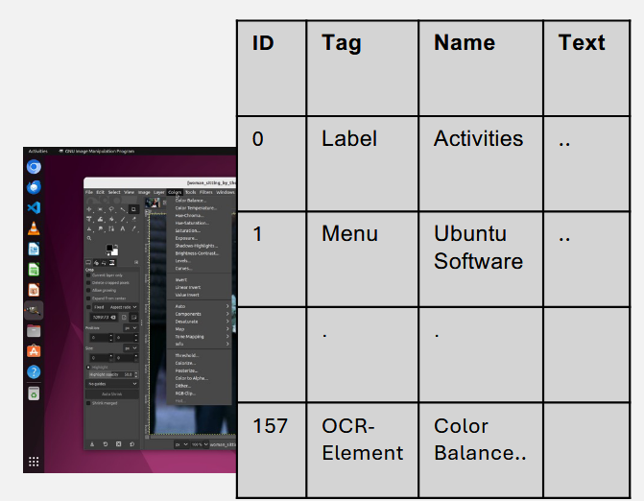
Agent-Computer Interface
The accessibility tree input is used for reasoning about the next step and, more importantly, grounding specific elements in the environment.
To achieve this, we tag each element in the accessibility tree with unique integer tags which can be used by agents when referring to these elements. we augment the tree with details from the image. To achieve this, we run an OCR module on the image and parse textual blocks from the screenshot. We then add these blocks to the accessibility tree as interactable UI elements if they do not already exist in the tree. To check for existing elements, we perform an IOU (Intersection over Union) match with all elements in the tree.

Slide 26
Experiments

Slide 27
Benchmarks
Benchmarks. We evaluate Agent S on OSWorld (Xie et al., 2024), a benchmark for testing the multimodal agents capability of executing a wide range of computer tasks in a real computer environment. This executable environment allows free-form keyboard and mouse control of real computer applications, including OS, Office (LibreOffice Calc, Impress, Writer), Daily (Chrome, VLC Player, Thunderbird), Professional (VS Code and GIMP), and Workflow (tasks involving multiple apps). In addition, we also evaluate the generalization of Agent S on WindowsAgentArena (Bonatti et al., 2024), a contemporaneous benchmark in the Windows operating system.

Slide 28
Settings & Baselines
Since the OSWorld benchmark contains 369 tasks on Ubuntu, for the backbone model of Agent S, we leverage GPT-4o and Claude-3-Sonnet, respectively. For WindowsAgentArena, we test all 154 tasks on GPT-4o. We use the PaddleOCR2 toolkit as our OCR tool in augmenting accessibility trees for grounding. The embedding model for the retrieval we use is text-embedding-3-small. Agent S takes the accessibility tree and screenshot as inputs, so we also use the reported results in OSWorld (Xie et al., 2024) and WindowsAgentArena (Bonatti et al., 2024) with same input setting as baselines. The OSWorld baseline takes the coordinates-based accessibility tree and screenshots as input for spatial grounding to generate the action with coordinates at each step. The WindowsAgentArena baseline NAVI (Bonatti et al., 2024) utilizes an accessibility tree, OCR, and Proprietary models to process the screenshot and create Set-of-Marks as input. Its action space includes a constrained set of primitives but allows multiple actions to be chained together.

Slide 29
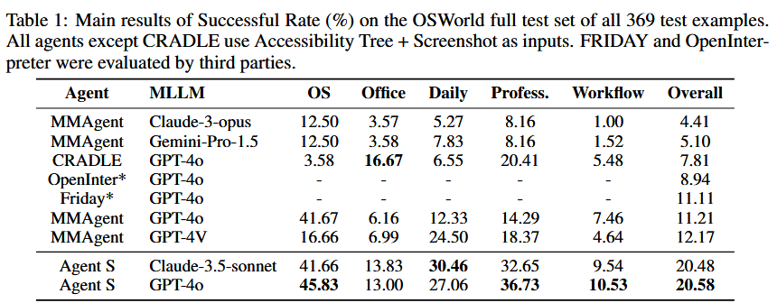
Main Results
Agent S achieves an overall success rate of 20.58%, nearly doubling the performance of the best corresponding MMAgent baseline (11.21%). Agent S consistently outperforms the baselines in the “Daily” and “Professional” tasks, where it reaches 27.06% and 36.73% success rates, respectively, compared to the best baseline results of 24.50% and 18.37%.

Slide 30
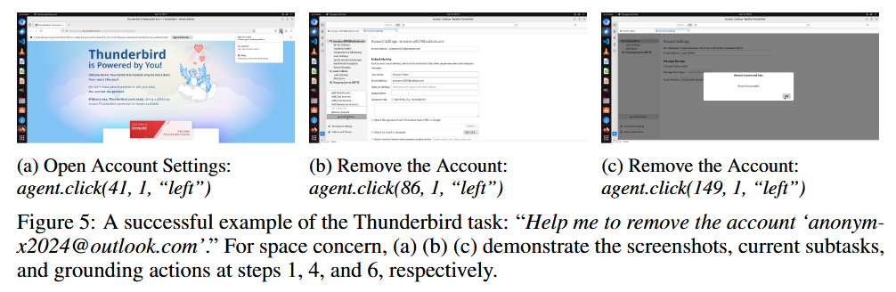
Main Results
We illustrate an example of a task from the Thunderbird app from OSWorld: Help me to remove the account ”anonym-x2024@outlook.com”. Agent S completes tasks by interacting with the desktop through a combination of actions. More qualitative examples are demonstrated in Appendix D.1.

Slide 31
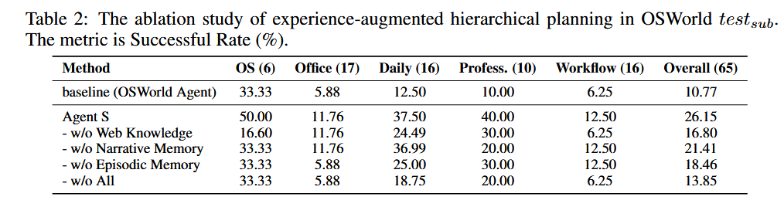
Ablation Study - Learning from experience enhances the domain knowledge of GUI agents
The Experiential learning process of Agent S involves searching web knowledge, retrieving full task experience from narrative memory and retrieving subtask experience from episodic memory. To assess the impact of different components, we systematically remove each component and observe performance changes across different task categories.

Slide 32
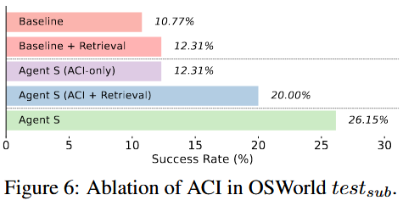
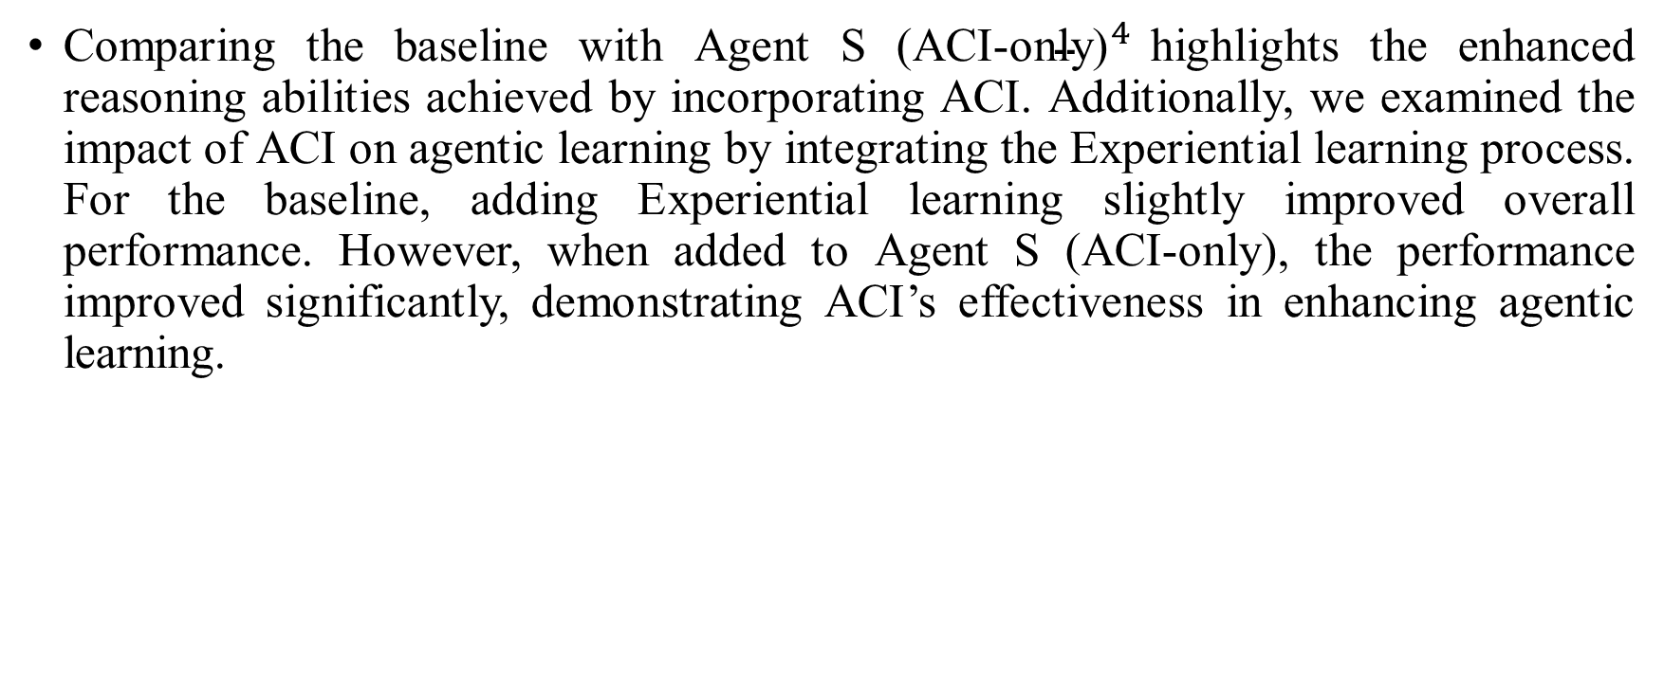
Ablation Study - ACI elicits better reasoning abilities of LLMs and supports better agentic learning
Comparing the baseline with Agent S ${\text{(}\text{ACI}\text{−}\text{only}\text{)}}^{4}$highlights the enhanced reasoning abilities achieved by incorporating ACI. Additionally, we examined the impact of ACI on agentic learning by integrating the Experiential learning process. For the baseline, adding Experiential learning slightly improved overall performance. However, when added to Agent S (ACI-only), the performance improved significantly, demonstrating ACI’s effectiveness in enhancing agentic learning.

Slide 33
Ablation Study - Hierarchical Planning supports long-horizon workflows
The (ACI-only + Experiential Learning) setup in Figure 6 shows Agent S performance without Hierarchical Planning, and the observed performance drop (26.15% to 20.00%) compared to the full Agent S underscores the importance of Hierarchical Planning in modeling long-horizon workflows. The effect of hierarchical formulation becomes pronounced in the presence of Experiential learning as the Manager can generate more detailed and accurate plans in the subtask planning stage.

Slide 34
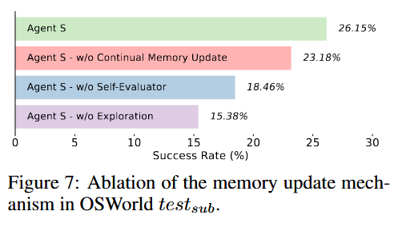
Exploration, Continual Memory Update and Self-Evaluator are indispensable for memory construction
To assess the effectiveness of these two learning stages and further examine our Self-evaluator which stores experience as summaries instead of unfiltered trajectories we run the ablation shown in Figure 7.

Slide 35
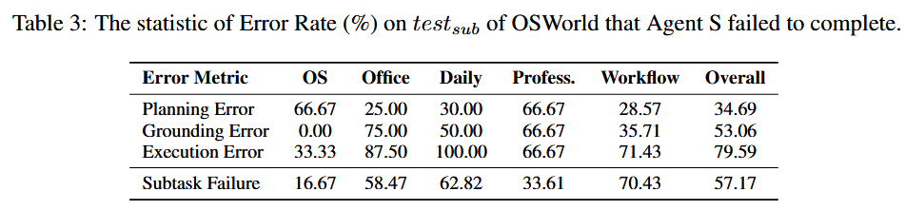
Error Analysis
(1) Planning Error: A planning error occurs when the agent generates unsuitable plans for a task, including inaccuracies in the plan, misleading subtask information, or misalignment of subtask sequence with task requirements.
(2) Grounding Error: A grounding error arises when the agent fails to accurately interact with target elements despite their visibility and the application of correct reasoning. This includes incorrect element selection or inaccurate coordinate selection due to the inherent limitations of our action space (e.g., selecting the center instead of a more precise part of the element).
(3) Execution Error: An execution error emerges when the agent makes incorrect decisions or fails to adjust its behavior during task execution. This includes repetitive actions, diverging from subtask goals, delays in transitioning between subtasks, or violating established protocols by combining multiple actions into one.
Notes:
We performed a thorough error analysis on the tasks that Agent S failed within $test_{sub}$ of the OSWorld. There are three types of errors that we observed

Slide 36
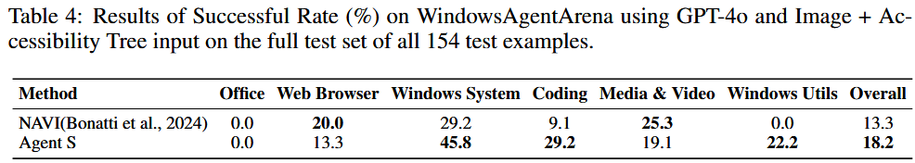
Generalization To Different Operating Systems
We test the Agent S framework with no modification on WindowsAgentArena (Bonatti et al., 2024), a Windows OS benchmark released contemporaneously with our work. We compare Agent S with the similar configuration with GPT-4o as the MLLM backbone, Accessibility Tree + Image as the input, and parsing with OCR. As shown in Table 4, Agent S outperforms the Navi agent without any adaptation to the new Windows environment.

Slide 37
Conclusion

Slide 38
Conclusion
In this work, we present Agent S—A novel framework for developing fully Autonomous Graphical User Interface (GUI) agents that can perform a wide range of user queries by directly controlling the keyboard and mouse. Through the Agent S framework, we show the benefits of Learning from Experience for Task-oriented GUI agents. We also discuss the concept of an Agent Computer Interface for the GUI domain, arguing in favor of an abstraction layer that allows MLLM agents to perceive and reason at a language level with rich and continuous feedback. By leveraging Experience-Augmented Hierarchical Planning, Online Web Knowledge, and an Agent-Computer Interface (ACI), Agent S demonstrates SOTA performance on the OSWorld benchmark and generalizability across different operating systems. We demonstrate the potential of MLLM agents to learn from external sources and through direct interaction with the environment, without any human or environmental feedback in the GUI agents domain, thus opening a discourse on zero-shot, agentic methods for GUI agents.

Slide 39
Conclusion Future Work
A key metric that has been unaddressed in existing work on MLLM agents for computer control, including ours, is the number of agent steps and wall clock time required for task completion. While our work focuses on achieving significant improvement in task performance, future work can consider a shortest-path navigation formulation of GUI control and evaluate the Pareto-optimality of various agents on the dimensions of time and accuracy. In our work, we use the state-of-the-art GPT-4o and Claude-3.5-sonnet models. However, future work can extend the ideas of experiential learning and Agent Computer Interface for smaller, open-source MLLMs which could be fine-tuned to bridge the gap.

Slide 40
真正的實作

Slide 41
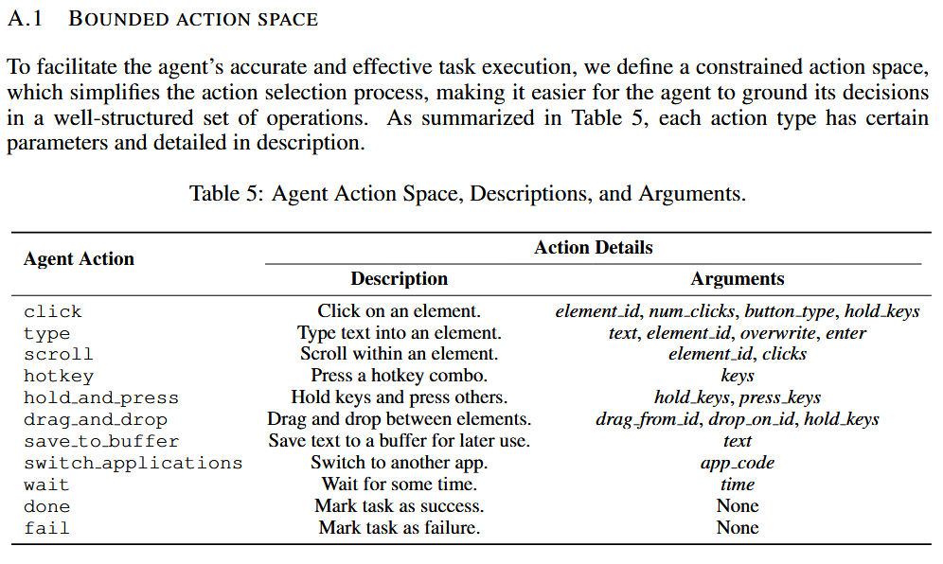

Slide 42
f"""
def {attr_name}{signature}:
'''{attr.__doc__}'''
"""
procedural_memory += textwrap.dedent(
"""
Your response should be formatted like this:
(Previous action verification)
Carefully analyze based on the screenshot and the accessibility tree if the previous action was successful. If the previous action was not successful, provide a reason for the failure.
(Screenshot Analysis)
Closely examine and describe the current state of the desktop along with the currently open applications.
(Next Action)
Based on the current screenshot, the accessibility tree and the history of your previous interaction with the UI, decide on the next action in natural language to accomplish the given task.
(Grounded Action)
Translate the next action into code using the provided API methods. Format the code like this:
```python
agent.click(123, 1, "left")
```
Note for the code:
1. Only perform one action at a time.
2. Do not put anything other than python code in the block. You can only use one function call at a time. Do not put more than one function call in the block.
3. You must use only the available methods provided above to interact with the UI, do not invent new methods.
3. Only return one code block every time. There must be a single line of code in the code block.
4. Please only use the available methods provided above to interact with the UI.
5. If you think the task is already completed, you can return `agent.done()` in the code block.
6. If you think the task cannot be completed, you can return `agent.fail()` in the code block.
7. Do not do anything other than the exact specified task. Return with `agent.done()` immediately after the task is completed or `agent.fail()` if it cannot be completed.
8. Whenever possible use hot-keys or typing rather than mouse clicks.
9. My computer's password is 'password', feel free to use it when you need sudo rights
"""

Slide 43
DAG_TRANSLATOR_PROMPT = """You are a plan to Dependency Graph conversion agent. Your task is to analyze a given plan and generate a structured JSON output representing the plan and its corresponding directed acyclic graph (DAG).
The output should be a valid JSON object wrapped in <json></json> tags, with the following structure:
<json>
{
"dag": {
"nodes": [
{
"name": "Short name or brief description of the step",
"info": "Detailed information about executing this step"
}
],
"edges": [
[
{"name": "Name of the source node", "info": "Info of the source node"},
{"name": "Name of the target node", "info": "Info of the target node"}
]
]
}
}
</json>
Guidelines:
1. The "plan" field should contain the entire original plan as a string.
2. In the "dag" object:
a. Each node in the "nodes" array should contain 'name' and 'info' fields.
b. 'name' should be a concise, one-line description of the subtask.
c. 'info' should contain all available information about executing that subtask from the original plan. Do not remove or edit any information from the 'info' field.
3. The "edges" array should represent the connections between nodes, showing the order and dependencies of the steps.
4. The graph must be a directed acyclic graph (DAG) and must be connected.
5. Do not include repeated or optional steps in the graph. Any extra information should be incorporated into the 'info' field of the relevant node.
Analyze the given plan and provide the output in this JSON format within the <json></json> tags. Ensure the JSON is valid and properly escaped.
"""

