Slide 1
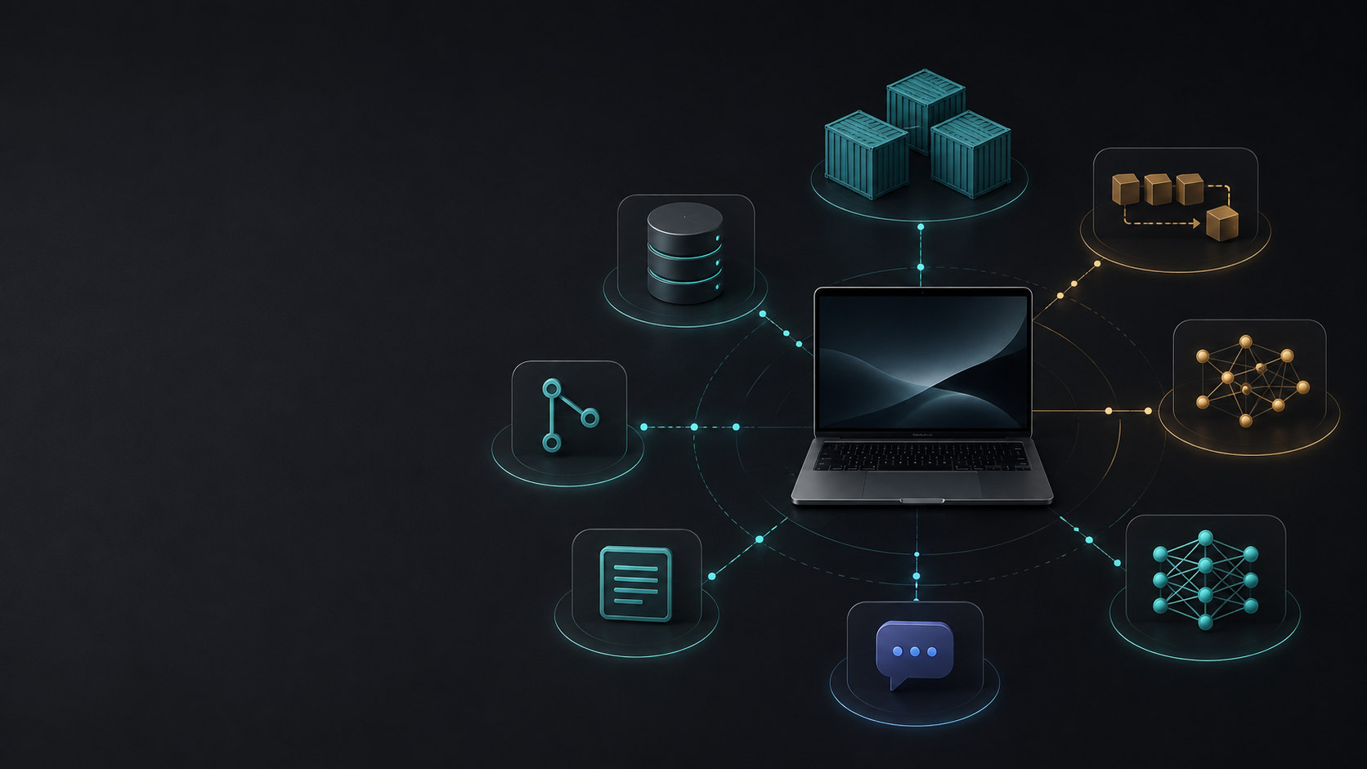
LifeAgent Architecture
Local-first agent workflows for code review, academic planning, and finance monitoring
Intern technical interview version
Notes:
Generated cover image used as an abstract visual only.
Sources: IMPLEMENTATION_PLAN.md; compose.yaml; infra/Dockerfile

Slide 2
What LifeAgent does
One local system coordinates three personal automation workflows with shared reliability controls.
Code review
Academic planner
Finance monitor
Evidence-based reviews
Study planning
Source-gated briefings
GitHub push events trigger exact-SHA checkout, scanner runs, Qwen review, finding validation, and Discord summaries.
Notion data and PDFs become typed assessments. Python allocates study blocks and Qwen critiques the plan.
Exactly eight approved finance sources feed normalized event cards, exposure mapping, and thesis journal updates.
Shared platform
FastAPI, PostgreSQL, Procrastinate, the artifact store, audit tables, health checks, and Discord delivery are reused by every agent.
02
Notes:
System scope and shared architecture.
Sources: IMPLEMENTATION_PLAN.md; docs/implementation/phase-2.md; docs/implementation/phase-3.md; docs/implementation/phase-5.md; docs/implementation/phase-6.md

Slide 3
Runtime topology
One codebase and one Docker image run as the API or as one of three queue-specific workers.
FastAPI app
worker-code-review
API, webhooks, console
Jinja pages
static assets
queue: code_review
External systems
GitHub App
Notion API
Discord bot
finance APIs
macOS host
PostgreSQL 16
worker-academic-planner
Native Ollama
qwen3-32gb:latest
Apple Metal stays local
application data
queue tables
LangGraph checkpoints
queue: academic_planner
Artifact volume
worker-finance
reports
PDF extracts
tool logs
queue: finance
API and workers share PostgreSQL, the artifact volume, and host-native Ollama.
03
Notes:
Topology mirrors Compose and Dockerfile.
Sources: compose.yaml; infra/Dockerfile; app/main.py; IMPLEMENTATION_PLAN.md

Slide 4
Shared durable core
Each workflow inherits the same idempotency, retry, audit, and artifact behavior.
Shared object
What it stores
Why it matters
agent_runs
run identity, trigger, status, summary
replays and UI history have one record
run_steps
node attempts, diagnostics, timing
operators can reconstruct failures
deliveries
intent, receipt, nonce, permalink
retries avoid duplicate Discord posts
audit_events
append-only actor/action/result
approval and retention changes stay reviewable
artifacts
content hash and metadata sidecar
large/redacted bodies stay out of relational rows
Interview framing
LifeAgent treats the database as the recovery boundary, and treats external side effects as durable intents before it sends anything.
04
Notes:
Shared schema and artifact behavior.
Sources: app/db/models.py; app/artifacts/store.py; app/queue/tasks.py; docs/implementation/phase-2.md

Slide 5
Code-review agent pipeline
The model receives bounded evidence, then deterministic validation decides what can be published.
Webhook intake
Checkout
Evidence packet
Qwen proposal
Validation
Delivery
verify GitHub HMAC
allowlist repository
deduplicate delivery
clone exact SHA
timebox process
clean temporary path
diffs and changed lines
scanner output
risk classification
structured FindingBatch
no arbitrary tools
low temperature
line ownership
evidence IDs
confidence threshold
redacted report artifact
Discord summary
no GitHub comments
How to explain it
The LLM acts like a reviewer constrained to packet-owned facts. Git, Semgrep, Gitleaks, Trivy, and native commands produce evidence the model must cite.
05
Notes:
Code-review workflow and GitHub boundary.
Sources: app/api/github.py; app/agents/code_review/workflow.py; app/connectors/discord.py; docs/implementation/phase-3.md

Slide 6
Academic planner pipeline
Python owns constraints and state changes. Qwen helps with breakdowns, critiques, and check-in extraction.
Notion sync
Documents
Uncertainty
Allocator
Daily flow
Confirmation
three scoped databases
courses, assessments, blocks
PDF extraction
page citations
full-text retrieval
ambiguous facts become questions
no hard constraint yet
7 to 14 day horizon
fixed commitments stay fixed
buffer preserved
morning Discord plan
end-of-day check-in
exact token required
then Notion write
Interview framing
The planner separates extraction, scheduling, and writing. A wrong model suggestion can create a question or proposal, but it cannot silently move a deadline or update Notion.
06
Notes:
Academic planner workflow.
Sources: app/agents/academic_planner/workflow.py; app/api/academic.py; app/connectors/notion.py; docs/implementation/phase-5.md

Slide 7
Finance thesis-monitoring pipeline
The finance agent runs only after its source allowlist gate is satisfied.
Approval gate
Scoped fetch
Normalize
Exposure map
Event cards
Briefing
exactly eight enabled sources
allowlist version match
approved adapters only
no browser search fallback
dedupe source docs
validate freshness and licence limits
holdings, watchlist, ETF exposure
manual portfolio source
facts, uncertainty, counter-case
monitor or revisit thesis
Discord summary
thesis journal update
source health records
How to explain it
This pipeline optimizes for compliance and traceability. It does not trade, give buy/sell instructions, or replace an unapproved data source when one fails.
07
Notes:
Finance workflow and approved source registry.
Sources: app/agents/finance/workflow.py; app/connectors/finance_sources/adapters.py and app/agents/finance/sources.py; app/api/finance.py; docs/implementation/phase-6.md

Slide 8
How someone uses the software
A user mainly interacts through Discord, Notion, GitHub webhooks, and the local operations console.
Daily use
Approval moments
Operations console
Read Discord summaries and study plans. Reply to academic check-ins with explicit progress.
Confirm Notion changes with the exact confirmation event. Enable finance sources only after entitlement review.
Open localhost console with Basic auth to view health, activity, run detail, and finance source settings.
Surface
User action
System response
GitHub
Push to an allowlisted repo
Accepts signed webhook and queues review
Discord
Read plan, briefing, alert, or review summary
Uses durable delivery intent and nonce
Notion
Keep course data and assessments current
Syncs scoped databases and writes only after confirmation
Console
Inspect /, /activity, /settings/sources
Returns escaped, redacted, read-only pages
08
Notes:
Usage surfaces and routes.
Sources: app/main.py; app/api/operations.py and app/api/pages.py; app/api/academic.py; app/api/github.py; app/connectors/discord.py; docs/implementation/phase-7.md

Slide 9
Reliability and operations
Phase 8 closes the loop between working workflows and an operable local service.
Health checks
Backups
Recovery behavior
Runbooks
database
queue depth
artifact root
Ollama
GitHub, Discord, Notion
host pg_dump
age encryption
launchd daily at 03:00
restore safety checks
worker restart policy
graceful shutdown
stalled job visibility
idempotent delivery
queue backlog
model slow
source failure
migration failure
Validation layer
What it proves
Unit and acceptance tests
Contracts, HTML safety, queue behavior, Playwright console smoke tests
Integration tests
PostgreSQL migrations, persistence, connectors with stubs
Docker acceptance
Compose worker kill and delivery-idempotency drills when host tools exist
CI
Ruff, format, Pyright, unit, acceptance, integration, opt-in Docker acceptance
09
Notes:
Reliability and CI evidence.
Sources: docs/implementation/phase-8.md; docs/operations/backup-restore.md and scripts/backup_database.sh; .github/workflows/ci.yml; compose.yaml; app/queue/tasks.py

Slide 10
Technology choices
Each tool keeps the local deployment small while preserving type safety, durable state, and testability.
Technology
Repo-specific reason
Tradeoff to discuss
Python 3.12 and uv
one typed app, reproducible lockfile, fast local commands
Python concurrency needs clear async/process boundaries
FastAPI, Pydantic, Jinja, HTMX
API and read-only console stay in one service
less client interactivity than a SPA
LangGraph and LangChain Ollama
explicit workflow steps and local structured model calls
more ceremony than a direct LLM call
PostgreSQL, SQLAlchemy, Alembic
single durable store for app data, queue, audit, checkpoints
heavier than SQLite for local-only use
Procrastinate
durable jobs, locks, retries, periodic tasks in PostgreSQL
ties queue scaling to Postgres operations
Docker Compose
one image, isolated workers, named volumes, restart policy
not built for multi-host orchestration
10
Notes:
Stack choices.
Sources: IMPLEMENTATION_PLAN.md; pyproject.toml; compose.yaml; infra/Dockerfile; docs/implementation/phase-0.md; docs/implementation/phase-2.md

Slide 11
Model and security boundaries
The architecture limits where the model can influence state.
Model boundary
Least privilege connectors
Secrets and display
All calls go through LLMGateway. Responses must match Pydantic schemas and may get one repair attempt.
GitHub, Notion, Discord, and finance adapters expose narrow operations, not generic request tools.
SecretStr settings, redacted diagnostics, escaped templates, and strict browser security headers.
Interview answer
The interesting design choice is that deterministic code owns validation and side effects. The model proposes structured analysis, but the application decides whether the proposal can become a database row or outbound message.
11
Notes:
LLM and security boundaries.
Sources: app/llm/gateway.py; app/core/config.py; app/main.py; app/api/github.py; app/connectors/notion.py; app/connectors/discord.py; app/connectors/finance_sources/adapters.py and app/agents/finance/sources.py

Slide 12
Technical interview narrative
A concise way to explain LifeAgent without underselling the engineering decisions.
Question
Answer an intern can give
What is the architecture?
A local-first FastAPI application with Dockerized workers, PostgreSQL durability, and native Ollama inference on the Mac host.
Why separate workers?
Fault isolation and independent schedules. They share code and schema, but each listens to its own queue.
Where does AI fit?
Qwen handles constrained analysis and critique. It never gets shell, database, or broad connector access.
How do you avoid duplicate side effects?
The app writes delivery intents with idempotency keys and provider nonces before sending.
What would you improve next?
Semantic retrieval for academic documents, but only after real usage shows full-text search misses paraphrased questions.
Bottom line: LifeAgent is designed as a reliable local orchestration system, not a set of unconstrained chatbots.
12
Notes:
Suggested interview phrasing and deferred enhancement boundary.
Sources: IMPLEMENTATION_PLAN.md; docs/implementation/phase-1.md; docs/implementation/phase-2.md; docs/implementation/phase-8.md

