Slide 1
Philadelphia i-team Data Analytics Manager Technical Exercise
Richard Barad
03/28/2025

Slide 2
Outline
Methodology
Results
Areas for Future Work

Slide 3
Variables Used
Black, Indigenous, and People of Color (BIPOC) Population
People 25+ without a High School Diploma
Percent of Overcrowded Housing Units
Households with No Vehicle
Population below 150%
Heat Exposure Index

Slide 4
Methodology
Thematic Maps
Analysis By Region
Correlation Matrix

Slide 5
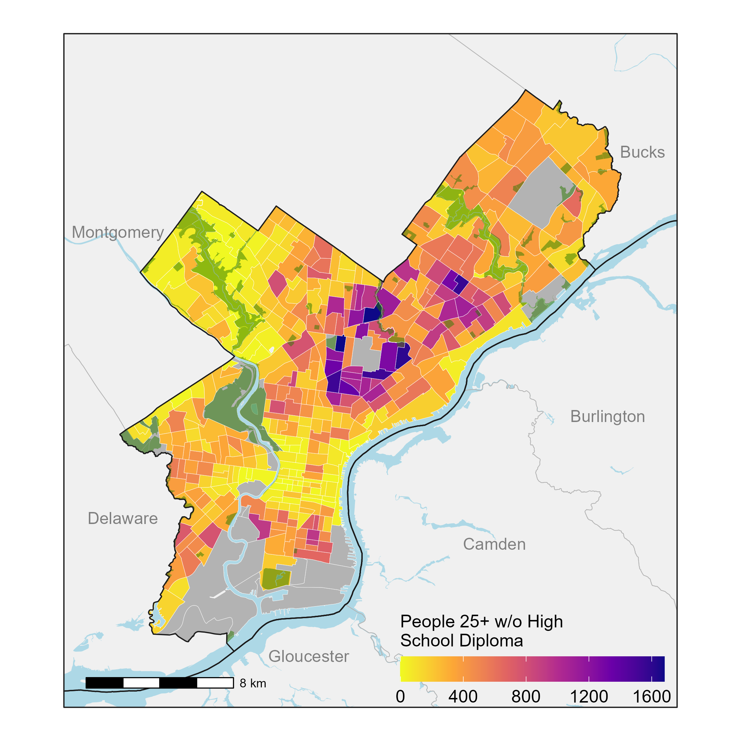
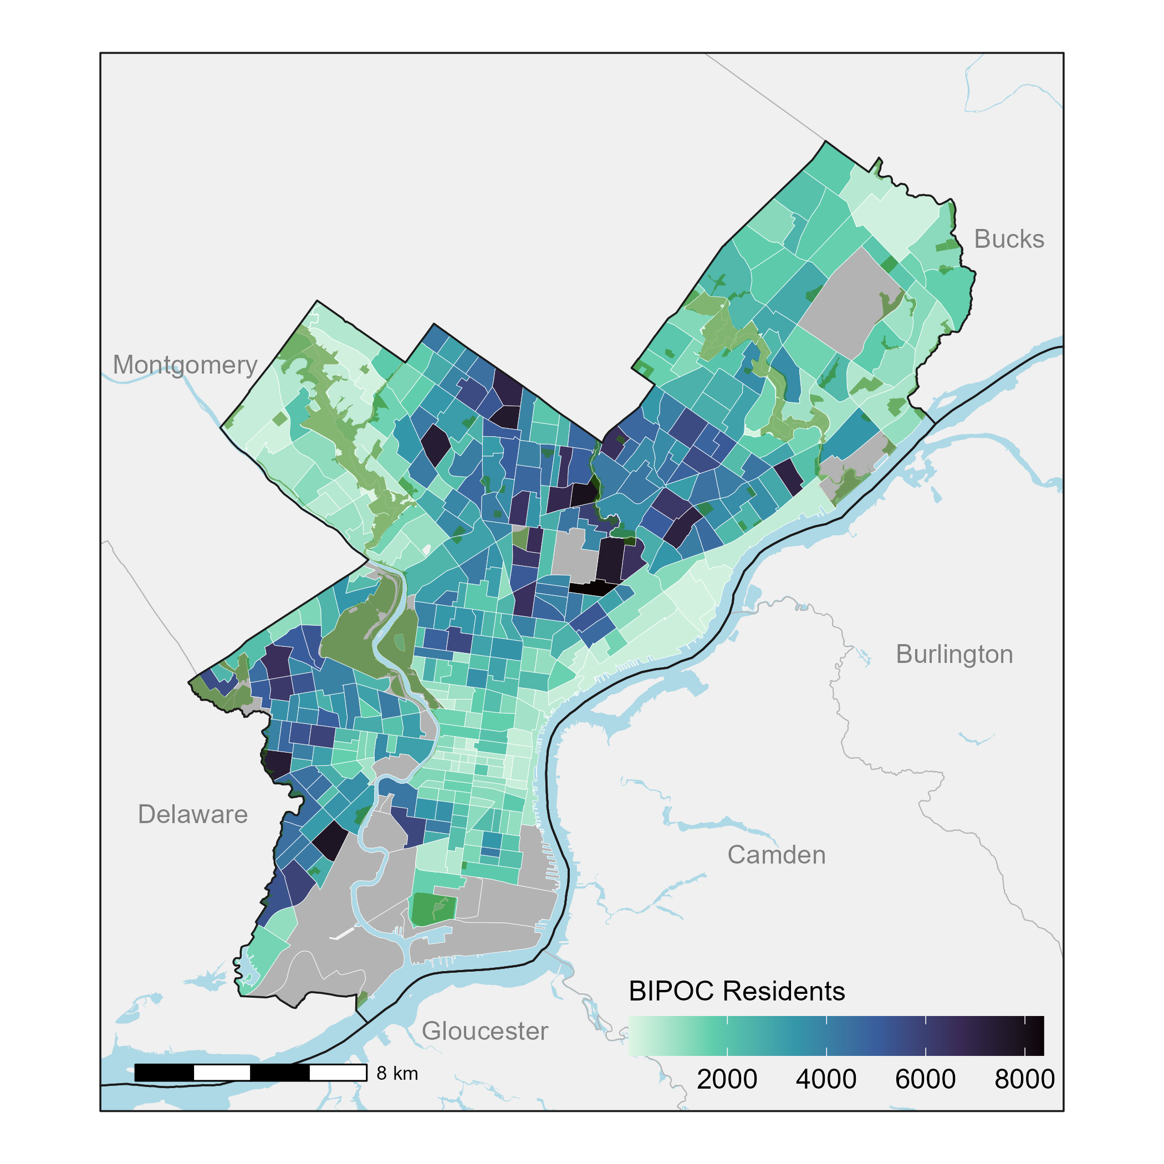
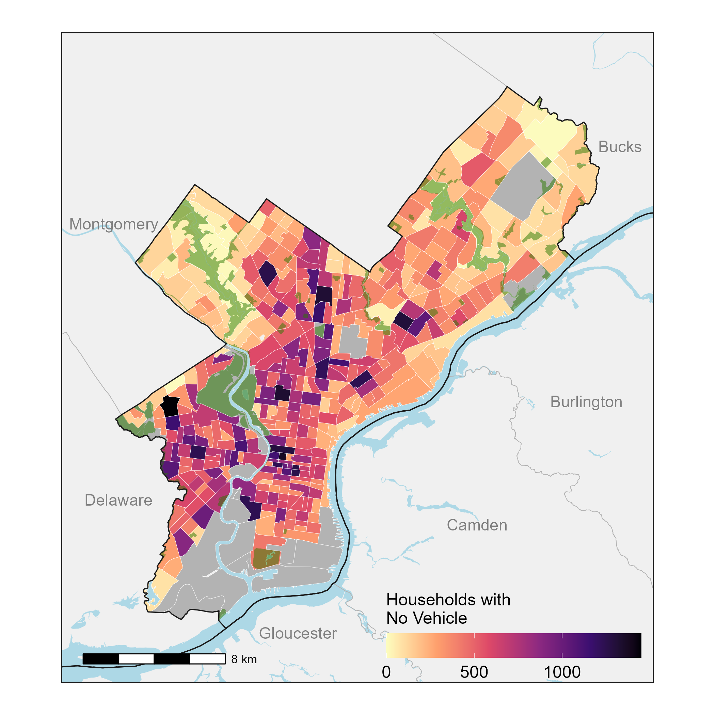
Thematic Maps
High School Diploma
BPIOC Residents
Households w/o Vehicle

Slide 6
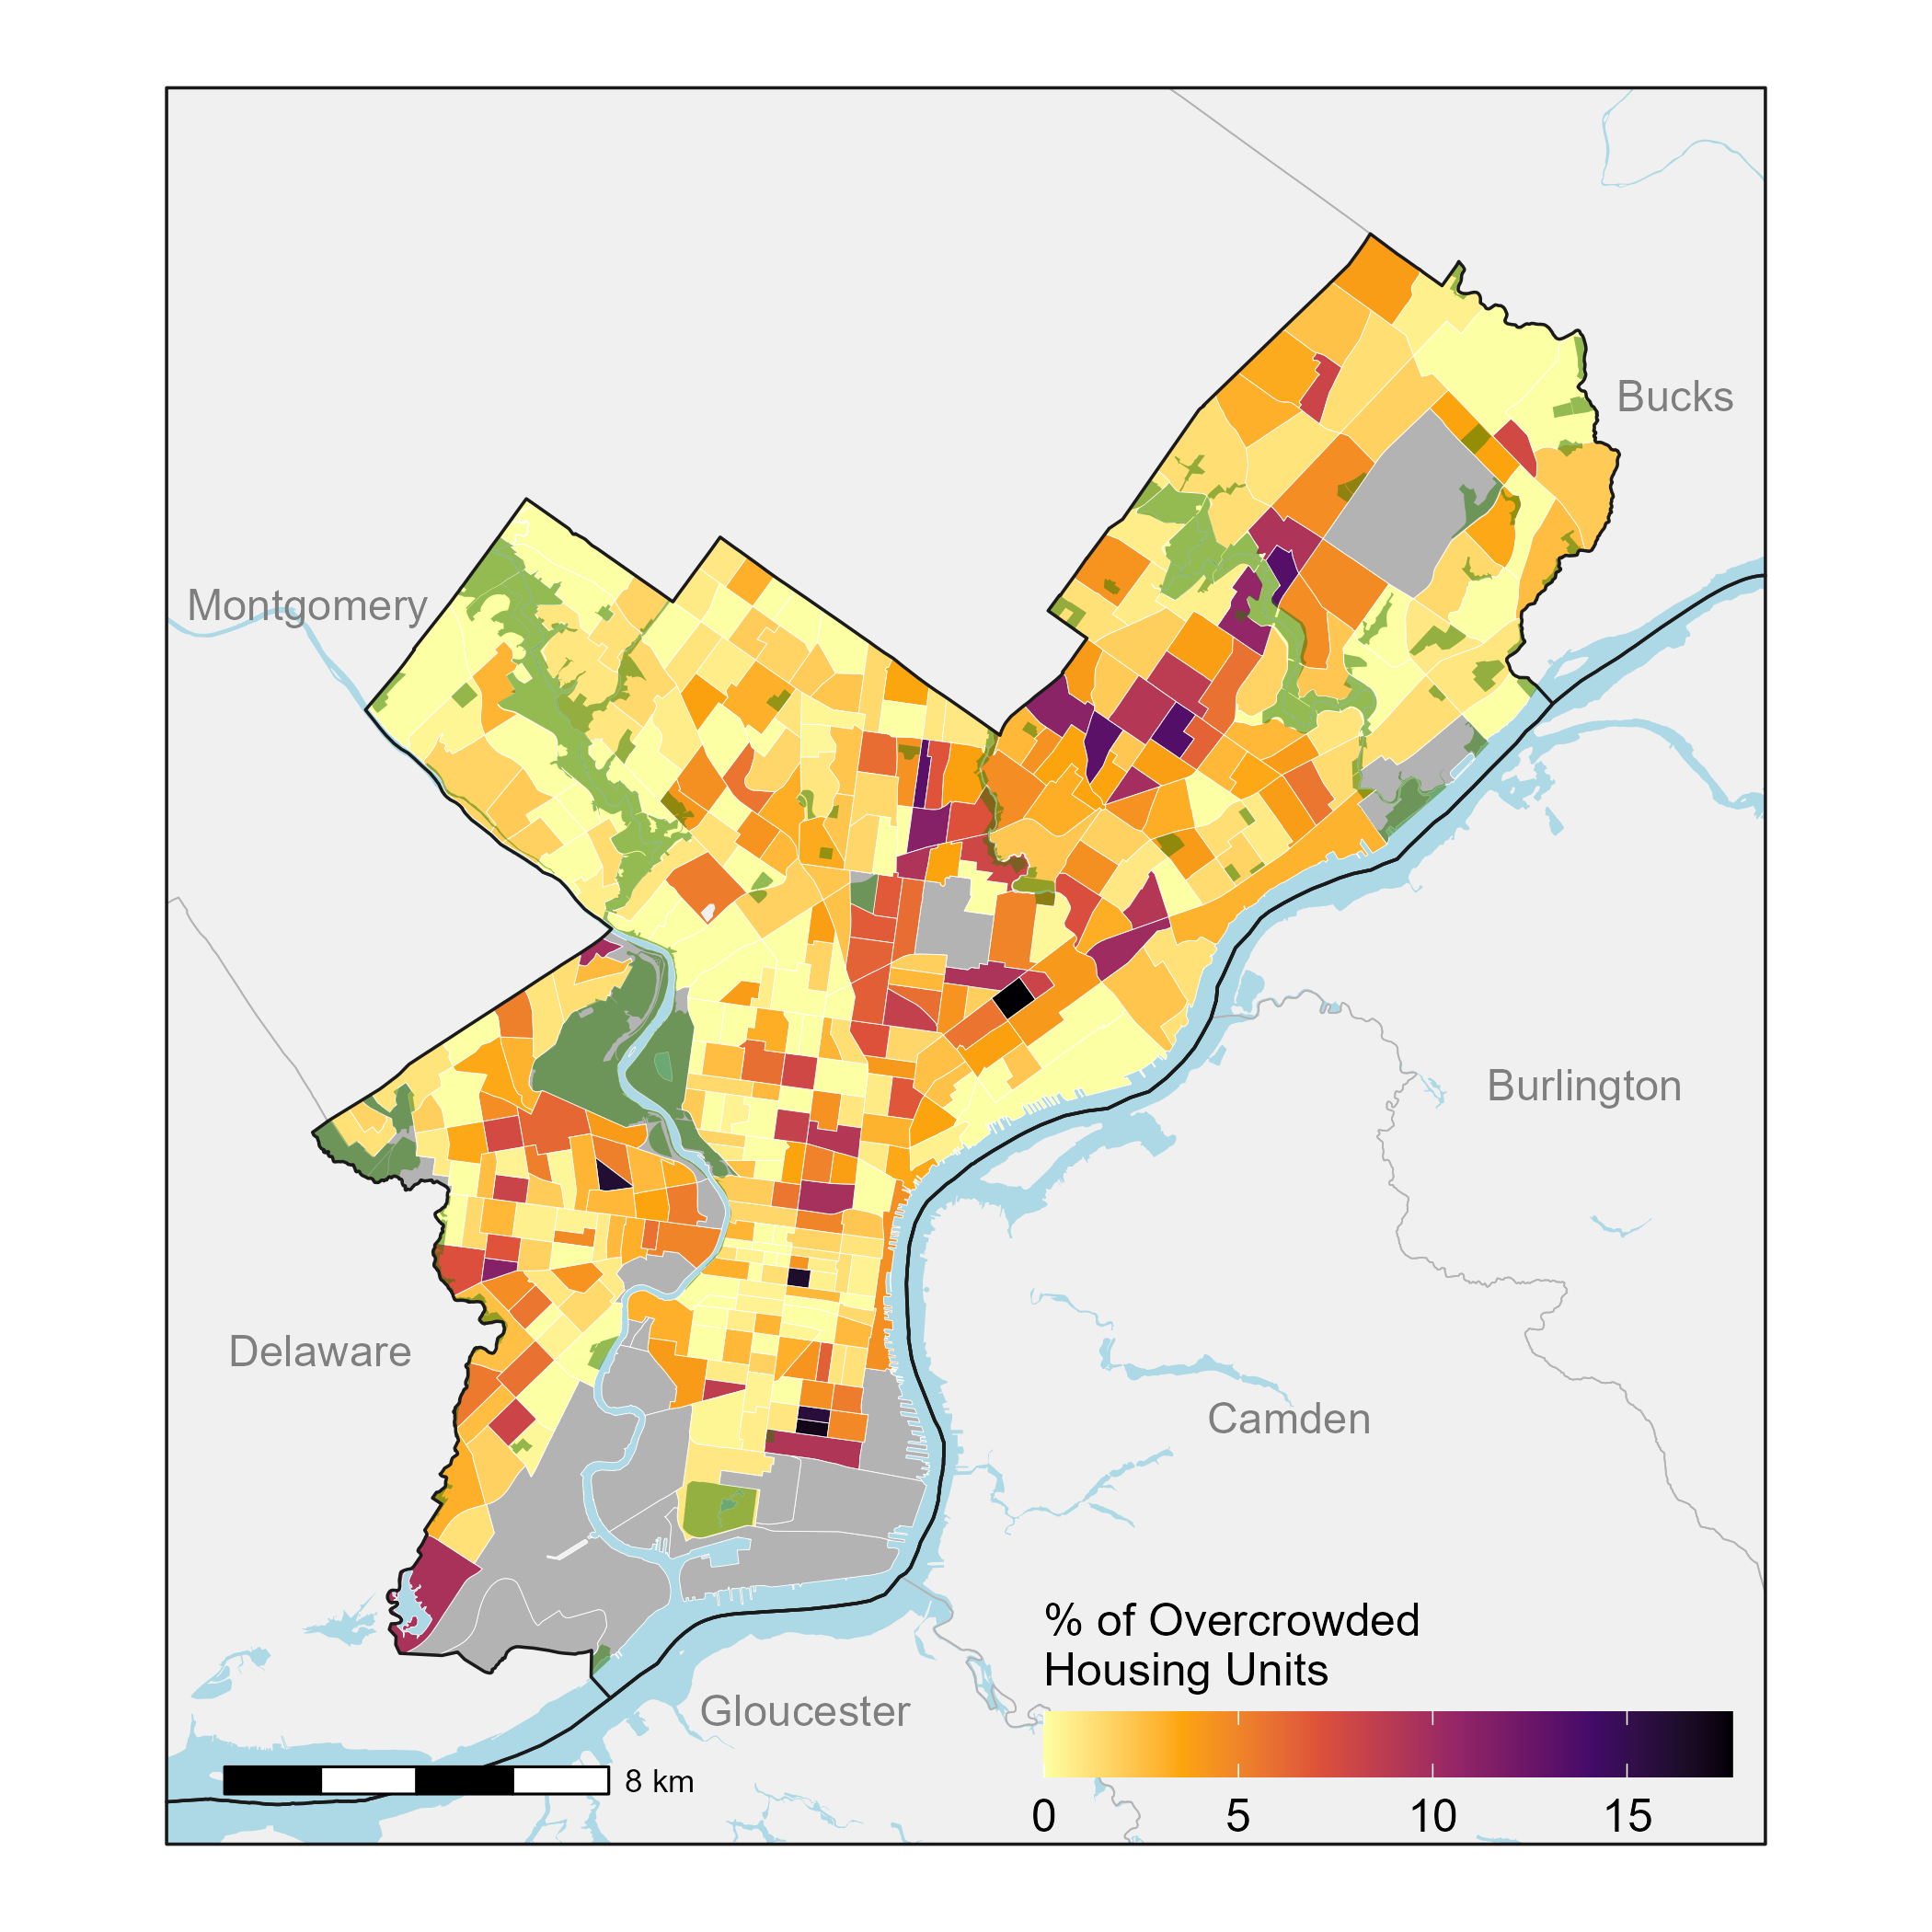
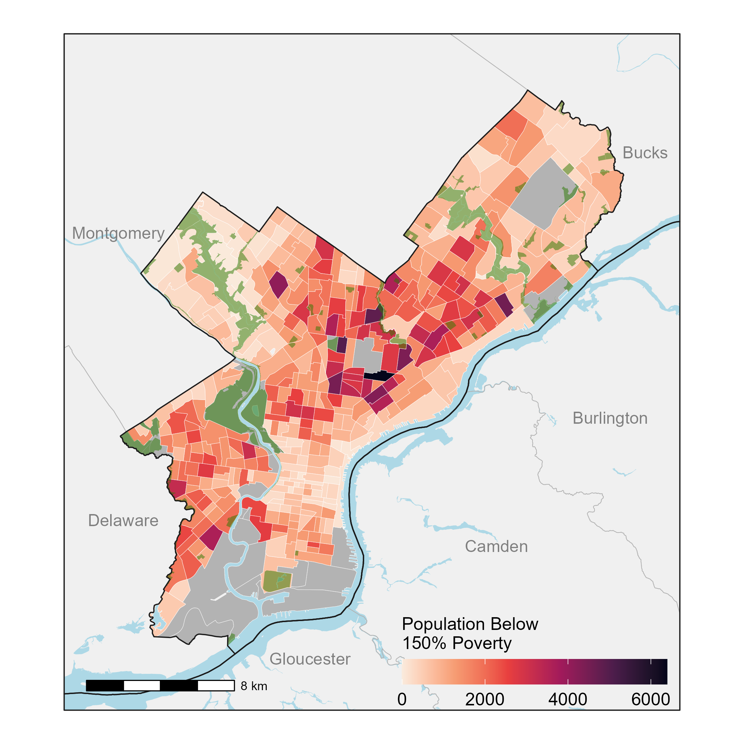
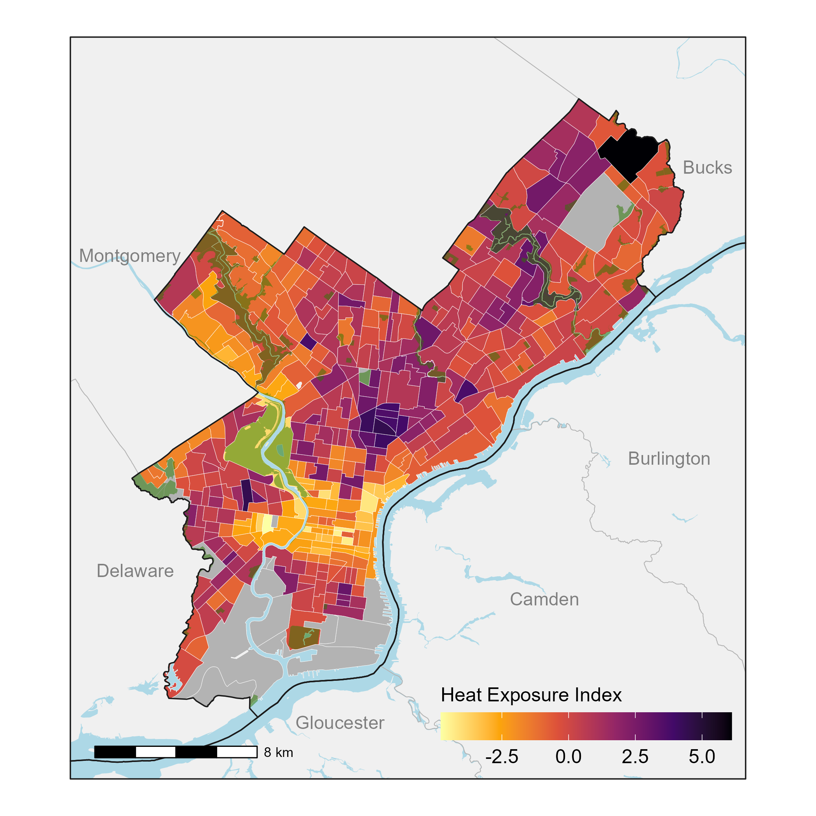
Thematic Maps
Overcrowded Housing Units
Poverty
Heat Exposure Index

Slide 7
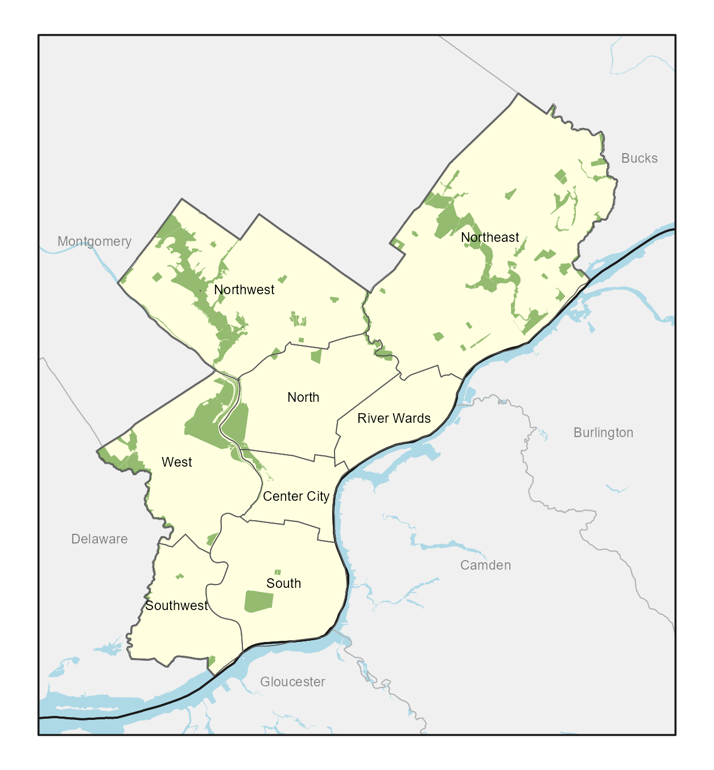
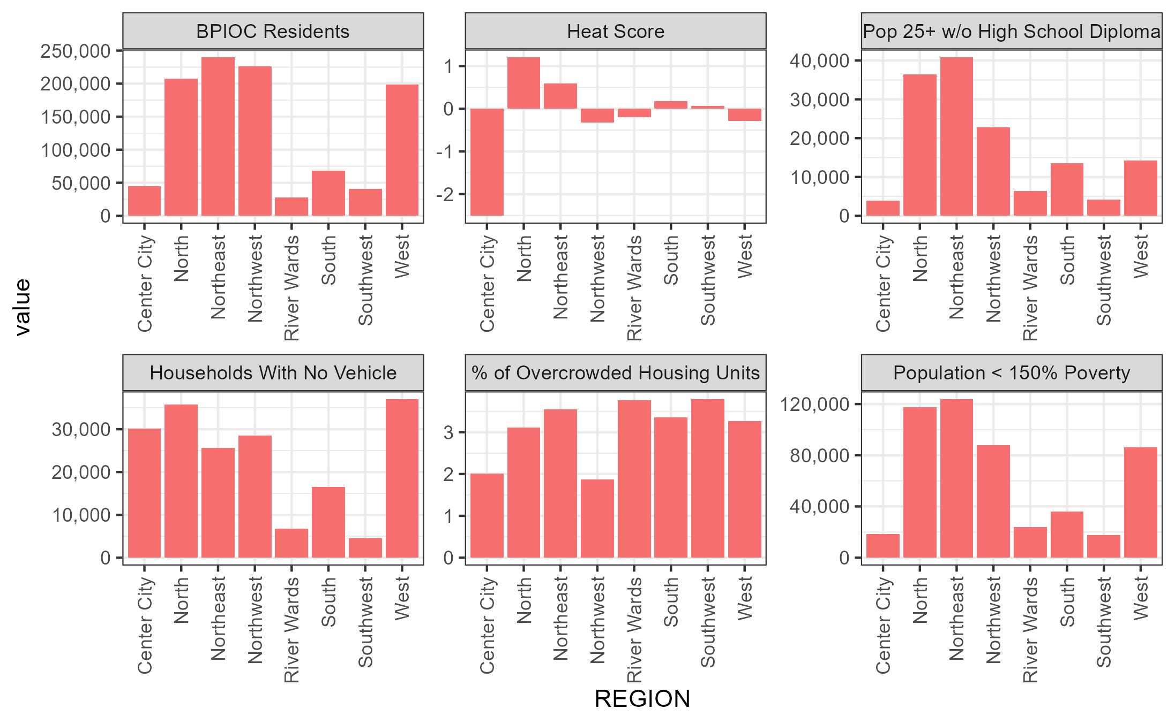
Analysis By Region

Slide 8
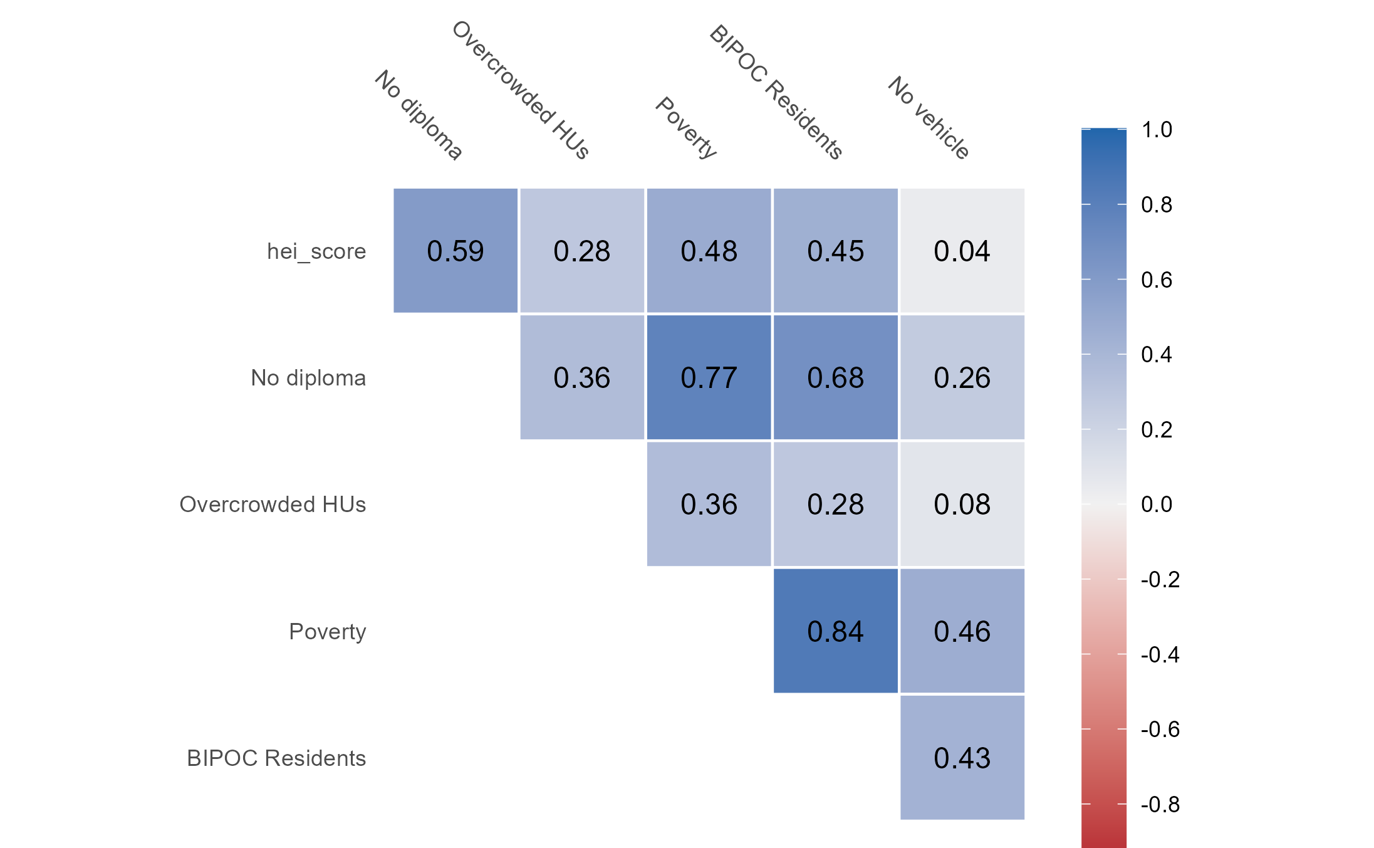
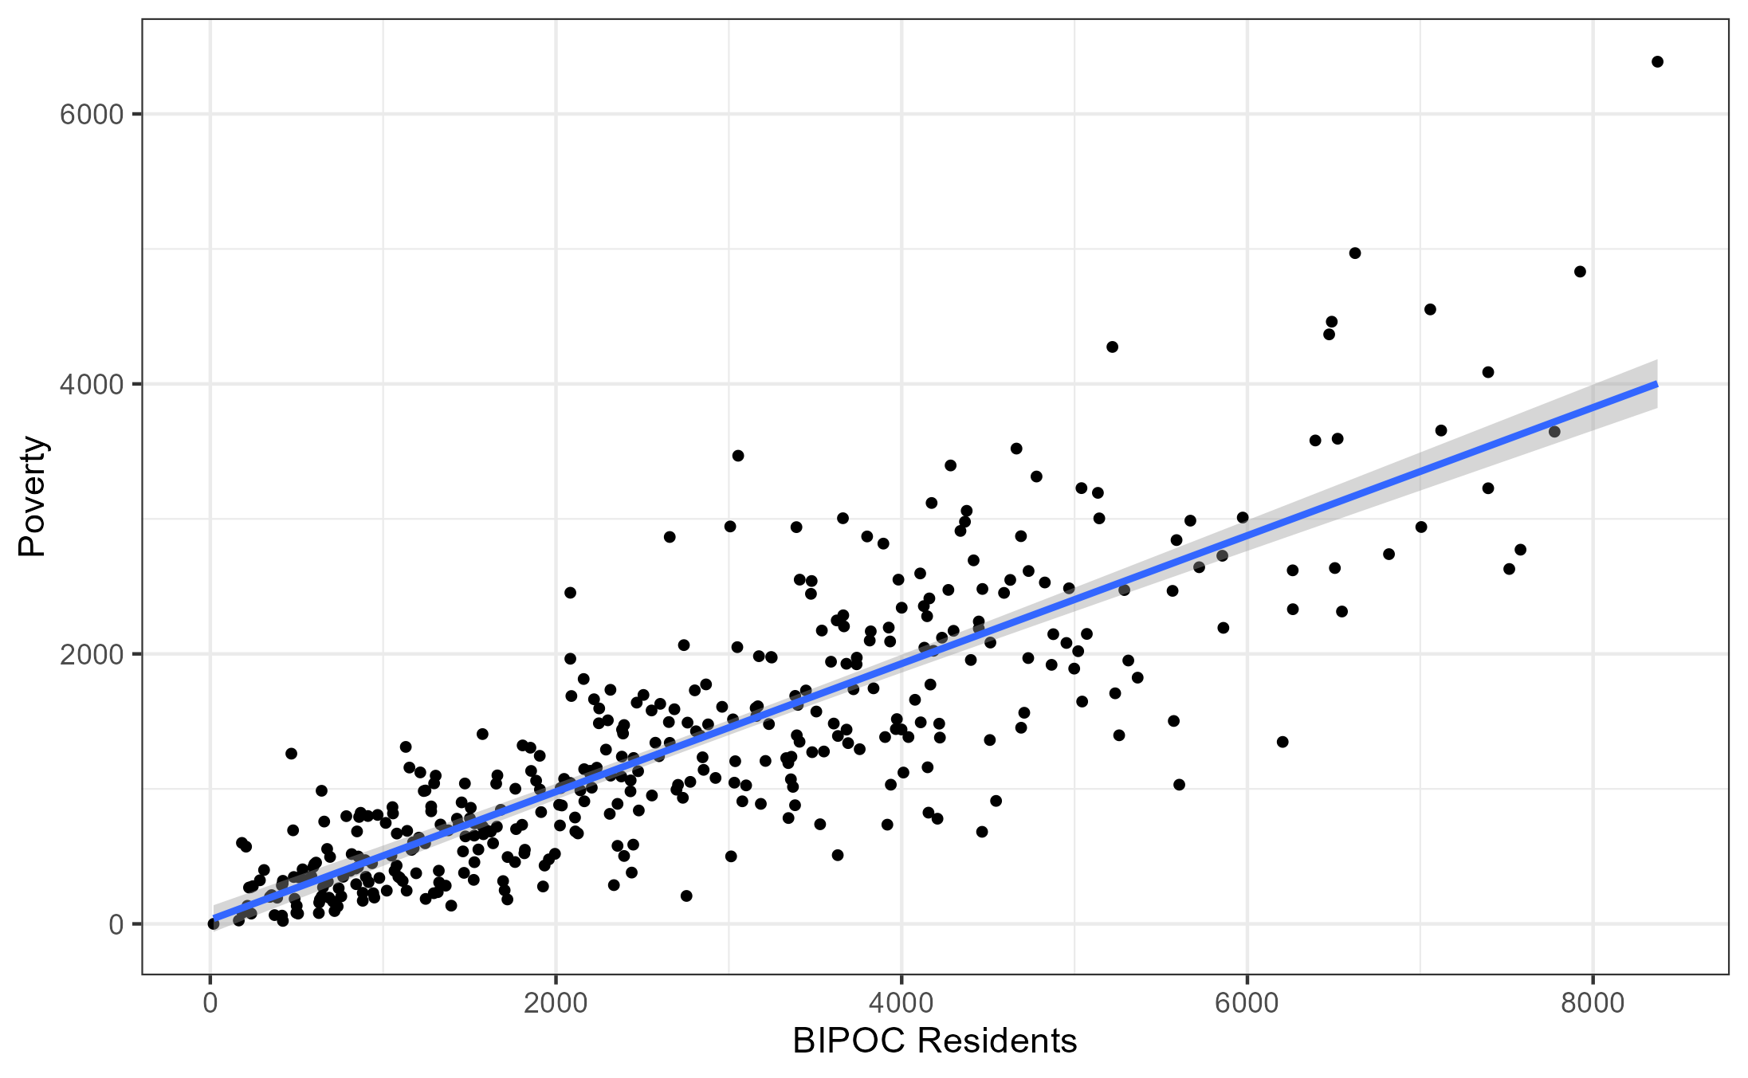
Correlation Matrix

Slide 9
Areas for Future Work
Linear Regression Model
K-means Cluster Analysis

Slide 10
R Code
https://github.com/richardbarad/jhu_technical_exercise

