Slide 1
Chapter 13
Penetration Testing

Slide 2
Certification Objectives
CompTIA Security+
1.2 Compare and contrast types of attacks.
1.4 Explain penetration testing concepts.
3.1 Explain use cases and purpose for frameworks, best practices and secure configuration guides.
5.1 Explain the importance of policies, plans and procedures related to organizational security.
5.3 Explain risk management processes and concepts.

Slide 3
Certification Objectives (continued)
Microsoft MTA Security Fundamentals
1.1 Understand core security principles.
1.2 Understand physical security.

Slide 4
Section 13.1
Overview of
Penetration
Testing

Slide 5
Key Terms
active information gathering
banner grabbing
black box test
Electronic Data Gathering Analysis and Retrieval System (EDGAR)
ethical hacking
executive summary
gray box test
National Institute of Standards and Technology (NIST)
nondisclosure agreement (NDA)
Open Source Intelligence (OSINT)

Slide 6
Key Terms (continued)
OS fingerprinting
passive information gathering
penetration testing
Penetration Testing Execution Standard
port scanning
pretext
scope
scope creep
semipassive information gathering
STRIDE
technical report
testing time line

Slide 7
Key Terms (continued)
threat modeling
Visual, Agile, and Simple Threat (VAST)
vulnerability analysis
white box test

Slide 8
Learning Goals
Describe penetration testing and its use in ethical hacking.
Design a penetration test covering the standard test procedures.
Assess legal issues related to penetration testing.

Slide 9
Penetration Testing Basics
Penetration testing: process in which security personnel attempt to penetrate a network to locate vulnerabilities; also called pen testing
Ethical hacking: another term for penetration testing
Pen testers must continually update and improve skills
Industry certification
Expertise in Windows and Linux operating systems

Slide 10
Penetration Testing Basics
Five W’s of pen testing
Why
Who
What
Where
When

Slide 11
Penetration Testing Basics (continued)
Why:
Why does the customer want the test completed?
Knowing will guide the testing
Who:
Who likely wants to attack the company
Help focus on specific testing areas

Slide 12
Penetration Testing Basics (continued)
What:
What does the customer want tested?
Tells the tester the boundaries of testing
Where:
Where will the security testing take place?
Sometimes can be done remotely, other times it must be on site

Slide 13
Penetration Testing Basics (continued)
When:
When will the security testing be conducted?
Might need to be done annually or throughout the year

Slide 14
Standard Test Procedures
Penetration Testing Execution Standard: goal is to provide a minimum set of standard that all penetration tests should address
Preengagement interactions
Intelligence gathering
Threat modeling
Vulnerability analysis

Slide 15
Standard Test Procedures (continued)
Penetration Testing Execution Standard (continued)
Exploitation
Post exploitation
Reporting

Slide 16
Standard Test Procedures (continued)
Preengagement Interactions
Before testing can begin, topics must be discussed and agreed on
Scope of testing
Time lines
Payment of fees
Third-party individuals or business impacted by testing
White box, black box, and gray box testing

Slide 17
Standard Test Procedures (continued)
Preengagement Interactions (continued)
Scope: defines exactly what will be tested
Scope creep: occurs when changes or additional requests are made after the project begins
Physical Testing: which locations will be tested
Web Testing which web applications will be tested

Slide 18
Standard Test Procedures (continued)
Preengagement Interactions (continued)
Scope (continued)
Network Testing: will testing include physical and wireless networks
Social Engineering Testing: phishing and spear phishing attacks
Pretext: fabricated scenario or story that entices recipient to click on link

Slide 19
Standard Test Procedures (continued)
Preengagement Interactions (continued)
Time Line
Testing time line: states when the stages of testing will happen
Ensures testing will occur within the dates specified by the contract
Padding: adding a cushion to the time line to help keep project on time if something unexpected occurs

Slide 20
Standard Test Procedures (continued)

Slide 21
Standard Test Procedures (continued)
Preengagement Interactions (continued)
Fees
Fee charged should always refer to the scope of the job
Each company has unique needs, situations, and network configurations
Third-Party Vendors
Written permission must be obtained from companies
Be aware of and follow the policies of the vendors

Slide 22
Standard Test Procedures (continued)
Preengagement Interactions (continued)
White, Black, or Gray Box
Black box test: when pen tester has no knowledge of system
Gray box test: when tester has some knowledge of system
White box test: when pen tester has been given full knowledge of system
Merits to all three kinds

Slide 23
Standard Test Procedures (continued)
Intelligence Gathering
Can provide clues to gaining entry into the building or network
Social engineering is a way preliminary intelligence can be gathered
Job postings reveal what type of infrastructure they have

Slide 24
Standard Test Procedures (continued)
Intelligence Gathering (continued)
Electronic Data Gathering Analysis and Retrieval System (EDGAR): database found on the United States Security and Exchange Commission (SEC) website for electronic SEC filings
Companies file reports and forms with the SEC
Pen tester can find out about the company and its financial dealings

Slide 25
Standard Test Procedures (continued)
Intelligence Gathering (continued)
Open Source Intelligence (OSINT): involves obtaining information that is freely available online
Three levels or methods
Passive Information Gathering: target is not aware of reconnaissance

Slide 26
Standard Test Procedures (continued)
Intelligence Gathering (continued)
Open Source Intelligence (continued)
Semipassive Information Gathering: using target’s resources just as any customer would, but collecting data at the same time
Active Information Gathering: actions are taken that may be noticed by the target

Slide 27
Standard Test Procedures (continued)
Threat Modeling
Identifying potential threats and determining which are high-value assets
Hackers want to get the most out of their attack
Take relevant information, determine primary and secondary targets
Work with customer to identify targets

Slide 28
Standard Test Procedures (continued)
Threat Modeling (continued)
Attacker viewpoint: why hacker is conducting attack
Asset viewpoint: assets that have value to hacker
System viewpoint: entry points

Slide 29
Standard Test Procedures (continued)
Threat Modeling (continued)
STRIDE: threat model consisting of six categories of threats
Spoofing identity
Tampering
Repudiation
Information disclosure
Denial of service (DoS)
Elevation of privelege

Slide 30
Standard Test Procedures (continued)

Slide 31
Standard Test Procedures (continued)
Threat Modeling (continued)
Data-flow diagram: visual representation of infrastructure or application
Visual, Agile, and Simple Threat (VAST): threat model based on scaling the model across the infrastructure
Scalability is one of the biggest benefits of VAST
Combination of two model types: operational and application
Process-flow model

Slide 32
Standard Test Procedures (continued)

Slide 33
Standard Test Procedures (continued)
Vulnerability Analysis: involves attempting to discover flaws that may be exploited by a hacker
Typically when active intelligence gathering techniques occur
Port Scanning: actively probing a system to discover open ports
OS fingerprinting: identifying the operating system of the network
Banner grabbing: used to determine what services are running on a remote system

Slide 34
Standard Test Procedures (continued)
Vulnerability Analysis (continued)
Port Scanning (continued)
Banner grabbing: used to determine what services are running on a remote system
Netcat

Slide 35
Standard Test Procedures (continued)
Exploitation
Once vulnerabilities are found, pen tester will try to exploit
Defenses need to be tested and results listed and identified
Antivirus programs
Firewalls
Intrusion-detection and prevention systems

Slide 36
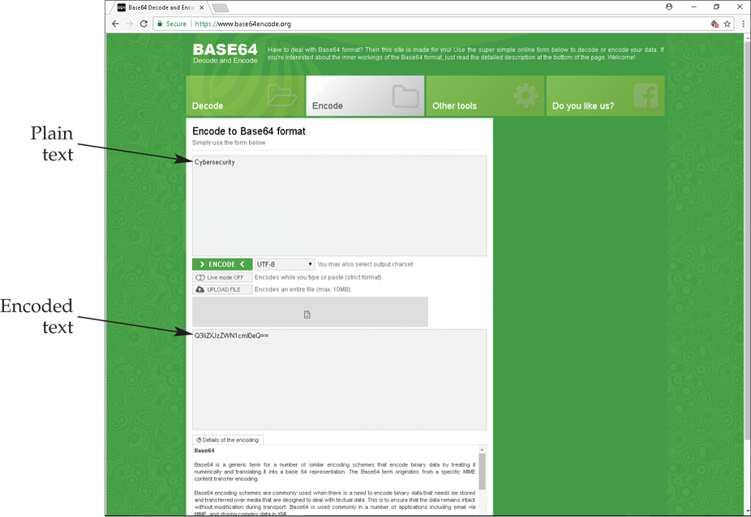
Standard Test Procedures (continued)

Slide 37
Standard Test Procedures (continued)
Exploitation (continued)
Methods:
Exploit buffer overflows and SQL injections
Searching DNS and ARP caches
USB injection
Social engineering

Slide 38
Standard Test Procedures (continued)
Post Exploitation
If exploits are successful, pen tester attempts to keep connection alive
Place tools on key devices in the network
Install key loggers and root kits
Critical to document everything that is done

Slide 39
Standard Test Procedures (continued)
Reporting
After all testing is done, pen tester compiles documentation for client
Report includes two areas: executive summary and technical report
Once submitted, all data and information collected must be destroyed
All files must be removed from customer’s sites and configuration files restored to original values

Slide 40
Standard Test Procedures (continued)
Reporting (continued)
Executive summary: states in plain language the high-value targets that were identified and the impact breaches of these targets will have
Brief and to the point
Information should be easy to read and understand
Infographics help make data more understandable
Should include a security-risk-rating scale

Slide 41
Standard Test Procedures (continued)

Slide 42
Standard Test Procedures (continued)
Reporting (continued)
Technical report: details specific vulnerabilities found during the pen test
Should provide specific details on why the issues are vulnerabilities
Audience is IT staff who will be tasked with correct them
May include screenshot of details
Organized by scope or degree of vulnerabilities identified

Slide 43
Standard Test Procedures (continued)
Reporting (continued)
Additional Report Terminology
National Institute of Standards and Technology (NIST): governmental organization for standardizing measurement, technology, and industrial standards
Many publications that can be freely used by anyone on the website

Slide 44
Legal Considerations
First and most important step is to get written permission from client
Must be part of contract that details scope
Outline immunity from prosecution or repercussions
Nondisclosure agreement (NDA): forbids revealing any information discussed or discovered

Slide 45
Legal Considerations (continued)
Pen tester must check for applicable laws federally, at the state level, and locally
Pen testing is still hacking
Must stay within scope of permission or could be charged with a crime

Slide 46
Section 13.1 Review
In a penetration test, the _____ identifies what is to be tested.
scope
What public database would a pen tester use to locate information about a company’s financial data?
EDGAR
Which type of port scanning during a pen test may be noticed by the customer’s security?
active

Slide 47
Section 13.1 Review
What is used in pen testing to help determine high-value assets in a company?
threat modeling
A message sent to the target contains service information. This message is called a(n) _____.
banner

Slide 48
Section 13.2
Certifications for
Penetration Testing

Slide 49
Key Terms
Certified Ethical Hacker (CEH)
Certified Hacking Forensics Investigator (CHFI)
Certified Security Analyst (ECSA)
CompTIA Penetration Tester (CPT+)
computer forensics
cyber range
Cybersecurity Analyst (CySA+)
enumeration
GIAC Penetration Tester (GPEN)

Slide 50
Key Terms (continued)
Licensed Penetration Tester (LPT)
metasploit
pass-the-hash attack
password spraying

Slide 51
Learning Goals
Describe what is measured by Certified Ethical Hacker (CEH) certification.
Explain the use of frameworks in the Cybersecurity Analyst (CySA+) certification.
Identify unique aspects of CompTIA Penetration Tester (CPT+) certification.
Evaluate computer forensic topics related to Certified Hacking Forensics Investigator (CHFI) certification.

Slide 52
Learning Goals (continued)
Differentiate Certified Security Analyst (ECSA) certification from CEH certification.
Appraise the requirements to obtain Licensed Penetration Tester (LPT) certification.
Discuss GIAC Penetration Tester (GPEN) certification.

Slide 53
Certified Ethical Hacker
Certified Ethical Hacker (CEH): certification that tests your ability to conduct, analyze, and assess the security of a system
Includes pen testing
International Council of E-Commerce Consultants (EC-Council)
Requires skills in a wide array of hardware and software
Enumeration: process of extracting information, such as user names, permissions, running services, etc

Slide 54
Certified Ethical Hacker (continued)
Certified Ethical Hacker (CEH) (continued)
EC-Council promotes use of high ethical standards when conducting pen testing
Created a code of ethics with 19 standards

Slide 55
Cybersecurity Analyst
Cybersecurity Analyst (CySA+): CompTIA certification that has the candidate apply the fundamental issues defined in the Security+ certification
Analyze threats and vulnerabilities
Interpret incident response actions
Perform data analysis
Provide recommendations for securing systems

Slide 56
Cybersecurity Analyst (continued)

Slide 57
Cybersecurity Analyst (continued)
Cybersecurity Analyst (CySA+) (continued)
Key aspect of exam is understanding use of industry-standard frameworks
Helps improve ability to prevent, detect, and respond to threats

Slide 58
Cybersecurity Analyst (continued)
Cybersecurity Analyst (CySA+) (continued)
NIST’s Cybersecurity Framework (CSF) based around four key areas:
Functions
Categories
Subcategories
Informative references
Five functions: identify, protect, detect, respond, and recover

Slide 59
Penetration Tester
CompTIA Penetration Tester (CPT+): certification tests ability to conduct penetration testing, including vulnerability assessment and management skills
Similar to CEH certification
Diverse set of skills is needed to pass the exam

Slide 60
Penetration Tester (continued)
CompTIA Penetration Tester (CPT+) (continued)
Unique aspect: exploiting vulnerabilities as malicious hacker might do
Pass-the-hash attack: involves obtaining the hash of an object and submitting it as if it were the real data

Slide 61
Certified Hacking Forensics Investigator
Certified Hacking Forensics Investigator (CHFI): certification from EC-Council demonstrates knowledge of properly extracting evidence from data gathering and ensuring this evidence can be submitted in a court of law
Computer forensics: finding evidence in computers and digital media

Slide 62
Certified Hacking Forensics Investigator (continued)
Computer forensics technician may have to respond to potential hack for prosecution
Investigate situations where trade secrets or intellectual property may be at risk
Password spraying: hacker tries the same password on every account in a system

Slide 63
Certified Hacking Forensics Investigator (continued)
CHFI exam is 150 multiple-choice questions
Candidate for exam must prove one of two things:
He or she has attended training from EC-Council
He or she must prove at least two years of work experience in the information security field

Slide 64
Certified Security Analyst
Certified Security Analyst (ECSA): certification tests the candidate’s ability to incorporate testing methodologies in a variety of testing
Advanced certification from the EC-Council
Taken after completing requirements for CEH
Cyber range: virtual environment used to train for cyberwarfare and malicious hacks

Slide 65
Licensed Penetration Tester
Licensed Penetration Tester (LPT): certification is a hands-on demonstration of the candidate’s ability to successfully test a target
Highest certification for pen testing from the EC-Council
Three levels with three challenges each taking 18 hours to complete
Masters at EC-Council are watching your activities and actions live
To prepare, EC-Council provides four-day intense course

Slide 66
Licensed Penetration Tester (continued)
Licensed Penetration Tester (LPT) (continued)
Must have completed CEH and CSA certifications
Provide references
Submit to a background check

Slide 67
Licensed Penetration Tester (continued)

Slide 68
GIAC Penetration Tester
GIAC Penetration Tester (GPEN):
Certification that demonstrates skill in pen testing methods, conducting pen tests, and understanding legal issues related to pen testing
Advanced password cracking, port and target scanning, using command line and PowerShell

Slide 69
GIAC Penetration Tester (continued)
GIAC Penetration Tester (GPEN) (continued)
Single test of 115 questions
SANS Institute
Metasploit: open-source computer security project that provides information and tools for pen testers

Slide 70
Section 13.2 Review
Which organization promotes many penetration testing certifications of different levels, including the Certified Ethical Hacker?
EC-Council
The process of extracting information such as user names is called _____.
enumeration

Slide 71
Section 13.2 Review
Which CompTIA certification tests vulnerability assessment and management skills and is similar to CEH?
Certified Penetration Tester+ (CPT+)
What is password spraying?
Trying to login with one password on all known users.
A(n) _____ is virtual environment to test cyberwarfare and security skills.
cyber range

