Slide 1
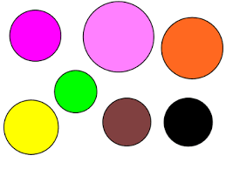
Shape Buster

Slide 2

Shape buster is inspired by an old school games which is very simple type of game
The game consist of the following

Slide 3
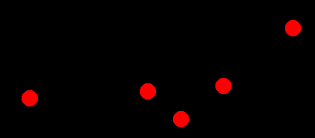

Enemies
Player

Slide 4
Mechanics of the game:
Avoid the enemies to reach the player
Hit the enemies to defend yourself
Keep away the enemies
Once the enemy hits the player, the game is over

Slide 5

Goal of the game
To reach a score as high as you can
To test the players patience
The score board will show the current points and it is located on the upper left corner of the screen

Slide 6
Start the Game

