Slide 1
Rag
Chat
Colapse
Scenario Ov Name, players
Game controls, step turns
Switch: Animations, Audio, Hover,…
Rag
Exp Strategy (Expl Replay) Colapse
Log Vscroll
Mapa
Zoom
Pan
Rotate
Rag
Exp Strategy (Expl Runtime) Colapse
Rag
Exp Tactical(Expl Runtime) Colapse
Unit State (H Scroll)
Combat Panel

Slide 2
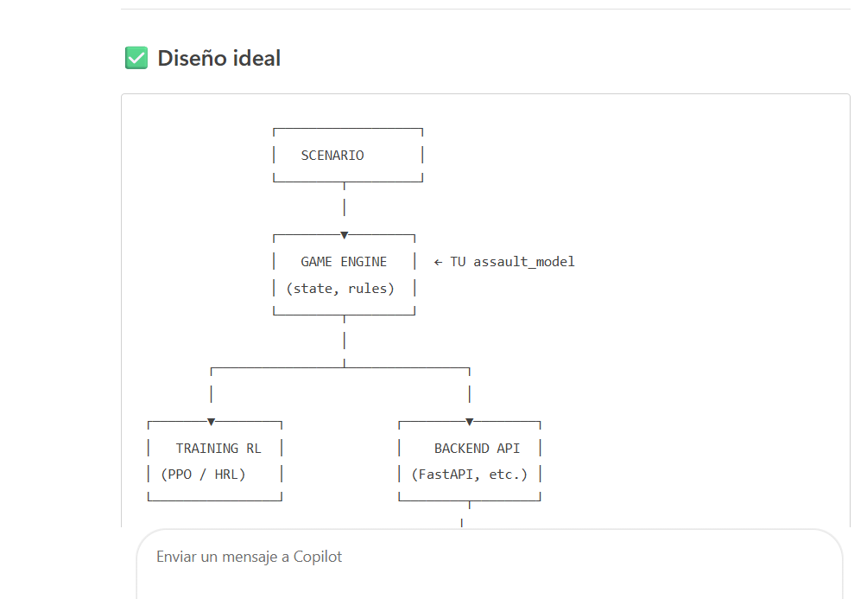
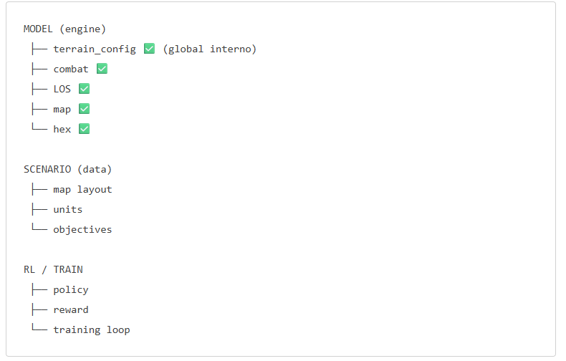

Slide 3
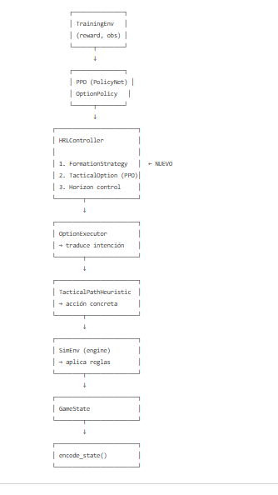
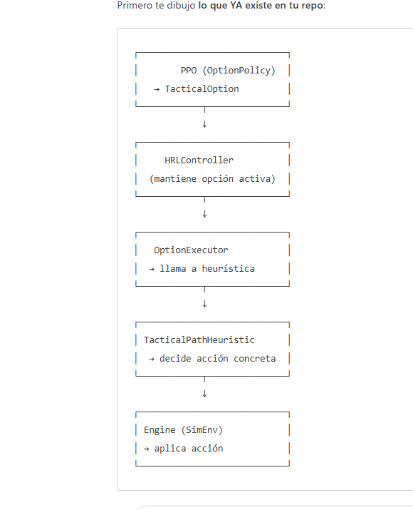
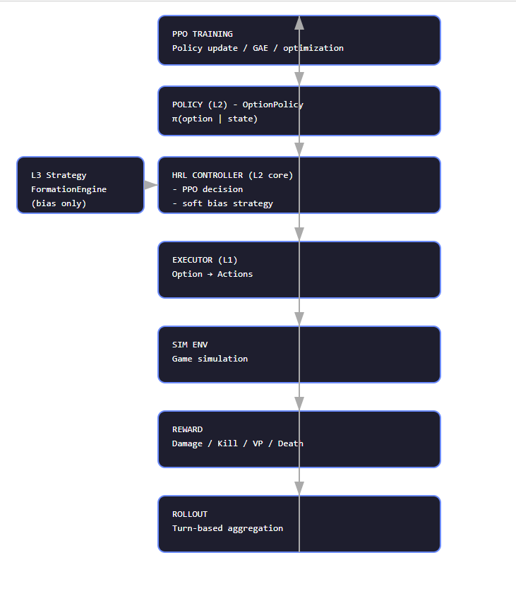

Slide 4
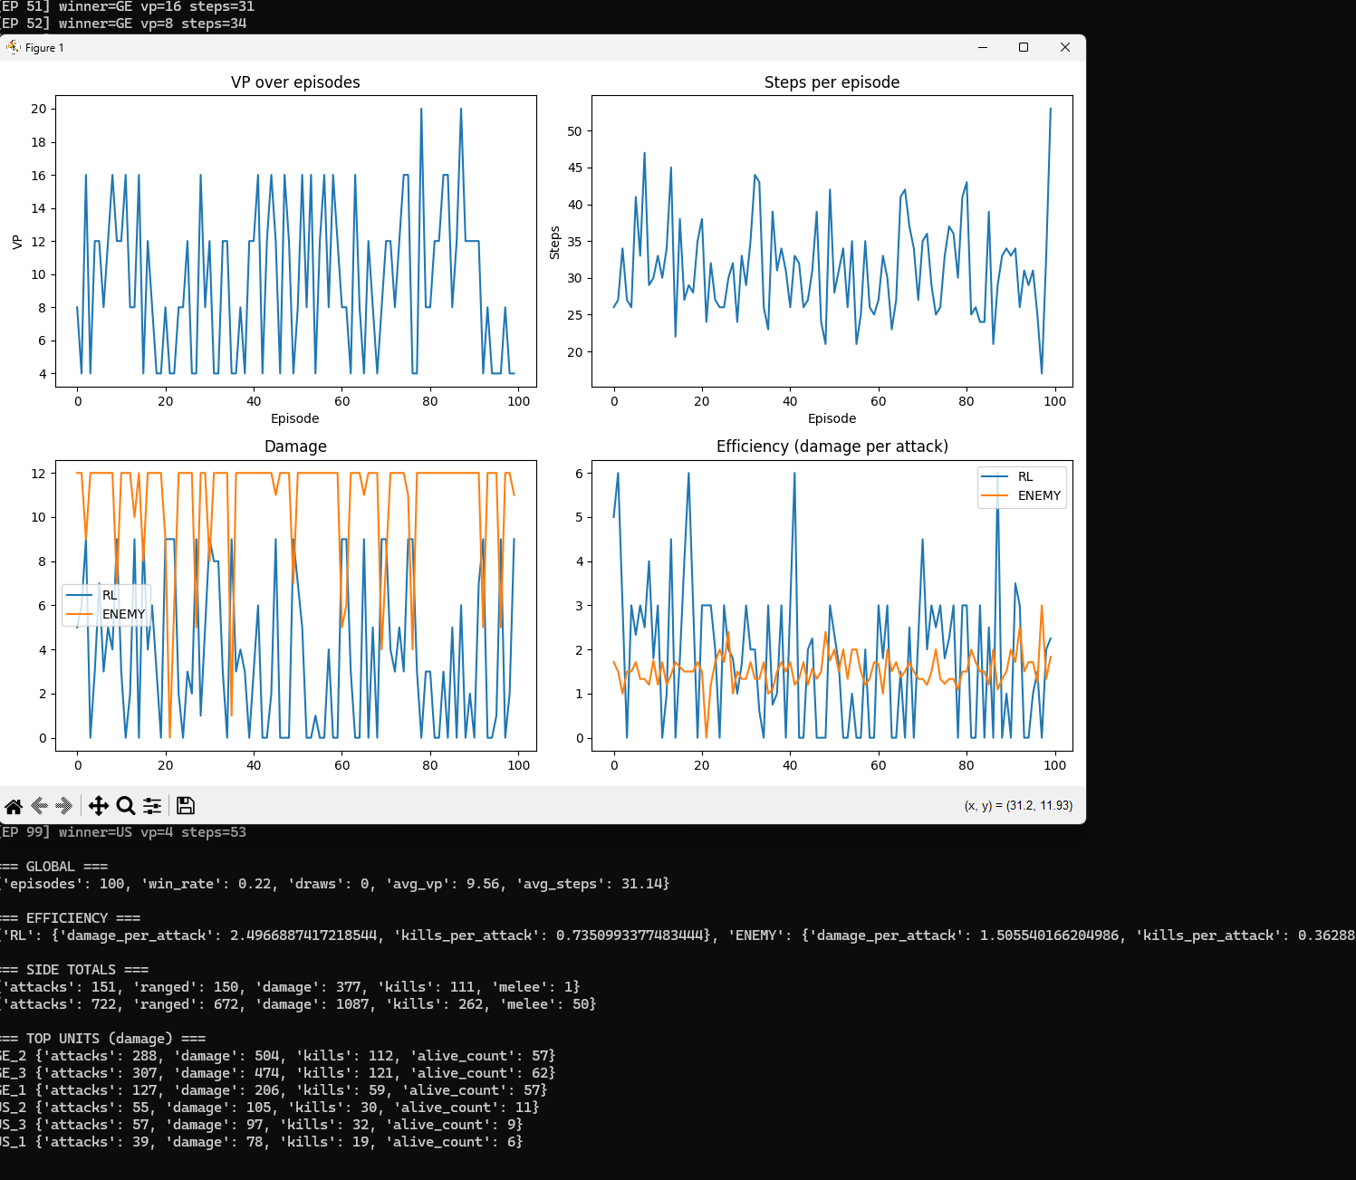

Slide 5
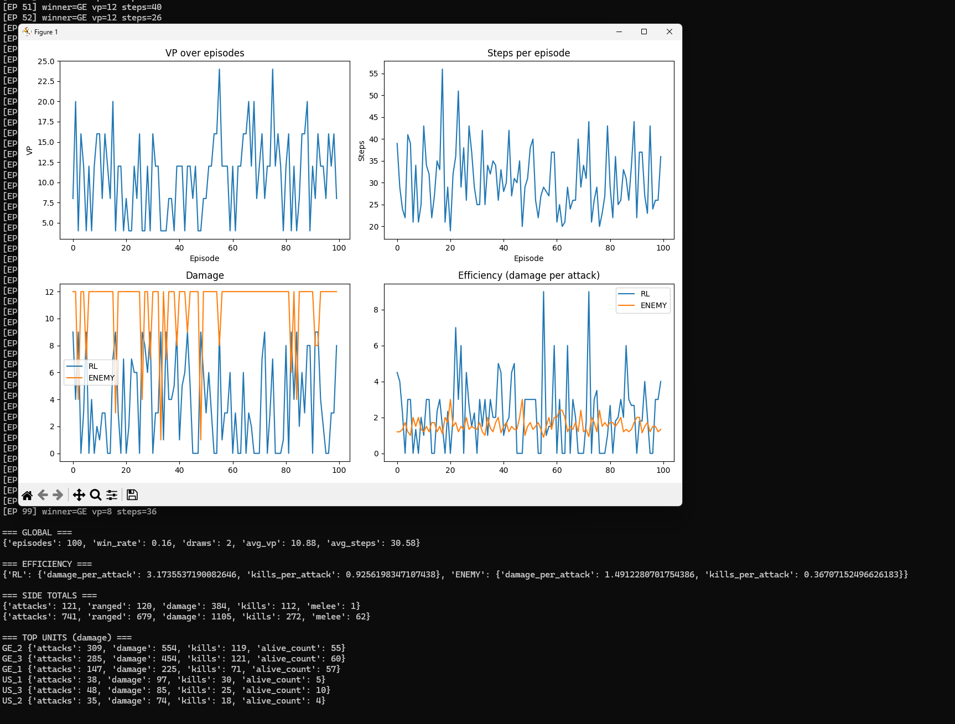

Slide 6
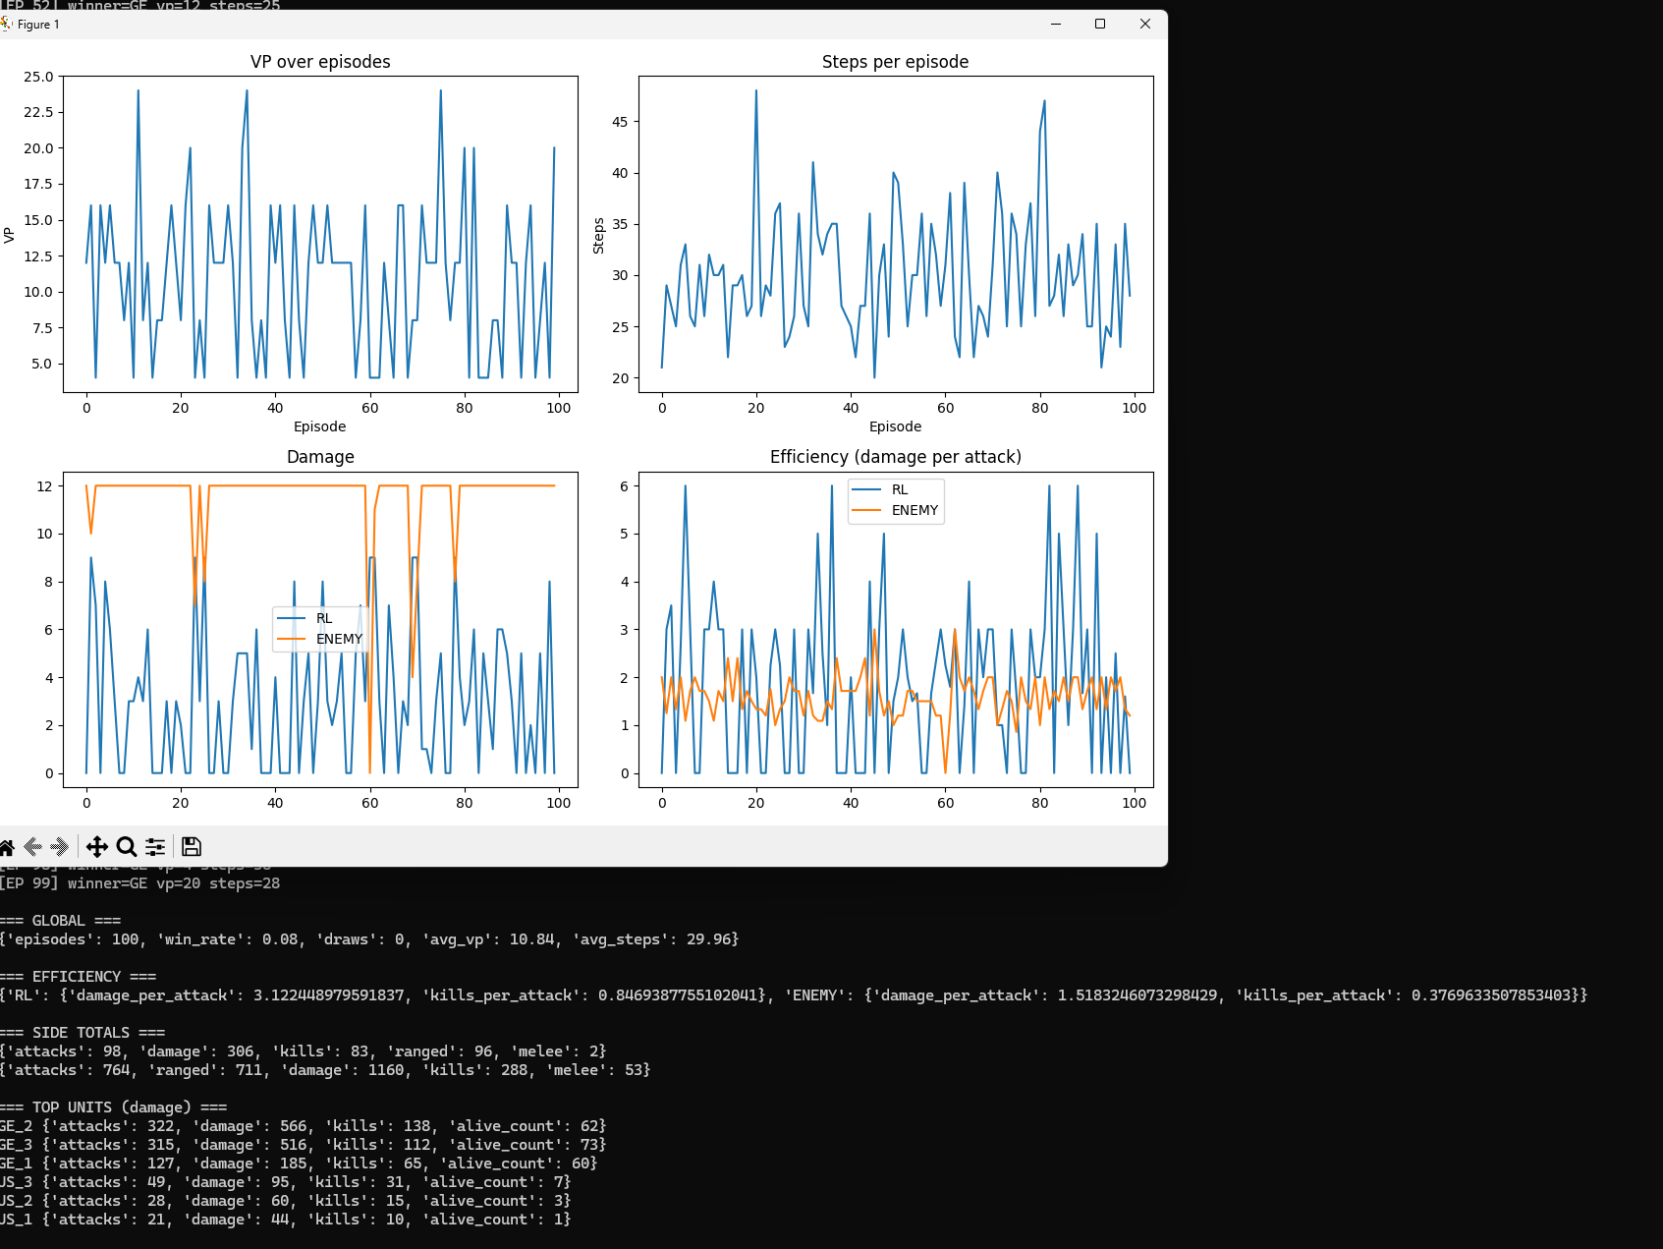

Slide 7
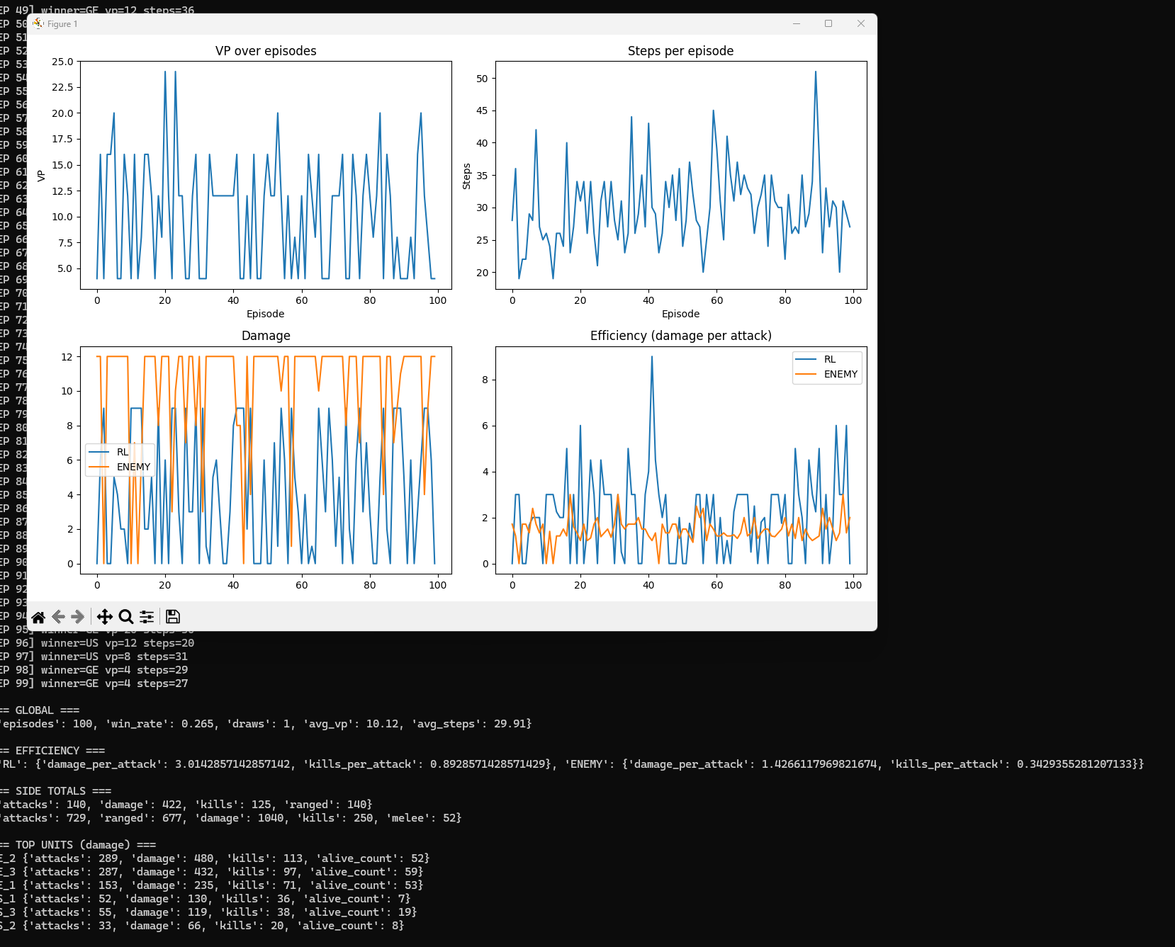

Slide 8
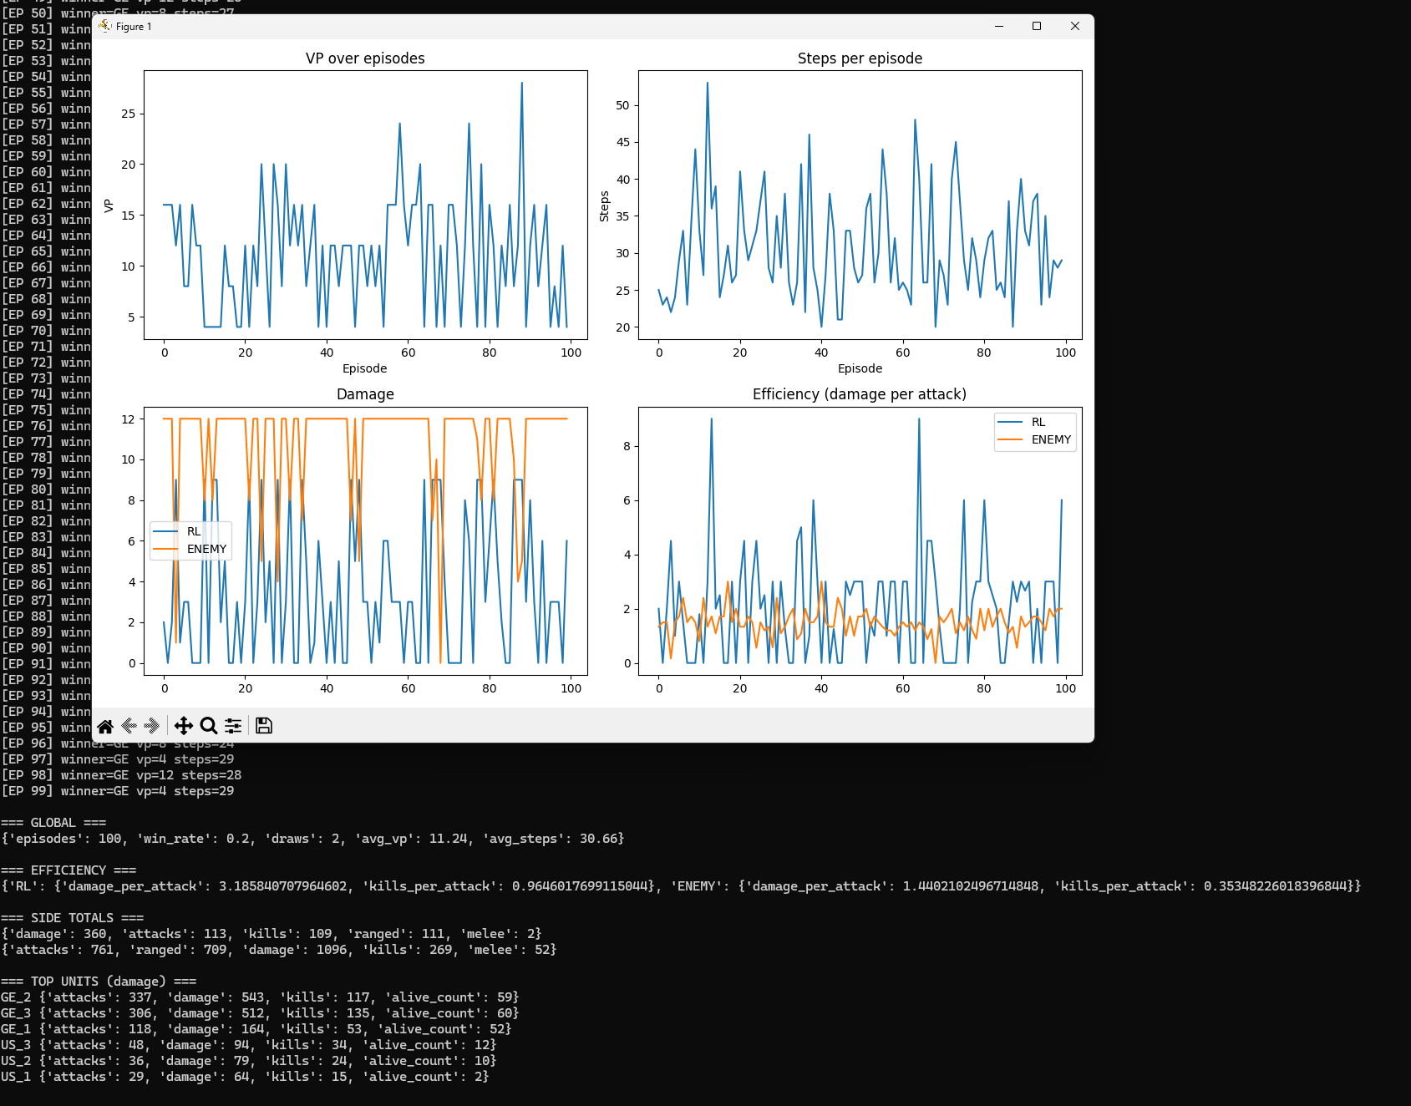

Slide 9
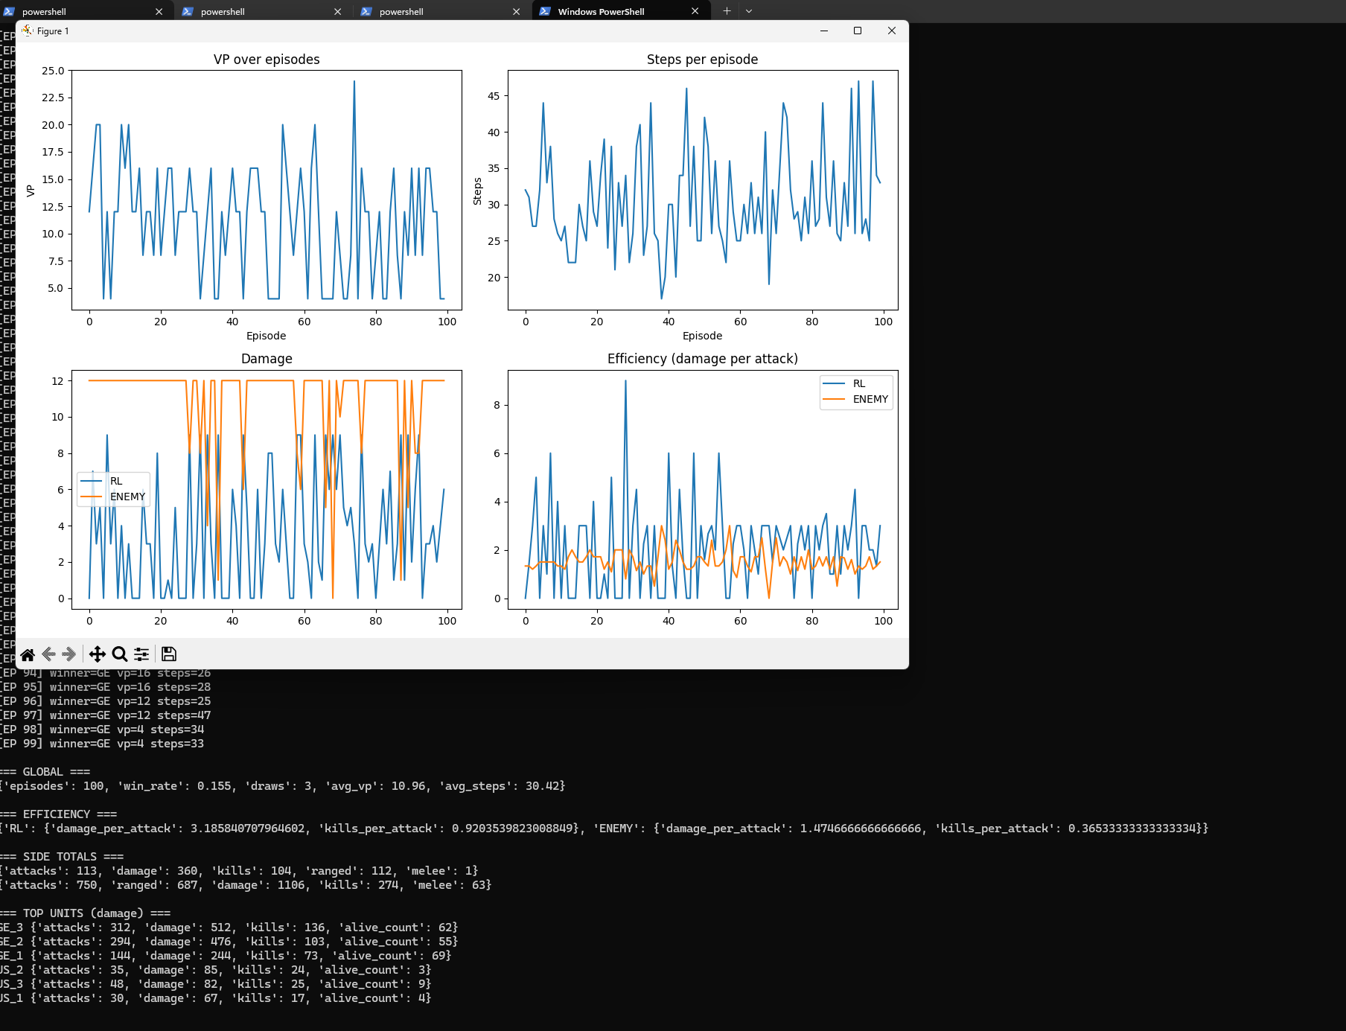

Slide 10
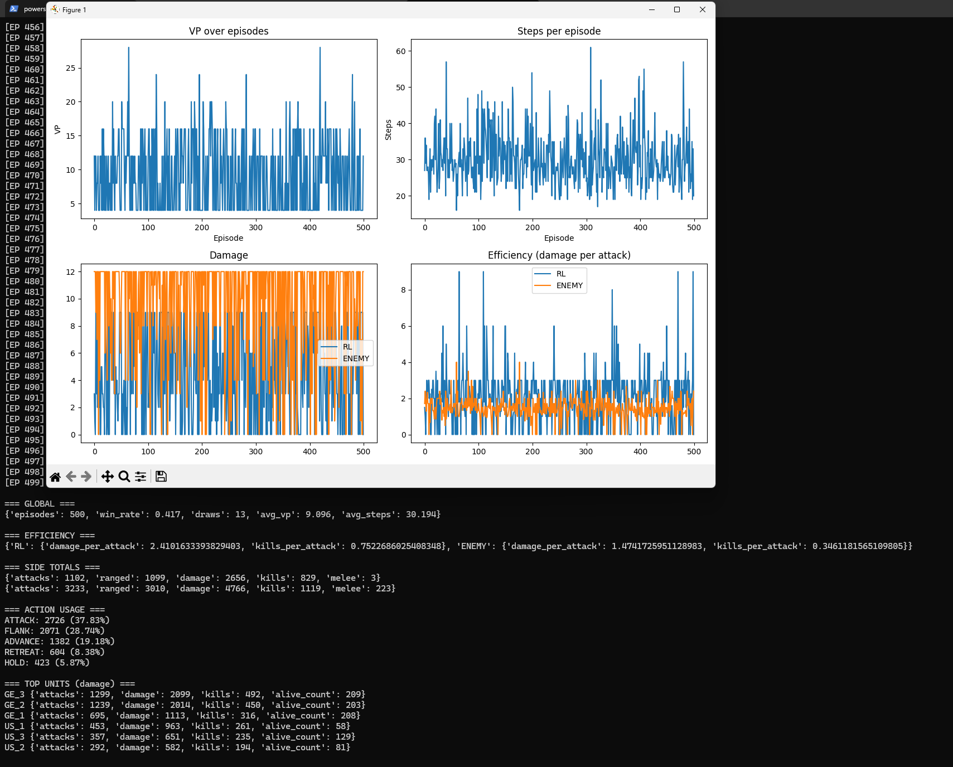

Slide 11
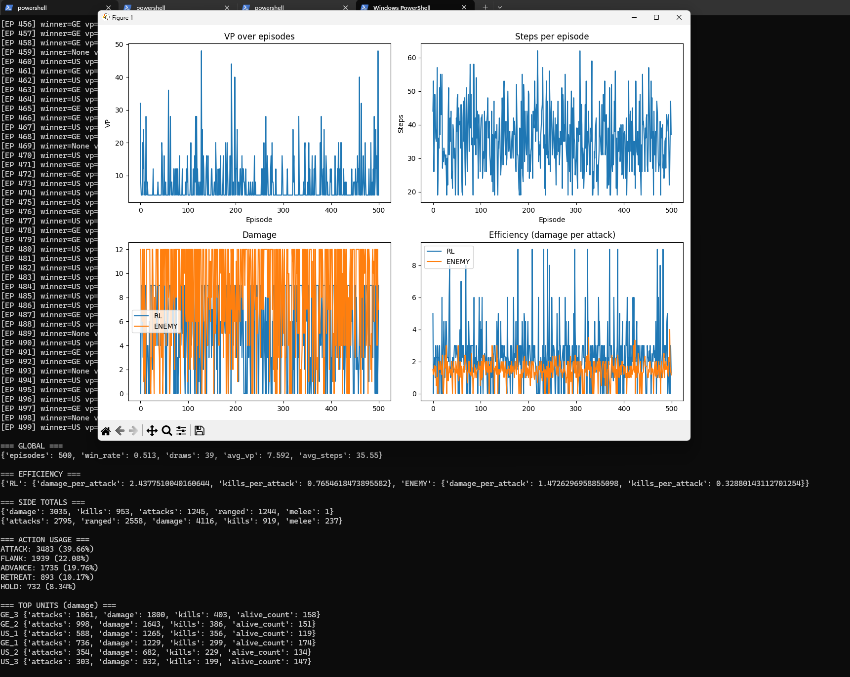

Slide 12
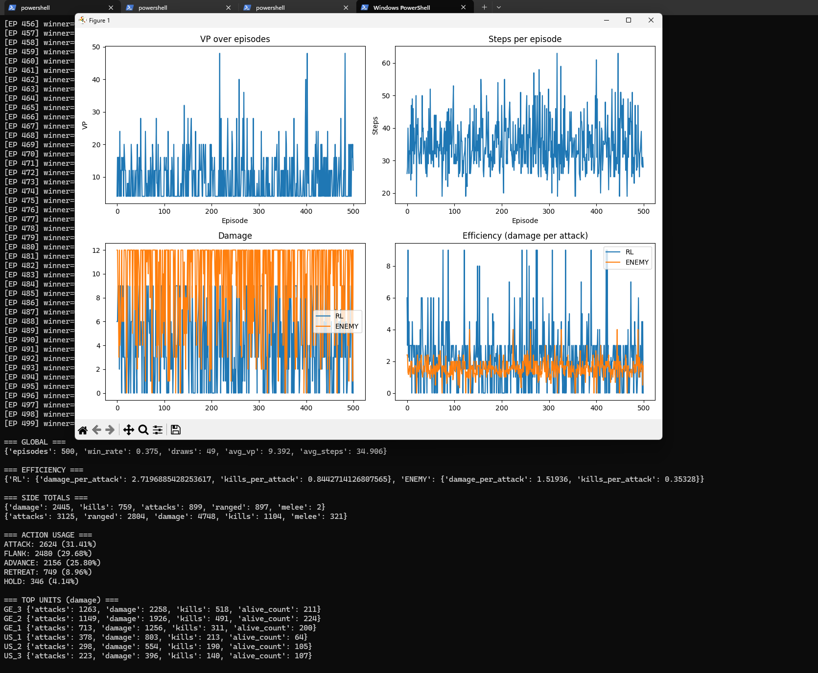

Slide 13
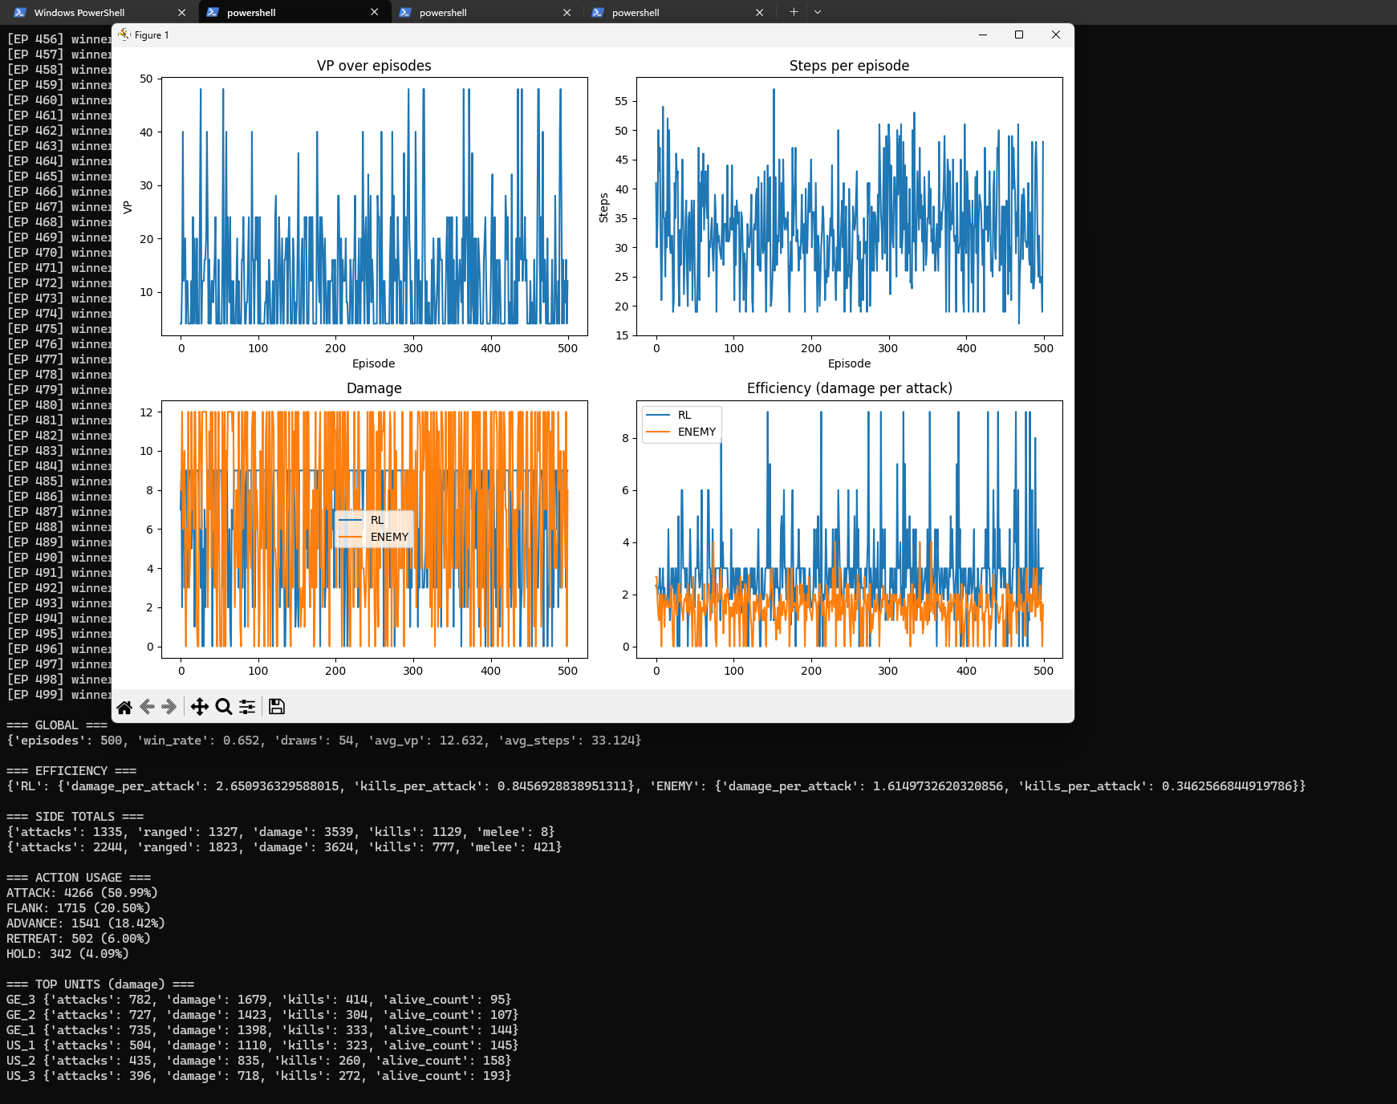

Slide 14
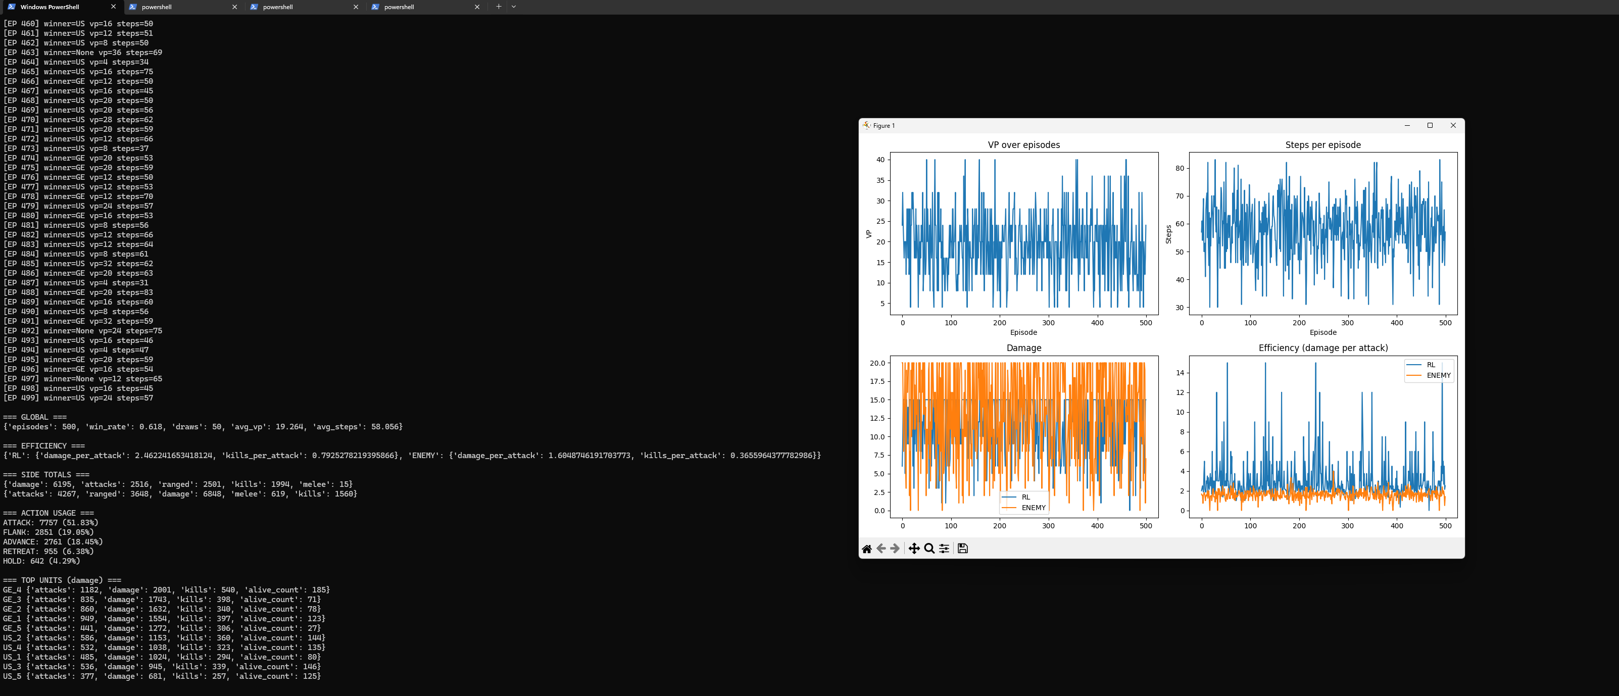
Engine 3x3 simulando en 5x5

Slide 15
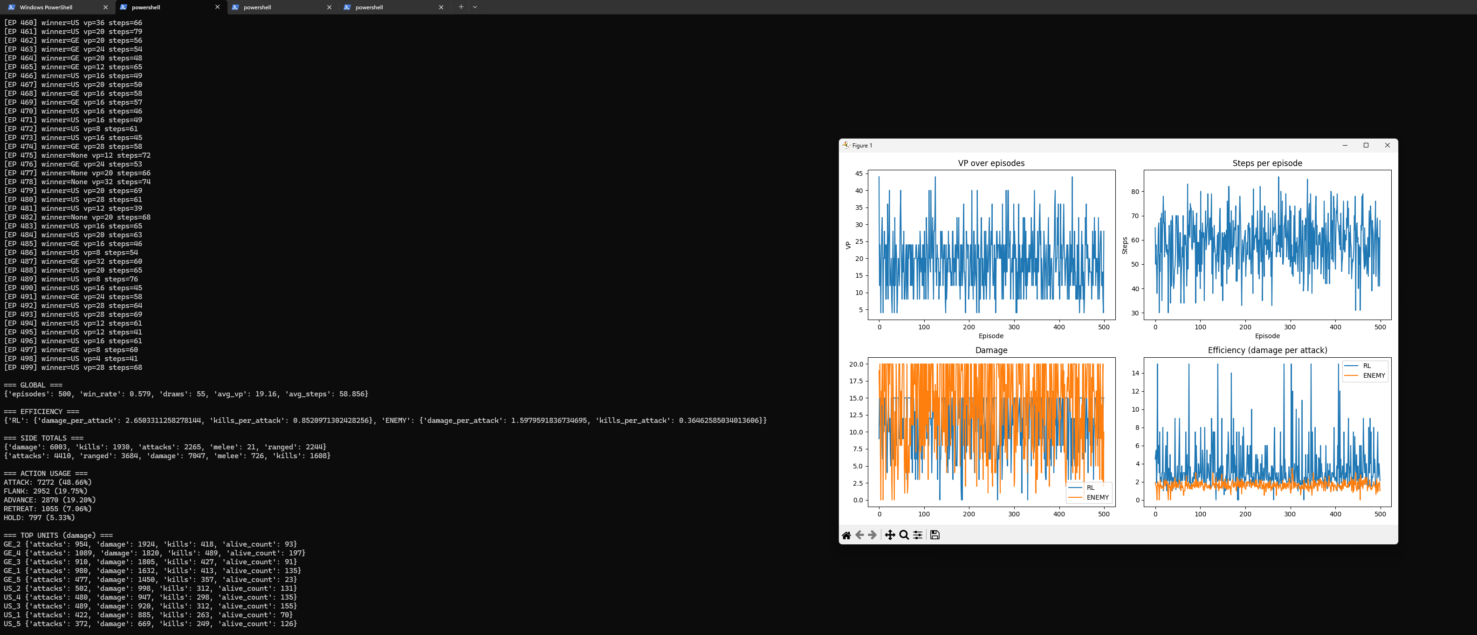
Engine 5x5 simulando en 5x5 2 Capas

Slide 16
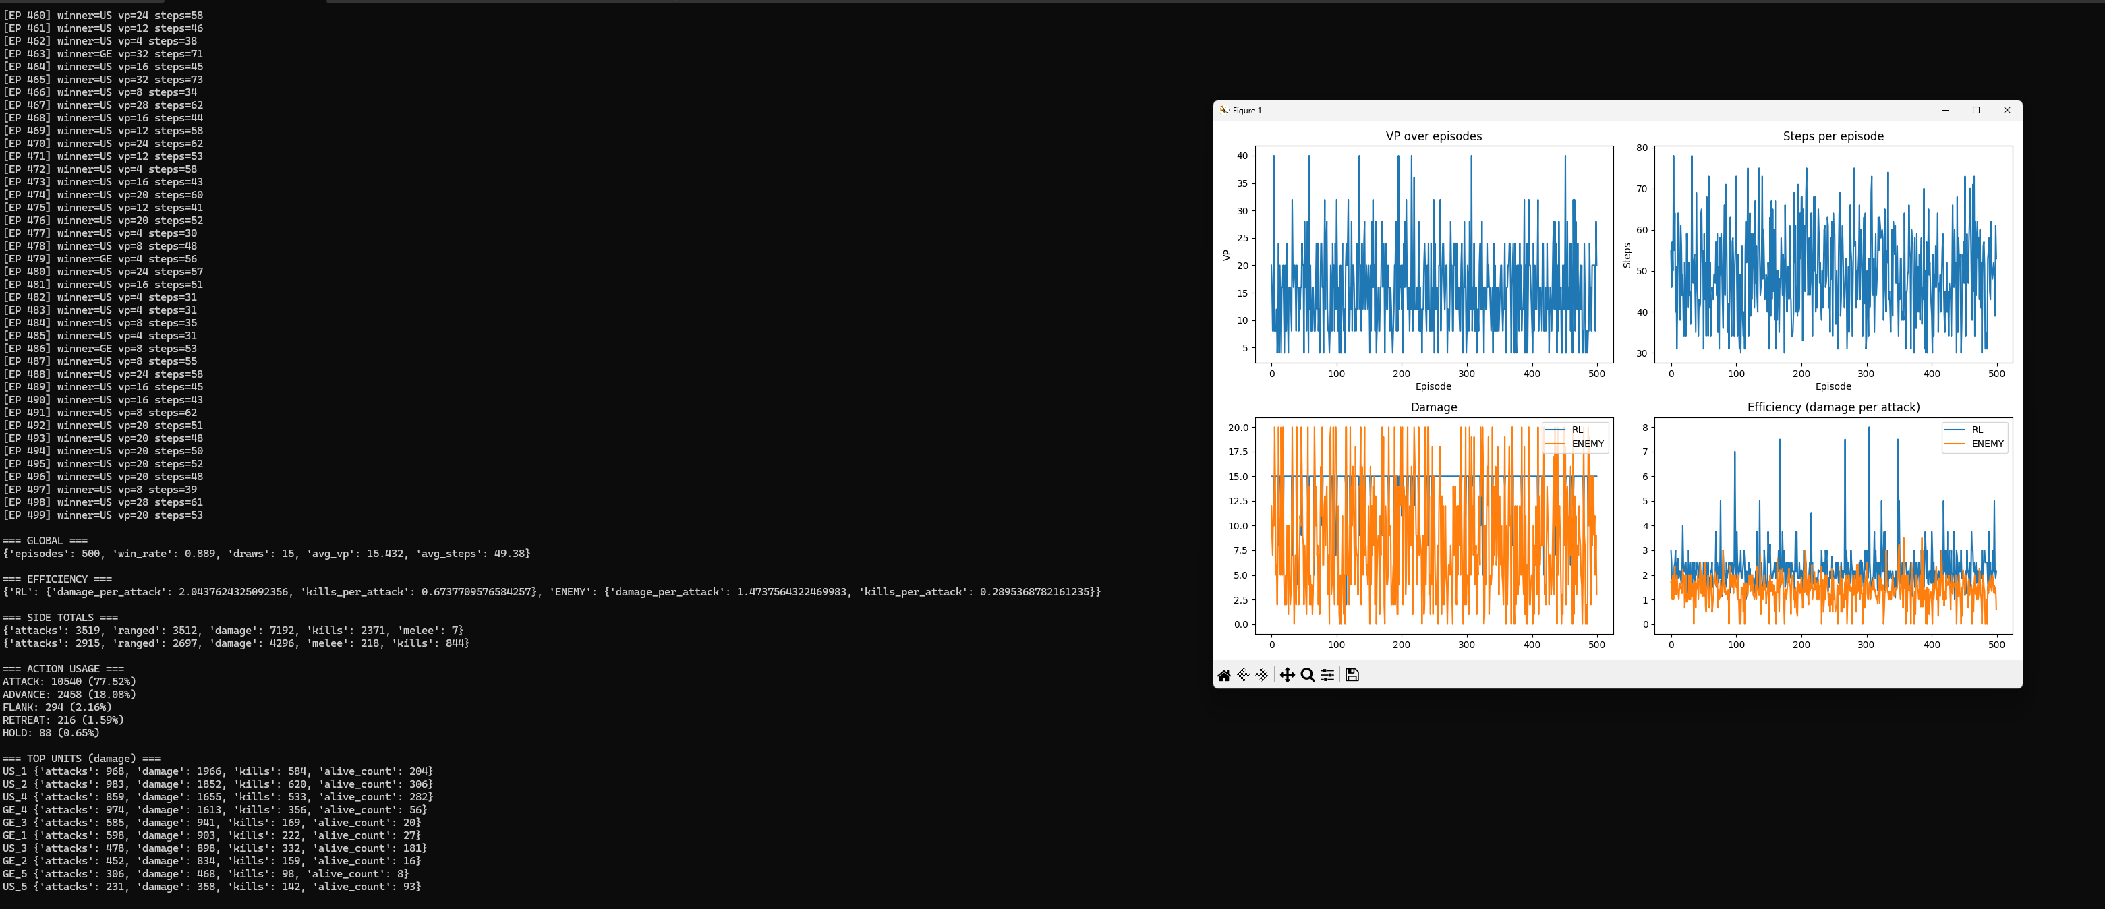

Slide 17
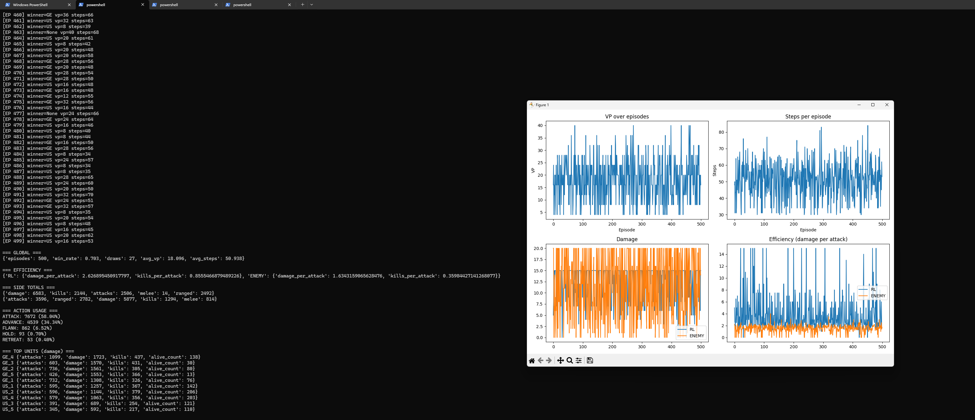

Slide 18
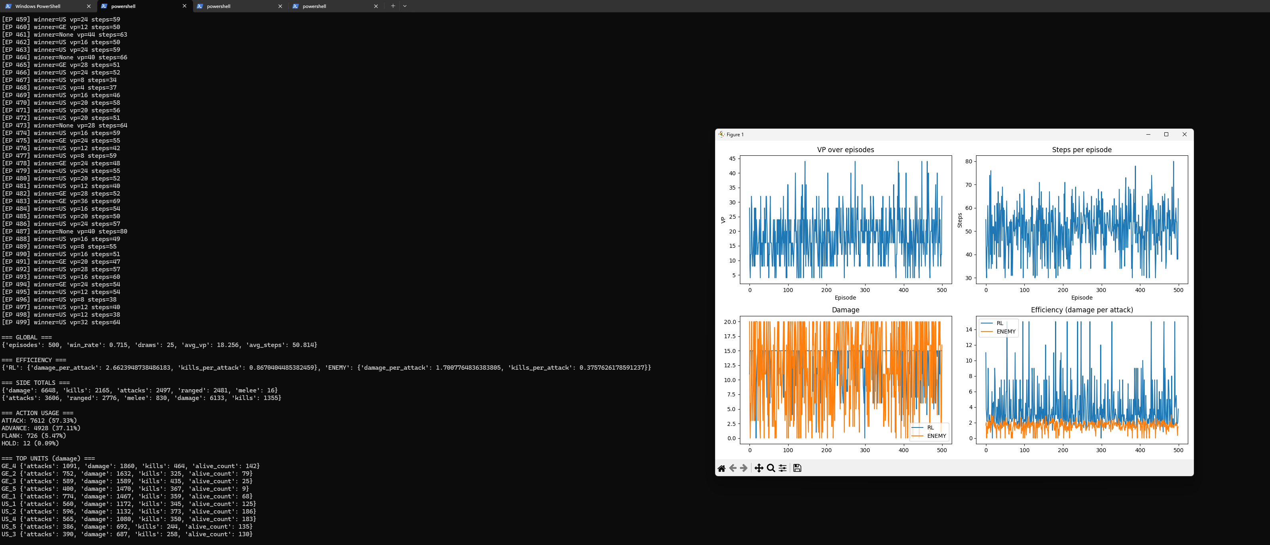

Slide 19
