Slide 1
TUTORIAL LESSON Linux & Tools
Institute of Parallel and Distributed Systems (iPads)
Shanghai Jiao Tong University
Rong Chen
rongchen@sjtu.edu.cn
2018.9

Slide 2
BIRTH of TUTORIAL LESSON
ICS introduces the Computer Systems, then WHO introduces ICS ?
A new environment: Linux
Many new tools: svn, …
ICS Book does not contain them

Slide 3
OUTLINE
Pre-requisite
Linux
Tools

Slide 4
Pre-requisite
Linux
Tools

Slide 5
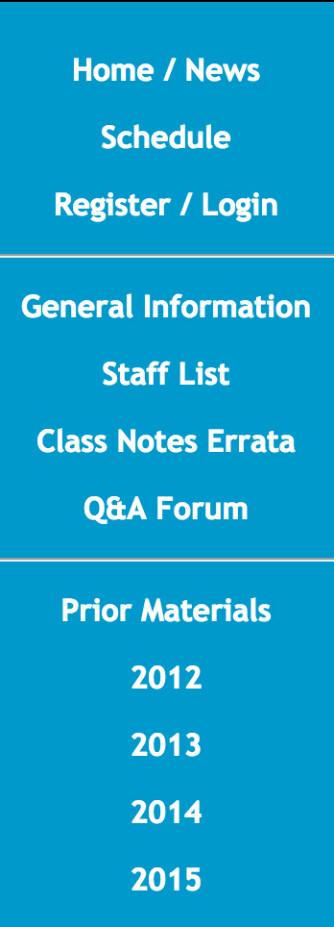
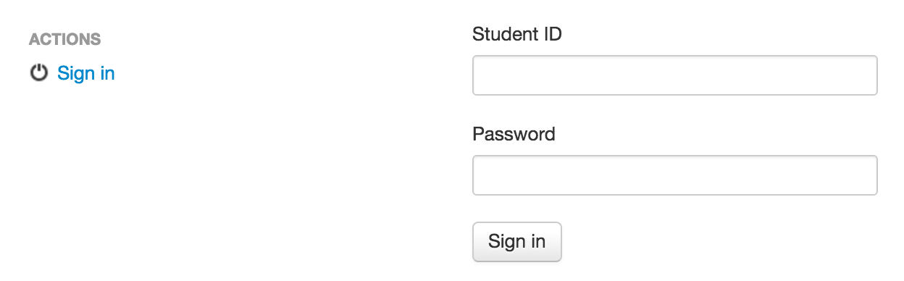
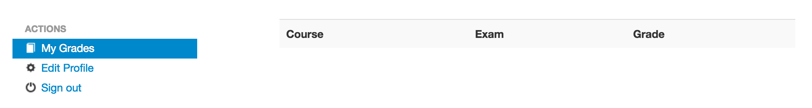
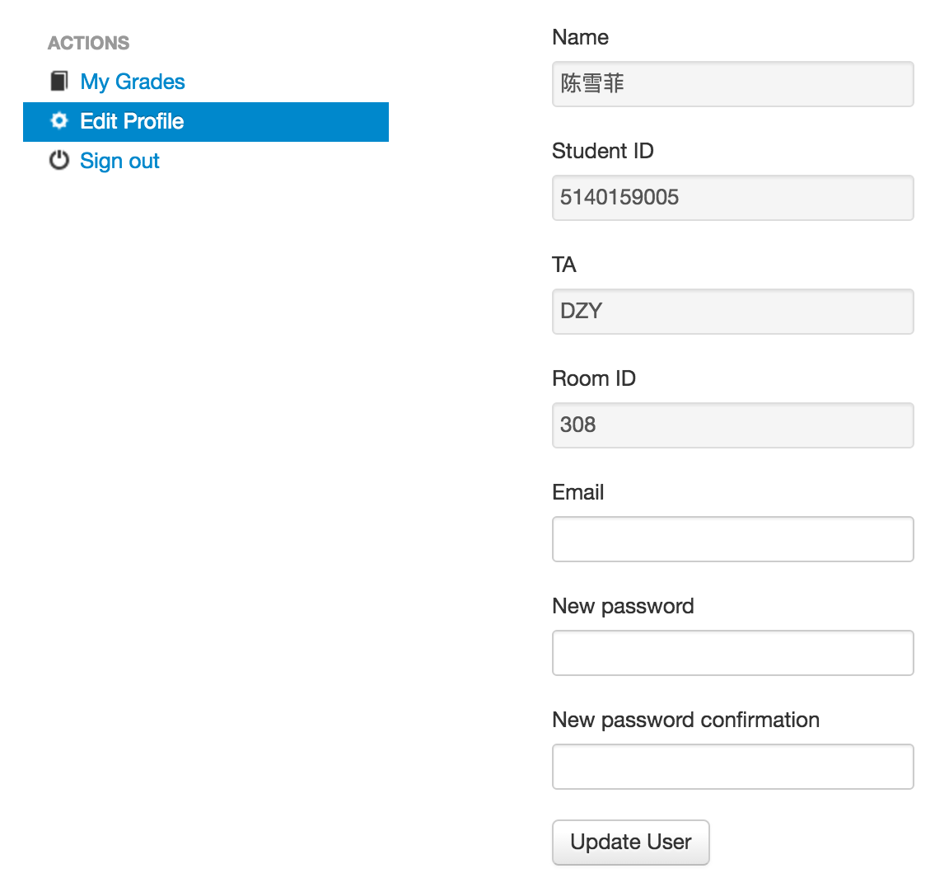
REGISTRATION

Slide 6
TASKS
Labs (25%)
1: Bits
2: Bomb *
3: Buffer Overflow *
4: Y86 Assembler
5: Y86 Compiler
6: Y86 Processor
* Online Test
Exams (70%)
Middle
Final
Homework (5%)

Slide 7
HARD RULES
Deadline: No Extension
Multiple submissions
Plagiarism: No Tolerance
Forbid C&P
from Network
from Classmates
Punishment
0 point for ALL

Slide 8
Cheating will not be tolerated
…
All homework, labs and exams are to be done individually.
…
It is your responsibility to ensure that your passwords are well-guarded, directories protected, and printouts do not fall into other hands.

Slide 9
STATISTICS
2012
Semester 1: 35
Cheating: 29
Register: 2
Submission: 4
Semester 2: 12
Cheating: 4
Submission: 8
2013
Semester 1: 17
Cheating: 4
Register: 7
Submission: 6
Semester 2: 11
Cheating: 8
Submission: 3

Slide 10
STATISTICS
2014
Semester 1: 21
Cheating: 19
Register: 0
Submission: 2
Semester 2: 17
Cheating: 10
Submission: 7

Slide 11
WARNING
… 不过我的本意并没有提供代码让他抄袭的啊。他有一个binfile 的函数怎么调试都不对，我确实把这段代码发给了他，但我教会了他怎么做的了。…
…, 她请教我怎么优化，我跟她讲了优化方法然后她自己去改了，改过以后问我为什么效率没有提升， 我就叫她让我看下她的代码，发现没有实质性的优化，我嫌讲不清就叫她参考我的代码, …
… 我们都是“好学生”，在同学之间会很难拒绝。这次之后就没有这种情况发生了。…
…, 知道了，只是实在不会写唉，没学c这个指针真的看不太懂额。这次错了，下次一定不会这么做了。不过能不能请老师不要把 XX判为0分 …
… XXX没有错，有错的是将他的代码直接交上去的人，他们根本就没考虑一下这可能对XXX造成什么影响。… （From YY BBS）

Slide 12
Pre-requisite
Linux
Tools
Introduction
Installation
Shell

Slide 13
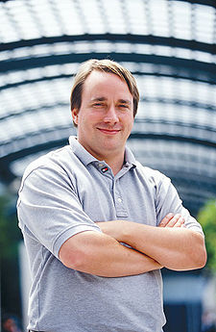

BACKGROUND
The History of Linux
Linus Torvalds, 1991
Unix-like Operating Systems
“ Unix is not so much an operating system as an oral history ”
Heirs: Linux, BSD, Solaris, MacOS X, …
Principle: KISS
Keep It Simple, Stupid !

Slide 14
COMPARISON
Differences between Windows and Linux
One Kernel and Multiple Distribution
3.2.x kernel (newest: 3.13.5 2014.2.22)
RedHat / Fedora, Debian
Suse, Gentoo, Arch, Ubuntu, …
Powerful Command Line Interface
Directories Organization
…

Slide 15













Slide 16
Pre-requisite
Linux
Tools
Introduction
Installation
Shell

Slide 17
INSTALL
Tips: about version
Fedora
Sulphur(9), Cambridge(10)
Debian (Toy Story)
Squeeze (6.0), Wheezy(7.0), Jessie(8.0)
Step 0: How to find it ?
SJTU Depository ftp://ftp.sjtu.edu.cn/
e.g. Debian-9.4.0 /debian-cd/9.4.0/amd64/iso-dvd/
Online: get the official web-site by google
e.g. Debian (/'dɛbiːjən/, Debra + Ian) http://www.debian.org/distrib/

Slide 18
INSTALL
Tips: virtual machine
Definition
provides a complete system platform which supports the execution of a complete operating system
Java Runtime Environment
Step 1: Where to install it ?
Cygwin
Sorry, no technical support
on RAW machine
Cool !
on VIRTUAL machine
Safety!
Dangerous !
Recommendation !

Slide 19
INSTALL
Tips: VMware Workstation
Benefit
hosted, popular, graphic
easy, stable, checkpointed
Step 2: Create VM
Select a Guest Operating System (if no ISO)
e.g. Debian 9
Set name and location
Disk capacity
20G (engross on demand)
Network connection (customized)
Bridge (separate IP) or NAT (internal IP, default)
Done !

Slide 20
INSTALL
Step 3: Configure VM
Insert ISO image
“VM -> Settings -> CD-ROM : Use ISO Image”
ISO Image: “debian-9.4.0-amd64-DVD-1.iso”
Configure Hardware (Customized)
Memory Size
#CPU / #Core
Ethnet Mode
Power On
Let’s go !

Slide 21
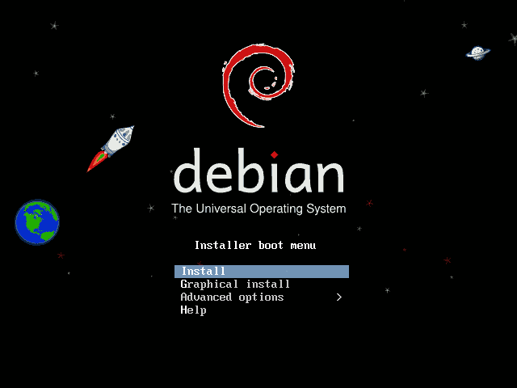

Slide 22
INSTALL
Tips: VMware Workstation
Switch
Ctrl + Alt
Step 4: Install Debian
Select a language and your location
Select a keyboard layout
U.S. English
Configure the network
Hostname and Domain name
Set root password and Create a User
Configure the clock
Time Zone

Slide 23
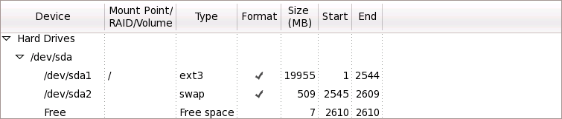
INSTALL
Tips: hard Disk in Linux
Naming: sd[x][y]
sda 1 - the 1st section of 1st HD
sdb3 - the 2nd section of 3rd HD
* sd: SCSI disk / hd: IDE disk
Step 4: Install Debian
Partition disks
Manual
Partitioning
1. _ swap 512M (equal to memory size) - sda2
2. / ext3 fill to maximum allowable size - sda1

Slide 24
INSTALL
Tips: Desktop Environment
GNOME /gə'noʊm/
from GNU Project
KDE /'keidiː‘iː/
from Qt Software
as you like
Step 4: Install Debian
Configure package manager
Use a Network mirror
Hostname: ftp://ftp.sjtu.edu.cn
Mirror directory: /debian/
Software selection
Graphical desktop environment
Standard System Utilities
…

Slide 25
INSTALL
Step 4: Install Debian
Install GRUB boot loader
Waiting …
Reboot … OK ☺
Welcome to Debian 9 !

Slide 26
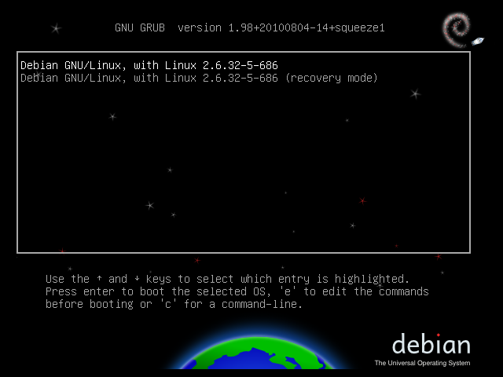

Slide 27
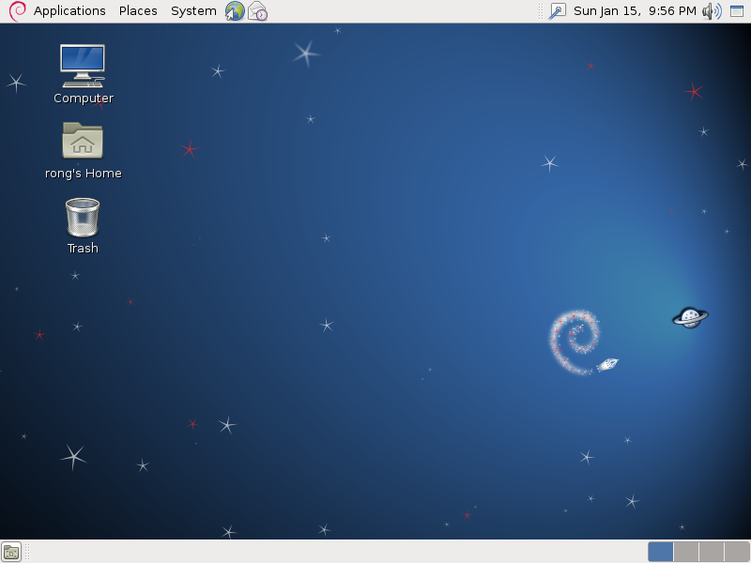

Slide 28
APPENDIX: System Virtualization
Architecture
VM
VM
Unmodified
User Software
Unmodified
User Software
VM
VM
Unmodified
User Software
Unmodified
User Software
Operating System
Operating System
Operating System
Operating System
Virtual Machine Monitor
Virtual Machine Monitor
Host Operating System
Hardware
(CPU, Memory, Disk, Ethernet)
Hardware
(CPU, Memory, Disk, Ethernet)
Non-hosted
Hosted

Slide 29





APPENDIX: System Virtualization
Virtual Machine Monitor
VMware (EMC)
Player, Workstation, …
Fusion, VMware Server, ESX Server, …
Other s
Hyper-V (Virtual PC)
xVM (VirtualBox)
KVM, Xen
…

Slide 30
APPENDIX: VMware Workstation
Snapshot (unsupported in VMware Player)
Backup the whole computer
Don’t worry about system crash
Trade of between storage and computers
Files in VMware Workstation
Configuration (.vmx) BIOS (.nvram) Paging file (.vmem) Disk (.vmdk) Snapshot (.vmsn ) …

Slide 31
APPENDIX: VMware Workstation
Configuration
Network
>setup
select ‘network configuration’
>ping ftp.sjtu.edu.cn
Install VMware Tools

Slide 32
Pre-requisite
Linux
Tools
Introduction
Installation
Shell

Slide 33
SHELL
Operating System Shell
Provide access to the services of a kernel
Command-Line Interface (CLI)
Unix Shell
e.g. Bounce-Again Shell, bash
Non-Unix Shell
e.g. DOS
Graphical User Interface (GUI)
Windows, X Window (KDE, GNOME, Xfce), Mac OS

Slide 34
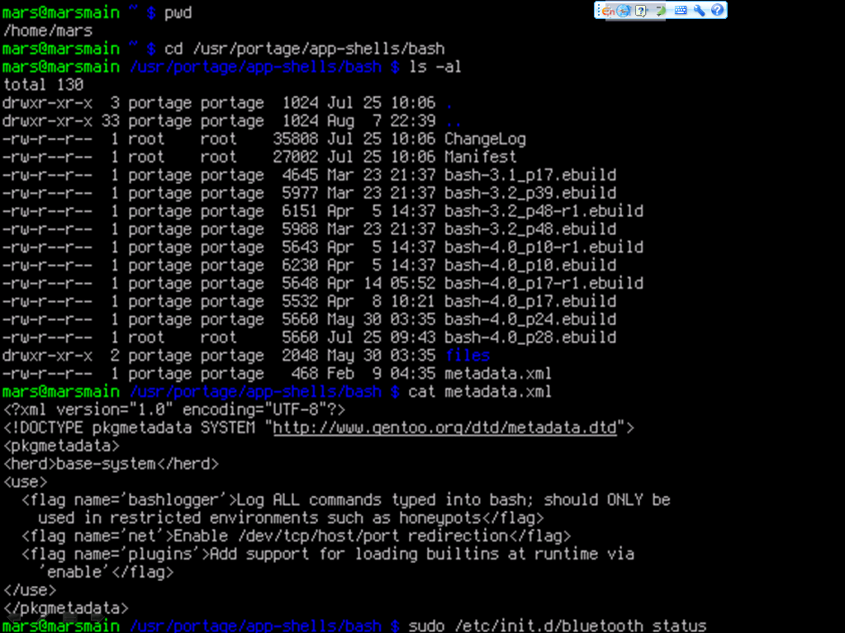

Slide 35
Commands
MOST IMPORTANT
Search Path: /bin, /usr/bin, ...
Command is case sensitive
man – display the on-line manual pages e.g. >man man
whatis – search the whatis database for complete words e.g. >whatis passwd

Slide 36
Commands
File and Directory
ls - list files/dirs e.g. >ls -l
mkdir – create a dir e.g. >mkdir test
cd - change dir e.g. >cd test
rm - remove files/dirs e.g. >rm -f a.txt
cp - copy files/dirs e.g. >cp a.txt b.txt
mv – move files/dir s e.g. >mv a.txt c.txt
pwd – show current path e.g. >pwd
du – estimate files/dirs space usage e.g. >du -c -h test
df – report free disk space e.g. >df

Slide 37
Commands
File and Directory
chmod – change mode of file/dir e.g. >chmod 777 test
chown – change owner of file/dir e.g. >chown rong edit
chgrp – change group of file/dir e.g. >chgrp guest draft -R
$ ls -l
drwxr--r-- 1 peter admin 4096 Mar 1 2007 drafts
-rw-r--r-- 1 peter admin 30405 Mar 1 2007 edition-32
-r-xr-xr-x 1 terry admin 8460 Mar 1 2007 edit
duuugggooo C owner group size date name
C:(hard link count)

Slide 38
Commands
Search
whereis - locate special files for a command (binary, src and manual file) e.g. >whereis cp
find – search for files/dirs in a dir hierarchy e.g. >find . –name “c.txt”
locate – locate files/dirs by name in system based on a database e.g. >locate test
grep – text search utility e.g. >grep “abc” . -R

Slide 39
Commands
User Account
useradd – create a new user e.g. >useradd rong
userdel – delete a user account e.g. >userdel rong
passwd – set password for a user account based on a database e.g. >passwd rong
users – print name of user currently logged e.g. >users

Slide 40
Commands
Text
cat – concatenate and print files e.g. >cat b.txt
head – output the first part of files e.g. >head –n 4 b.txt
tail – output the last part of files e.g. >tail –c 50 b.txt
wc – print the number of newlines, words, and bytes in files e.g. >wc b.txt
cut – remove sections from each line of files e.g. >cut –c 4-10 b.txt

Slide 41
Commands
Misc
echo – display a line of text e.g. >echo $PATH
mount – mount a file system e.g. >mount /dev/sda3 /mnt
umount – unmount a file system e.g. >umount /mnt
ping – send ICMP ECHO_REQUEST to network hosts e.g. >ping 10.132.143.100
date – print or set the system date and time e.g. >date "+%m/%d/%y“
time – time a simple command e.g. >time locate mapreduce

Slide 42
Commands
Misc
; – join two command in one line e.g. >echo $PATH; whereis echo
< > >> – redirect input and output e.g. >cat b.txt >> c.txt
| – pipe the former output as the later input e.g. >cat b.txt | grep “abc”
& – do command in new process e.g. >cat b.txt &

Slide 43
Pre-requisite
Linux
Tools
Software Installer
Compressing and Archiving
Remote Login
Text Editor

Slide 44
VERSION CONTROL
APT (Advanced Package Tools)
A management system for software packages
Package resource list for APT:
/etc/apt/sources.list
$ cat /etc/apt/source.list
...
deb http://ftp.sjtu.edu.cn/debian/ squeeze main
dbe-src http://ftp.sjtu.edu.cn/debian/ squeeze main
type URI of source dist comp
URI type: http, ftp, cdrom, file, ssh ...

Slide 45
VERSION CONTROL
APT (Advanced Package Tools)
apt-get: command-line tool
update e.g. >apt-get update
install e.g. >apt-get install htop
remove e.g. >apt-get remove htop
upgrade e.g. >apt-get upgrade htop
apt-cache: cache manipulator
search e.g. >apt-cache search htop
showpkg e.g. >apt-cache showpkg htop

Slide 46
VERSION CONTROL
APT (Advanced Package Tools)
example: install vim
>su root user
>apt-get update update apt list
>apt-cache search vim search in cache
>apt-get install vim install vim
>man vim manual of vim
$ apt-cache search vim
...
vim – Vi IMproved – enhanced vi editor
vim-doc - Vi IMproved – HTML documentation
...

Slide 47
Pre-requisite
Linux
Tools
C Language
Lab
Software Installer
Compressing and Archiving
Remote Login
Text Editor

Slide 48
COMPRESSING
GZIP (Gnu ZIP)
gzip file format
Compress just single file
Replace the original file with .gz file
e.g. >gzip test.txt
>gunzio test.txt.gz

Slide 49
ARCHIVING
TAR (Tape ARchive)
tar file format
Suffix:
.tar e.g. >tar -cf src.tar src/
.tgz/.tar.gz e.g. >tar -zxf src.tar.gz
.tbz/.tar.bz2 e.g. >tar -jcf src.tbz src/

Slide 50
Pre-requisite
Linux
Tools
C Language
Lab
Software Installer
Compressing and Archiving
Remote Login
Text Editor

Slide 51
REMOTE LOGIN
SSH (Secure SHell)
A Replacement for Telnet
Communication through a secure channel
Tatu Ylönen, 1995
OpenSSH (OpenBSD Secure Shell), 1999
e.g. >ssh -l root 10.132.143.112
SCP, A Replacement for FTP
e.g. >scp b.txt root@10.132.143.112:~/test/ >scp root@10.132.143.112:~/test/b.txt ./

Slide 52
REMOTE LOGIN
Remote Login from Windows
Command-Line Interface
PuTTY
act as a client for SSH and Telnet
Developed by Microsoft
Graphical User Interface
VNC (Virtual Network Client)
Platform Independent
Client-Sever Model

Slide 53
Pre-requisite
Linux
Tools
C Language
Lab
Software Installer
Compressing and Archiving
Remote Login
Text Editor

Slide 54

TEXT EDITOR
vi (Visual Editor)
/'viː'ai/, not /'siks/ ☺
Extension: vim, vile, xvi, …
Simple and Convenient
BOOK: “learning the vi editor”
http://www.china-pub.com/computers/common/info.asp?id=9208
Cheat Sheet (Chinese version)
http://jserv.sayya.org/misc/vi-vim-cheat-sheet.png
“>vimtutor” to get a simple tutorial

Slide 55
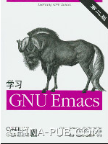
TEXT EDITOR
Emacs (Editing MACroS)
/'imæks/
More powerful than IDE !
Emacs List
BOOK: “Learning GNU Emacs”
http://www.china-pub.com/computers/common/info.asp?id=13395

Slide 56
Thanks

Slide 57
Tutorial-1
Tasks
Install Linux
Shell http://ipads.se.sjtu.edu.cn/courses/ics/tutorials/shell.html

