Slide 1
Representing Information
Notes:
W 87

Slide 2
Outline
Bit and Byte
Understand machine representations of numbers
Suggested reading
  1.1, 2.1.1
Notes:
W 87

Slide 3
Why Bit?
Modern computers store and process
  Information represented as two-valued signals
  These lowly binary digits are bits
Bits form the basis of the digital revolution
Notes:
W 87

Slide 4
The Decimal Representation
Base-10
Has been in use for over 1000 years
Developed in India
Improved by Arab mathematicians in the 12th century
Brought to the West in the 13th century by
  the Italian mathematician Leonardo Pisano,
    better known as Fibonacci.
Notes:
W 87

Slide 5
Why Bit?
Using decimal notation is natural for ten-fingered humans
But binary values work better when building machines
  that store and process information
Notes:
W 87

Slide 6
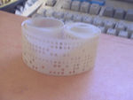
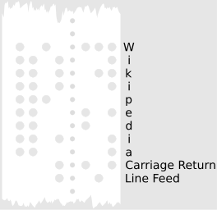
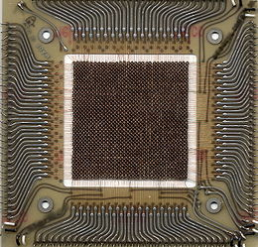
Why Bit?
Two-valued signals can readily be
  represented, stored, and transmitted,
Examples
  The presence or absence of a hole in a punched card
  A high or low voltage on a wire
  A magnetic domain oriented clockwise or counterclockwise.
0
1
0
Voltage
Time
Notes:
W 87

Slide 7
Why Bit?
The electronic circuitry is very simple and reliable for
  storing and performing computations on two-valued signals
This enabling manufacturers to integrate
  millions of such circuits on a single silicon chip
Notes:
W 87

Slide 8
Group Bits
In isolation, a single bit is not very useful
In English, there are 26(or 52) characters in its alphabet. They are not useful either in isolation
However, there are plenty of words in its vocabulary. How is this achieved?
Similarly, we are able to represent the elements of any finite set by using bits (instead of bit)
Notes:
W 87

Slide 9
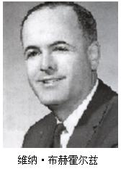
Group Bits
To do this, we
  first group bits together
  then apply some interpretation to the different possible bit patterns
    that gives meaning to each patterns
8-bit chunks are organized as a byte
  Dr. Werner Buchholz in July 1956
  during the early design phase for the IBM Stretch computer
Notes:
W 87

Slide 10
Value of Bits
Bits 01010
Value 0*2⁴+1*2³+0*2²+1*2¹+0*2⁰ = 10
Value 102(1100110)
Bits 102 = 51*2 + 0 (0)
51 = 25*2 + 1 (1)
25 = 12*2 + 1 (1)
12 = 6*2 + 0 (0)
6 = 3*2 + 0 (0)
3 = 1*2 + 1 (1)
1 = 0*2 + 1 (1)
Notes:
W 87

Slide 11
Group bits as numbers ⎯ Three encodings
Unsigned encoding
  Representing numbers greater than or equal to 0
  Using traditional binary representation
Two’s-complement encoding
  Most common way to represent either positive or negative numbers
Floating point encoding
  Base-two version of scientific notation for representing real numbers
Notes:
W 87

Slide 12
Group bits as numbers ⎯ Understanding numbers
Machine representation of numbers are not same as
  Integers and real numbers
They are finite approximations to integers and real numbers
  Sometimes, they can behave in unexpected way
Notes:
W 87

Slide 13
‘int’ is not integer
Overflow
  200*300*400*500 = -884,901,888
  Product of a set of positive numbers yielded a negative result
Commutativity & Associativity remain
  (500 * 400) * (300 * 200)
  ((500 * 400) * 300) * 200
  ((200 * 500) * 300) * 400
  400 * (200 * (300 * 500))
Notes:
W 87

Slide 14
‘float’ is not real number
Product of a set of positive numbers is positive
Overflow and Underflow
Associativity does not hold
  (3.14+1e20)-1e20 = 0.0
  3.14+(1e20-1e20) = 3.14
Notes:
W 87

Slide 15
Hexadecimal
Base 16 number representation
Use characters ‘0’ to ‘9’ and ‘A’ to ‘F’
Write FA1D37B₁₆ in C as
  0xFA1D37B or
  0xfa1d37b
Notes:
W 87

Slide 16
Hexadecimal
Byte = 8 bits
  Binary 00000000₂ to 11111111₂
  Decimal: 0₁₀ to 255₁₀
  Hexadecimal 00₁₆ to FF₁₆
Decimal
Hex
Binary
0
0
0000
1
1
0001
2
2
0010
3
3
0011
4
4
0100
5
5
0101
6
6
0110
7
7
0111
8
8
1000
9
9
1001
A
10
1010
B
11
1011
C
12
1100
D
13
1101
E
14
1110
F
15
1111
Notes:
W 87

Slide 17
Hexadecimal vs. Binary
0x173A4C
Hexadecimal 1 7 3 A 4 C
Binary 0001 0111 0011 1010 0100 1100
1111001010110110110011
Binary 11 1100 1010 1101 1011 0011
Hexadecimal 3 C A D B 3
0x3CADB3
Notes:
W 87

Slide 18
Hexadecimal vs. Decimal
Hexadecimal 0xA7
Decimal 10*16+7 = 167
Decimal 314156 = 19634*16 + 12 (C)
19634 = 1227*16 + 2 (2)
1227 = 76*16 + 11 (B)
76 = 4*16 + 12 (C)
4 = 0*16 + 4 (4)
Hexadecimal 0x4CB2C
Notes:
W 87

Slide 19
Hexadecimal vs. Binary
0x39A7F8 ->
1100100101111011 ->
0xD5E4C ->
1001101110011110110101 ->
0011 1001 1010 0111 11111 000
C97B
1101 0101 1110 0100 1100
2 6 E 7 B 5
Notes:
W 87

Slide 20
Decimal, Hexadecimal, Binary
Decimal Binary Hexadecimal
167
62
188
0011 0111
1000 1000
1111 0011
0x52
0xAC
0xE7
10100111
0xA7
00111110
0x3E
10111100
0xBC
3*16+7=55
0x37
8*16+8=136
0x88
15*16+3=243
0xF3
5*16+2=82
01010010
10*16+12=172
10101100
14*16+7=231
11100111
Notes:
W 87

Slide 21
Hexadecimal
0x503c + 0x8 =
0x503c – 0x40 =
0x503c + 64 =
0x50ea -0x503c =
0x5044
0x4ffc
0x507c
0xae
Notes:
W 87

Slide 22
C Programming Language (1)
Notes:
W 87

Slide 23
Outline
Sample codes
Introduction
Compiler drivers
Assembly code and object code
Suggested reading
  1.2
Notes:
W 87

Slide 24
“Hello world” example
1 #include <stdio.h>
2
3 int main()
4 {
5 printf("hello, world\n");
}
Header file
Standard Library

Slide 25
File Inclusion and Macro Substitution
a.c #include “b.h” main() { return i+j ; }
b.h #define i 100 int j ;
int j ;
main()
{
return 100 + j ;
}
Macro Substitution
Notes:
W 87

Slide 26
File Inclusion and Macro Substitution
#include “filename”
#include <filename>
#define forever for(;;) /* infinite loop */
#define square(x) (x)*(x)
Notes:
W 87

Slide 27
Formatted Output - Printf
int printf(char* format, arg1, arg2, …)
int a=1, b=2;
printf(“a=%d, b=%d\n), a, b);
%d, %i decimal number
%o octal number(without a leading zero)
%x, %X hexadecimal number
%c single charater
Notes:
W 87

Slide 28
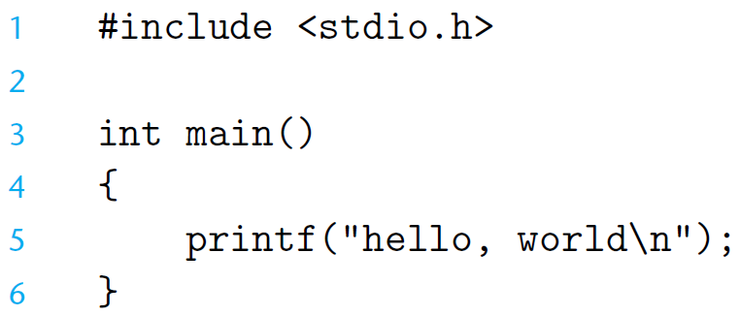
The Hello Program
Notes:
W 87

Slide 29
The Hello Program
Source program
  Created by editor and saved as a text file (Consists exclusively of ASCII characters)
  Binary file
    Not text file
Begins life as a high-level C program
  Can be read and understand by human beings
The individual C statements must be translated by compiler drivers
  So that the hello program can run on a computer system
Notes:
W 87

Slide 30

ASCII
American Standard Code for Information Interchange
  7-bit encoding of character set
  Control Characters
  07 \a Bell
  08 \b Backspace
  09 \t Horizontal Tab
  0A \n Line feed
  0B \v Vertical Tab
  0C \f Form feed
  0D \r Carriage return
Notes:
W 87

Slide 31
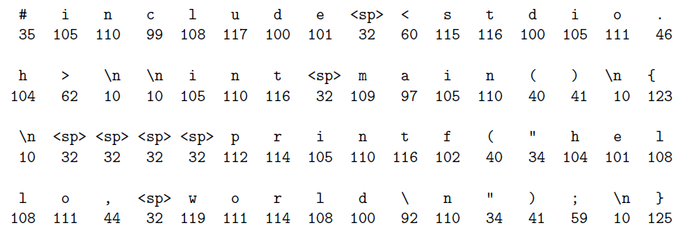
The Hello Program
Notes:
W 87

Slide 32
The Hello Program
The C programs are translated into
  A sequence of low-level machine-language instructions
These instructions are then packaged in a form
  called an object program
Object program are stored as a binary disk file
  Also referred to as executable object files
Notes:
W 87

Slide 33
The Context of a Compiler (gcc)
hello.c
Source program (text)
Preprocessor (cpp)
hello.i
Modified source program (text)
Compiler (cc1)
hello.s
Assembly program (text)
Assembler (as)
hello.o
Relocatable object program (binary)
Linker (ld)
hello
Executable object program (binary)
Notes:
W 87

Slide 34
Preprocessor
Macro Substitution
a.c #include “b.h” main() { return i+j ; } | b.h #define i 100 int j ;
# 1 "a.c"
# 1 "<built-in>"
# 1 "<command-line>"
# 1 "a.c"
# 1 "b.h" 1
int j;
# 2 "a.c" 2
main()
{
return 100 +j ;
}
Obtain with command
  gcc -E a.c
Source file a.i
Notes:
W 87

Slide 35
Source Code and Assembly Code
//C code long mult2(long, long); void multstore(long x, long y, long *dest) { long t = mult2(x, y); *dest = t; }
Obtain with command gcc –Og -S mstore.c | Assembly file mstore.s multstore: pushq %rbx movq %rdx,%rbx call mult2 movq %rax, (%rbx) popq %rbx ret

Slide 36
Relocatable Object Code
53 48 89 d3 e8 00 00 00 00 48 89 03 5b c3 | Obtain with command gcc –Og -c mstore.c Relocatable object file mstore.o
Notes:
W 87

Slide 37
Executable Object Code
#include <stdio.h> void mulstore(long, long, long*) int main() { long d; multstore(2, 3, &d); printf(“2 * 3 --> %d\n”, d); return 0; } long mult2(long a, long b) { long s = a * b ; return s; } | 53 48 89 d3 e8 42 00 00 00 48 89 03 5b c3
 | Obtain with command gcc –Og –o prog main.c mstore.c
Notes:
W 87

Slide 38
















COMPILING
C Program Preprocessor
C Program
Compiler
Source Codes
[*.i]
Source Codes
[*.c, *.h]
E
S
GNU Compiler Collection
Assembly Codes
[*.s]
Binary Codes
[*.out]
c
o
Binary Codes
[*.o]
Linker
Assembler
Notes:
W 87

