Slide 1
Exception Handling

Slide 2
Outline
Exception Handling
Suggested Reading 4.5.9

Slide 3
Exceptions
Condition: instruction encounter an error condition
Deal flow:
  Break the program flow
  Invoke the exception handler provided by OS.
  (Maybe) continue the program flow
    E.g. page fault exception
Notes:
很重要的一点就是在exception发生时，引起exception的语句之前的语句已经全部执行完毕，而在exception之后的语句还没有被执行。
Precise exception包括exception之间的相互关系，exception的类型, exception的位置等等。

Slide 4
Exceptions
  Conditions under which processor cannot continue normal operation
Causes
  Halt instruction (Current)
  Bad address for instruction or data (Previous)
  Invalid instruction (Previous)
Typical Desired Action
  Complete some instructions
    Either current or previous (depends on exception type)
  Discard others
  Call exception handler
    Like an unexpected procedure call
Notes:
完成当前还是前面的指令，主要是说当出现exception时，首先当前指令（引起exception的指令）之前的指令必须已经完成。然后，看语义决定当前指令要不要完成。

Slide 5
Exception Examples
Detect in Fetch Stage
jmp $-1 # Invalid jump target
.byte 0xFF # Invalid instruction code
halt # Halt instruction
Detect in Memory Stage
irmovq $100,%rax
rmmovq %rax,0x10000(%rax) # invalid address

Slide 6
Exceptions in Pipeline Processor #1
# demo-exc1.ys
irmovq $100,%rax
rmmovq %eax,0x10000(%rax) # Invalid address
nop
.byte 0xFF # Invalid instruction code
1
2
3
4
5
0x000: irmovq $100,%rax
F
D
E
M
W
0x00a: rmmovq %rax,0x10000(%rax)
F
D
E
M
0x014: nop
F
D
E
0x015: .byte 0xFF
F
D
Exception detected
Desired Behavior
  rmmovq should cause exception
  Following instructions should have no effect on processor stat
Notes:
假定我们不允许访问地址超过0x10000以上的内存。
上图中出现了两个exception. 显然我们希望在比较后面阶段的那条指令（也就是先执行的那条指令）触发的exception

Slide 7
Exceptions in Pipeline Processor #2
# demo-exc2.ys
0x000: xorq %rax,%rax # Set condition codes
0x002: jne t # Not taken
0x00b: irmovq $1,%rax
0x015: irmovq $2,%rdx
0x01f: halt
0x020: t: .byte 0xFF # Target
1
2
3
4
5
6
7
8
9
0x000: xorl %rax,%rax
F
D
E
M
W
0x002: jne t
F
D
E
M
0x020: t: .byte 0xFF
F
D
E
M
W
0x???: (I’m lost!)
F
D
E
M
W
0x00b: irmovq $1,%rax
F
D
E
M
W
Desired Behavior
  No exception should occur
Exception detected
Notes:
因为misprediction造成的branch错误，使得本来不该执行的指令执行了。这也可能引发exception。

Slide 8
Maintaining Exception Ordering
W
stat
icode
valE
valM
dstE
dstM
M
stat
icode
Cnd
valE
valA
dstE
dstM
E
stat
icode
ifun
valC
valA
valB
dstE
dstM
srcA
srcB
D
stat
icode
ifun
rA
rB
valC
valP
F
predPC
Add exception status field to pipeline registers
Fetch stage sets to either “AOK”, “ADR” (when bad fetch address), “HTL” (halt instruction) or “INS” (illegal instruction)
Decode & Execute pass values through
Memory either passes through or sets to “ADR”
Exception triggered only when instruction hits Write-back
Notes:
AOK表示合法的指令。其他两种表示错误的指令。
只在Write back阶段才去处理exception，因为指令是顺序流出的，这样exception的先后顺序就保证了。
当某些指令先fetch了，后来又取消了（比如misprediction），那么我们只要简单的将其取消就可以了（连同保存的exception状态）。因为它无法到达Write back阶段，所以也就不会爆出exception.

Slide 9
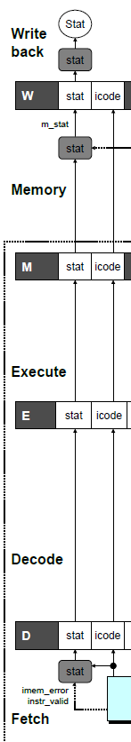
Exception Handling Logic
dmem_error
int Stat = [
# SBUB in earlier stages indicates bubble
W_stat == SBUB : SAOK;
1 : W_stat;
];
Write-back Stage
# Update the status
int m_stat = [
dmem_error : SADR;
1 : M_stat;
];
Memory Stage
# Determine status code for fetched instruction
int f_stat = [
imem_error: SADR;
!instr_valid : SINS;
f_icode == IHALT : SHLT;
1 : SAOK;
];
Fetch Stage

Slide 10
Side Effects in Pipeline Processor
# demo-exc3.ys
irmovq $100,%rax
rmmovq %rax,0x10000(%rax) # invalid address
addq %rax,%rax # Sets condition codes
1
2
3
4
5
0x000: irmovq $100,%rax
F
D
E
M
W
0x00a: rmmovq %rax,0x10000(%rax)
F
D
E
M
0x014: addq %rax,%rax
F
D
E
Exception detected
CC set
Desired Behavior
  rmmovq should cause exception
  No following instruction should have any effect
Notes:
前面的exception引发后就不应该执行后面的指令，这样addl指令也就不应该修改状态。
但现在会修改状态的。

Slide 11
Avoiding Side Effects
Presence of Exception Should Disable State Update
  Invalid instructions are converted to pipeline bubbles
    Except have stat indicating exception status
  Data memory will not write to invalid address
  Prevent invalid update of condition codes
    Detect exception in memory stage
    Disable condition code setting in execute
    Must happen in same clock cycle

Slide 12
Avoiding Side Effects
Presence of Exception Should Disable State Update
  Handling exception in final stages
    When detect exception in memory stage
      Start injecting bubbles into memory stage on next cycle
    When detect exception in write-back stage
      Stall excepting instruction
  Included in HCL code

Slide 13
Control Logic for State Changes
Setting Condition Codes
# Should the condition codes be updated?
bool set_cc = (E_icode == IOPL)
# State changes only during normal operation
&& !m_stat in { SADR, SINS, SHLT }
&& !W_stat in { SADR, SINS, SHLT };
Stage Control
  Also controls updating of memory
# Start injecting bubbles as soon as exception passes through memory stage
bool M_bubble = m_stat in { SADR, SINS, SHLT }
|| W_stat in { SADR, SINS, SHLT };
# Stall pipeline register W when exception encountered
bool W_stall = W_stat in { SADR, SINS, SHLT };

Slide 14
Rest of Exception Handling
Calling Exception Handler
  Push PC onto stack
    Either PC of faulting instruction or of next instruction
    Usually pass through pipeline along with exception status
  Jump to handler address
    Usually fixed address
    Defined as part of ISA
Implementation
  Haven’t tried it yet!

Slide 15
Performance of Processor

Slide 16
Outline
Performance Analysis
Suggested Reading 4.5.12

Slide 17
Performance Metrics
Clock rate
  Measured in Gigahertz
  Function of stage partitioning and circuit design
    Keep amount of work per stage small
Rate at which instructions executed
  CPI: cycles per instruction
  On average, how many clock cycles does each instruction require?
  Function of pipeline design and benchmark programs
    E.g., how frequently are branches mispredicted?
Notes:
Stage设计的基本原则：每个stage的工作量尽可能少。Stage的大小尽可能平均。

Slide 18
CPI for PIPE
CPI ≈ 1.0
  Fetch instruction each clock cycle
  Effectively process new instruction almost every cycle
    Although each individual instruction has latency of 5 cycles
CPI > 1.0
  Sometimes must stall or cancel branches
Notes:
我们的设计目标是CPI=1

Slide 19
CPI for PIPE
Computing CPI
  C: clock cycles
  I: instructions executed to completion
  B: bubbles injected (C = I + B)
  CPI = C/I = (I+B)/I = 1.0 + B/I
  Factor B/I represents average penalty due to bubbles
Notes:
我们的设计目标是CPI=1

Slide 20
CPI for PIPE (Cont.)
LP: Penalty due to load/use hazard stalling
  Fraction of instructions that are loads 0.25
  Fraction of load instructions requiring stall 0.20
  Number of bubbles injected each time 1
  ⇒ LP = 0.25 * 0.20 * 1 = 0.05
MP: Penalty due to mispredicted branches
  Fraction of instructions that are cond. jumps 0.20
  Fraction of cond. jumps mispredicted 0.40
  Number of bubbles injected each time 2
  ⇒ MP = 0.20 * 0.40 * 2 = 0.16
Typical Values
Notes:
要减少CPI，关键是MP。因为它占了最大的比重。

Slide 21
CPI for PIPE (Cont.)
RP: Penalty due to ret instructions
  Fraction of instructions that are returns 0.02
  Number of bubbles injected each time 3
  RP = 0.02 * 3 = 0.06
Net effect of penalties 0.05 + 0.16 + 0.06 = 0.27
  CPI = 1.27 (Not bad!)
  B/I = LP + MP + RP
Typical Values
Notes:
要减少CPI，关键是MP。因为它占了最大的比重。

Slide 22
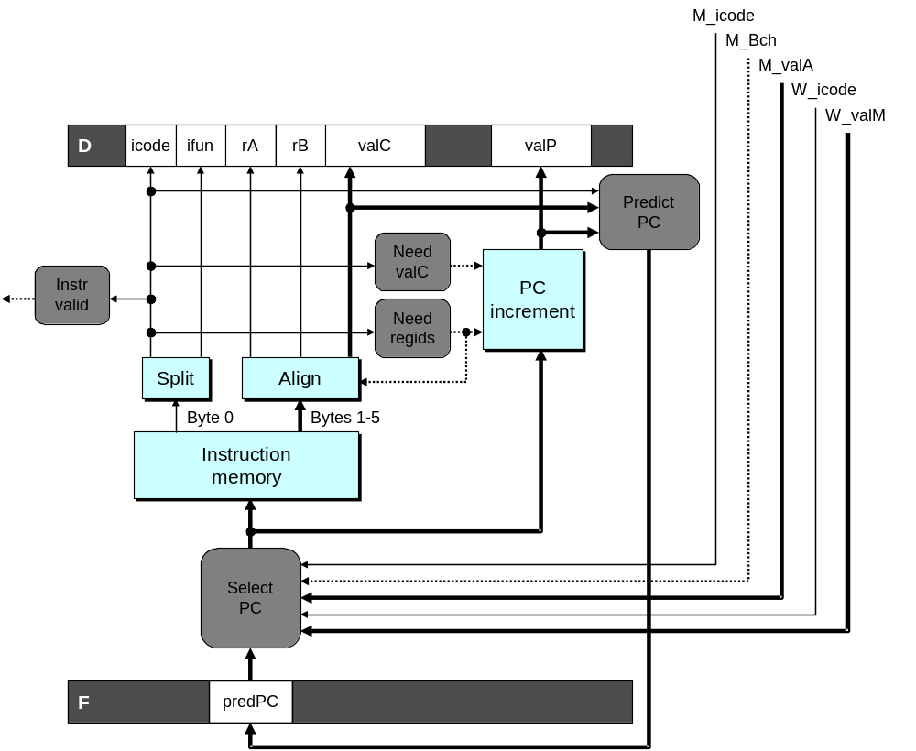
Fetch Logic Revisited
During Fetch Cycle
  Select PC
  Read bytes from instruction memory
  Examine icode to determine instruction length
  Increment PC
Timing
  Steps 2 & 4 require significant amount of time

Slide 23
Standard Fetch Timing
Select PC
need_regids, need_valC
Mem. Read
Increment
1 clock cycle
  Must Perform Everything in Sequence
  Can’t compute incremented PC until know how much to increment it by

Slide 24
A Fast PC Increment Circuit
incrPC
High-order 60 bits
Low-order 4 bits
MUX
carry
0
1
60-bit
incre-
menter
4-bit adder
Slow
Fast
need_regids
0
High-order 60 bits
need_ValC
Low-order 4 bits
PC
Notes:
因为指令长度为1-6个字节。所以大部分时间只有PC的低3位在变化。而高位很多时候是不变的。
利用这一性质。我们可以只加低3位。如果没有进位，那么高29位就直接输出，如果有进位，再加1。

Slide 25
Modified Fetch Timing
need_regids, need_valC
Select PC
4-bit add
Mem. Read
MUX
Incrementer
Standard cycle
1 clock cycle
60-Bit Incrementer
  Acts as soon as PC selected
  Output not needed until final MUX
  Works in parallel with memory read
Notes:
因为高29位的加一是一直在加的。即使最后没有被选中，它也会加。而且这个加法只依赖于Select PC的结果，不依赖于其他任务（比方说内存读取的完成）。

Slide 26
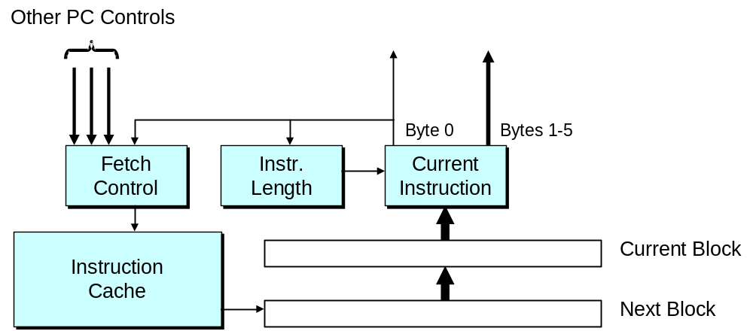
More Realistic Fetch Logic
Fetch Box
  Integrated into instruction cache
  Fetches entire cache block (16 or 32 bytes)
  Selects current instruction from current block
  Works ahead to fetch next block
    As reaches end of current block
    At branch target

Slide 27
Processor Summary
Design Technique
  Create uniform framework for all instructions
    Want to share hardware among instructions
  Connect standard logic blocks with bits of control logic
Operation
  State held in memories and clocked registers
  Computation done by combinational logic
  Clocking of registers/memories sufficient to control overall behavior
Enhancing Performance
  Pipelining increases throughput and improves resource utilization
  Must make sure maintains ISA behavior

