Slide 1
Modern Processors

Slide 2
Outline
Understanding Modern Processor
  Super-scalar
  Out-of –order execution
Suggested reading
  5.7

Slide 3
Modern Processor (review)
Superscalar
  Perform multiple operations on every clock cycle
  Instruction level parallelism
Out-of-order execution
  The order in which the instructions execute need not correspond to their ordering in the assembly program

Slide 4
Instruction Control
Fetch
Control
Address
Instruction
Cache
Retirement
Unit
Instruction
Decode
Instructions
Register
File
Operations
Register Updates
Prediction OK?
Execution
Functional
Units
Branch
Arithmetic
operations
Arithmetic
operations
Load
Store
Operation Results
Addr.
Addr.
Data
Data
Data
Cache

Slide 5
Modern Processor (review)
Two main parts
  Instruction Control Unit (ICU)
    Responsible for reading a sequence of instructions from memory
    Generating from above instructions a set of primitive operations to perform on program data
  Execution Unit (EU)
    Execute these operations

Slide 6
Instruction Control Unit (review)
Instruction Cache
  A special, high speed memory containing the most recently accessed instructions.
Instruction Control
Fetch
Control
Address
Instruction
Cache
Retirement
Unit
Register
File
Instruction
Decode
Instructions
Operations
Register Updates
Prediction OK?

Slide 7
Instruction Control Unit (review)
Fetch Control
  Fetches ahead of currently accessed instructions
    enough time to decode instructions and send decoded operations down to the EU
Instruction Control
Fetch
Control
Address
Instruction
Cache
Retirement
Unit
Register
File
Instruction
Decode
Instructions
Operations
Register Updates
Prediction OK?

Slide 8
Fetch Control (review)
Branch Predication
  Branch taken or fall through
  Guess whether branch is taken or not
Speculative Execution
  Fetch, decode and execute only according to the branch prediction
  Before the branch predication has been determined whether or not

Slide 9
Instruction Control Unit (review)
Instruction Decoding Logic
  Take actual program instructions
Instruction Control
Fetch
Control
Address
Instruction
Cache
Retirement
Unit
Register
File
Instruction
Decode
Instructions
Operations
Register Updates
Prediction OK?

Slide 10
Instruction Control Unit (review)
Instruction Decoding Logic
  Take actual program instructions
  Converts them into a set of primitive operations
    An instruction can be decoded into a variable number of operations
  Each primitive operation performs some simple task
    Simple arithmetic, Load, Store
  Register renaming
addq %rax, 8(%rdx)
    load 8(%rdx) → t1
    addq %rax, t1 → t2
    store t2, 8(%rdx)

Slide 11
Execution Unit (review)
Multi-functional Units
  Receive operations from ICU
  Execute a number of operations on each clock cycle
  Handle specific types of operations
Execution
Functional
Units
Branch
Arithmetic
operations
Arithmetic
operations
Load
Store
Operation Results
Addr.
Addr.
Data
Data
Data
Cache

Slide 12
Multi-functional Units (review)
Multiple Instructions Can Execute in Parallel
  Haswell CPU (Core i7)
      0. Integer arithmetic, FP multiplication, integer and FP division, branches
      1. Integer arithmetic, FP addition, integer multiplication, FP multiplication
      2. Load, address computation
      3. Load, address computation
      4. Store
      5. Integer arithmetic(basic operations)
      6. Integer arithmetic, branches
      7. Store address computation

Slide 13
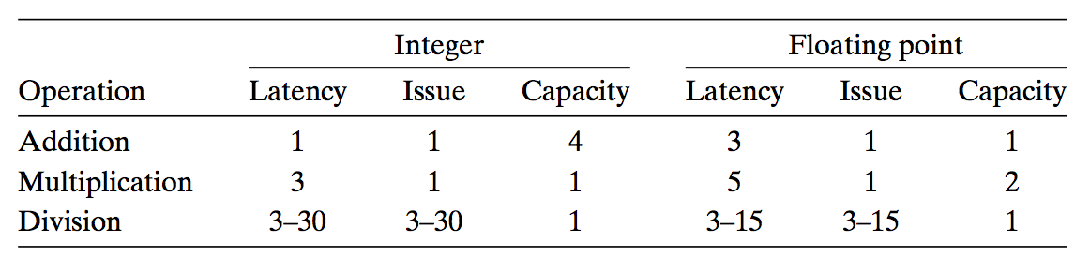
Multi-functional Units (review)
Some Instructions Take > 1 Cycle, but Can be Pipelined
  Hasweell (Core i7)

Slide 14
Execution Unit
Operation is dispatched to one of multi-functional units, whenever
  All the operands of an operation are ready
  Suitable functional units are available
Execution results are passed among functional units

Slide 15
Execution Unit
Data Cache
  Load and store units access memory via data cache
  A high speed memory containing the most recently accessed data values
Execution
Functional
Units
Branch
Arithmetic
operations
Arithmetic
operations
Load
Store
Operation Results
Addr.
Addr.
Data
Data
Data
Cache

Slide 16
Instruction Control Unit
Retirement Unit
  Keep track of the ongoing processing
  Obey the sequential semantics of the machine-level program (misprediction & exception)
Instruction Control
Fetch
Control
Address
Instruction
Cache
Retirement
Unit
Instruction
Decode
Instructions
Register
File
Operations
Register Updates
Prediction OK?

Slide 17
Instruction Control Unit
Register File
  Integer, floating-point and other registers
  Controlled by Retirement Unit
Instruction Control
Fetch
Control
Address
Instruction
Cache
Retirement
Unit
Register
File
Instruction
Decode
Instructions
Operations
Register Updates
Prediction OK?

Slide 18
Instruction Control Unit
Instruction Retired/Flushed
  Place instructions into a first-in, first-out queue
  Retired: any updates to the registers being made
    Operations of the instruction have completed
    Any branch prediction to the instruction are confirmed correctly
  Flushed: discard any results have been computed
    Some branch prediction was mispredicted
    Mispredictions can’t alter the program state

Slide 19
Execution Unit
Operation Results
  Functional units can send results directly to each other
  A elaborate form of data forwarding techniques
Execution
Functional
Units
Integer/
Branch
General
Integer
FP
Add
FP
Mult/Div
Load
Store
Operation Results
Addr.
Addr.
Data
Data
Data
Cache

Slide 20
Execution Unit
Register Renaming
  Values passed directly from producer to consumers
  A tag t is generated to the result of the operation
    e.g. %rcx.0, %rcx.1
  Renaming table
    Maintain the association between program register r and tag t for an operation that will update this register

Slide 21
Translation Example
Example
  combine4 (data_t = float, OP = *)
void combine4(vec_ptr v, data_t *dest)
{
long i;
long length = vec_length(v);
data_t *data = get_vec_start(v);
data_t x = IDENT;
for (i = 0; i < length; i++)
x = x OP data[i];
*dest = x;
}

Slide 22
Translation Example
.L25: # Loop:
vmulsd (%rdx),%xmm0,%xmm0 # t *= data[i]
addq $8, %rdx # Increment data+i
cmpq %rax,%rdp # Comp to data+len
jne .L25 # if !=, goto Loop
load (%rdx.0) ➔ t.1
mulq t.1, %xmm0.0 ➔ %xmm0.1
addq $8, %rdx.0 ➔ %rdx.1
cmpq %rax, %rdx.1 ➔ cc.1
jne-taken cc.1

Slide 23
Understanding Translation Example
vmulsd (%rdx),%xmm0,%xmm0
load (%rdx.0)➔ t.1
mulq t.1, %xmm0.0 ➔ %xmm0.1
Split into two operations
  Load reads from memory to generate temporary result t.1
  Multiply operation just operates on registers

Slide 24
Understanding Translation Example
vmulsd (%rdx),%xmm0,%xmm0
load (%rdx.0)➔ t.1
mulq t.1, %xmm0.0 ➔ %xmm0.1
Operands
  Register %xmm0 changes on every iteration
  Uniquely identify different versions as
    %xmm0.0, %xmm0.1, %xmm0.2, …
  Register renaming
    Values passed directly from producer to consumers

Slide 25
Understanding Translation Example
addq $8, %rdx
addq $8, %rdx.0 ➔ %rdx.1
Register %rdx changes on each iteration
Renamed as %rdx.0, %rdx.1, %rdx.2, …

Slide 26
Understanding Translation Example
cmpq %rax,%rdx
cmpq %rax, %rdx.1 ➔ cc.1
Operands
  Registers %rax does not change in loop
  Values will be retrieved from register file during decoding

Slide 27
Understanding Translation Example
cmpq %rax,%rdx
cmpq %rax, %rdx.1 ➔ cc.1
Condition codes are treated similar to registers
Assign tag to define connection between producer and consumer

Slide 28
Understanding Translation Example
jne .L25
jne-taken cc.1
Instruction control unit determines destination of jump
Predicts whether target will be taken
Starts fetching instruction at predicted destination

Slide 29
Understanding Translation Example
jne .L25
jne-taken cc.1
Execution unit simply checks whether or not prediction was OK
If not, it signals instruction control unit
  Instruction control unit then “invalidates” any operations generated from misfetched instructions
  Begins fetching and decoding instructions at correct target

Slide 30
Data-Flow Graphs
Data-Flow Graphs
  Visualize how the data dependencies in a program dictate its performance
  Example: combine4 (data_t = float, OP = *)
void combine4(vec_ptr v, data_t *dest)
{
long i;
long length = vec_length(v);
data_t *data = get_vec_start(v);
data_t x = IDENT;
for (i = 0; i < length; i++)
x = x OP data[i];
*dest = x;
}

Slide 31
Graphical Representation
%rax
%rdx
%xmm0
load
vmulsd (%rdx), %xmm0, %xmm0
mul
add
t
addq $8,%rdx
cmp
cmpq %rax,%rdx
jne
jne loop
cc
%rax
%rdx
%xmm0
Registers
  read-only: %rax
  write-only: -
  Loop: %rdx, %xmm0
  Local: t, cc
load (%rdx.0) ➔ t.1
mulq t.1, %xmm0.0 ➔ %xmm0.1
addq $8, %rdx.0 ➔ %rdx.1
cmpq %rax, %rdx.1 ➔ cc.1
jne-taken cc.1

Slide 32
Refinement of Graphical Representation
%rax
%rdx
%xmm0
Data Dependencies
load
mul
add
t
cmp
%xmm0
%rax
%rdx
jne
cc
load
%rax
%rdx
%xmm0
add
mul
cmp
jne
%xmm0
%rdx

Slide 33
Refinement of Graphical Representation
%xmm0
%rdx
Data Dependencies
load
data[i]
add
mul
%xmm0
%rax
%rdx
%xmm0
%rdx
load
add
mul
cmp
jne
%xmm0
%rdx

Slide 34
Refinement of Graphical Representation
%xmm0
%rdx
%xmm0.0
%rdx.0
load
data[i]
load
data[0]
add
add
mul
mul
%xmm0
%rdx
%xmm0.1
%rdx.1
load
data[1]
add
mul
%xmm0.2
%rdx.2

Slide 35
Refinement of Graphical Representation
load
data[0]
%xmm0.0
%rdx.0
add
mul
load
data[0]
add
mul
load
data[1]
add
%xmm0.1
%rdx.1
mul
load
data[1]
..
..
add
mul
load
data[n-1]
add
%xmm0.2
%rdx.2
mul

Slide 36
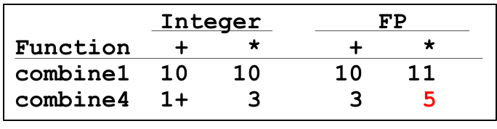
Refinement of Graphical Representation
data[0]
Two chains of data dependencies
  Update x by mul
  Update i by add
Critical path
  Latency of mul is 5
  Latency of add is 1
The latency of combine4 is 5
load
add
mul
load
data[1]
add
mul
..
..
load
data[n-1]
add
mul

Slide 37
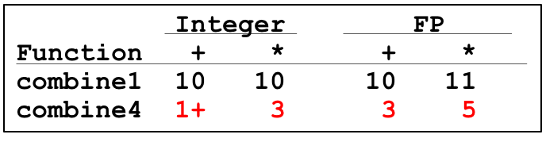
Performance-limiting Critical Path
  Nehalem (Core i7)

Slide 38
Other Performance Factors
Data-flow representation provide only a lower bound
  e.g. Integer addition, CPE = 1.2
  Total number of functional units available
  The number of data values can be passed among functional units
Next step
  Enhance instruction-level parallelism
  Goal: CPEs close to 1.0

Slide 39
More Code Optimization

Slide 40
Outline
More Code Optimization techniques
Optimization Limiting Factors
Memory Performance
Suggested reading
  5.8 ~ 5.12

Slide 41
Loop Unrolling
void combine5(vec_ptr v, int *dest)
{
int i;
int length = vec_length(v);
int limit = length - 2;
data_t *data = get_vec_start(v);
data_t acc = IDENT;
/* combine 2 elements at a time */
for (i = 0; i < limit; i+=2)
acc = acc OPER data[i] OPER data[i+1];
/* finish any remaining elements */
for (; i < length; i++)
acc = acc OPER data[i];
*dest = acc ;
}

Slide 42
Translation
Loads can pipeline, since don’t have dependencies
Only one set of loop control operations
load (%rax,%rdx.0,4) ➔ d.1a
vmuld d.1a, %xmm0.0 ➔ %xmm0.1a
load 4(%rax,%rdx.0,4) ➔ d.1b
vmuld d.1b, %xmm0.1a ➔ %xmm0.1b
addq $2,%rdx.0 ➔ %rdx.1
cmpq %rdx.1, %rbp ➔ cc.1
jg-taken cc.1

Slide 43
Graphical Representation
%rax
%rbp
%rdx
%xmm0
load
vmulsd (%rax,%rdx,4), %xmm0
mul
load
d.a
vmulsd 4(%rax,%rdx,4), %xmm0
mul
d.b
add
addq $2,%rdx
cmp
cmpq %rdx,%rbp
jg
jg loop
cc
%rax
%rbp
%rdx
%xmm0

Slide 44
Graphical Representation
%xmm0
%rax
%rbp
%rdx
%xmm0
%rdx
load
load
data[i]
mul
mul
load
data[i+1]
load
mul
mul
add
add
%xmm0
%rdx
cmp
jg
%xmm0
%rdx

Slide 45
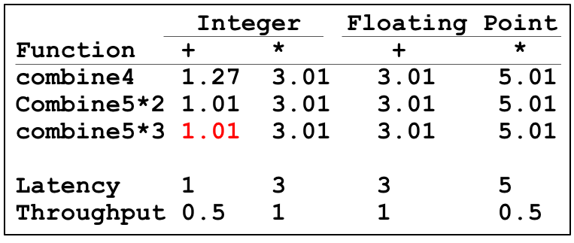
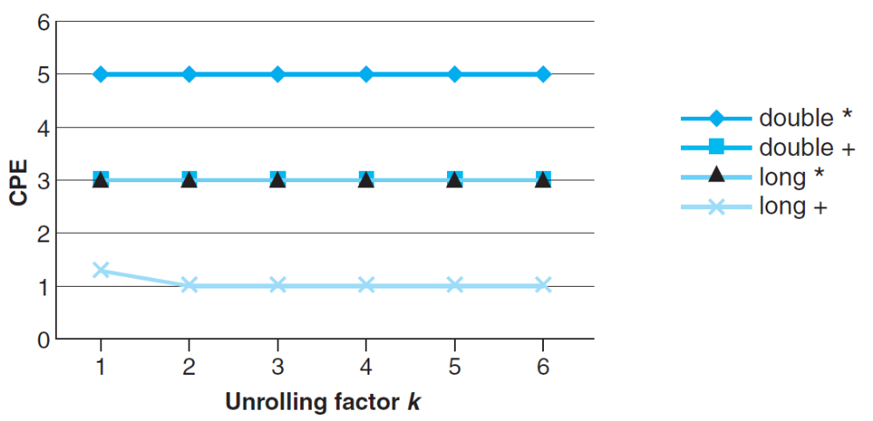
Graphical Representation
load
data[0]
mul
load
data[1]
add
mul
load
data[2]
mul
load
data[4]
add
mul

Slide 46
Loop Unrolling
Improve performance
  Reduces the number of operations
  (e.g. loop indexing and conditional branching)
  Transform the code to reduce the number of operations in the critical paths
CPEs for basic integer ops improve
But for both complex integer ops and floating-point ops do not

Slide 47
Effect of Unrolling
load
data[i]
load
data[i]
mul
add
load
data[i+1]
load
data[i+1]
add
load
data[i+2]
mul
add
add
load
data[i+2]
Critical path
  Latency of integer add is 1
  Latency of double mul is 5
mul
add

Slide 48
Effect of Unrolling
Only helps integer sum for our examples
  Other cases constrained by functional unit latencies
Effect is nonlinear with degree of unrolling
  Many subtle effects determine exact scheduling of operations

Slide 49
Enhance Parallelism
Multiple Accumulators
  Accumulate in two different sums
    Can be performed simultaneously
  Combine at end

Slide 50
Multiple Accumulator
void combine6(vec_ptr v, int *dest)
{
int i;
int length = vec_length(v), limit = length-1;
data_t *data = get_vec_start(v);
data_t acc0 = IDENT, acc1 = IDENT;
/* combine 2 elements at a time */
for (i = 0; i < limit; i+=2){
acc0 = acc0 OPER data[i];
acc1 = acc1 OPER data[i+1];
}
/* finish any remaining elements */
for (; i < length; i++)
acc0 = acc0 OPER data[i];
*dest = acc0 OPER acc1;
}

Slide 51
Translation
Two multiplies within loop no longer have data dependency
Allows them to pipeline
load (%rax,%rdx.0,4) ➔ d.1a
mulq d.1a, %xmm0.0 ➔ %xmm0.1
load 4(%rax,%rdx.0,4) ➔ d.1b
mulq d.1b, %xmm1.0 ➔ %xmm1.1
addq $2,%rdx.0 ➔ %rdx.1
cmpq %rdx.1, %rbp ➔ cc.1
jg-taken cc.1

Slide 52
Graphical Representation
%rax
%rbp
%rdx
%xmm0
%xmm1
load
mulsd (%rax,%rdx,4), %xmm0
mul
d.a
load
mulsd 4(%rax,%rdx,4), %xmm1
mul
add
d.b
addq $2,%rdx
cmp
cmpq %rdx,%rbp
jg
jg loop
cc
%rax
%rbp
%rdx
%xmm0
%xmm1

Slide 53
Graphical Representation
%xmm0
%rax
%xmm1
%rbp
%rdx
%xmm0
%xmm1
%rdx
load
data[i]
load
load
load
mul
mul
add
data[i+1]
add
mul
mul
cmp
%xmm0
%xmm1
%rdx
jg
%xmm0
%xmm1
%rdx

Slide 54
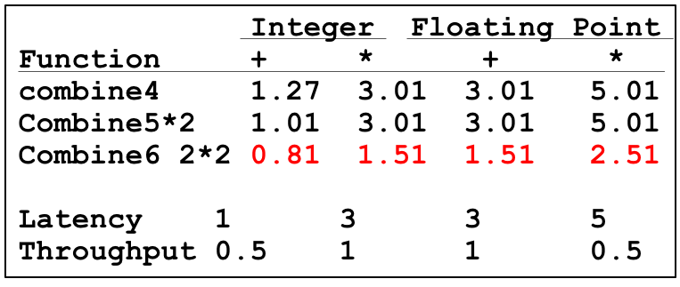
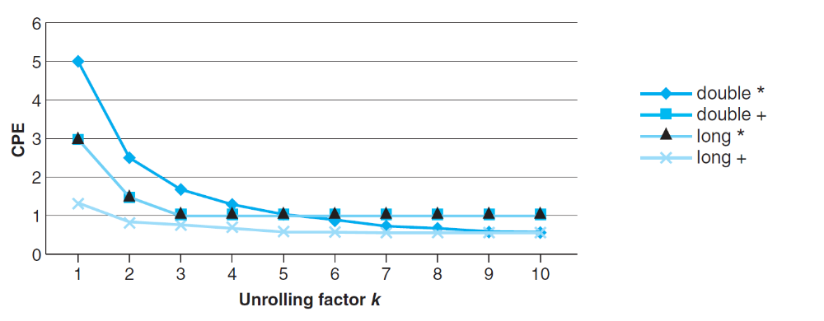
Graphical Representation
load
data[0]
load
mul
add
data[1]
mul
load
data[2]
load
mul
add
data[3]
mul
..
..
..
load
data[n-2]
load
mul
add
data[n-1]
mul

Slide 55
Enhance Parallelism
Multiple Accumulators
  Accumulate in two different sums
    Can be performed simultaneously
  Combine at end
Re-association Transformation
  Exploits property that integer addition & multiplication are associative & commutative
  FP addition & multiplication not associative, but transformation usually acceptable

Slide 56
Re-association Transformation
void combine7(vec_ptr v, int *dest)
{
int i;
int length = vec_length(v), limit = length-1;
data_t *data = get_vec_start(v);
data_t acc = IDENT;
/* combine 2 elements at a time */
for (i = 0; i < limit; i+=2){
acc = acc OPER (data[i] OPER data[i+1]);
}
/* finish any remaining elements */
for (; i < length; i++)
acc = acc OPER data[i];
*dest = acc ;
}

Slide 57
Translation
Two multiplies within loop no longer have data dependency
Allows them to pipeline
load (%rax,%rdx.0,4) ➔ xmm0.0
load 4(%rax,%rdx.0,4) ➔ t.1
mulq t.1, %xmm0.0 ➔ xmm0.1
mulq %xmm0.1, %xmm1.0 ➔ xmm1.1
addq $2,%rdx.0 ➔ %rdx.1
cmpq %rdx.1, %rbp ➔ cc.1
jg-taken cc.1

Slide 58
Graphical Representation
%rax
%rbp
%rdx
%xmm0
%xmm1
load
movsd (%rax,%rdx,4), %xmm0
load
mulsd 4(%rax,%rdx,4), %xmm0
mul
t
mul
mulsd %xmm0, %xmm1
add
addq $2,%rdx
cmp
cmpq %rdx,%rbp
jg
jg loop
cc
%rax
%rbp
%rdx
%xmm0
%xmm1

Slide 59
Graphical Representation
%xmm1
%rax
%rbp
%rdx
%xmm1
%rdx
load
load
load
load
data[i]
mul
add
mul
add
data[i+1]
cmp
mul
mul
jg
%xmm0
%rdx
%xmm0
%rdx

Slide 60
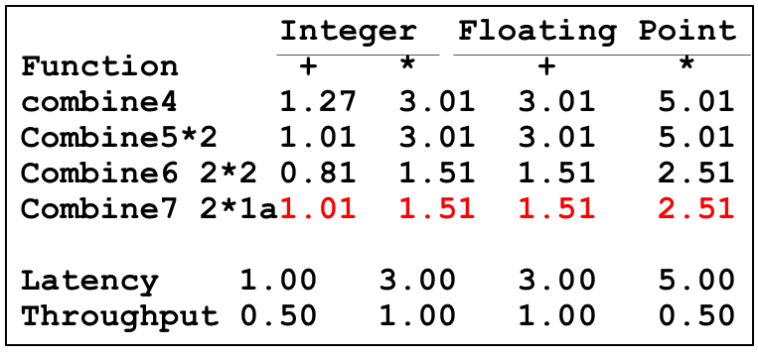
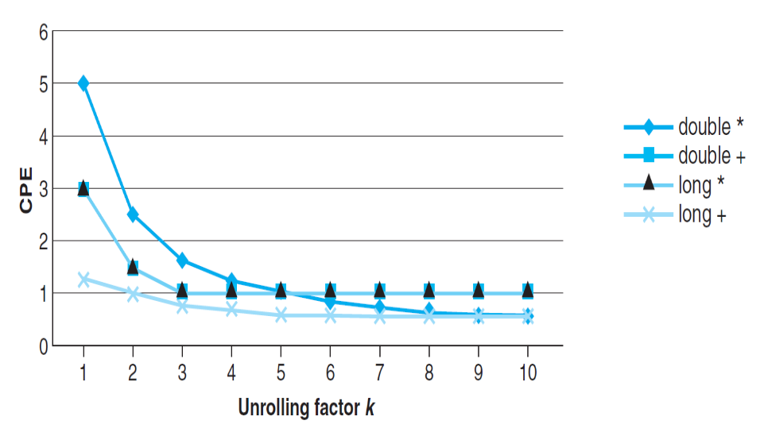
Graphical Representation
load
load
data[0]
mul
add
data[1]
mul
load
load
data[2]
mul
add
data[3]
mul

Slide 61
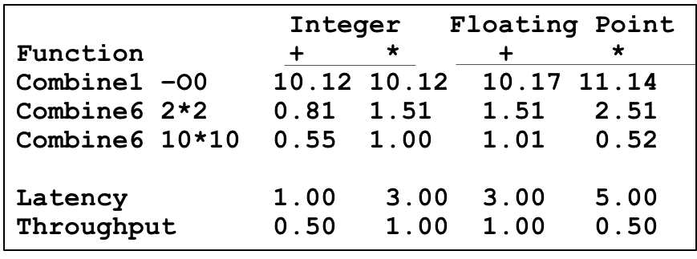
Summary of Results
Machine Indep. Opts
Eliminating loop inefficiencies
Reducing procedure calls
Eliminating unneeded memory references
Machine dep. Opts
Loop Unrolling
Multiple Accumulator
Reassociation

Slide 62
Summary of Results
Optimization Results for Combining
  Archive a CPE close to throughput bound for all combinations
  Performance improvement of over 10X

Slide 63
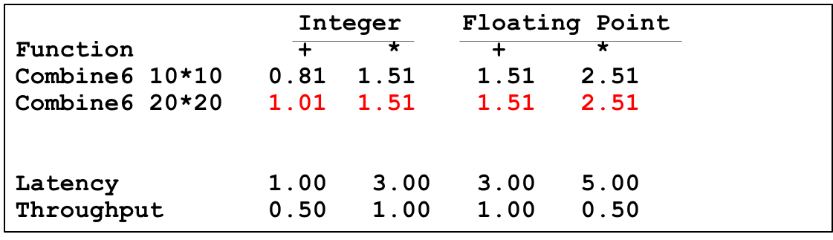
Optimization Limiting Factors
Register spilling
  When no enough registers available
  Using stack(memory) as storage

Slide 64
Optimization Limiting Factors
10*10 unrolling
  vmulsd (%rdx), %xmm0, %xmm0 acc0 *= data[i]
20*20 unrolling
  vmovsd 40(%rsp), %xmm0
  vmulsd (%rdx), %xmm0, %xmm0
  vmovsd %xmm0, 40(%rsp)

Slide 65
Optimization Limiting Factors
Register Spilling
  When no enough registers available
  Using stack(memory) as storage
Branch Prediction
  Speculative Execution
  Misprediction Panelties

Slide 66
Branch Prediction
Challenges
  Instruction Control Unit must work well ahead of Exec. Unit
  To generate enough operations to keep EU busy
Speculative Execution
  Guess which way branch will go
  Begin executing instructions at predicted position
    But don’t actually modify register or memory data

Slide 67
Example: Loop
80488b1: movl (%ecx,%edx,4),%eax
80488b4: addl %eax,(%edi)
80488b6: incl %edx
80488b7: cmpl %esi,%edx
80488b9: jl 80488b1
80488be: movl (%ecx,%edx,4),%eax
Branch Not-Taken
Branch Taken
80488b1: movl (%ecx,%edx,4),%eax
80488b4: addl %eax,(%edi)
80488b6: incl %edx
80488b7: cmpl %esi,%edx
80488b9: jl 80488b1

Slide 68
Branch Prediction Through Loop
80488b1: movl (%ecx,%edx,4),%eax
80488b4: addl %eax,(%edi)
80488b6: incl %edx
80488b7: cmpl %esi,%edx
80488b9: jl 80488b1
Assume vector length = 100
i = 98
Predict Taken (OK)
80488b1: movl (%ecx,%edx,4),%eax
80488b4: addl %eax,(%edi)
80488b6: incl %edx
80488b7: cmpl %esi,%edx
80488b9: jl 80488b1
i = 99
Predict Taken
(Oops)
80488b1: movl (%ecx,%edx,4),%eax
80488b4: addl %eax,(%edi)
80488b6: incl %edx
80488b7: cmpl %esi,%edx
80488b9: jl 80488b1
Executed
Read invalid location
i = 100
Fetched
80488b1: movl (%ecx,%edx,4),%eax
80488b4: addl %eax,(%edi)
80488b6: incl %edx
80488b7: cmpl %esi,%edx
80488b9: jl 80488b1
i = 101

Slide 69
Branch Misprediction Invalidation
80488b1: movl (%ecx,%edx,4),%eax
80488b4: addl %eax,(%edi)
80488b6: incl %edx
80488b7: cmpl %esi,%edx
80488b9: jl 80488b1
Assume vector length = 100
i = 98
Predict Taken (OK)
80488b1: movl (%ecx,%edx,4),%eax
80488b4: addl %eax,(%edi)
80488b6: incl %edx
80488b7: cmpl %esi,%edx
80488b9: jl 80488b1
i = 99
Predict Taken
(Oops)
80488b1: movl (%ecx,%edx,4),%eax
80488b4: addl %eax,(%edi)
80488b6: incl %edx
80488b7: cmpl %esi,%edx
80488b9: jl 80488b1
i = 100
Invalidate
80488b1: movl (%ecx,%edx,4),%eax
80488b4: addl %eax,(%edi)
80488b6: incl %edx
80488b7: cmpl %esi,%edx
80488b9: jl 80488b1
i = 101

Slide 70
Instruction Control
Fetch
Control
Address
Instruction
Cache
Retirement
Unit
Instruction
Decode
Instructions
Register
File
Operations
Register Updates
Prediction OK?
Execution
Functional
Units
Branch
Arithmetic
operations
Arithmetic
operations
Load
Store
Operation Results
Addr.
Addr.
Data
Data
Data
Cache

Slide 71
Branch Misprediction Invalidation
80488b1: movl (%ecx,%edx,4),%eax
80488b4: addl %eax,(%edi)
80488b6: incl %edx
80488b7: cmpl %esi,%edx
80488b9: jl 80488b1
Assume vector length = 100
i = 98
Predict Taken (OK)
80488b1: movl (%ecx,%edx,4),%eax
80488b4: addl %eax,(%edi)
80488b6: incl %edx
80488b7: cmpl %esi,%edx
80488b9: jl 80488b1
80488be: movl (%ecx,%edx,4),%eax
i = 99
Definitely not taken

Slide 72
Branch Misprediction Recovery
Performance Cost
  Misprediction on Core i7 wastes ~19 clock-cycle
  Don’t be overly concerned about predictable branches
    E.g. loop-closing branches would typically be predicted as being taken, and only incur a misprediction penalty on the last time around
    If an inner loop is computational bound, branch prediction may not be in the critical path

Slide 73
void minmax1(int a[],
int b[], int n)
{
int i;
for (i = 0; i < n; i++) {
if (a[i] > b[i]) {
int t = a[i];
a[i] = b[i];
b[i] = t;
}
}
}
Write Suitable Code
void minmax2(int a[],
int b[], int n)
{
int i;
for (i = 0; i < n; i++) {
int min = a[i]<b[i]?a[i]:b[i];
int max = a[i]<b[i]?b[i]:a[i];
a[i] = min;
b[i] = max;
}
}
Function random predictable
minmax1 14.5 2.5-3.5
minmax2 4.0 4.0

Slide 74
Instruction Control
Fetch
Control
Address
Instruction
Cache
Retirement
Unit
Instruction
Decode
Instructions
Register
File
Operations
Register Updates
Prediction OK?
Execution
Functional
Units
Branch
Arithmetic
operations
Arithmetic
operations
Load
Store
Operation Results
Addr.
Addr.
Data
Data
Data
Cache

Slide 75
Load Performance
load unit can only initiate one load operation every clock cycle (Issue=1.0)
typedef struct ELE {
struct ELE *next ;
int data ;
} list_ele, *list_ptr ;
long list_len(list_ptr ls) {
long len = 0 ;
while (ls) {
len++ ;
ls = ls->next;
}
return len ;
}
len in %rax, ls in %rdi
.L3:
addq $1, %rax
movq (%rdi), %rdi
testq %rdi, %rdi
jne .L3
Function CPE
list_len 4.0
load latency 4.0

Slide 76
Store Performance
store unit can only initiate one store operation every clock cycle (Issue=1.0)
void array_clear(int *dest, int n)
{
int i;
int limit = n-3;
for (i = 0; i < limit; i++)
dest[i] = 0;
}
Function CPE
array_clear 1.0

Slide 77
Store Performance
void write_read(long *src,
long *dest, long n)
{
long cnt = n;
long val = 0;
while (cnt) {
*dest = val;
val = (*src)+1;
cnt--;
}
}
Example A: write_read(&a[0],&a[1],3)
initial
initial
initial
initial
cnt
3
2
1
0
a
-10
17
-10
0
-10
-9
-10
-9
val
0
-9
-9
-9
Example B: write_read(&a[0],&a[0],3)
initial
initial
initial
initial
cnt
3
2
1
0
a
-10
17
0
17
1
17
2
17
Function CPE
Example A 1.3
Example B 7.3
val
0
1
2
3

Slide 78
Load and Store Units
Load
Unit
Store Unit
Store buffer
address
data
address
Matching
addresses
Data
Address
Data
Address
Data
Data Cache

Slide 79
Graphical Representation
%rax
%rdi
%rsi
%rdx
s_addr
movq %rax,(%rsi)
s_data
load
movq (%rdi), %rax
add
addq $1,%rax
sub
subq $1,%rdx
jne
jne loop
%rax
%rdi
%rsi
%rdx
//inner-loop
while (cnt) {
*dest = val;
val = (*src)+1;
cnt--;
}

Slide 80
Graphical Representation
%rax
%rdi
%rsi
%rdx
%rax
%rdx
1
s_addr
s_data
s_data
2
load
3
load
sub
add
sub
add
jg
%rax
%rdx
%rax
%rdx

Slide 81
Graphical Representation
Example A
Example B
Critical Path
s_data
s_data
load
load
add
sub
add
sub
Function bounds
Example A 1
Example B 7
s_data
s_data
load
load
add
sub
add
sub
Notes:
Dependence on addresses of store and load

Slide 82
Getting High Performance
Good compiler and flags
Don’t do anything stupid
  Watch out for hidden algorithmic inefficiencies
  Write compiler-friendly code
    Watch out for optimization blockers:
    procedure calls & memory references
  Look carefully at innermost loops
Tune code for machine
  Exploit instruction-level parallelism
  Avoid unpredictable branches
  Make code cache friendly

