Slide 1
Miscellany
Rong Chen
Institute of Parallel and Distributed Systems
Shanghai Jiao Tong University
http://ipads.se.sjtu.edu.cn/rong_chen

Slide 2
Machine Code Generated with Higher Levels of Optimization

Slide 3
Function select, -O1
x at %ebp+8, y at %ebp+12, i at %ebp+16
1 select:
Setup code
2 pushl %ebp Save frame pointer (S)
3 movl %esp, %ebp Create new frame pointer (S)
4 subl $16, %esp Allocate 16 bytes on stack (S)
Body code
5 movl 16(%ebp), %edx Get i (B)
6 movl $0, %eax Set result = 0 (B)
7 cmpl $1, %edx Compare i:1 (B)
8 ja .L3 if i < 0 or i > 1, goto done (B)
int select(int x, int y, int i)
{
int data[2] = { x, y };
if (i >= 0 && i < 2)
return data[i];
else
return 0;
}

Slide 4
9 movl 8(%ebp), %eax Get x (B)
10 movl %eax, -8(%ebp) Store in a[0] (B)
11 movl 12(%ebp), %eax Get y (B)
12 movl %eax, -4(%ebp) Store in a[1] (B)
13 movl -8(%ebp,%edx,4), %eax Set result = a[i] (B)
14 .L3: done:
Completion code
15 leave Restore stack and
frame pointers (C)
16 ret Return (C)
int select(int x, int y, int i)
{
int data[2] = { x, y };
if (i >= 0 && i < 2)
return data[i];
else
return 0;
}
Level-one optimization
Distinct section
  Setup
  Body
  completion
Single return point

Slide 5
Function select, -O3
x at %ebp+8, y at %ebp+12,
i at %ebp+16
1 select:
2 pushl %ebp Save frame pointer (S)
3 xorl %eax, %eax Set result = 0 (B)
4 movl %esp, %ebp Create new frame pointer (S)
5 subl $16, %esp Alloc 16Bs on the stack (S)
6 movl 16(%ebp), %edx Get i (B)
7 cmpl $1, %edx Compare i:1 (B)
8 jbe .L6 If i >= 0 and i <= 1,
goto index (B)
9 leave Restore stack and
frame pointers (C)
10 ret Return (C)
int select(int x, int y, int i)
{
int data[2] = { x, y };
if (i >= 0 && i < 2)
return data[i];
else
return 0;
}

Slide 6
11 .p2align 4,,7 (Inserted to improve
instruction alignment)
12 .p2align 3
13 .L6: index:
14 movl 8(%ebp), %eax Get x (B)
15 movl %eax, -8(%ebp) Store in a[0] (B)
16 movl 12(%ebp), %eax Get y (B)
17 movl %eax, -4(%ebp) Store in a[1] (B)
18 movl -8(%ebp,%edx,4), %eax Set result = a[i] (B)
19 leave Restore stack and
frame pointers (C)
20 ret Return (C)
int select(int x, int y, int i)
{
int data[2] = { x, y };
if (i >= 0 && i < 2)
return data[i];
else
return 0;
}
Level-one optimization
No longer distinct
Multiple return points
Directives for alignment

Slide 7
Inline Substitution
int test_select()
{
return select(5,6,1);
}
Inline substitution is a very basic and effective technique for eliminating the overhead due to function calls and enable optimization based on characteristics of the context in which a function is called
Approach: replace the call to a function with the code that implements that function
Function test_select, -O1
1 test_select:
2 pushl %ebp
3 movl %esp, %ebp
4 subl $12, %esp
5 movl $1, 8(%esp)
6 movl $6, 4(%esp)
7 movl $5, (%esp)
8 call select
9 leave
Function test_select, -O3
x at %ebp+8, y at %ebp+12,
i at %ebp+16
1 test_select:
2 pushl %ebp
3 movl $6, %eax
4 movl %esp, %ebp
5 popl %ebp
6 ret

Slide 8
Inline Substitution
Drawbacks and Limitations
Harder to debug: unexpected results with GDB
Code size can grow: replication of an entire function’s worth of code
May not be possible: access to the source code
...

Slide 9
Machine Code Generated with Higher Levels of Optimization
(II)

Slide 10
$gcc –m32 –o x struct32.c
$objdump –D x > res32
struct p { int x; int y; };
int sum(struct p s) {
return s.x + s.y
}
int main(void) {
struct p s = {5, 6};
int tot = sum(s);
return 0;
}
1 <main>:
2 push %ebp
3 mov %esp, %ebp
4 subl $0x18, %esp
5 movl $0x5, 0xc(%esp)
6 movl $0x6, 0x10(%esp)
7 mov 0xc(%esp), %eax
8 mov 0x10(%esp), %edx
9 mov %eax, (%esp)
10 mov %edx, 0x4(%esp)
11 call <sum>
12 mov %eax, 0x14(%esp)
13 mov $0x0, %eax
14 leave
15 ret
1 <sum>:
2 push %ebp
3 mov %esp, %ebp
4 mov $0x8(%esp), %edx
5 mov $0xc(%esp), %eax
6 lea (%ecx,%eax,1)), %eax
7 pop %ebp
8 ret

Slide 11
$gcc –o x struct64.c
$objdump –D x > res64
struct p { int x; int y; };
int sum(struct p s) {
return s.x + s.y
}
int main(void) {
struct p s = {5, 6};
int tot = sum(s);
return 0;
}
1 <main>:
2 push %rbp
3 mov %rsp, %rbp
4 subl $0x10, %esp
5 movl $0x5, -0x10(%rbp)
6 movl $0x6, -0xc(%rbp)
7 mov -0x10(%rbp), %rax
8 mov %rax, %rdi
9 call <sum>
10 mov %eax, -0x4(%rbp)
11 mov $0x0, %eax
12 leaveq
13 retq
1 <sum>:
2 push %rbp
3 mov %rsp, %rbp
4 mov %rdi, -0x10(%rbp)
5 mov -0x10(%rbp), %edx
6 mov -0xc(%rbp), %eax
7 lea (%rcx,%rax,1)), %eax
8 leaveq
9 ret

Slide 12
$gcc –o x struct64.c
$objdump –D x > res64_2
struct p { long x; long y; };
long sum(struct p s) {
return s.x + s.y
}
int main(void) {
struct p s = {5, 6};
long tot = sum(s);
return 0;
}
1 <main>:
2 push %rbp
3 mov %rsp, %rbp
4 sub $0x20, %rsp
5 movq $0x5, -0x20(%rbp)
6 movq $0x6, -0x18(%rbp)
7 mov -0x20(%rbp), %rdx
8 mov -0x18(%rbp), %rax
9 mov %rdx, %rdi
10 mov %rax, %rsi
9 call <sum>
10 mov %rax, -0x8(%rbp)
11 mov $0x0, %eax
12 leaveq
13 retq
1 <sum>:
2 push %rbp
3 mov %rsp, %rbp
4 mov %rdi, %rdx
...
10 lea (%rdx,%rax,1), %eax
11 leaveq
12 ret

Slide 13
$gcc –o x pstruct64.c
$objdump –D x > res64
struct p { int x; int y; };
int sum(struct p *s) {
return s->x + s->y
}
int main(void) {
struct p s = {5, 6};
long tot = sum(&s);
return 0;
}
1 <main>:
2 push %rbp
3 mov %rsp, %rbp
4 sub $0x10, %rsp
5 movl $0x5, -0x10(%rbp)
6 movl $0x6, -0xc(%rbp)
7 lea -0x10(%rbp), %rax
8 mov %rax, %rdi
9 call <sum>
10 mov %eax, -0x4(%rbp)
11 mov $0x0, %eax
12 leaveq
13 retq
1 <sum>:
2 push %rbp
3 mov %rsp, %rbp
4 mov %rdi, -0x8(%rbp)
5 mov -0x8(%rbp), %rax
6 mov (%rax), %edx
7 mov 0x4(%rax), %eax
9 lea (%rdx,%rax,1), %eax
11 leaveq
12 ret

Slide 14
int f(int x) {
int y = P(x); /* Some computation */
return g(y); /* Tail call */
}
Sibling Call Optimization
Any computations it needs to perform have been completed,
Any local storage it has allocated (except possibly for variable y) is no longer needed
→
The compiler can then replace the call to g by a jump,
and g will return directly to the function that called f
Challenge: how to pass y to g?

Slide 15
$gcc -fno-inline ...
$objdump –D x > res
int square(int x) {
return x * x;
}
int proc(int x, int y, int i) {
int b[2] = {x, y};
return square(b[i & 0x1]);
}
1 <proc>:
2 pushl %ebp
3 movl %esp, %ebp
4 subl $16, %esp
5 movl 8(%ebp), %eax
6 movl 16(%ebp), %edx
7 movl %eax, -8(%ebp)
8 movl 12(%ebp), %eax
9 andl $1, %edx
10 movl %eax, -4(%ebp)
11 movl -8(%ebp,%edx,4), %eax
12 movl %eax, 8(%ebp)
13 leave
14 jmp square
# alloc 16bytes on stack
# x
# i
# b[0]=x
# y
# i&0x1
# b[1]=y
# b[i&0x1]
# set first argument
# deallocate stack frame
# make sibling call

Slide 16
Branch Prediction on Pipeline

Slide 17
Branch Behavior in Programs
Based on SPEC benchmarks
  Branches occur with a frequency of 14% to 16% in INT programs and 3% to 12% in FP programs.
  About 75% of the branches are forward branches
  60% of forward branches are taken
  80% of backward branches are taken
  67% of all branches are taken

Slide 18
Branch Behavior in Programs
Why are branches (especially backward branches) more likely to be taken than not taken?

Slide 19
Dealing with Branch Stalls
Approach 1: Stall until branch direction is clear
  Simple
Approach 2: Predict Branch Not Taken
  Execute successor instructions in sequence
  (more efficient than Taken in deep pipeline)
  PC+4 already calculated
  33% branches not taken on average

Slide 20
Dealing with Branch Stalls
Approach 3: Predict Branch Taken
  67% branches taken on average
  But haven’t yet calculated target address in deep pipeline
    still incur a 1-cycle latency
  Makes sense on machines where branch target is known before outcome (e.g., Y86)

Slide 21
Dealing with Branch Stalls
Approach 4: Delayed Branch
  Define branch to take place AFTER n following instructions
  Branch Delay Slots
    Instructions in the branch delay slot(s) get executed whether or not branch is taken
    Heavily used in early RISC machines (e.g., MIPS)
    Machines with deep pipelines require additional delay slots to avoid branch penalties

Slide 22
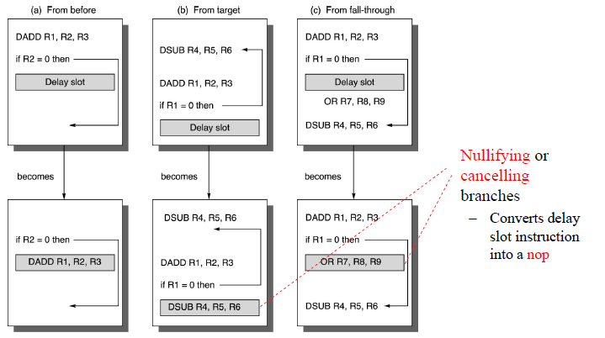
Scheduling the Branch Delay Slot
Where does the instruction for the delay slot come from?

Slide 23
Importance of Avoiding Branch Stalls
Crucial in modern microprocessors, which issue and execute multiple instructions every cycle
  Need to have a steady stream of instructions to keep the hardware busy
  Stalls due to control hazards dominate
So far, we have looked at static schemes for reducing branch penalties

Slide 24
Static vs. Dynamic
Static schemes: same scheme applies to every branch instruction
Dynamic schemes: choose most appropriate scheme separately for each instruction
  e.g., branches to top of loop // Taken
  if (x == 0) return; // Not Taken
  Can “learn” appropriate scheme based on observed behavior

Slide 25
Branch Predictor
Two parts
  Target Buffer: maps PC to taken target
  Direction predictor: maps PC to taken/not taken
What does it mean to “map PC” ?
  Use some PC bits as index into an array of data items

Slide 26
Mapping PCs
If array of data has N entries
  Need log(N) bits to index it
Which log(N) bits to choose?
  Least significant log(N) after the least significant 2
  Least significant change most often

Slide 27
Mapping PCs
What if two PCs have same pattern in that subset of bits (aliasing)
  We get a nonsense target (intended for another PC)
  That’s OK, it’s just a guess anyway, we can recover
  if it’s wrong

Slide 28
Branch Prediction (History) Buffer
Small memory indexed by the low-order bits of the branch instruction
  Stores a single bit of information: T or NT
  Starts off as T, flips whenever a branch behaves opposite to prediction
  Maintained by the Fetch stage
  A correct prediction implies no branch penalty

Slide 29
Branch Prediction (History) Buffer
Problems with this simple scheme
  Does not do a good job of predicting “mostly-taken branches”
    e.g., for (i=0; i<10; i++) { … }
    Repeated exec of the loop will result in 2 mispredictions
      Last iteration flips T to NT
      First iteration flips NT to T
    Prediction accuracy of 80%

Slide 30
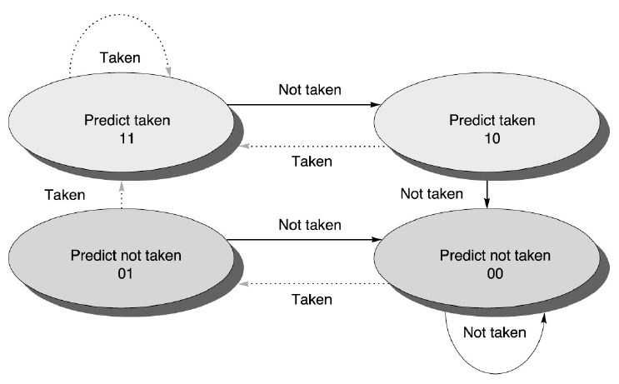
2-bit Prediction Schemes
Store 2 bits of info in branch history buffer
  1 misprediction per iteration if we start off in the (11) state

