Slide 1
Memory Hierarchy (Ⅱ)

Slide 2
Outline
SSD
Storage trends
Locality
The memory hierarchy
Suggested Reading: 6.1, 6.2, 6.3, 6.4

Slide 3
SSD
Storage technologies and trends
Locality
The memory hierarchy

Slide 4
Solid State Disk (SSD)
Solid state disk (SSD) is a storage technology, based on flash memory
  SSD package plugs into a standard disk slot on the I/O bus (typically USB or SATA)
  Flash translation layer = disk controller

Slide 5
Solid State Disk (SSD)
I/O bus
Requests to read and write logical disk blocks
Solid State Disk (SSD)
Flash
translation layer
Flash memory
Block 0
Block B-1
…
…
…
Page 0
Page 1
Page P-1
Page 0
Page 1
Page P-1
Pages: 512B to 4KB, Blocks: 32 to 128 pages
Data read/written in units of pages.
Page can be written only after its block has been erased
A block wears out after 100,000 repeated writes.

Slide 6
SSD Performance Characteristics
Sequential read tput 550 MB/s Sequential write tput 470 MB/s
Random read tput 365 MB/s Random write tput 303 MB/s
Avg.seq read access 50 us Avg. seq write access 60 us
Why are random writes so slow?
  Erasing a block is slow (around 1 ms)
  Write to a page triggers a copy of all useful pages in the block
    Find an used block (new block) and erase it
    Write the page into the new block
    Copy other pages from old block to the new block

Slide 7
SSD Tradeoffs vs Rotating Disks
Advantages
  No moving parts → faster, less power, more rugged
Disadvantages
  Have the potential to wear out
    Mitigated by “wear leveling logic” in flash translation layer
    e.g. Intel X25 guarantees 1 petabyte (1015 bytes) of random writes before they wear out
  About 30 times more expensive per byte
Applications
  MP3 players, smart phones, laptops
  Beginning to appear in desktops and servers

Slide 8
SSD
Storage technologies and trends
Locality
The memory hierarchy

Slide 9
Storage Trends
SRAM
Metric 1985 1990 1995 2000 2005 2010 2015 2015:1985
$/MB 2,900 320 256 100 75 60 25 116
access (ns) 150 35 15 3 2 1.5 1.3 115
DRAM
Metric 1985 1990 1995 2000 2005 2010 2015 2015:1985
$/MB 880 100 30 1 0.1 0.06 0.02 44,000
access (ns) 200 100 70 60 50 40 20 10
typical size (MB) 0.256 4 16 64 2,000 8,000 16,000 62,500
Disk
Metric 1985 1990 1995 2000 2005 2010 2015 2015:1985
$/GB 100,000 8,000 300 10 5 0.3 0.03 3,333,333
access (ms) 75 28 10 8 4 3 3 25
typical size (GB) 0.01 0.16 1 20 160 1,500 3000 1,500,000

Slide 10
CPU Clock Rates
Inflection point in computer history
when designers hit the “Power Wall”
 | 1985 | 1990 | 1995 | 2000 | 2003 | 2005 | 2010 | 2015 | 2015:1985
CPU | 80286 | 80386 | Pent. | P-III | Pent.4 | Core 2 | Core i7(n) | Core i7(h) | ---
Clock rate (MHz) | 6 | 20 | 150 | 600 | 3,300 | 2,000 | 2,500 | 3,000 | 500
Cycle time (ns) | 166 | 50 | 6 | 1.6 | 0.3 | 0.5 | 0.4 | 0.33 | 500
Cores | 1 | 1 | 1 | 1 | 1 | 2 | 4 | 4 | 4
Effective cycle time (ns) | 166 | 50 | 6 | 1.6 | 0.3 | 0.25 | 0.10 | 0.08 | 2,075

Slide 11
The CPU-Memory Gap
Disk
SSD
DRAM
CPU

Slide 12
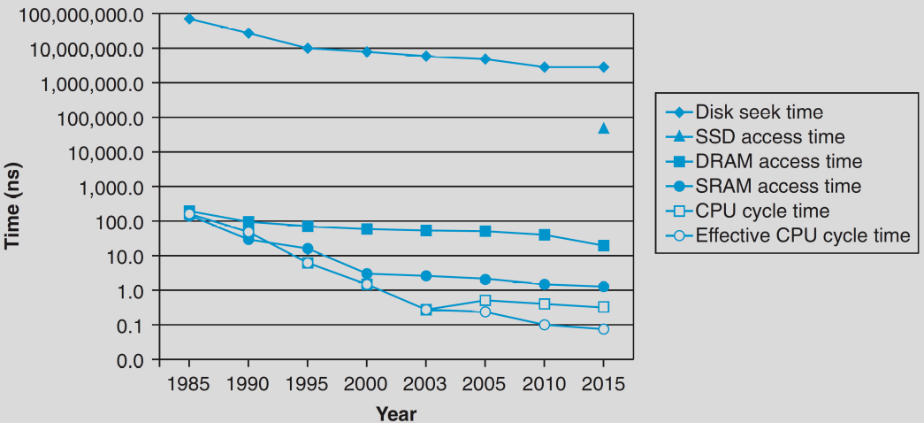
The CPU-Memory Gap
Disk
The key to bridging this CPU-Memory gap is
a fundamental property of computer programs
known as locality
SSD
DRAM
CPU

Slide 13
SSD
Storage technologies and trends
Locality
The memory hierarchy

Slide 14
Locality
Principle of Locality: Programs tend to use data and instructions with addresses near or equal to those they have used recently
  Temporal locality
    Recently referenced items are likely
    to be referenced again in the near future
  Spatial locality
    Items with nearby addresses tend
    to be referenced close together in time

Slide 15
Locality
All levels of modern computer systems are designed to exploit locality
  Hardware
    Cache memory (to speed up main memory accesses)
  Operating systems
    Use main memory to speed up virtual address space accesses
    Use main memory to speed up disk file accesses
  Application programs
    Web browsers exploit temporal locality by caching recently referenced documents on a local disk

Slide 16
Locality
int sumvec(int v[N])
{
int i, sum = 0 ;
for (i = 0 ; i < N ; i++)
sum += v[i] ;
return sum ;
}
Address | 0 | 4 | 8 | 12 | 16 | 20 | 24 | 28
Contents | v₀ | v₁ | v₂ | v₃ | v₄ | v₅ | v₆ | v₇
Access order | 1 | 2 | 3 | 4 | 5 | 6 | 7 | 8

Slide 17
Locality
Locality in the example
  sum: temporal locality
  v: spatial locality
    Stride-1 reference pattern
Stride-k reference pattern
  Visiting every k-th element of a contiguous vector
  As the stride increases, the spatial locality decreases

Slide 18
Stride-1 reference pattern
int sumarrayrows(int a[M][N]) //M=2,N=3
{
int i, j, sum = 0 ;
for (i = 0 ; i < M ; i++)
for ( j = 0 ; j < N ; j++ )
sum += a[i][j] ;
return sum ;
}
Address | 0 | 4 | 8 | 12 | 16 | 20
Contents | a₀₀ | a₀₁ | a₀₂ | a₁₀ | a₁₁ | a₁₂
Access order | 1 | 2 | 3 | 4 | 5 | 6

Slide 19
Stride-N reference pattern
int sumarraycols(int a[M][N]) //M=2,N=3
{
int i, j, sum = 0 ;
for (j = 0 ; j < N ; j++)
for ( i = 0 ; i < M ; i++ )
sum += a[i][j] ;
return sum ;
}
Address | 0 | 4 | 8 | 12 | 16 | 20
Contents | a₀₀ | a₀₁ | a₀₂ | a₁₀ | a₁₁ | a₁₂
Access order | 1 | 3 | 5 | 2 | 4 | 6

Slide 20
Locality
Locality of the instruction fetch
  Spatial locality
    In most cases, programs are executed in sequential order
  Temporal locality
    Instructions in loops may be executed many times

Slide 21
Locality
sum = 0;
for (i = 0; i < n; i++)
sum += a[i];
return sum;
Data references
  Reference array a elements in succession Spatial locality
  Reference variable sum each iteration Temporal locality
Instruction references
  Reference instructions in sequence. Spatial locality
  Cycle through loop repeatedly Temporal locality

Slide 22
SSD
Storage technologies and trends
Locality
The memory hierarchy

Slide 23
Memory Hierarchy
Fundamental properties of storage technology and computer software
  Different storage technologies have widely different access times
  Faster technologies cost more per byte than slower ones and have less capacity
  The gap between CPU and main memory speed is widening
  Well-written programs tend to exhibit good locality

Slide 24
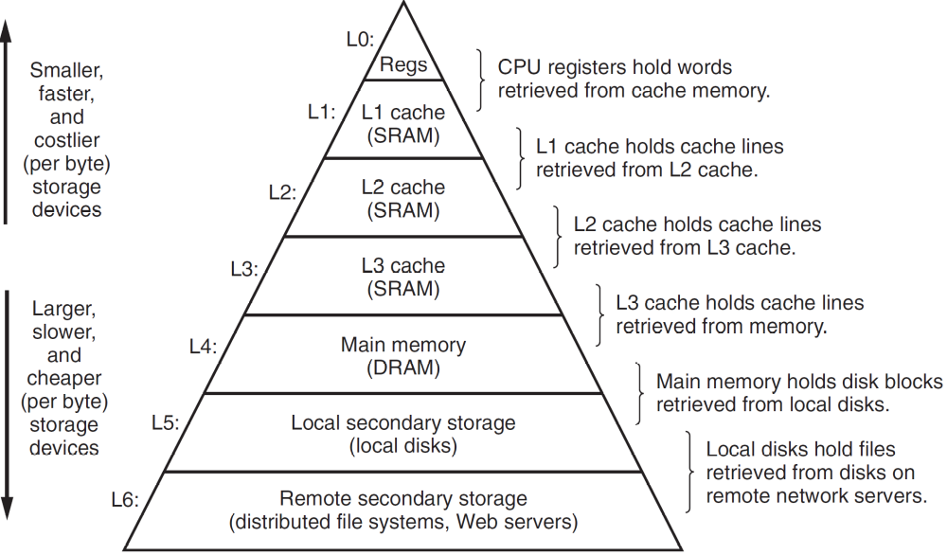
An example memory hierarchy

Slide 25
Caches
Fundamental idea of a memory hierarchy:
  For each K, the faster, smaller device at level K serves as a cache for the larger, slower device at level K+1.
Why do memory hierarchies work?
  Because of locality, programs tend to access the data at
  level k more often than they access the data at level k+1.
  Thus, the storage at level k+1 can be slower, and thus larger and cheaper per bit.
Big Idea: The memory hierarchy creates a large pool of storage that costs as much as the cheap storage near the bottom, but that serves data to programs at the rate of the fast storage near the top.

Slide 26
General Cache Concepts
Smaller, faster, more expensive
memory caches a subset of
the blocks
Cache
8
8
9
14
14
3
Data is copied in block-sized transfer units
4
14
Larger, slower, cheaper memory
viewed as partitioned into “blocks”
0
1
2
3
4
4
5
6
7
8
9
10
10
11
12
13
14
15

Slide 27
General Cache Concepts: Hit
Request: 14
Data in block b is needed
Cache
Block b is in cache:
Hit!
8
9
14
3
14
0
1
2
3
4
5
6
7
8
9
10
11
12
13
14
15

Slide 28
General Cache Concepts: Miss
Request: 13
Data in block b is needed
Cache
Block b is not in cache:
Miss!
8
9
14
3
13
Block b is fetched from
memory
13
Request: 13
Block b is stored in cache
Placement policy:
determines where b goes
Replacement policy:
determines which block
gets evicted (victim)
0
1
2
3
4
5
6
7
8
9
10
11
12
13
13
14
15

Slide 29
Types of Cache Misses
Cold (compulsory) miss
  Cold misses occur because the cache is empty.
Capacity miss
  Occurs when the set of active cache blocks (working set) is larger than the cache.

Slide 30
Types of Cache Misses
Conflict miss
  Most caches limit blocks at level k+1 to a small subset (sometimes a singleton) of the block positions at level k.
    e.g. Block i at level k+1 must be placed in block (i mod 4) at level k.
  Conflict misses occur when the level k cache is large enough, but multiple data objects all map to the same level k block.
    e.g. Referencing blocks 9, 13, 9, 13, 9, 13, ... would miss every time.

Slide 31
Cache Memory
History
  At very beginning, 3 levels
    Registers, main memory, disk storage
  10 years later, 4 levels
    Register, cache, main memory, disk storage
  Modern processor, 6 levels
    Registers, SRAM L1, L2,L3 cache, main DRAM memory, disk storage
  Cache memories
    small, fast SRAM-based memories
    managed by hardware automatically
    can be on-chip, on-die, off-chip

Slide 32
Examples of Caching in the Hierarchy
Cache Type
What is Cached?
Where is it Cached?
Latency (cycles)
Managed By
Registers
4-8 bytes words
CPU core
0
Compiler
TLB
Address translations
On-Chip TLB
0
Hardware
L1 cache
64-bytes block
On-Chip L1
4
Hardware
L2 cache
64-bytes block
On-Chip L2
10
Hardware
L3 cache
64-bytes block
On-Chip L3
50
Hardware
Virtual Memory
4-KB page
Main memory
200
Hardware + OS
Buffer cache
Parts of files
Main memory
200
OS
Disk cache
Disk sectors
Disk controller
100,000
Disk firmware
Network buffer cache
Parts of files
Local disk
10,000,000
AFS/NFS client
Browser cache
Web pages
Local disk
10,000,000
Web browser
Web cache
Web pages
Remote server disks
1,000,000,000
Web proxy server

