Slide 1
Memory Hierarchy (Ⅳ)

Slide 2
Outline
Issues with writes
Performance impact of cache parameters
Write cache friendly codes
Matrix multiplication
Memory mountain
Suggested Reading: 6.5, 6.6

Slide 3
Issues with Writes
Write hits
  Write through
    Cache updates its copy
    Immediately writes the corresponding cache block to memory
  Write back
    Defers the memory update as long as possible
    Writing the updated block to memory only when it is evicted from the cache
    Maintains a dirty bit for each cache line

Slide 4
Issues with Writes
Write misses
  Write-allocate
    Loads the corresponding memory block into the cache
    Then updates the cache block
  No-write-allocate
    Bypasses the cache
    Writes the word directly to memory
Combination
  Write through, no-write-allocate
  Write back, write-allocate (modern implementation)

Slide 5
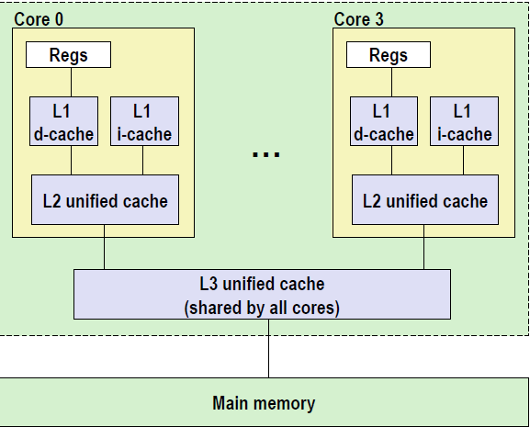
Multi-level caches
L1 d-cache, i-cache
32k 8-way
Access: 4 cycles
L2 unified-cache
256k 8-way
Access: 10 cycles
Block size
64 bytes for all cache
L3 unified-cache
8M 16-way
Access: 40~75 cycles

Slide 6
Cache performance metrics
Miss Rate
  fraction of memory references not found in cache (misses/references)
  Typical numbers:
    3-10% for L1
    Can be quite small (<1%) for L2, depending on size
Hit Rate
  fraction of memory references found in cache (1 - miss rate)

Slide 7
Cache performance metrics
Hit Time
  time to deliver a line in the cache to the processor (includes time to determine whether the line is in the cache)
  Typical numbers:
    4 clock cycles for L1 in core i7
    11 clock cycles for L2 in core i7
Miss Penalty
  additional time required because of a miss
    Typically 50-200 cycles for main memory (Trend: increasing!)

Slide 8
What does Hit Rate Mean?
Consider
  Hit Time: 2 cycles
  Miss Penalty: 200 cycles
  Average access time:
  Hit rate 99%: 2*0.99 + 200*0.01 = 4 cycles
  Hit rate 97%: 2*0.97 + 200*0.03 = 8 cycles
This is why “miss rate” is used instead of “hit rate”

Slide 9
Cache performance metrics
Cache size
  Hit rate vs. hit time
Block size
  Spatial locality vs. temporal locality
Associativity
  Thrashing
  Cost
  Speed
  Miss penalty
Write strategy
  Simple, read misses, fewer transfer

Slide 10
Writing Cache-Friendly Code
Principles
  Programs with better locality will tend to have lower miss rates
  Programs with lower miss rates will tend to run faster than programs with higher miss rates

Slide 11
Writing Cache-Friendly Code
Basic approach
  Make the common case go fast
    Programs often spend most of their time in a few core functions.
    These functions often spend most of their time in a few loops
  Minimize the number of cache misses in each inner loop

Slide 12
Writing Cache-Friendly Code
(pp. 634)
int sumvec(int v[N])
{
int i, sum = 0 ;
for (i = 0 ; i < N ; i++)
sum += v[i] ;
return sum ;
}
Temporal locality,
These variables are usually put in registers
v[i]
i=0
i= 1
i= 2
i= 3
i= 4
i= 5
i= 6
i= 7
Access order,
[h]it or [m]iss
1[m]
2[h]
3[h]
4[h]
5[m]
6[h]
7[h]
8[h]

Slide 13
Writing cache-friendly code
Temporal locality
  Repeated references to local variables are good because the compiler can cache them in the register file

Slide 14
Writing cache-friendly code
Spatial locality
  Stride-1 references patterns are good because caches at all levels of the memory hierarchy store data as contiguous blocks
Spatial locality is especially important in programs that operate on multidimensional arrays

Slide 15
Writing cache-friendly code
Example (pp. 635, M=4, N=8)
int sumarrayrows(int a[M][N])
{
int i, j, sum = 0 ;
for (i = 0 ; i < M ; i++)
for ( j = 0 ; j < N ; j++ )
sum += a[i][j] ;
return sum ;
}

Slide 16
Writing cache-friendly code
a[i][j] | j=0 | j= 1 | j= 2 | j= 3 | j= 4 | j= 5 | j= 6 | j= 7
i=0 i=1 i=2 i=3 | 1[m] 9[m] 17[m] 25[m] | 2[h] 10[h] 18[h] 26[h] | 3[h] 11[h] 19[h] 27[h] | 4[h] 12[h] 20[h] 28[h] | 5[m] 13[m] 21[m] 29[m] | 6[h] 14[h] 22[h] 30[h] | 7[h] 15[h] 23[h] 31[h] | 8[h] 16[h] 24[h] 32[h]

Slide 17
Writing cache-friendly code
Example (pp. 636, M=4, N=8)
int sumarraycols(int a[M][N])
{
int i, j, sum = 0 ;
for ( j = 0 ; j < N ; j++ )
for ( i = 0 ; i < M ; i++ )
sum += a[i][j] ;
return sum ;
}

Slide 18
Writing cache-friendly code
a[i][j] | j=0 | j= 1 | j= 2 | j= 3 | j= 4 | j= 5 | j= 6 | j= 7
i=0 i=1 i=2 i=3 | 1[m] 2[m] 3[m] 4[m] | 5[m] 6[m] 7[m] 8[m] | 9[m] 10[m] 11[m] 12[m] | 13[m] 14[m] 15[m] 16[m] | 17[m] 18[m] 19[m] 20[m] | 21[m] 22[m] 23[m] 24[m] | 25[m] 26[m] 27[m] 28[m] | 29[m] 30[m] 31[m] 32[m]

Slide 19
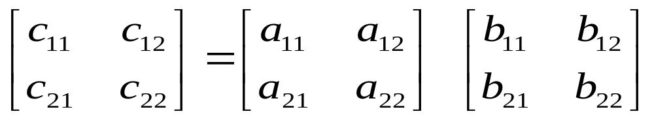
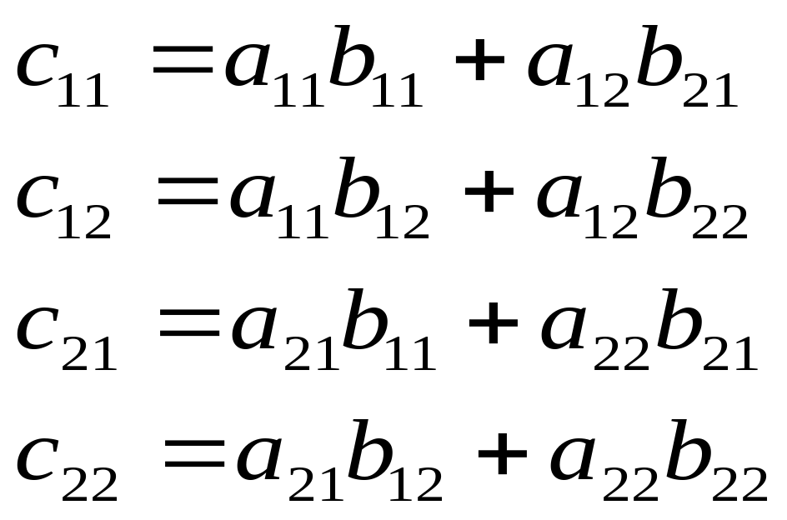
Matrix Multiplication

Slide 20
Matrix Multiplication Implementation
/* ijk */
for (i=0; i<n; i++) {
for (j=0; j<n; j++) {
c[i][j] = 0.0;
for (k=0; k<n; k++)
c[i][j] += a[i][k] * b[k][j];
}
}
O(n³)adds and multiplies
Each n² elements of A and B is read n times

Slide 21
Matrix Multiplication
Assumptions:
  Each array is an n×n array of double, with size 8
  There is a single cache with a 32-byte block size ( B=32 )
  The array size n is so large that a single matrix row does not fit in the L1 cache
  The compiler stores local variables in registers, and thus references to local variables inside loops do not require any load and store instructions.

Slide 22
Matrix Multiplication
/* ijk */
for (i=0; i<n; i++) {
for (j=0; j<n; j++) {
sum = 0.0;
for (k=0; k<n; k++)
sum += a[i][k] * b[k][j];
c[i][j] = sum;
}
}
Variable sum
held in register

Slide 23
Matrix multiplication (ijk)
/* ijk */
for (i=0; i<n; i++) {
for (j=0; j<n; j++) {
sum = 0.0;
for (k=0; k<n; k++)
sum += a[i][k] * b[k][j];
c[i][j] = sum;
}
}
Inner loop:
(*,j)
(i,j)
(i,*)
A
B
C
Row-wise
Column-wise
Fixed
Misses per Inner Loop Iteration:
  A B C
  0.25 1.0 0.0
  2 loads, 0 stores
  misses/iter = 1.25

Slide 24
Matrix multiplication (jik)
/* jik */
for (j=0; j<n; j++) {
for (i=0; i<n; i++) {
sum = 0.0;
for (k=0; k<n; k++)
sum += a[i][k] * b[k][j];
c[i][j] = sum;
}
}
Inner loop:
(*,j)
(i,j)
(i,*)
A
B
C
Row-wise
Column-wise
Fixed
Misses per Inner Loop Iteration:
  A B C
  0.25 1.0 0.0
  2 loads, 0 stores
  misses/iter = 1.25

Slide 25
Matrix multiplication (kij)
/* kij */
for (k=0; k<n; k++) {
for (i=0; i<n; i++) {
r = a[i][k];
for (j=0; j<n; j++)
c[i][j] += r * b[k][j];
}
}
Inner loop:
(i,k)
(k,*)
(i,*)
A
B
C
Fixed
Row-wise
Row-wise
Misses per Inner Loop Iteration:
  A B C
  0.0 0.25 0.25
  2 loads, 1 store
  misses/iter = 0.5

Slide 26
Matrix multiplication (ikj)
/* ikj */
for (i=0; i<n; i++) {
for (k=0; k<n; k++) {
r = a[i][k];
for (j=0; j<n; j++)
c[i][j] += r * b[k][j];
}
}
Inner loop:
(i,k)
(k,*)
(i,*)
A
B
C
Fixed
Row-wise
Row-wise
Misses per Inner Loop Iteration:
  A B C
  0.0 0.25 0.25
  2 loads, 1 store
  misses/iter = 0.5

Slide 27
Matrix multiplication (jki)
/* jki */
for (j=0; j<n; j++) {
for (k=0; k<n; k++) {
r = b[k][j];
for (i=0; i<n; i++)
c[i][j] += a[i][k] * r;
}
}
Inner loop:
(*,k)
(*,j)
(k,j)
A
B
C
Column -wise
Fixed
Column-wise
Misses per Inner Loop Iteration:
  A B C
  1.0 0.0 1.0
  2 loads, 1 store
  misses/iter = 2.0

Slide 28
Matrix multiplication (kji)
/* kji */
for (k=0; k<n; k++) {
for (j=0; j<n; j++) {
r = b[k][j];
for (i=0; i<n; i++)
c[i][j] += a[i][k] * r;
}
}
Inner loop:
(*,k)
(*,j)
(k,j)
A
B
C
Column -wise
Fixed
Column-wise
Misses per Inner Loop Iteration:
  A B C
  1.0 0.0 1.0
  2 loads, 1 store
  misses/iter = 2.0

Slide 29
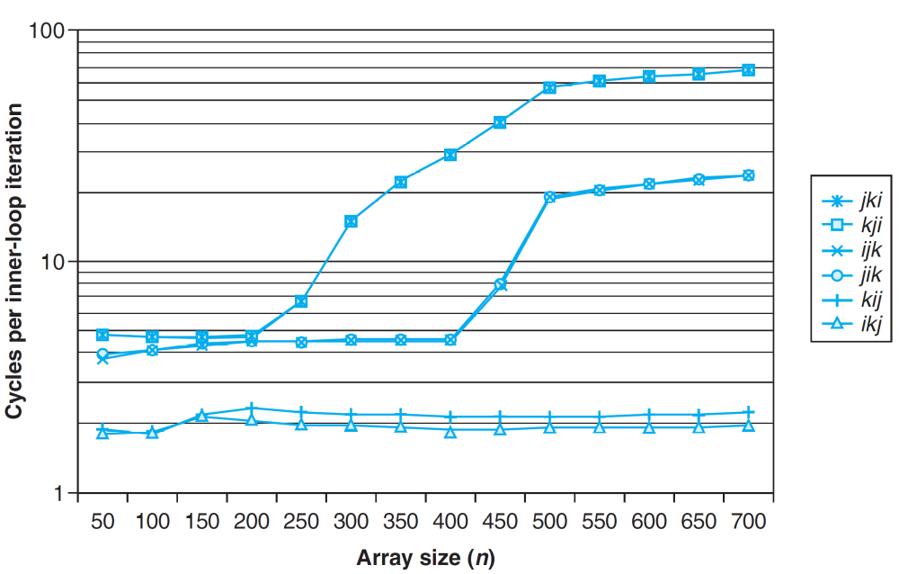
Pentium matrix multiply performance

Slide 30
Pentium matrix multiply performance
The performance difference is
  almost 40 times for the same application
Pairs of versions have almost identical measured performance
  with the same number of memory references and misses per
The worst memory behavior versions run significantly slower than the other versions
  in terms of the number of accesses and misses per iteration

Slide 31
Pentium matrix multiply performance
Miss rate, in this case, is a better predictor of performance than the total number of memory accesses.
The performance of the fastest pair of versions (kij and ikj) is constant
  the array is much larger than any of the cache
The prefetching hardware is
  smart enough to recognize the stride-1 access
  fast enough to keep up with memory accesses in the tight inner loop

Slide 32
The Memory Mountain

Slide 33
The Memory Mountain
Read throughput (read bandwidth)
  The rate that a program reads data from the memory system
Memory mountain
  A two-dimensional function of read bandwidth versus temporal and spatial locality
  Characterizes the capabilities of the memory system for each computer

Slide 34
Memory mountain main routine
/* mountain.c - Generate the memory mountain. */
#define MINBYTES (1 << 14) /* Working set size ranges from 2 KB */
#define MAXBYTES (1 << 27) /* ... up to 64 MB */
#define MAXSTRIDE 11 /* Strides range from 1 to 11 */
#define MAXELEMS MAXBYTES/sizeof(long)
long data[MAXELEMS]; /* The array we'll be traversing */

Slide 35
Memory mountain main routine
int main()
{
int size; /* Working set size (in bytes) */
int stride; /* Stride (in array elements) */
double Mhz; /* Clock frequency */
init_data(data, MAXELEMS); /* Initialize each element in data to 1 */
Mhz = mhz(0); /* Estimate the clock frequency */

Slide 36
Memory mountain main routine
for (size = MAXBYTES; size >= MINBYTES; size >>= 1) {
for (stride = 1; stride <= MAXSTRIDE; stride++)
printf("%.1f\t", run(size, stride, Mhz));
printf("\n");
}
exit(0);
}

Slide 37
Memory mountain test function
/* The test function */
int test (int elems, int stride) {
long i, sx2=stride*2, sx3=stride*3, sx4=stride*4 ;
long acc0 = 0, acc1 = 0, acc2 = 0, acc3 =0;
long length = elems;
long limit = length – sx4 ;
/*
for (i = 0; i < elems; i += stride)
result += data[i];
*/

Slide 38
Memory mountain test function
for (i = 0; i < limit; i += sx4) {
acc0 += data[i];
acc1 += data[i+stride];
acc2 += data[i+sx2];
acc3 += data[i+sx3];
}
for (; i < length; i+=stride)
acc0 += data[i]
return ((acc0+acc1)+(acc2+acc3)) ;
}

Slide 39
Memory mountain test function
/* Run test (elems, stride) and return read throughput (MB/s) */
double run (int size, int stride, double Mhz)
{
double cycles;
int elems = size / sizeof(long);
test (elems, stride); /* warm up the cache */
cycles = fcyc2(test, elems, stride, 0); /* call test (elems,stride) */
return (size / stride) / (cycles / Mhz); /* convert cycles to MB/s */
}

Slide 40
The Memory Mountain
Data
  Size
    MAXBYTES(64M) bytes or MAXELEMS(8M) longs
  Partially accessed
    Working set: from 128MB to 16KB
    Stride: from 1 to 11

Slide 41
The Memory Mountain

Slide 42
Ridges of temporal locality
Slice through the memory mountain with stride=8
  illuminates read throughputs of different caches and memory

Slide 43
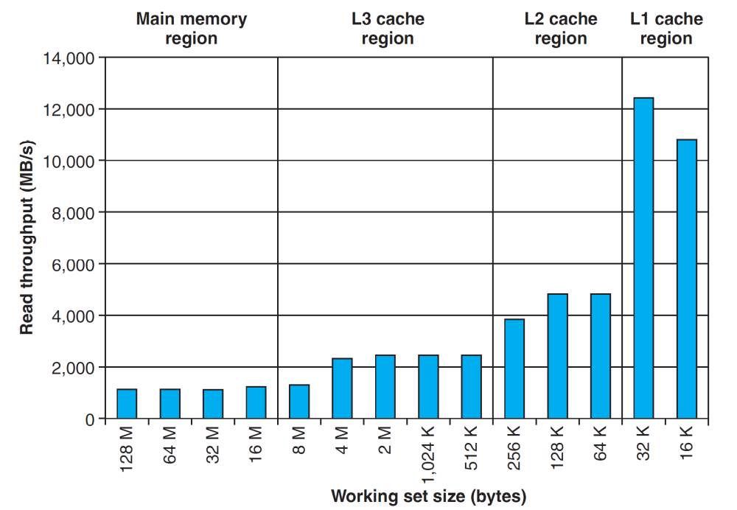
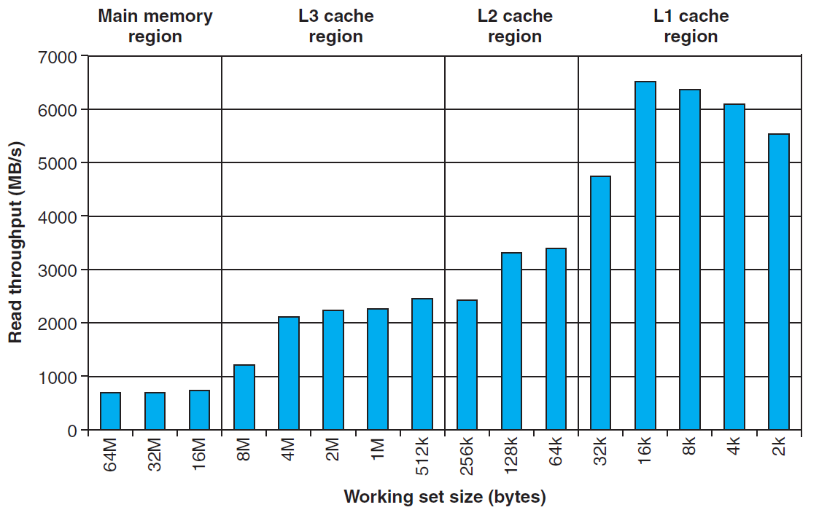
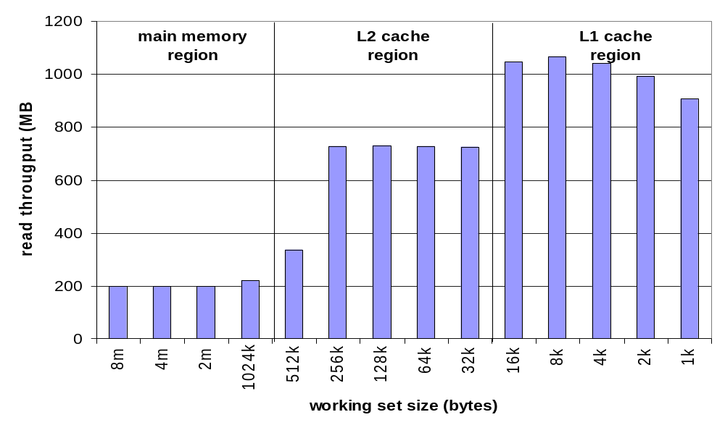
Ridges of temporal locality

Slide 44
A slope of spatial locality
Slice through memory mountain with size=4M
  shows cache block size.

Slide 45
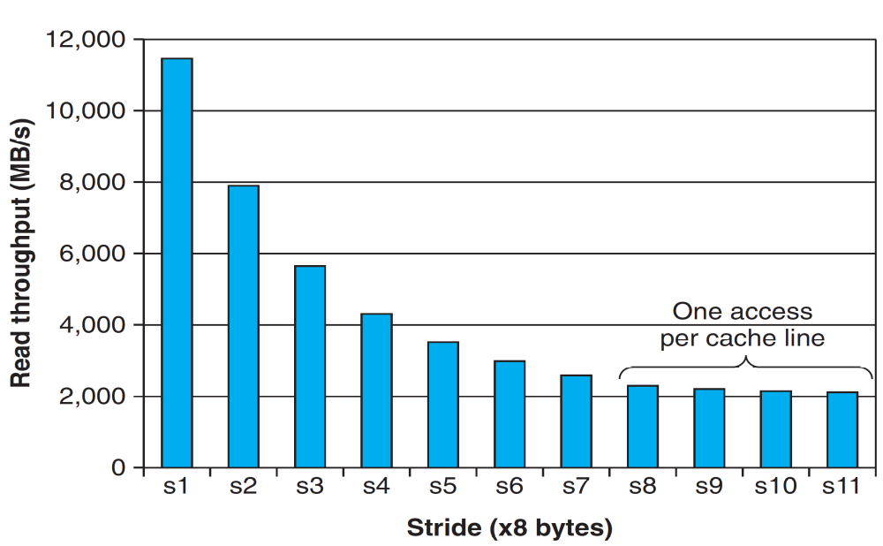
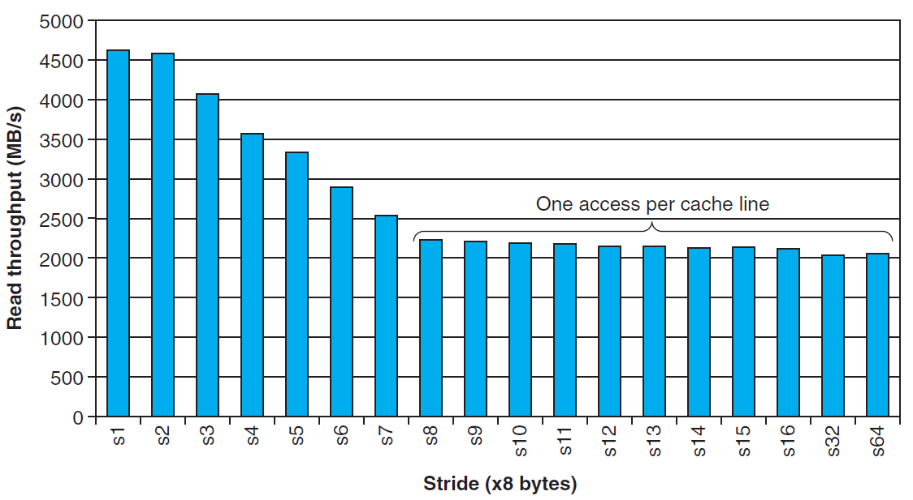
A slope of spatial locality

Slide 46
The Memory Mountain

Slide 47
Interesting Flat Ridge
Extends perpendicular to the stride axis for a stride of 1
  The read throughput is a relatively flat 12GB/s even though the working set exceeds the capacities of L1 and L2
  This is apparently due to a hardware prefetching mechanism

