Slide 1

DV3: A dynamic stochastic
multipath network decision
process
As first reported in:
PROCEEDINGS OF SEMINAR K OF THE EUROPEAN TRANSPORT CONFERENCE 2000, HELD HOMERTON COLLEGE, CAMBRIDGE, UK, 11-13 SEPTEMBER 2000 - TRANSPORT MODELLING. VOLUME P445, 2000, p. 55-67
By
Niels Hoffmann

Slide 2
Abstract:
The DV3 framework for routing pedestrians in complex networks has been used since the beginning of the nineties in modelling passenger flows and densities in railway stations, airports and at major events such as Olympic/Commonwealth games and a million plus population at the projected Mecca expansion . The method is shown to be a probit model dealing appropriately with multiple paths and their correlation, reflecting the behaviour of infinitely many travellers. This is achieved by combining E(X) and V(X) in an assignment process over the network as an integral part of the tree/vine building process towards each destination subject to no circular path being generated. In the process splitting rate/progression probabilities are calculated at each stage from E, V , and C, where C=capacity or quality factor. A deterministic function for calculating Path Progression Probabilities PPP=G(E,V,C) is presented and shown to give results corresponding well with the equivalent Monte Carlo simulation probabilities. C deals with the problem of the well-known IIA problem. Finally, each destination process enables travellers from everywhere to reach its destination by evaluating multiple paths at every stage of the progression either by flow or individual agents. Since the process is linear in E and V we assume that changes to journey times in the simulation/model is scalable and the process hence able to cope with the dynamics of a seamless update of simulated or observed journey times.

Slide 3
Background History
The Kings Cross fire 1987 sparked a desire to be able to model pedestrian movements in Underground Stations.
Attempts were made to model the dynamics of underground stations by conventional flow based road traffic assignment models.
More promising was London underground’s Station Congestion Model SCM: a flow based, fixed route simulation model. Representing Queuing and waiting in a more realistic way.
The widely used SATURN road traffic assignment model was initially used to produce the fixed set of routes in SCM.
It was soon recognised not to be dynamic enough especially during evacuation modelling – consequently route creation on demand was built into SCM as a general feature.
Holding the routes during the simulation turned out to be impossible due to limited computer capacity, beckoning a different approach.

Slide 4
A more dynamic way: The DV3 framework.
How it evolved:
  Dial’s, Dijkstra’s and Van Vliet’s Decision Vine: DV3.
Inspired by:
  Dial: A Probabilistic Multi Path Traffic Assignment Model which obviates Path enumeration. Which, however, failed to consider all possible
  paths and their dependency (IIA problem), as overcome by the DV3
  framework.
  Dijkstra: Vine Build with sorted list of loose ends. (Cascading). Has made it
  possible to short cut links causing loops as well as to assign the
  mean time/cost from individual links to the destination in the Vine in a
  multiple path cost/time update, (Stochastic User Equilibrium SUE assignment). UE may be achieved by adding flow time curves sequentially or in parallel. (now superseded)
  Van Vliet: SATURN UE and SUE assignment procedures: Following the success of the SUE option in SATURN providing fixed routing for the SCM this was the target for the dynamic implementation in SCM.
  The use of random numbers on individual links in an all or nothing assignment process, however, did not always produce balanced solutions.

Slide 5
A more dynamic way: The DV3 framework.
How it evolved:
The following development path took place:
  A convergent assignment process using Path Progression Probabilities PPPs (splitting rates) enabling both User Equilibrium UE and Stochastic User Equilibrium SUE assignment methodologies was developed. An efficient way of creating static routes for the SCM model and avoiding out of balance parallel flows. (Down side: ran out of route space)
  Replaced Routes RP with PPPs to save computing space in SCM.
  The flow based simulation was changed to individual agents following PPPs augmented by an individual’s understanding of the immediate congestion ahead.
  Since flows at major interchanges are often not well defined an option of defining PPPs based on time/cost and space availability/capacity was introduced.

Slide 6
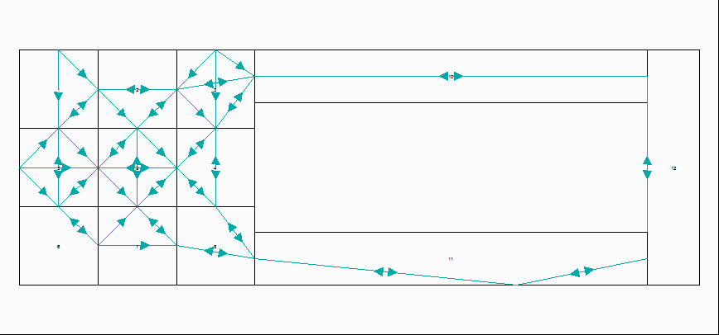
A more dynamic way: The DV3 framework.
What it is:
The Network with progressions: link to link movements

Slide 7
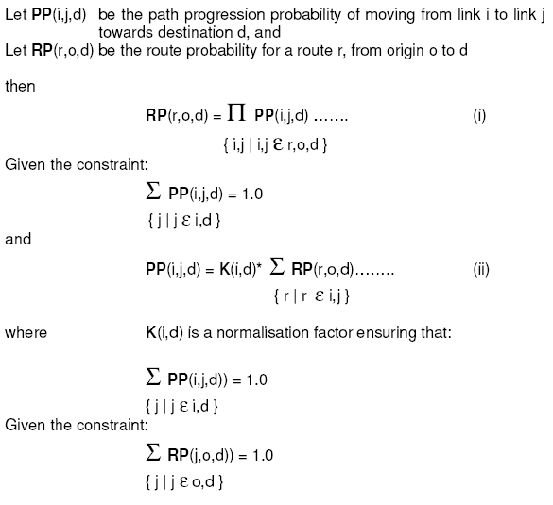
A more dynamic way: The DV3 framework.
What it is:
Path Progression VS Paths
    Path Progressions are an efficient way
    of picking up all defined routes . They
    are a natural part of the Vine/tree
    building process and it can be proved
    that they map to one another as one to
    one.

Slide 8
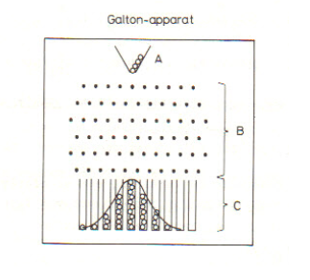
A more dynamic way: The DV3 framework.
What it is:
The Central Limit Theorem:
Galton’s Apparatus as an illustration.
E(Y_{k}) = E(X₁)+E(X₂)+…+E(X_{k}) = ∑ µ_{i}
V( Y_{k}) = V(X₁)+V(X₂)+…+V(X_{k}) = ∑ σ_{i}²
i=1,k
Given V(X)=β*E(X)
(This is the clasical way also used in
Saturn)
We have the rules for dressing the Vine.

Slide 9
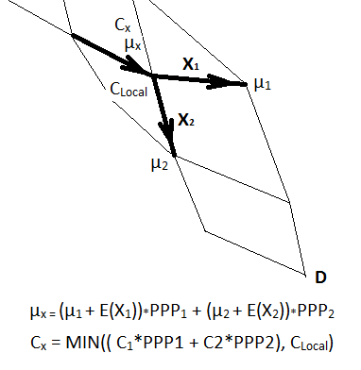
A more dynamic way: The DV3 framework.
What it is:
Dressing the Vine E(X), C(X)
  Note: The process of calculating mean
  values is done as part of the Vine build
  rooted in the destination D:
  First path: Pick up links visited more
  than once. L
  Sort L in distance from D.
  For each element Li in L complete
  the Vine build rooted in Li
  Capacities Cx are calculated in the same
  way and constrained to C_{Local}

Slide 10
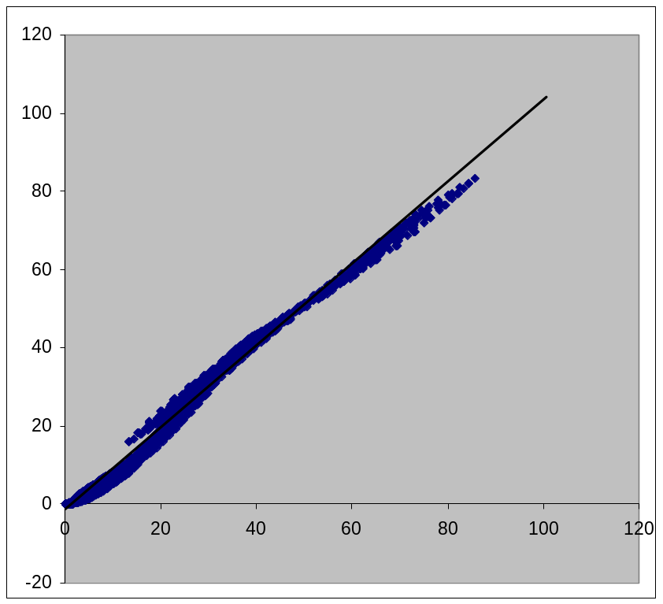
A more dynamic way: The DV3 framework.
What it is:
Calculating Progression Probabilities
A good fit ?
Compared with
Monte Carlo
technique over a
range of alternatives
2 to 5.

Slide 11
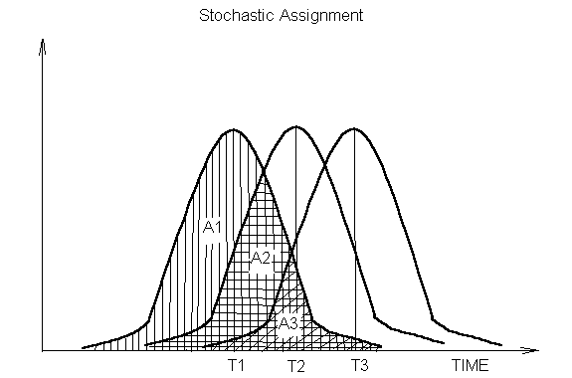
A more dynamic way: The DV3 framework.
What it is:
Calculating Progression Probabilities
Note:
Going back to basics:
Dealing with relative
areas on the density
distributions.
areas on
P1 = (A1-A2)/1 + (A2-A3)/2 + (A3)/3
P2 = + (A2-A3)/2 + (A3)/3
P3 = + (A3)/3
In general: P_{i} = Σ(A_{n}-A_{n+1})/n Extended to: P_{i} = Σ(E(a_{n})-E(A_{n+1}))/n : A₁=1 A_{N+1}=0
n=i,N n=i,N

Slide 12
A more dynamic way: The DV3 framework.
What it is:
Calculating Progression Probabilities
Note:
In Bayesian statistics
qi resembles a priori
probabilities! May also
be seen as Stated
Preference factors.
V vanishing we would pick up all equal routes
from any origin.
Capacity/Quality Weighting:
P1 = (A1-A2)*q1/q1 + (A2-A3)q1/(q1+q2) + (A3)*q1/(q1+q2+q3)
P2 = + (A2-A3)q2/(q1+q2) + (A3)*q2/(q1+q2+q3)
P3 = + (A3)*q3/(q1+q2+q3)
In general: P_{i} = Σ(E(a_{n})-E(A_{n+1}))(q_{i} / Σ q_{k}) : A₁=1 A_{N+1}=0
n=i,N k=1,n

Slide 13
A more dynamic way: The DV3 framework.
What it is:
Scalability and Seamless Journey time update
Briefly:
For the purpose of updating and enable journey time changes to have an impact on the simulation between complete re-routings we keep the shortest time as well as the mean times from each link of the Vine.
Any changes that may have happened to the congestion in shorter time intervals in between re-routing times may be assembled into an update of ‘shortest times only’ in the Vine. The updated mean times used in the simulation becomes the original mean time factored by new_shortest /original_shortest. Possibly the best estimate of the new mean? Intuitively so? Gives comparable results to rerouting more often.
This technique has proved invaluable in big models like Mecca with more than 2000 junctions/blocks and in excess of 1mill agents moving at the same time in faster than real time.
Note, each agent at the point of decision makes the decision based on what can be seen ahead augmented to the mean time before recalculating the PPPs as a target for redistribution. Given a running total of agents the alternative that brings running total distribution nearer the instantaneous distribution is selected.

Slide 14
A more dynamic way: The DV3 framework.
What’s next:
Some aspects of this presentation which would be worth while pursuing:
A study into how far we can go with the concept of the DV3 framework as a fixed entity in a dynamic situation. Currently in progress.
The framework has been used for activity and process modelling in airports (T5). What use could this be in a reformulation of for example demand forecasting in Urban networks into a more dynamic form?
Would be good to see a better estimation of E(A) in the PPP calculation routine. A challenge to a mathematician!
Given its dynamic nature dealing with all possible paths simultaneously it has the ability to deal dynamically with directing a number of agents simultaneously to alternative paths in congested network where one or more incidents may have occurred. This may be relevant in a transportation network. Could this be relevant for the internet?

Slide 15
A more dynamic way: The DV3 framework.
Bibliography:
Dial, R.B. (1971), A Probabilistic MultiPath Traffic Assignment Model which
obviates Path Enumeration, Transp. Res Vol 5, pp. 83-111
Dijkstra, E.W. (1959), Note on Two Problems in Connection with Graphs,
Numer. Math., 1, pp.269-271.
Florian, M., Fox, B. (1976) Short Communications: On the Probabilistic Origin
Of Dial’s Multipath Traffic Assignment Model. Transpn Res vol.10 pp. 339-341.
Sheffi, Y., Daganzo, C. F. (NA) Hypernetworks and Supply-Demand Equilibrium Obtained With Disaggregate Demand Models. Sponsored by: Committee on Passenger Travel Demand Forecasting and Committee on Travel Behavior and Values.
Thomas, R. (1991) Traffic Assignment Techniques, Academic Publishing Group.
User Guide to PEDROUTE Version 3.15 : London Underground Limited and Halcrow Fox and Associates, May 1994.
User Guide to PAXPORT, BAA and Halcrow Fox, 1994.
Van Vliet, D. (1985), SATURN notes, version 7.1, Institute for Transport Studies, University of Leeds.

