Slide 1

Tenth Mathematics of Networks meeting, September 2011, Loughborough University
Proof of convergence of a natural splitting-rate adjustment algorithm in models of (telecommunication and) transportation networks
Mike Smith (Dept. of Maths, University of York)
Richard Mounce (Dept. of Architecture, University of Cambridge)

Slide 2
A splitting rate model of traffic re-routeing and traffic control
19th International Symposium on Transport and Traffic Theory (July 2011)
Mike Smith (Dept. of Maths, University of York)
Richard Mounce (Dept. of Architecture, University of Cambridge)

Slide 3
Splitting Rate Designing Modelling Signal Controls
Gentile (LUCE/VISUM) Henk Van Zuylen
Gentile, Noekel (LUCE/V) Henk Taale
Hillel Bar Gera (OBA) ●
Mike Maher (SAM) ●
● ●
● ●
● ●
● ●
Previous Work on

Slide 4
EQUILIBRIUM MODELLING AND ITS
ITS
DYNAMICS
EQUILIBRATION/
ROUTEING
DYNAMICS
SPLITTING RATE
DYNAMICS

Slide 5
EQUILIBRIUM MODELLING AND ITS
ITS
DYNAMICS
EQUILIBRATION/
ROUTEING
DYNAMICS
SPLITTING RATE
DYNAMICS

Slide 6
EQUILIBRIUM MODELLING AND ITS
ITS
DYNAMICS
EQUILIBRATION/
ROUTEING
DYNAMICS
SPLITTING RATE
DYNAMICS

Slide 7
EQUILIBRIUM MODELLING AND ITS
ITS
DYNAMICS
EQUILIBRATION/
ROUTEING
DYNAMICS
SPLITTING RATE
DYNAMICS

Slide 8
EQUILIBRIUM MODELLING AND ITS
ITS
DYNAMICS
EQUILIBRATION/
ROUTEING
DYNAMICS
SPLITTING RATE
DYNAMICS

Slide 9
EQUILIBRIUM MODELLING AND ITS
ITS
DYNAMICS
EQUILIBRATION/
ROUTEING
DYNAMICS
SPLITTING RATE
DYNAMICS

Slide 10
WHAT CAN GO WRONG!!
RESPONSIVE
SIGNAL
AX₂
d₂
s
s
ORIGIN
d₁
AX₁
DESTINATION

Slide 11
PITCHFORK
BIFURCATION
,
s
X₂
ORIGIN
SIGNAL
DESTINATION
RESPONSIVE
.
Bold lines = equilibria
Non-unique
For each T: 5 or 3
0 X₁ s-4B/As s

Slide 12
PITCHFORK
,
s
X₂
ORIGIN
SIGNAL
DESTINATION
RESPONSIVE
.
BIFURCATION
Bold lines = equilibria
Non-unique
For each T: 5 or 3
0 X₁ s-4B/As s

Slide 13
UNPREDICTABLE RESULTS!
,
s
ORIGIN
SIGNAL
DESTINATION
.
X₂
BIFURCATION
Red trajectory shows hysterisis
0 X₁ s-4B/As s

Slide 14
OUTLINE OF SELECTED CONTENTS:
A SIMPLE RE-ROUTEING DYNAMIC
STABILITY / CONVERGENCE
ADDING BOTTLENECK DELAYS AND SIGNAL RED TIME
COMBINED RE-ROUTEING AND SIGNAL RED TIME DYNAMICS
APPLICATION TO INTELLIGENT DECISION SUPPORT

Slide 15
1.
A SIMPLE
RE-ROUTEING DYNAMIC

Slide 16
SIMPLE NETWORK 1
Currently:
c₂(x₂)
x₂
x₁
c₁(x₁)
Origin
Destination
Total Origin – Destination Flow = T (fixed)

Slide 17
How does x = x₁ change ?
x₂
SIMPLE NETWORK:
c₂(x₂)
x₂
x₁
c₁(x₁)
Origin
Destination
Total Origin – Destination Flow = T (fixed)

Slide 18
How does x = x₁ change ?
x₂
SUPPOSE: c₂(x₂) > c₁(x₁).
c₂(x₂)
x₂
x₁
c₁(x₁)
Origin
Destination
Total Origin – Destination Flow = T (fixed)

Slide 19
How does x = x₁ change ?
x₂
SUPPOSE: c₂(x₂) > c₁(x₁).
c₂(x₂)
x₂
x₁
c₁(x₁)
Origin
Destination
Total Origin – Destination Flow = T (fixed)

Slide 20
Suppose x = x₁ x₁ + δx₁ = x + δx
x₂ x₂ + δx₂
SUPPOSE: c₂(x₂) > c₁(x₁).
c₂(x₂)
x₂
x₁
c₁(x₁)
Origin
Destination
Total Origin – Destination Flow = T (fixed)

Slide 21
Re-routeing adjustment [c₂(x₂) > c₁(x₁)] :
δx = x₂ [c₂(x₂) – c₁(x₁)]
- x₂[c₂(x₂) - c₁(x₁)]
c₂(x₂)
x₂
x₁
c₁(x₁)
Origin
Destination
Total Origin – Destination Flow = T (fixed)

Slide 22
Re-routeing adjustment [c₂(x₂) > c₁(x₁)] :
δx = x₂ [c₂(x₂) – c₁(x₁)]
- x₂[c₂(x₂) - c₁(x₁)]
POSITIVE
NEGATIVE
c₂(x₂)
x₂
x₁
c₁(x₁)
Origin
Destination
Total Origin – Destination Flow = T (fixed)

Slide 23
Re-routeing adjustment [c₂(x₂) > c₁(x₁)] :
δx = x₂ [c₂(x₂) – c₁(x₁)]
- x₂[c₂(x₂) - c₁(x₁)]
= x₁[c₁(x₁) – c₂(x₂)]₊∆₁₂ + x₂[c₂(x₂) – c₁(x₁)]₊∆₂₁
c₂(x₂)
x₂
x₁
c₁(x₁)
Origin
Destination
Total Origin – Destination Flow = T (fixed)

Slide 24
Re-routeing adjustment [c₂(x₂) > c₁(x₁)]:
δx = x₂ [c₂(x₂) – c₁(x₁)]
- x₂[c₂(x₂) - c₁(x₁)]
= x₁[c₁(x₁) – c₂(x₂)]₊∆₁₂ + x₂[c₂(x₂) – c₁(x₁)]₊∆₂₁
c₂(x₂)
> c₁(x₁)
x₂
x₁
c₁(x₁)
Origin
Destination
Total Origin – Destination Flow = T (fixed)

Slide 25
Re-routeing adjustment [c₂(x₂) > c₁(x₁)] :
δx = x₂ [c₂(x₂) – c₁(x₁)]
- x₂[c₂(x₂) - c₁(x₁)]
c₂(x₂)
x₂
x₁
c₁(x₁)
Origin
Destination
Total Origin – Destination Flow = T (fixed)

Slide 26
SIMPLE NETWORK 1
Currently:
c₂(x₂)
x₂
x₁
c₁(x₁)
Origin
Destination
Total Origin – Destination Flow = T (fixed)

Slide 27
SIMPLE NETWORK 2
Currently:
c₂(x₂)
x₂
c₁(x₁)
x₁
Origin
S
Destination
Total Origin – Destination Flow = T (fixed)

Slide 28
SIMPLE NETWORK 2
Currently:
c₂(x₂)
x₂
c₁(x₁)
x₁
Origin
S
Destination
Total Origin – Destination Flow = T (fixed)

Slide 29
SIMPLE NETWORK 2
Currently:
C₂(x)
x₂
C₁(x)
x₁
Origin
S
Destination
Total Origin – Destination Flow = T (fixed)

Slide 30
SIMPLE NETWORK 2
Currently:
C₂(x)
x₂
C₁(x)
x₁
Origin
S
Destination
Total Origin – Destination Flow = T (fixed)

Slide 31
SIMPLE NETWORK 2
Currently:
Cost to destination
C₂(x)
x₂
C₁(x)
x₁
Origin
S
Destination
Total Origin – Destination Flow = T (fixed)

Slide 32
SIMPLE NETWORK 2
Currently:
Flow-weighted average
cost to destination
C₂(x)
x₂ c₂
C₁(x)
x₁ c₁
Origin
S
Destination
Total Origin – Destination Flow = T (fixed)

Slide 33
SIMPLE NETWORK 2
Currently:
C(x) = M(x)c(x)
C₂(x)
x₂ c₂
C₁(x)
x₁ c₁
Origin
S
Destination
Total Origin – Destination Flow = T (fixed)

Slide 34
SIMPLE NETWORK 2
Currently:
C = Mc
C₂(x)
x₂ c₂
C₁(x)
x₁ c₁
Origin
S
Destination
Total Origin – Destination Flow = T (fixed)

Slide 35
2.
A SPLITTING RATE DYNAMIC

Slide 36
SIMPLE NETWORK 1
Currently:
C₂(x)
x₂
x₁
C₁(x)
Origin
Destination
Total Origin – Destination Flow = T (fixed)

Slide 37
SIMPLE NETWORK 1
Currently:
C₂(x)
x₂= Tp₂
x₁= Tp₁
C₁(x)
Origin
Destination
Total Origin – Destination Flow = T (fixed)

Slide 38
SPLITTING RATE DYNAMIC [C₂ > C₁]:
δx = x₂ [C₂ – C₁]
- x₂[C₂ - C₁]

Slide 39
SPLITTING RATE DYNAMIC [C₂ > C₁]:
δx = x₂ [C₂ – C₁]
- x₂[C₂ - C₁]
δx = Tp₂ [C₂ – C₁]
-Tp₂[C₂ - C₁]

Slide 40
SPLITTING RATE DYNAMIC [C₂ > C₁]:
δx = x₂ [C₂ – C₁]
- x₂[C₂ - C₁]
δx = Tp₂ [C₂ – C₁]
-Tp₂[C₂ - C₁]
δp = δx/T = p₂ [C₂ - C₁]
-p₂[C₂ - C₁]

Slide 41
SPLITTING RATE DYNAMIC [C₂ > C₁]:
δx = x₂ [C₂ – C₁]
- x₂[C₂ - C₁]
δx = Tp₂ [C₂ – C₁]
-Tp₂[C₂ - C₁]
SAME!!
δp = δx/T = p₂ [C₂ - C₁]
-p₂[C₂ - C₁]

Slide 42
SPLITTING RATE DYNAMIC [C₂ > C₁]:
δx = x₂ [C₂ – C₁]
- x₂[C₂ - C₁]
δx = Tp₂ [C₂ – C₁]
-Tp₂[C₂ - C₁]
SAME!!
IF
T > 0
δp = δx/T = p₂ [C₂ - C₁]
-p₂[C₂ - C₁]

Slide 43
3.
STABILITY
OR
CONVERGENCE TO EQUILIBRIUM

Slide 44
Re-routeing adjustment [c₂(x₂) > c₁(x₁)] :
δx = x₂ [c₂(x₂) – c₁(x₁)]
- x₂[c₂(x₂) - c₁(x₁)]
c₂(x₂)
x₂
x₁
c₁(x₁)
Origin
Destination
Total Origin – Destination Flow = T (fixed)

Slide 45
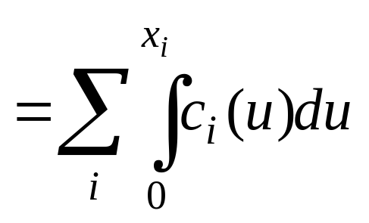
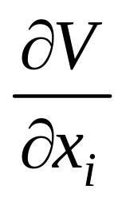
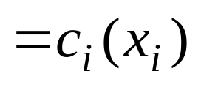
Re-routeing adjustment [c₂(x₂) > c₁(x₁)]:
δx = x₂{c₂(x₂) – c₁(x₁)}
-x₂{c₂(x₂) – c₁(x₁)}
V(x)
Grad V(x) = c(x)

Slide 46
Re-routeing adjustment [c₂(x₂) > c₁(x₁)]:
δx = x₂{c₂(x₂) – c₁(x₁)}
-x₂{c₂(x₂) – c₁(x₁)}
V(x)
Grad V(x) = c(x)
δx·c(x) = x₂{c₂(x₂)–c₁(x₁)} c₁(x₁)
-x₂{c₂(x₂) – c₁(x₁)} c₂(x₂)
●

Slide 47
Re-routeing adjustment [c₂(x₂) > c₁(x₁)]:
δx = x₂{c₂(x₂) – c₁(x₁)}
-x₂{c₂(x₂) – c₁(x₁)}
V(x)
Grad V(x) = c(x)
δx·c(x) = x₂{c₂(x₂)–c₁(x₁)} c₁(x₁)
-x₂{c₂(x₂) – c₁(x₁)} c₂(x₂)
●

Slide 48
Re-routeing adjustment [c₂(x₂) > c₁(x₁)]:
δx = x₂{c₂(x₂) – c₁(x₁)}
-x₂{c₂(x₂) – c₁(x₁)}
V(x)
Grad V(x) = c(x)
< 0
δx·c(x) = x₂{c₂(x₂)–c₁(x₁)} c₁(x₁)
-x₂{c₂(x₂) – c₁(x₁)} c₂(x₂)
●

Slide 49
Descent to equilibrium
V(x) = 4
V(x) = 3
V(x) = 2
V(x) = 1
EQUILIBRIUM: V(x) = minimum

Slide 50
Descent to equilibrium
V(x) = 4
●
V(x) = 3
V(x) = 2
V(x) = 1
EQUILIBRIUM: V(x) = minimum

Slide 51
Descent to equilibrium
V(x) = 4
●
V(x) = 3
●
V(x) = 2
V(x) = 1
EQUILIBRIUM: V(x) = minimum

Slide 52
Descent to equilibrium
V(x) = 4
●
V(x) = 3
●
V(x) = 2
●
V(x) = 1
EQUILIBRIUM: V(x) = minimum

Slide 53
Descent to equilibrium
V(x) = 4
●
V(x) = 3
●
V(x) = 2
●
V(x) = 1
●
EQUILIBRIUM: V(x) = minimum

Slide 54
Descent to equilibrium
V(x) = 4
●
V(x) = 3
●
V(x) = 2
●
●
V(x) = 1
●
EQUILIBRIUM: V(x) = minimum

Slide 55
Descent to equilibrium
V(x) = 4
●
V(x) = 3
gradV(x)
●
V(x) = 2
●
●
V(x) = 1
δx
●
EQUILIBRIUM: V(x) = minimum

Slide 56
4.
BIGGER NETWORKS

Slide 57
Direction of travel
x₁ c₁
x₃ c₃
Origin
2
1
0
Destination
x₂ c₂
x₄ c₄
x₅ c₅

Slide 58
C = Mc
Direction of travel
x₁ c₁
x₃ c₃
Origin
2
1
0
Destination
x₂ c₂
x₄ c₄
x₅ c₅

Slide 59
δx = x₂{C₂(x₂) – C₁(x₁)}
-x₂{C₂(x₂) – C₁(x₁)}
C = Mc
x₂ c₂
x₃ c₃
Origin
2
1
0
Destination
x₁ c₁
x₄ c₄
x₅ c₅

Slide 60
δx = x₂{C₂(x₂) – C₁(x₁)}
-x₂{C₂(x₂) – C₁(x₁)}
C = Mc
∆x = Nδx
x₂ c₂
x₃ c₃
Origin
2
1
0
Destination
x₁ c₁
x₄ c₄
x₅ c₅

Slide 61
δx = x₂{C₂(x₂) – C₁(x₁)}
-x₂{C₂(x₂) – C₁(x₁)}
C = Mc
∆x = M^{T}δx
x₂ c₂
x₃ c₃
Origin
2
1
0
Destination
x₁ c₁
x₄ c₄
x₅ c₅

Slide 62
δx = x₂{C₂(x₂) – C₁(x₁)}
-x₂{C₂(x₂) – C₁(x₁)}
C = Mc
∆x = M^{T}δx
x₂ c₂
x₃ c₃
Origin
2
1
0
Destination
x₁ c₁
x₄ c₄
x₅ c₅
∆x●gradV ???

Slide 63
δx = x₂{C₂(x₂) – C₁(x₁)}
-x₂{C₂(x₂) – C₁(x₁)}
C = Mc
∆x = M^{T}δx
x₂ c₂
x₃ c₃
Origin
2
1
0
Destination
x₁ c₁
x₄ c₄
x₅ c₅
∆x●gradV = ∆x●c = [δx^{T}M]c

Slide 64
δx = x₂{C₂(x₂) – C₁(x₁)}
-x₂{C₂(x₂) – C₁(x₁)}
C = Mc
∆x = M^{T}δx
x₂ c₂
x₃ c₃
Origin
2
1
0
Destination
x₁ c₁
x₄ c₄
x₅ c₅
∆x●gradV = ∆x●c = [δx^{T}M]c = δx^{T}[Mc]

Slide 65
δx = x₂{C₂(x₂) – C₁(x₁)}
-x₂{C₂(x₂) – C₁(x₁)}
C = Mc
∆x = M^{T}δx
x₂ c₂
x₃ c₃
Origin
2
1
0
Destination
x₁ c₁
x₄ c₄
x₅ c₅
∆x●gradV = ∆x●c = [δx^{T}M]c = δx^{T}[Mc] = δx^{T}C = δx●C

Slide 66
δx = x₂{C₂(x₂) – C₁(x₁)}
-x₂{C₂(x₂) – C₁(x₁)}
C = Mc
∆x = M^{T}δx
x₂ c₂
x₃ c₃
Origin
2
1
0
Destination
x₁ c₁
x₄ c₄
x₅ c₅
∆x●gradV = ∆x●c = [δx^{T}M]c = δx^{T}[Mc] = δx^{T}C = δx●C
< 0

Slide 67
Direction of travel
x₂ c₂
x₃ c₃
Origin
2
1
0
Destination
x₁ c₁
x₄ c₄
x₅ c₅
∆x●gradV = ∆x●c = δx●C < 0

Slide 68
GENERAL LOOP-FREE NETWORK
∆x●grad V(x) = ∆x●c(x) = δx●C(x) < 0
Hence the splitting rate dynamical system converges for any loop-free network

Slide 69
5.
ADDING
SIGNAL GREEN TIMES
OR
RED TIMES!

Slide 70
Re-routeing adjustment [c₂ + b₂ > c₁ + b₁]:
δx = x₂{[c₂(x₂) + b₂(x₂+s₂r₂)] – [c₁(x₁ ) + b₁(x₁+s₁r₁)]}
- x₂{[c₂(x₂) + b₂(x₂+s₂r₂)] – [c₁(x₁) + b₁(x₁+s₁r₁)]}
c₂
x₂
b₂
x₁
c₁
Origin
SIGNAL
Destination
b₁
Total Origin – Destination Flow = T (fixed)

Slide 71
Re-routeing adjustment [c₂ + b₂ > c₁ + b₁]:
δx = x₂{[c₂(x₂) + b₂(x₂+s₂r₂)] – [c₁(x₁ ) + b₁(x₁+s₁r₁)]}
- x₂{[c₂(x₂) + b₂(x₂+s₂r₂)] – [c₁(x₁) + b₁(x₁+s₁r₁)]}
c₂
r₂
x₂
b₂
x₁
r₁
c₁
Origin
SIGNAL
Destination
b₁
Total Origin – Destination Flow = T (fixed)

Slide 72
( flow₂ , redtime₂)
(x₂, r₂)
s₂
s₁
(flow₁ , redtime₁)
(x₁, r₁)
Bentley and Lambe; Smith

Slide 73
50%
s₁
Bottleneck delay = b₁ = b₁(flow₁ , redtime₁)
Bottleneck delay = b₁ = b₁(flow₁ + s₁redtime₁) = b₁(x₁ + s₁ r₁)
s₁

Slide 74
P0 RED-TIME ADJUSTMENT [s₂b₂ > s₁b₁]:
δr = r₂{s₂b₂(x₂+s₂r₂) – s₁b₁(x₁+s₁r₁)}
- r₂{s₂b₂(x₂+s₂r₂) – s₁b₁(x₁+s₁r₁)}
c₂
x₂
r₂
b₂
x₁
r₁
c₁
Origin
Destination
b₁
Total Origin – Destination Flow = T (fixed)

Slide 75
6.
COMBINED DYNAMICS
OF
TRAFFIC AND RED TIME (P0) –
STABILITY PROOF

Slide 76
TWO adjustments
δx = x₂{[c₂(x₂) + b₂(x₂+s₂r₂)] – [c₁(x₁ ) + b₁(x₁+s₁r₁)]}
-x₂{[c₂(x₂) + b₂(x₂+s₂r₂)] – [c₁(x₁) + b₁(x₁+s₁r₁)]}
δr = r₂{s₂b₂(x₂+s₂r₂) – s₁b₁(x₁+s₁r₁)}
- r₂{s₂b₂(x₂+s₂r₂) – s₁b₁(x₁+s₁r₁)}

Slide 77
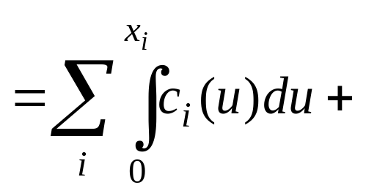
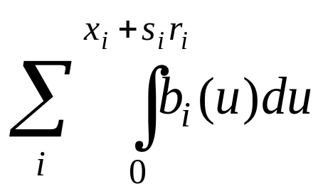
TWO adjustments
δx = x₂{[c₂(x₂) + b₂(x₂+s₂r₂)] – [c₁(x₁ ) + b₁(x₁+s₁r₁)]}
-x₂{[c₂(x₂) + b₂(x₂+s₂r₂)] – [c₁(x₁) + b₁(x₁+s₁r₁)]}
δr = r₂{s₂b₂(x₂+s₂r₂) – s₁b₁(x₁+s₁r₁)}
- r₂{s₂b₂(x₂+s₂r₂) – s₁b₁(x₁+s₁r₁)}
V(x, r)

Slide 78
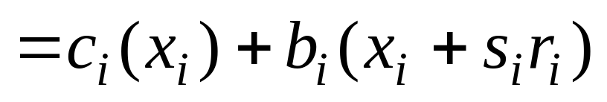
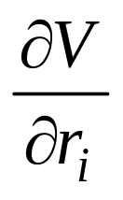
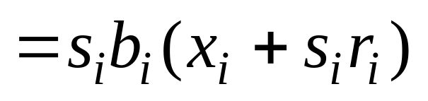
TWO adjustments
δx = x₂{[c₂(x₂) + b₂(x₂+s₂r₂)] – [c₁(x₁ ) + b₁(x₁+s₁r₁)]}
-x₂{[c₂(x₂) + b₂(x₂+s₂r₂)] – [c₁(x₁) + b₁(x₁+s₁r₁)]}
δr = r₂{s₂b₂(x₂+s₂r₂) – s₁b₁(x₁+s₁r₁)}
- r₂{s₂b₂(x₂+s₂r₂) – s₁b₁(x₁+s₁r₁)}
V(x, r)

Slide 79
δx = x₂{[c₂(x₂) + b₂(x₂+s₂r₂)] – [c₁(x₁ ) + b₁(x₁+s₁r₁)]}
-x₂{[c₂(x₂) + b₂(x₂+s₂r₂)] – [c₁(x₁) + b₁(x₁+s₁r₁)]}
δr = r₂{s₂b₂(x₂+s₂r₂) – s₁b₁(x₁+s₁r₁)}
- r₂{s₂b₂(x₂+s₂r₂) – s₁b₁(x₁+s₁r₁)}
Grad V(x, r) =
c₁(x₁ ) + b₁(x₁+s₁r₁)
c₂(x₂) + b₂(x₂+s₂r₂) s₁b₁(x₁+s₁r₁)
s₂b₂(x₂+s₂r₂)

Slide 80
x₂{[c₂ + b₂] – [c₁+ b₁]}
δx -x₂{[c₂ + b₂] – [c₁+ b₁]}
r₂{s₂b₂ – s₁b₁}
- r₂{s₂b₂ – s₁b₁}
=
δr
c₁ + b₁
c₂ + b₂
s₁b₁
s₂b₂
Grad V(x, r) =

Slide 81
x₂{[c₂ + b₂] – [c₁+ b₁]}
δx -x₂{[c₂ + b₂] – [c₁+ b₁]}
r₂{s₂b₂ – s₁b₁}
- r₂{s₂b₂ – s₁b₁}
POSITIVE
NEGATIVE
=
δr
c₁ + b₁
c₂ + b₂
s₁b₁
s₂b₂
Grad V(x, r) =

Slide 82
x₂{[c₂ + b₂] – [c₁+ b₁]}
δx -x₂{[c₂ + b₂] – [c₁+ b₁]}
r₂{s₂b₂ – s₁b₁}
- r₂{s₂b₂ – s₁b₁}
POSITIVE
NEGATIVE
=
δr
δx
c₁ + b₁
c₂ + b₂
s₁b₁
s₂b₂
●
Grad V(x, r) =
δr
δx
●
δr

Slide 83
x₂{[c₂ + b₂] – [c₁+ b₁]}
δx -x₂{[c₂ + b₂] – [c₁+ b₁]}
r₂{s₂b₂ – s₁b₁}
- r₂{s₂b₂ – s₁b₁}
POSITIVE
NEGATIVE
=
δr
● < 0
δx
c₁ + b₁
c₂ + b₂
s₁b₁
s₂b₂
Grad V(x, r) =
δr
δx
●
δr

Slide 84
7.
RESULTS FROM THE
SIGNAL TIMING DESIGN PROCEDURE

Slide 85
Network 3
Approach 1
Control 1
Destination
Origin
Approach 4
Control 2

Slide 86
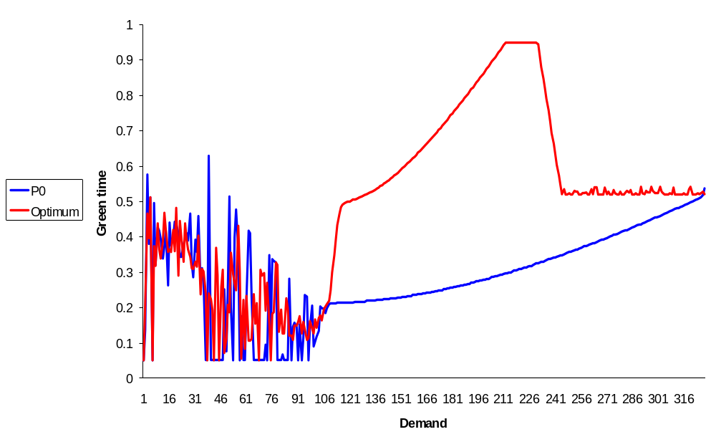
Green-times for approach 1

Slide 87
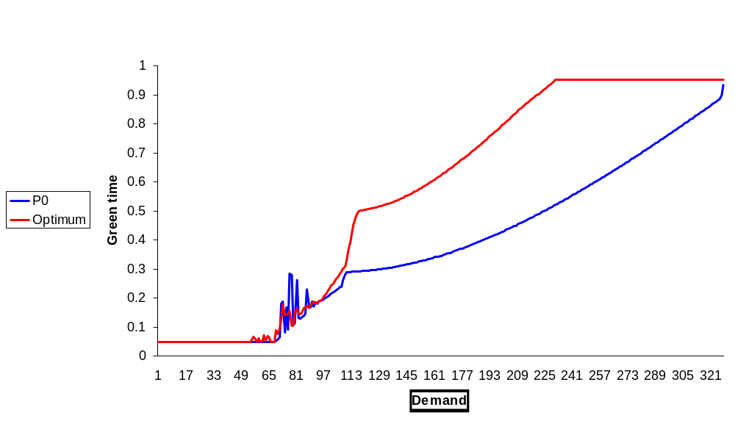
Green-times for approach 4

Slide 88
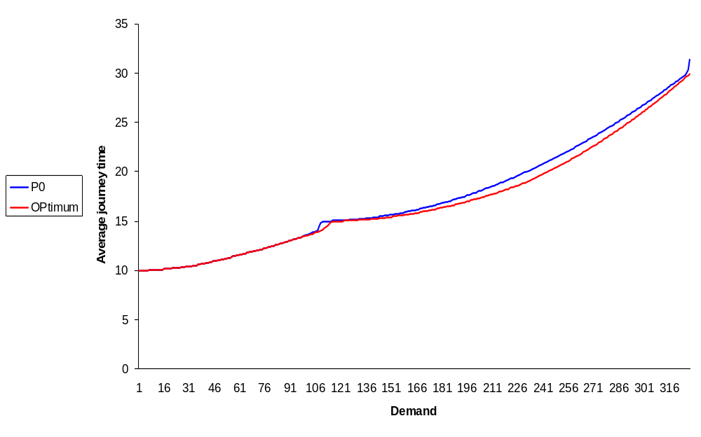
Average journey time

Slide 89
8.
APPLICATION TO INTELLIGENT DECISION SUPPORT

Slide 90
INCIDENT SCENARIO AND INTELLIGENT SIGNAL CHANGES
Approach 1
Control 1
Origin
Destination
Approach 4
Control 2

Slide 91
SCENARIO: BYPASS INCIDENT DOUBLES NETWORK OD FLOW
Control 1
Origin O
Destination D
Approach 4
Control 2

Slide 92
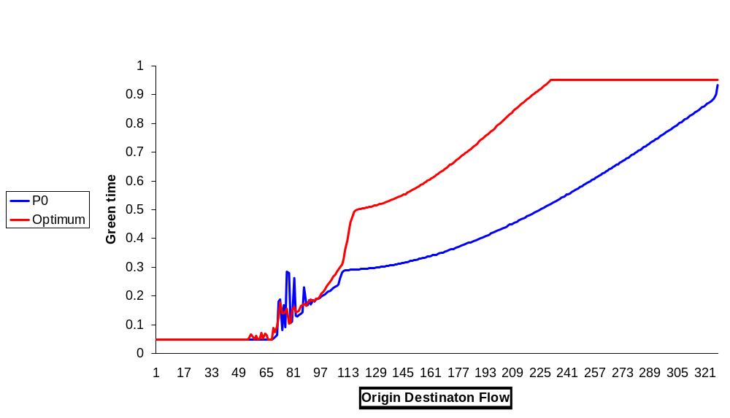
GREEN TIME FOR APPROACH 4
^{OD FLOW DOUBLES}

Slide 93
GREEN TIME FOR APPROACH 4
^{INTELLIGENT}
^{GREEN-TIME}
^{RESPONSE}
^{OD FLOW DOUBLES}

Slide 94
Conclusion and further work
Model would help both network managers and travellers
Use of P₀ needs further justification
Various comparisons with other signal setting methods needed

Slide 95
Acknowledgements
1. Previous work by Janet Clegg and Yanling Xiang; who obtained the programming results.
2. Partial support through the FREEFLOW project; aimed at intervening proactively in network management. FREEFLOW is supported by:
  the Engineering and Physical Sciences Research Council (UK),
  the Department for Transport (UK),
  the Technology Strategy Board (UK) and
  the FREEFLOW Partners.

Slide 96
7.
CAPACITY-MAXIMISING RESULT FOR P0

Slide 97
Network 2: Capacity results
Long,Broad
Short, Narrow
Origin
Control
Destination

Slide 98
Results
Standard
P0
Average
journey
time
OPT
MAX/2
MAX
Demand

