Slide 1
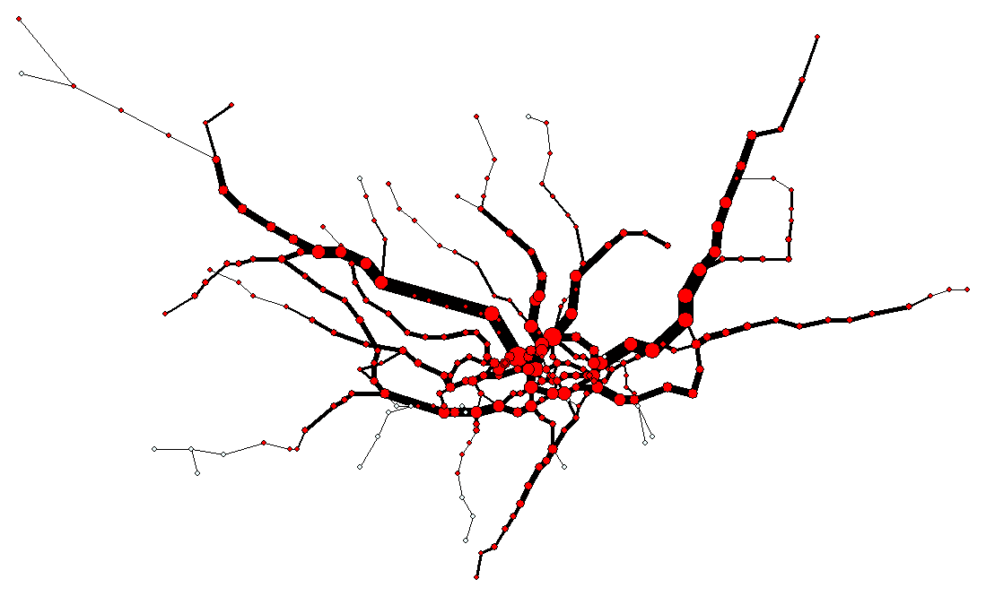
Polymer physics for route optimisation on the London underground
Aston University
Birmingham
Bill C. H. Yeung*, David Saad* and K.Y Michael Wong#
*Nonlinearity and Complexity Research Group – Aston
#Hong Kong University of Science and Technology
[1] C. H. Yeung and D. Saad, PRL 108, 208701 (2012)
[2] C. H. Yeung, D. Saad, and K.Y.M Wong, PNAS 110, 13717 (2013).

Slide 2
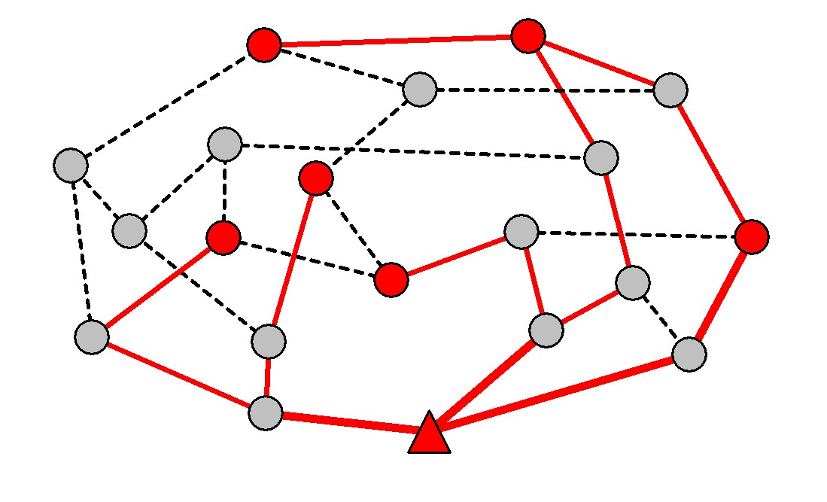
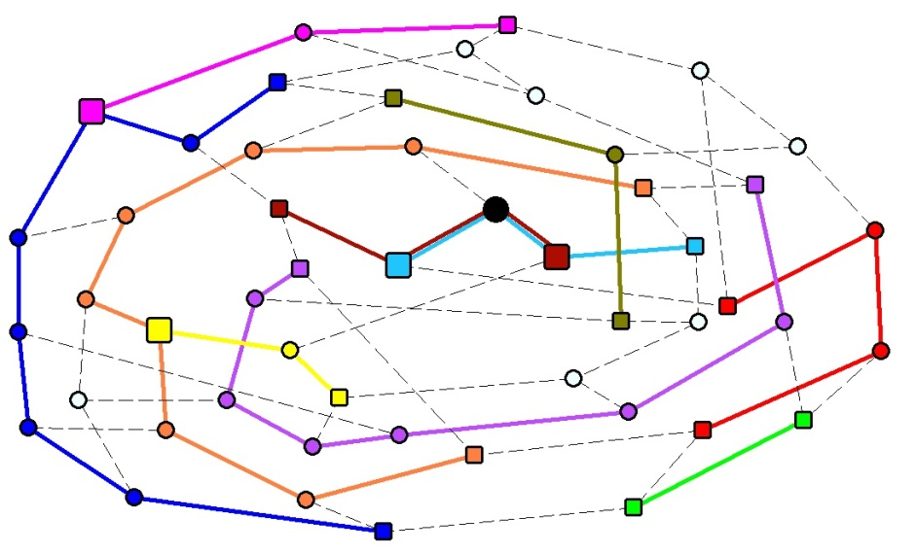
Presentation outline
Motivation – why routing?
The models – two scenarios
Results: microscopic solution, macroscopic phenomena
Applications: e.g. subway, air traffic networks
Conclusions
① One universal source
② Ordinary routing

Slide 3
Motivation

Slide 4
Why routing?
Are existing algorithms any good?
Routing tables computed by shortest-path, or minimal weight on path (e.g. Internet)
Geographic routing (e.g. wireless networks)
Insensitive to other path choices → congestion, or low occupancy routers/stations for sparse traffic
Heuristics- monitoring queue length → sub-optimal
D
Des 1: k
Des 2: j
…
i
j
Des 1
source
destination
k

Slide 5
Choices-sensitive optimization, difficult?
A sparse network with non-local variables
Non-local interaction among communications: avoid congestion → repulsion
consolidate traffic → attraction
communications interact with each other
Unlike most combinatorial problems such as Graph coloring, Vertex cover, K-sat, etc.
source
destination
Interaction is absent in similar problems: spanning trees and Stenier trees
[3] M.Bayati et al , PRL 101, 037208 (2008)

Slide 6
Models

Slide 7
The model
N nodes (i, j, k…)
M communications (ν,..)
each with a fixed source and destination
Denote, σ_{j}^{ν} = 1 (communication ν passes through node j)
σ_{j}^{ν} = 0 (otherwise)
Traffic on j → I_{j} = Σ_{ν} σ_{j}^{ν}
Find path configuration which globally minimizes
H=Σ_{j} (I_{j})^{γ} or H=Σ_{(ij)} (I_{ij})^{γ}
γ >1 repulsion (between com.) → avoid congestion
γ <1 attraction → aggregate traffic (to ↑ idle nodes)
γ =1 no interaction, H=Σ_{ν j} σ_{j}^{ν} → shortest path routing
cost
γ >1
γ =1
γ <1
I_{j}

Slide 8
Realistic?
Optimal path configuration is static → fine when the source and destination have steady traffic: p2p file sharing, traffic between subway stations….
Routing problems generally involve dynamics, current model is only a simplified representation
To include temporal traffic in the same framework use space-time network
destination
k
i
. . .
i
source
destination
source
j
k
j
t=0
t=1
t=2
t=3

Slide 9
Two scenarios studied
① One universal source
② Ordinary routing
e.g. broadcast or multicast, sensor networks, network with outlet/central router, etc.
e.g. internet, p2p networks, transportation (e.g. subway, air traffic), etc.
[1] C. H. Yeung, D. Saad, PRL 108, 208701 (2012)
[2] C. H. Yeung, D. Saad, K.Y.M Wong, PNAS
110, 13717 (2013)
Phenomena/quantities observed: path length, fraction of idle nodes, data collapse (scaling), phase transition, RS/RSB, ….

Slide 10
Scenario ① Routing to Base Station/Central Router

Slide 11
Analytical approach ①
Map the routing problem onto a
model of resource allocation:
Each node i has initial resource Ʌ_{i}
Receiver (base station, router) Ʌ_{i} = +∞
Senders (e.g. com. nodes) Ʌ_{i} = -1
others Ʌ_{i} = 0
Minimize H=Σ_{(ij)} (I_{ij})^{γ}
Constraints: (i) final resource R_{i} = Ʌ_{i} + Σ_{j∈L} I_{ji} = 0, all i
(ii) currents are integers
Central router com. nodes (integer current)
→ each sender has to establish a single path to the receiver
A example of ground state with γ =2 → avoid congestion, unlike spanning/Stenier trees
resource

Slide 12
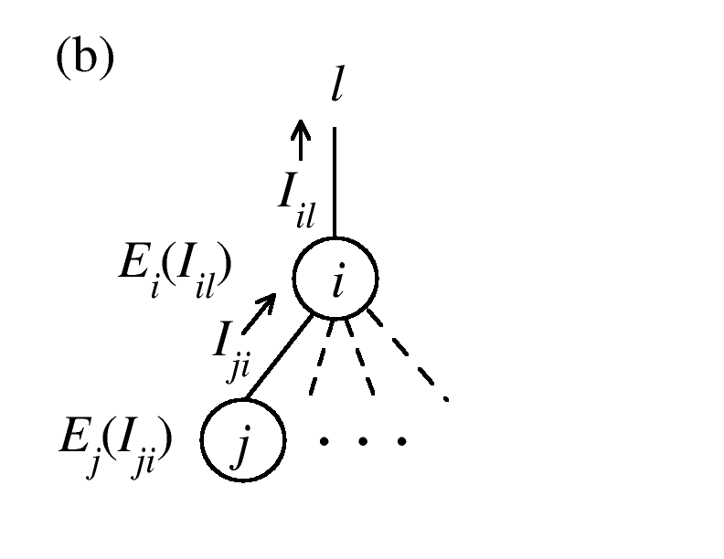
The cavity method
E_{i}(I_{il}) = optimized energy of the tree
terminated at node i without l
At zero-temperature, we use the following recursion to obtain a stable P[E_{i}(I_{il})]
However, constrained minimization
over integer domain → difficult
γ>1, we can show that E_{i}(I_{il}) is convex
→ computation greatly simplified
Algorithm:
[1] Yeung and Saad, PRL 108, 208701 (2012)

Slide 13
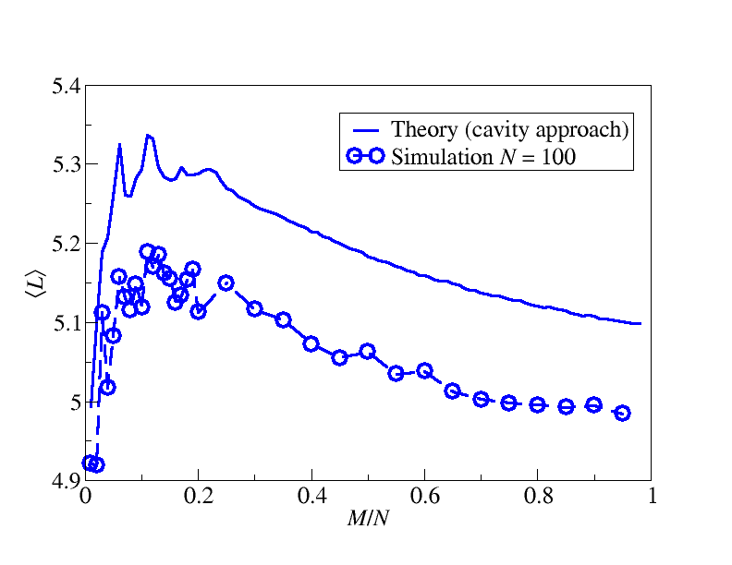
Results - Non-monotonic ⟨L⟩
①
H=Σ_{(ij)} (I_{ij})² i.e. γ =2 →avoid congestion
M – number of senders
???
Small deviations between simulation - finite size effect, N ↑, deviation ↓
Average path length
per communication
Random regular graph k=3
Initial ↑ in ⟨L⟩ - as short routes are being occupied longer routes are chosen
Final ↓ in ⟨L⟩ - when traffic is dense, everywhere is congested

Slide 14
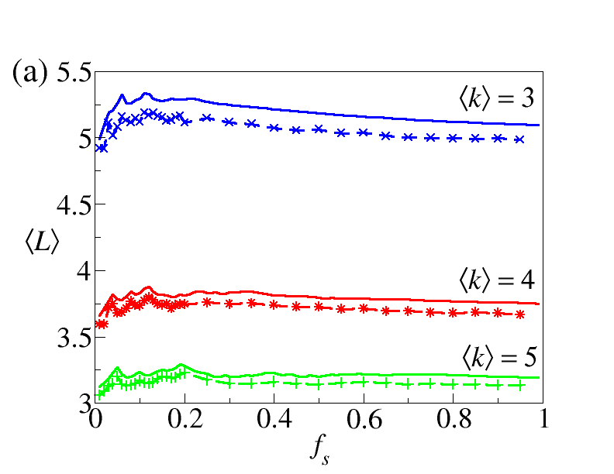
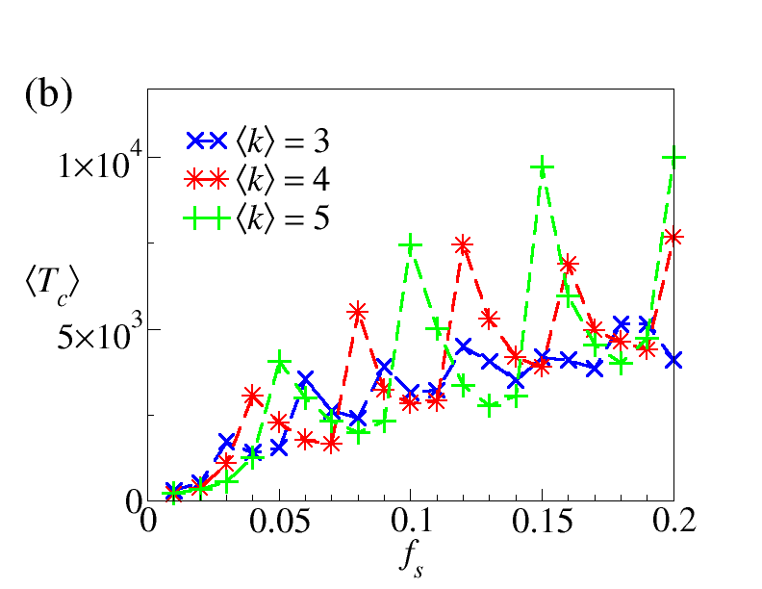
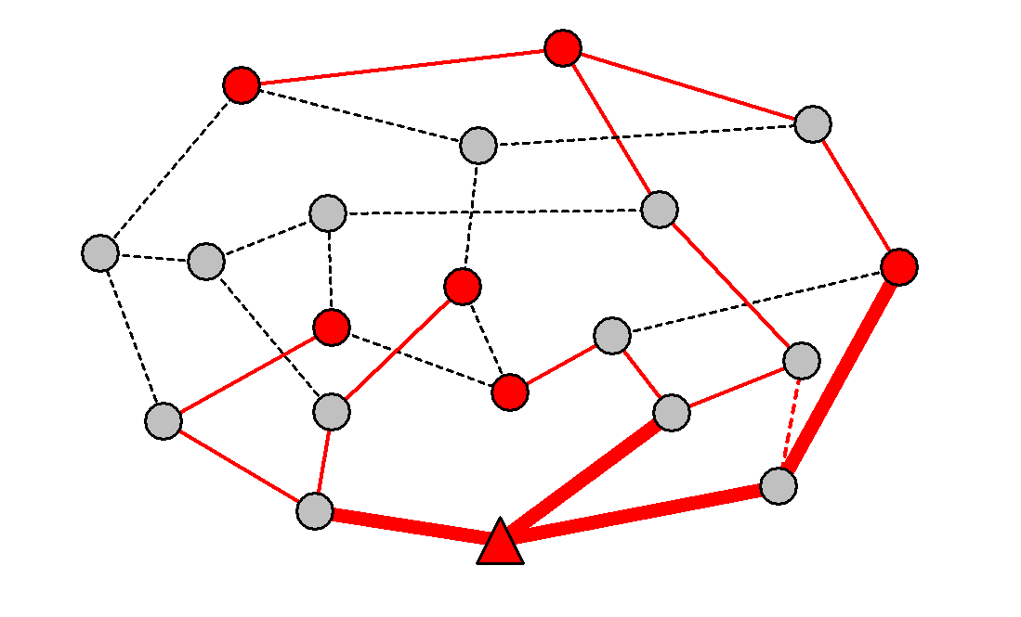
Results - balanced receiver
???
Algorithmic convergence time
Random regular graphs
Example:
M=6, ⟨k⟩=3
H=Σ_{(ij)} (I_{ij})²
Small peaks in ⟨L⟩ are multiples of ⟨k⟩, balance traffic around receiver
Consequence →peaks occur in convergence time ⟨T_{c}⟩
1
1
1
1
1
1
1
1
1
1
2
1
2
2
2

Slide 15
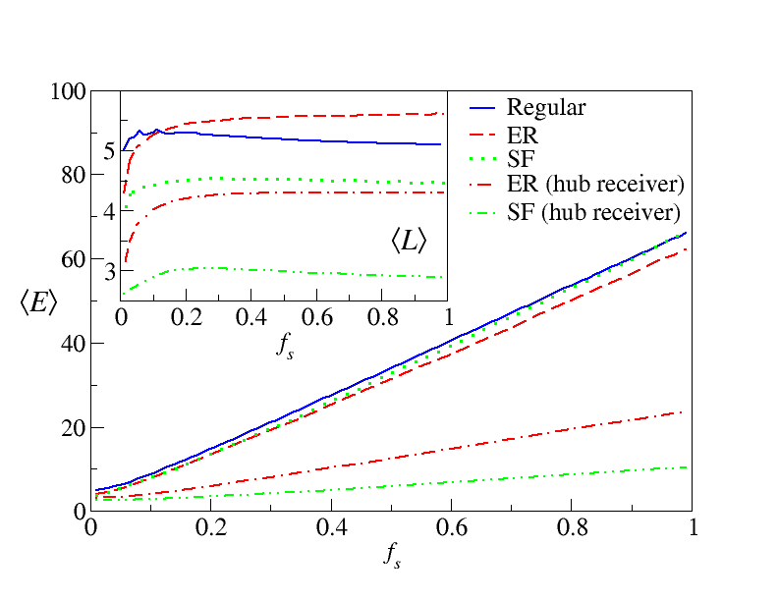
Results - Behaviors vs topology
①
H=Σ_{(ij)} (I_{ij})²
⟨E⟩ – average energy per communication
ER - random network, SF - scale-free network
Hub receiver – base station on largest degree
Similar trend in ⟨L⟩ for all networks
⟨E⟩ ∝ M, compared to worst case ⟨E⟩ ∝M² (all share the same path)
Hub receiver (SF, ER) greatly ↓ ⟨L⟩ & ⟨E⟩
SF with hub receiver → lowest ⟨E⟩ per com. →possible reason for routing systems to be SF
all with ⟨k⟩ =3
(hub receiver)
(hub receiver)

Slide 16
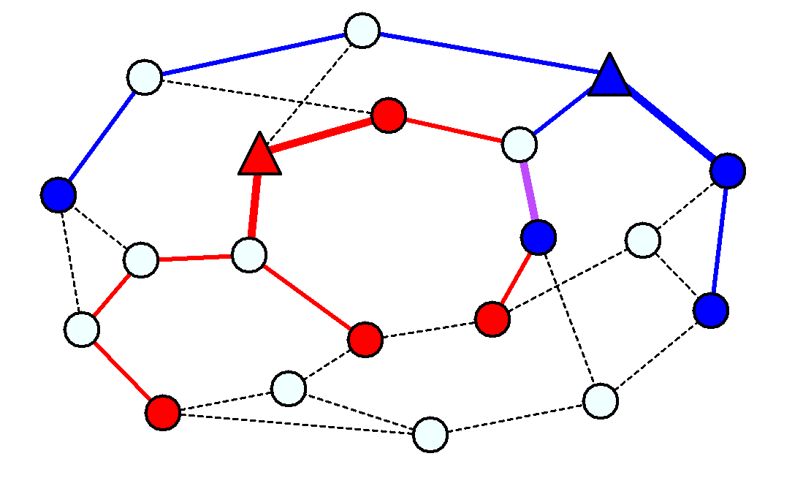
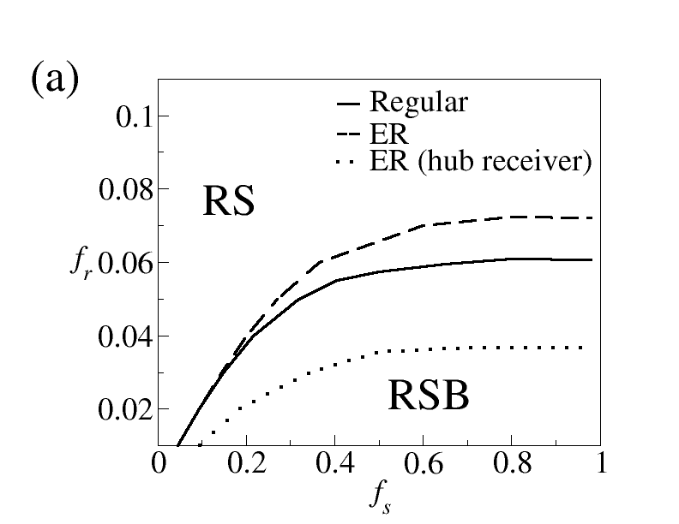
Results – RS/RSB multiple router types
Cost
One receiver “type”
H=Σ_{(ij)} (I_{ij})^{γ} ,γ>1
E_{j}(I_{ji}) is convex
RS for any M/N
RS
Solution space
Cost
RSB
Solution space
Two receiver “types”: A & B
Senders with Ʌ^{A} = -1 or Ʌ^{B} = -1
H=Σ_{(ij)} (|I_{ij}^{A}|+|I_{ij}^{B}|)^{γ} ,γ>1
E_{j}(I_{ij}^{A}, I_{ij}^{B}) not always convex
Experiments where f_{r} (=1/N_{finite}) are receivers, f_{s} (=M/N_{finite}) are senders exhibit RSB-like behavior
Hub receiver → ↓ ⟨L⟩ & ⟨E⟩ , ↓RSB phase

Slide 17
Scenario ② Ordinary Routing

Slide 18
Analytical approach
②
More complicated, cannot map
to resource allocation
Use model of interacting polymers
communication → polymer with fixed ends
σ_{j}^{ν} = 1 (if polymer ν passes through j), σ_{j}^{ν} = 0 (otherwise)
I_{j} = Σ_{ν} σ_{j}^{ν} (no. of polymers passing through j)
minimize H=Σ_{j} (I_{j})^{γ}, of any γ
We use polymer method+ replica approach
polymers

Slide 19
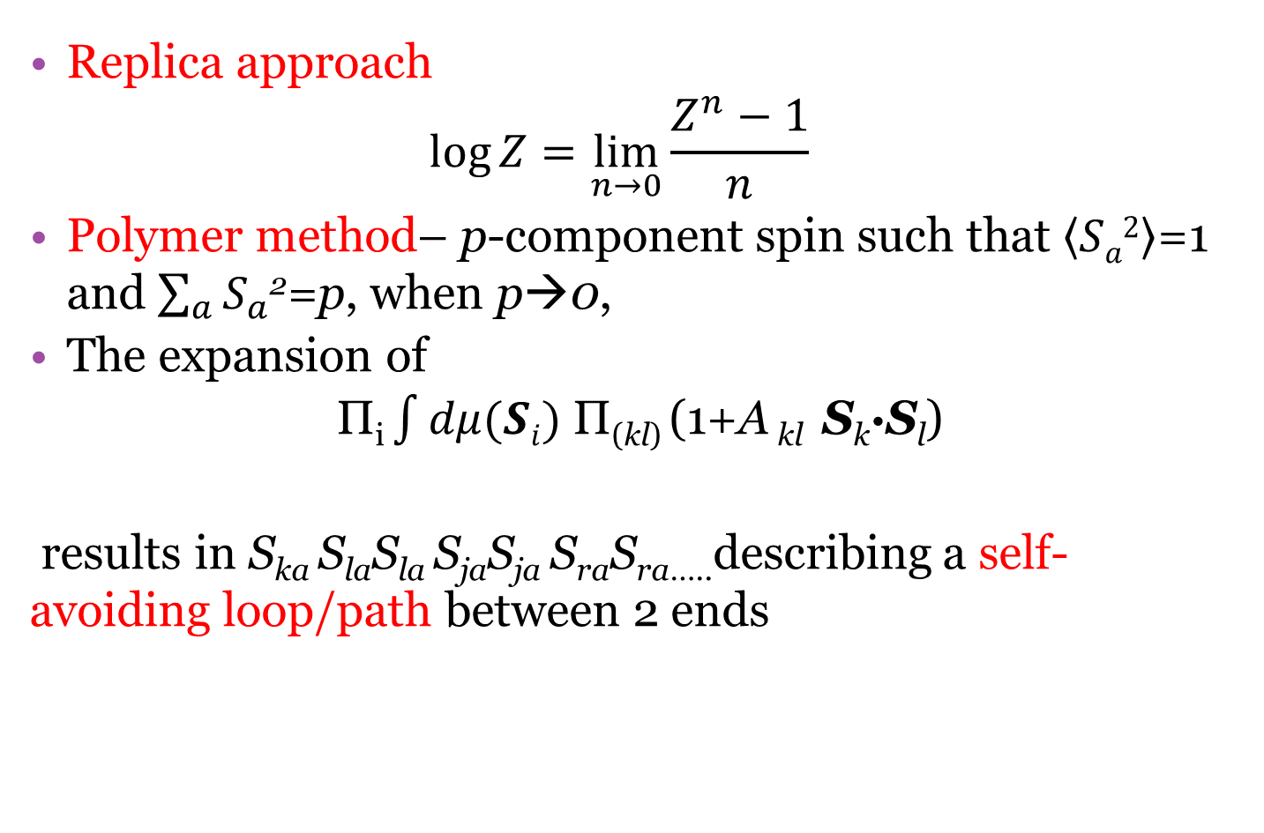
Analytical approach
Replica approach
$$\log{Z}=\lim_{n→0}{{\frac{Z^{n}−1}{n}}^{ }}$$
Polymer method– p-component spin such that $\left\langle Sa2\right\rangle$=1 and $\sum_{a}{S_{a}^{}}$²=p, when p→0,
The expansion of
Π_{i} $\int{dμ(Si)}$ Π_{(kl)} (1+A _{kl} S_{k}∙S_{l})
results in S_{ka} S_{la}S_{la} S_{ja}S_{ja} S_{ra}S_{ra…..}describing a self-avoiding loop/path between 2 ends
[4] M. Daoud et al (and P. G. de Gennes) Macromolecules 8, 804 (1976)

Slide 20
Related works
②
Polymer method+ replica approach
was used to study travelling salesman
problem (Difference: one path, no polymer interaction)
Cavity approach was used to study interacting polymers (Diff: only neighboring interactions considered, here we consider overlapping interaction)
Here: polymer + replica/cavity approach to solve a system of polymers with overlapping interaction
→recursion + message passing algorithms (for any γ)
[5] M. Mezard, G. Parisi, J. Physique 47, 1284 (1986)
[6] A. Montanari, M. Muller, M. Mezard, PRL 92, 185509 (2004)

Slide 21
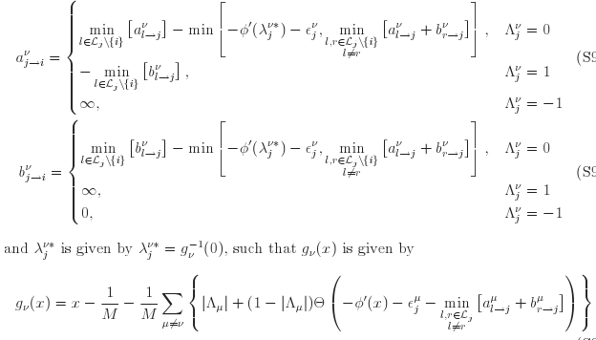
The algorithm

Slide 22
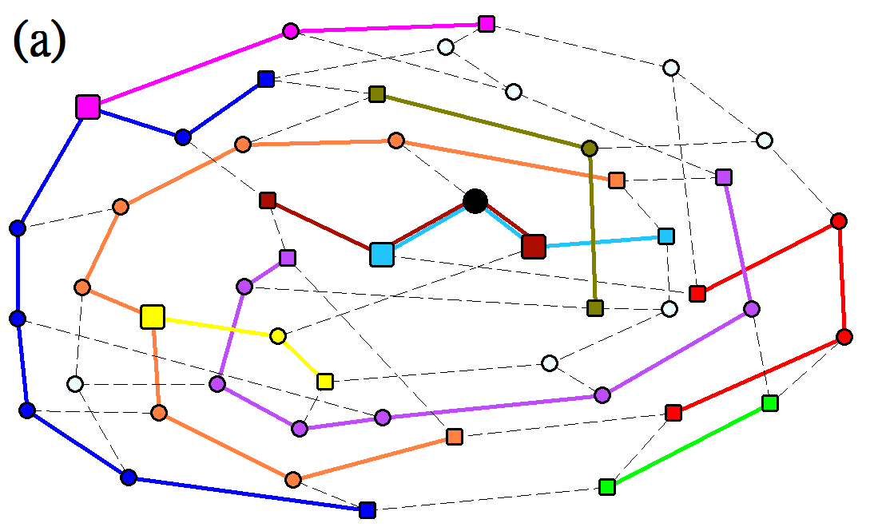
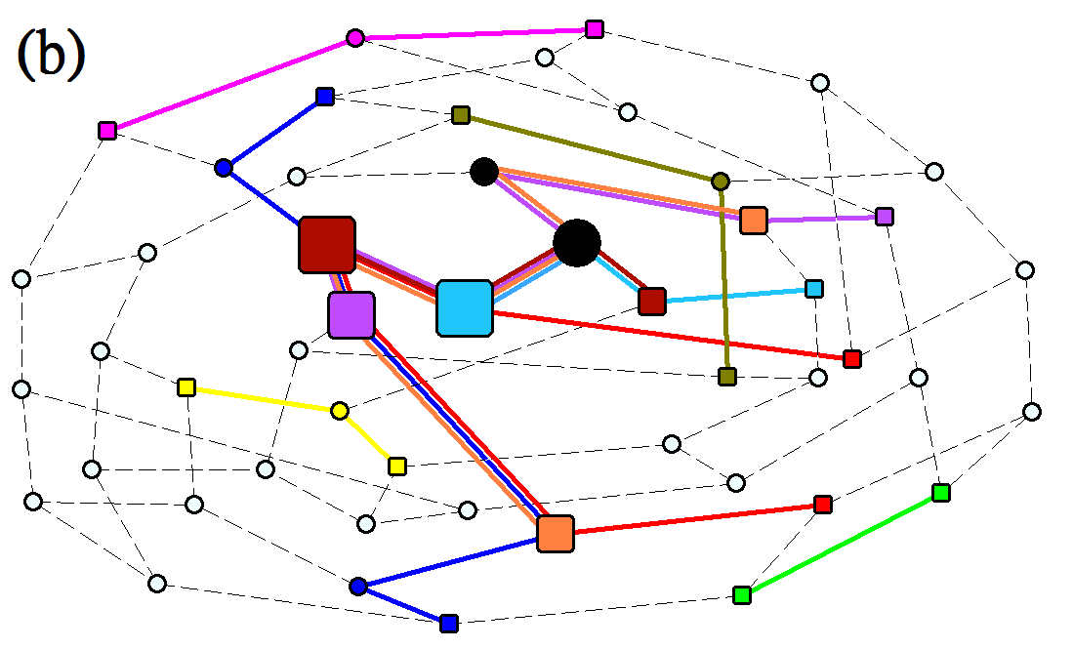
Results – Microscopic solution convex vs. concave cost
cost
γ >1
γ =1
γ <1
I_{j}
- source/destination of a communication - shared by more than 1 com.
Size of node ∝ traffic N=50, M=10
γ=2
γ=0.5
γ >1 repulsion (between com.) → avoid congestion
γ <1 attraction → aggregate traffic (to ↑ idle nodes) → to save energy

Slide 23
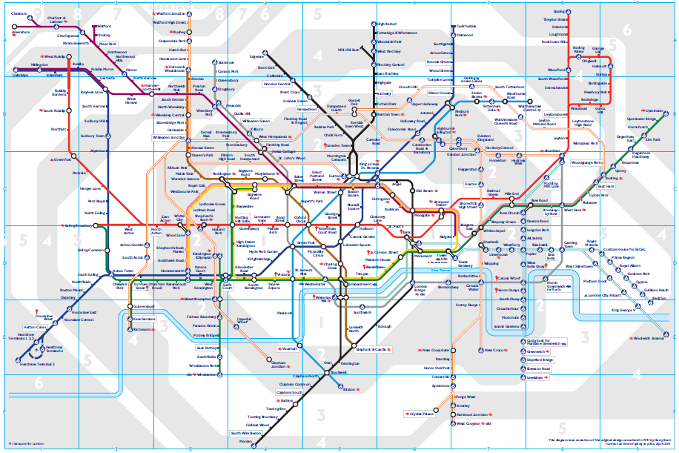

London subway network
275 stations
Each polymer/communication – Oyster card recorded real passengers source/destination pair
Oyster card
London tube map

Slide 24
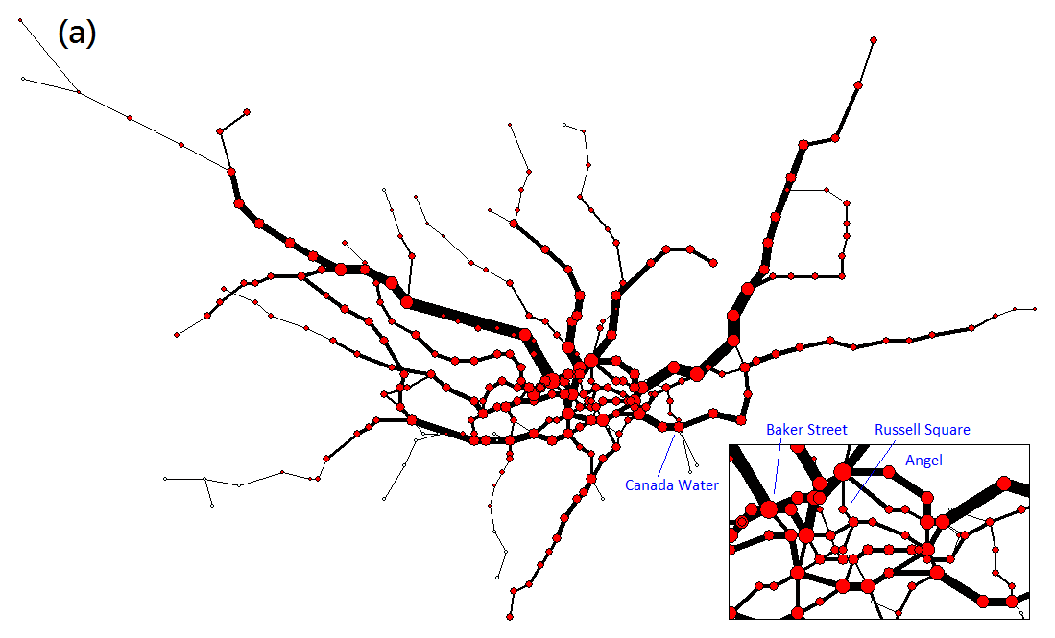
Results – London subway with real source destination pairs recorded by Oyster card
cost
γ >1
γ=2
M=220
γ =1
γ <1
I_{j}

Slide 25
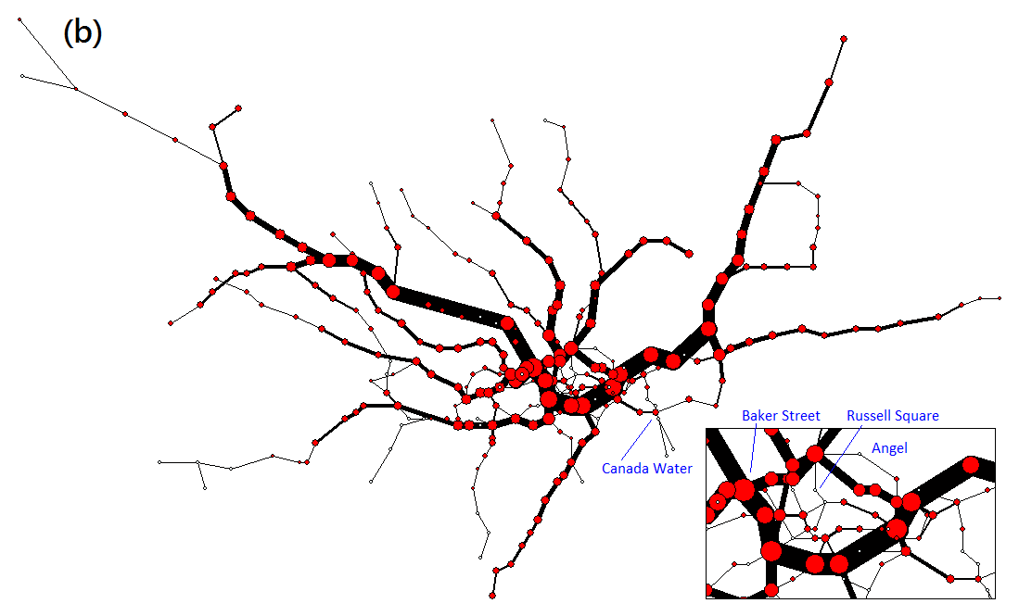
Results – London subway with real source destination pairs recorded by Oyster card
cost
γ >1
γ=0.5
M=220
γ =1
γ <1
I_{j}

Slide 26
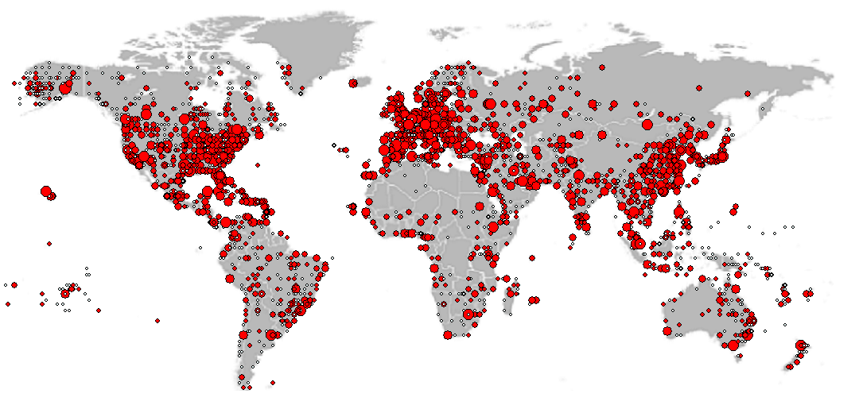
Results – Airport network
γ=2, M=300

Slide 27
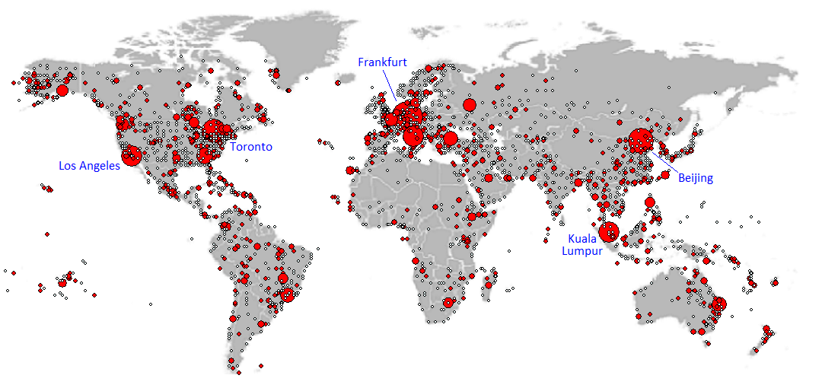
Results – Airport network
γ=0.5, M=300

Slide 28
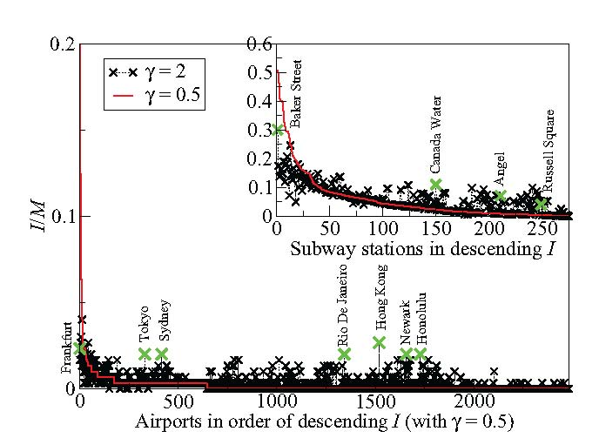
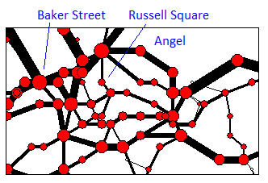
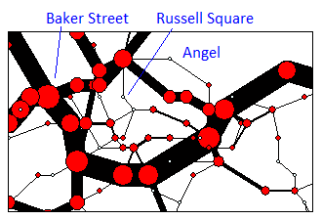
Results – comparison of traffic
cost
γ >1
γ =1
γ <1
I_{j}
γ=2
Denver
γ=0.5
γ=2 vs γ=0.5
Overloaded station/airport has lower traffic
Underloaded station /airport has higher traffic

Slide 29
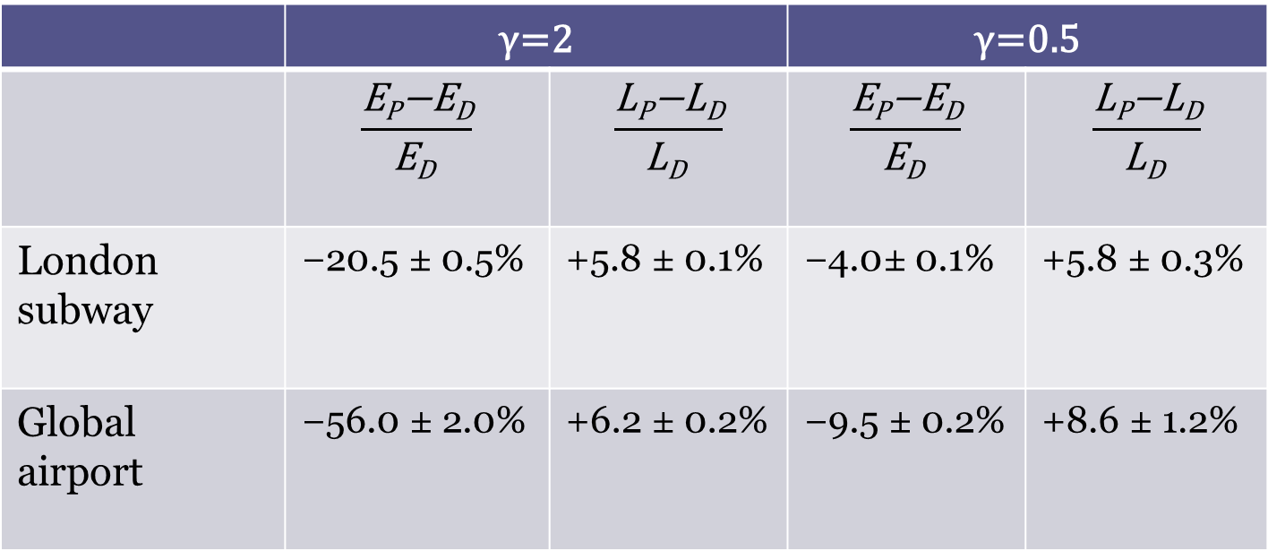
Comparison with Dijkstra algorithm
Comparison of energy E and path length L obtained by polymers-inspired (P) and Dijkstra (D) algorithms
 | γ=2 |  | γ=0.5
 | $$\frac{\text{E}\text{P}\text{−}\text{ED}}{\text{E}\text{D} }$$ | $$\frac{\text{L}\text{P}\text{−}\text{L}\text{D}}{\text{L}\text{D} }$$ | $$\frac{\text{E}\text{P}\text{−}\text{ED}}{\text{E}\text{D} }$$ | $$\frac{\text{L}\text{P}\text{−}\text{L}\text{D}}{\text{L}\text{D} }$$
London subway | −20.5 ± 0.5% | +5.8 ± 0.1% | −4.0± 0.1% | +5.8 ± 0.3%
Global airport | −56.0 ± 2.0% | +6.2 ± 0.2% | −9.5 ± 0.2% | +8.6 ± 1.2%

Slide 30
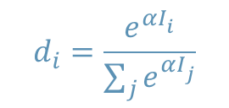
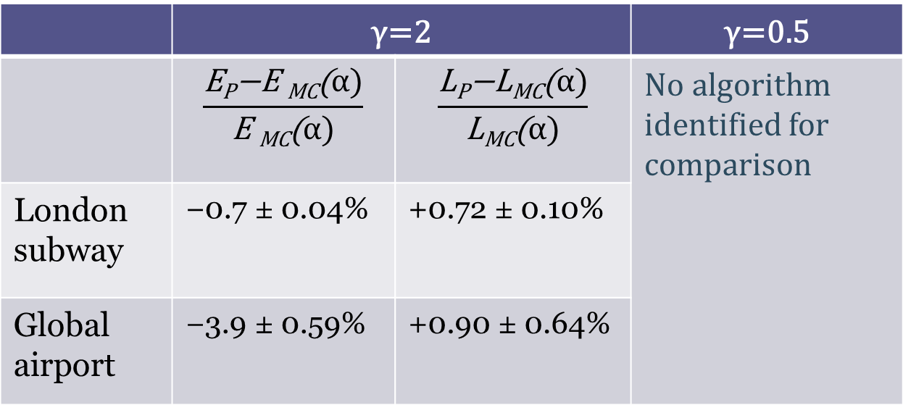
and with a Multi-Commodity flow algorithm
Comparison of energy E and path length L obtained by polymers-inspired (P) and Multi-Commodity flow (MC) algorithms (optimal α)
Based on node-weighted shortest paths d_{i} using total current I_{i}; rerouting longest paths below edge capacity
$$d_{i}=\frac{e^{αI_{i}^{}}}{\sum_{j}{e^{αI_{j}^{}}}}$$
 | γ=2 |  | γ=0.5
 | $$\frac{\text{E}\text{P}\text{−}\text{E} \text{MC}\text{(}α)}{\text{E} \text{MC}\text{(}α)}$$ | $$\frac{\text{L}\text{P}\text{−}\text{L}\text{MC}\text{(}α)}{\text{L}\text{MC}\text{(}α)}$$ | No algorithm identified for comparison
London subway | −0.7 ± 0.04% | +0.72 ± 0.10%
Global airport | −3.9 ± 0.59% | +0.90 ± 0.64%

Slide 31
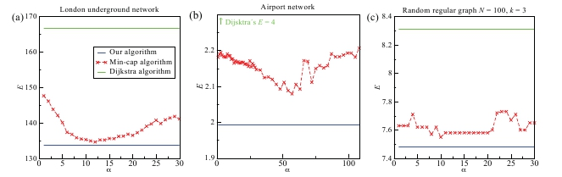

Multi-Commodity flow algorithm
Results show a comparison for the optimal α value
$$d_{i}=\frac{e^{αI_{i}^{}}}{\sum_{j}{e^{αI_{j}^{}}}}$$

Slide 32
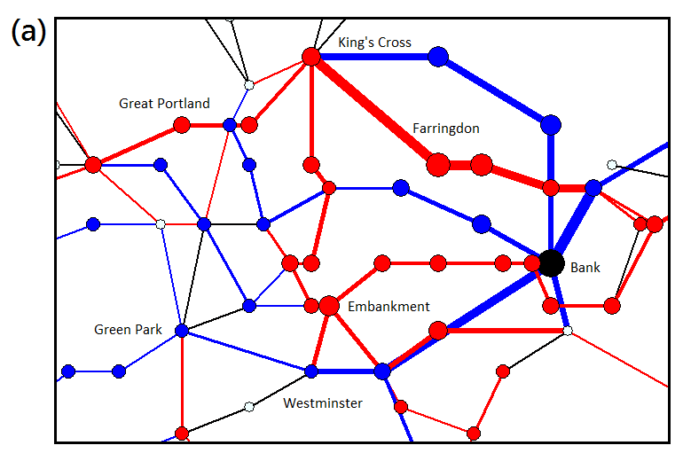
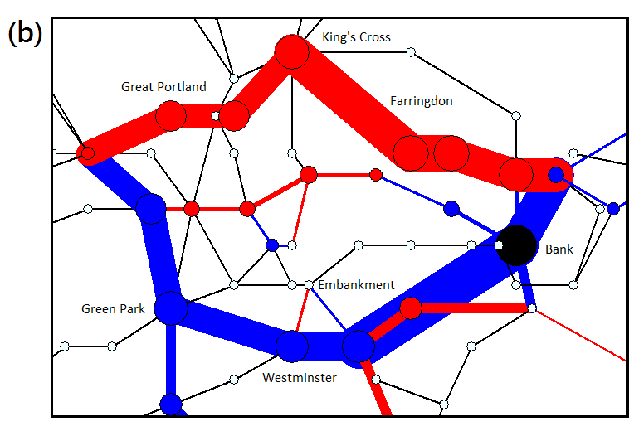
Results - Change of Optimal Traffic & Adaptation to Topology Change
γ=2
γ=0.5
After the removal of station “Bank” ( ) …
Size of node, thickness of edges ∝ traffic
, - traffic ↑ , - traffic ↓ - no change
γ=2 has smaller, yet more extensive, changes on
individual nodes and edges

Slide 33
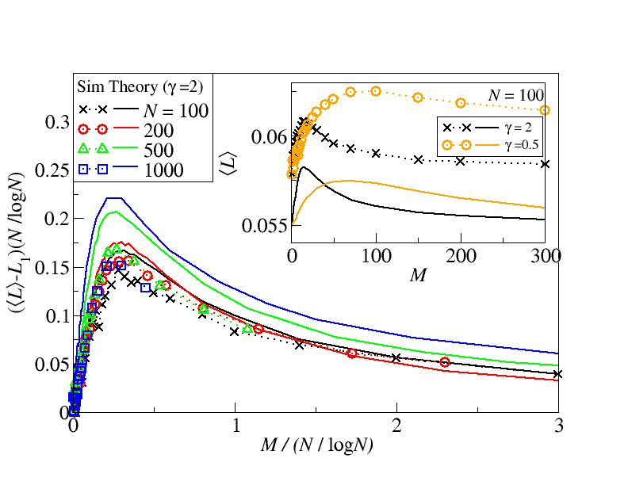
Macroscopic behavior – Non-monotonic ⟨L⟩ and data collapse
②
①
No balanced receiver
Data collapse of ⟨L⟩ vs M for different N
log N ∝ typical distance
M logN/N ∝ average traffic per node
∝ average traffic per node

Slide 34
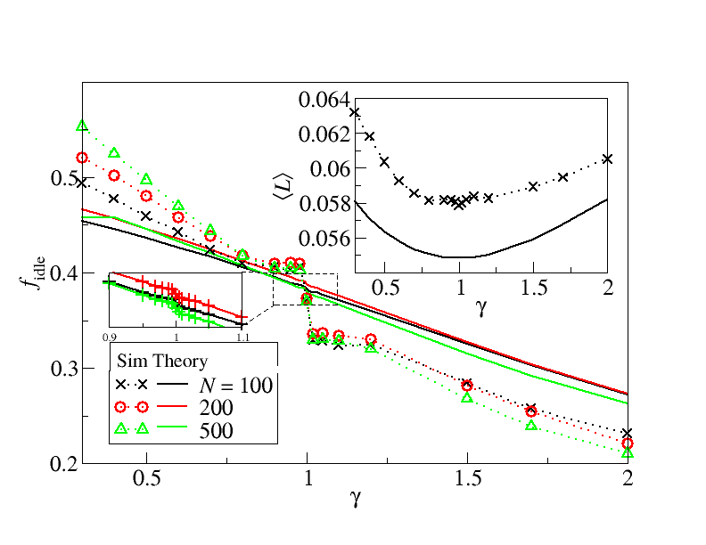
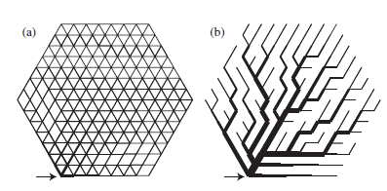
Phase transition at γ=1
γ=2
γ=0.5
⟨L⟩ attains minimum at γ=1, → shortest path routing
Discrete jumps of f_{idle} at γ=1 →slight decrease of γ from γ=1 can ↑ f_{idle}
A very similar phase transition is observed in resistor networks:
[7] S. Bohn, M. O. Magnasco, PRL 98, 088702 (2007)
Difference: No separate communication (the same current satisfy anyone), continuous variables, …
γ=2
γ=0.5

Slide 35
Conclusion
①
②
We employed statistical physics of disordered system to study two routing problems
Microscopically, we derive a traffic-sensitive optimization algorithm
Macroscopically, we observe interesting phenomena: non-monotonic path length, balanced receiver, different routing patterns, phase transitions in the optimal routing state
Extensions: Edge cost, weighted and directed edges
Applications: routing in random networks (Internet), transportation networks (subway, air traffic)
[1] C. H. Yeung and D. Saad, PRL 108, 208701 (2012)
[2] C. H. Yeung, D. Saad, K.Y.M. Wong, submitted (2012)

