Slide 1
Epidemic spreading in complex networks: from populations to the Internet
Maziar Nekovee, BT Research
Y. Moreno, A. Paceco (U. Zaragoza)
A. Vespignani (LPT- Paris)

Slide 2
Outline of the talk
Complex networks
Epidemic protocols for information dissemination on the internet and parallels with disease spreading.
Monte Carlo simulations of epidemic protocols.
Analytical model and calculations.
Work in progress (epidemic spreading in mobile ad hoc networks) & conclusions

Slide 3
Complex networks:
large scale networks with
internal structure
between random graphs (mathematicians) and
regular lattices (physicist).
The Internet, WWW, peer-to-peer networks (napster), email networks.
Food webs (who eats who), sexual contacts, protein networks.
Friendship networks, citation networks.

Slide 4
Current research on complex networks
Characterisation: average connectivity, degree distribution, clustering, diameter, network motifs, degree correlations
Network models: random graphs, small world networks, scale-free networks ….
Dynamic processes on complex networks:
spreading phenomena: epidemics, rumours, computer viruses, information dissemination.

Slide 5
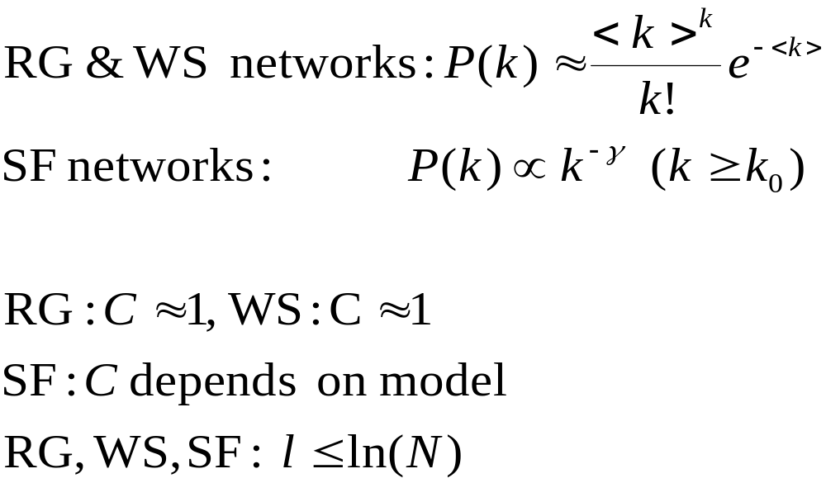
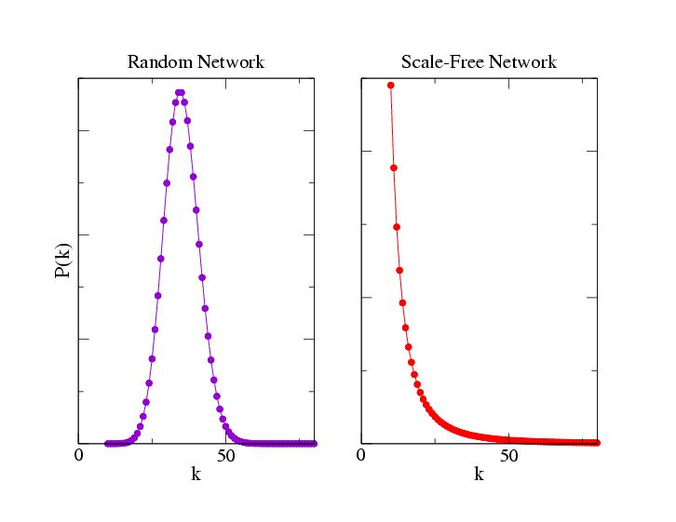
Network models
Random graphs (Erdös&Rényi)
Small-world networks (Watts&Strogatz).
Scale-free (Barabási&Albert)

Slide 6
one-to-many information dissemination in computer networks
Server-based: updates are forwarded from the source to one or more servers which then forward them to all nodes (scalability, central point of failure)
Overlay multicast: updates are forwarded along a (minimum) spanning tree rooted at source (too complex for highly dynamic networks, robustness and reliability issues)
Epidemic information dissemination: updates spread from the source through local interactions, like a benign epidemic (or rumour) spreading in a population.

Slide 7
Epidemic information dissemination
New updates spread from the source through a probabilistic message passing process in which nodes who have received the update randomly forward it to a group of other nodes.
Highly robust against link and node failures (due to built-in redundancy), simple and decentralised and fast.
However, they require careful tuning in order to achieve high reliability, and minimize load on the network.

Slide 8
Ingredients of epidemic protocols
Logical connection topology (who knows whom) Each node maintains a list of other nodes to which it gossips messages. How should these lists be organized→
connection topology: fully connected network (central server), random graph (partial views in SCAMP), …….
Message forwarding policy: Upon receiving a message nodes make a decision whether to forward a message or not, based on some criteria: counter-based, timer, rumour model.

Slide 9



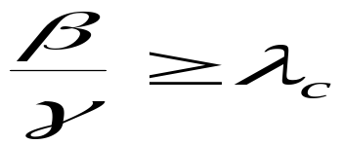
Epidemic models in a nutshell (SIR)
Individuals are either susceptible (S), Infected (I) or removed (R).
Susceptibles become infected through their contacts with infected individuals at a rate
Infected individuals are removed (die out) at a rate
There is an epidemic threshold above which the diseases spread through the population
However, this result is based on the homogeneous mixing hypothesis (complete graphs)

Slide 10
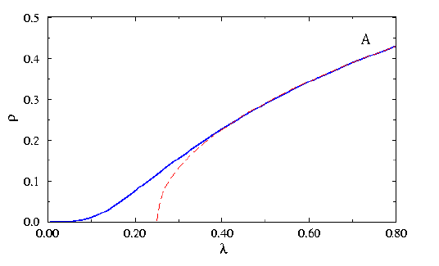
SIS(R) on networks Pastor-Satorras &Vespignani (2001), Lloyd & May (2002), Moreno and Vespignani (2002)
RG&WS networks
SF networks
ρ
disease dies
disease spreads
λ _{c}
λ
λ _{c}
<k>
=
<k²>

Slide 11

Rumour spreading model (Daley-Kendal, Demers)
timestep ti
ignorant
i
spreader
s
stifler
r

Slide 12

Simulations studies
SF and RG Networks with up to 10,000 nodes considered.
Each simulation starts with 1 randomly chosen node in the spreader state, and he rest in the ignorant state.
At every timestep, each spreader contacts all its neighbours, in a random sequence, unless it turns into a stifler at contact.
Spreaders avoid contacting the node from which they receive the update.
Results averaged over: at least 10 Monte Carlo realizations of each network, 100 MC runs per network and 10 initial infected node.

Slide 13
Performance metrics
Reliability: fraction of nodes that receive the message upon termination of the protocol, starting from 1 infected node.
Delivery latency: time it takes for a message to reach all nodes.
Load: amount of forwarding traffic that protocol generates in the network.

Slide 14
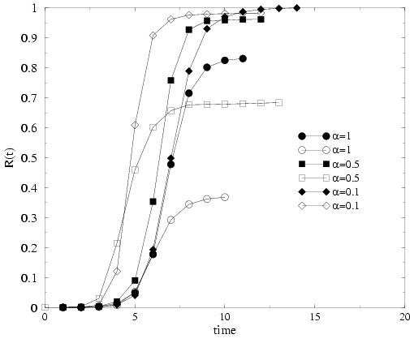
Time evolution (stifler population)

Slide 15
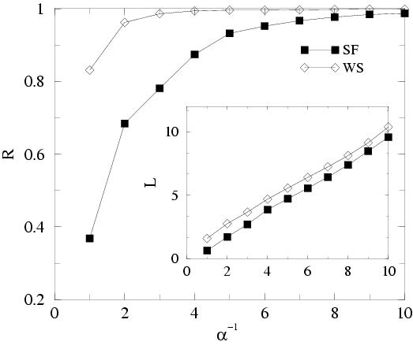
Final fraction of nodes reached, number of transmitted messages (per node)

Slide 16
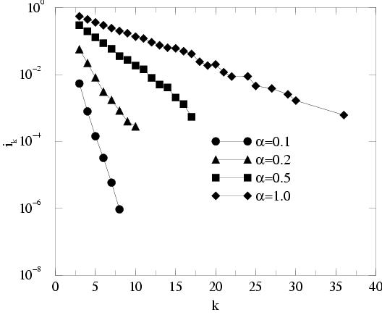
SF networks: the role of hubs

Slide 17
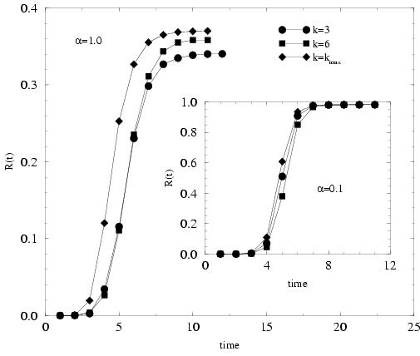
SF networks: impact of the initial spreader node

Slide 18
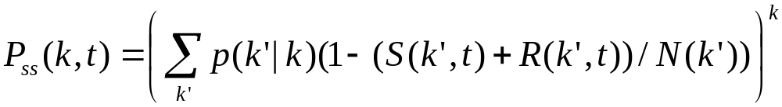
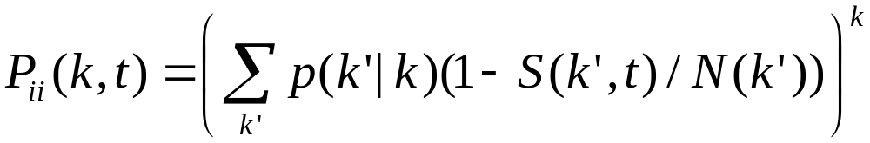
Interacting Markov chain model
i
i
s
r
k links
s
r

Slide 19
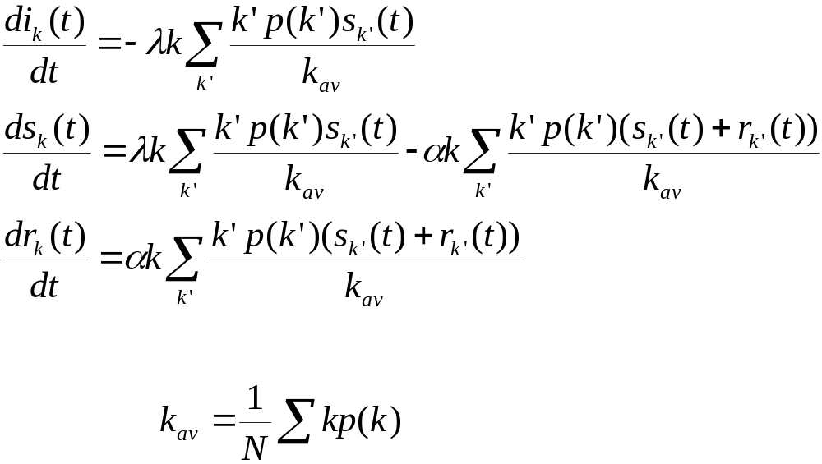
Coupled differential equations large networks, Poisson process

Slide 20
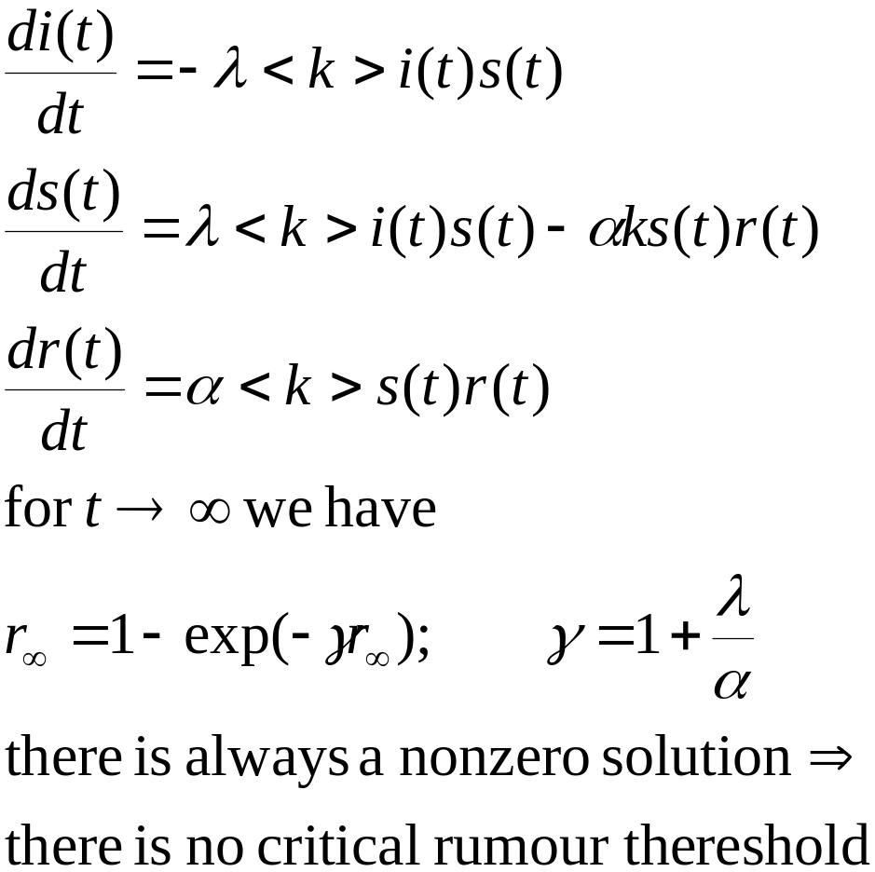
Coupled differential equations
Homogeneous case

Slide 21
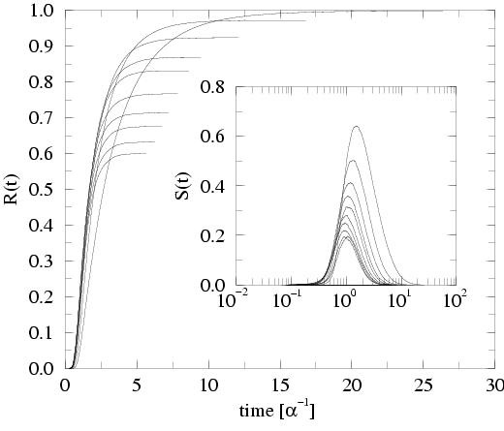
Time evolution (from coupled differential equations)

Slide 22
Role of hubs (from coupled differential equations)

Slide 23
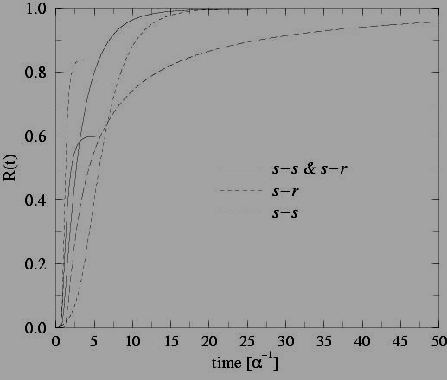
Changing interactions (from couple differential equations)

Slide 24
Epidemic in wireless ad-hoc networks
wireless device
transmission range
interference range

Slide 25
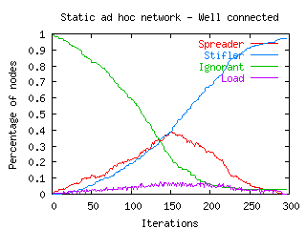
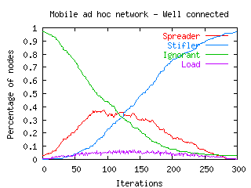
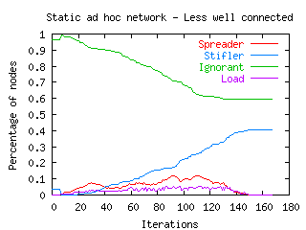
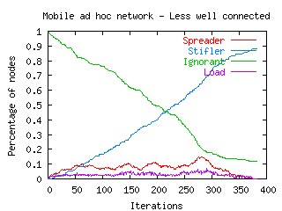
1000 nodes, random walk mobility

Slide 26
Summary and outlook
Simulation studies show that there is a complex interplay between protocol parameters (rules) and the underlying connection topology.
Epidemic protocols are more effective and reliable in random graphs than in scale-free networks (surprise!). This is due to the conflicting roles played by hubs in SF networks.
Analytical model allows further analysis of the performance in complex networks, without the need of MC simulations .
In progress: wireless ad-hoc networks, rumour spreading in social networks on the Internet (e.g. email networks)

Slide 27
References
Y. Moreno, M. Nekovee, A. Vespignani, Phys. Rev. E (R), 69, 055101 (2004).
M. Nekovee, Y. Moreno, Proceedings of ICCS2004 (in press)
Y. Moreno, M. Nekovee, A. Pacheco, Phys. Rev. E 69, 066130 (2004).

