Slide 1
The El Farol Bar Problem on Complex Networks
Maziar Nekovee
BT Research
Mathematics of Networks, Oxford, 7/4/2006

Slide 2
Content
Motivation.
The El Farol Bar problem.
Solutions extensions and critique.
El Farol on social networks.
Conclusions.

Slide 3
Motivation
Many real-life situations involve a set of independent agents/entities competing for the same resource, in an uncoordinated fashion.
drivers choosing similar travel routes.
visitors to a popular website.
…………………………..
……………………………
wireless devices (wifi, Bluetooth etc) sharing RF spectrum.

Slide 4
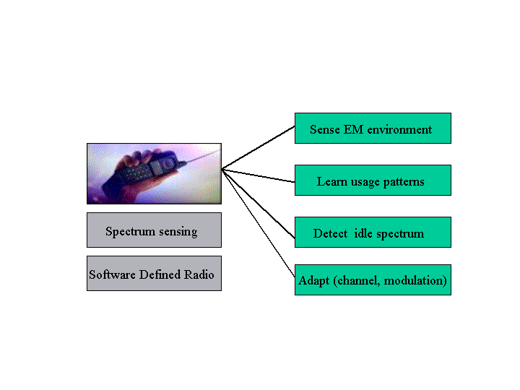
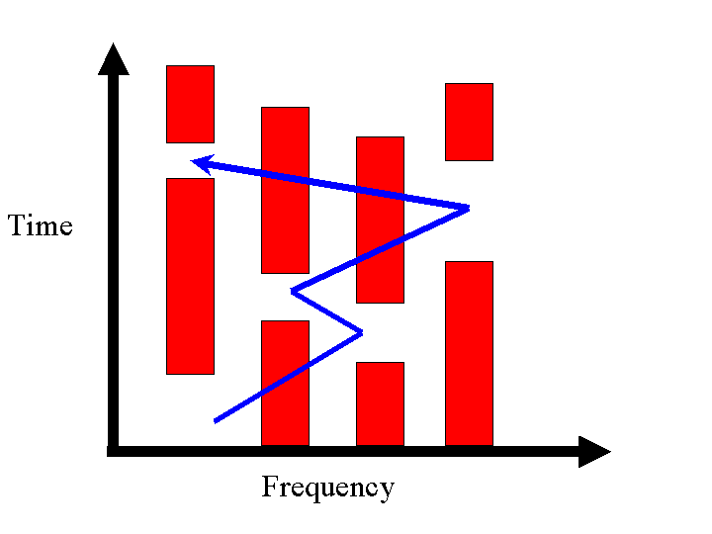
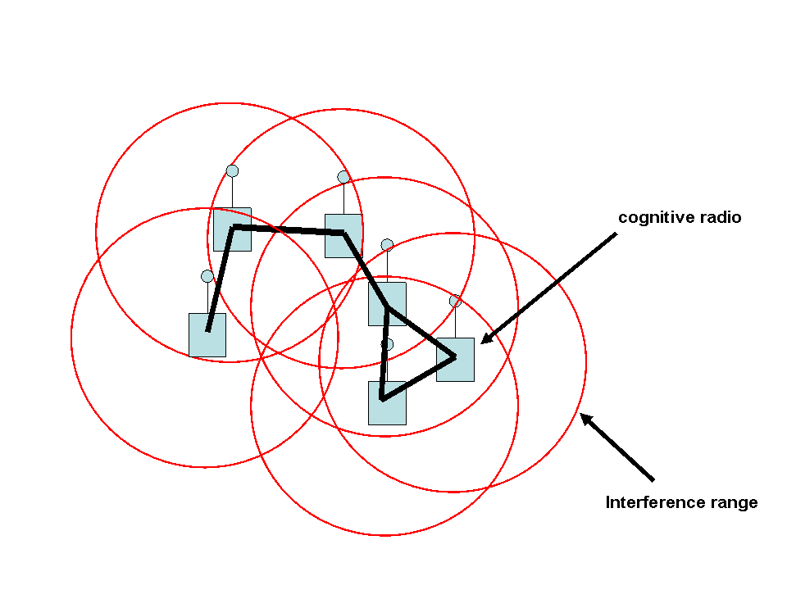
Scientific American, March 2006
a cognitive radio
a network of cognitive radios:
independent learners and
decision makers competing the same
resource (RF Spectrum)

Slide 5
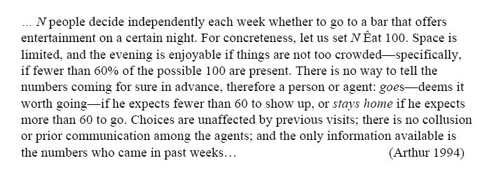

The El Farol Bar Problem

Slide 6
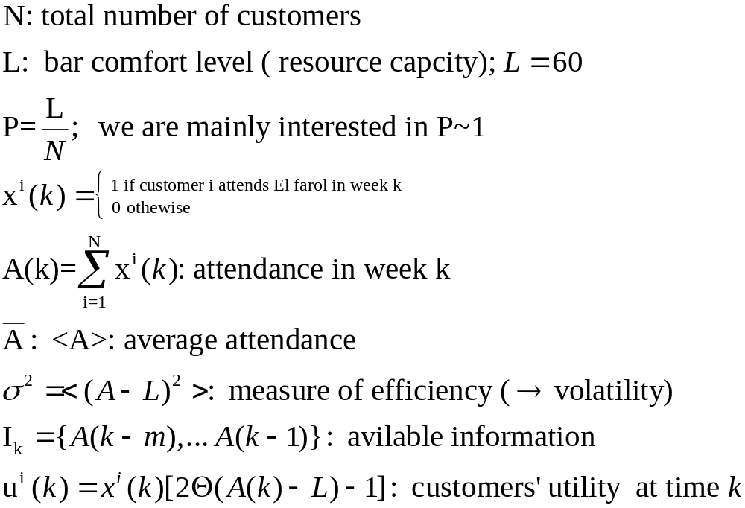
Mathematical formulation

Slide 7
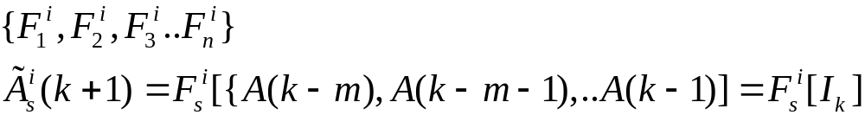
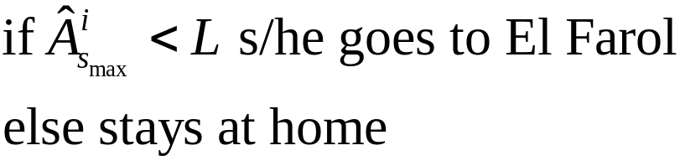
Decision making model
Each customer has a finite set of predictors which s/he uses to predictor next week’s attendance, based on past attendance history.
Each predictor has a score associated to it, which is updated according to:
Customers use the predictor with the highest score to predict next week’s attendance. Then:
reinforced learning

Slide 8






Predictors
The same as last week
A (rounded) average of the last m attendances.
The same as 3 weeks ago.
The trend in the last 8 weeks (bounded by 0 and 100)
…

Slide 9
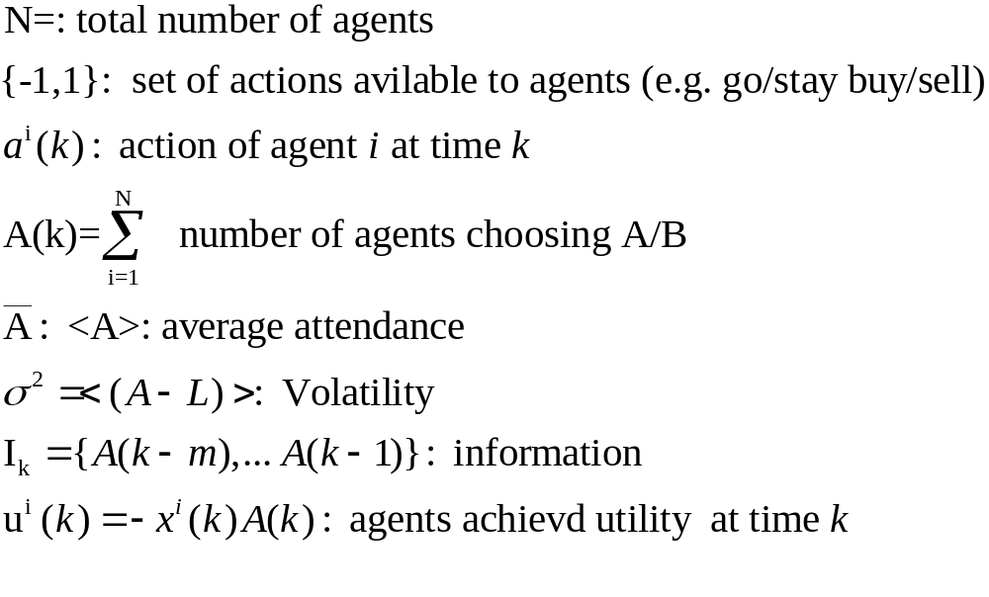
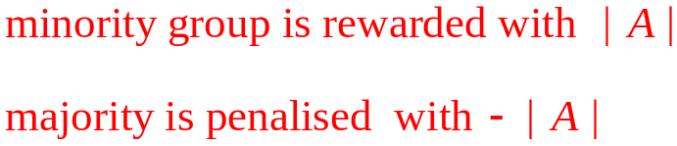
Simplified El Farol (Minority Game)
Challet and Zhang, 1997.

Slide 10
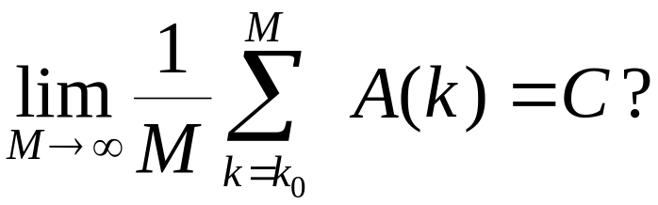
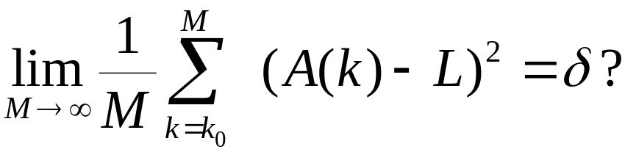
Key questions
Would bar attendance settles to some stationary state:
Can decentralised decision making result in efficient utilization of the bar:

Slide 11
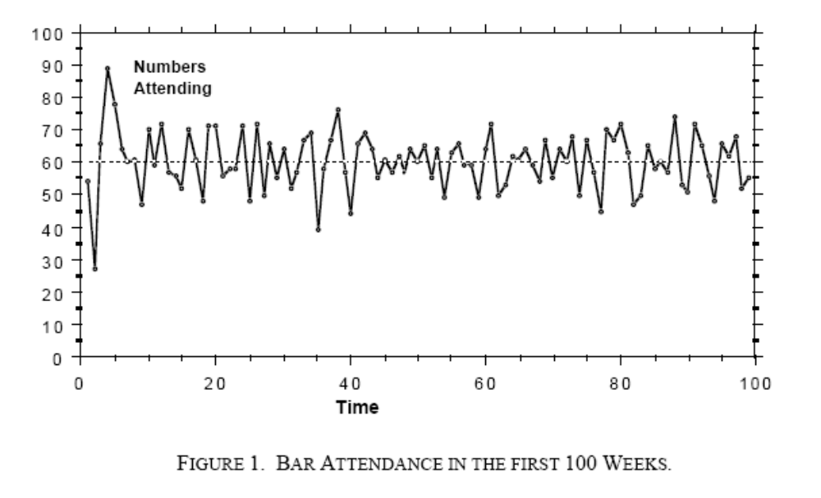
Nash Equilibrium
W. B. Arthur, 1984.

Slide 12
Critique of El Farol
Predictor’s choice.
Global information available to agents regardless attendance.
Other learning mechanisms.
The impacts of inter-agent communication (via a social network).

Slide 13
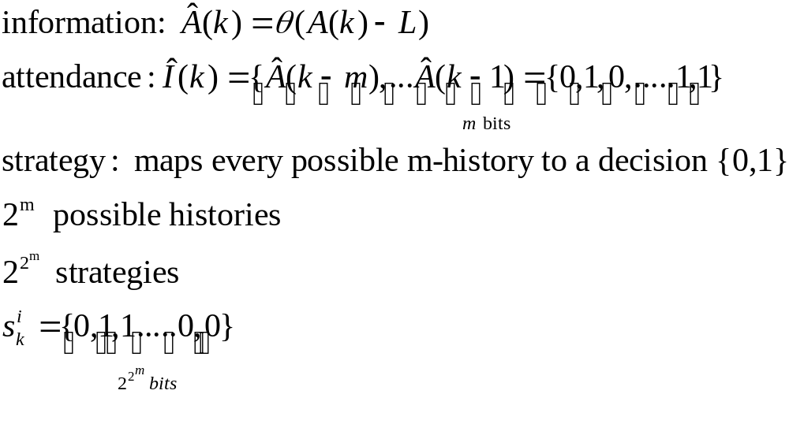
Statistical mechanic’s approach
Marsili, Challet, et al
Johnson et al

Slide 14
A strategy soup
1
0
1
0
0
0
0
1
0
1
0
0
1
0
1
0
0
1
1
1
1
1
0
1
0
0
1
0
0
1
0
1
1
1
0
0
0
0
1
0
1
1
0
0
1
0
1
0
0

Slide 15
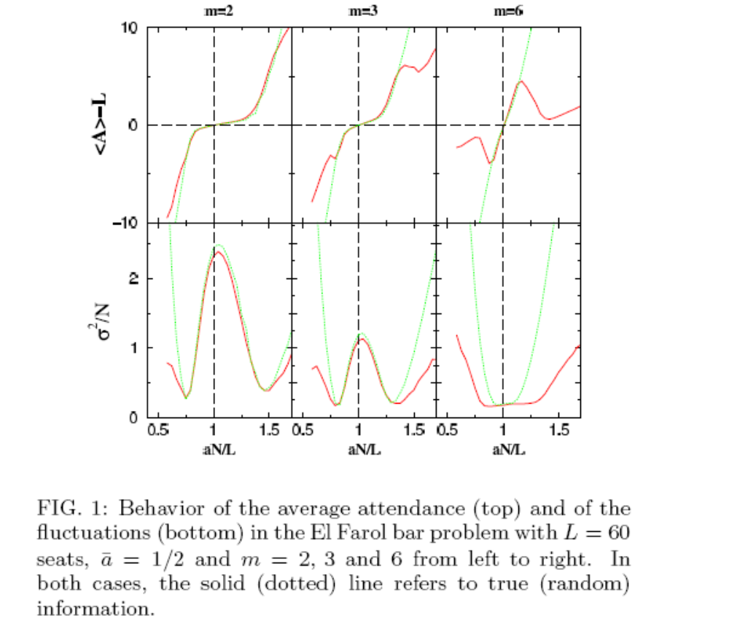
Marsili, Challet, Otino, 2003

Slide 16

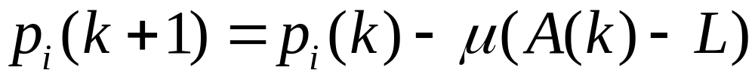
Stochastic solution with simple adaptive behaviour
Bell, Sethares, Buklew, 2003
Agents adapt their attendance probability
through a simple process of “habit forming”:
Full information on attendance:
Partial information on attendance:
(bounded by 0 and 1)

Slide 17
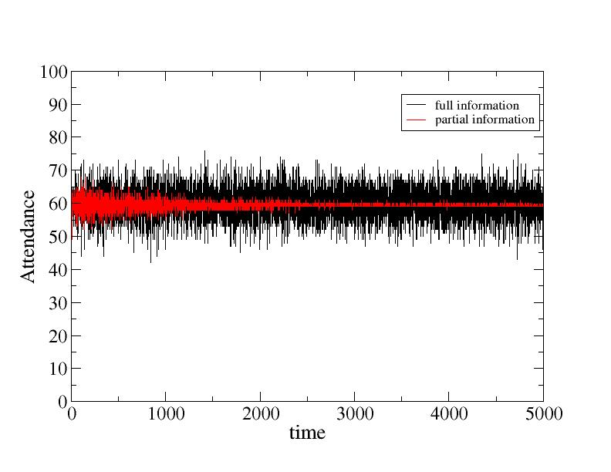

Slide 18
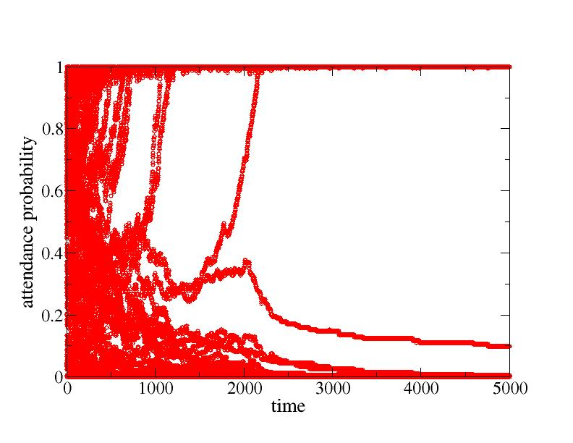

Slide 19
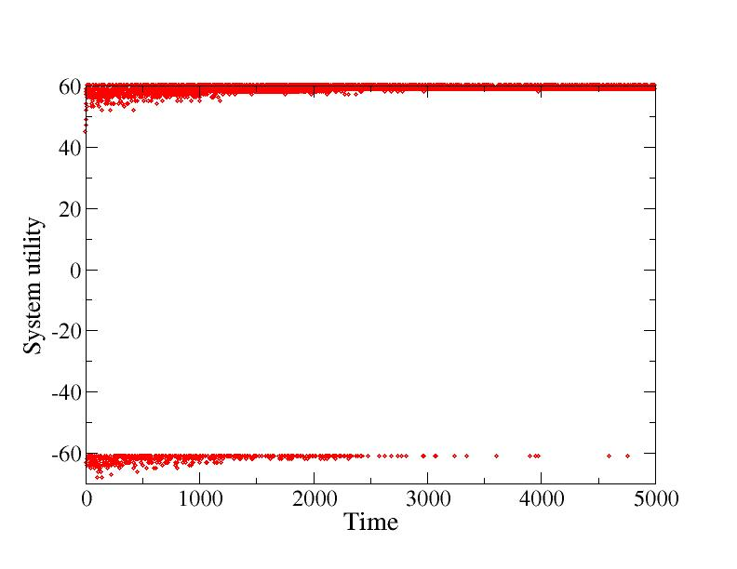

Slide 20
(simplified) El Farol on networks

Slide 21
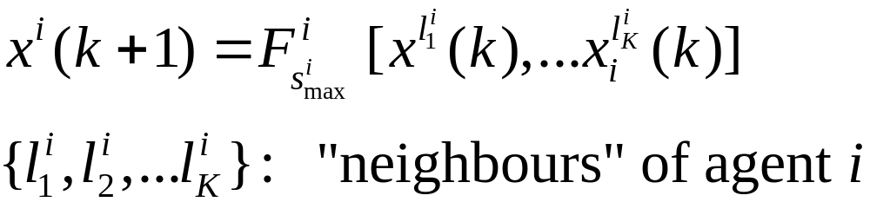
El Farol on social networks
N agents connected via a social network.
Instead of interacting via a global signal of attendance history, agents interact with K other (randomly chosen) agents.
Galstyan, Kolar, Lerman, 2003

Slide 22
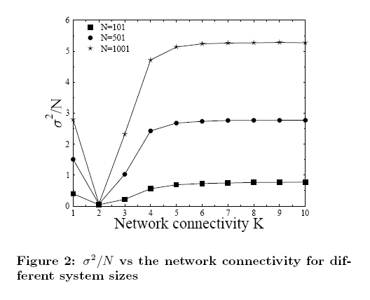

Slide 23
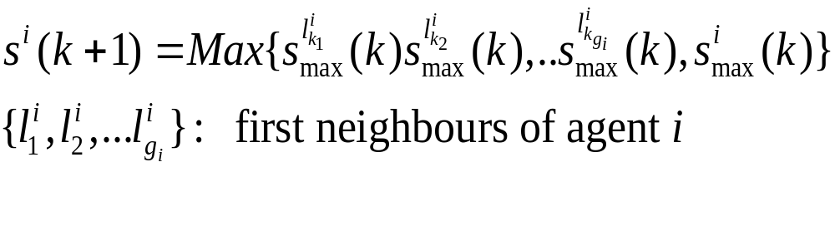
Emergence of scale-free influence networks
Toroczkai, Anghel, Basselr, Korniss, 2004
A social network of N agents through which agents communicate (ER random graph).
Agents play the minority game on the graph, using reinforced learning to select a leader among their nearest neighbours:

Slide 24
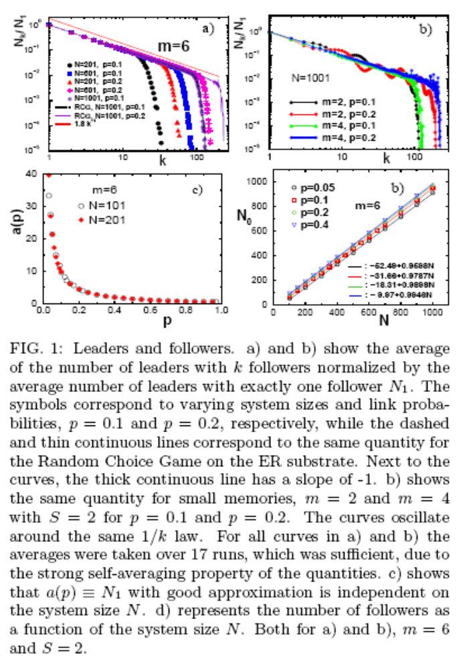
Emergence of scale-free influence network
Toroczkai, Anghel, Basselr, Korniss, 2004

Slide 25
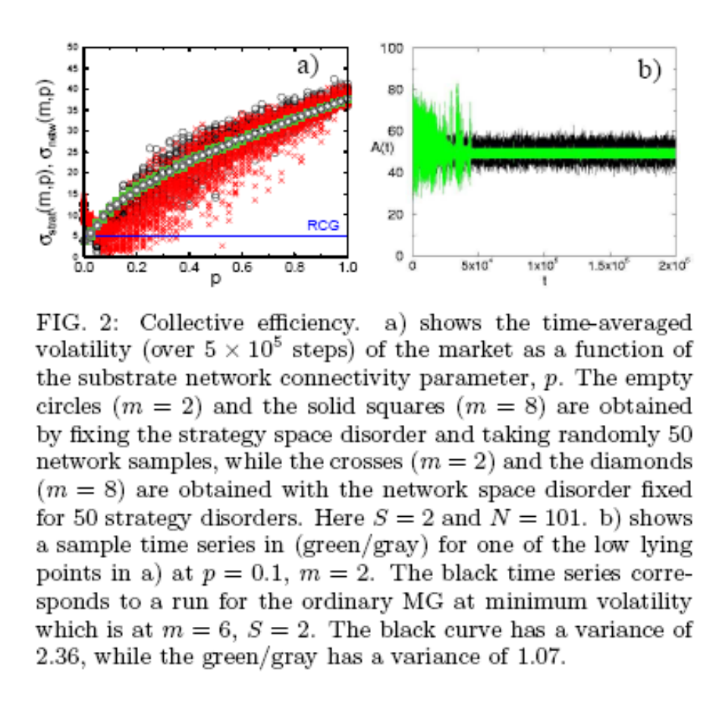

Slide 26
Conclusions
The El Farol bar problem (EFBP) is highly relevant to understanding distributed resource sharing in interacting multi-agent systems.
Many unexplored questions remain.
Information flow via inter-agent networks can greatly impact the dynamics of EFP.
EFP on cognitive radio networks.
work in progress
Thanks to Matteo Marsili for pointing me to the EFBP

