Slide 1

Master Tour Routing
Vladimir Deineko, Warwick Business School

Slide 2
Outline
Vehicle routing
Master tour problem
Travelling Salesman Problem with Kalmanson matrices
Quadratic Assignment Problem/ Special Case
Summary

Slide 3
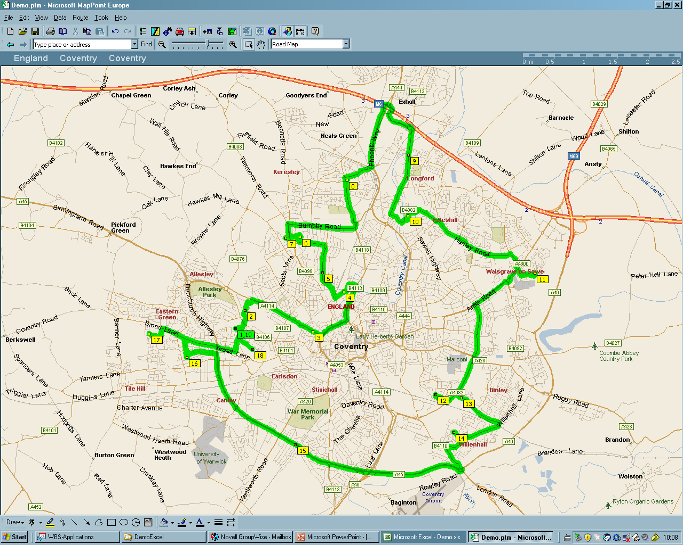

Vehicle routing problem
Given a set of customers
Find a tour with the minimal total length
A1
PostCode 1
A2
PostCode 2
A3
PostCode 3
A4
PostCode 4
A5
PostCode 5
A6
PostCode 6
A7
PostCode 7
A8
PostCode 8
A9
PostCode 9
A10
PostCode 10
A11
PostCode 11
A12
PostCode 12
A13
PostCode 13
A14
PostCode 14
A15
PostCode 15
Given a set of today’s customers
A1
PostCode 1
A2
PostCode 2
A3
PostCode 3
A4
PostCode 4
A5
PostCode 5
A6
PostCode 6
A7
PostCode 7
???
A8
PostCode 8
A9
PostCode 9
A10
PostCode 10
A11
PostCode 11
A12
PostCode 12
A13
PostCode 13
A14
PostCode 14
A15
PostCode 15

Slide 4
Vehicle routing problem
Given a set of customers
Find a tour with the minimal total length
A1
PostCode 1
A2
PostCode 2
A3
PostCode 3
A4
PostCode 4
A5
PostCode 5
A6
PostCode 6
A7
PostCode 7
A8
PostCode 8
A9
PostCode 9
A10
PostCode 10
A11
PostCode 11
A12
PostCode 12
A13
PostCode 13
A14
PostCode 14
A15
PostCode 15
Given a set of today’s customers
A1
PostCode 1
A2
PostCode 2
A3
PostCode 3
A4
PostCode 4
A5
PostCode 5
A6
PostCode 6
A7
PostCode 7
???
A8
PostCode 8
A9
PostCode 9
A10
PostCode 10
A11
PostCode 11
A12
PostCode 12
A13
PostCode 13
A14
PostCode 14
A15
PostCode 15

Slide 5
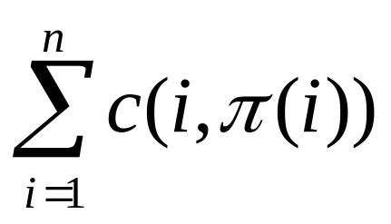
The travelling salesman problem (TSP)
city3
city2
city5
city1
city4
city6
Find a cyclic permutation (tour) π that minimizes
An optimal TSP tour < π₁, π₂, π₃,…, π_{n}, π₁> is called the master tour, if it is an optimal tour and it remains to be an optimal after deleting any subset of cities.

Slide 6
TSP with the master tour
j
k
A matrix is called Kalmanson matrix if for all i<j<k<l the inequalities below are satisfied.
l
i
+
c_{ij}
c_{ik}
(c_{mn} )=
−
c_{lj}
c_{lk}
c_{ij}
+
c_{lk}
≤
c_{lj}
+
c_{ik}
c_{ik}
+
c_{jl}
≥
c_{il}
+
c_{jk}

Slide 7
Specially structured matrices
j
k
i
l
If (c_{mn} ) is a Kalmanson matrix, then
+
c_{ij}
c_{ik}
(c_{mn} )=
−
c_{lj}
c_{lk}
<1,2,…,n> is an optimal TSP tour
then (c_{mn} ) is a Kalmanson matrix
<1,2,…,n> is the master tour for the TSP with (c_{mn} )

Slide 8
Recognition of specially structured matrices
d_{ij}
d_{ik}
c_{ij}
c_{ik}
(d_{mn} )=
(c_{mn} )= d_{σ(m)σ(n)} =
∈ X
d_{lj}
d_{lk}
c_{lj}
c_{lk}
Is there a permutation σ to permute rows and columns in the matrix so that the new permuted matrix (c_{mn}) with c_{mn}= d_{σ(m)σ(n)} is a Kalmanson matrix?
 | 1 | 2 | 3 | 4 | 5 | 6
1 |  | 12 | 13 | 10 | 15 | 17
2 | 12 |  | 1 | 2 | 3 | 5
3 | 13 | 1 |  | 3 | 4 | 6
4 | 10 | 2 | 3 |  | 5 | 7
5 | 15 | 3 | 4 | 5 |  | 8
6 | 17 | 5 | 6 | 7 | 8
1
4
2
6
3
5
10
1
10
12
17
13
15
2
+
−
4
10
2
7
3
5
3
5
2
12
2
5
1
3
∈ K
1
6
17
7
5
6
8
3
13
3
1
6
4
5
15
5
3
8
4

Slide 9
Recognition of specially structured matrices
d_{ij}
d_{ik}
(d_{mn} )=
d_{lj}
d_{lk}
+
Permuted Kalmanson matrices can be recognized in O(n²) time
c_{ij}
c_{ik}
(c_{mn} )=
−
c_{lj}
c_{lk}

Slide 10
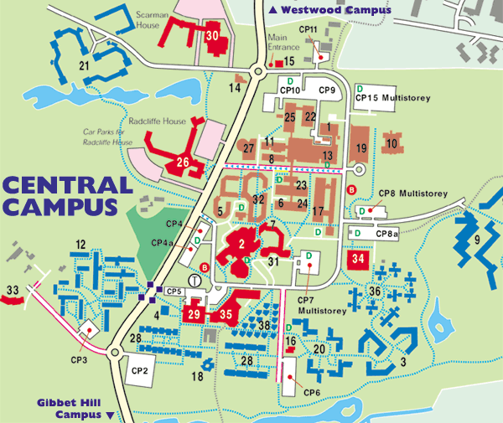
Related problems: Quadratic Assignment Problem (QAP)
Site 4
Site 1
Site 2
Site 3

Slide 11
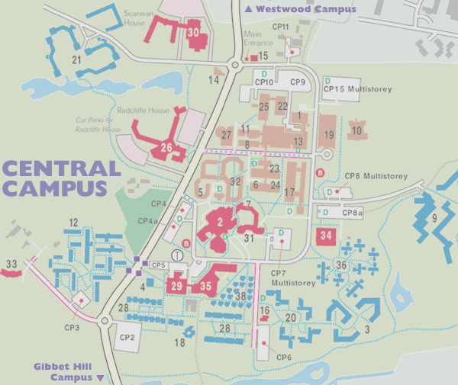
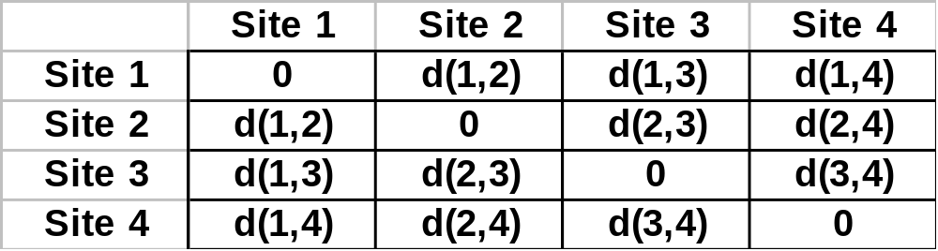
Site 4
Site 1
Site 2
Site 3
Distance matrix d(i,j)=

Slide 12
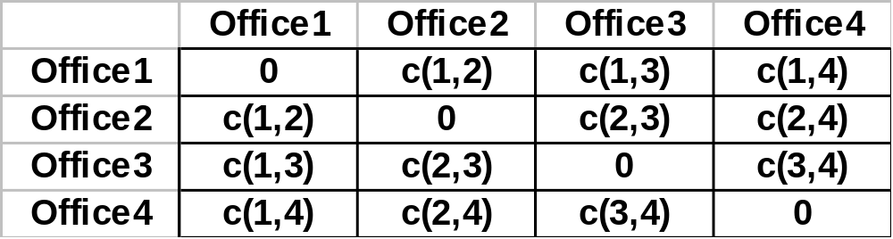
π3
π1
π2
Office1
Site1
Office2
Site2
Office3
Site3
Site4
Office4
Distance matrix d(i,j)=
Frequency of contacts c(i,j)=

Slide 13
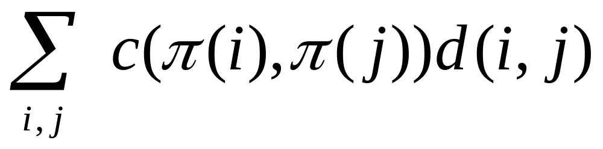
Quadratic Assignment Problem
Find a permutation π that minimizes
total distance traveled in the allocation problem above

Slide 14
Quadratic Assignment Problem (QAP)
Find a permutation π that minimizes
NP-hard ⇒ little hopes to find a polynomial algorithm
The hardest solved instances ⇒ n=22 (30?)
Heuristics (approximate algorithms)
Identify solvable cases

Slide 15
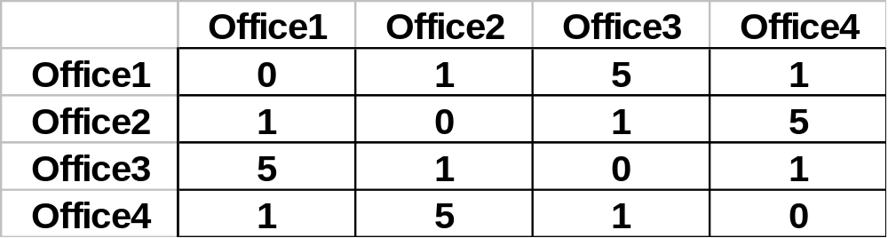
Quadratic assignment problem: Solvable case
Distance matrix d(i,j)=
Frequency of contacts c(i,j)=
If the distance matrix d(i,j) is a Kalmanson matrix, and the frequencies c(i,j) are proportional to the distances along a circle, then the identity is an optimal permutation for the QAP

Slide 16
Related specially structured matrices
+
c_{ij}
c_{ik}
(c_{mn} )=
−
Kalmanson matrices ⇒
π_{K}*= <1,2,…,n> is an optimal TSP tour
c_{lj}
c_{lk}
c_{ij}
c_{ik}
Demidenko matrices ⇒ π* is a pyramidal tour ⇒ O(n²) time
n
(c_{mn} )=
−
8
7
c_{lj}
c_{lk}
6
4
5
2
3
1
1
+
(c_{mn} )=
Relaxed Kalmanson matrices ⇒
π_{S}* is in a special set of N-permutations
⇒ O(n⁴) time
1
1

Slide 17
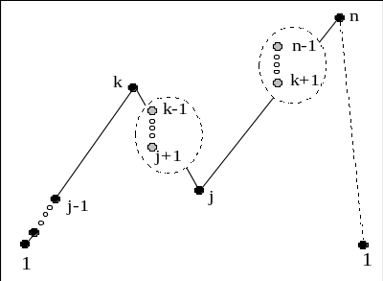
Specially Structured Matrices & Heuristics
1
2
3
4
5
6
1
2
3'
4'
5'
6'
1
x
x
?
?
?
1
x
x
+
+
+
2
?
?
can be
transformed to
2
?
?
x
x
x
x
3
?
3'
?
x
x
x
x
4
x
4'
x
x
x
5
5'
x
x
6
6'
Know how to solve the TSP with the matrices like
local
search?
1'
2'
3'
4'
5'
6'
1'
x
x
+
+
+
2'
x
+
+
x
3'
+
x
x
4'
x
x
5'
x
6'

Slide 18
Summary
Master tour exists only for the TSP with Kalmanson matrices
If distances are calculated along the unique paths in a tree, then the corresponding matrix is the Kalmanson matrix
Kalmanson matrices (➔ the master tour case) can be recognised in O(n²) time

