Slide 1
Dynamic Modelling of Road Transport Networks
Benjamin Heydecker
JD (Puff) Addison
  Centre for Transport Studies
  UCL

Slide 2
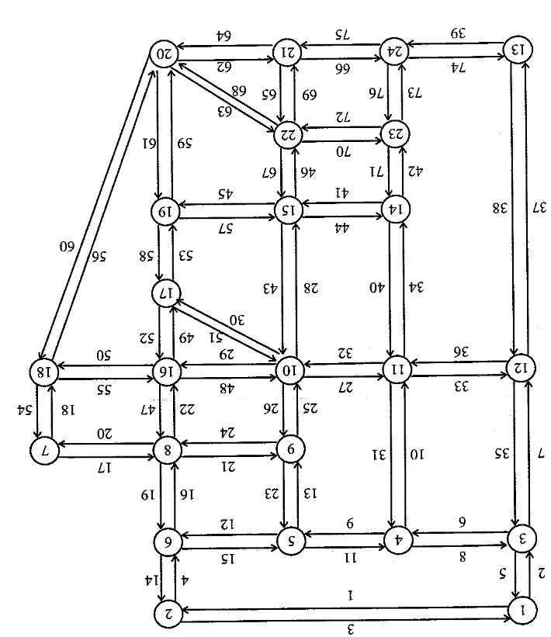
Transport Networks
Dominated by link travel time:
1km ~ 100s
Sioux Falls:
24 nodes
76 links
552 OD pairs

Slide 3
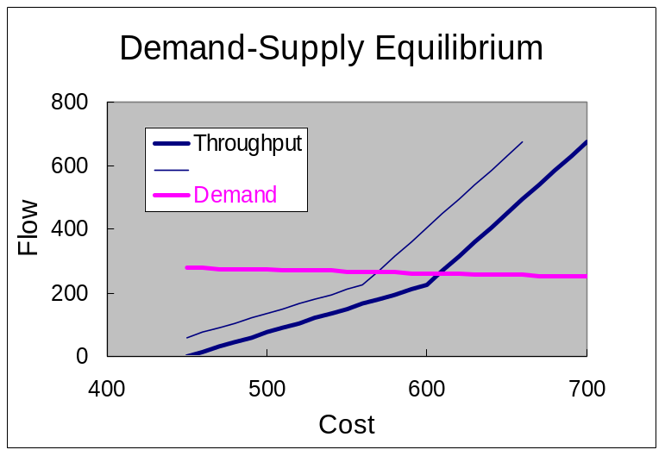
Transport Networks
Serve individual needs for travel
Demand reflects travellers’ experience – response to change
Dimensions of choice:
  Origin
  Destination
  O-D pair
  Frequency of travel
  Mode
  Departure time
  Route
}
C= F(T, p)
Equilibrium
analysis
T = D(C)

Slide 4

Dynamic Link Traffic Model
Link inflow e_{a}(s)
Inflow
Link a
Outflow
e_{a}(t)
x_{a}(t)
g_{a}(t)
→ link state x_{a} (t)
→ link exit time τ_{a} (t)
→ link outflow g_{a}[τ_{a} (t)] .

Slide 5
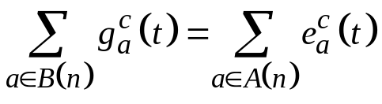
Transport Networks: Features
Conservation of traffic at nodes

Slide 6
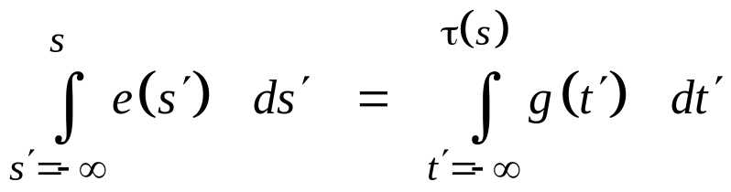

Dynamic Traffic Flows
First-In First-Out: Accumulated flow
Flow propagation
Flows and travel times interlinked
A = E(t)
A = G(t)
Traffic A
0
s
τ(s)
Time t

Slide 7



Traffic Modelling
First In First Out (FIFO):
Entry time s , exit time τ(s)
Flow propagation:
Entry flow e(s) , exit flow g(s)
Multi-commodity FIFO:
Papageorgiou (1990)
e_{p}
x_{a}

Slide 8

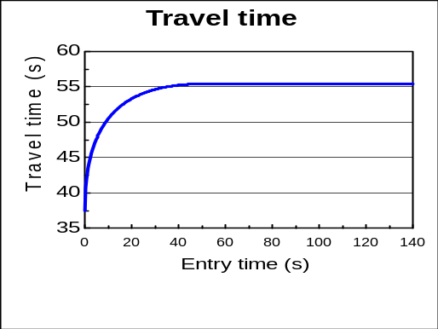
Travel Time Models
Link characteristics:
    Free-flow travel time φ
    Capacity (Max outflow) Q
Exit time:
Link a
Free-flow φ Capacity Q
State x_{a}(t)

Slide 9
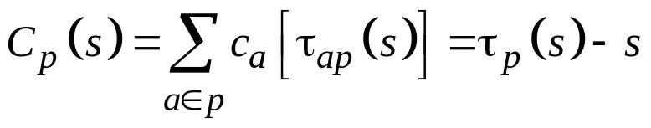
Calculation of Costs
Accumulate link costs according to time τ_{ap}(s) of entry
Travel time:
Nested cost operator

Slide 10
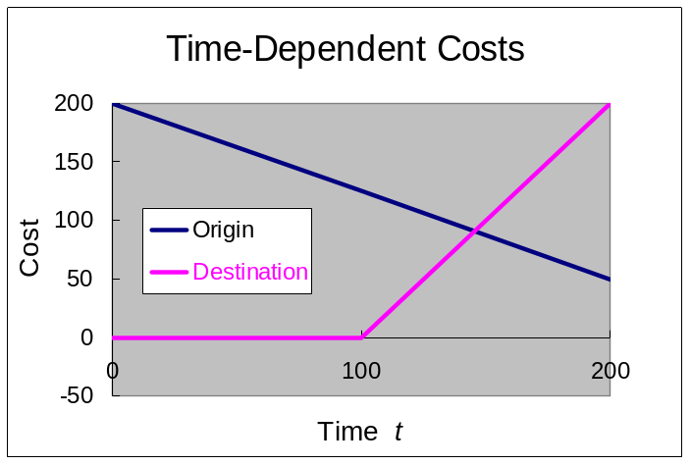
Calculation of Costs
Accumulate link costs according to time τ_{ap}(s) of entry
Travel time:
Nested cost operator
Origin-specific costs: h_{o}(s)
Destination-specific costs: f_{d}[τ_{p}(s)]

Slide 11
Calculation of Costs
Accumulate link costs according to time τ_{ap}(s) of entry
Travel time:
Nested cost operator
Origin-specific costs: h_{o}(s)
Destination-specific costs: f_{d}[τ_{p}(s)]
Total cost associated with journey:

Slide 12
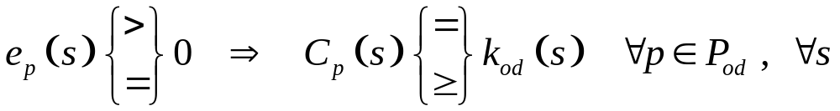
Dynamic equilibrium condition
Path inflow e_{p}(s) , path p , departure time s
Cost C_{p}(s)

Slide 13

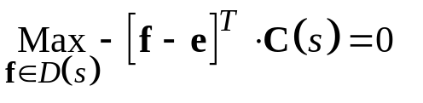
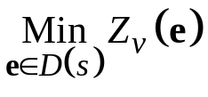
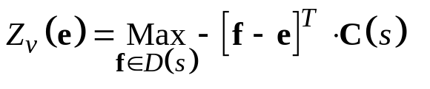
A Variational Inequality (VI) approach
Smith (1979) Dafermos (1980) Variational Inequality
Set of demand feasible assignments: D(s)
Assignment e ∈ D(s) is an equilibrium if
Then (set f = e )
Equilibrium assignment solves (solution is 0 )
where
Solve forwards over time s : forward dynamic programming

Slide 14
Demand for Travel
Dynamic trip matrix T(s) = {T_{od}(s)}
Fixed: T(s) is exogenous - estimation?
.

Slide 15
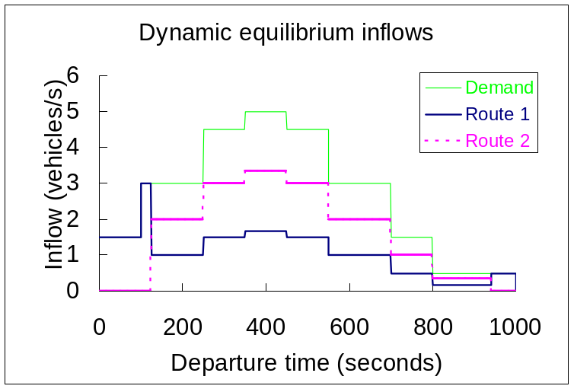
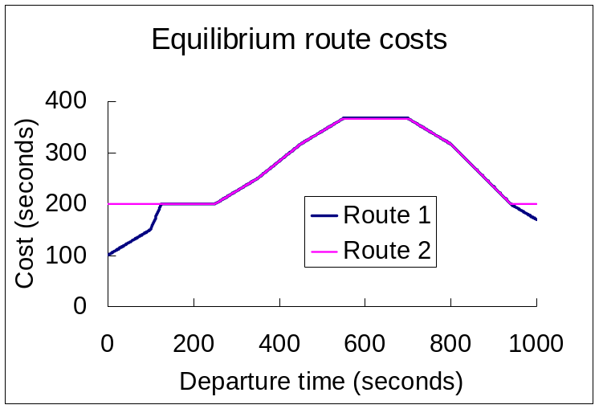
Demand for Travel
Dynamic trip matrix T(s) = {T_{od}(s)}
Fixed: T(s) is exogenous - estimation?
.

Slide 16
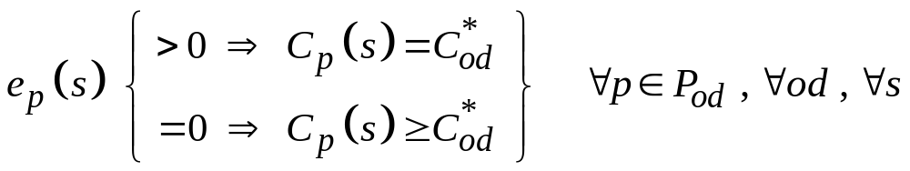
Demand for Travel
Dynamic trip matrix T(s) = {T_{od}(s)}
Fixed: T(s) is exogenous - estimation?
Departure time choice:
T(s) varies according to C(s)
- endogenous
Cost of travel is determined uniquely for each o – d pair

Slide 17
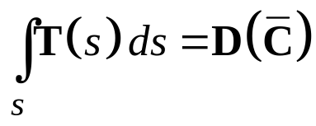
Demand for Travel
Dynamic trip matrix T(s) = {T_{od}(s)}
Fixed: T(s) is exogenous - estimation?
Departure time choice:
T(s) varies according to C(s)
- endogenous
Elastic demand:
C= F(T, p)
T = D(C)

Slide 18
Dynamic Traffic Assignment
Route choice in congested road networks
  Flows vary rapidly by comparison with travel times
  Travel times and congestion encountered vary
Planning and management:
  Congestion
  Capacities
  Free-flow travel times
  Tolls
  …

Slide 19
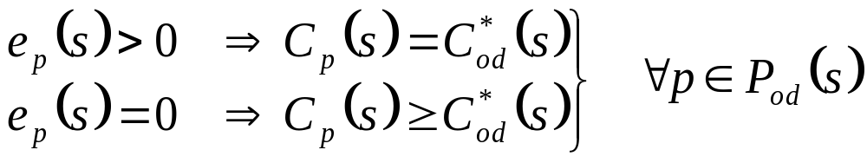
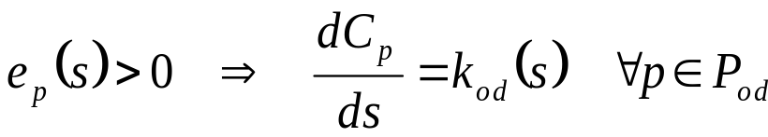
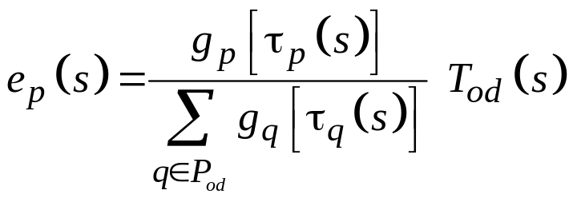
Analysis of Dynamic Equilibrium Assignment
Wardrop’s user equilibrium (1952) after Beckmann (1956):
To maintain equilibrium:
Necessary condition for equilibrium:

Slide 20
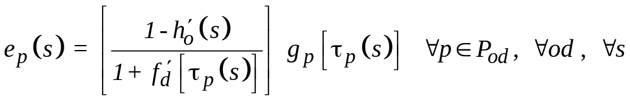
Dynamic Equilibrium Assignment with
Departure Time Choice
Hendrickson and Kocur: cost of all used combinations is equal
Necessary condition for equilibrium:
Cost of travel is determined uniquely for each o – d pair

Slide 21
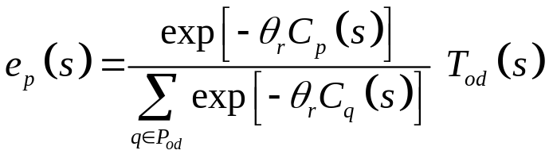
Dynamic Stochastic Equilibrium Assignment
Logit: Assigned flows e_{p}(s) given by
e_{p}(s) is continuous in path costs C_{p}(s)
C_{p}(s) is continuous in state x_{a}(s)
for finite inflows, x_{a}(s) is continuous in time s
⇒ e_{p}(s) is continuous in time s
Can use recent costs to estimate assignments

Slide 22
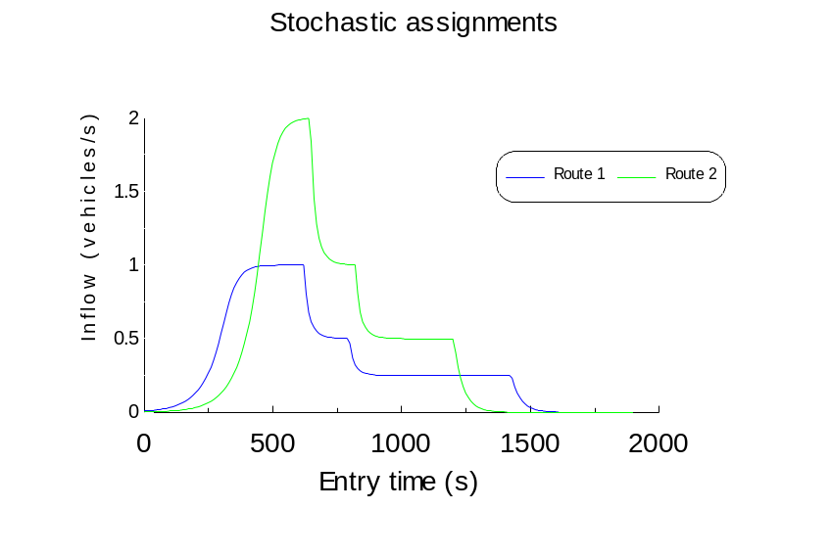
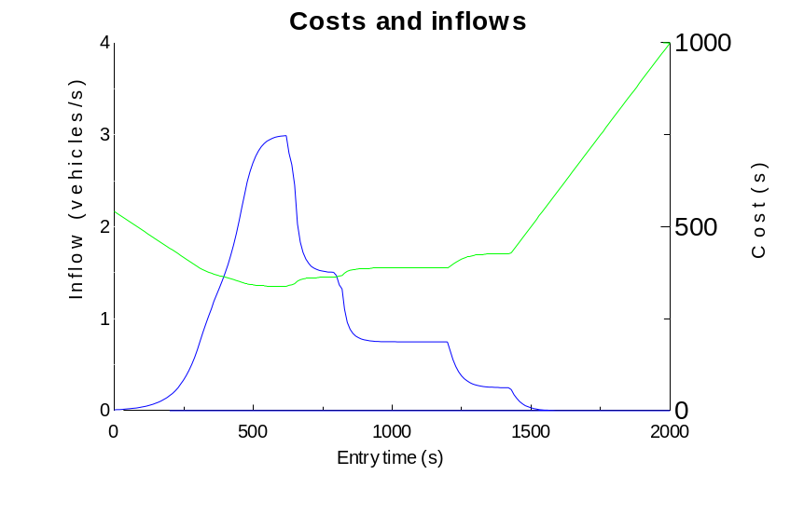
Example Dynamic Stochastic Assignments
DSUE assignments Costs and Inflows

Slide 23
Equilibrium Network Design: structure
Bi-level Structure
Design p variables
Evaluation
S(C(T, p)) - U(p)
Response variables T(p)
S(C(T, p)): Travellers’ surplus
U(p): Construction costs

Slide 24
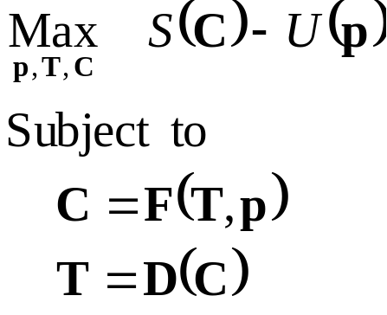
Equilibrium Network Design:
Formulation:
Bi-level structure:
  Costs C depend on
    Throughput T
    Design p
  Demands T are
  consistent with costs C
C= F(T, p)
T = D(C)

Slide 25
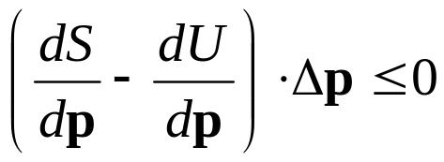
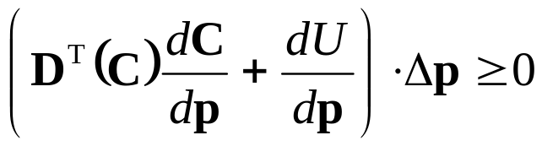
Optimality Conditions
No feasible variation Δp in design improves objective S - U
Using properties of S
Sensitivity analysis for d C / d p

Slide 26
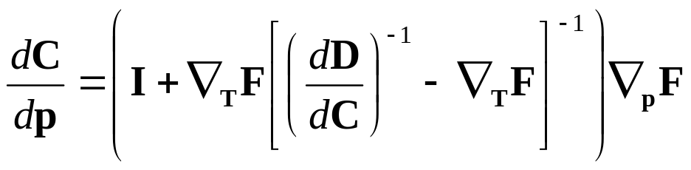
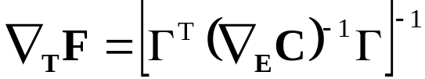
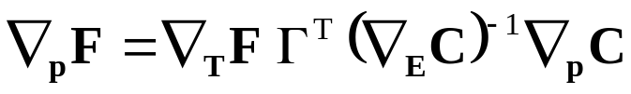
Sensitivity Analysis of Equilibrium
Sensitivity of costs C to design p:
Partial sensitivity to origin-destination flows:
Partial sensitivity to design:

Slide 27
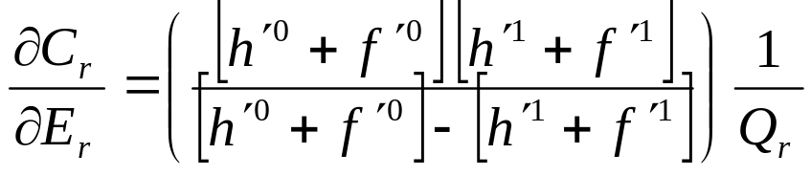
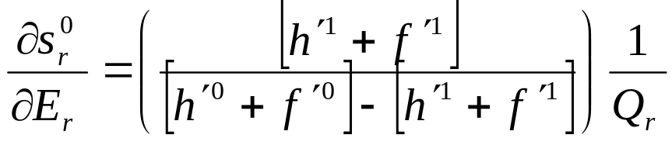
Sensitivity Analysis: Volume of Traffic E_{r}
  Cost-throughput:
  Start time:
  Dependence on values of time f ’(.) and h ’(.)

Slide 28
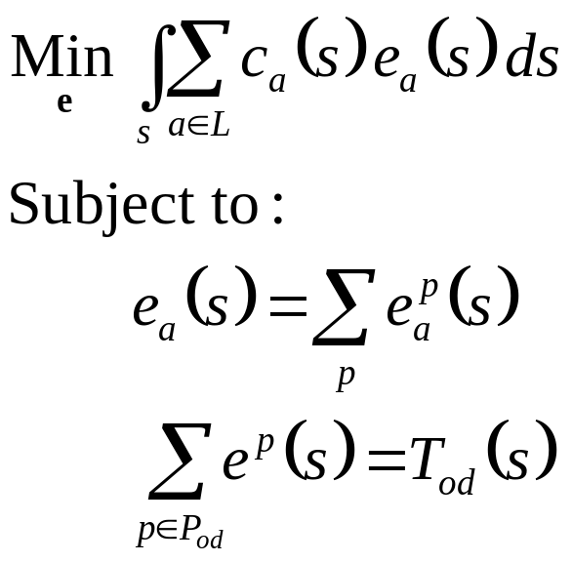
Dynamic System Optimal Assignment
Minimise total travel costs
(Merchant and Nemhauser, 1978)
Specified demand profile T(s)

Slide 29
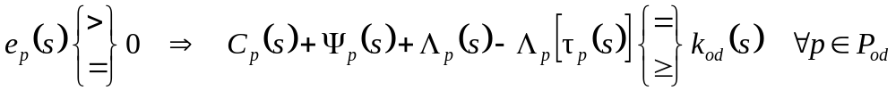
Dynamic System Optimal Assignment
Solution by Optimal Control Theory
Chow (2007)
Private cost
Costate variables
Direct externality

Slide 30
Comment on Optimal Control Theory solution
Necessary condition
Hard to solve
Non-convex
(non-linear equality constraints)
Curse of dimensionality

Slide 31

Analysis: Recover convexity
Carey (1992):
FIFO as inequality constraints
Convex formulation
Not all traffic need flow – holding back

Slide 32
Illustrative example
Q₁
d₁
g₁
Q_{o}
o
g₂
Q₂
d₂

Slide 33
Illustrative example
DSO as LP
Q₁
d₁
g₁
Q_{o}
g₁+g₂ < Q₀
o
g₂
h_{i} < Q_{i}
Q₂
d₂

Slide 34
Illustrative example
DSO as LP
Q₁
d₁
g₁
Q_{o}
g₁+g₂ < Q₀
o
g₂
h_{i} < Q_{i}
g₂
Q₂
d₂
Q₀
Q₂
g₁
Q₁
Q₀

Slide 35
Illustrative example
DSO as LP
Q₁
d₁
g₁
Q_{o}
g₁+g₂ < Q₀
o
g₂
h_{i} < Q_{i}
g₂
Demand
Q₂
d₂
Q₀
Q₂
g₁
Q₁
Q₀

Slide 36
Illustrative example
DSO as LP
Q₁
d₁
g₁
Q_{o}
g₁+g₂ < Q₀
o
g₂
h_{i} < Q_{i}
g₂
Demand
Q₂
d₂
Q₀
Q₂
Solution region
g₁
Q₁
Q₀

Slide 37
Illustrative example
DSO as LP
Q₁
d₁
g₁
Q_{o}
g₁+g₂ < Q₀
o
g₂
h_{i} < Q_{i}
g₂
Demand
Q₂
d₂
Q₀
Q₂
Solution region
Not proportional to demand
g₁
Q₁
Q₀

Slide 38
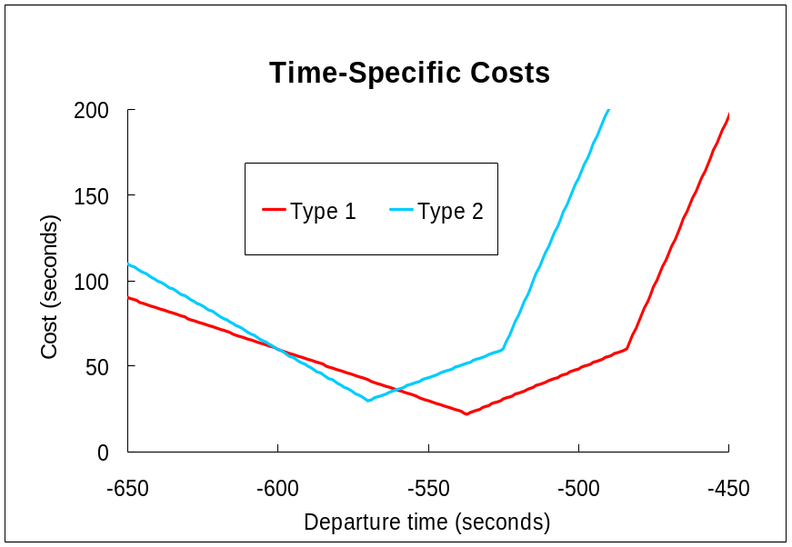
Directions for Further Work
Investigate:
  Network effects
  Heterogeneous travellers
  Pricing
Type 1
Type 2
Type 1

