Slide 1
STATISTICAL ANALYSIS FOR
ORIGIN-DESTINATION MATRICES
OF TRANSPORT NETWORK
Baibing Li
Business School
Loughborough University
Loughborough, LE11 3TU

Slide 2
Overview
  STATISTICAL ANALYSIS FOR ORIGIN-DESTINATION
  MATRICES OF TRANSPORT NETWORKS
  Background
  Statement of the problem
  Existing methods
  Bayesian analysis via the EM algorithm
  A numerical example
  Conclusions

Slide 3
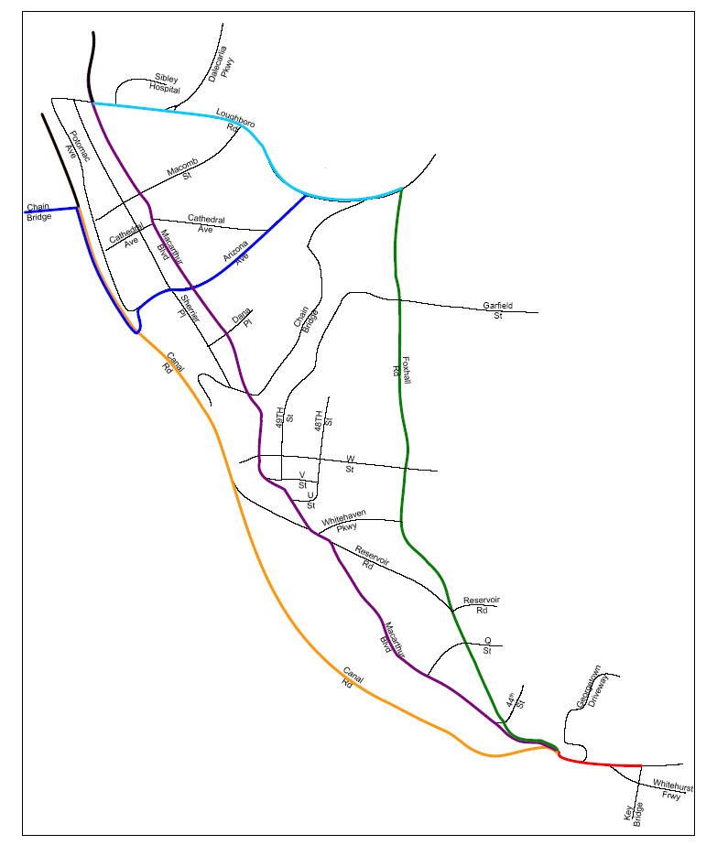
Background
Example.
Located in Northwest Washington, DC, bounded by Loughboro Road in the north; Canal Road and MacArthur Boulevand in the west; and Foxhall Road in the east
Canal Road is a principal arterial, two lanes wide, generally running northwest-southeast
Foxhall Road is a two-way, two-lanes minor arterial running north-south through the study area
Loughboro Road is a two-way east-west road

Slide 4
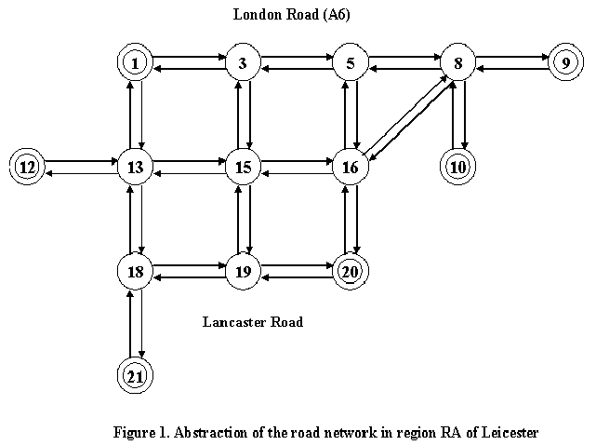
Background
What is a transport network
A transport network consists of nodes and directed links
An origin (destination) is a node from (to) which traffic flows start (travel)
A path is defined to be a sequence of nodes connected in one direction by links

Slide 5
Background
Origin-destination (O-D) matrices
  An O-D matrix consists of traffic counts from all origins to all destinations
  It describes the basic pattern of demand across a network
  It provides fundamental information for transport management

Slide 6
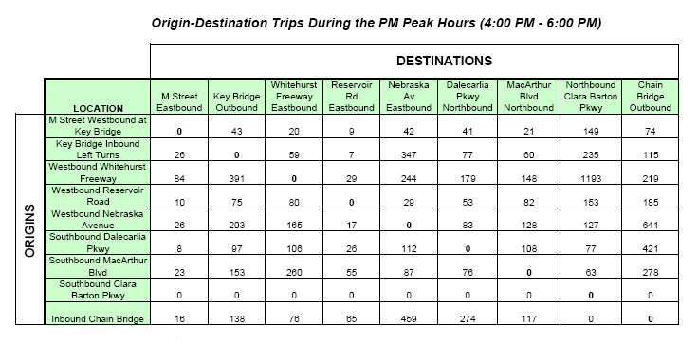
Background

Slide 7
Background
Methods of obtaining O-D data
  Roadside interviews and roadside mailback questionnaires
  disruption of traffic flow; unpopular with drivers and highway authorities
  Registration plate matching
  very susceptible to error (e.g. a vehicle passing two observation points has its plate incorrectly recorded at one of the points)
  Use of vantage point observers or video
  for small study area (e.g. to determine the pattern of flows through a complex intersection)
  Traffic counts
  much cheaper than surveys; much smaller observation errors

Slide 8
Statement of the problem
Statement of the problem
  Aim:
  Inference about O-D matrices
  Available data: traffic counts
  A relatively inexpensive method is to collect a single observation of traffic counts on a specific set of network links over a given period

Slide 9
Statement of the problem
Notation
  y=[y₁,…,y_{c}]^{T} is the vector of the traffic counts on all feasible paths (ordered in some arbitrary fashion)
  x=[x₁,…,x_{m}]^{T} is the vector of the observed traffic counts on the monitored links.
  z=[z₁,…,z_{n}]^{T} be the vector of O-D traffic counts
  The matrix A is an m×c path-link incidence matrix for the monitored links only, whose (i, j)th element is 1 if link i forms part of path j; otherwise 0
  The matrix B is an n×c matrix whose (i, j)th element is 1 if path j connects O-D pair i; otherwise 0

Slide 10
Statement of the problem
Statistical model (I)
  x = Ay
  z = By
  Assume that y₁,…,y_{c} are unobserved independent Poisson random variables with means θ₁,…,θ _{c} respectively, i.e. y_{i} ~ Poisson(y_{i}; θ_{i}). Denote θ=[θ₁,…,θ _{c}]^{T}
  Vector x has a multivariate Poisson distribution with a mean of Aθ

Slide 11
Statement of the problem
y₁₂₃
x (monitored link)
1
2
3
y₄₂₃
y₄₃
x=y₁₂₃+y₄₂₃
4
z₄₃=y₄₃+y₄₂₃

Slide 12
Statement of the problem
Statistical model (II)
x = Pz
  P*= [p_{ij}] is a proportional assignment matrix, where p_{ij} is defined to be the proportions of using link j which connects O-D pair i (assumed to be available). P is a sub-matrix of selecting those rows associated with x
  A common assumption is that the O-D counts z_{j} are independent Poisson variates, thus x being linear combinations of the Poisson variates with mean of Pμ, where μ is the mean of z

Slide 13
Statement of the problem
y₁₂₃
x (monitored link)
1
2
3
y₄₂₃
y₄₃
Note y₁₂₃=z₁₃
If y₄₂₃=0.3z₄₃
4
then x=1.0z₁₃+0.3z₄₃

Slide 14
Statement of the problem
Relationship between Model (I) and Model (II)
Assumptions:
  O-D traffic counts z_{j} are independent Poisson random variables with mean μ_{j}
  If y_{j} =[y_{jk}] is vector of route flows and p_{j}=[p_{jk}] route probabilities for O-D pair j, then conditional upon the total number of O-D trips, then y_{j} ~ multinomial(z_{j,} p_{j})
  Conclusion:
  The distributions of y_{jk} are Poisson with parameters θ_{jk} =μ_{j}p_{jk}

Slide 15
Statement of the problem
Major research challenges
  A highly underspecified problem for inference about an O-D matrix from a single observation
  An analytically intractable likelihood

Slide 16
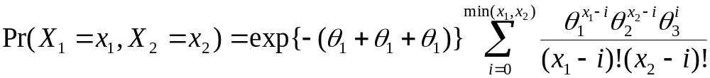
Statement of the problem
Example of multivariate Poisson distributions
  Let Y₁, Y₂, and Y₃ be three independent Poisson variates
  Y_{i} ~ Poisson(y_{i}; θ_{i})
  Define X₁= Y₁+Y₃ and X₂= Y₂+Y₃. The joint distribution of X₁ and X₂ is a multivariate Poisson distribution:

Slide 17
Previous research
Maximum entropy method (Van Zuylen and Willumsen, 1980)
--- Dealing with the issue of under-specification
  Maximising entropy, subject to the observation equations
  Adding as little information as possible to the knowledge contained in the observation equations

Slide 18


Previous research
Using normal approximations (Hazelton, 2001)
--- Dealing with intractability of multivariate Poisson distributions
To circumvent the problem, Hazelton (2001) considered following multivariate normal approximation for the distribution of y:
Since x = Ay, we obtain
Note that the covariance matrix Θ depends on θ.

Slide 19
Bayesian analysis + EM algorithm
Basic idea --- dealing with the issue of intractability
Instead of an analysis on the basis of the observed traffic counts x, the inference will be drawn based on unobserved y
  Incomplete data
    The observed network link traffic counts x are treated as incomplete data (observable)
    Follow a multivariate Poisson --- analytically intractable
  Complete data
    The traffic counts on all feasible paths, y, are treated as complete data (unobservable)
    Follow a univariate Poisson --- analytically tractable

Slide 20
Bayesian analysis + EM algorithm
Basic idea --- dealing with the issue of under-specification
Bayesian analysis combines two sources of information
  Prior knowledge
  e.g. an obsolete O-D matrix; or non-informative prior in the case of no prior information
  Current observation on traffic flows

Slide 21
Bayesian analysis
Complete-data Bayesian inference
  Complete-data likelihood P(y | θ)
  The joint distribution of y: ∏_{j} Poisson(y_{j} | θ_{j} )
  Incorporate a natural conjugate prior π(θ)
  θ_{j} ~ Gamma Γ(α_{j}; β_{j})
  Result in a posterior density P(θ | y )
  θ_{j} ~ Gamma Γ(a_{j}; b_{j}) with a_{j}= α_{j}+ y_{j} and b_{j}= β _{j}+1

Slide 22
The EM algorithm
Posterior density
  Prior density π(θ)
  Complete-data likelihood P(y | θ)=P(x | θ)P(y | x, θ)
  Complete-data posterior density P(θ | y ) ∝ P(y | θ)π(θ)
E-step: averaging over the conditional distribution of y given (x, θ^{(t)})
  E{logP(θ | y ) | x, θ^{(t)} }=l(θ | x)+E{logP(y | x, θ) | x, θ^{(t)} }+logπ(θ^{(t)})+c
M-step: choosing the next iterate θ^{(t+1)} to maximize
E{logP(θ | y ) | x, θ^{(t)} }
Each iteration will increase l(θ | x) and {θ^{(t)}} will converge

Slide 23
The EM algorithm
Bayesian inference via the EM algorithm
  M-step
  The a posteriori most probable estimate of θ_{j} is given by
  (α_{j}+ y_{j}−1)/( β _{j}+1)
  E-step
  Replacing the unobservable data y_{j} by its conditional expectation at the t-th iteration:
  (α_{j}+ E{y_{j} | x, θ^{(t)}}−1)/( β _{j}+1)

Slide 24
Conditional expectation
Calculation of conditional expectation
  Theorem. Suppose that {y_{j}} are independent Poisson random variables with means {θ_{j}} (j=1,…,c) and A=[A₁,…,A_{c}] is an m×c matrix with A_{j} the jth column of A. Then for a given m×1 vector, x, we have
E{y_{j} | x, θ^{(t)}}= θ_{j}^{(t)} {Pr(Ay=x−A_{j}) /Pr(Ay=x)}
Major advantage: guarantee positivity

Slide 25
Estimation, prediction & reconstruction
Hazelton (2001) has investigated some fundamental issues and clarified some confusion in the inference for O-D matrices. He clearly defines the following concepts:
  Estimation
  The aim is to estimate the expected number of O-D trips
  Prediction
  The aim is to estimate future O-D traffic flows
  Reconstruction
  The aim is to estimate the actual number of trips between each O-D pair that occurred during the observational period

Slide 26





Prediction
For future traffic counts, the complete-data posterior predictive distribution is
The complete-data marginal posterior predictive distributions are negative binomial distributions
with
The mode of the marginal posterior predictive distribution is at
Given the incomplete data x, the prediction is

Slide 27

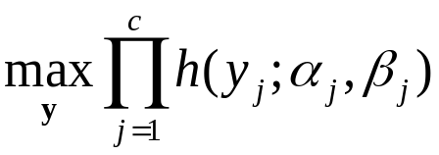
Reconstruction
The marginal distributions of y_{j} are NB(α_{j ,}β_{j} ). Denote the corresponding probability mass functions as
For given observation x, the reconstructed traffic counts can be calculated as the a posteriori most probable vector of y, i.e. the solution to the following maximization problem:
subject to Ay=x
Solving the above problem yields the reconstructed traffic counts

Slide 28
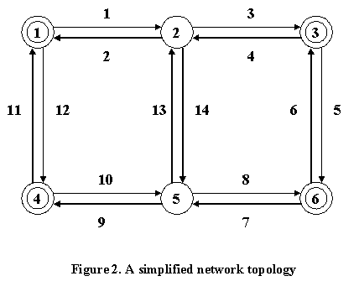
A numerical example

Slide 29
A numerical example
Origin |  | Destination
 | 1 | 3 | 4 | 6
1 | 0 | 793 | 593 | 99
3 | 526 | 0 | 440 | 37
4 | 269 | 542 | 0 | 30
6 | 138 | 69 | 81 | 0
Table A1. Prior estimates of origin-destination counts

Slide 30
A numerical example
Origin |  | Destination
 | 1 | 3 | 4 | 6
1 | 0 | 783 | 677 | 137
3 | 429 | 0 | 524 | 104
4 | 225 | 701 | 0 | 30
6 | 104 | 132 | 81 | 0
Table A2. True values of origin-destination counts

Slide 31
A numerical example
Prior distributions
  The prior distributions are taken as Gamma distributions with parameters α_{j} being the prior estimates in Table A1 and β_{j} =1
Simulated data
  Simulation of unobservable vector of traffic counts, y
  outcomes of independent Poisson variables with means displayed in Table A2.
  Monitored links
  Assume the traffic counts are available on m=8 of the links, i.e. links 1, 2, 5, 6, 7, 8, 11, 12.
  Simulation of a single observation, x=Ay
  x = [884, 548, 111, 133, 191, 144, 214, 640]^{T}.

Slide 32
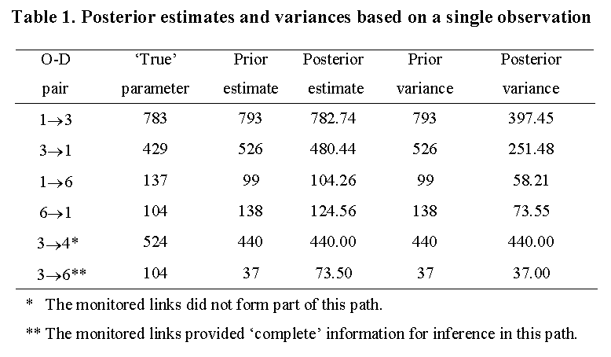
A numerical example

Slide 33


A numerical example
Repeated experiments
  The simulation experiment was repeated 500 times
  The quality of prior information varies via adjusting the parameters of the prior distributions Γ(α_{j}; β_{j})
  with η = 1, 2, 5, 10, 20 ,50
  θ_{j}* are the ‘true’ values of the parameters in Table A2 and θ_{j0} are the prior values in Table A1

Slide 34
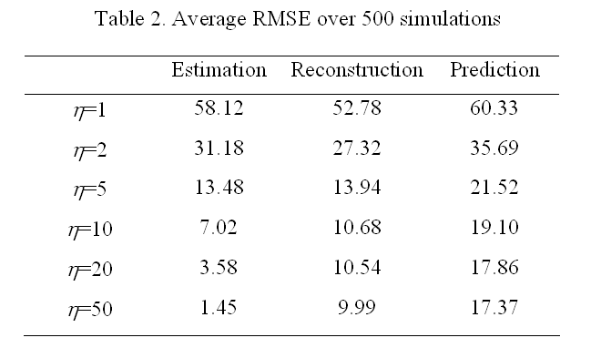
A numerical example

Slide 35
Conclusions
Bayesian analysis
  Challenge: a highly underspecified problem for inference about an O-D matrix from a single observation
  Solution: Bayesian analysis combining the prior information with current observation
The EM algorithm
  Challenge: an analytically intractable likelihood of observed data
  Solution: the EM algorithm dealing with unobservable complete data which have analytically tractable likelihood

Slide 36
References
Hazelton, L. M. (2001). Inference for origin-destination matrices: estimation, prediction and reconstruction. Transportation Research, 35B, 667-676.
Li, B. (2005). Bayesian inference for origin-destination matrices of transport networks using the EM algorithm. Technometrics, 47, 2005, 399-408.
Van Zuylen, H. J. and Willumsen, L. G. (1980). The most likely trip matrix estimated from traffic counts. Transportation Research, 14B, 281-293.

