Slide 1
Exploring Markov models for gate-limited service and their application to network-based services
Glenford Mapp and Dhawal Thakker
Networking Research Group
School of Engineering and Information Sciences (EIS)
Middlesex University, London

Slide 2
Outline of Talk
Context
Types of Service
Exhaustive-Limited Service
Gated-Limited Service
An Approximate Solution
Application to Network-Based Services
Conclusion and Future Work

Slide 3
Context: Queuing Theory
Customers being served in some way
  Teller at bank, roving salesman, etc
Servers do work on customers after which customers may leave the system or join another queue for further service.
Servers may serve other queues
Different ways of serving
  Exhaustive
  Gated

Slide 4
Types of Service
Exhaustive – the server serves until the queue is empty. So it serves customers who arrive after service on the queue has started.
Gated Service – the server only serves the customers in the queue at the start of service. Customers arriving after service has begun are served on subsequent server visits.

Slide 5
Limited Service Derivatives
Exhaustive-Limited: The server serves a maximum of k customers. Other customers are serviced on subsequent visits.
Gated-Limited: The server only serves a maximum of k customers that it finds in the queue when it arrives. Other customers are serviced in the same manner but on subsequent visits

Slide 6
Application
Different applications may different service models
We focus on gated-limited systems for a number of reasons
  Transport:
    Large systems such as buses can be modelled as gated-limited servers.
  Network Services can also be modelled as gated-limited service

Slide 7
Simple Example of a
Network-Based System
APPL 1
Client Service Thread
NETWORK
APPL 2
SERVER
APPL 3
APPL 4
Network Buffer
(Multiple Requests)

Slide 8
Key Observations
Once the network buffer is sent off to the server, applications must wait before putting new requests in the buffer
The buffer is finite, so there is a maximum number of requests, K, that can be serviced at the same time
Gated-Limited Service

Slide 9
Motivation
Everything is going to be network-based
  The network is the computer
New streaming applications are being used that require better than best-effort service.
    You-Tube; BBC iPlayer, etc
Can use pre-fetching techniques
  but we have to see about demand misses

Slide 10
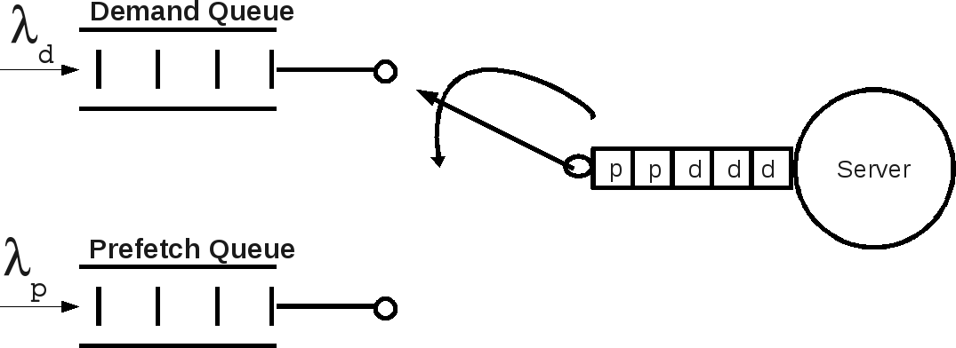
Network-Based Storage Service to support pre-feteching

Slide 11
What’s already been done
If you look at the literature, a lot of work has been done on exhaustive or exhaustive-limited systems
Gated service also studied
Gate-limited solutions exist but are generally too hard to calculate
  Not back-of-the envelope stuff

Slide 12
Standard Solution: The Partial Bulk Service Model (PBM)
Found in standard text-books:
Each Markov state is defined by 2 parameters:
    n = the total number of customers in the system
    s = the number of customers currently being served
Note: the maximum number of customer that can be served at the same time is given by K.

Slide 13
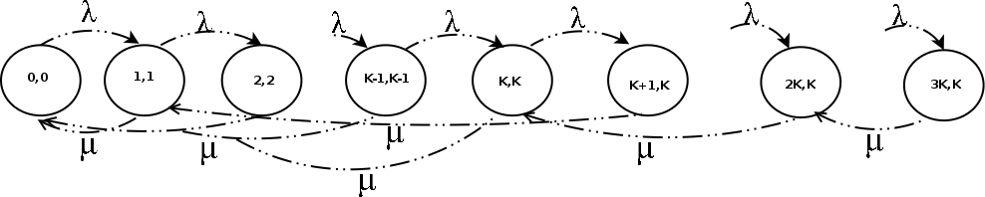
PBM Con’t
The PBM is exhaustive-limited service, but we need to
understand the solution. If K = 1, we have normal MM1.
The general solution is quite similar to the MM1 solution

Slide 14
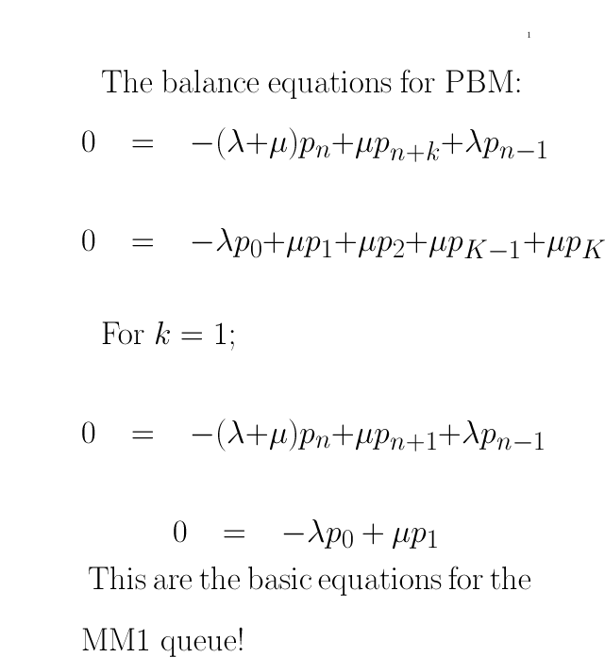

Slide 15
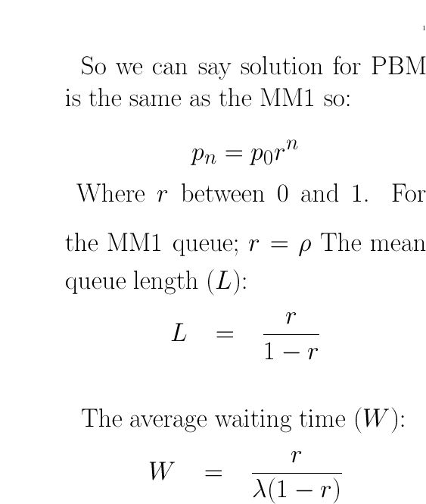

Slide 16
Evaluation of PBM
Exhaustive-limited not gated-limited
However, at extremely high loads, the gated-limited waiting times will approach the exhaustive waiting times because there will almost always be K or more customers in the queue.
We need to remember this!

Slide 17
Our approach
Use Markov Models
  Previous approaches have been very mathematical from the word go!
Look at arrival and departure moments
For the gated-limited model, the number of customers served in the next cycle is evaluated at the end of the current cycle.

Slide 18
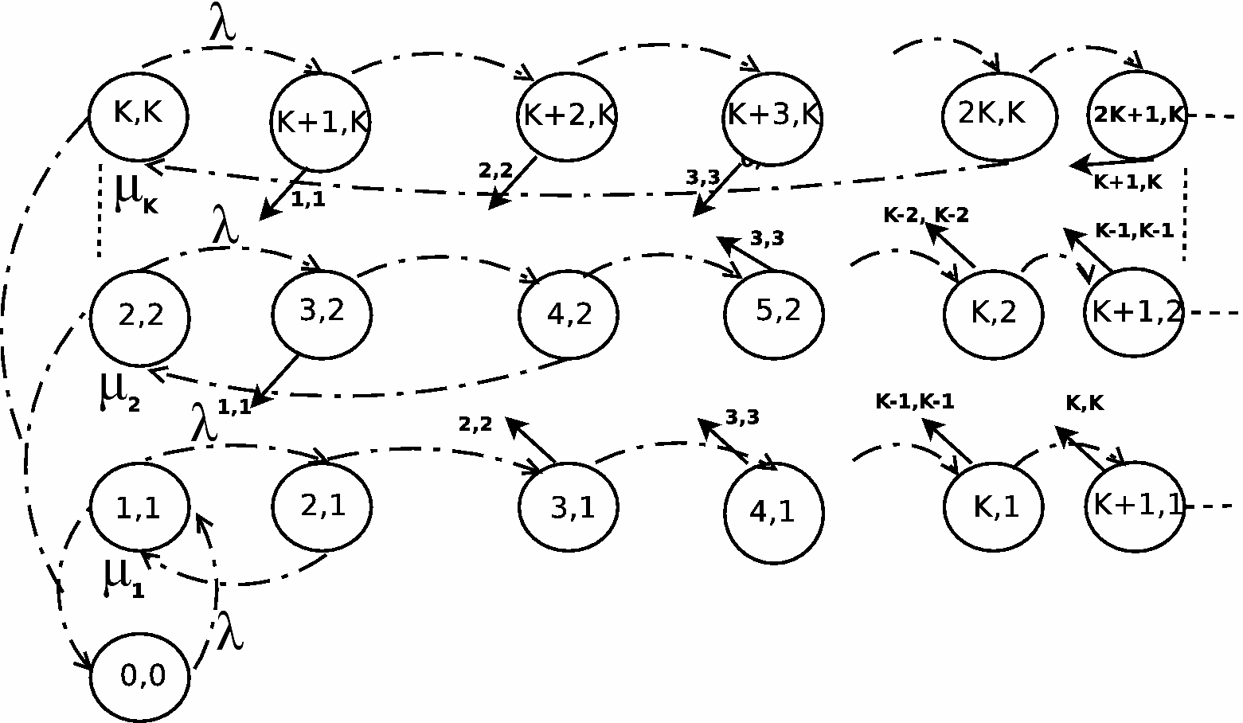
Our Markov Model for Gate-Limited Service

Slide 19
Model is complicated because..
There are several chains where each chain represents the number of customers currently being served.
  So Chain 1, represents 1 customer being served, etc.
You can jump over several chains in one go depending on how many people are left in your queue at the end of the current service time.

Slide 20
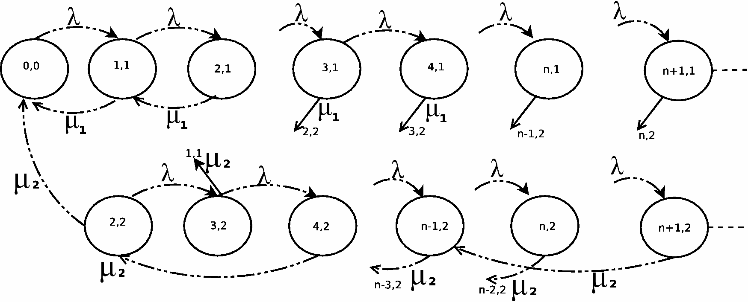
Gated Limited Model for K=2

Slide 21
How do you solve this model?
There are K chains; so if K is 2; there are 2 chains
Our approach
    Try to express the probability of being in each state of each chain in terms of the probabilty of lowest element in the chain. For K = 2; we need to express Chain 1 in terms of P₁₁ and P₂₂ for Chain 2.
  Then we concentrate on solving each chain

Slide 22
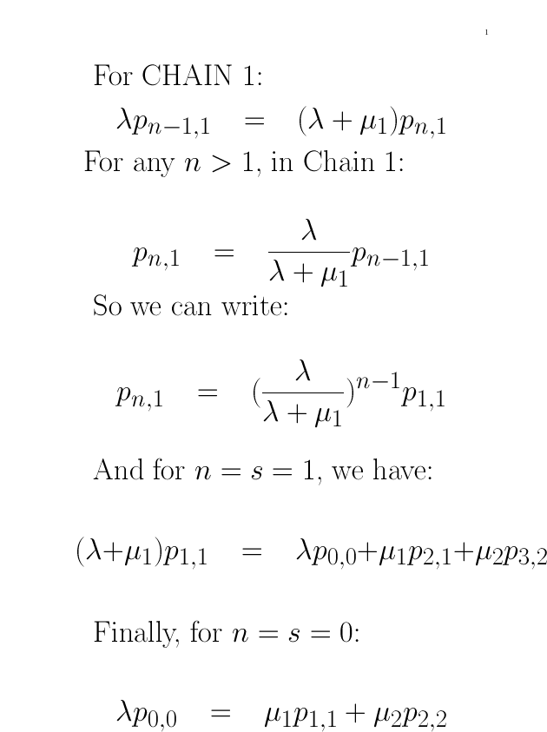

Slide 23
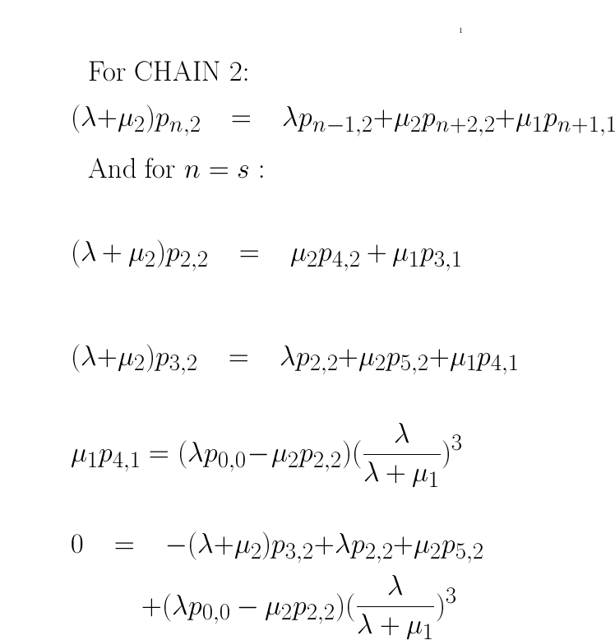

Slide 24
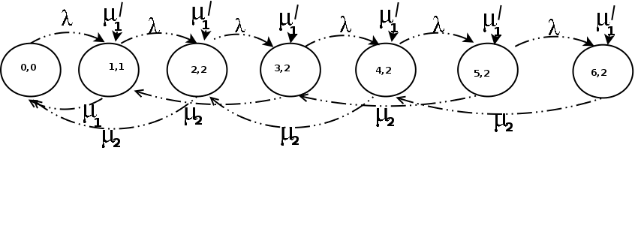
The Effect of this Approach
By only expressing Markov state equations for Chain 2 in
terms of other Markov states for Chain 2, we are saying
that we can imagine that the states for Chain 2 in the
gated-limited model to be part of an IMAGINARY PBM chain
So we can solve for root r, between 0 and 1, just like in the
PBM approach

Slide 25
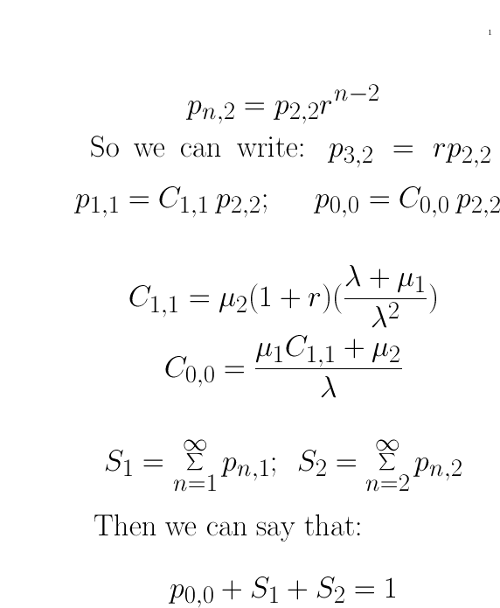

Slide 26
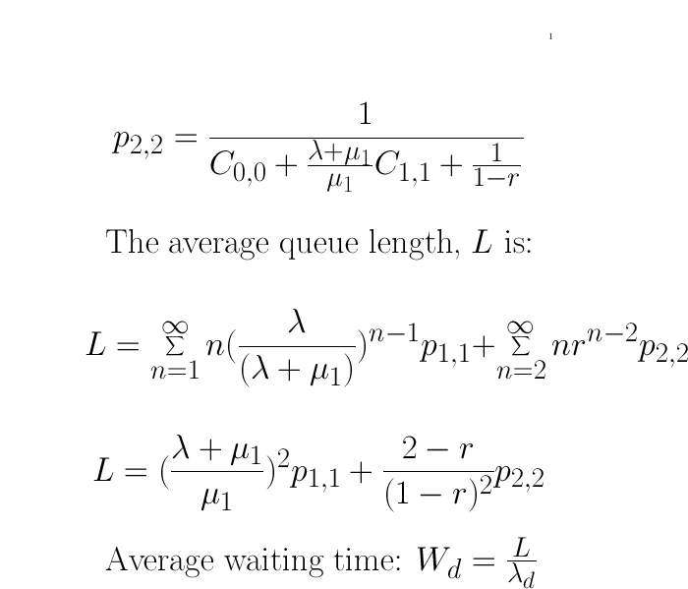

Slide 27
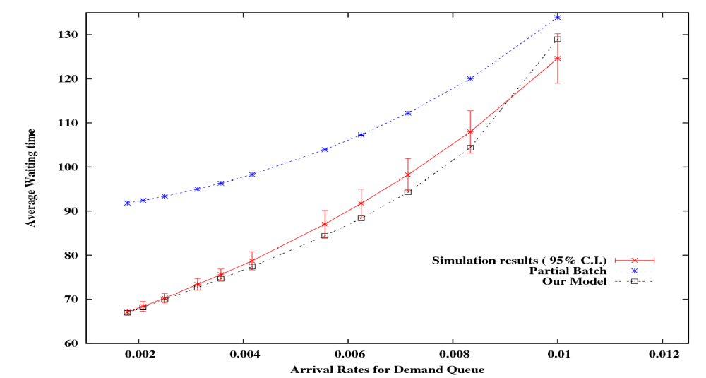
Results for K = 2

Slide 28
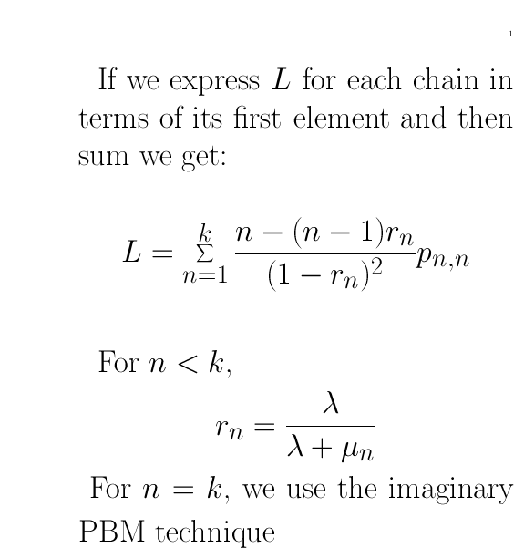
Towards a general solution

Slide 29
Towards a general solution
The most difficult part is to calculate p_{n,n}
Use the equations for p_{n,n} and express these variables in terms of p_{k,k}.
Mathematics is complicated
  Need to look at using matrix techniques to solve these equations.
Still a lot of work to be done but the approach looks promising.

Slide 30
Application – Global Storage Server Project
Aim
  To develop a high performance globally accessible storage server
    Eliminate dependency on local storage
      More green: less power, noise
  Network Memory Server (NMS)
    Uses the memory of another machine
    Appears as a hard-disk to the client OS

Slide 31
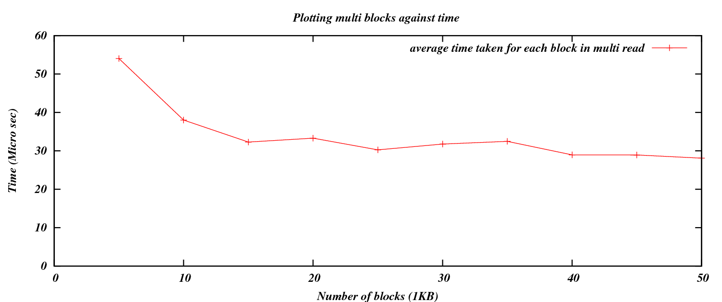
Clustering in the NMS
      Time to Fetch p blocks = L + Cp

Slide 32
Approach
To allow stream to run without jitter
  Time to fetch < Time to process
    L + Cp < Tcpu * p
Average waiting time expereince to satisfy Demand misses < the average waiting time on disk (Tdisk)‏
    L + (d * C) + Twait < Tdisk

Slide 33
Looking at Conservative Pre-fetching (PonD)
Prefetch only when there is a demand miss
Therefore, using PonD:
  L + (p+d) * C < ( Tcpu * p)
For demand misses, the waiting time < Tdisk:
  Time to fetch + Twait < Tdisk
    L + (p+d) * C + Twait < Tdisk

Slide 34
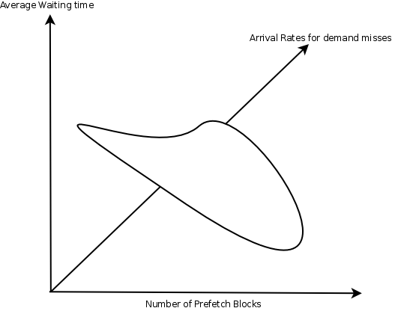
Developing an Operational Space
Define an operational space consisting of three axes
Twait, demand misses < Tdisk
Tnet(p+d) < P* Tcpu

Slide 35

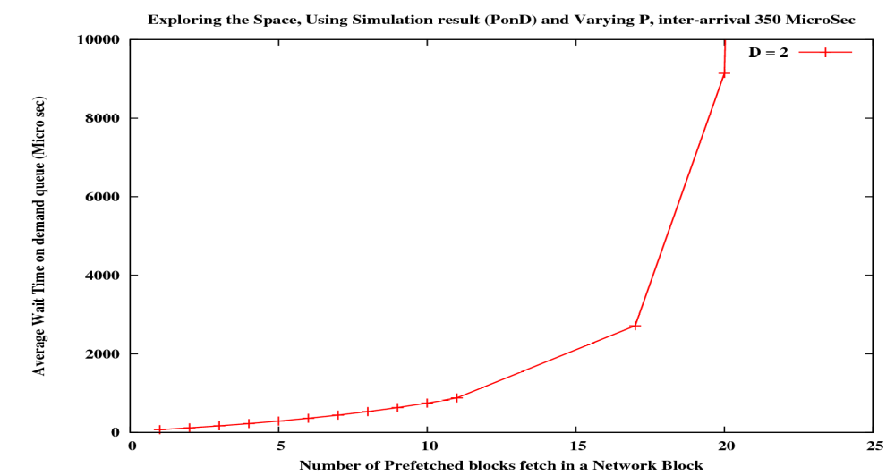
Exploring the Space for a given inter-arrival time, 350 microseconds

Slide 36
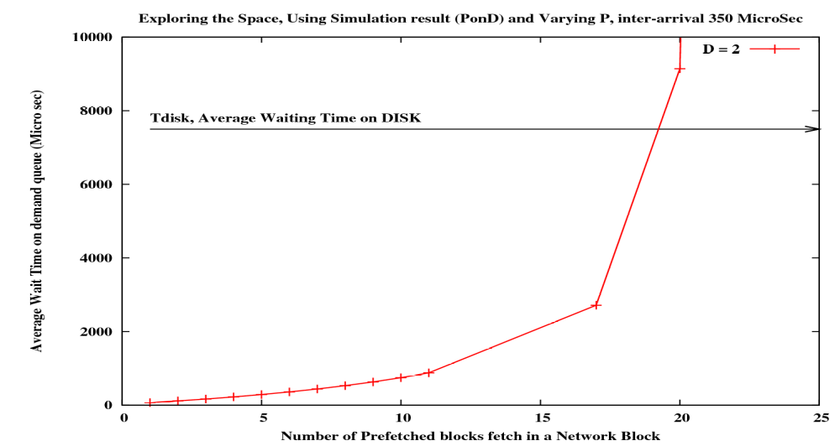
Exploring the Space, 350 microseconds

Slide 37
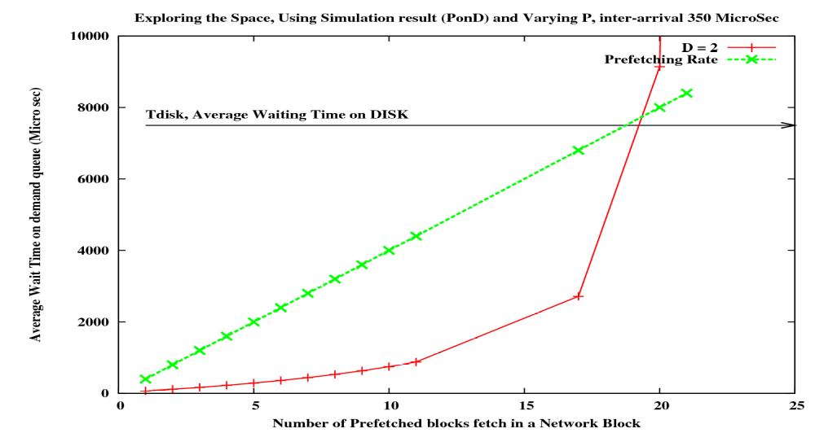
Exploring the Space, 350 microseconds

Slide 38
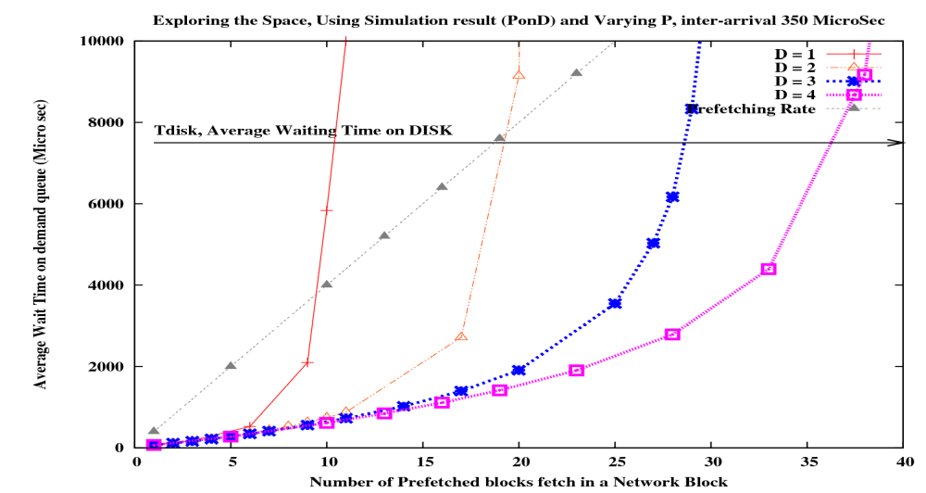
Exploring the Space, 350 microseconds
School of EIS, CCM Research group

Slide 39
Future Work
Further explore analytical model
Investigate the effect of different network loads
Develop a practical algorithm that can be part of an autonomous system that can balance pre-fetching and demand paging.
Develop a file server that uses the algorithm and measure its performance.

Slide 40
Thank You
QUESTIONS?

