Slide 1
DoG functions
Excitatory area
Inhibitory area
Ganglion
cells
Simple cells

Slide 2
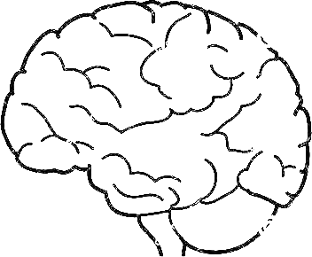
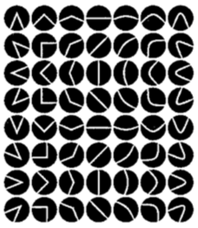
V1
V2
V4
IT

Slide 3
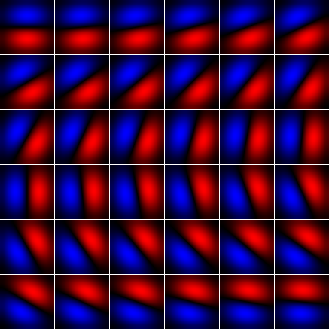
Orientation columns
. . . . . . . . . . . .
. . . . . . . . . . . .
Input Image
Partially overlapped receptive field

Slide 4
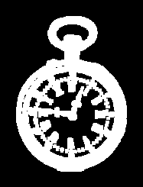
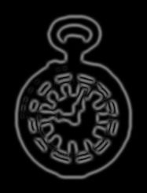

(a)
Input image
Response map
Ridge line
(b)
Inhibit if greater
or
Ridge
Inhibition
Excitation
Orientation columns

Slide 5
Burr
Noise
Graph of simple units
Spanning tree
Longest path in tree

Slide 6
O
x
s
t
y

Slide 7
5 | 80 | 80 | 70 | 70 | 70 | 5
60 | 5 | 5 | 55 | 55 | 55 | 60
60 | 5 | 5 | 55 | 55 | 55 | 60
70 | 60 | 60 | 0 | 0 | 0 | 70
70 | 60 | 60 | 0 | 0 | 0 | 70
5 | 80 | 80 | 70 | 70 | 70 | 5
Simple unit

Slide 8
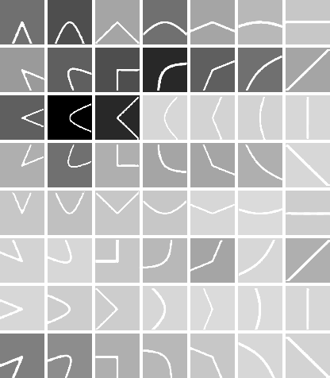
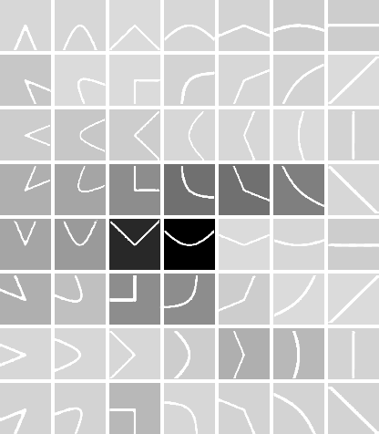
Inner representation
(a)
Learning
Frechet
Distance
Activation
function
Testing
(b)

