Slide 1

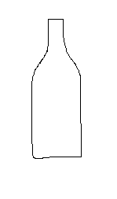
Curves of routes
Curves in template
y
Rotate curve so that its most extended direction is along x-axis
y
x
x
y
Calculate the similarity between two curves by solving optimization problem
x

