Slide 1
ANALYSTLAB AFRICA • DATA ANALYTICS INTERNSHIP • WEEK 5 ASSIGNMENT
Telco Customer Churn
Business Analytics Case Study
Why are customers leaving — and which factors drive churn the most?
PREPARED BY
Richard Fajorin
PROGRAM
AnalystLab Africa — Data Analytics Internship
Tools: Python • Pandas • Matplotlib • Seaborn

Slide 2
01 — BUSINESS PROBLEM
Why Are Customers Leaving?
THE PROBLEM
ANALYTICAL APPROACH
Customer churn is eroding the subscriber base.
1 in 4 customers (26.54%) left within the analysis period — a retention problem that compounds with every billing cycle.
▪ Explore — 7,043 customer records structure, quality, distributions
▪ Quantify — churn across contract type, tenure, charges, internet service & payment method
▪ Diagnose — behavior patterns and high-risk segments behind the 26.54% churn rate
▪ Recommend — 3–5 practical, data-backed retention actions
KEY QUESTIONS
▪ Why — are customers leaving, and what patterns precede churn?
▪ Which factors — contribute most contract, tenure, charges, service, payment?
▪ Who — are the highest-risk segments we should target first?
Telco Customer Churn — Business Analytics Case Study
02

Slide 3
02 — EXPLORATORY DATA ANALYSIS
Dataset at a Glance
7,043
1,869
5,174
26.54%
Total customer records analyzed
Churned customers
Retained customers
Overall churn rate
CUSTOMER PROFILE (AVERAGES)
DATA QUALITY & PREPARATION
▪ Average monthly charge — $64.76 across the customer base
▪ Average tenure — 32.37 months
▪ Demographics & services — senior-citizen status, contract, internet service, payment method captured per customer
▪ Assessment — missing-value checks, data-type verification and summary statistics completed
▪ Encoding — churn converted to a numeric flag for correlation analysis
▪ Segmentation — tenure grouped into bands (0–12, 13–24, 25–48, 49–72 months) for trend analysis
Telco Customer Churn — Business Analytics Case Study
03

Slide 4
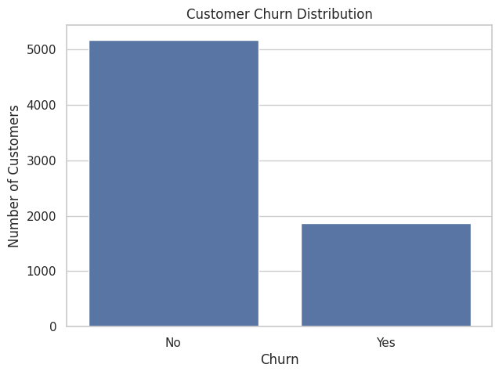
03 — CHURN OVERVIEW
One in Four Customers Is Leaving
CUSTOMER CHURN DISTRIBUTION
26.54%
of all customers churned (1,869 of 7,043)
73.46%
retained — but the base is shrinking every cycle
STAKEHOLDER TAKEAWAY
Churn is not evenly spread it concentrates in specific segments. The next slides isolate exactly where the risk sits.
Telco Customer Churn — Business Analytics Case Study
04

Slide 5
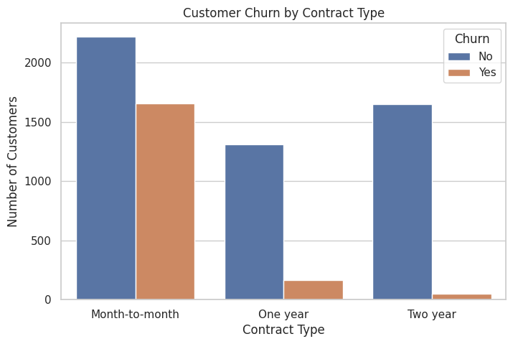
04 — KEY CHURN FACTOR: CONTRACT TYPE
Contract Flexibility Is the Strongest Churn Driver
CHURN RATE BY CONTRACT
CHURNED VS RETAINED, BY CONTRACT
Month-to-month
42.71%
One year
11.27%
Two year
2.83%
WHAT IT MEANS
Month-to-month customers churn ~15× more than two-year customers. Commitment length is the single clearest churn signal in the data.
Telco Customer Churn — Business Analytics Case Study
05

Slide 6
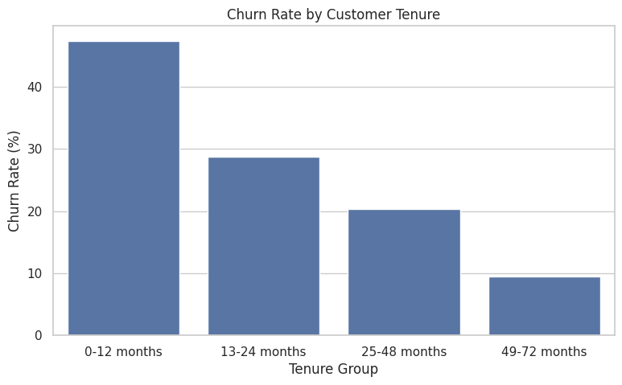
05 — KEY CHURN FACTOR: TENURE
The First Year Is the Danger Zone
CHURN RATE BY TENURE GROUP
17.98 mo
37.57 mo
avg tenure — churned customers
avg tenure — retained customers
47.44% of customers in their first 12 months churned
Churn falls steadily with every tenure band
WHAT IT MEANS
Churned customers leave after less than half the tenure of retained ones. Onboarding and the first-year experience are the critical retention window.
Telco Customer Churn — Business Analytics Case Study
06

Slide 7
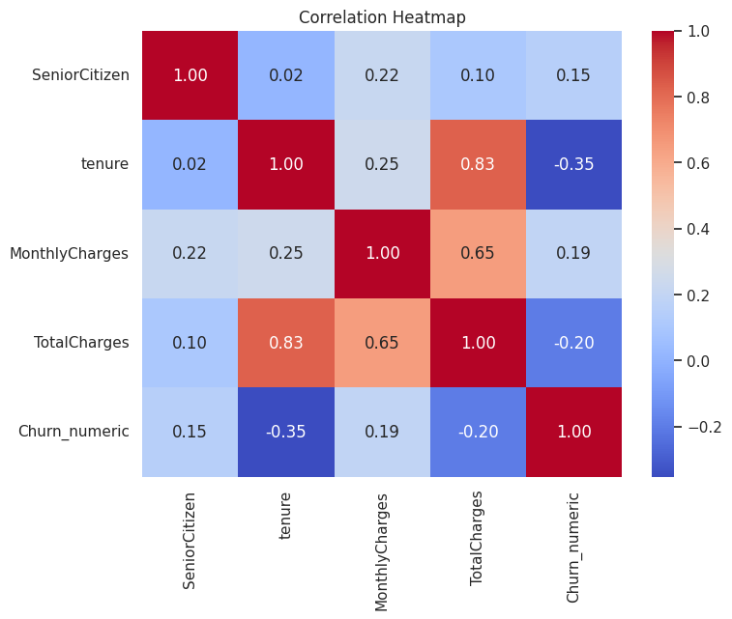
06 — KEY CHURN FACTOR: MONTHLY CHARGES
Churned Customers Pay ~$13 More Per Month
CORRELATION HEATMAP — NUMERIC VARIABLES
$74.44
$61.27
avg monthly charge — churned
avg monthly charge — retained
$13.18 higher average monthly bill among churners
Price sensitivity is a measurable churn signal
WHAT IT MEANS
Tenure shows the strongest relationship with churn (−0.35): loyalty builds over time, while higher bills accompany departures.
Telco Customer Churn — Business Analytics Case Study
07

Slide 8
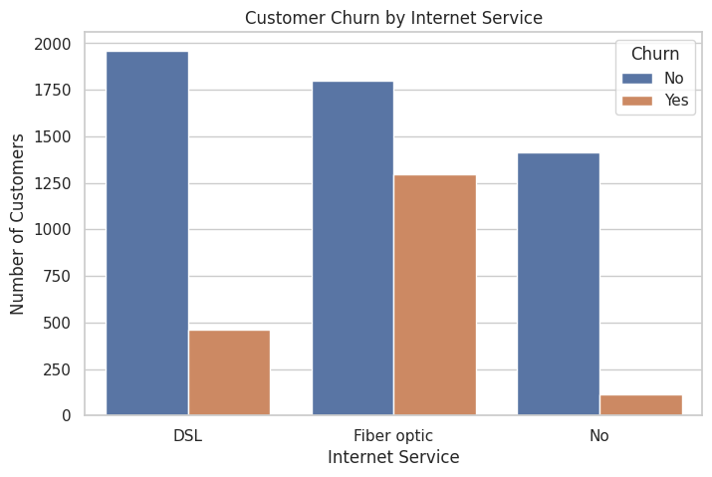
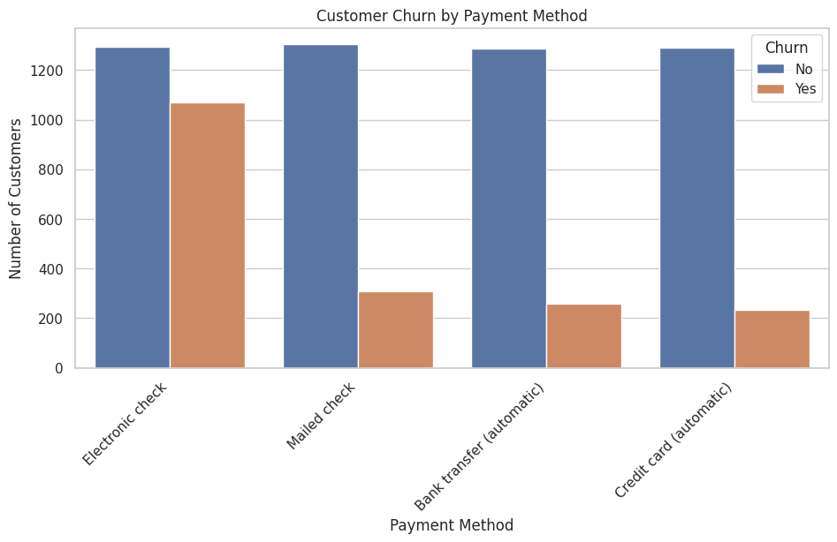
07 — KEY CHURN FACTORS: SERVICE & PAYMENT
Service Type and Payment Behavior Shape Risk
CHURN BY INTERNET SERVICE
CHURN BY PAYMENT METHOD
WHAT IT MEANS Fiber-optic customers account for the largest churn count, and electronic-check payers churn far more than customers on automatic payment methods, billing friction and service experience both merit investigation.
Telco Customer Churn — Business Analytics Case Study
08

Slide 9
08 — BUSINESS INSIGHTS
High-Risk Segments & Opportunities
HIGH-RISK SEGMENTS
BEHAVIOR PATTERNS
OPPORTUNITIES
▪ Month-to-month contracts — 42.71% churn — the dominant risk pool
▪ First-year customers — 47.44% churn within 0–12 months
▪ High bills + short tenure — churners pay $74.44/mo and leave at 17.98 months
▪ Electronic-check payers — largest churn count among payment methods
▪ No lock-in, no loyalty — churn falls 42.71% → 11.27% → 2.83% as contract length rises
▪ Value erosion — churners carry ~$13.18 higher monthly charges
▪ Risk decays with time — tenure correlates −0.35 with churn; loyalty compounds
▪ Convert to contracts — shift month-to-month users to 1–2 year plans
▪ Win the first year — onboarding & early-life engagement at 0–12 months
▪ Smooth billing — migrate electronic-check users to automatic payments
▪ Review fiber-optic value — address service experience for the largest churn pool
Telco Customer Churn — Business Analytics Case Study
09

Slide 10
09 — RECOMMENDATIONS
Recommended Actions
1
Prioritize the first-year experience
47.44% churn in months 0–12 demands a dedicated onboarding program — welcome outreach, check-in calls, and early-issue resolution.
2
Incentivize longer contracts
Month-to-month churn (42.71%) collapses to 2.83% on two-year plans. Offer targeted upgrade incentives and discounts to at-risk monthly subscribers.
3
Address price sensitivity
Churners pay $13.18/mo more on average. Introduce plan reviews, loyalty discounts, or downshift options for high-bill, low-tenure customers.
4
Migrate customers to automatic payments
Electronic-check users churn disproportionately. Encourage bank-transfer or credit-card autopay enrollment to reduce billing friction.
5
Investigate fiber-optic service experience
Fiber-optic holds the largest churn count. Audit service quality, support responsiveness, and perceived value for this segment.
Prepared by Richard Fajorin • AnalystLab Africa — Data Analytics Internship • Python · Pandas · Matplotlib · Seaborn

