Slide 1
Software development, responsibility and ethics: the coming crisis
Richard Fontana @richardfontana

Slide 2
The Software shall be used for Good, not Evil. json.org/license

Slide 3
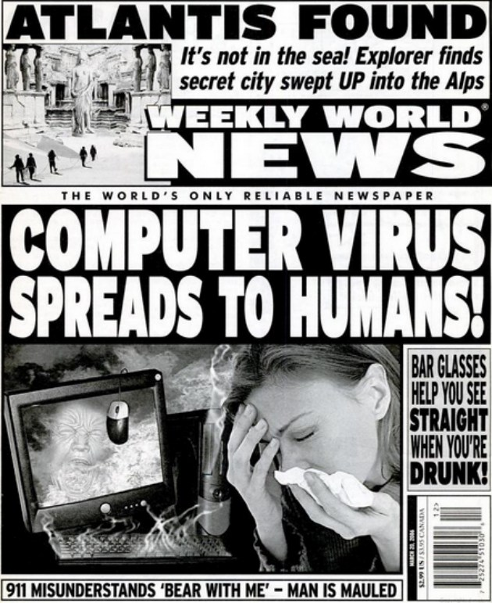

Slide 4
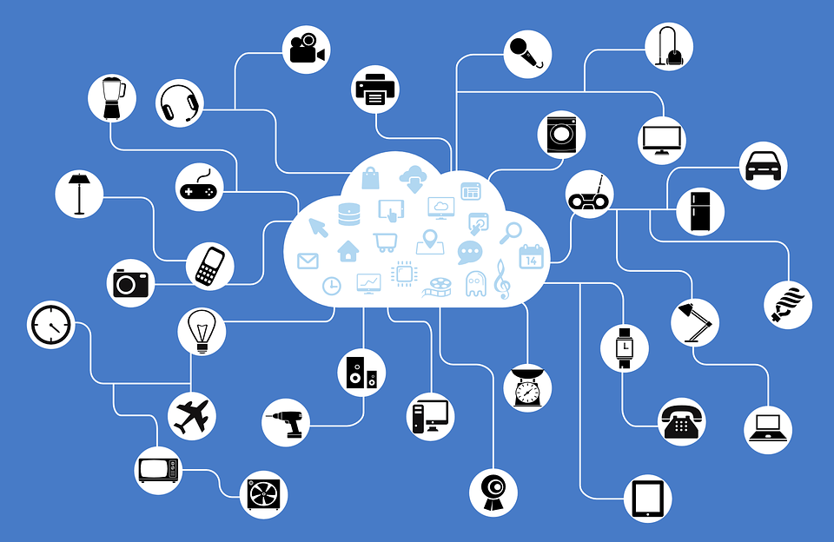

Slide 5
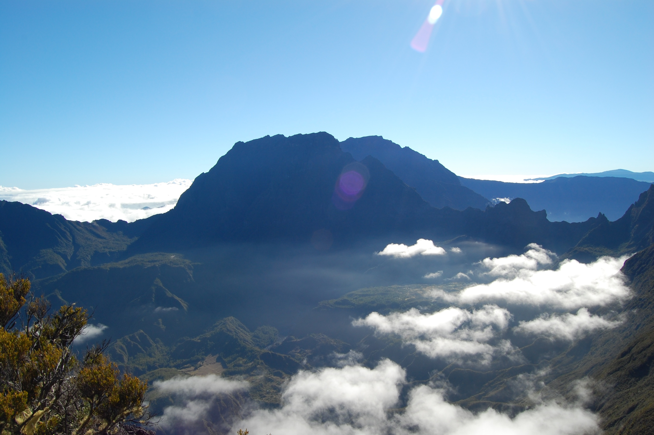

Slide 6
Caveat user
4. DISCLAIMER OF WARRANTY. THE SOFTWARE IS PROVIDED "AS IS" WITHOUT WARRANTY OF ANY KIND. ORACLE FURTHER DISCLAIMS ALL WARRANTIES, EXPRESS AND IMPLIED, INCLUDING WITHOUT LIMITATION, ANY IMPLIED WARRANTIES OF MERCHANTABILITY, FITNESS FOR A PARTICULAR PURPOSE OR NONINFRINGEMENT.
5. LIMITATION OF LIABILITY. IN NO EVENT SHALL ORACLE BE LIABLE FOR ANY INDIRECT, INCIDENTAL, SPECIAL, PUNITIVE OR CONSEQUENTIAL DAMAGES, OR DAMAGES FOR LOSS OF PROFITS, REVENUE, DATA OR DATA USE, INCURRED BY YOU OR ANY THIRD PARTY, WHETHER IN AN ACTION IN CONTRACT OR TORT, EVEN IF ORACLE HAS BEEN ADVISED OF THE POSSIBILITY OF SUCH DAMAGES. ORACLE'S ENTIRE LIABILITY FOR DAMAGES HEREUNDER SHALL IN NO EVENT EXCEED ONE THOUSAND DOLLARS (U.S. $1,000).

Slide 7
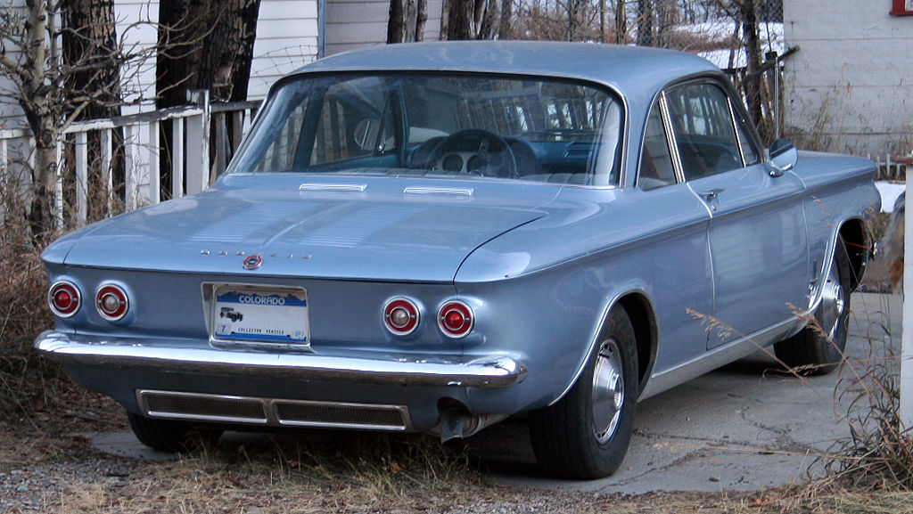
Unsafe at any speed

Slide 8
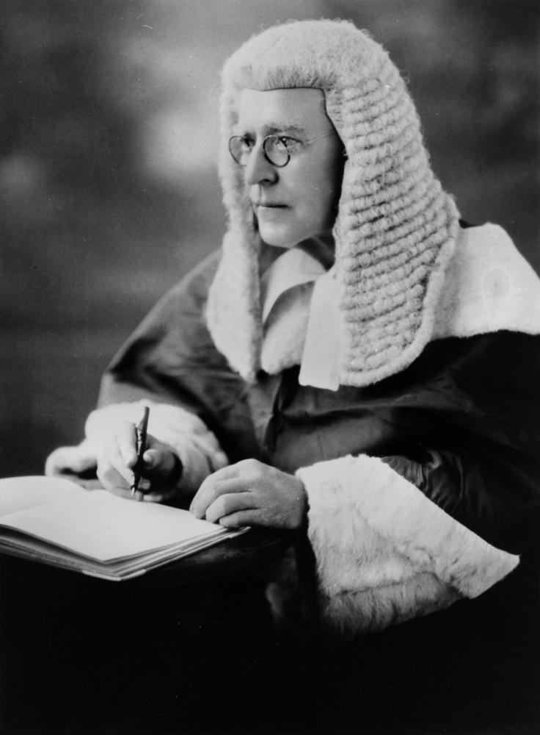

Slide 9


Slide 10
Self-regulation

Slide 11
“Software is eating the world”

Slide 12
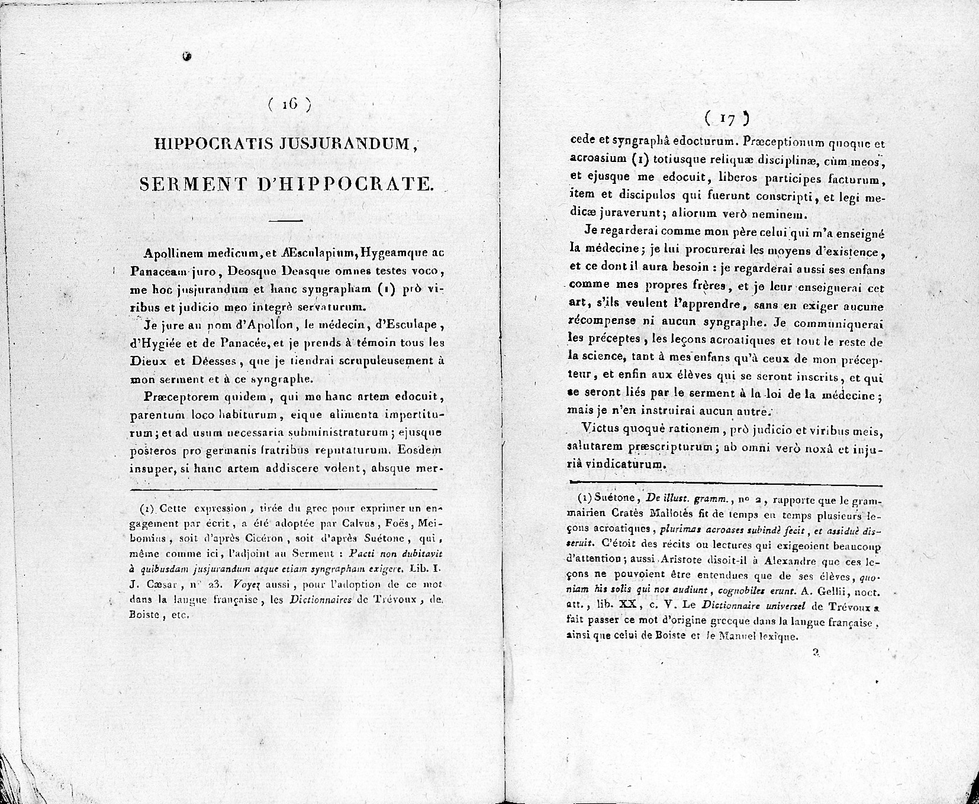

Slide 13
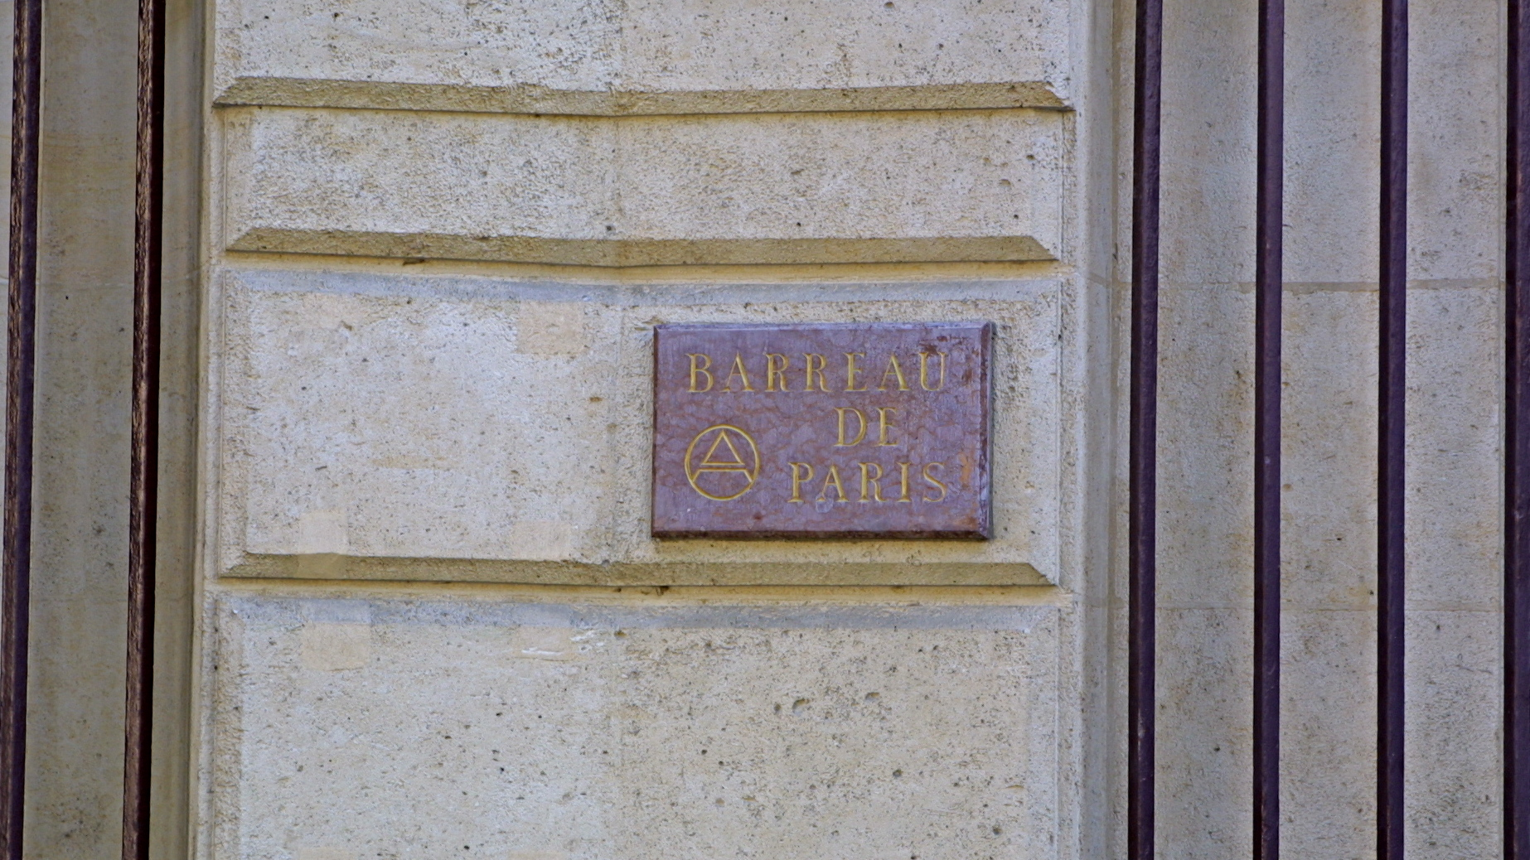

Slide 14


Slide 15
Merci | Thanks
Presentation © 2016 Richard Fontana. License: CC BY-SA 4.0. "Chevrolet Corvair Monza Coupé" by Mr.choppers. License: CC BY-SA 3.0 Unported. The OSI keyhole logo is a registered trademark of the Open Source Initiative. Use is subject to the OSI Trademark Guidelines and
Logo Usage Guidelines. "Barreau de Paris, 11 Place Dauphine 75053 Paris" by Edhral. License: CC BY-SA 2.0. All other images are in the public domain or are covered by a fair use rationale.

