Slide 1
Impact of Internal Models on Homeokenetic Controlled Autonomous Robot
Athanasios Polydoros
MSc Dissertation
Artificial Intelligence
Supervisor
Dr. M. Herrmann

Slide 2
Outline
Introduction
Principal of homeokinesis
Internal Models
Evaluation procedure
Feature plan

Slide 3
Introduction
Intelligent Autonomous Robots
  Intelligence
    Execute non-preprogrammed tasks
    Learn from experience
    Adapt to dynamic environment
  Autonomy
    Human independent
    Power and processing independent
      Higher levels
        Self-organized
        Self-regulated

Slide 4
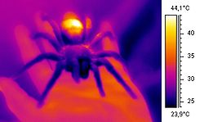
Introduction
Self-regulation
  Maintain state
Biological example
  Keep steady temperature or pH
Result:
  Maintain behaviour against disturbance

Slide 5

Introduction
Self-organization
  Order from chaos
Occurs in
  Physics (crystallization)
  Chemistry(oscillators)
  Biology (swarming)
Result
  Generation of capabilities

Slide 6
Introduction
One single robot
  Agents: motors
  Embodiment: brain, robot and environment treated as unity
    Closed loop control
    Internal model

Slide 7
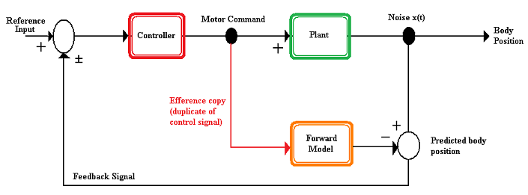
Introduction
Internal Model
  Learn the world

Slide 8
Introduction
Motivation
  Emergence of complex sensorimotor coordination
  Behaviours that fit embodiment
  Intrinsic motivated robots
Hypothesis
  Quality of internal model affects the behaviour
  Dependence between:
      Model and environment complexity
      Model and behaviour complexity

Slide 9
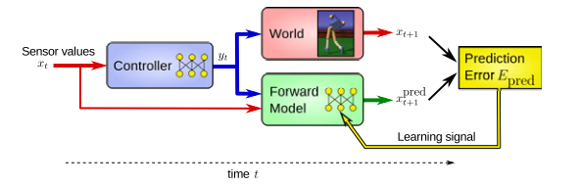

Homeokenetic Controller
[Der et al. (1999)]
The sensorimotor loop
Controller
Model
World
Prediction Error

Slide 10
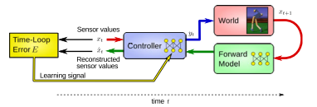




Homeokenetic Controller
[Der et al. (1999)]
The Time Loop Error
Loop model
Quantity
Time Loop Error

Slide 11
Internal Models
Recurrent Neural Networks
  Fully connected, all weights updated, RTRL
  Echo State Network, gradient descent
  Reservoir network, only output weights updated, BPDC
Regression Methods
  Linear regression, LSE
  Linear predictor, gradient descent
  Locally weighted regression, LSE

Slide 12
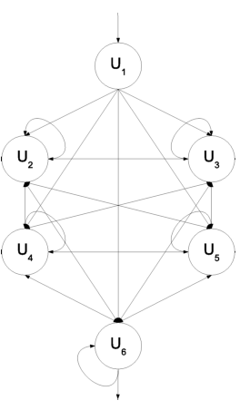

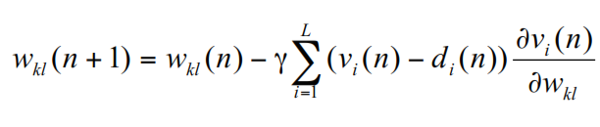
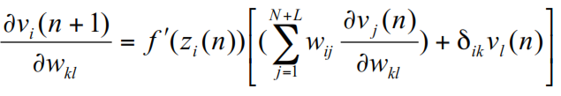
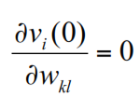
Recurrent Neural Networks
Real Time Recurrent Learning [Williams & Zipser (1989)]
  Units’ activation
  Learning Rule

Slide 13
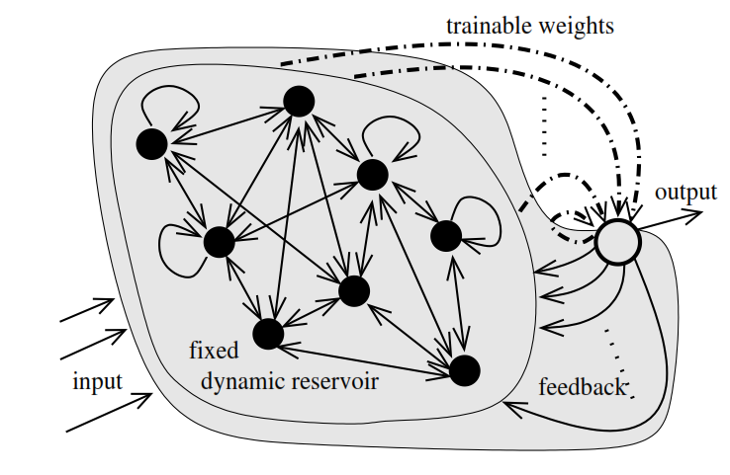

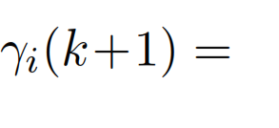

Recurrent Neural Networks
Back Propagation Decorrelation [Steil 2004]
  Units’ activation
  Learning Rule

Slide 14
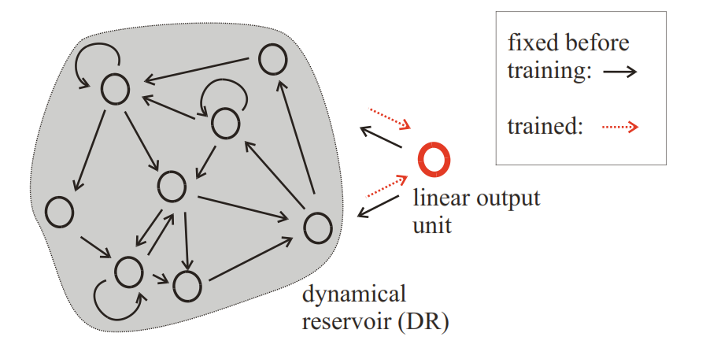
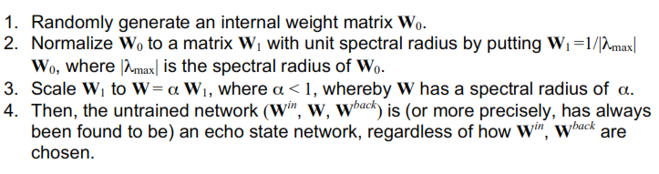
Recurrent Neural Networks
Echo State Network [Jaeger 2001]
  Echo state property
  States are contracted

Slide 15
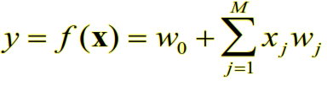

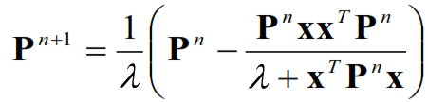
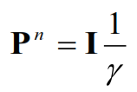

Regression Methods
Linear Regression
Least Square Estimator (BLUE)
Recursive Least Squares

Slide 16
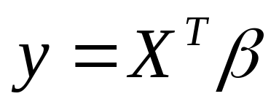
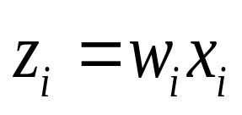
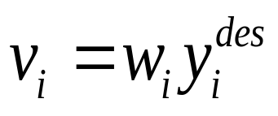



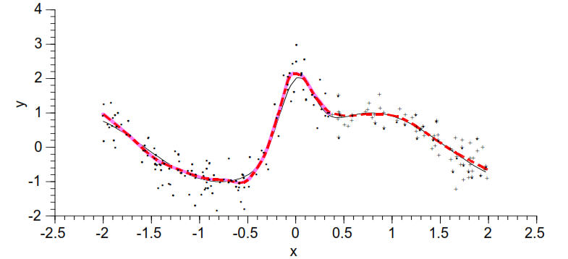
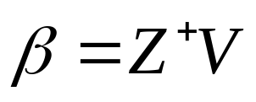
Regression Methods
Locally Weighted Regression [Atkeson et al.1991]
Weighting inputs-desired outputs
Weights derived based on distance
Least Square Estimator

Slide 17



Regression Methods
Linear Predictor
Learning Rule

Slide 18
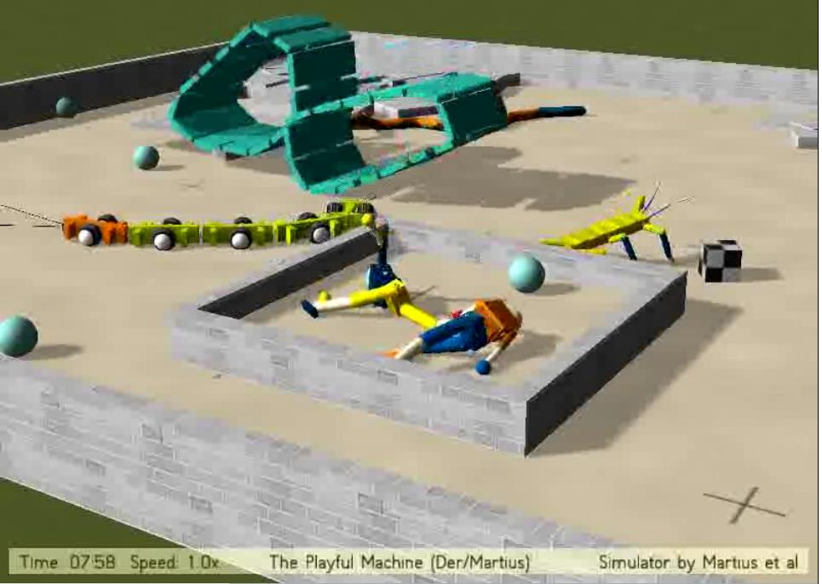
Evaluation Procedure
Software : LPZRobots [Martius et al. (2009)]
Hexapod
  12 joints/motors
Environment
  Terrain with 4 different
  degrees of complexity
Measured attributes
  Mean Squared Error
  Energy Consumption
  Position
10 simulations, 30 min each

Slide 19
Future Plan
26/07
  Derivation of evaluation results
31/07
  Completed dissertation parts
    Introduction
    Homeokinetic controller
    Internal Models
    Evaluation procedure
07/08
  Completed dissertation parts
    Evaluation Results, Conclusion
14/08 Revision
15/08 Submission

Slide 20
THE END

