Slide 1

Exploring Flutter A powerful Tool for Cross-Platform App Development
Franklin Developer Lunch & Learn
Meetup – Franklin, TN, USA
By Richard Hoehn – June 2024

Slide 2


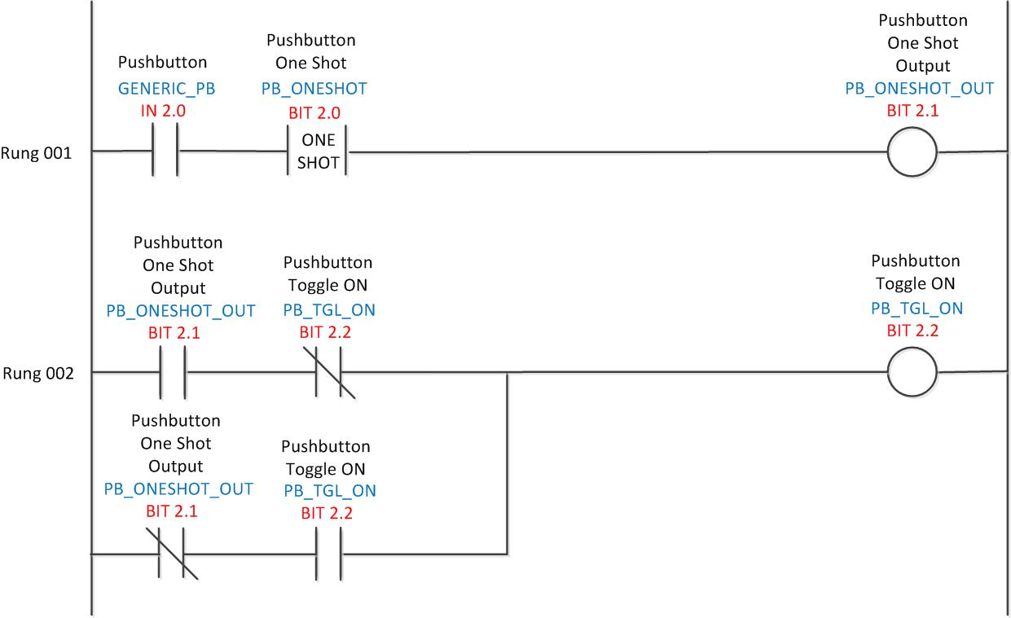
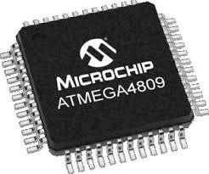

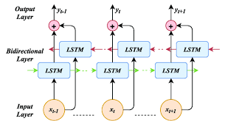
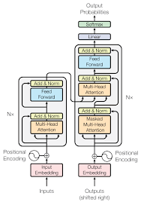




About Me
Living in Franklin, TN since 98 • Grew up in Switzerland Zurich Area • Machinist by Trade CNC Programmer • PLC – Ladder Logic ▼ Embedded ARM & AVR ▼ Web Development ▼ Application Backends
Academics
PhD Student MTSU Computational Data Science
•
Focused Research
NLP Tasks – Emotions using Transformers • Forecasting using LSTM(bi) • Inventory Location Positioning
Work
Hoehn Innovations
Technology Consulting Shop
Prior: Co-Founder / CTO Logistics Software +7yrs • Checkpoint Systems New Product Development • Griffin Technology iPhone Accessories

Slide 3
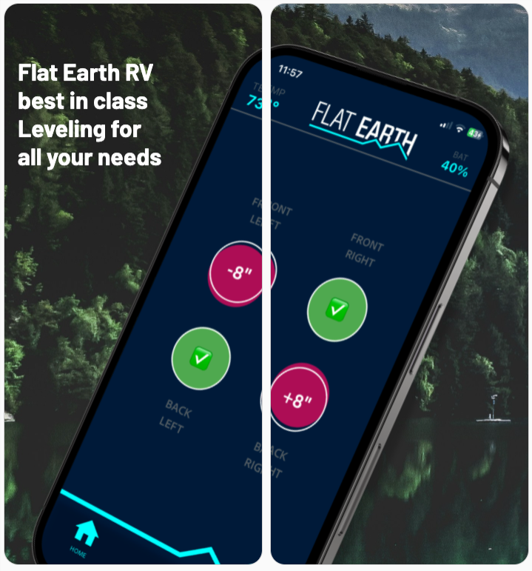
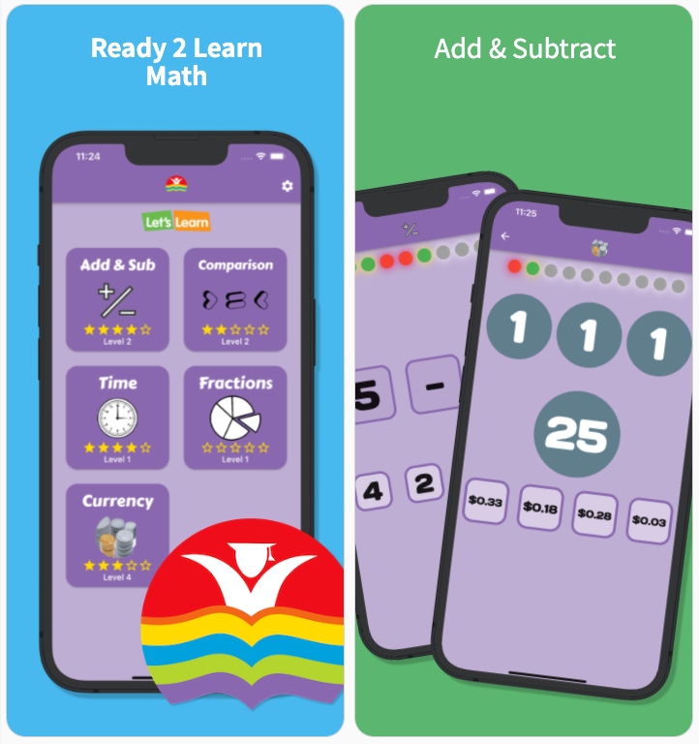
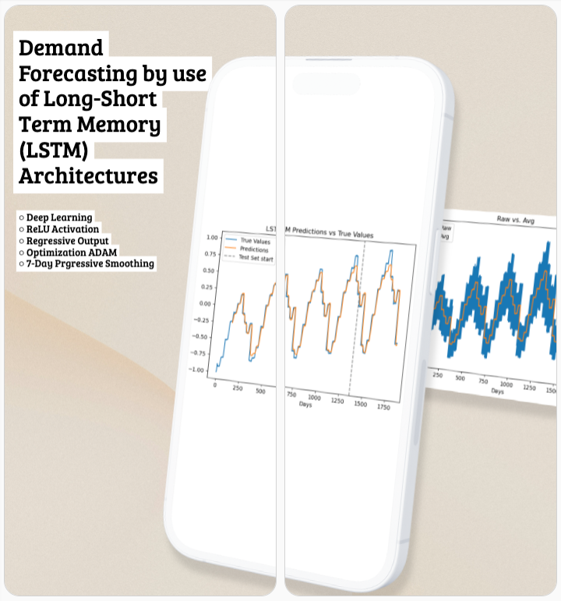
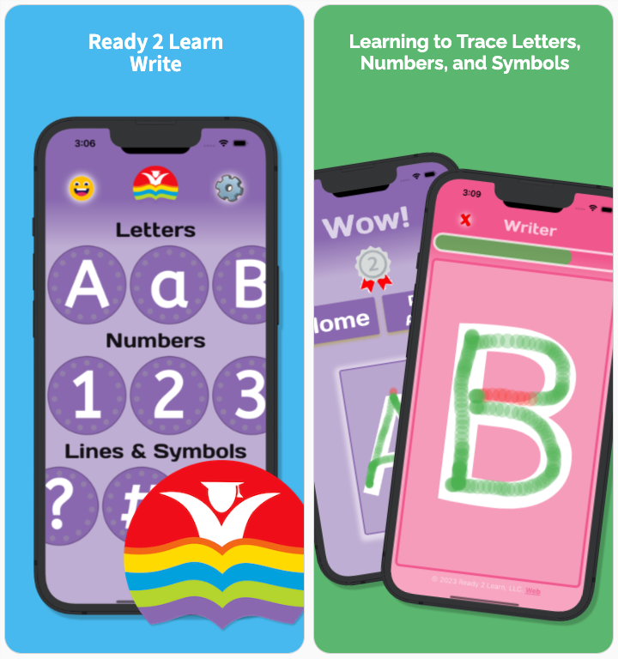
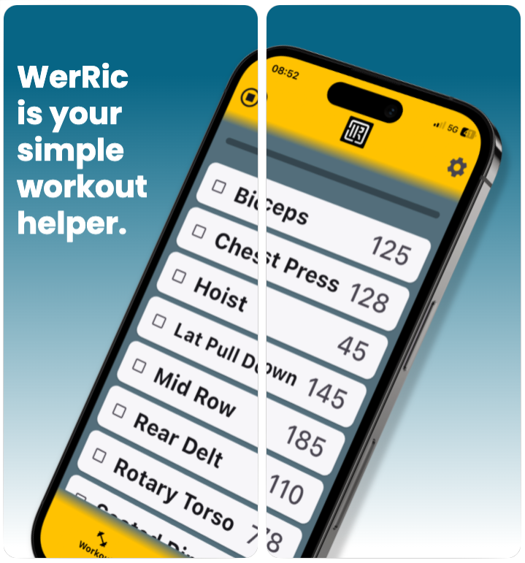
Introduction & Agenda
Introduction – Flutter is…
A cross-platform UI development Platform | Framework | SDK!
Based on Dart a Type Safe Compiled Language – By Google in 2011
Compiles to native iOS and Android – Hot-Reload on native Sim during Development!
and Finally Open-Source with a large community supporting module development
Agenda ~ 40min
What is Flutter, the Architecture, and the SDK Setup
Building an App, Widgets (both Stateless and Stateful), and the use of State Mgmt.
Methodology – Including Code Review and Demonstration!
and finally, Review of Unique Features, Demo, and Conclusions

Slide 4
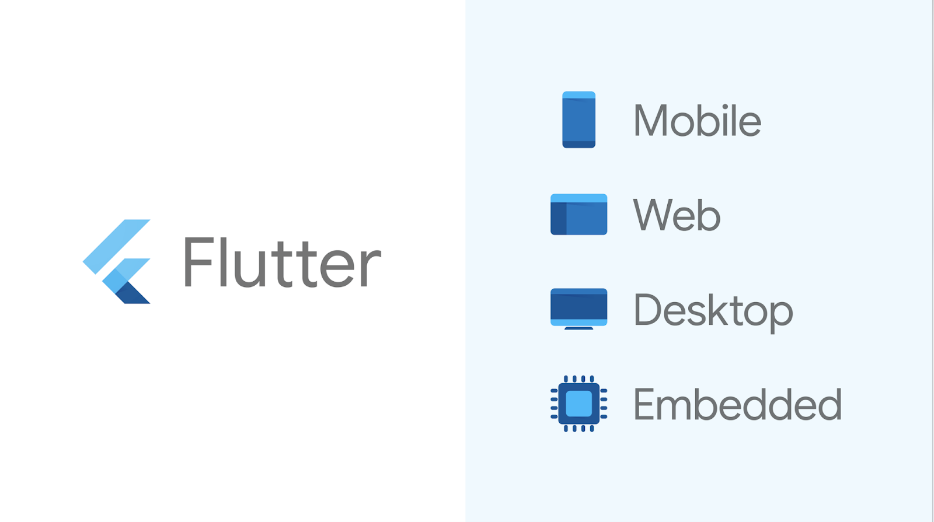
What is Flutter?
An open-source UI software development kit (SDK) created by Google.
• Flutter
Develop native Compiled Applications • Mobile (iOS, Android) Web Desktop (Windows, macOS, Linux) • From a Single codebase!

Slide 5
What is Flutter? Dart – Programing Language
Definition of Flutter
History & Development by Google
Key Features & Benefits of using Flutter
Comparison with others like: React Native & Xamarian
Example of Popular Apps made with Flutter

Slide 6
What is Flutter? Key Features & Benefits
Definition of Flutter
History & Development by Google
Key Features & Benefits of using Flutter
Comparison with others like: React Native & Xamarian
Example of Popular Apps made with Flutter

Slide 7
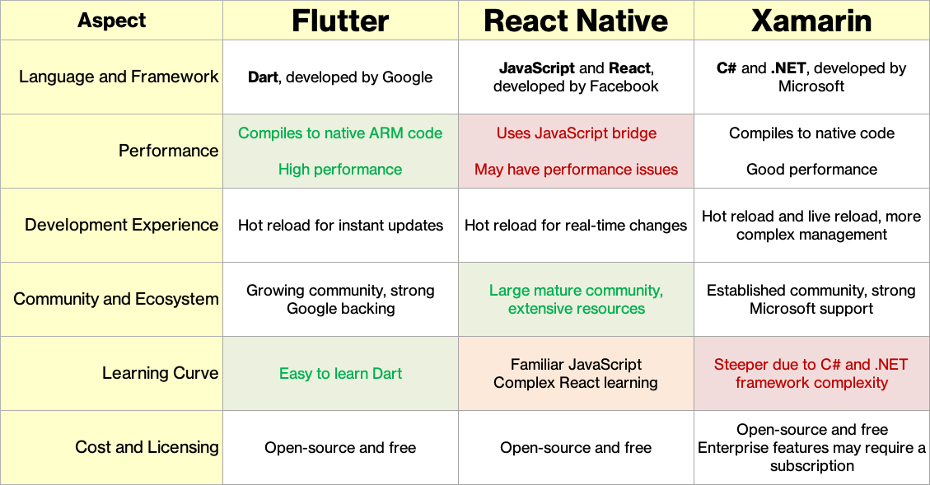
What is Flutter? Comparisons

Slide 8




What is Flutter? Popular Apps by Flutter
BMW My BMW App was launched in July 2020 and has established itself in 47 countries on five continents as a universal interface providing the user a seamless experience between mobile phone and vehicle.
eBay Motors eBay Motors ships a new version of their app to both app stores every week. Their apps share 98.3% of their code, the eBay Motors app has a single source of truth — which means one set of meetings, one set of designs, one backlog queue, and one team to manage.
Google Pay 1.1 million lines of code instead of 1.7 million from previous native versions. At the same time, the team estimates that they’ve saved about 60-70% of their engineers’ time because a single codebase.
Nubank Nubank is the largest independent digital bank outside of Asia, giving over 48 million users financial banking tools. Flutter provides more UI consistency. Using native tools, Nubank used to have multiple and inconsistent component libraries.

Slide 9
Flutter Architecture
Overview of Flutter Architecture
Explanational of Dart Programing Language
Structure of a Flutter App: Widgets, State, and the Build Context

Slide 10
Setting Up Flutter
System Requirements
Installation process for Flutter SDK
Setting up an IDE
Creating a new Flutter project

Slide 11
Building a Simple Flutter App
Intro to Flutter’s widget tree
Explanation of StatelessWidget and StatefulWidget
Building a basic Us with Flutter widgets
Live coding / demo: Create a simple “Hello World!” app

Slide 12
State Management
Importance of state management in Flutter
Overview of different state mgmt. solutions: Provider, Riverpod, and Bloc
Example of using Riverpod for state mgmt.

Slide 13
Flutter for Mobile and Beyond
Cross-platform: iOS, Android, Web, and Desktop
Advantages of using a single codebase for multiple platforms

Slide 14
Unique Features of Flutter
Hot Reload: Instant updates with restarting the app
Consistent UI across platforms due to custom rendering engine
Skia Graphics Engine: Smooth and fast rendering, even for complex animations

Slide 15
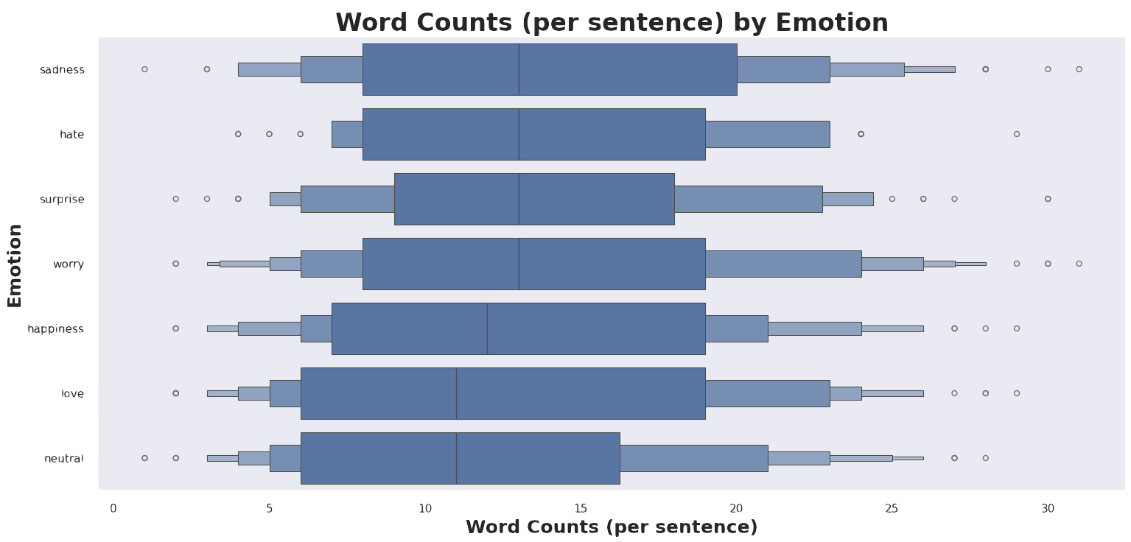
Methodology Sentence / Word Tokenization
Tokenizer can encode up to 512
Checked the Longest Sentence / Tokens
Decided to tokenize on 64 length
Shortening the token length generally improves training efficiency by reducing the computational load
# Setup / Instantiate the Tokenizer
tokenizer = BertTokenizer.from_pretrained("bert-base-uncased", do_lower_case=True)
# Show Detail on the BERT Tokenizer
print(f'Vocab size: {tokenizer.vocab_size}')
print(f'Max length: {tokenizer.model_max_length}')
print(f'Tokenizer Model Input: {tokenizer.model_input_names}')
# Vocab size: 30522
# Max length: 512
# Tokenizer Model Input: ['input_ids', 'token_type_ids', 'attention_mask’]
# Example of Tokenizer
print('Encoded text')
encoded_text = tokenizer("Hello World!",
add_special_tokens = True,
max_length = 10,
truncation=True,
padding=True)
print(encoded_text,'\n')
# {'input_ids': [101, 7592, 2088, 999, 102], 'attention_mask': [1, 1, 1, 1, 1]}

Slide 16

Demo & Code Review

Slide 17
Conclusions and Q&A
Concluding The model was verging on over-fitting. This is to be expected since there where only 1,500 sentences to train on.
The prediction rate is still not great compared to BERT models with lots of data! Those achieve up to 76%[12] in accuracy.
BERT outperformed the Naive Bayes and Random Forest models by over 6 - 10%, with far fewer epochs and hence less training time required. that it .

Slide 18


