Slide 1
Improving Emotion Detection Through Translation of Text to ML Models Trained in Different Languages
Qualifying Exam – Computational Data & Sciences
By Richard Hoehn
MTSU – August 2023

Slide 2
Welcome
Richard Hoehn
●
Living Franklin
●
MTSU Grad 2005, Vanderbilt Grad 2009
●
Last 15 years in SW development for Retail & Logistics Applications
● Primarily in Databases, API / PubSub Integration Work, and Business Reporting Apps

Slide 3
Introduction & Agenda
Introduction
Research on Emotion Detection (ED) in Text with an emphasis improving Prediction Rates
Specifically by extending Data through Translation to Different Languages
Training Multiple ML Models on Original & Extended Data to Compare Prediction Rates
and Finally in Real-Time Translate Text to process in Parallel for further expansion
Agenda
Significance of Emotion Detection
Challenges, Motivation and Scope of Research
Methodology – Including Code Review and Demonstration!
and finally Analysis of Results, Conclusion, and Future Work

Slide 4
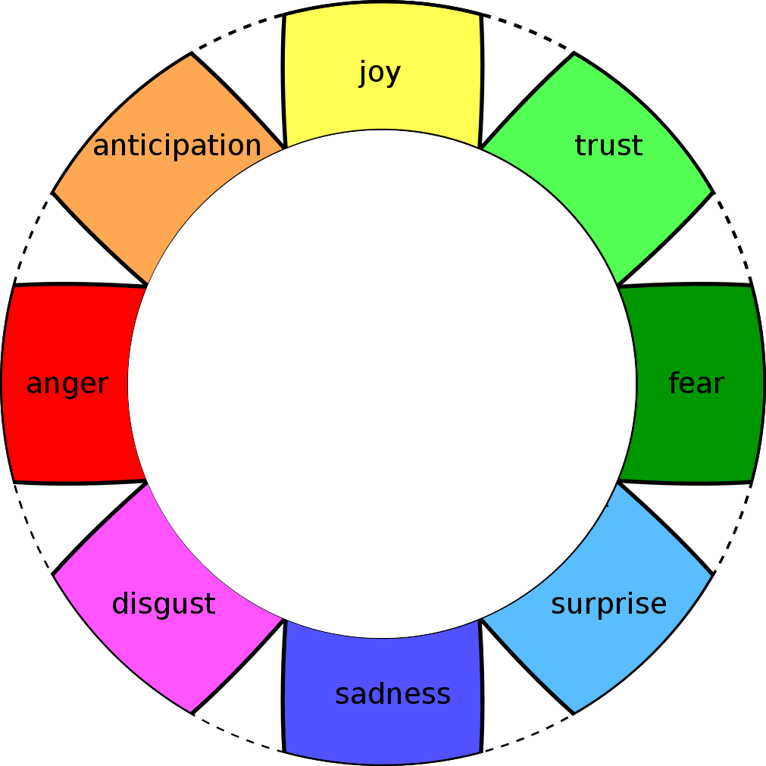
Significance of Emotion Detection
Emotions can vary depending on the framework or model being considered.
One well-known model is the Plutchik’s Wheel of Emotions, which proposes eight (8) primary emotions.
Joy / Happiness
Sadness
Anger
Worry / Fear
Surprise
Disgust / Hate
Trust / Love
Anticipation / Enthusiasm
By accurately identifying and understanding emotions from text data, ML applications can assist in improving:
User Experiences (chat-bots),
Decision-Making Processes
and Overall human-machine interactions in a positive manner[4, 5], with most of these interactions being processed in real-time.
ED is still a growing field in Text, Video, and Image reading. The market for ED software and services is estimated to reach $3.8billion[2] by 2025.

Slide 5
Challenges: Data Scarcity & Language Fragmentation
Emotion detection data requires primarily supervised learning data! Meaning human curated and labeled data.
Unlike Sentiment Analysis (SA) the availability of large datasets for training purposes of ML models is much smaller[3].
Many datasets that are available are in many different languages
Emotions in text are contextual in nature; meaning they conform in many cases based on the type and language and culture using them.

Slide 6
Motivation for Research and Evaluation of Dataset Extending for ML Prediction
ED is still a growing field in Text, Video, and Image reading. The market for ED software and services is estimated to reach $3.8billion[2] by 2025.
ED spans most all domains such like psychology, business, and education.
By use of ML models the analysis of human emotions at scale provides valuable insights into individual and collective emotional states both in real-time but also for measuring sentiments from the past versus the current time.
A recent paper[1] states that ”Emotions hold a paramount role in the conversation, as it expresses context to the conversation.”, this means that emotions are a part of a conversation and with that are needed to ensure valid analysis of a conversation.

Slide 7
Objectives & Scope of Research
The research project’s objectives were three-fold:
The first is to translate English data (feature & label) to German in order to extend the original German dataset for ML training purposes. With this will the added text lead to better predictions?
Similarly, can by translating German data to English and extending an original English dataset increase the predictability of English ML model?
And Lastly shifting the focus to real-time translation and its impact on prediction. Can by translating in real-time an input to multiple languages improve the predictability based on the combined output of two models.
In summary, this research project investigated innovative ways to enhance the predictability of Emotion Detection models in English and German.
With these three (3) objectives from above the scope was to Procure, Translate, Train, and Evaluate benefits of extending datasets by translation to improve emotion detection.

Slide 8
Literature Review
Our research considered publications only past 2015, thereby providing an up-to-date perspective on ED analysis.
”Emotions hold a paramount role in the conversation, as it expresses context to the conversation.” [1]
This means that emotions are a part of a conversation and with that are needed to ensure valid analysis of a conversation
Emotions can differ across Age groups, Genders, Cultures, and Languages[6], which again support our approach of using 2015 and beyond data
Fragmentation caused by different languages further exacerbates the issue of ED, as it reduces the size and diversity of data available for training, resulting in limited cross-lingual generalization and potentially biased models.[7]

Slide 9
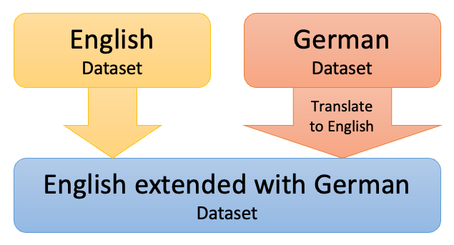
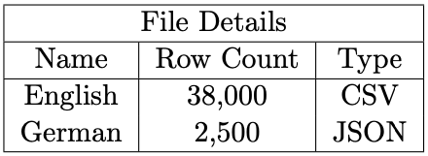
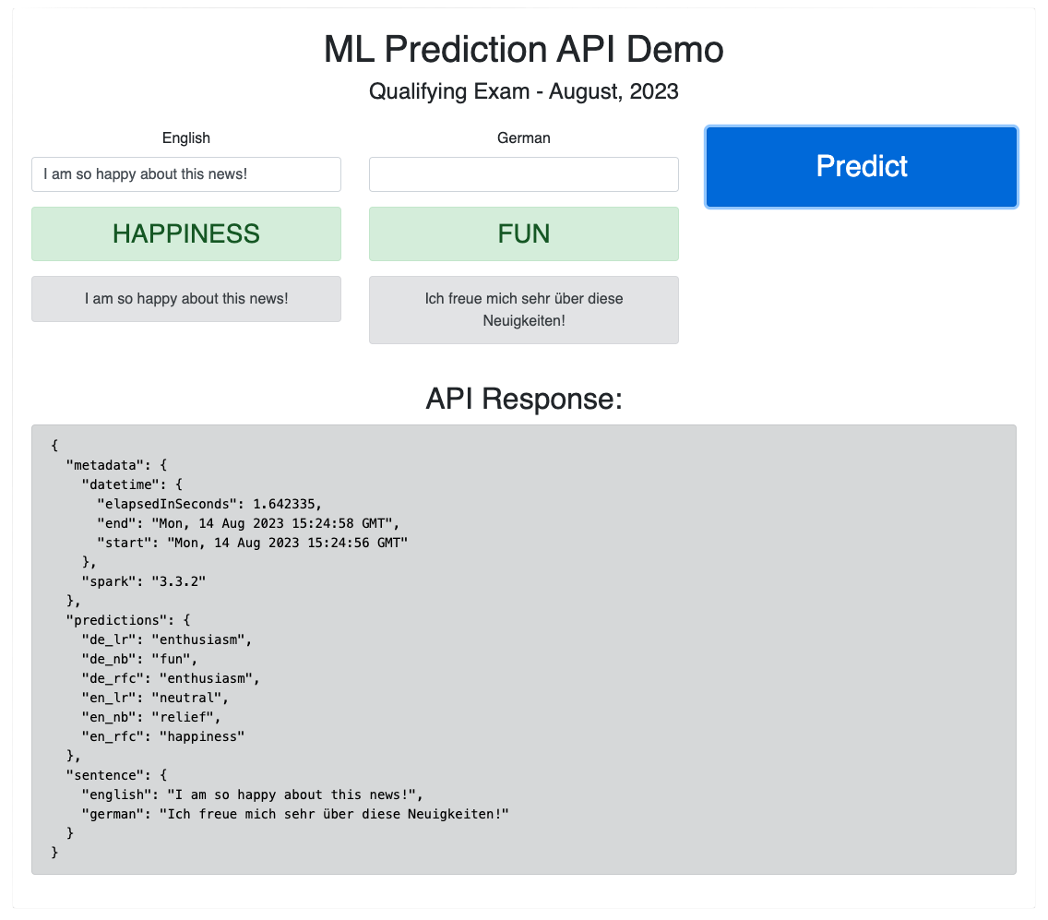
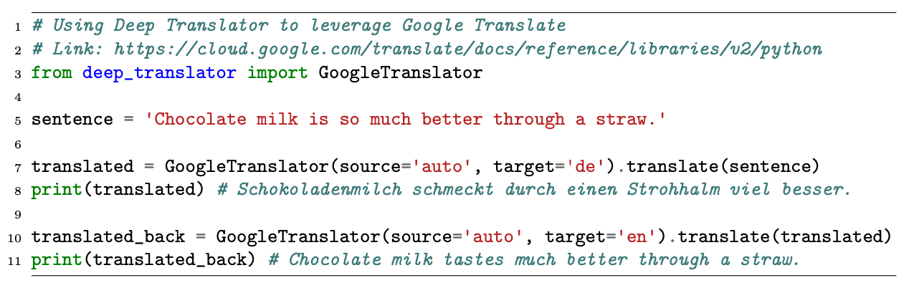
Methodology
Data Procurement
Parsing & Cleanup
Dataset Translation & Extending
ML Training & Testing
API for Real-Time Translation & Prediction

Slide 10
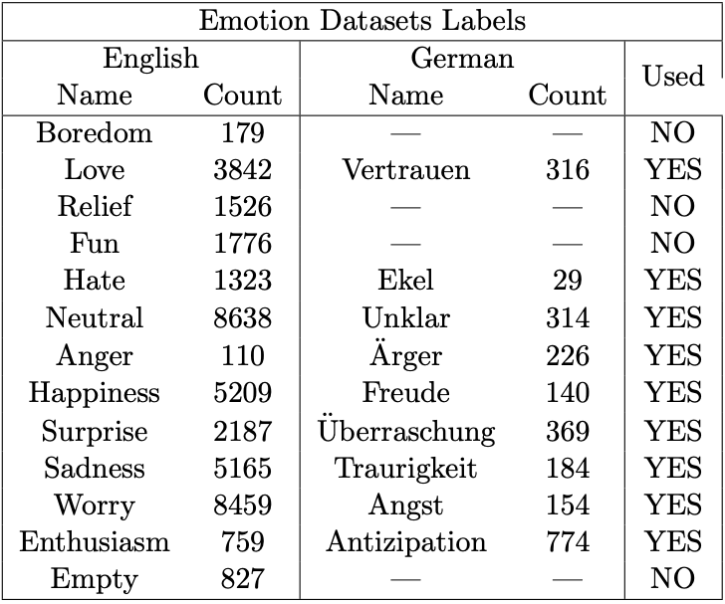
Methodology Data Procurement
The data procurement was relatively straight forward and once found by using multiple Google search terms for the Emotion Detection in English and German text languages.
The German data was obtained from the dataset built by ETH’s Emotion and Stance Detection for German Text[4] based on voting feedback.
The English dataset was downloaded from Kaggle[8] based on Tweets collected in 2021.
Unfortunately, there was a large quantity difference between German and English!

Slide 11

Methodology Parsing, Cleanup, & Emotion Linkage
By use of Jupyter Notebooks the English (csv) and German (JSON) files were read and processed ease of demo.
For processing I opted to use Pandas over PySpark.
Google Translator was used for Translation – Their API is Free!
# Emotion Panda DataFrame
# This was predetermined by review of the emotion from English to German
emotion_key = {
"boredom": "---",
"love": "Vertrauen",
"relief": "---",
"fun": "---",
"hate": "Ekel",
"neutral": "Unklar",
"anger": "Ärger",
"happiness": "Freude",
"surprise": "Überraschung",
"sadness": "Traurigkeit",
"worry": "Angst",
"enthusiasm": "Antizipation",
"empty ": "---",
"---": "Keine"
}
# Create a DataFrame from the emotion_key dictionary
df_emotions = pd.DataFrame(emotion_key.items(), columns=['emotion_en', 'emotion_de'])
# This google API take a Sentence and converts to German
def translate(sentence, dest_lang):
try:
translator = Translator()
translator.raise_Exception = True
translation = translator.translate(sentence, dest=dest_lang)
time.sleep(0.5) # Add a delay (This is due to rate limit of 1/s)
return translation.text
except Exception as e:
print(f"Translation Error: {e}")
return None

Slide 12
Methodology Translation Application
# 1
# Merge German Emotions onto English
df_en = pd.merge(df_en, df_emotions, on='emotion_en', how='left’)
# 2
# Add German Sentence Column
df_en["sentence_de"] = ""
# 3
# Randomly select 1500 rows
df_en = df_en.sample(n=1500, random_state=2023)
# 4
# Save original to Disk df_en.to_csv('./data/pd_en.csv', index=False)
# 5
# Iterate over the rows with tqdm to show the progress
for index, row in tqdm(df_en.iterrows(), total=df_en.shape[0]):
# 6
# Call Translation
sentence = translate(row["sentence_en"], 'de’) # To German (‘de’)
# 7
# Save Sentence on Column
df_en.at[index, 'sentence_de'] = sentence
# 8
#Save the file with all the translations!
df_en.to_csv('./data/pd_en_translated.csv', index=False)

Slide 13
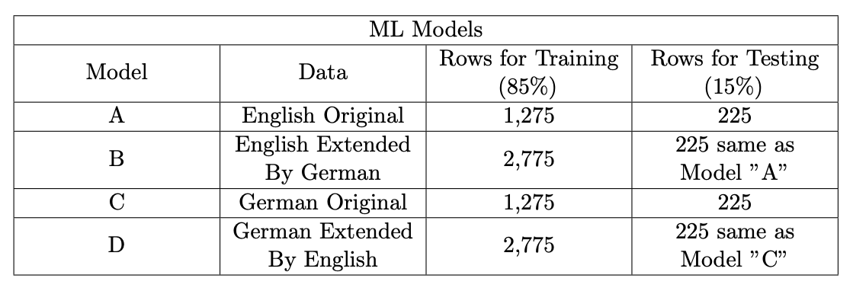
Methodology Dataset Extension
# Split the English and German Dataframes for Training and Testing
# We are using a 20/80 Split
df_en_train, df_en_test = df_en.randomSplit([0.85, 0.15], seed=2023)
df_de_train, df_de_test = df_de.randomSplit([0.85, 0.15], seed=2023)
print(f"English Train Row Count: {df_en_train.count()}")
print(f"German Train Row Count: {df_de_train.count()}")
# Create the Extended Dataframe wiht Translated Data
df_en_train_extended = df_en_train.union(df_de.select(*df_en_train.columns))
df_de_train_extended = df_de_train.union(df_en.select(*df_de_train.columns))
print(f"English Extended Train Row Count: {df_en_train_extended.count()}")
print(f"German Extended Train Row Count: {df_de_train_extended.count()}")

Slide 14

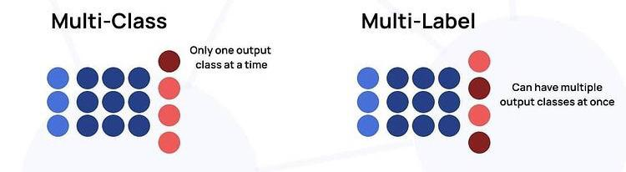
Methodology ML Training & Testing with PySpark Multi-Class Classification
Due to the eight (8) emotions present our research we decided to build of type Multi-Class Classification Model
This is due to the research scope to be in search of predictive improvement and measuring a single class of emotion is more distinct than using Multi-Label Classificaiton

Slide 15
Methodology ML Training & Testing with PySpark Pipeline: 1
Tokenizer
Count Vectorizer
Logistic Regression
Naïve Bayes
Word 2 Vec
Random Forest Classifier
Stop Words Remover
1 - Tokenization
Used DistilBERT (multi-language) for word tokenization.
We used the DistilBERT from Hugginface’s Transformers[9] due to it’s download size and multi-language features.
We opted to not use case sensitive tokenization due to the nature of tweets generally not following capitalizations and us mixing English with German.
5
3
6
1
2
4
7

Slide 16
Methodology ML Training & Testing with PySpark Pipeline: 2, 3, & 4
Tokenizer
Count Vectorizer
Logistic Regression
Naïve Bayes
Word 2 Vec
Random Forest Classifier
Stop Words Remover
2 - Stop Words Remover Removing words that occur commonly across the dataset.
3 - Count Vectorizer Is a method to convert text to numerical data.
4 - Word 2 Vec Is a way to group the vectors of similar words together in order to detect similarities mathematically. This was only used on Random Forest Classifier
5
3
6
1
2
4
7

Slide 17
Methodology ML Training & Testing with PySpark Pipeline: 5, 6, & 7
Tokenizer
Count Vectorizer
Logistic Regression
Naïve Bayes
Word 2 Vec
Random Forest Classifier
Stop Words Remover
Learning Models – All Supervised
5 – Logistic Regression It uses a logistic function to model the dependent variable. Standard approach but not optimal for Multi-Class approach. But works well when having classes.
6 – Naïve Bayes This model is a probabilistic machine learning model that’s used for classification task. Generally only used with Text.
7 – Random Forest Classifier RFC consists of a large number of individual decision trees that operate as a group. Each individual tree spits out a class prediction and the class with the most votes becomes our model’s prediction. Also helps with overfitting!
5
3
6
1
2
4
7

Slide 18

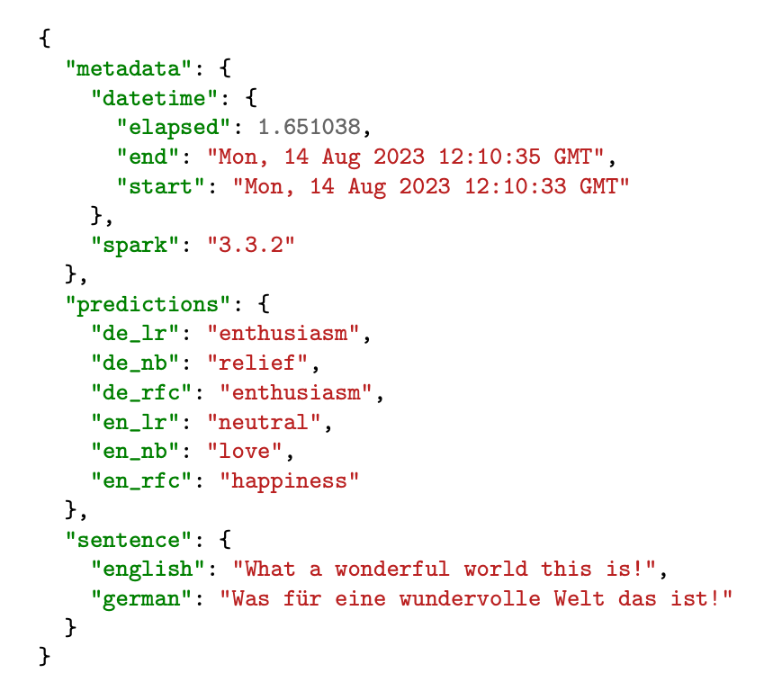
Methodology Creating an API for Real-Time Testing
In order to test Real-Time translation a simple API was created that exposed a GET method and processed a query-string.
The Server Performed:
Setting up a Flask Python Server
Loaded the Saved ML models
And processed by translation a query-string
Return the predicted values and translated sentence via JSON back to the calling client.

Slide 19
Demo & Code Review

Slide 20
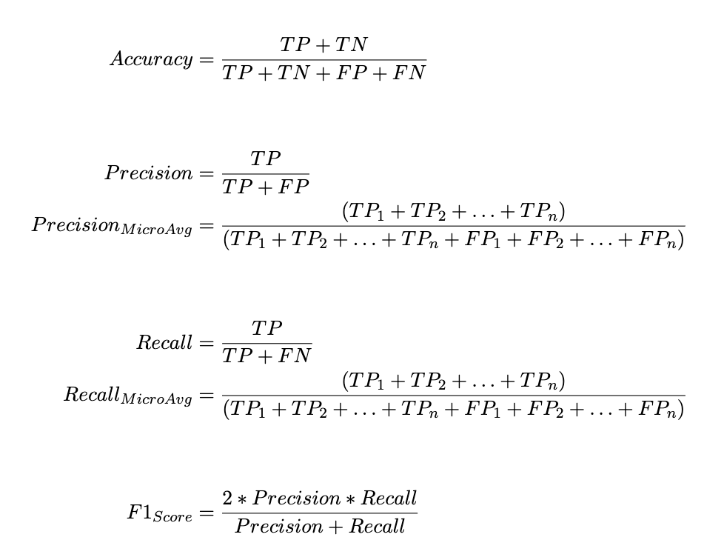
Results & Analysis
We used the Accuracy and F1 Score for our analysis on the results.
Taking the F1 Score into is important on Multi-Class models and therefore got higher importance given
Recall & Precision – Multi-Class
Due to the Multi-Class nature, we used the Micro Average on the Recall & Precision
This in turn gave us an accurate F1 Score
F1 Score because it assigns equal weight to each emotion regardless of the class label and the number of labels.

Slide 21
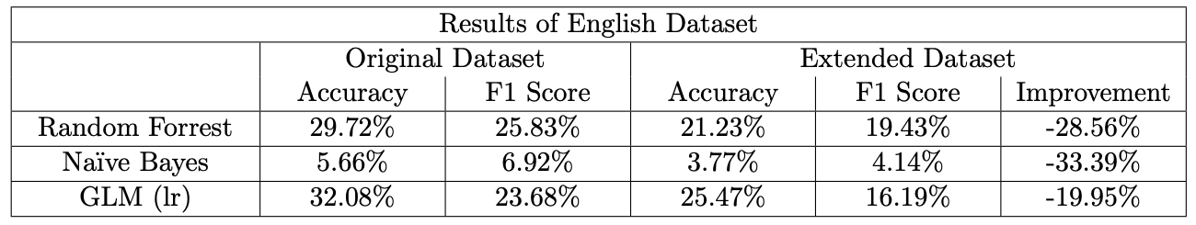
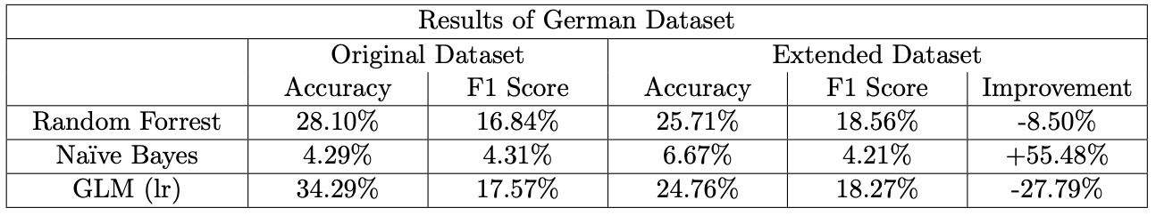
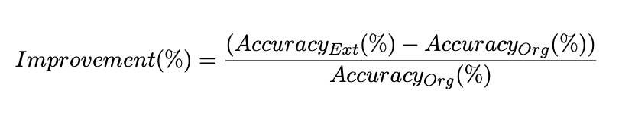
Results & Analysis Prediction Results of Original & Extended Datasets
Very low Prediction Rates were achieved during testing! Disappointing
Negative Improvements
Both on Accuracy
and F1 Score
Initally the GLM predicts better but the F1 Score is higher on RFC

Slide 22
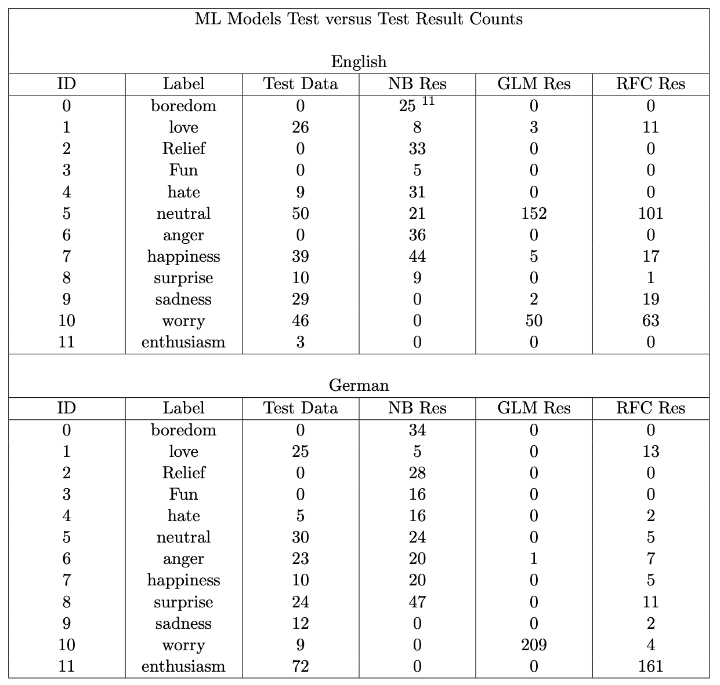
Results & Analysis Analysis of Original Dataset
Overall the prediction results from all trained models is Disappointing.
Although in the previous slide the GLM model predicted better on both German & English, I believe that:
NB on German performed better due to the distribution of TP values
RFC on English performed better due to the distribution of TP values
There’s an absence of context for the models to operate effectively and grasp the intricate nuances of both the English and German languages.
Secondly, in cases where class data is lacking, the models tend to memorize existing sentences[10], rather than learn the underlying patterns of the language.

Slide 23
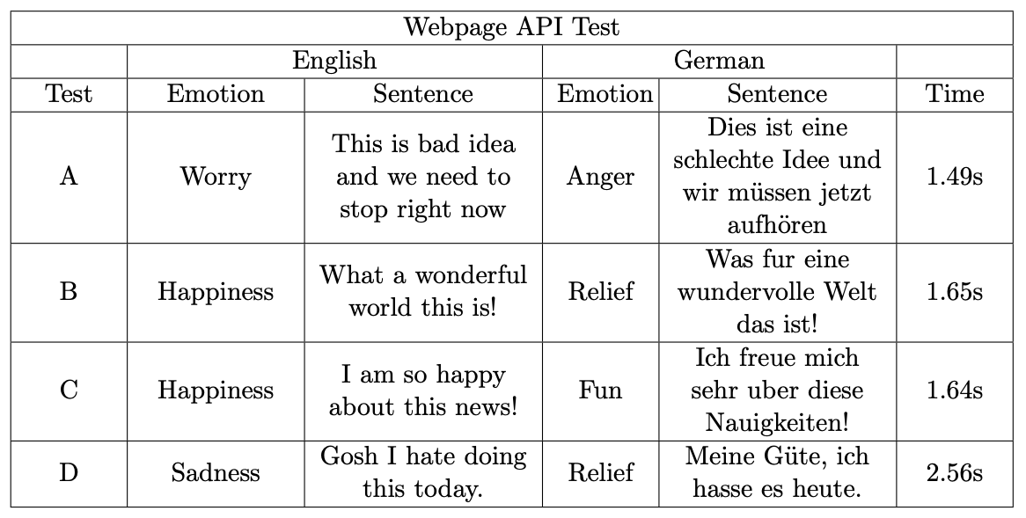
Results & Analysis Real-Time API Translation and Prediction
Considering the disappointing outcomes of data extension via translation, our approach of utilizing real-time translation through the creation of an API and translating text in real-time for both German and English appears to be unsatisfactory in terms of achieving any substantial improvement as well.

Slide 24
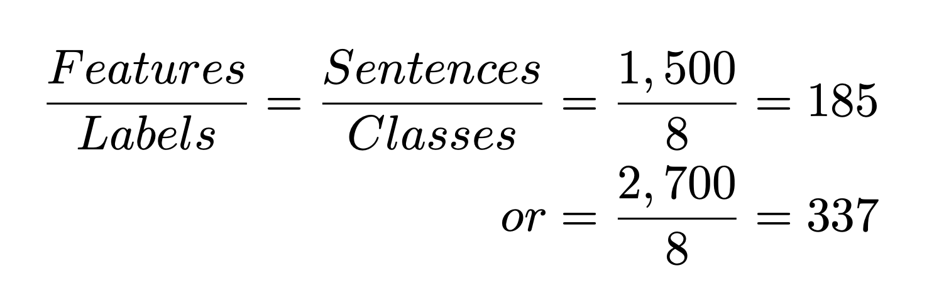
Conclusions & Future Work
Concluding No significant improvements through translation by extending the dataset improved prediction results. We believe one of the main culprits is that the data for learning based on eight classes was insufficient.
The models seemingly resorted to memorizing[10] the sentence rather than learning the intricacies of the labeled classes.
Areas of Future Work
Firstly, conducting further tests involving the translation of different models using diverse translation services. While Google Cloud’s translation service sufficed for this research, superior paid subscription-based translation services are available.
Secondly, to overcome the lack of data we could use AI to generated sentences that are similar yet distinct from the original. This could be achieved by providing a sentence and its associated labeled class for data creation. This approach aims to produce additional sentences imbued with similar emotional attributes, potentially expanding the labeled dataset.

Slide 25

Thank you

Slide 26
Citations
Andry Chowanda et al. “Exploring Text-based Emotions Recognition Machine Learning Techniques on Social Media Conversation”. In: Procedia Computer Science 179 (2021). 5th International Conference on Computer Science and Computational Intelligence 2020, pp. 821– 828. issn: 1877-0509. doi: https : / / doi . org / 10 . 1016 / j . procs . 2021 . 01 . 099. url: https://www.sciencedirect.com/science/article/pii/S1877050921001320.
Jay Stanley. ”THE DAWN OF ROBOT SURVEILLANCE”. 2019. url: https://www.aclu. org/report/dawn-robot-surveillance
Sajani Ranasinghe et al. “An Artificial Intelligence Framework for the Detection of Emotion Transitions in Telehealth Services”. In: July 2022, pp. 1–5. doi: 10.1109/HSI55341.2022.9869503.
Laura Mascarell et al. “Stance Detection in German News Articles”. In: Proceedings of the Fourth Workshop on Fact Extraction and VERification (FEVER). Dominican Republic: Association for Computational Linguistics, Nov. 2021, pp. 66–77. doi: 10.18653/v1/2021.fever-1.8. url: https://aclanthology.org/2021.fever-1.8.
Valentina Colonnello, Katia Mattarozzi, and Paolo M Russo. “Emotion recognition in medical students: effects of facial appearance and care schema activation”. In: Medical Education 53.2 (2019), pp. 195–205. doi: https://doi.org/10.1111/medu.13760. eprint: https:// onlinelibrary.wiley.com/doi/pdf/10.1111/medu.13760. url: https://onlinelibrary.wiley.com/doi/abs/10.1111/medu.13760.
Shalini Kapoor and Tarun Kumar. “Detecting emotion change instant in speech signal using spectral patterns in pitch coherent single frequency filtering spectrogram”. In: Expert Systems with Applications 232 (2023), p. 120882. issn: 0957-4174. doi: https://doi.org/10.1016/j.eswa.2023.120882. url: https://www.sciencedirect.com/science/article/pii/S0957417423013842.
Sheetal Kusal et al. “AI Based Emotion Detection for Textual Big Data: Techniques and Contribution”. In: Big Data and Cognitive Computing 5.3 (2021). issn: 2504-2289. doi: 10.3390/bdcc5030043 . url: https://www.mdpi.com/2504-2289/5/3/43.
Kaggle. Url: https://www.kaggle.com/datasets/pashupatigupta/emotion-detection-from-text
Victor Sanh et al. “DistilBERT, a distilled version of BERT: smaller, faster, cheaper and lighter”. In: ArXiv abs/1910.01108 (2019).
Xue Ying. “An Overview of Overfitting and its Solutions”. In: Journal of Physics: Conference Series 1168 (Feb. 2019), p. 022022. doi: 10.1088/1742-6596/1168/2/022022.

