Slide 1
Comparing BERT Transformer Results To Naive Bayes & Random Forest Models for Emotion Detection
CSCI 6350
Selected Topics in AI: Natural Language Processing (NLP)
By Richard Hoehn MTSU – April 2024

Slide 2
Welcome
Richard Hoehn
●
Living Franklin
●
MTSU Grad 2005, Vanderbilt Grad 2009
●
PhD Student Computational & Data Science
● Web & Mobile Applications, Databases, API / PubSub Integrations, and Product Development

Slide 3
Introduction & Agenda
Introduction
Explore effectiveness of BERT Transformer for Emotion Detection with small datasets
Compare to previous work on Naïve Bayes & Random Forest Models
Visual Plots indicating Training & Validation and comparing Test with past model results
and Finally compare to current BERT ED work on larger datasets.
Agenda
Significance of Emotion Detection
Challenges, Motivation and Scope of Research
Methodology – Including Code Review and Demonstration!
and finally, Analysis of Results, Comparisons, Conclusion, and Future Work

Slide 4
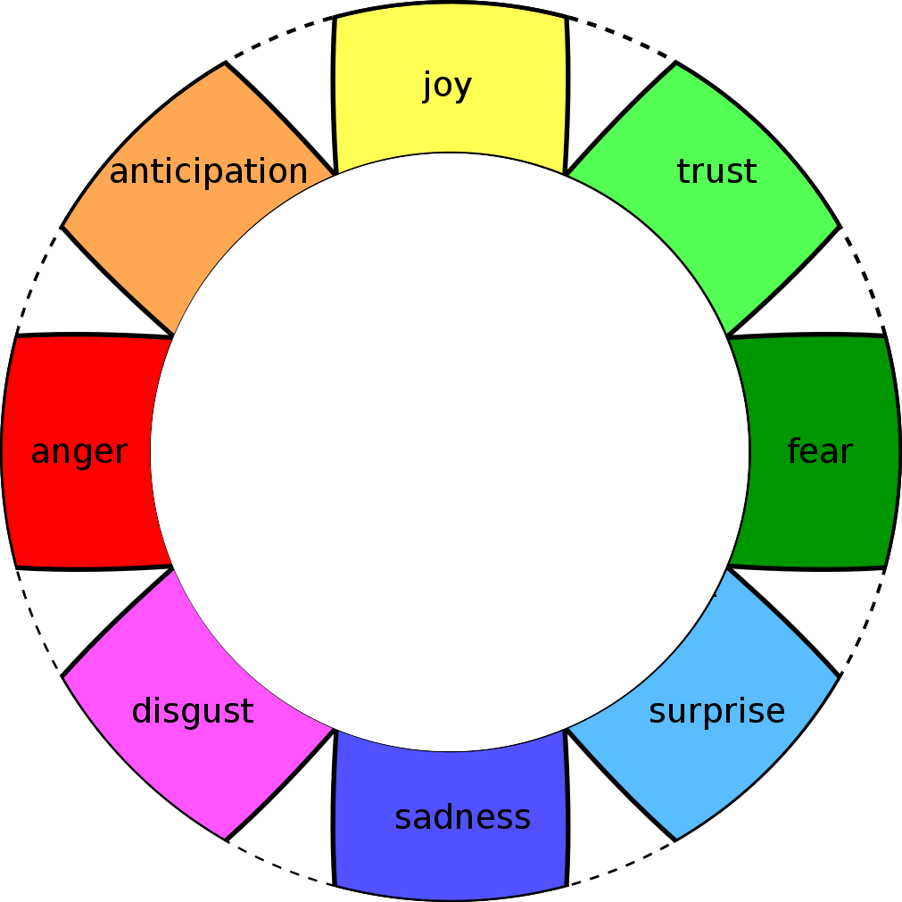
Significance of Emotion Detection
Emotions can vary depending on the framework or model being considered.
One well-known model is the Plutchik’s Wheel of Emotions, which proposes eight (8) primary emotions.
Joy / Happiness
Sadness
Anger
Worry / Fear
Surprise
Disgust / Hate
Trust / Love
Anticipation / Enthusiasm
Accurately Identifying emotions can improve:
User Experiences (chat-bots),
Decision-Making Processes
and Overall human-machine interactions in a positive manner[4, 5]
With most of these interactions being processed in real-time.

Slide 5
Challenges: Data Scarcity & Language Fragmentation
Emotion detection data requires primarily supervised learning data! Meaning human curated and labeled data.
Unlike Sentiment Analysis (SA) the availability of large datasets for training purposes of ML models is much smaller[3].
Many datasets that are available are in many different languages
Emotions in text are contextual in nature; meaning they conform in many cases based on the language and culture using them.

Slide 6
Motivation for Research? Evaluation of Models for Prediction?
ED is still a growing field in Text, Video, and Image reading.
The market for ED software and services is estimated to reach $3.8billion[2] by 2025.
What model can be used for ED to improve on my past work? Random Forest, Naïve Bayes, or BERT?
A recent paper[1] states that ”Emotions hold a paramount role in the conversation, as it expresses context to the conversation.”, this means that emotions are a part of a conversation and with that are needed to ensure valid analysis of a conversation.

Slide 7
Objectives & Scope of Research
This Graduate Project’s objectives were:
Build, Train, and Validate a Transformer for Emotion Detection, using PyTorch[6].
Display the learning rates and validation results in graphical forms using plots.
Evaluate the Transformer’s results against those from Hoehn[11] et al.’s paper. In specific the Naive Bayes & Random Forest results.
Compare the transformer with Lee et al.’s transfer learning-based emotion detection model[12] to ensure comparative results in ED have been achieved with the fine-tuned model.
In summary, this research project investigated BERT Tranformers to enhance the predictability of Emotion Detection and compare to previous work by Hoehn[11].

Slide 8
Methodology
1) Data Preparation & Pre-Processing
2) Feature Engineering & Label Encoding
3) Sentence / Word Tokenization
4) Model Training & Validation
5) Test & Comparison

Slide 9
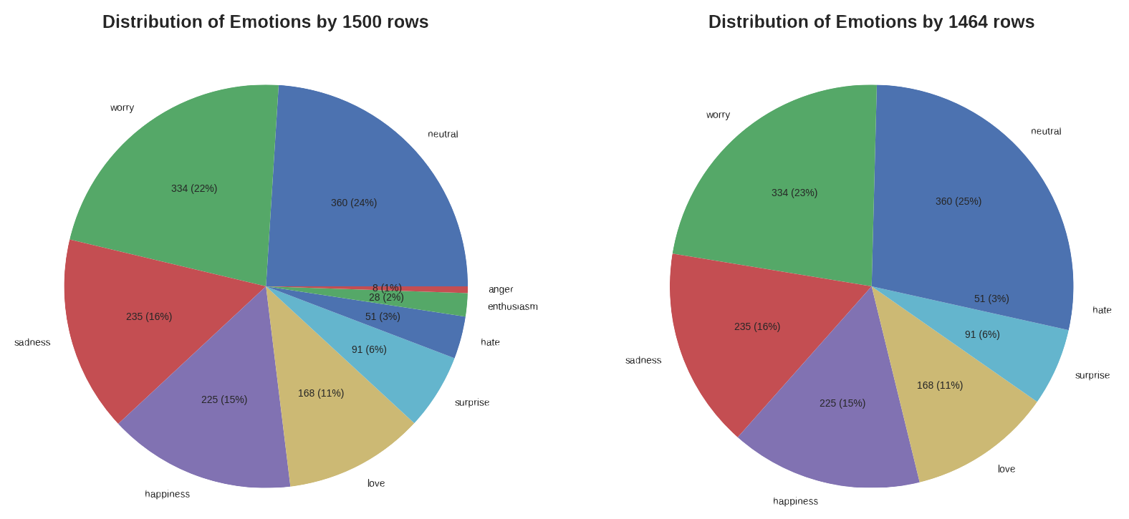
Methodology Data Preparation & Pre-Processing
Loaded data into Pandas for review
Visualized the distribution of the emotions.
Removed:
Anger
Enthusiasm
Emotion Count: 7
Only 1,464 rows of sentence and labeled emotions

Slide 10

Methodology Feature Engineering & Label Encoding
By use of Label Encoder converted named emotion to numerical values
Indexes:
0 - 'Happiness’
1 - 'Hate’
2 - 'Love’
3 - 'Neutral’
4 - 'Sadness’
5 - 'Surprise’
6 - 'Worry'
# SKlearn
from sklearn.preprocessing import LabelEncoder
# Label Encoding the Emotions
label_encoder = LabelEncoder()
# Encode labels in column 'emotion_en'
df['label'] = label_encoder.fit_transform(df['emotion_en'])
# Show Updated Dataframe
display(df.head(10))

Slide 11
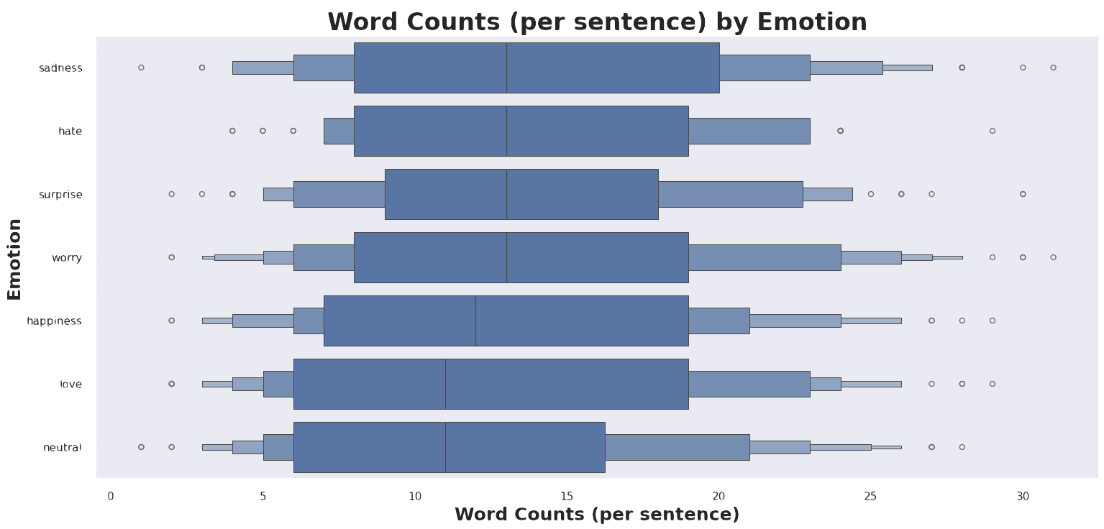
Methodology Sentence / Word Tokenization
Tokenizer can encode up to 512
Checked the Longest Sentence / Tokens
Decided to tokenize on 64 length
Shortening the token length generally improves training efficiency by reducing the computational load
# Setup / Instantiate the Tokenizer
tokenizer = BertTokenizer.from_pretrained("bert-base-uncased", do_lower_case=True)
# Show Detail on the BERT Tokenizer
print(f'Vocab size: {tokenizer.vocab_size}')
print(f'Max length: {tokenizer.model_max_length}')
print(f'Tokenizer Model Input: {tokenizer.model_input_names}')
# Vocab size: 30522
# Max length: 512
# Tokenizer Model Input: ['input_ids', 'token_type_ids', 'attention_mask’]
# Example of Tokenizer
print('Encoded text')
encoded_text = tokenizer("Hello World!",
add_special_tokens = True,
max_length = 10,
truncation=True,
padding=True)
print(encoded_text,'\n')
# {'input_ids': [101, 7592, 2088, 999, 102], 'attention_mask': [1, 1, 1, 1, 1]}

Slide 12
Methodology Sentence / Word Tokenization
Example:
Sentence that was tokenized at 64 length
Attention mask used
Start and Stop Tokens 101 & 102
Sentence: ->
@Desert_Star95 oh so you know how I feel then Damn representative for bank of america tried to make it sound like I did it. What a b ...
Tokens: ->
'input_ids’:
[101, 1030, 5532, 1035, 2732, 2683, 2629, 2821, 2061, 2017, 2113, 2129, 1045, 2514, 2059, 4365, 4387, 2005, 2924, 1997, 2637, 2699, 2000, 2191, 2009, 2614, 2066, 1045, 2106, 2009, 1012, 2054, 1037, 1038, 1012, 1012, 1012, 102, 0, 0, 0, 0, 0, 0, 0, 0, 0, 0, 0, 0, 0, 0, 0, 0, 0, 0, 0, 0, 0, 0, 0, 0, 0, 0],
'attention_mask’:
[1, 1, 1, 1, 1, 1, 1, 1, 1, 1, 1, 1, 1, 1, 1, 1, 1, 1, 1, 1, 1, 1, 1, 1, 1, 1, 1, 1, 1, 1, 1, 1, 1, 1, 1, 1, 1, 1, 0, 0, 0, 0, 0, 0, 0, 0, 0, 0, 0, 0, 0, 0, 0, 0, 0, 0, 0, 0, 0, 0, 0, 0, 0, 0]
Label: -> 6 Emotion: -> worry

Slide 13
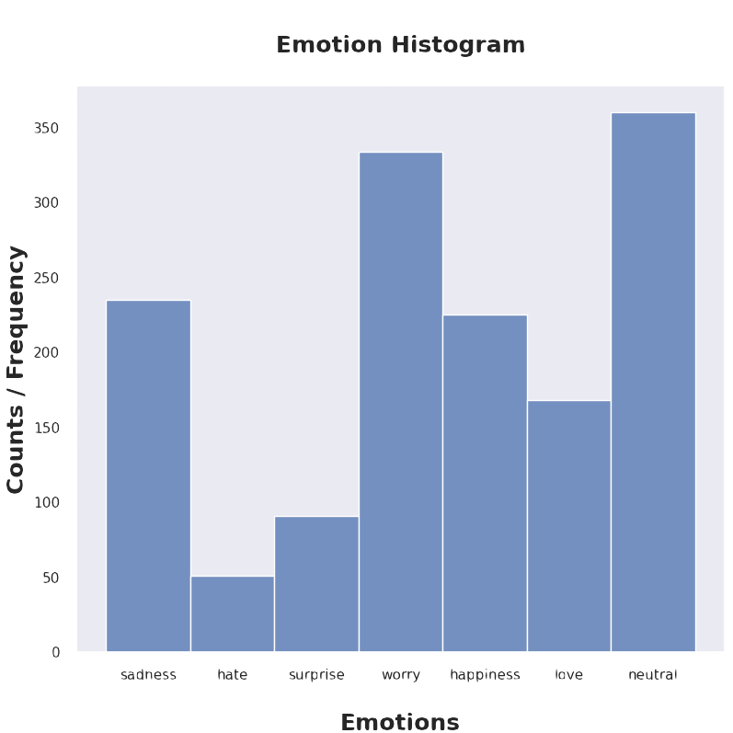
Methodology Model Training & Validation
Create Training, Validation, and Testing Datasets 80%, 10% and 10%
Use Stratification for randomization!
This maintains the distribution of labels across datasets.
# SKlearn
from sklearn.model_selection import train_test_split
# Get Classes
n_classes = len(df["label"].unique())
print(f"Unique Classes: {n_classes}")
# Settings
PCT_TRAIN = 0.8 # => 80%
X_train, X_test, y_train, y_test = train_test_split(tokens,
labels,
test_size=(1-PCT_TRAIN),
random_state=SEED,
stratify=labels)
X_val, X_test, y_val, y_test = train_test_split(X_test,
y_test,
test_size=0.5, # Split in Half (50%)
random_state=SEED,
stratify= y_test )

Slide 14
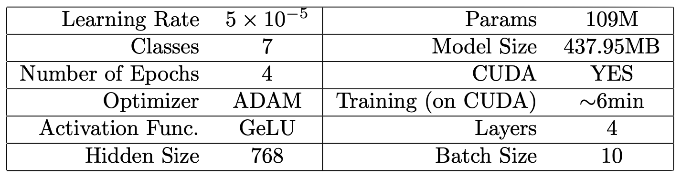
Methodology Model Training & Validation
BERT Model – Init, Forward, & Predict
class BertClassifier(pl.LightningModule):
def __init__(self, n_classes: int, learning_rate:float):
super().__init__()
self.bert = BertForSequenceClassification.from_pretrained("bert-base-uncased", num_labels=n_classes)
self.learning_rate = learning_rate
self.accuracy = Accuracy(num_classes = n_classes, task='multiclass')
def forward(self, input_ids, attention_mask, labels=None):
output = self.bert(input_ids, attention_mask=attention_mask, labels=labels)
return output
def predict(self, input_ids, attention_mask):
self.eval() # Set the model to evaluation mode
with torch.no_grad(): # Disable gradient calculation.
outputs = self.bert(input_ids, attention_mask=attention_mask)
logits = outputs.logits
probs = F.softmax(logits, dim=1) # Return probabilities
return probs

Slide 15
Methodology Model Training & Validation
BERT Model – Training Step
def training_step(self, batch, batch_idx):
input_ids, attention_mask, labels = batch
output = self.forward(input_ids, attention_mask, labels)
# Get Loss
loss = output.loss
self.log('train_loss', loss, on_step=False, on_epoch=True)
# Get Acc
logits = output.logits
preds = torch.argmax(logits, dim=1)
acc = self.accuracy(preds, labels)
self.log('train_acc', acc, on_step=False, on_epoch=True)
# Get Learning Rate (for Logging)
lr = self.trainer.optimizers[0].param_groups[0]['lr’]
self.log('lr', lr, on_step=False, on_epoch=True)
return loss

Slide 16
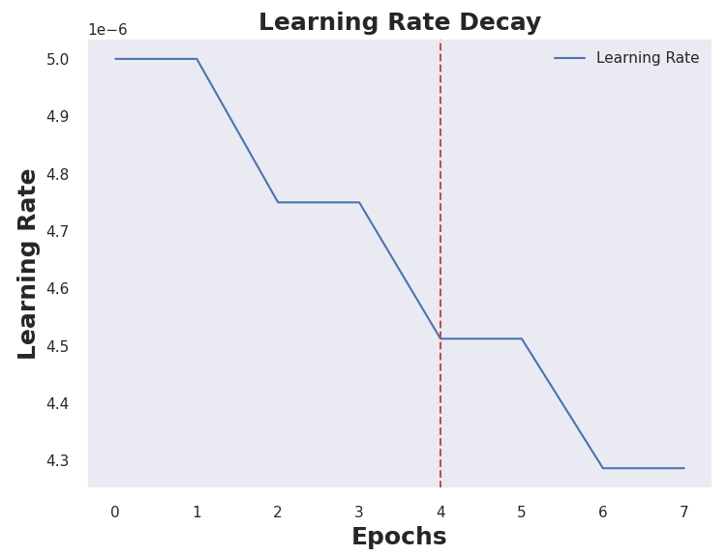
Methodology Model Training & Validation
BERT Model – Optimizer
def configure_optimizers(self):
# Define Optimizer
optimizer = torch.optim.Adam(self.parameters(), lr=self.learning_rate)
# Define LR scheduler
scheduler = {
'scheduler': StepLR(optimizer,
step_size = 1, # Drop Each Epoch
gamma = 0.95), # 5% Drop in LR
'interval': 'epoch',
'frequency': 2,
}
# Return the Optimizer and Scheduler in Dictionary List
return [optimizer], [scheduler]

Slide 17

Demo & Code Review

Slide 18
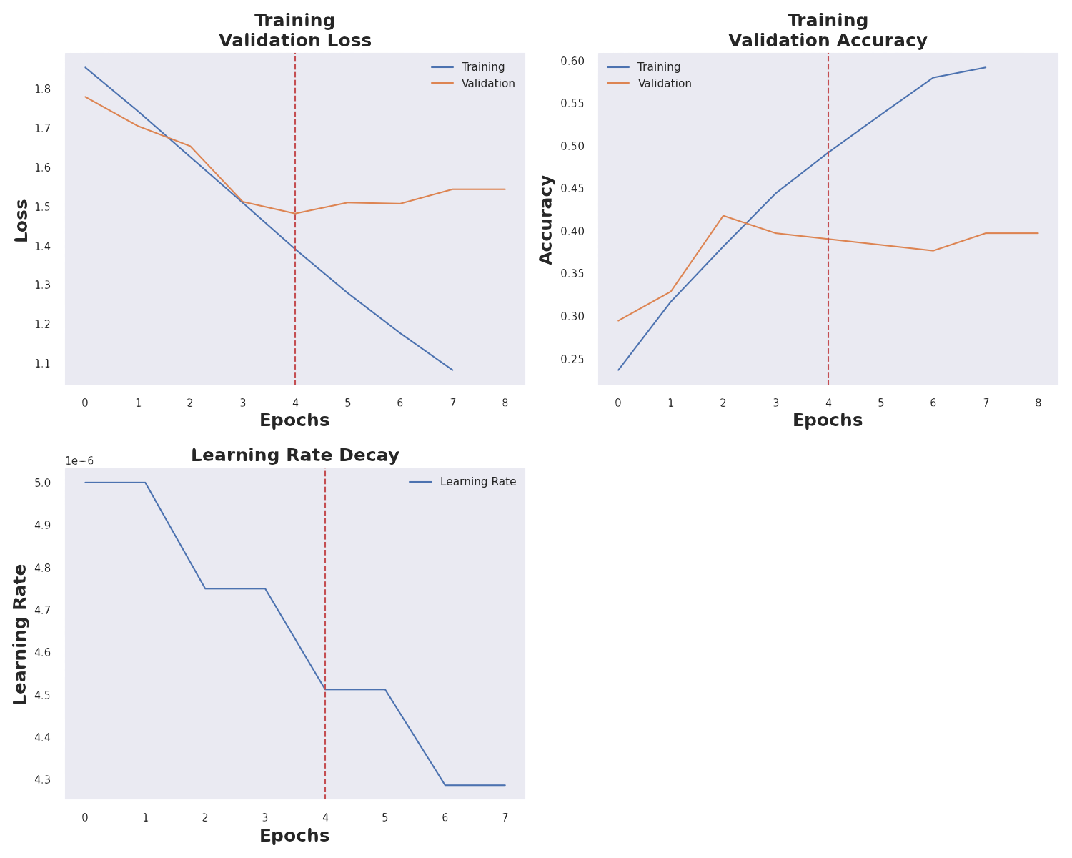
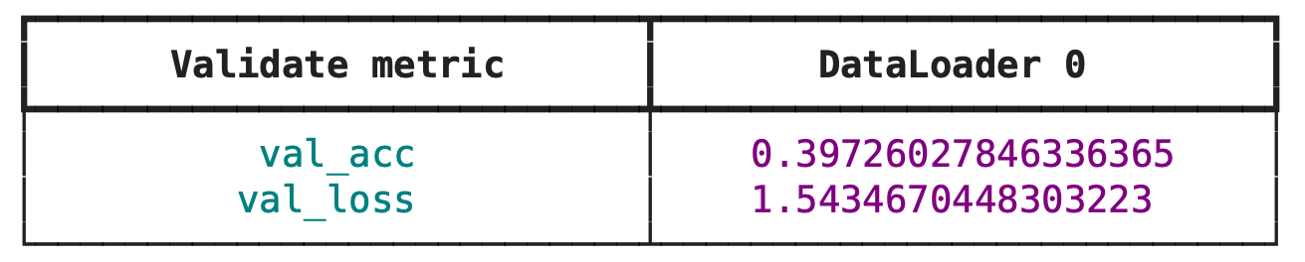
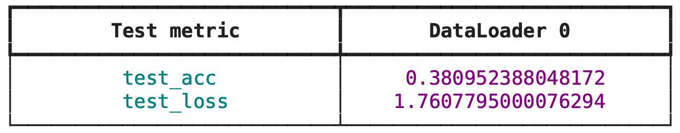
Results & Analysis
Best convergence achieved with only 4 Epochs
Early stopping allowed for quicker training time
Validation Acc: 39%
Test Acc: 38%
Model was not – overfitted!

Slide 19
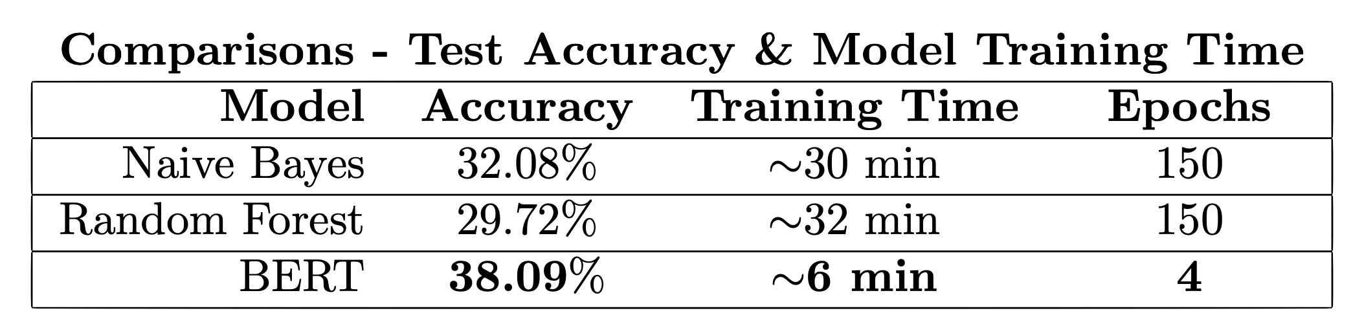
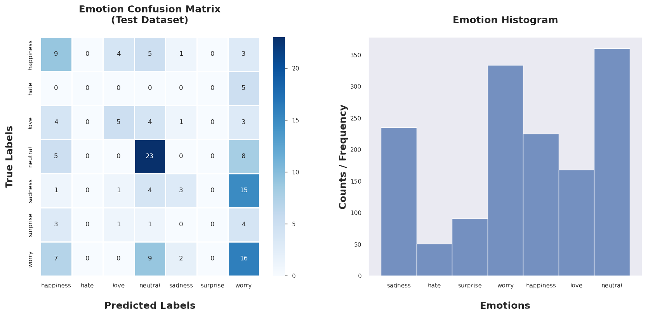
Results & Analysis Prediction Results
Improved over Naïve Bays and Random Forest
Training Time Improvements
Confusion Matrix indicated Neutral to good predictor
Miss Classifications:
’Happiness’ and ’Neutral’
’Love’ and ’Neutral’
’Sadness’ and ’Worry’
’Neutral’ and ’Happiness’ are the most prevalent emotions, while ’Hate’ has the least occurrence.

Slide 20
Conclusions & Future Work
Concluding The model was verging on over-fitting. This is to be expected since there where only 1,500 sentences to train on.
The prediction rate is still not great compared to BERT models with lots of data! Those achieve up to 76%[12] in accuracy.
BERT outperformed the Naive Bayes and Random Forest models by over 6 - 10%, with far fewer epochs and hence less training time required. that it .
Areas of Future Work
Regularization Techniques Implementing more sophisticated regularization techniques could help mitigate the overfitting observed in the training process. Techniques such as dropout variations, L2 regularization (weight decay) might help.
Exploration of Learning Rate Schedules The learning rate schedule has a big impact on the training dynamics of BERT. Experimenting with different schedules, might lead to better optimization pathways and quicker convergence without falling into local minima or overfitting

Slide 21

Thank you

Slide 22
Citations
Andry Chowanda et al. “Exploring Text-based Emotions Recognition Machine Learning Techniques on Social Media Conversation”. In: Procedia Computer Science 179 (2021). 5th International Conference on Computer Science and Computational Intelligence 2020, pp. 821– 828. issn: 1877-0509. doi: https : / / doi . org / 10 . 1016 / j . procs . 2021 . 01 . 099. url: https://www.sciencedirect.com/science/article/pii/S1877050921001320.
Jay Stanley. ”THE DAWN OF ROBOT SURVEILLANCE”. 2019. url: https://www.aclu. org/report/dawn-robot-surveillance
Sajani Ranasinghe et al. “An Artificial Intelligence Framework for the Detection of Emotion Transitions in Telehealth Services”. In: July 2022, pp. 1–5. doi: 10.1109/HSI55341.2022.9869503.
Laura Mascarell et al. “Stance Detection in German News Articles”. In: Proceedings of the Fourth Workshop on Fact Extraction and VERification (FEVER). Dominican Republic: Association for Computational Linguistics, Nov. 2021, pp. 66–77. doi: 10.18653/v1/2021.fever-1.8. url: https://aclanthology.org/2021.fever-1.8.
Valentina Colonnello, Katia Mattarozzi, and Paolo M Russo. “Emotion recognition in medical students: effects of facial appearance and care schema activation”. In: Medical Education 53.2 (2019), pp. 195–205. doi: https://doi.org/10.1111/medu.13760. eprint: https:// onlinelibrary.wiley.com/doi/pdf/10.1111/medu.13760. url: https://onlinelibrary.wiley.com/doi/abs/10.1111/medu.13760.
Shalini Kapoor and Tarun Kumar. “Detecting emotion change instant in speech signal using spectral patterns in pitch coherent single frequency filtering spectrogram”. In: Expert Systems with Applications 232 (2023), p. 120882. issn: 0957-4174. doi: https://doi.org/10.1016/j.eswa.2023.120882. url: https://www.sciencedirect.com/science/article/pii/S0957417423013842.
Sheetal Kusal et al. “AI Based Emotion Detection for Textual Big Data: Techniques and Contribution”. In: Big Data and Cognitive Computing 5.3 (2021). issn: 2504-2289. doi: 10.3390/bdcc5030043 . url: https://www.mdpi.com/2504-2289/5/3/43.
Kaggle. Url: https://www.kaggle.com/datasets/pashupatigupta/emotion-detection-from-text
Victor Sanh et al. “DistilBERT, a distilled version of BERT: smaller, faster, cheaper and lighter”. In: ArXiv abs/1910.01108 (2019).
Xue Ying. “An Overview of Overfitting and its Solutions”. In: Journal of Physics: Conference Series 1168 (Feb. 2019), p. 022022. doi: 10.1088/1742-6596/1168/2/022022.
Richard Hoehn and Jaishree Ranganathan. Improving Emotion Detection through Translation of Text to ML Models Trained in Different Languages. Version 1.0.1. https://github.com/richardhoehn/ mtsu.coms.qualifying-exam. Aug. 2023. url: https://github.com/richardhoehn/mtsu.coms. qualifying-exam.
Sanghyub John Lee et al. “Transformer transfer learning emotion detection model: synchronizing socially agreed and self-reported emotions in big data”. In: Neural Computing and Applications 35.15 (2023), pp. 10945–10956. doi: 10.1007/s00521-023-08276-8. url: https://doi.org/10.1007/s00521- 023-08276-8.

