Slide 1
Demand Forecasting by use of Long-Short Term Memory (LSTM) Architecture
Term Project – Deep Learning 7850
By Richard Hoehn
MTSU – November 30th, 2023

Slide 2
Welcome
Richard Hoehn ●
PhD Student – Computational & Data Sciences
●
Living Franklin
●
MTSU Grad 2005, Vanderbilt Grad 2009
●
Last 15 years in SW development for Retail, Mfg. & Logistics Applications
● Primarily in Databases (PostgreSQL), API / Pub-Sub (Queues), and Business Reporting Apps

Slide 3
Introduction & Agenda
Introduction & I will Speak About
Significance of Demand Forecasting and Prediction Results
Motivation for using LSTM Models on Historical Sales Dataset
Key Goals & Aims for Term Project -> The Methodology, Process, and Results
and finally, Presentation of Visual Results for Review
Agenda
Significance of Demand Forecasting & Background, Literature Review
Motivation and Scope of this project including Key Goals & Aims
Methodology – Details on process flow and Completed Work
and finally, Analysis of Results, Conclusion, and Future Work

Slide 4
Significance of Demand Forecasting
Types
Qualitative Forecasts
Expert Opinions: This involves gathering insights from individuals within or outside the organization
Market Research: Involves collecting data through surveys, focus groups, or customer interviews to predict future demand.
Quantitative Forecasts
Time Series Analysis: Utilizes historical sales data to identify trends, patterns, and seasonal variations.
Causal Models: These models believe that demand is influenced by certain factors or events.
Market
By accurately identifying and understanding Sales Demand companies can:
Optimize Inventory & Production
Manage Supply Chains (Re-Supply)
and help with Financial Planning.
The market for Demand Forecast software and services is estimated to be $3.62billion[1] in 2022.
LSTM Architecture

Slide 5
Motivation for Demand Forecast Project
Time-series problems are interesting!
●
I often question how one can predict the future based on past data.
●
Additionally, how the future might change if the input of data had changed?
A better understanding of RNNs in specific the LSTM architecture will better my understanding of this deep learning field.
●
This will prepare me for my future research in Computation & Data Sciences for forecasting model design.

Slide 6
Objectives & Key Aims
Deploy a dataset in the cloud (AWS) for remote extraction, process, and normalization that can then be used for training and validation.
Build, Train, and Validate the LSTM model with the pre-processed dataset from cloud.
Using plotting techniques provide a visual approach to reviewing performance of the LSTM model.
In summary, the student learning was how to Process, Build, and Test the LSTM model for sales demand prediction using a publicly available dataset.
●
and… Visualize the validity of using the LSTM architecture for sales demand forecasting.

Slide 7
Literature Review
Unlike traditional RNN architectures the LSTM design can regulate the forward and backwards flow of information and more importantly be able to forget non-valuable data-traits[4].
”LSTM are adept at reading Seasonal Traits in Demand Forecasting.” [3]
LSTM models have emerged as a ”go-to” tool[4, 5] in the field of demand forecasting.

Slide 8
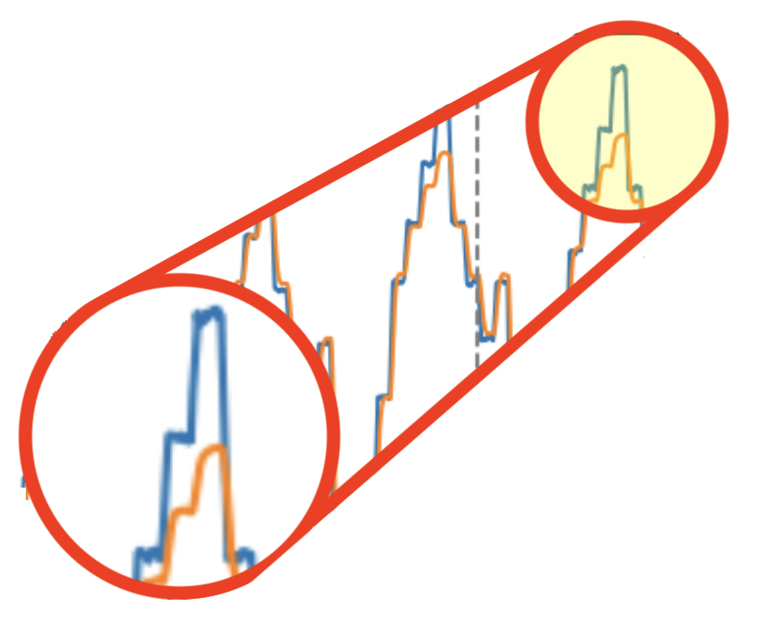
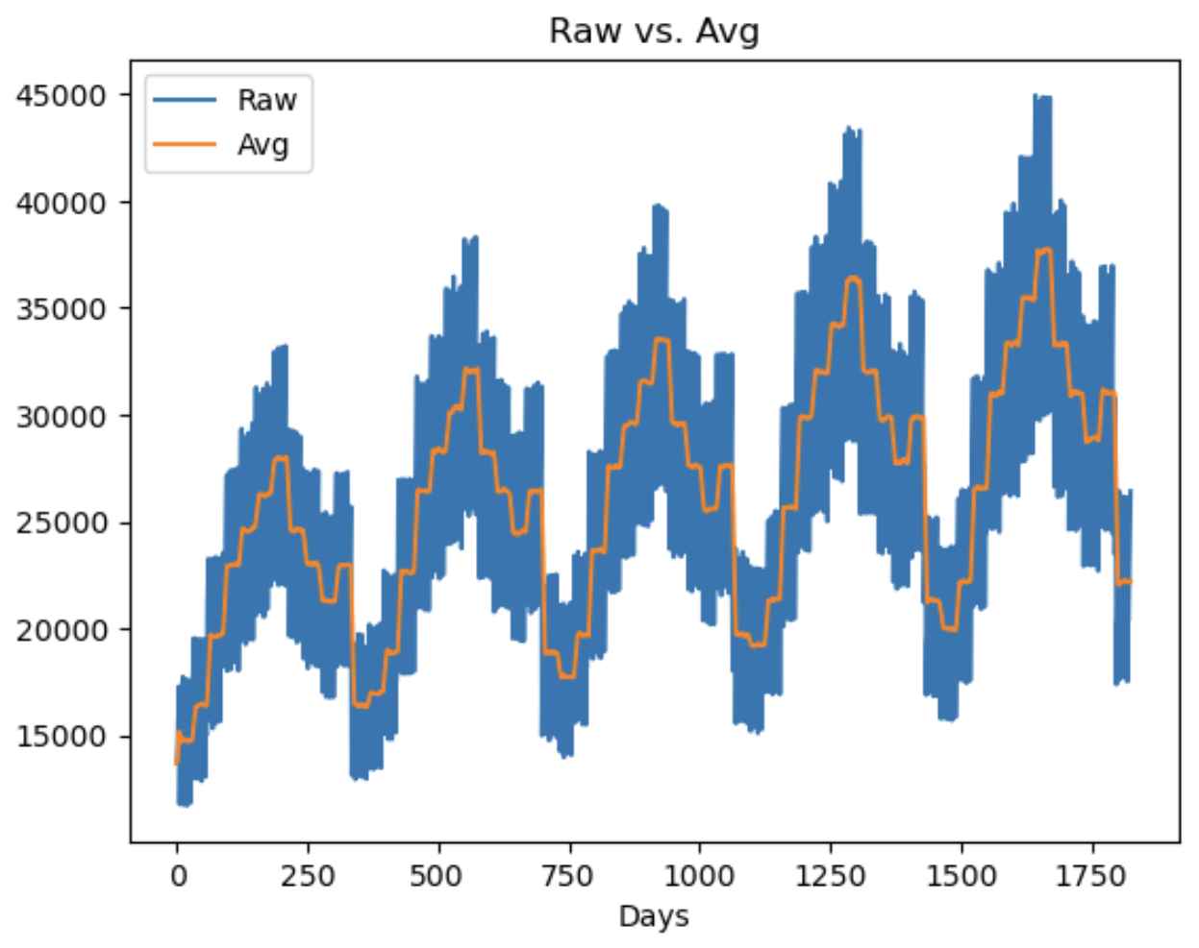
Methodology
Data Procurement
Parsing & Cleanup, Normalization
LSTM Training & Validation
Visual Review

Slide 9
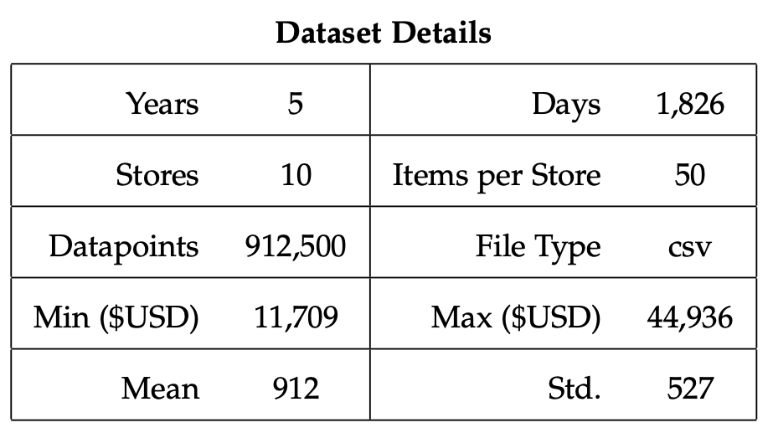
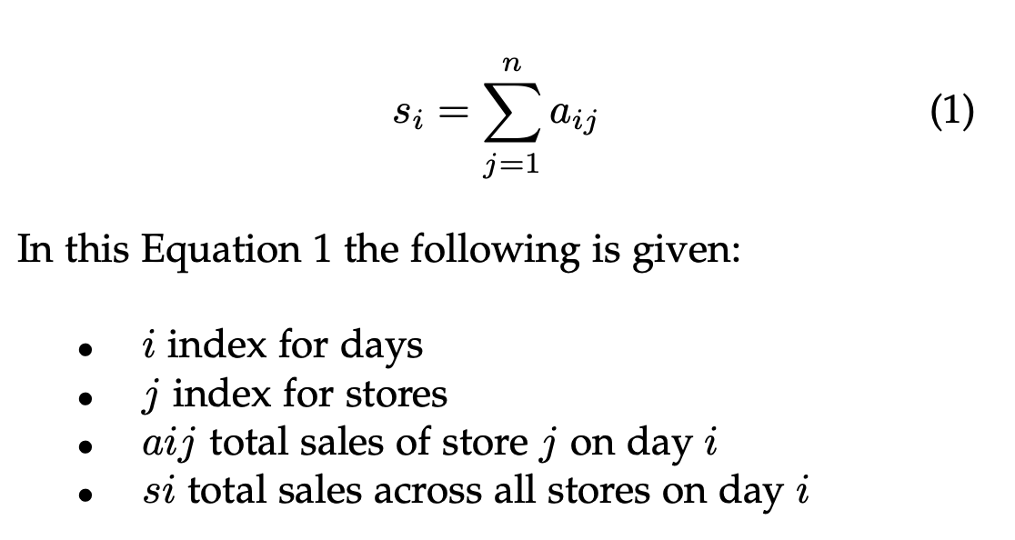
Methodology Data Procurement & Review
The dataset is from Kaggle[2] demand forecast challenge of about five (5) years ago.
It is comprised of five (5) years of store sales data.
Based on 50 different items at 10 different stores.
Each data point is a single day’s data-point (rows) with this being said the dataset is comprised of 912,500.
In order to make this a “Uni-Variante” project I grouped that all the sales by “date”.
Equation 1 – Depicts the Group-Summation by Date (Day)

Slide 10
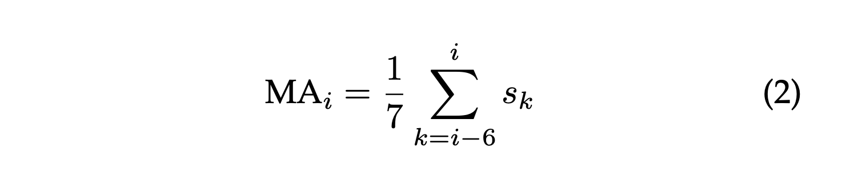
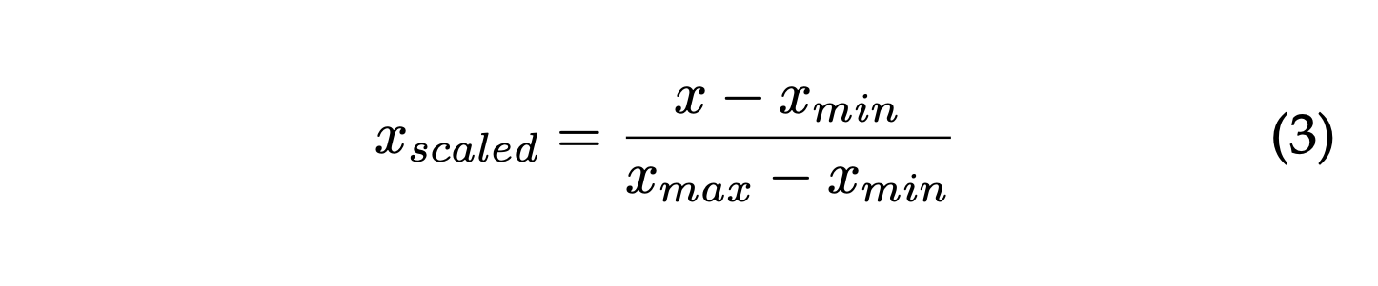
Methodology Data Smoothing & Normalization
The dataset is derived from real-world sources, suggesting it’s inherent noise.
I used a smoothing algorithm to help the model learn more easily without the daily noise. A good methodical approach was to use a 7day moving average approach[Eq:2].
I chose for this project was using the Min-Max Scaler[Eq:3], where the minimum value of the data becomes -1 and the maximum value becomes 1.

Slide 11
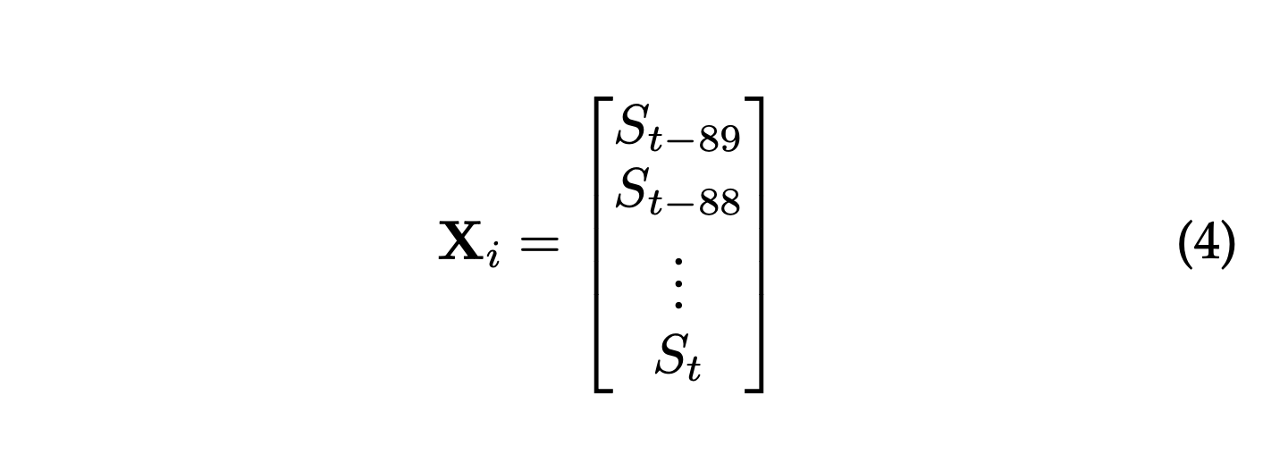
Methodology Data Sequence – 90days & Setup
After smoothing and normalization, I divided the data into overlapping 90-day.
Example, the first sequence consists of sales data from January 1 to March 31, and then the next from January 2 to April 1, and so on. [Eq:4].
Once X & Y datasets where created I split them into the 80 / 20 for training and validation.
I choose 90days to capture the seasons (4x) per year.
# Function to create sequences
def create_sequence(data, seq_length):
xs = []
ys = []
for i in range(len(data) - seq_length):
x = data[i:(i + seq_length)]
y = data[i + seq_length]
xs.append(x)
ys.append(y)
return np.array(xs), np.array(ys)
# Create sequences
x, y = create_sequence(df.values, 90)

Slide 12
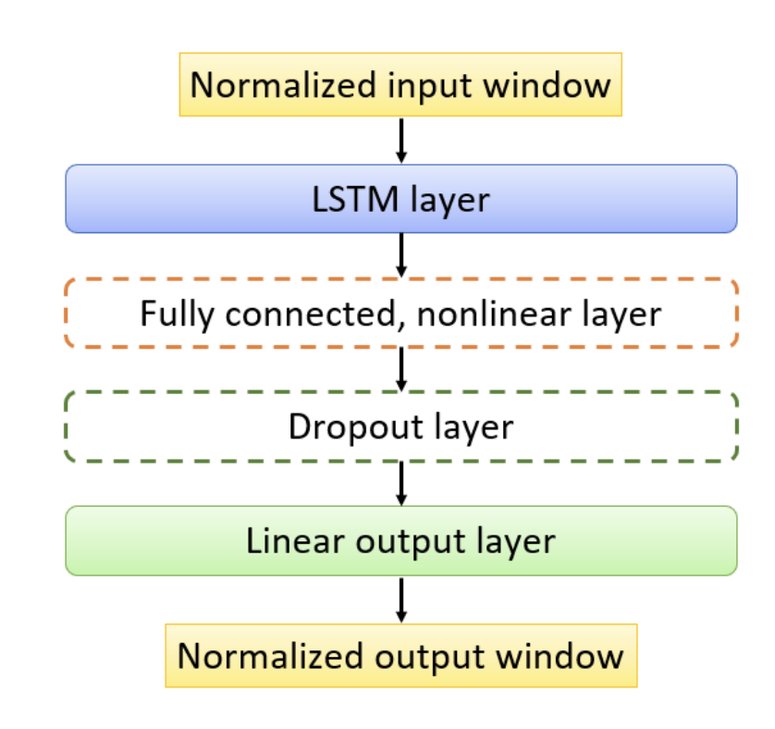
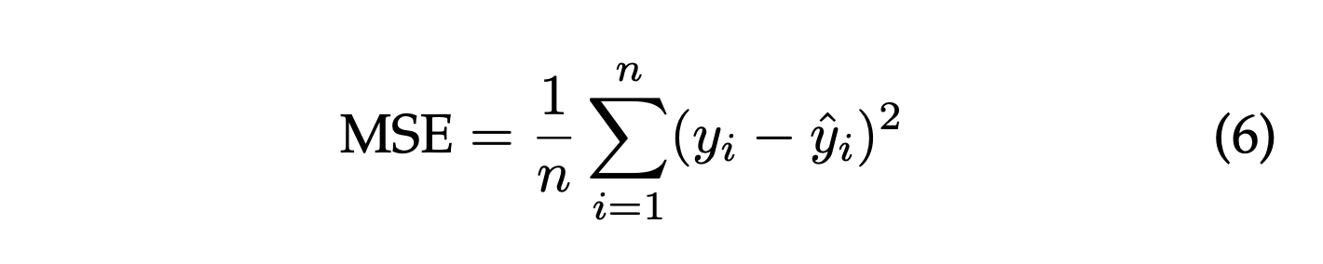
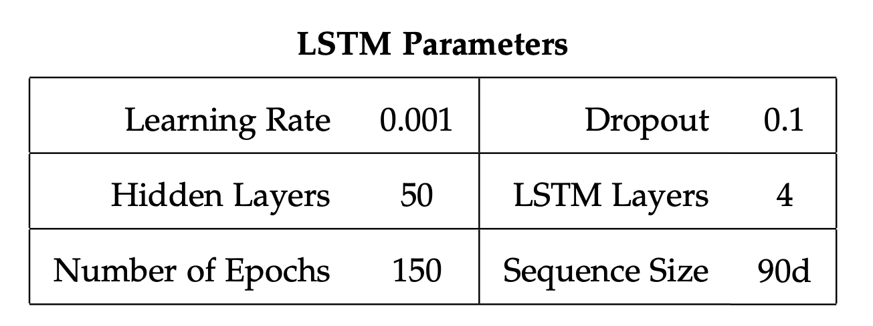

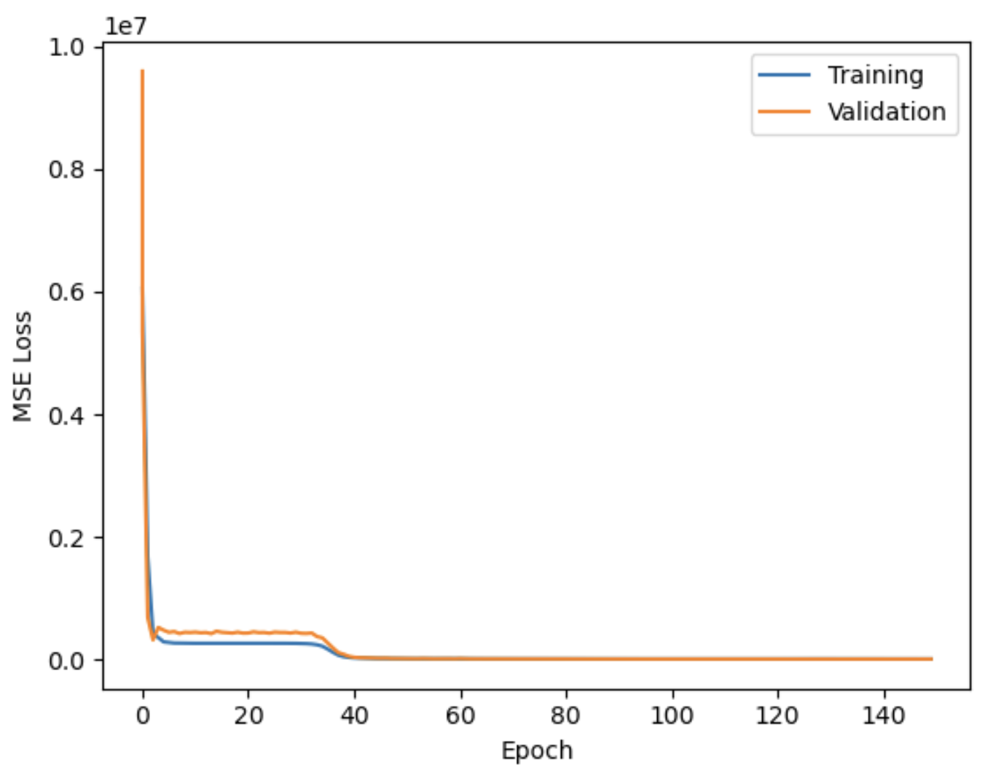
Methodology LSTM Model Build & Training
The training time for this compact model was brief, ~6 minutes on the HPC GPUs performing 150 epochs.
Mean Squared Error (MSE) loss is commonly[3] used as a learning metric, quantifying the difference between predicted and actual values.
class LSTM(nn.Module):
def __init__(self, input_size, hidden_size, num_layers, output_size):
super(LSTM, self).__init__()
self.hidden_size = hidden_size
self.num_layers = num_layers
self.lstm = nn.LSTM(input_size,
hidden_size,
num_layers,
dropout=0.1
batch_first=True)
self.lin = nn.Linear(hidden_size, output_size)
def forward(self, x):
y = x
y, _ = self.lstm(y)
y = self.lin(y[:, -1, :])
return y

Slide 13
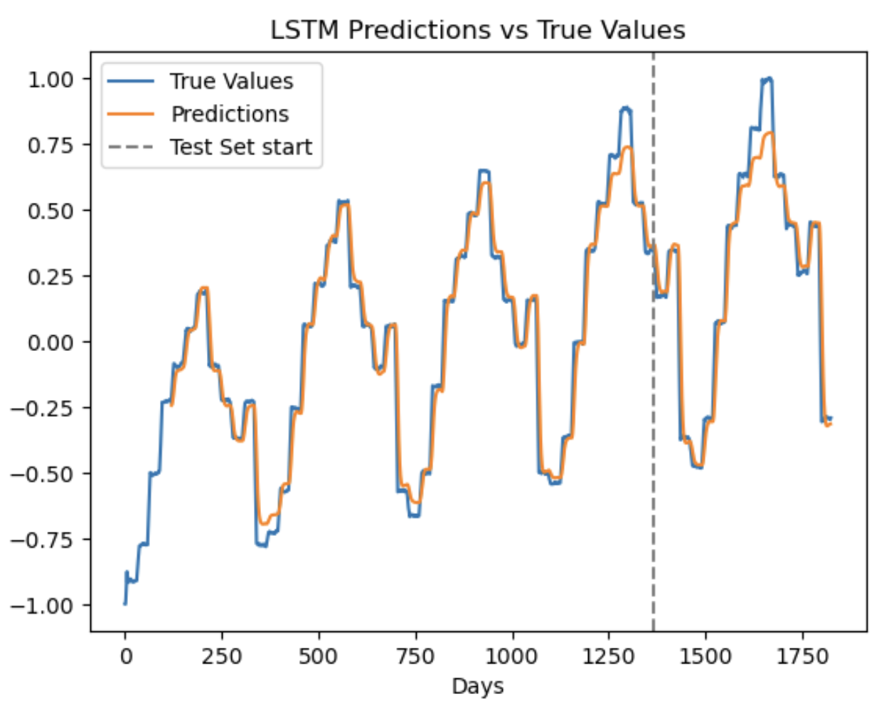
Results & Analysis
The training validation of the model are quite promising. The visual to the right illustrate that it overall follows the true path during the training and test phases.
In the main visual it is apparent that the LSTM model as able to learn the underlying seasonality of the sales and would therefore be able to predict future demands.
As one can see in the detail visual it seems as time moves forward that the difference between true vs. predicted values skews higher over time.

Slide 14
Conclusions & Future Work
Concluding The LSTM model worked well for learning demand over time and recognized seasonality shifts in the sales demand.
As time passed the model did start failing to predict the “highes” of the season. The reason for this is not fully apparent and will require further analysis.
Areas of Future Work
First, I intend to explore the extraction of additional contextual information related to the timestamps, such as seasons, weekdays, holidays, or any other relevant time-based factors.
Second, with additional information the problem becomes a “multi-variante”. Comparing to the non-expanded dataset presented previously analysis might shed light on the extent to which the inclusion of more temporal information influences forecasting accuracy.
Third, find a way to show the accuracy of the model in dollars so a business could use ti to better predict needs in the future.

Slide 15

Thank you

Slide 16
Citations
Zion Market Research – Demand Planning Solutions Market. URL: https://www.zionmarketresearch.com/report/demand-planning-solutions-market
Kaggle. Store Item Demand Forecasting Challenge. 2018. URL: https://kaggle.com/competitions/demand-forecasting-kernels-only
Tong Zhou. “Improved Sales Forecasting using Trend and Seasonality Decomposition with Light- GBM”. In: 2023 6th International Conference on Artificial Intelligence and Big Data (ICAIBD). IEEE, May 2023. DOI: 10 . 1109 / icaibd57115 . 2023 . 10206380. URL: http://dx.doi.org/10.1109/ ICAIBD57115.2023.10206380.
Barıs ̧ Karaman. Predicting Sales, Forecasting the monthly sales with LSTM. URL: https://towardsdatascience.com/predicting-sales-611cb5a252de
Abeselomgebrekidan. Pharmaceutical Sales predic- tion Using LSTM Recurrent Neural Network. URL: https://medium.com/@abeselomgebrekidan12/pharmaceutical-sales-prediction-using-lstm-recurrent-neural-network-db0f980572cc

