Slide 1
WebSockets
&
Harry Potter Films
Mozilla Developer Network
WebSockets is an advanced technology that makes it possible to open an interactive communication session between the user's browser and a server.
With this API, you can send messages to a server and receive event-driven responses without having to poll the server for a reply.
Harry Potter
The Sorcerers Stone, Chamber of Secrets, Prisioner of Azkaban,
Goblet of Stone, Order of the Phoenix, Half Blood Prince,
Deathly Hallows Pt 1, Deathly Hallows Pt 2

Slide 2
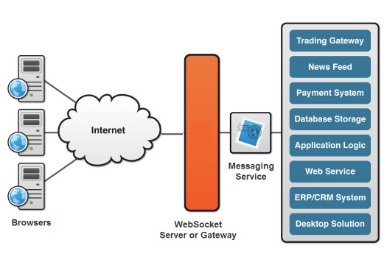
Websockets Architecture

Slide 3
The Socket.IO Library
Socket.IO enables real-time bidirectional event-based communication
It works on every platform, browser or device, focusing equally on reliability and speed
It also has a number of fallback mechanisms for clients that don't support WebSockets

Slide 4

HARRY !
“Where do I come into the equation?

Slide 5








Which Harry Potter Movie Reigns Supreme ?

Slide 6
SERVER: Socket.IO
SERVER: Create a socket.io server that :
  Receives actions and pass to Redux Store
  Store calls the reducer and reducer executes logic
  Store updates state based on return from reducer
  Store executes the listener function subscribed by the server
  Server emits a ‘state’ event
  All connected clients receive new state

Slide 7

Server Side – Code
import Server from ‘socket.io’
export default function startServer(store) {
  const io = new Server().attach(8090)
  store.subscribe(
    () => io.emit(‘state’, store.getState().toJS())
  )
  io.on(‘connection’, (socket) => {
    Socket.emit(‘state’, store.getState().toJS())
    Socket.on(‘action’, store.dispatch.bind(store))
  })
}
Notes:
What we'll do is subscribe a listener to the store that reads the current state, turns it into a plain JavaScript object, and emits it as a state event on the Socket.io server.
The result will be that a JSON-serialized snapshot of the state is sent over all active Socket.io connections.
In addition to sending a state snapshot whenever state changes, it will be useful for clients to immediately receive the current state when they connect to the application. That lets them sync their client-side state to the latest server state right away.
We can listen to 'connection' events on our Socket.io server. We get one each time a client connects. In the event listener we can emit the current state right away.
In addition to emitting the application state out to clients, we should also be able to receive updates from them: Voters will be assigning votes, and the vote organizer will be moving the contest forward using the NEXT action.
The solution we'll use for this is actually quite simple. What we can do is simply have our clients emit 'action' events that we feed directly into our Redux store:
This is where we start to go beyond "regular Redux", since we are now essentially accepting remote actions into our store. However, the Redux architecture makes it remarkably easy to do: Since actions are just JavaScript objects, and JavaScript objects can easily be sent over the network, we immediately got a system with which any number of clients can participate in voting. That's no small feat!

Slide 8
CLIENT: Socket.IO-client
CLIENT: Create a socket.io-client, connects to the socket.io server on the same port, so that:
  When a user clicks a vote, A VOTE action is dispatched
  Middleware sends the action over the socket.IO connection
  Client-side Redux store sets local hasVote
  Server-side Redux store handles the Action, updatingTally
  Server-side Redux store broadcasts a SET_STATE action to every connected client
  Local client Redux Store handles the SET_STATE action with the updated state.

Slide 9

Client Side – Code
Import io from ‘socket.io-client’
const socket = io(`${location.protocol}//${location.hostname}:8090`)
  socket.on('state', state =>store.dispatch(setState(state))
)
Notes:
Importing this library gives us an io function that can be used to connect to a Socket.io server. Let's connect to one that we assume to be on the same host as our client, in port 8090 (matching the port we used on the server).
If you now make sure you have the server running, open the client app in a browser and inspect the network traffic, you should see it make a WebSocket connection and start transmitting Socket.io heartbeats on it.
Receiving Actions from the Server
Given that we now have a Socket.io connection, there's actually not much we need to do to get data in from it. The server is sending us state events - once when we connect and then every time something changes. We just need to listen to those events. When we get one, we can simply dispatch a SET_STATE action to our Store. We already have a reducer that will handle it:

Slide 10
Middleware - don’t foget about me!
Redux middleware is a function that gets invoked when an action is dispatched, before the action hits the reducer and the store itself
The Middleware will be applied when the Store is being created using applyMiddleware supplied by Redux
export default socket => store => next => action => {
  if (action.meta && action.meta.remote) {socket.emit('action', action)
  }
  return next(action)
}
This style of nesting single-argument functions is called.. ?

Slide 11

Socket.IO-client Connection
CONNECTION: With server not running, opening a browser and inspecting network traffic, see a WebSocket connection transmitting socket.io heartbeats
Start Server ... Connection made ... Let the voting begin!

Slide 12
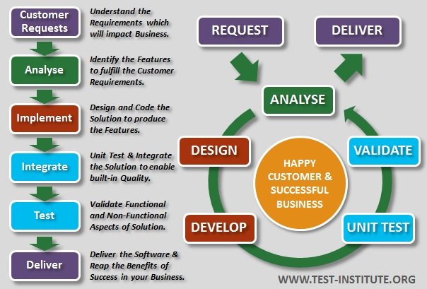
Test Driven Development (TDD)
App tutorial took me thru TDD - interesting
13 server side tests
14 client side tests
Often broke my tests ... spent hours ‘learning’

Slide 13

Demo
How about a demo ?

