Slide 1
Discussion 4

Slide 2
Storage: Page organization

Slide 3
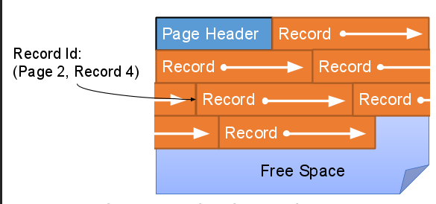
What type of page format is this? And is it for variable length records?
Packed - no

Slide 4
What is a Record ID

Slide 5
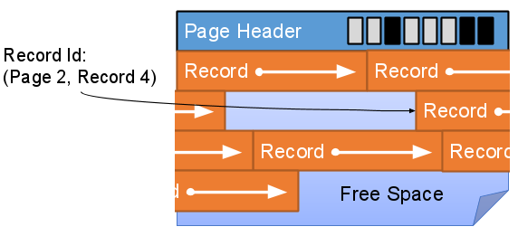
What type of page format is this? And is it for variable length records?
Unpacked Bitmap - no

Slide 6
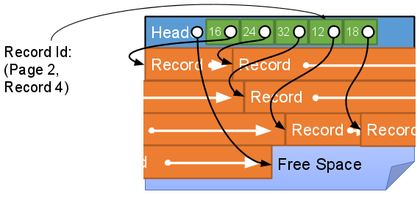
What type of page format is this?
And is it for variable length records?

Slide 7
File Organization
Heap files: unordered set of records
Sorted file: ordered set of records
4
1
8
1
2
4
2
9
6
6
8
9
Heap file
Sorted file

Slide 8
I/O Costs
PACKED!
Operation | Heap File | Sorted File
Scan all records | B | B
Equality Search | 0.5B | log_2(B)
Range Search | B | log_2(B) + # pages matched
Insert | 2 | log_2(B)+ (B/2) *2
Delete | 0.5B+1 | log_2(B)+ (B/2) *2

Slide 9
Heap File Insertion
DATA

Slide 10
Heap File Insertion
DATA
2 I/Os

Slide 11
Sorted File Deletion: find page

Slide 12
Sorted File Deletion: Save page

Slide 13
Sorted File Deletion

Slide 14
Indexes

Slide 15
Indexes
Index
Students Table
Biology
Bob CS
CS
Joe Biology
English
Jim English
Math
Sue CS
Jill Math
Tim English
Disk-based data structure for fast lookup by value (search key)
Find students in the CS department

Slide 16
3 Ways to Store Entries in Index
Alt 1: Actual data stored at index
Can have at most one index per table
Alt 2: Store key and record ID of the matching record
Alt 3: Store key and list of record IDs

Slide 17
Alt 1
Actual data stored at the leaf
Bob
Joe
Steve
Abe CS
Dan Math
Zack CS
Zack Art

Slide 18
Alt 2
<key, record ID>
Bob
Joe
Steve
(Bob, 1)
(Jen, 4)
(Steve, 6)
(Tom, 5)

Slide 19
Alt 3
<key, list of matching record IDs>
Bob
Joe
Steve
(Bob, {1,2,3})
(Jan, {4}
(Tam, {5,6})

Slide 20
Clustered vs Unclustered
index data entries are stored in (approximate) order by value of search keys
Can be clustered on at most one key
Alternative 1 is always clustered
Data entries
Data records
Clustered

Slide 21
Clustered vs Unclustered
Data entries
Data records
Unclustered

Slide 22
What about multiple columns?
Notes:
Multiple indices
Lexicographical

Slide 23
B+ Trees

Slide 24
Definitions
F = fanout
N = # leaf pages
Order = Min entries per node
Data entry = (previously defined)

Slide 25
Insertion
Copy up in leaf
vs Push up in non-leaf

