Slide 1
Review Session

Slide 2
External Sorting

Slide 3

General External Merge Sort
More than 3 buffer pages. How can we utilize them?
To sort a file with N pages using B buffer pages:
Pass 0: use B buffer pages. Produce sorted runs of B pages each.
Pass 1, 2, …, etc.: merge B-1 runs.
INPUT 1
INPUT 2
. . .
OUTPUT
INPUT B-1
RAM
Disk
Merging Runs
Notes:
7

Slide 4
Cost of External Merge Sort
Number of passes:
Cost = 2N * (# of passes)
E.g., with 5 buffer pages, to sort 108 page file:
Pass 0: = 22 sorted runs of 5 pages each (last run is only 3 pages)
Pass 1: = 6 sorted runs of 20 pages each (last run is only 8 pages)
Pass 2: 2 sorted runs, 80 pages and 28 pages
Pass 3: 1 run => Sorted file of 108 pages
Formula check: 1+┌log₄ 22┐= 1+3 → 4 passes √
Notes:
8

Slide 5
External Hashing

Slide 6
Two Phases
Original
Relation
OUTPUT
Partitions
1
1
INPUT
2
hash
function
h_{p}
2
Partition: (Divide)
. . .
B-1
B-1
Disk
B main memory buffers
Disk

Slide 7
Two Phases
Original
Relation
OUTPUT
Partitions
1
1
INPUT
2
hash
function
h_{p}
2
Partition: (Divide)
Rehash: (Conquer)
. . .
B-1
B-1
Disk
B main memory buffers
Disk
Partitions
Result
Hash table for partition
R_{i} (k <= B pages)
hash
h_{r}
Disk
B main memory buffers

Slide 8
Tournament Sort

Slide 9
Tournament Sort (Heapsort)
First, load a heap with B-2 pages of records
Heap 1
Input
Buffer
This is a priority heap, so it is in sorted order (hence called Heapsort)

Slide 10
Tournament Sort (2)
while (records left on input) {
m = H1.removemin(); // get smallest value
Output(m) // put m in output buffer;
if (H1 NOT empty)
r = InputRecord()
if (r < m) H2.insert(r);
else H1.insert(r);
else
H1 = H2; H2.reset();
start new output run;
}
r
>= m
< m
H1
H2
Current Run
Next Run

Slide 11
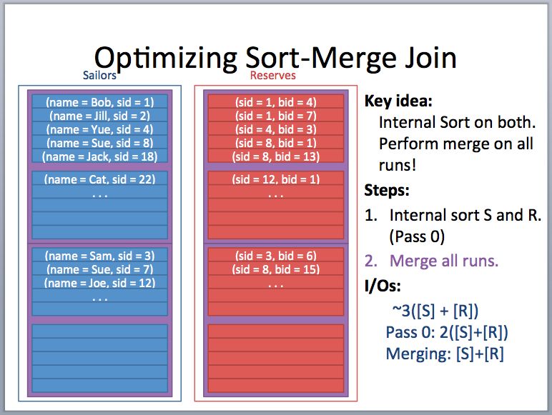
TRICKY QUESTION

Slide 12
Using General Merge Sort, when can you do Optimized Sort Merge join? Express with an inequality.
STEP 1:
# runs for R – ceil([R]/B)
# run for S – ceil([S]/B)
STEP 2:
We need to fit EACH run into buffer
ceil([S]/B) + ceil([R]/B) <= B - 1

Slide 13
Using tournament sort, when can you do Optimized Sort Merge join? Express with an inequality.
STEP 1:
# runs for R – ceil([R]/2(B-2))
# run for S – ceil([S]/2(B-2))
STEP 2:
We need to fit EACH run into buffer
ceil([S]/2(B-2)) + ceil([R]/2(B-2)) <= B - 1

Slide 14
NOW, let’s assume [R] is equal to [S]. Express the same inequality with [R] and [B].
STEP 1:
# runs for R – ceil([R]/2(B-2))
We need to fit EACH run into buffer
STEP 2:
# runs for S – ceil([R]/2(B-2))
ceil([R]/2(B-2)) + ceil([R]/2(B-2)) <= B - 1

Slide 15
Tournament Sort + Optimized Sort Merge
ceil([R]/(B-2)) < B
[R] < (B)(B-2)
As B becomes very large, we can approximate this:
SQRT([R]) < B

Slide 16
SQL

Slide 17
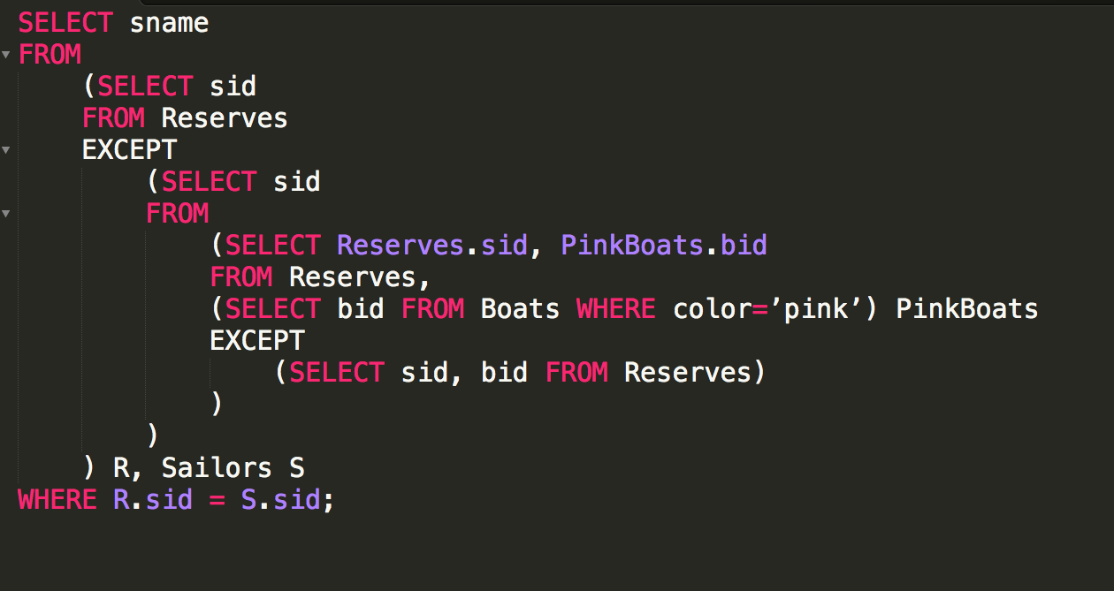
Vitamin Question

Slide 18
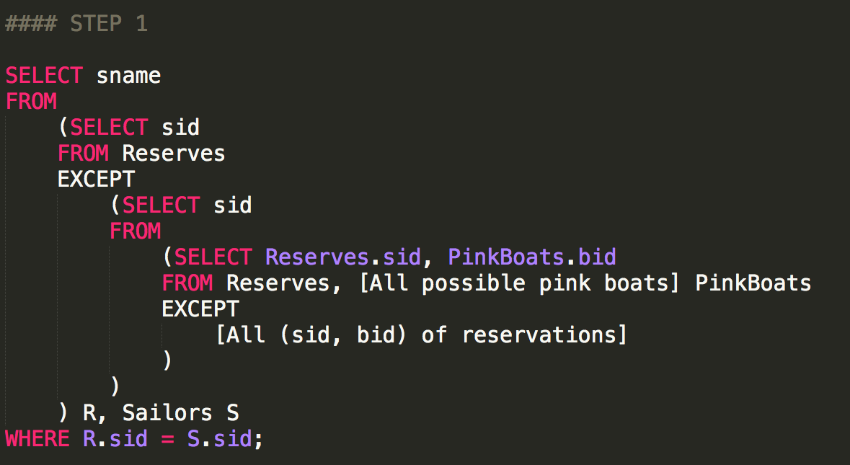
Vitamin Question Step 1

Slide 19
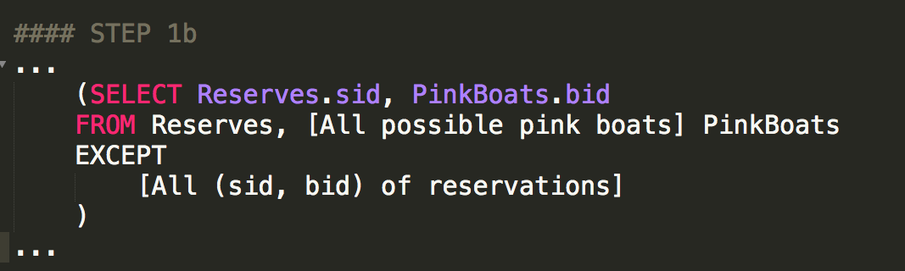
[All sailors in the reservation table X All pinkboats ]
- [All (sailors, pink boat) existing reservations]
= [All (sailor_R, pink boats) combos that do not exist]
...(sailor_R are all sailors that have made a reservation)

Slide 20
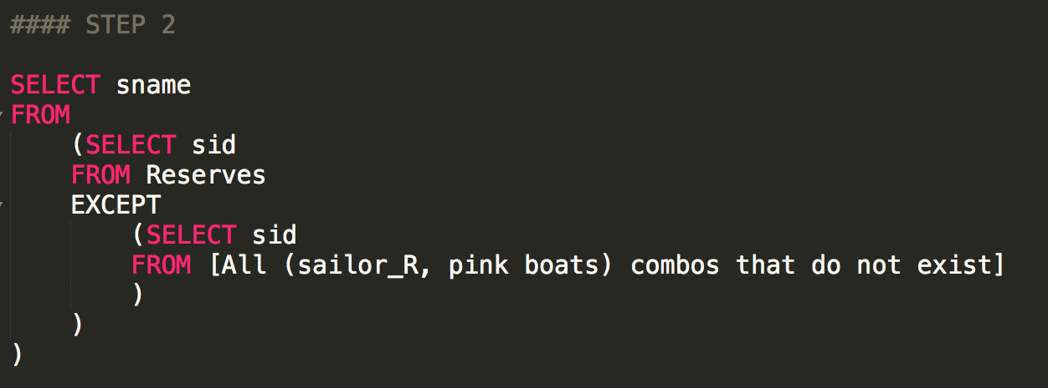
Step 2
*do not exist in Reservations

Slide 21
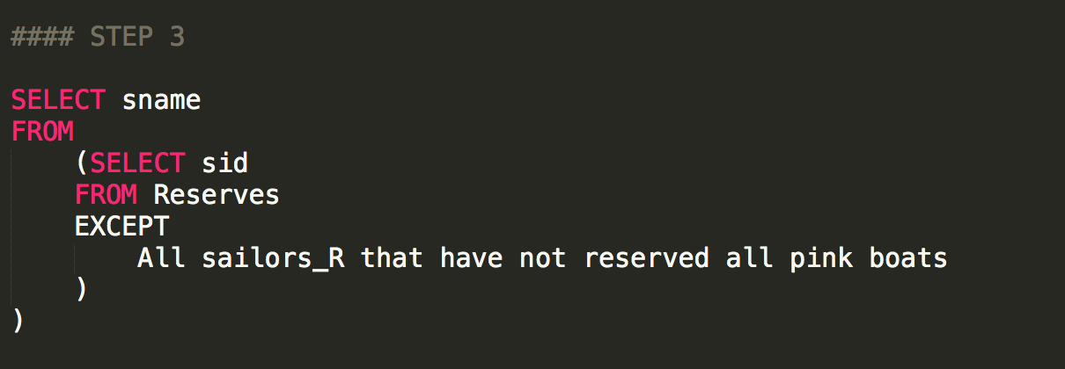
Step 3

Slide 22
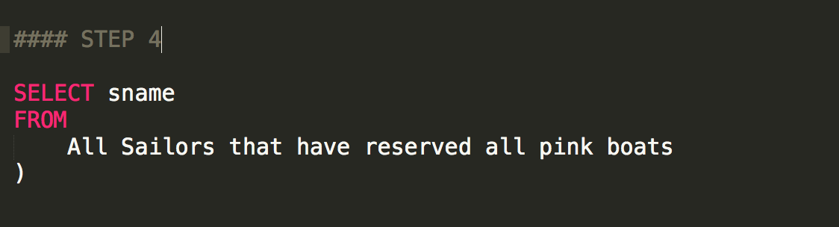
Step 4
This actually only true sometimes (it has some implicit assumptions) – what happens when certain tables are NULL?

Slide 23
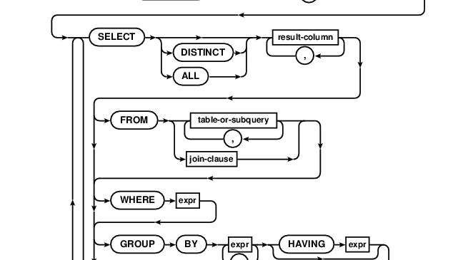
HAVING

Slide 24
formats
Record id = <page id, slot #>.

Slide 25
Record Formats
Fixed vs Variable Length

Slide 26
Record Formats: Fixed Length
F1
F2
F3
F4
L1
L2
L3
L4
Base address (B)
Address = B+L1+L2
Field types same for all records in a file.
Type info stored separately in system catalog.
Finding i’th field done via arithmetic like arrays

Slide 27
Record Formats: Variable Length
Two alternative formats (# fields is fixed):
F1 F2 F3 F4
$
$
$
$
1. Fields Delimited by Special Symbols
F1 F2 F3 F4
2. Array of Field Offsets
Second offers direct access to i’th field, efficient storage
of nulls (special unknown value); small directory overhead.

Slide 28
Page formats

Slide 29
Page Formats: Fixed Length Records
Slot 1
Slot 1
Slot 2
Slot 2
. . .
Free
Space
. . .
Slot N
Slot N
Slot M
N
1
. . .
0
1
1
M
number
of records
M ... 3 2 1
number
of slots
PACKED
UNPACKED, BITMAP
Record id = <page id, slot #>. In first alternative, moving records for free space management changes rid; may be problematic!

Slide 30
“Slotted Page” Format: Variable Length Records
Rid = (i,N)
Page i
Rid = (i,2)
Rid = (i,1)
20
16
24
N
Pointer
to start
of free
space
N . . . 2 1
# slots
SLOT DIRECTORY
Can move records on page without changing rid! So, attractive for fixed-length records too.

Slide 31
Unordered (Heap) Files
Collection of records in no particular order.
As file shrinks/grows, disk pages (de)allocated
To support record level operations, we must:
keep track of the pages in a file
keep track of free space on pages
keep track of the records on a page
There are many alternatives for keeping track of this.
We’ll consider 2

Slide 32
Heap File Implemented as a List
Data
Page
Data
Page
Data
Page
Full Pages
Header
Page
Data
Page
Data
Page
Data
Page
Pages with
Free Space
Header page ID and Heap file name stored elsewhere
Database “catalog”
Each page contains 2 “pointers” plus data
Problem for multi-page objects (blobs) – how to read blobs?

Slide 33
Better: Use a Page Directory
Data
Page 1
Header
Page
Data
Page 2
Data
Page N
DIRECTORY
Directory entries include #free bytes on the page.
Directory is a collection of pages; linked list implementation is just one alternative.
Much smaller than linked list of all HF pages!
Can also point to groups of pages (say 64k chunks)

