Slide 1
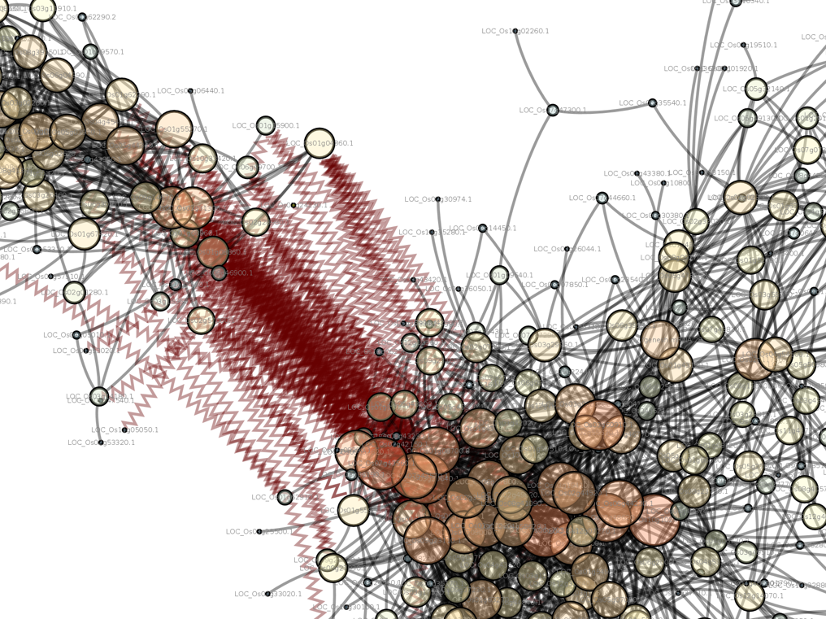
Introduction to Computing for Data Science
Day 29
04/23/2019
Hort 503-01 Spring 2019

Slide 2
Course Evaluations
Please fill out the course evaluations!
Once all students taking the class for credit have done so I’ll award 5 extra points on project #2.

Slide 3
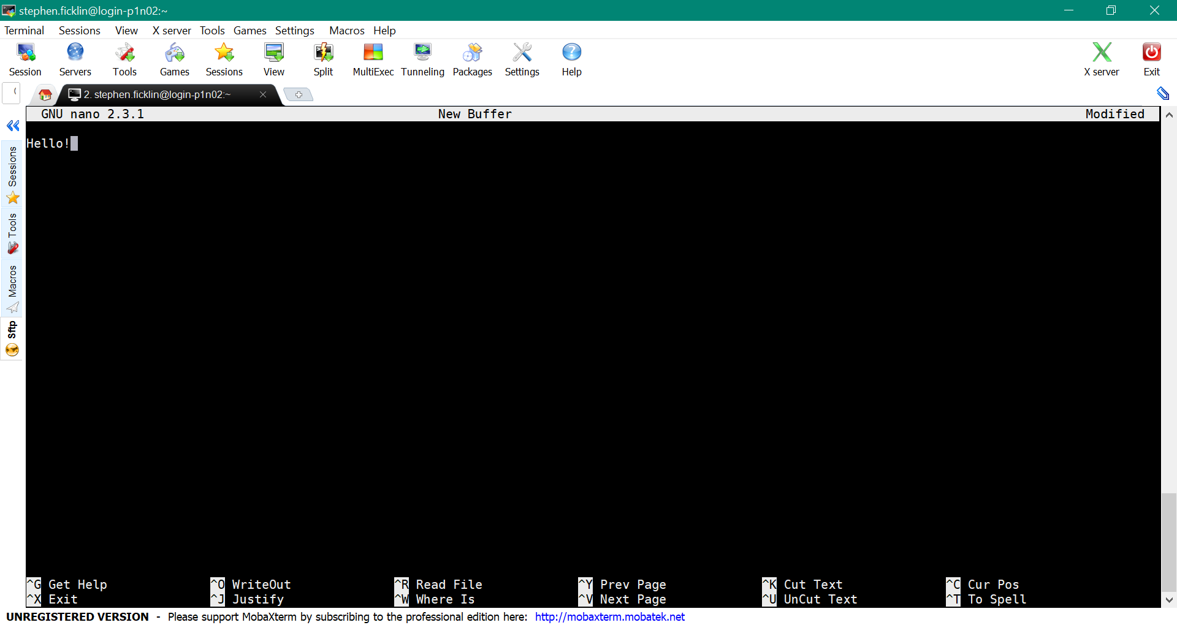
Using Nano to edit files

Slide 4
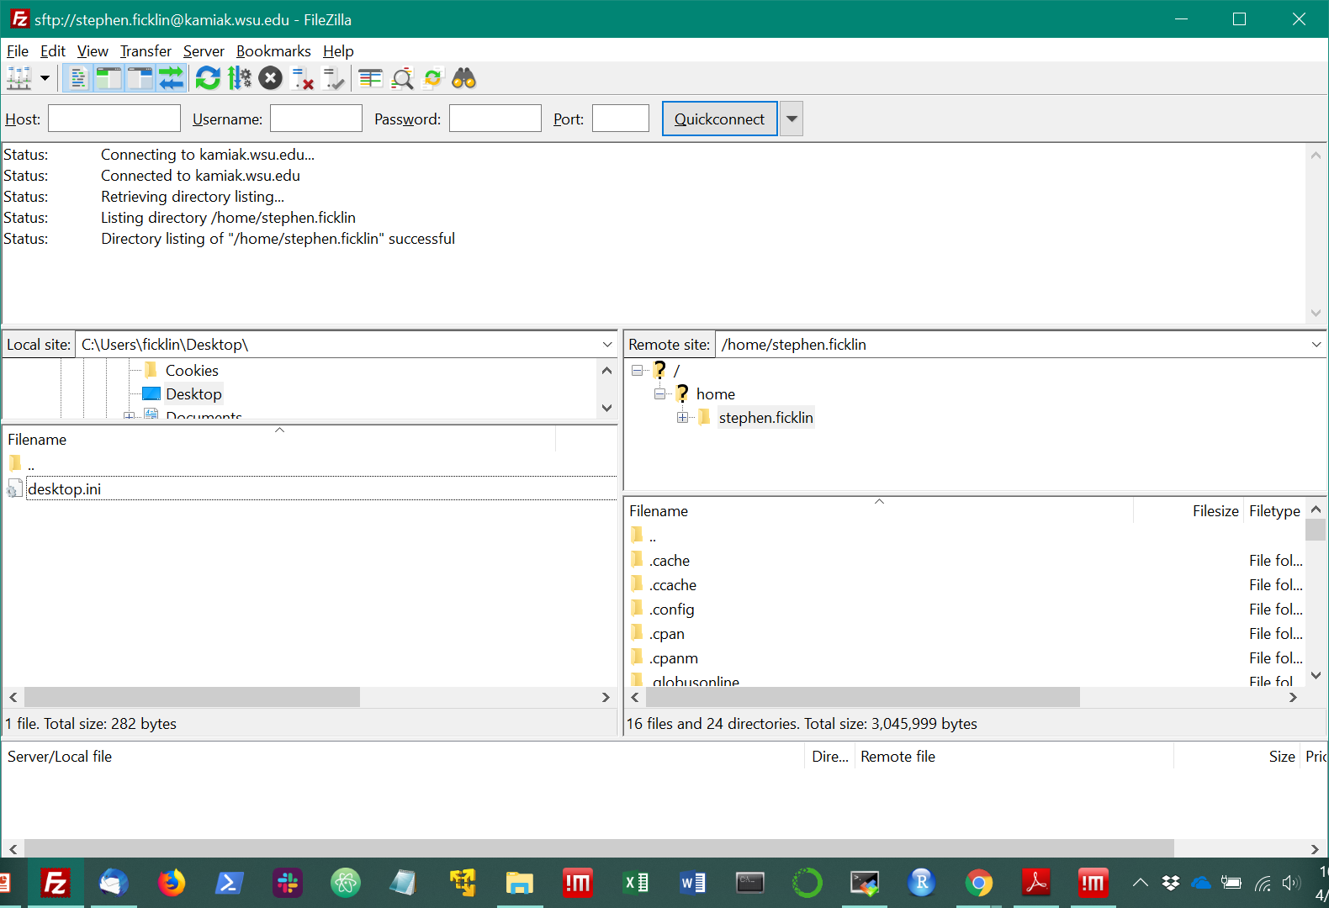
Using FileZilla to transfer files
https://filezilla-project.org/

Slide 5
Class Exercise #1 BLAST
BLAST is a sequence (DNA/protein) similarity tool
It requires an input file of sequences in FASTA format
It requires a formatted database of DNA or protein sequences to compare with.
Blast can be run in multi-threaded mode:
Check out the blast help to learn about additional options if you are unfamiliar with them
Using the blastp program, check out the help document (blastp -help) to do the following:
Create a SLURM script that will
Use the query file (-query option) of rice proteins in FASTA format found here: /data/hort503/example-data/all.pep
Use the database file of SwissProt curated protein sequences (-db option) here: /data/hort503/example-data/swissprot
And that will use 5 threads (-num_threads option).
Create an output format in tab delimited (-outfmt option)
Use an e-value threshold of 1e-6. (-evalue option).
Run the job and use your command-line knowledge to count the total number of sequence alignments found.

Slide 6
Class Exercise #2: Run Project 2
Let’s run your project #2 on Kamiak.
Do the following
Clone your class GitHub repository onto Kamiak in your /data/hort503/{user} directory
Create a slurm script to launch the job
Launch the job
Make sure you get proper output.

Slide 7
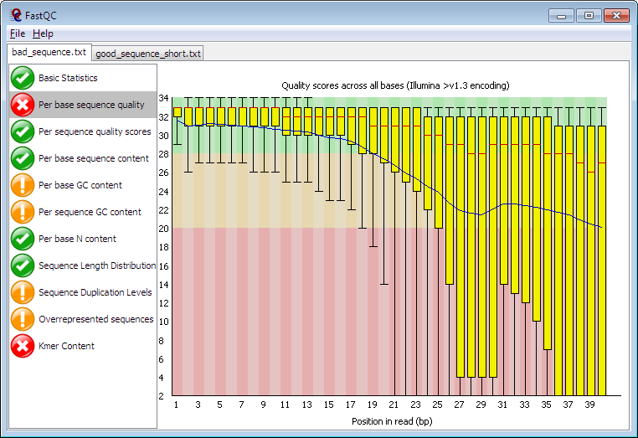
Class Exercise #3: FASTQC
FASTQC is a tool to provide quality metrics for high-throughput DNA sequence data in FASTQ files
https://www.bioinformatics.babraham.ac.uk/projects/fastqc/

Slide 8
Class Exercise #3: FASTQC
Write a SLURM submission script that will run FASTQC using the file in /data/hort503/example-data/SRR2931286.fastq
Be sure to use 5 threads.
Use the following to have an email sent when the job starts/completes:
#SBATCH --mail-user={user_id}@wsu.edu
#SBATCH --mail-type=ALL
Find out how to have SLURM email you when the job starts and ends, and include that in the submission script.
Run the script
Copy the resulting HTML to your laptop to view the results.

