Slide 1
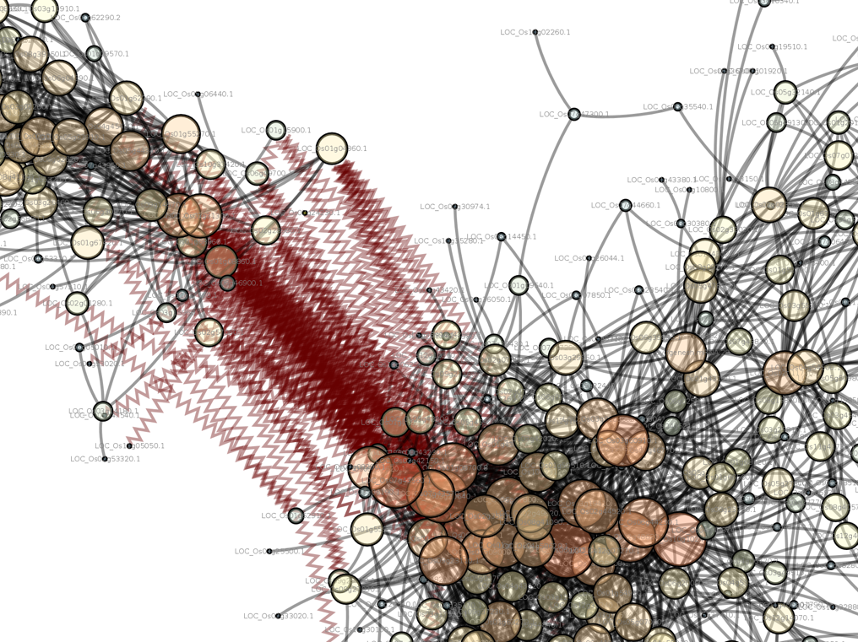
Introduction to Computing for Data Science
Day 30
04/25/2019
Hort 503-01 Spring 2019

Slide 2
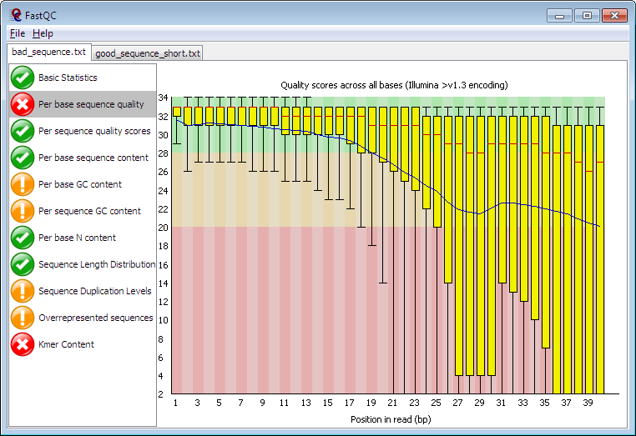
Class Exercise #1: FASTQC
FASTQC is a tool to provide quality metrics for high-throughput DNA sequence data in FASTQ files
https://www.bioinformatics.babraham.ac.uk/projects/fastqc/

Slide 3
Class Exercise #3: FASTQC
Write a SLURM submission script that will run FASTQC using the file in /data/hort503/example-data/SRR2931286.fastq
Be sure to use 5 threads.
Use the following to have an email sent when the job starts/completes:
#SBATCH --mail-user={user_id}@wsu.edu
#SBATCH --mail-type=ALL
Find out how to have SLURM email you when the job starts and ends, and include that in the submission script.
Run the script
Copy the resulting HTML to your laptop to view the results.

Slide 4
Assignment #13 Review
On a linux-based system where do you normally find software installed?
/usr/local/bin
/usr/bin
On a shared Linux machine sometimes here:
/opt
On a stand-alone UNIX/Linux machine you will need administrative (root) access to install into any of these directories.
On Kamiak you install in directories you have access to.
On a stand-alone UNIX/Linux machine this is where most user installed software wants to go.
Software installed by the UNIX/Linux package manager usually goes here.

Slide 5
Assignment #14 Review
What do these command-line instructions do?
cd /data/hort503/stephen.ficklin/src/hmmer-3.1b2
./configure --prefix=/data/hort503_01_s18/stephen.ficklin/local
make
make install

Slide 6
Assignment #14 Review
What do these command-line instructions do?
cd /data/hort503_01_s18/stephen.ficklin/src/hmmer-3.1b2
./configure --prefix=/data/hort503_01_s18/stephen.ficklin/local
make
make install
What would happen if I left off the --prefix argument?
This is where I want hmmer installed

Slide 7
Assignment #14 Review
What do these command-line instructions do?
cd /data/hort503_01_s18/stephen.ficklin/src/hmmer-3.1b2
./configure --prefix=/data/hort503_01_s18/stephen.ficklin/local
make
make install
What would happen if I left off the --prefix argument?
When make install is run, it would try to install into /usr/local
Why don’t we want it to install into /usr/local?
This is where I want hmmer installed

Slide 8
Assignment #14 Review
What do these command-line instructions do?
cd /data/hort503_01_s18/stephen.ficklin/src/hmmer-3.1b2
./configure --prefix=/data/hort503_01_s18/stephen.ficklin/local
make
make install
What would happen if I left off the --prefix argument?
When make install is run, it would try to install into /usr/local
Why don’t we want it to install into /usr/local?
Because we don’t have root access on Kamiak, so we need to install where we have permissions.
This is where I want hmmer installed

Slide 9
Assignment #14 Review
What is the configure command?
What is the make command?
What is the make install command?

Slide 10
Assignment #14 Review
What is the configure command?
It is a shell script for detecting your UNIX systems setup and creating Makefiles that are appropriate for building software.
What is the make command?
make is a utility that reads and executes Makefiles. Makefiles often contain commands for compiling source code into executables code.
What is the make install command?
“install” is simply an argument to make that tells the Makefile to execute the install commands. This only works if the Makefile has install commands.

Slide 11
How to start over?
When using the configure script you can usually start over with these commands:
Clears out all compiled code so you can recompile fresh. You can re-run make:
make clean
Completely removes all compiled code and Makefiles. You must re-run ./configure:
make distclean

Slide 12
What is this?
[stephen.ficklin@sn6 hmmer-3.1b2]$ make
SUBDIR easel
make[1]: Entering directory `/data/hort503_01_s18/stephen.ficklin/src/hmmer-3.1b2/easel'
CC easel.o
CC esl_alphabet.o
CC esl_buffer.o
CC esl_cluster.o
CC esl_composition.o
CC esl_dirichlet.o

Slide 13
What is this output from make?
[stephen.ficklin@sn6 hmmer-3.1b2]$ make
SUBDIR easel
make[1]: Entering directory `/data/hort503_01_s18/stephen.ficklin/src/hmmer-3.1b2/easel'
CC easel.o
CC esl_alphabet.o
CC esl_buffer.o
CC esl_cluster.o
CC esl_composition.o
CC esl_dirichlet.o
C++ code is being compiled

Slide 14
What is this output from make?
[stephen.ficklin@sn6 seqtools-4.44.1]$ make
bin/sh ../../libtool --tag=CXX --mode=compile g++ -DHAVE_CONFIG_H -I. -I../.. -pthread -I/usr/include/glib-2.0 -I/usr/lib64/glib-2.0/include -I/usr/include/gtk-2.0 -I/usr/lib64/gtk-2.0/include -I/usr/include/atk-1.0 -I/usr/include/cairo -I/usr/include/gdk-pixbuf-2.0 -I/usr/include/pango-1.0 -I/usr/include/harfbuzz -I/usr/include/freetype2 -I/usr/include/pixman-1 -I/usr/include/libpng15 -I/usr/include/libdrm -I../../src/include -I../../src/include/blatSrc -std=c++11 -g -Wall -g -O2 -MT gbtoolsUtils.lo -MD -MP -MF .deps/gbtoolsUtils.Tpo -c -o gbtoolsUtils.lo gbtoolsUtils.cpp
libtool: compile: g++ -DHAVE_CONFIG_H -I. -I../.. -pthread -I/usr/include/glib-2.0 -I/usr/lib64/glib-2.0/include -I/usr/include/gtk-2.0 -I/usr/lib64/gtk-2.0/include -I/usr/include/atk-1.0 -I/usr/include/cairo -I/usr/include/gdk-pixbuf-2.0 -I/usr/include/pango-1.0 -I/usr/include/harfbuzz -I/usr/include/freetype2 -I/usr/include/pixman-1 -I/usr/include/libpng15 -I/usr/include/libdrm -I../../src/include -I../../src/include/blatSrc -std=c++11 -g -Wall -g -O2 -MT gbtoolsUtils.lo -MD -MP -MF .deps/gbtoolsUtils.Tpo -c gbtoolsUtils.cpp -o gbtoolsUtils.o

Slide 15
What is this output from make?
[stephen.ficklin@sn6 seqtools-4.44.1]$ make
bin/sh ../../libtool --tag=CXX --mode=compile g++ -DHAVE_CONFIG_H -I. -I../.. -pthread -I/usr/include/glib-2.0 -I/usr/lib64/glib-2.0/include -I/usr/include/gtk-2.0 -I/usr/lib64/gtk-2.0/include -I/usr/include/atk-1.0 -I/usr/include/cairo -I/usr/include/gdk-pixbuf-2.0 -I/usr/include/pango-1.0 -I/usr/include/harfbuzz -I/usr/include/freetype2 -I/usr/include/pixman-1 -I/usr/include/libpng15 -I/usr/include/libdrm -I../../src/include -I../../src/include/blatSrc -std=c++11 -g -Wall -g -O2 -MT gbtoolsUtils.lo -MD -MP -MF .deps/gbtoolsUtils.Tpo -c -o gbtoolsUtils.lo gbtoolsUtils.cpp
libtool: compile: g++ -DHAVE_CONFIG_H -I. -I../.. -pthread -I/usr/include/glib-2.0 -I/usr/lib64/glib-2.0/include -I/usr/include/gtk-2.0 -I/usr/lib64/gtk-2.0/include -I/usr/include/atk-1.0 -I/usr/include/cairo -I/usr/include/gdk-pixbuf-2.0 -I/usr/include/pango-1.0 -I/usr/include/harfbuzz -I/usr/include/freetype2 -I/usr/include/pixman-1 -I/usr/include/libpng15 -I/usr/include/libdrm -I../../src/include -I../../src/include/blatSrc -std=c++11 -g -Wall -g -O2 -MT gbtoolsUtils.lo -MD -MP -MF .deps/gbtoolsUtils.Tpo -c gbtoolsUtils.cpp -o gbtoolsUtils.o
More complex C++ code is being compiled

Slide 16
Good Practices
Store your downloaded files and the compile directories together. For example:
/data/hort503/{user_name}/src
Install your software into a single directory, usually within a directory named local (similar to /usr/local). For example:
/data/hort503/{user_name}/local
Better yet! Store your software in separate folders for each package. For example
/data/hort503/{user_name}/local/hmmer-3.1b2

Slide 17
Challenges with software installation
Complicated software installations:
Old software: has out-of-date dependencies
Dependency trees!
Must have a specific version of a C++ compiler, specific version of linux libraries, etc.
You must install a lot of other tools before you can begin to compile.
Incompatible with infrastructure, so it needs major tweaks: InterProScan (doesn’t support SLURM)
Academic software woes
Continued development run out when graduate student leaves or project ends.
No quality standards for readability
Before coding, find a standards you like and stick with it: https://www.python.org/dev/peps/pep-0008/
Lacking in documentation
No testing regiment.
Unix-based software usually has no easy installer.

Slide 18
Assignment #13 Review
Most common forms of installation:
Building from source code
./configure, make, make install
make
cmake
Install from binary
Be sure to get the version correct for your system.
On UNIX/Linux most are 64-bit compatible.
Documentation
Usually a README.txt or INSTALL.txt that accompanies the program instructs how to install. Always check the INSTALL file!
Look online.

Slide 19
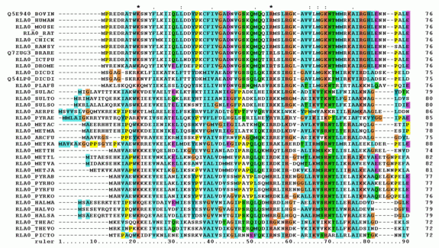
What is an multiple-sequence alignment?
When protein, DNA or RNA sequences from multiple individuals, families, orthologs or homologs are aligned.
Two primary applications:
Identify sequence homology
Phylogenetic analysis (identify shared evolutionary origins)
Notes:
https://en.wikipedia.org/wiki/Multiple_sequence_alignment

Slide 20
The workflow from Assignment #13
Protein FASTA file
muscle
MSA file
HMMs
hmmbuild
Protein Database
hmmsearch
Matches

Slide 21
How to view the muscle alignments?
Use the belvu tool from the SeqTools package

Slide 22
Class Exercise #2
Download and install SeqTools from here: http://www.sanger.ac.uk/science/tools/seqtools
Tasks:
Download SeqTools
Install SeqTools into it’s own directory named seqtools-4.44.1
Where should you put it?
On and idev session Run belvu
Note, you have to have X11 forwarding turned on to see GUI applications from Kamiak.
In UNIX (OS X or Linux): ssh -X {user_name}@kamiak.wsu.edu
In windows: Check out the MobaXterm settings: Settings > Configuration > X11

Slide 23
Sequence Alignment Software
The hmmer example showed an alternative to the popular BLAST sequence alignment tool.
BLAST is not specific enough to find conserved protein domains, but hmmer is.
However, what if we want to look for protein matches along an entire genome? BLAST is good for local alignments, but for whole genomes sometimes a sequence can map to multiple locations creating huge local alignments!
Exonerate to the rescue! https://www.ebi.ac.uk/about/vertebrate-genomics/software/exonerate

