Slide 1
Structure of RH90 MIPS Microprocessor
By: Jon Cowart III
jcowart2@nd.edu
2/24/2023
Notre Dame University

Slide 2
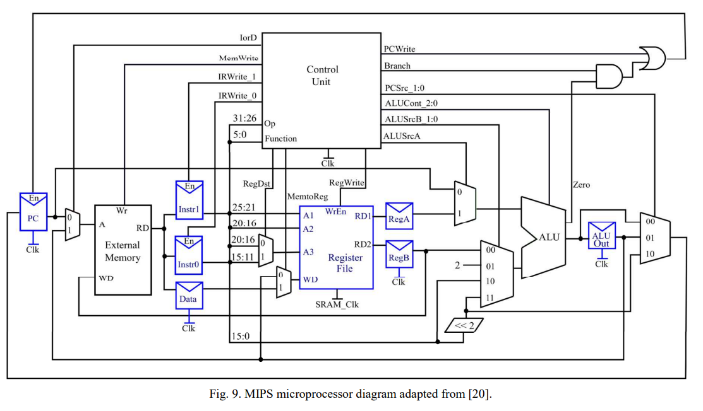
Structure of RH90 MIPS Microprocessor
[1]

Slide 3
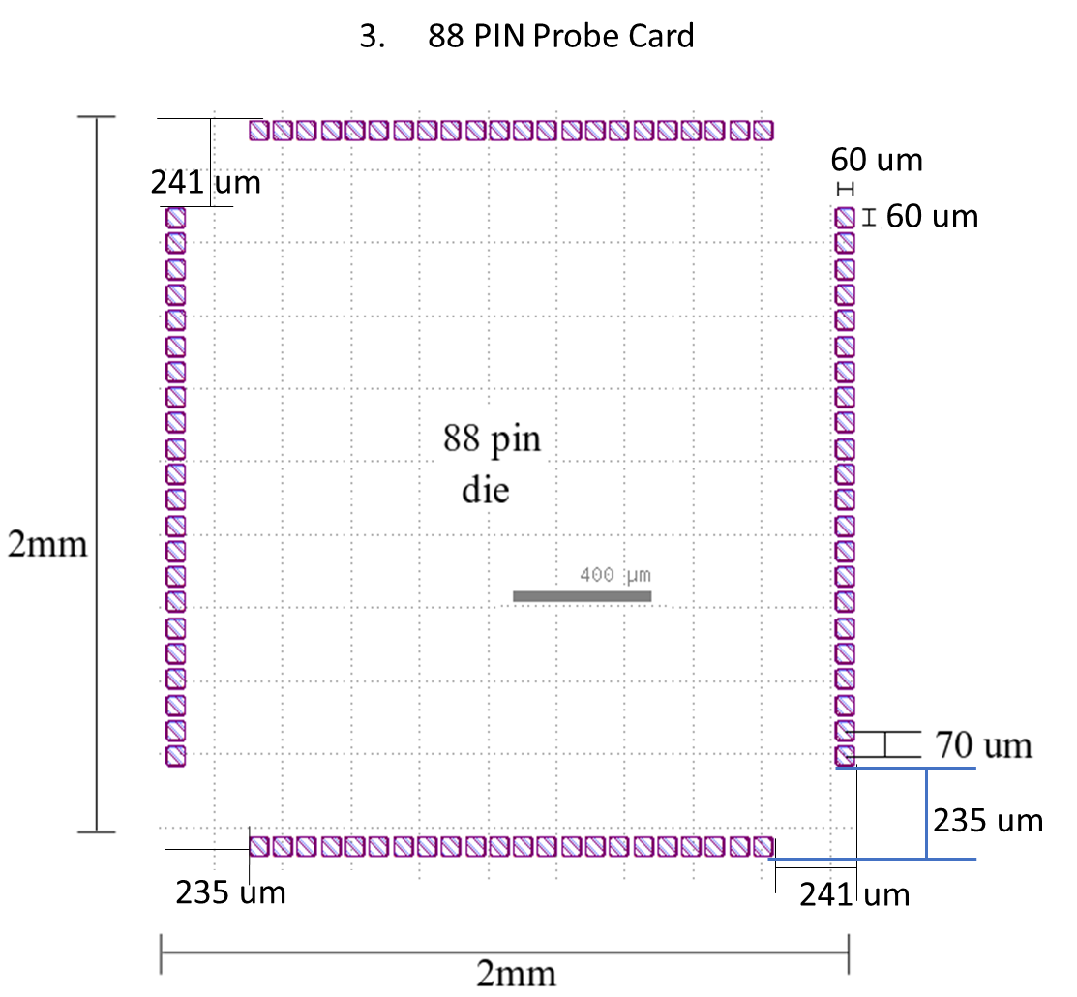
RH90 MIPS Microprocessor Die

Slide 4
FMC To Card Edge (F2CE) V3: Two PCB
Top View of main PCB (note: daughter PCB is vertical in this image)
Main PCB will have V Divider (FMC to header though holes)
Daughter PCB will carry signals (Card Edge to header right angle socket)
..
.
.
.
GND VDD
Voltage Divider
Header Socket
SMA
SMA
F2CE Daughter PCB
.
.
.
.
.
Card Edge Connector
88 1
Probe Card
.
.
.
.
FMC Cable
FMC
Socket
88 2
87 1
Two rows of headers. Make one odd and one even
Like Card Edge Connector (must match up with header socket)
Header through holes

Slide 5
FMC To Card Edge (F2CE) V3: Daughter PCB
Top View of Daughter F2CE PCB
Card Edge connector will go though PCB like though hole
Socket is a right angle SMD
Same naming as card edge for header sockets
Place names of pins on both PCB
1 3 …. … 87
4…. … 88
Daughter PCB
1 3 …. … 87
4…. … 88
Card Edge Connector
3.5”
Header Socket
FMC Connector
..
.
.
.
Voltage Divider Ck
F2CE Main PCB

Slide 6
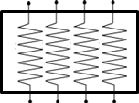
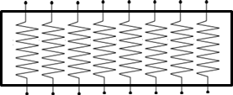

Voltage Divider Circuit
R
Schematic of each signal below
Any “input” or “input/output” into the MIPS must have a passive or active level shift
FMC side: 1.8V
MIPS side:1.2V
Voltage Divider Inside Block Diagram (8 bits)
FMC In
MIPS
R1
MIPS
FMC
Bourns R=120 ohm
YAGEO R=60 ohm
R2
Ground plane
Note: All wire lengths should be minimized and equal (ideally)

Slide 7
Basic Data Flow (CMM)
FPGA program 8 bit-stream download
(JTAG)
-IO 16 Bit (In/Out)
-Mem/Write (Out)
-PC 16 Bit (Out)
-Reset 1 Bit (In)
PC
FPGA
Passive Level Shifting
(On Any In Signal)
MIPS Microprocessor
FPGA upload program results
after program is completed
(JTAG)
DIN 5 Pin connector
Power Supply

Slide 8
16 – bit CMOS MIPS Microprocessor (CMM) PCB Layout
PWR (1.2V), GND
Voltage Divider on all lines except exclusively outputs from MIPS
See Excel Sheet for more details
MIPS power from FMC, but SMA connected via a jumper for back up
ALL GND shorted to Second SMA
Power Supply
SMA
SMA
Jumper Wire
FMC Cable
Voltage Divider
MIPS
Microprocessor
Socket
FMC Connector
Thermal Sensor Setup
R1
MIPS
FMC
R2

Slide 9
Basic Data Flow (AMM)
AWG
Reversable Clock
24 total inputs
(SMA connects)
AWG Trigger 1 Bit
FPGA program 8 bit-stream download (JTAG)
-IO 16 Bit (In/Out)
-Mem/Write (Out)
-PC (Out) 16 Bit
-Reset 1 Bit (In)
PC
FPGA
Active Level Shifting
MIPS Microprocessor
FPGA upload program results
after program is completed
(JTAG)
DIN 5 Pin connector
Power Supply

Slide 10
16–bit Adiabatic MIPS Microprocessor (AMM) PCB Layout
See next slide for Active Level shifters info
See Excel Sheet for more details
Power Supply
Active Level Shifters
(daughterboard)
MIPS
Microprocessor
Socket
FMC Cable
Thermal Sensor Setup
FMC Connector
AWG Clocks
(12 pin connector)
Reset Input from FPGA
AWG 0
AWG 1

Slide 11
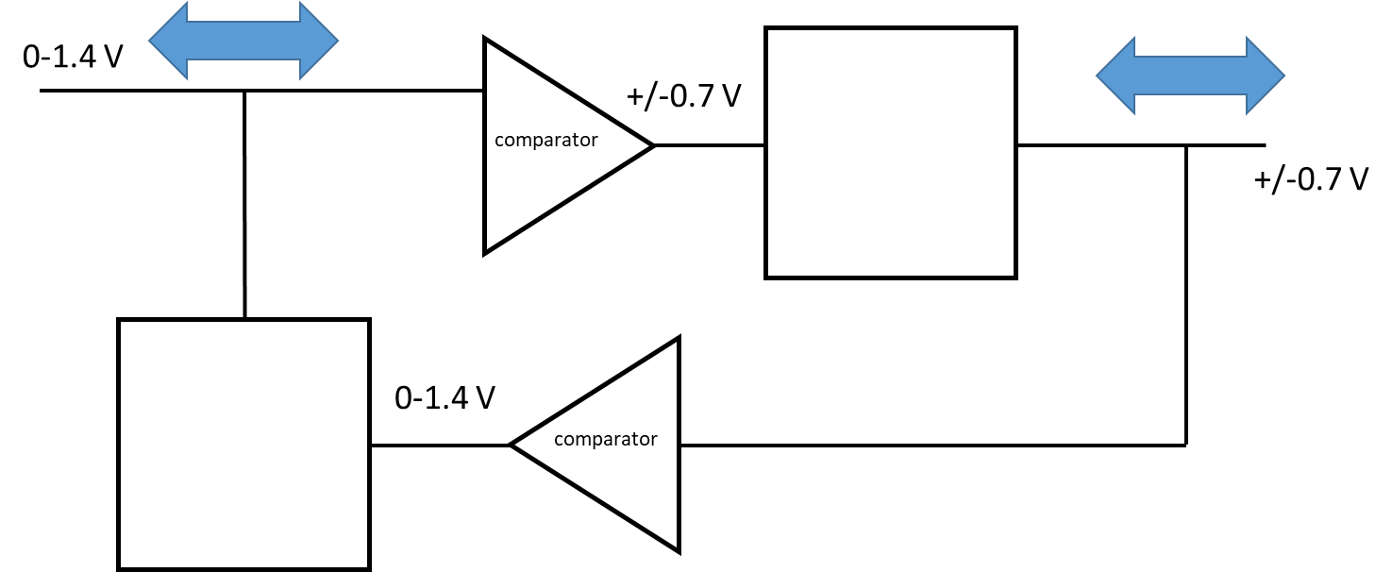
AMM Level Shifting Daughter Board
By: Dr. Orlov

Slide 12
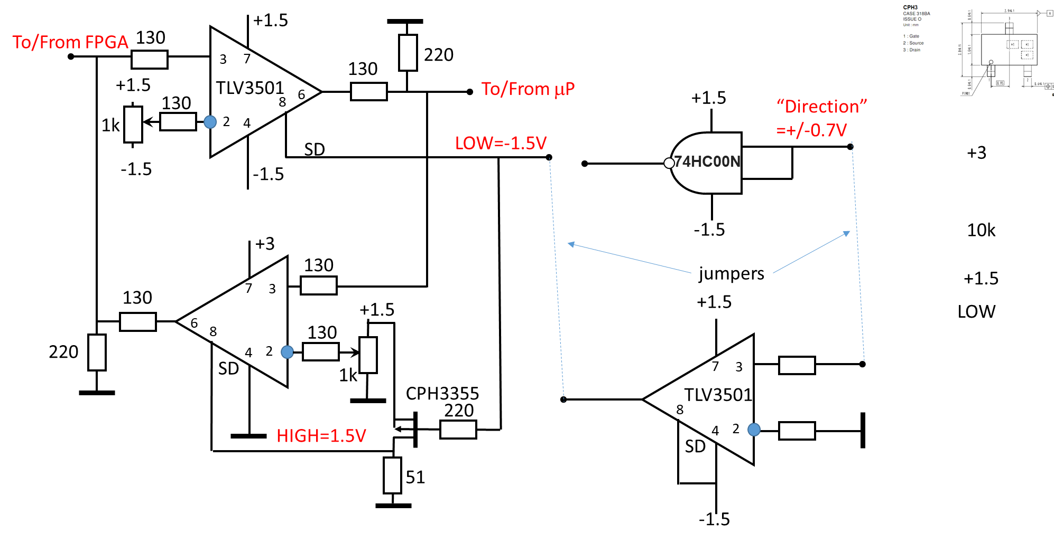
Single Channel Level Shifter
By: Dr. Orlov

Slide 13
Parts List:
Parts for F2CE
Additional parts for CMM & AMM
FMC Connector HPC: ASP-134602-01 (https://www.mouser.com/ProductDetail/Samtec/ASP-134602-01?qs=FESYatJ8odJXL2em%252Bh4I4Q%3D%3D)
YAGEO 60 Ohm resistor array: YC164-FR-0760R4L (https://www.mouser.com/ProductDetail/YAGEO/YC164-FR-0760R4L?qs=k2KEx2DUIRTSW82Om1Disw%3D%3D)
Bourns 120 Ohm resistor array: 4816P-1LF-120 (https://www.mouser.com/ProductDetail/Bourns/4816P-1-121LF?qs=%252BqDi%252BEsvRVhC5MY6A%252BJHwg%3D%3D)
Header Socket 88 pin: Mouser# 200-BCS144LDHE (https://www.mouser.com/ProductDetail/Samtec/BCS-144-L-D-HE?qs=0lQeLiL1qyYdKnn%2FODNdTw%3D%3D)
Header through holes 88 pin: Mouser# 200-DW4409GD200 (https://www.mouser.com/ProductDetail/Samtec/DW-44-09-G-D-200?qs=0lQeLiL1qybWrc0Fnlygtw%3D%3D)
Card Edge connector 88 pin: 345-088-500-202 (https://www.mouser.com/ProductDetail/EDAC/345-088-500-202?qs=X9HCC1dc6Jsts7Tqf4tnAA%3D%3D)
QFN Clamshell IC Socket: 88QN40S1100100 (https://datasheets.globalspec.com/ds/plastronics-socket/88qn40s1100100/ee94d42f-7df7-4213-868c-2a60ff52dd8f)
Please note that many of these parts are the same / similar for all 3 PCB. This is just for reference to all parts.

Slide 14
Sources Used
[1]D. Harris, and S. Harris, Digital design and computer architecture, Boston : Morgan Kaufmann Publishers, 2007.

Slide 15
Additional Info 1/19/2023

Slide 16
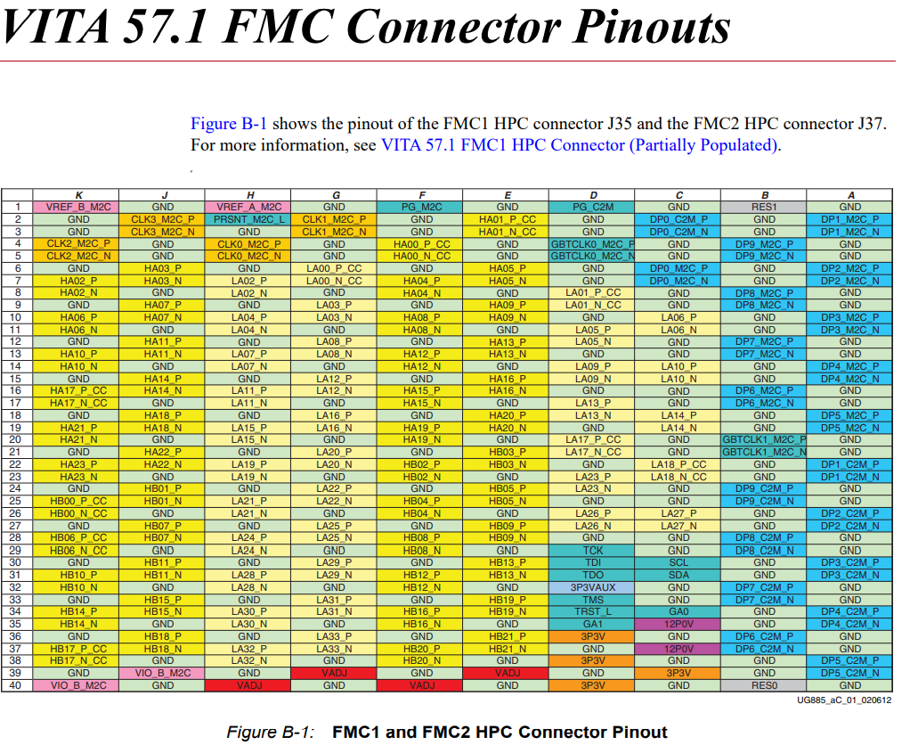
VITA 57.1 FMC Connector Pinouts

Slide 17
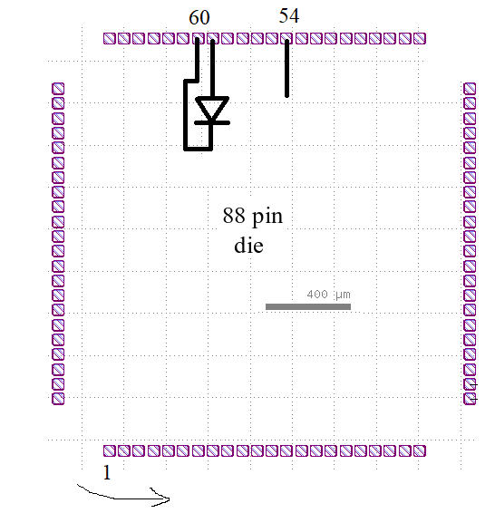
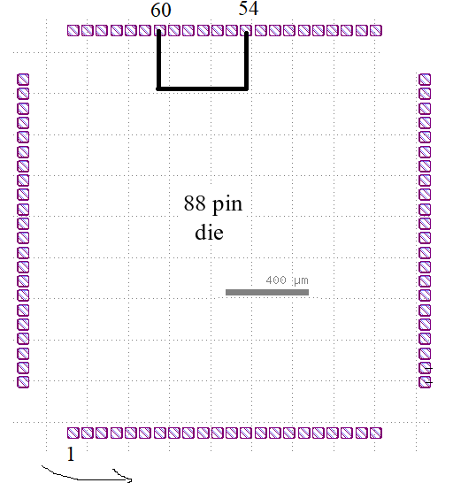
Microprocessor vs test chip
Pins 60 and 54 are shorted vs N side of PN junction
MIPS Test
By: Rene Celis-Cordova

Slide 18
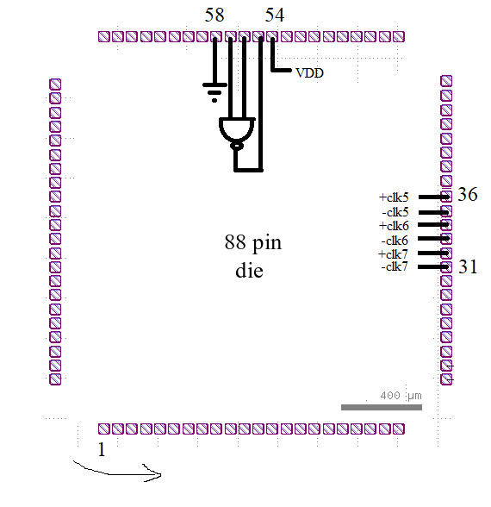
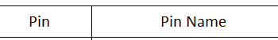
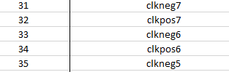
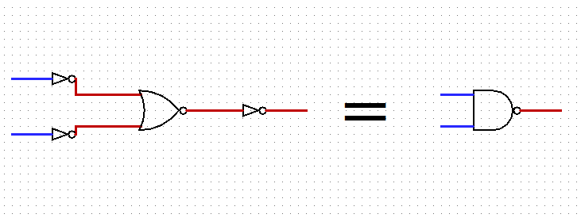
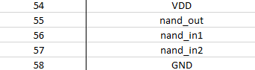
Test chip NAND gate – 3 levels
+clk can be tied to VDD, while –clk can be tied to GND
By: Rene Celis-Cordova

Slide 19
State Machine MIPS
By: Rene Celis-Cordova

Slide 20
Next State MIPS
By: Rene Celis-Cordova

Slide 21
FMC To Card Edge V2 (F2CE)
Only Required for testing structures on “Bridget Test Chip”
Passive Voltage Divider used for MIPS Microprocessor
R1 = 60 ohms
R2 = 120 ohms
V Divider
.
.
.
.
.
.
GND VDD
SMA
SMA
FMC Cable
FMC Connector
Card Edge Connector
Probe Card

Slide 22
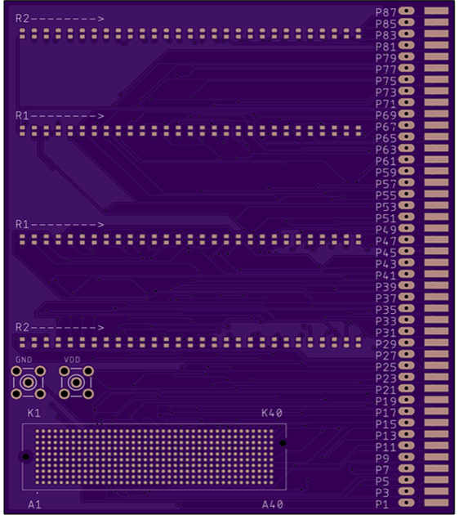
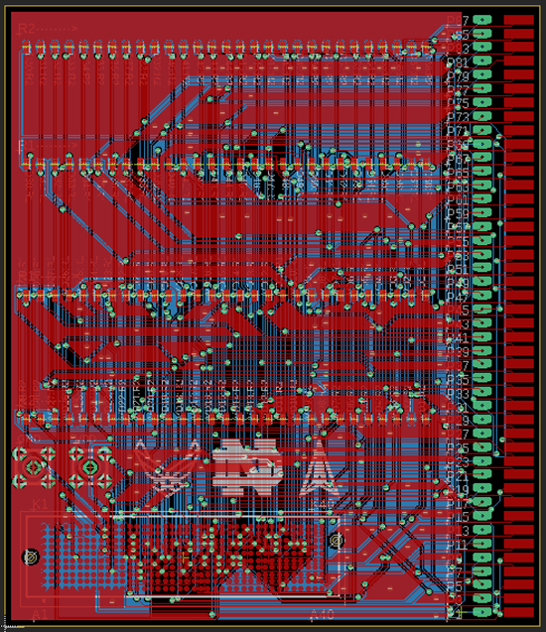
F2CE PCB Fab
Images by Richard McManus

Slide 23
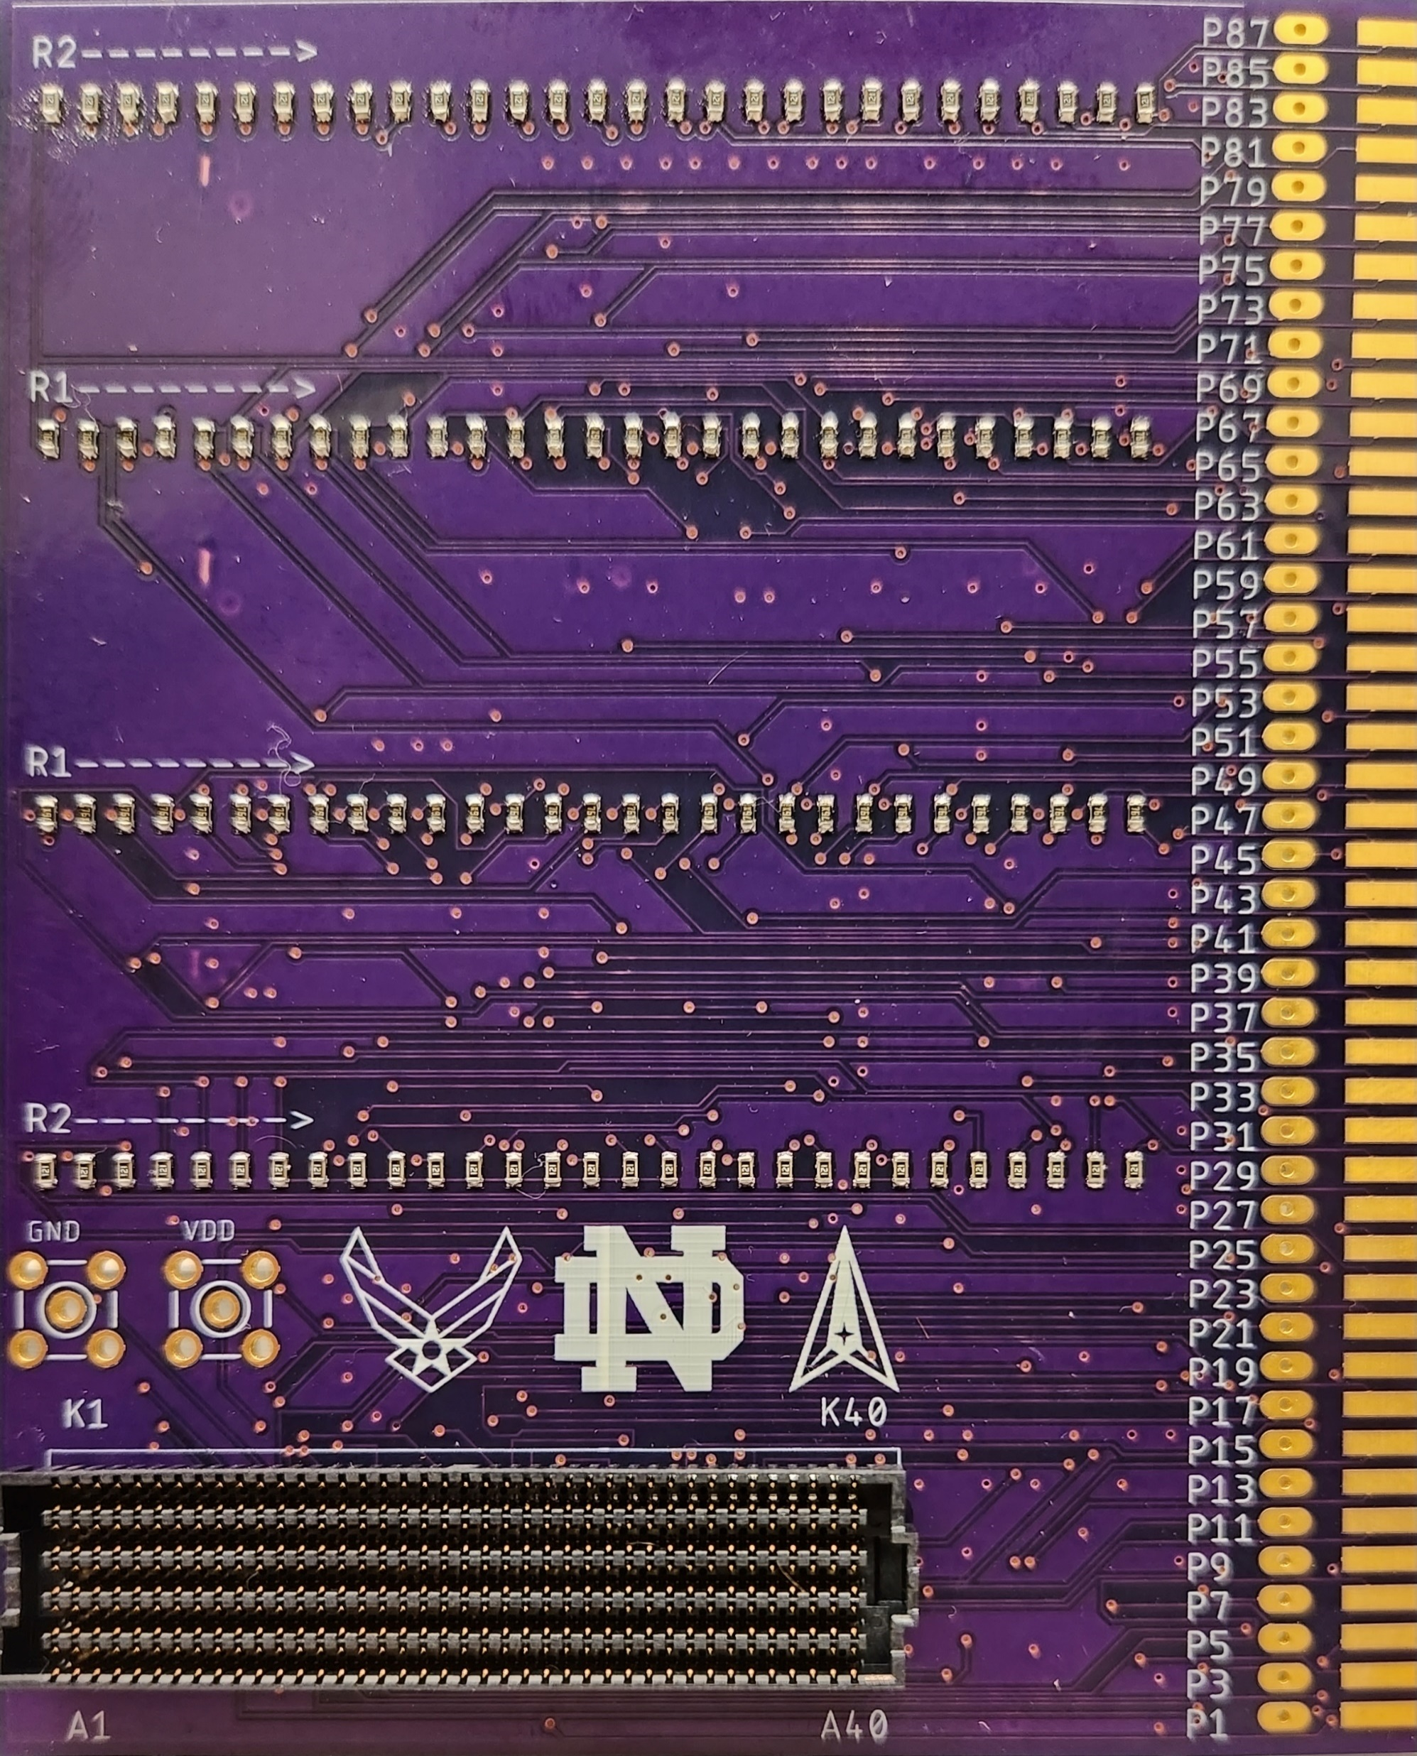
F2CE PCB Partial Completion

