Slide 1
React
Simple walkthrough

Slide 2
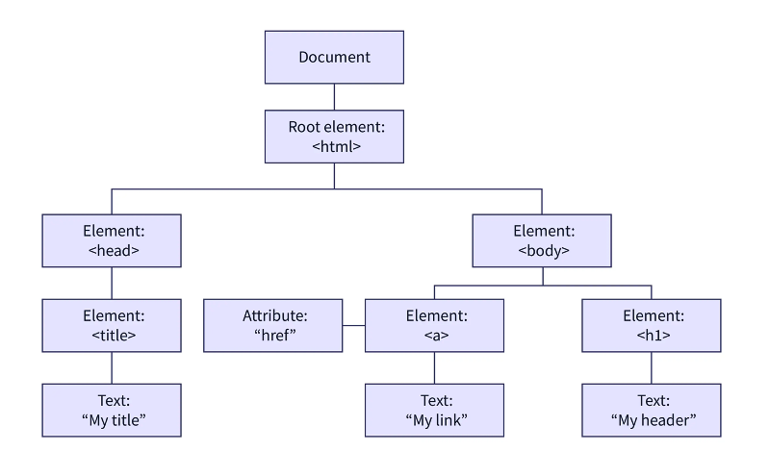
React concepts
Imperative vs Declarative

Slide 3
React concepts
Imperative
document.getElementById(id)
document.getElementByTagName()
document.createElement(name)
parentNode.appendChild(node)
element.innerHTML
element.style.left
element.setAttribute()
element.getAttribute()
element.addEventListener()
window.onload
Add new nodes
Update existing nodes
Delete existing nodes

Slide 4
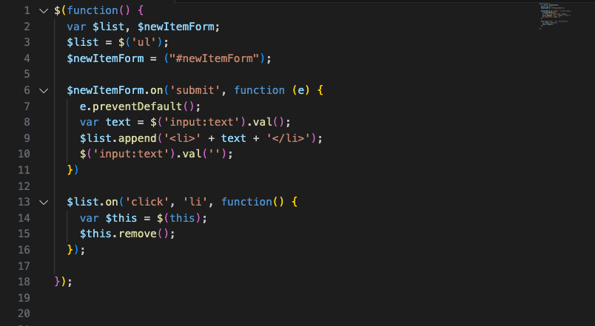
React concepts
Imperative

Slide 5
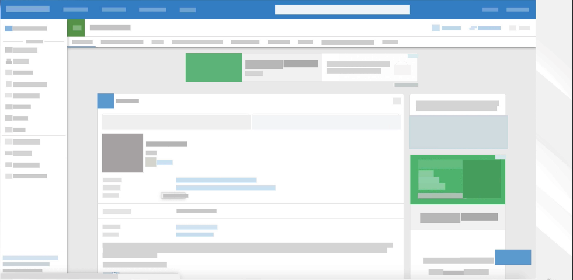
React concepts
Imperative

Slide 6
React concepts
Imperative
DOM manipulation is one of the biggest performance bottlenecks
It takes along time for DOM changes to happen
Two really intensive operations:
Repaint
Refloat

Slide 7
React concepts
Declarative
Don’t touch the DOM. I’ll do it

Slide 8
React concepts
Imperative
Just declare me what your application looks like
I’ll take care of it
You’ll never have to touch the DOM anymore

Slide 9
React concepts
Imperative
Javascript object with a massive blueprint.

Slide 10
React concepts
Imperative

Slide 11
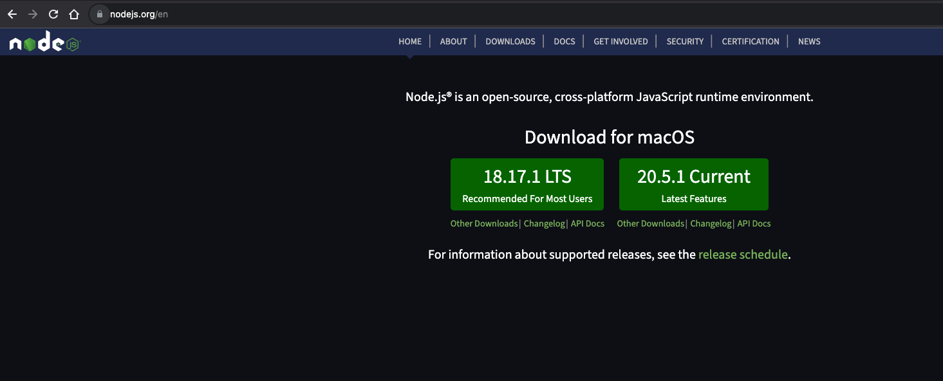
React concepts - Installing
https://nodejs.org

Slide 12
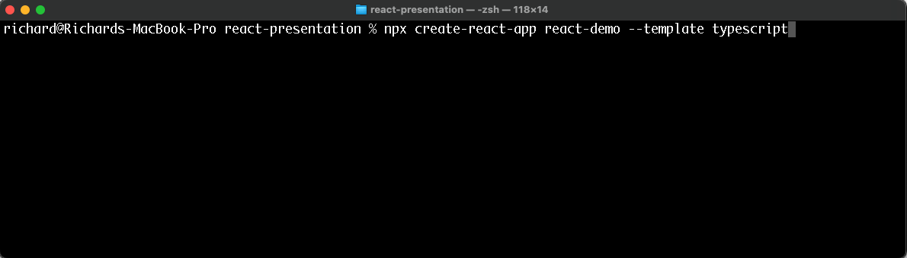
React concepts - Installing
npx create-react-app react-demo --template typescript

Slide 13
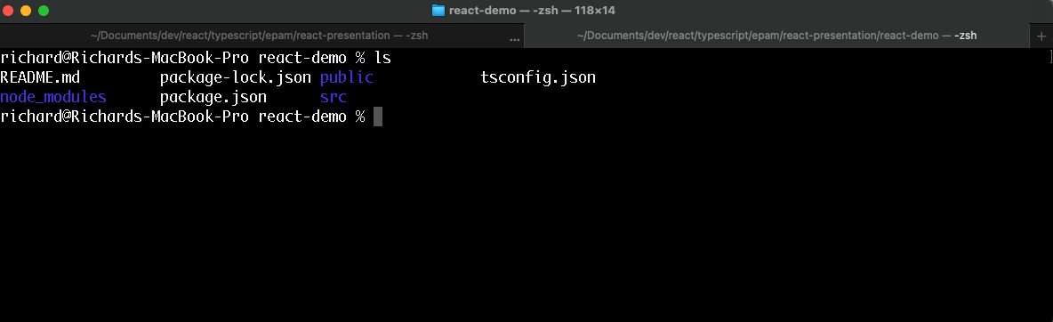
React concepts - Installing
npx create-react-app react-demo --template typescript

Slide 14
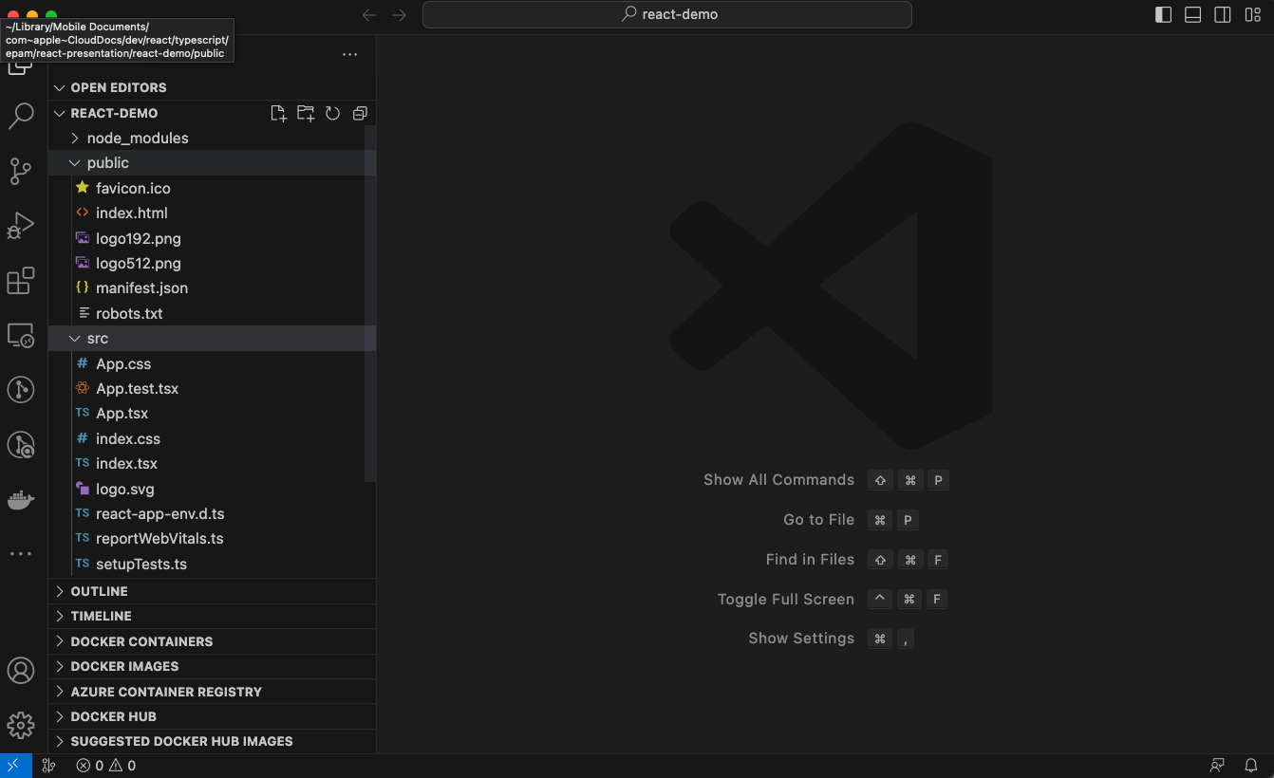
React concepts - Installing

