Slide 1
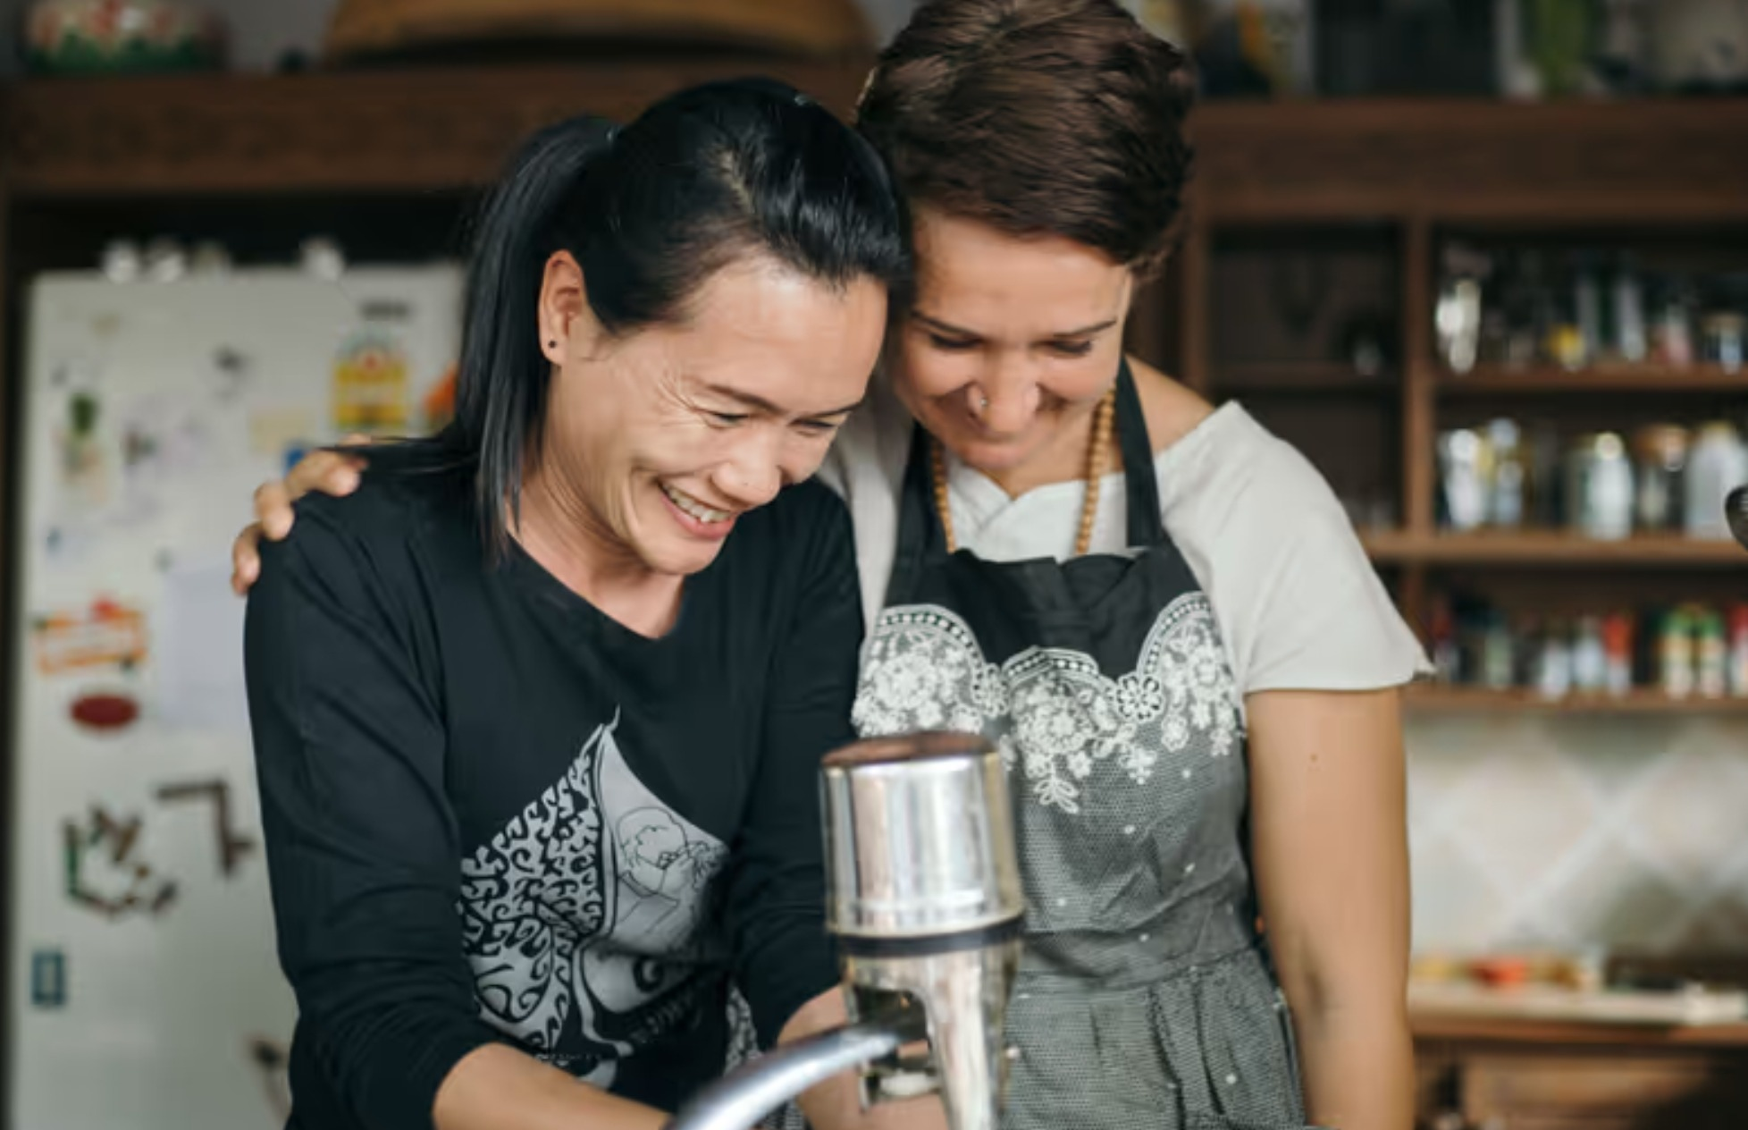

Let's go together. Meet the other half of Chiang Mai.
CLAUDE COMMUNITY HACKATHON · CHIANG MAI · 27 SEP 2026
Notes:
[~45s · STORY: your why] Sawasdee ka. Let me start with a confession. When I moved to Chiang Mai with my family, I really struggled. I had no Thai friends, I couldn't read the signs, and after a few years I was so frustrated I was ready to pack up and move to Uruguay. Instead, I stayed and started a business here. And that business is what finally opened the door: my Thai team, my neighbours, being invited to temple festivals, learning Thai. It brings me so much joy. But it took me years. It shouldn't take anyone years. That's why we built Bpai Duay Gan, ไปด้วยกัน: let's go together.

Slide 2

THE PROBLEM
Chiang Mai is a melting pot. So why is it so hard to connect?
Foreigners
Thai locals
Want to meet locals and learn Lanna and Thai culture, whether here for a week or two years.
No common ground to start
Proud of their food and culture, and many would love to share it, with the right person.
Meeting someone isn't enough. You need something in common.
Notes:
[~40s · THE PROBLEM] Chiang Mai is one of the great melting pots of the world. Thousands of people from everywhere, with every kind of skill, living right next to a proud Lanna and Thai culture. And yet the two worlds rarely meet. Foreigners want to connect with locals and learn the culture, whether they're here for a week or two years. Many Thais would love to share their food, their language, their city. But when we meet, what do we talk about? Meeting someone isn't enough. You need something in common. Say I love yoga and meditation, and I can teach English or help someone sell their products online. If I could put that out there, now a Thai friend and I have a reason to meet. And no one is forced: it's opt-in on both sides, only people who want to connect.

Slide 3
THE HIDDEN PROBLEM
Surrounded by people, and still alone.
1 in 6
71%
people worldwide are lonely
of expats find it hard to make local friends
WHO Commission on Social Connection, 2025
InterNations Expat Insider 2026
Yet expats rank Thais the friendliest people in the world. The friendship is there. The bridge is missing.
Notes:
[~25s · THE HIDDEN PROBLEM] And this isn't just my story. The World Health Organization says 1 in 6 people worldwide are lonely, and it names migrants among the groups who find it hardest to connect. Here in the expat world, 40% say it's hard to make local friends. But here's what surprised me: in the same survey, expats rank Thai people the friendliest in the world. The friendship is there. What's missing is the bridge. [Sources: WHO Commission on Social Connection, June 2025; InterNations Expat Insider 2026.]

Slide 4
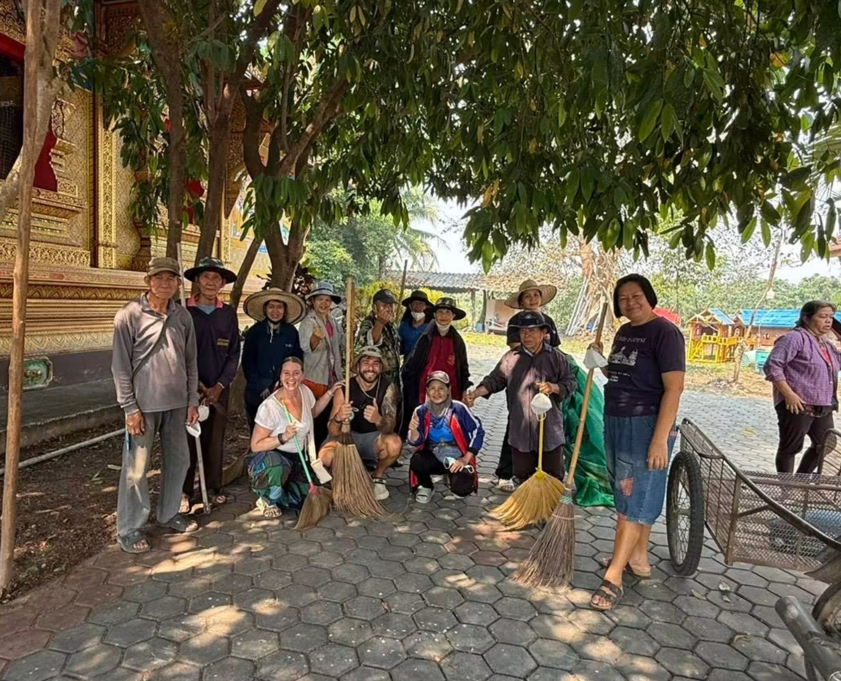
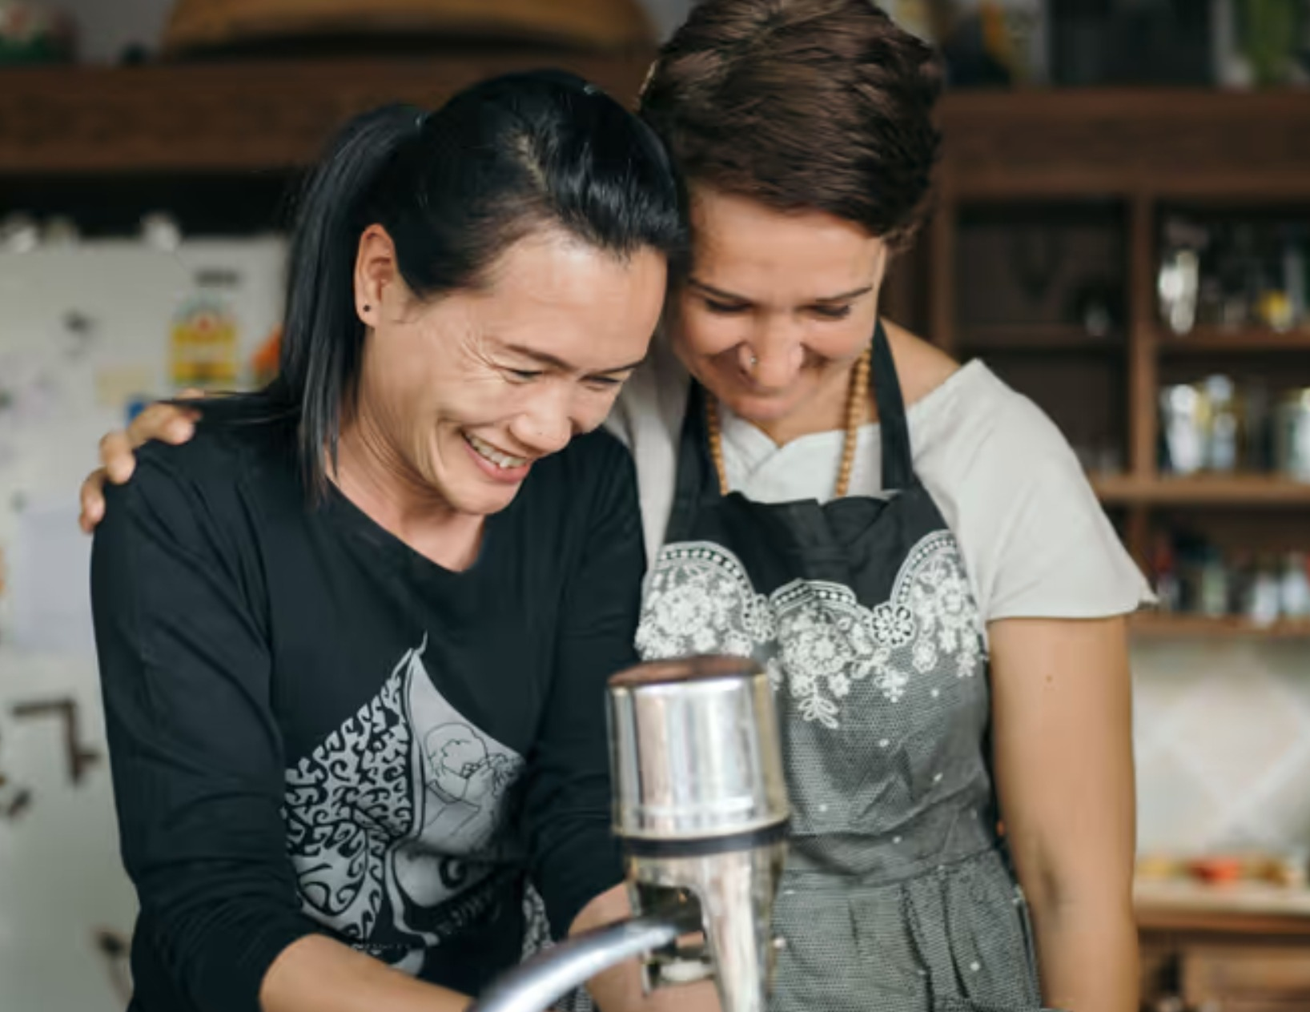
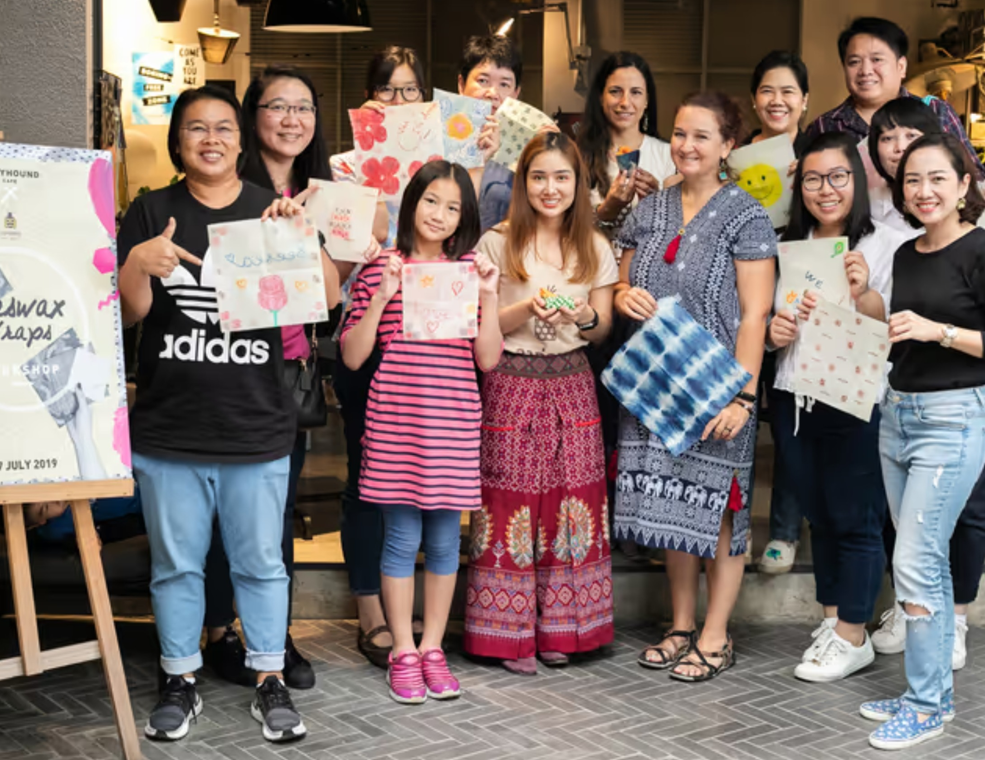
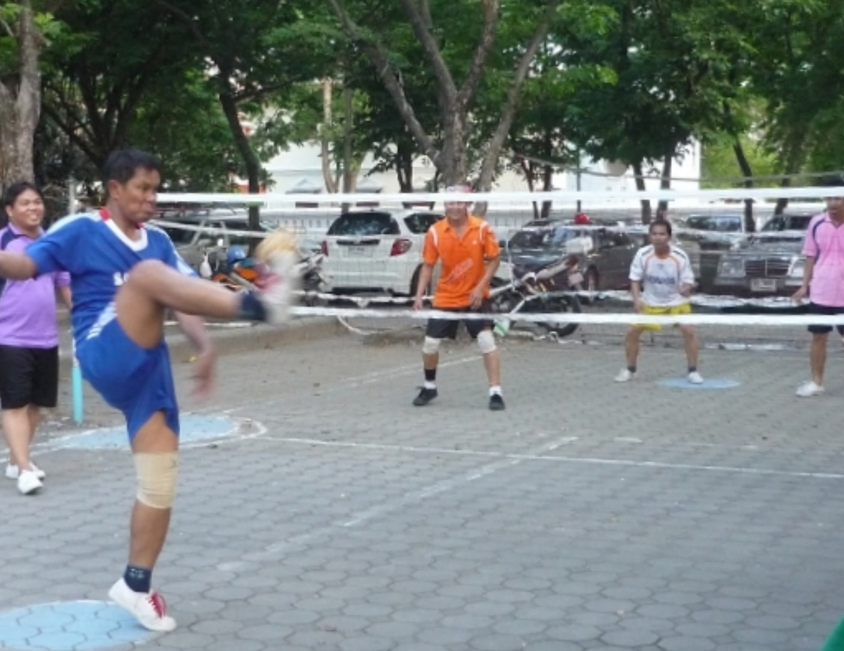
GOING TOGETHER
Real things to do, side by side.
Cooking together
Eco workshops
And much more
Language exchange · Muay Thai · Weaving · Scooter lessons · Night markets
Temple clean-up
Sepak takraw
Notes:
[~20s · THE VISION] This is what we want to create. Not swiping. Doing. Cleaning up a temple together. Cooking side by side. Making eco products at a workshop. Joining a game of sepak takraw. Language exchange, Muay Thai, weaving, scooter lessons, night markets. Every one of these starts with two people who have something to give each other.

Slide 5



NOT JUST FOR FUN
Share skills, grow businesses.
Khun Nok
Wendy
They swap know-how
Chiang Mai maker, sells Thai handmade products
Expat e-commerce seller, new to Thailand
KNOWS
KNOWS
Shopee
Lazada
Amazon
LEARNS
LEARNS
Amazon
Shopee
Lazada
Both sell on both platforms, and local Thai products reach global markets.
Notes:
[~25s · THE BUSINESS SIDE] And it's not only about fun. Meet Khun Nok. She makes beautiful Thai handmade products and she knows Shopee and Lazada inside out. And meet Wendy. She's new to Thailand and she knows how to sell on Amazon. On Bpai Duay Gan they find each other through the Business and digital tags, and they swap know-how. Now both of them sell on both platforms. That's how local Thai products reach global markets, one connection at a time.

Slide 6
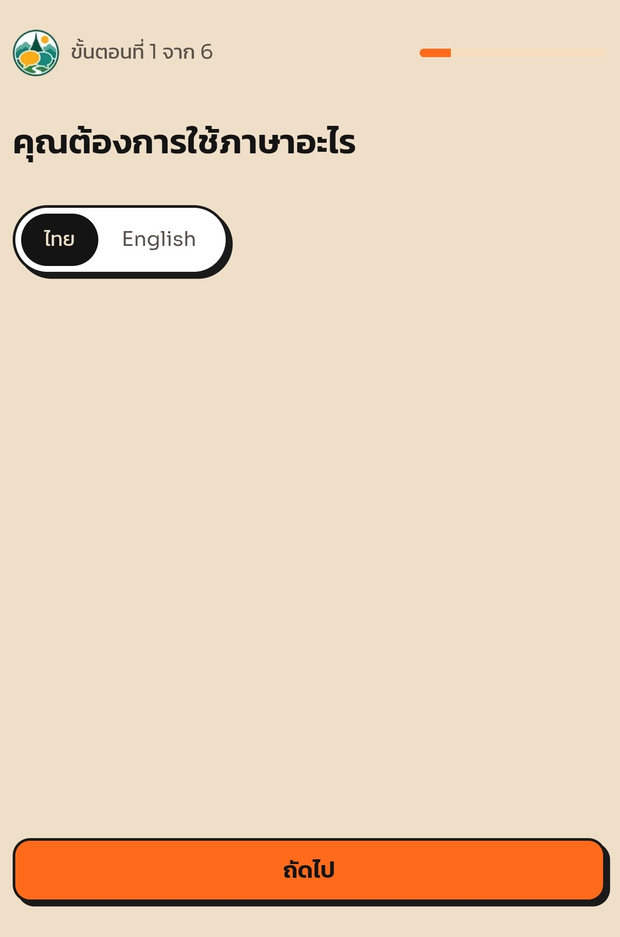
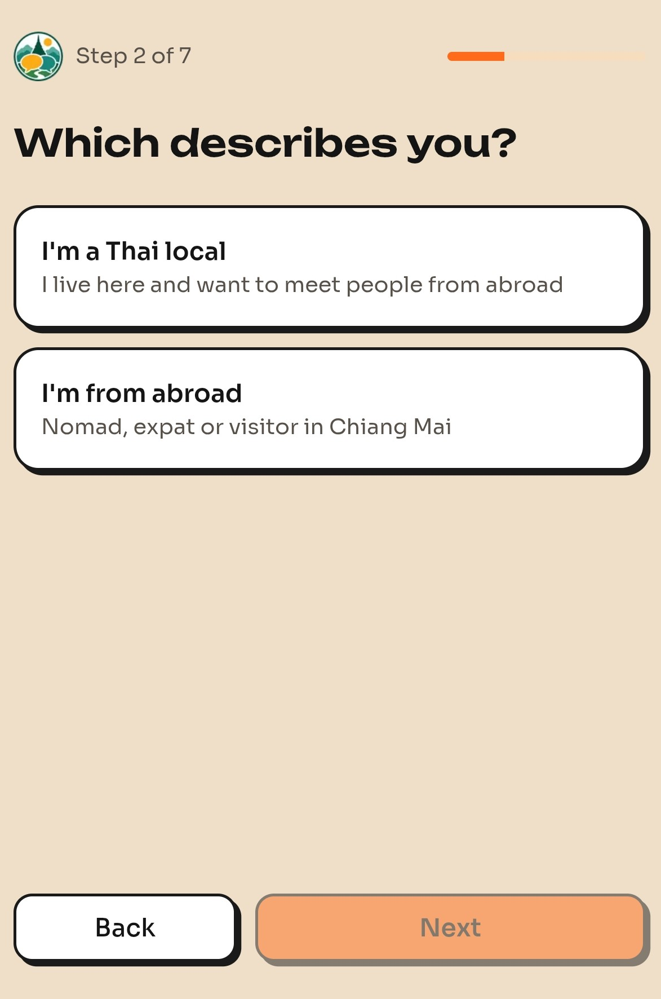
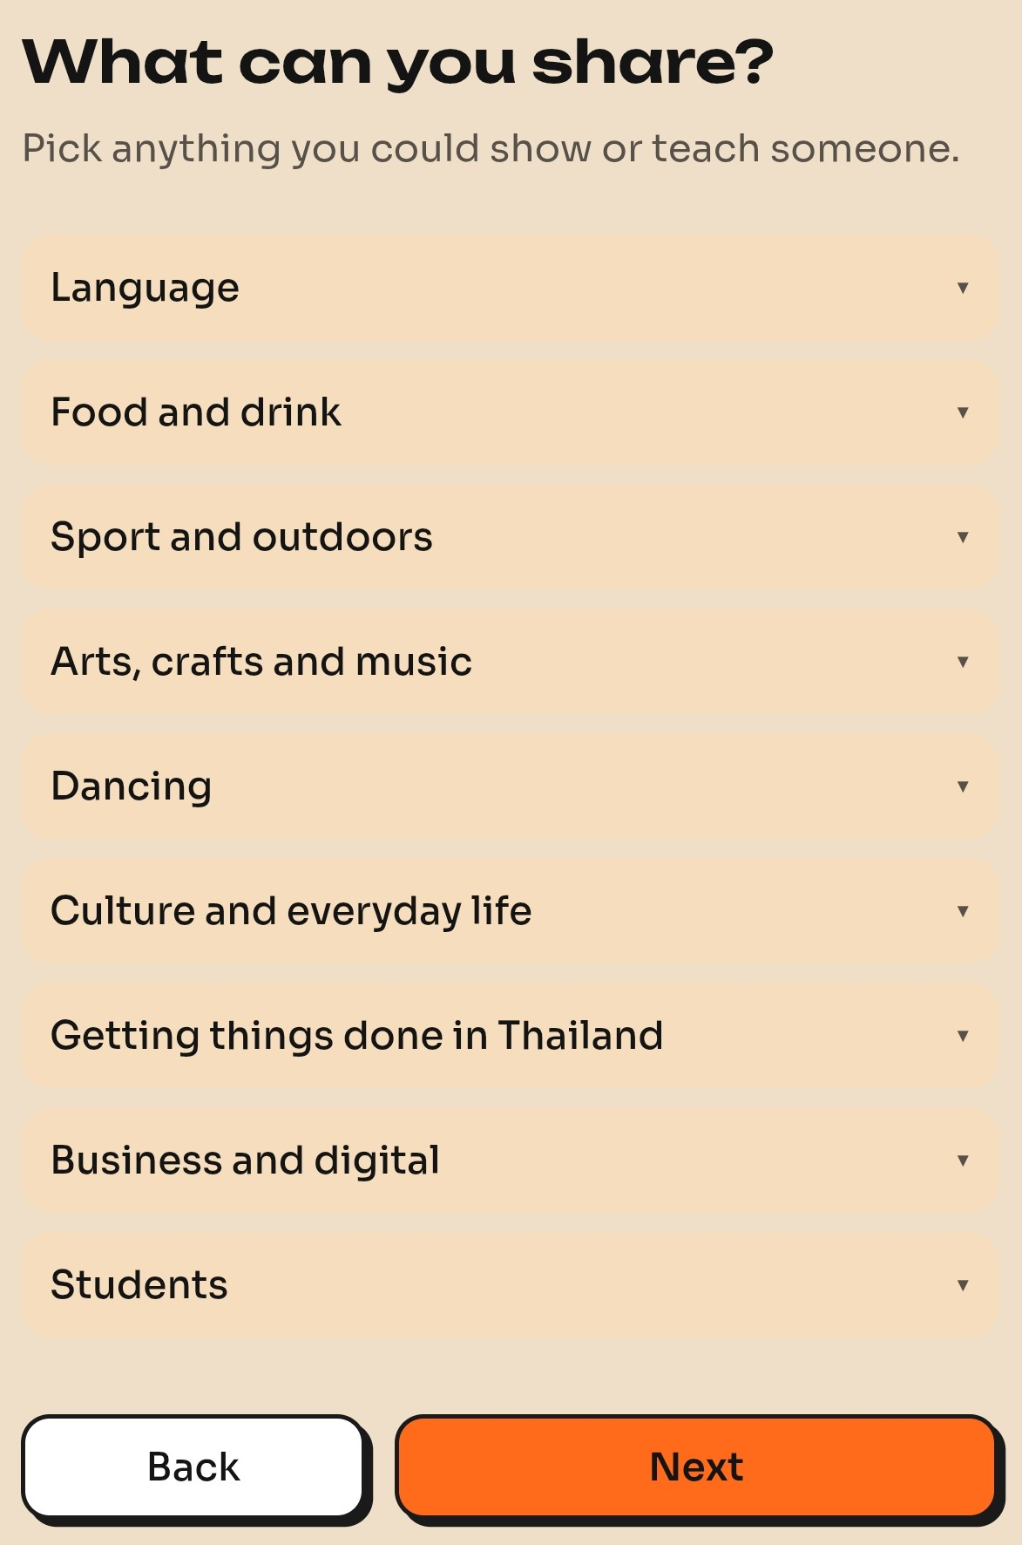
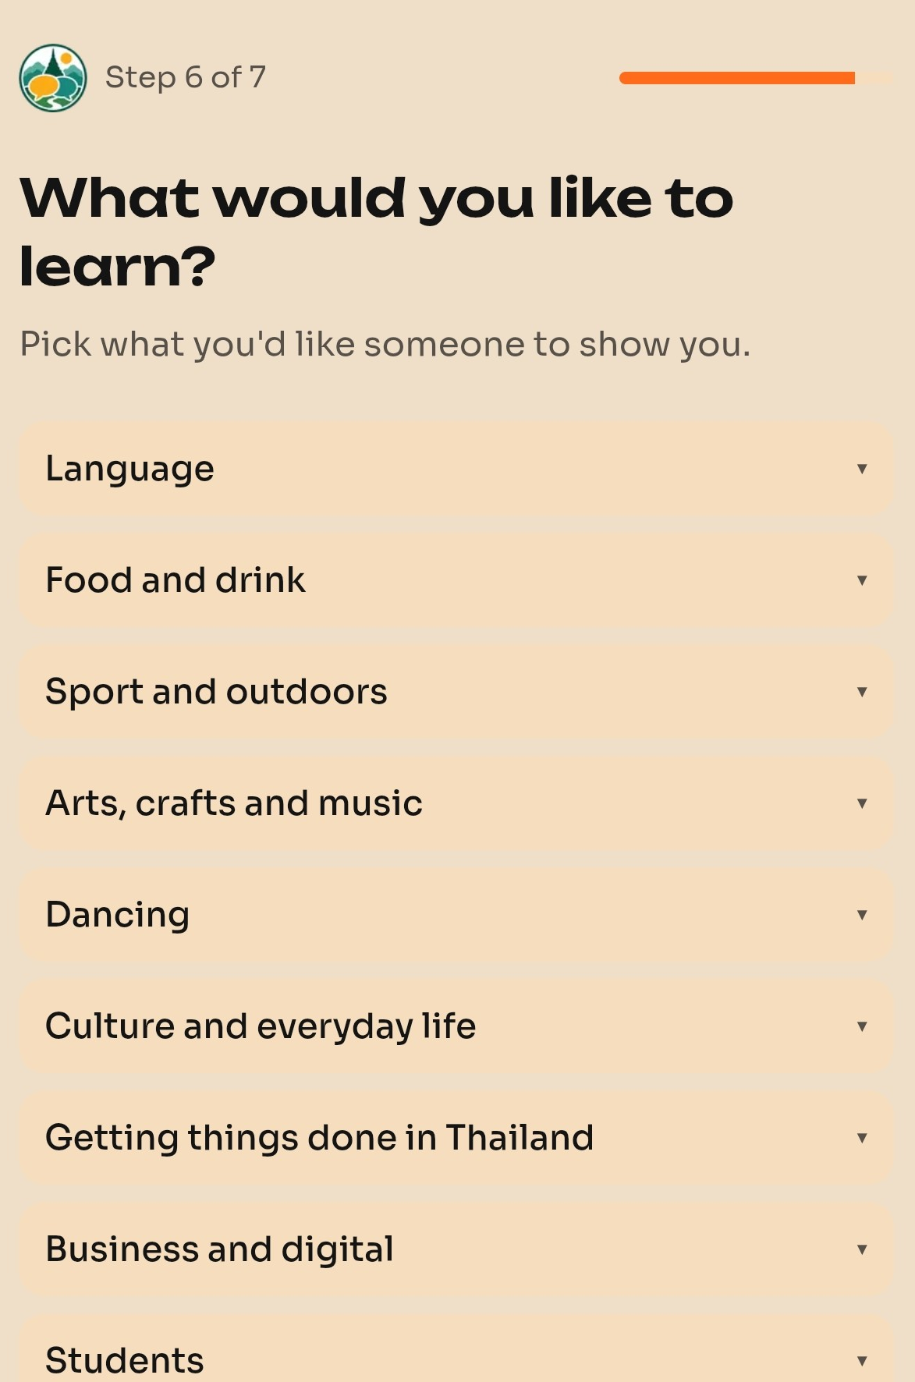
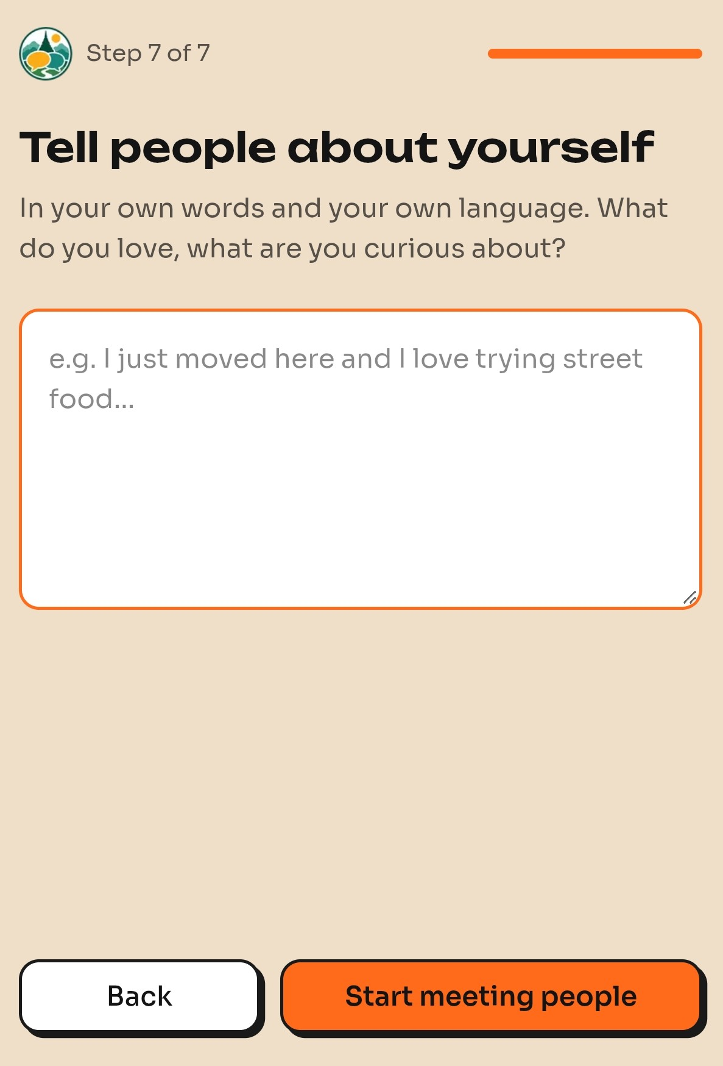
THE APP, STEP BY STEP
Sign up in under a minute.
1. Choose Thai or English
2. Thai local, or from abroad?
3. What you can share
4. What you'd like to learn
5. About you, in your own language
Notes:
[~20s · THE APP] So how does it work? It's simple. You choose Thai or English, the whole app works in both. You say whether you're a Thai local or from abroad. You pick what you can share, and what you'd like to learn. And you tell people about yourself in your own words, in your own language. Under a minute.

Slide 7
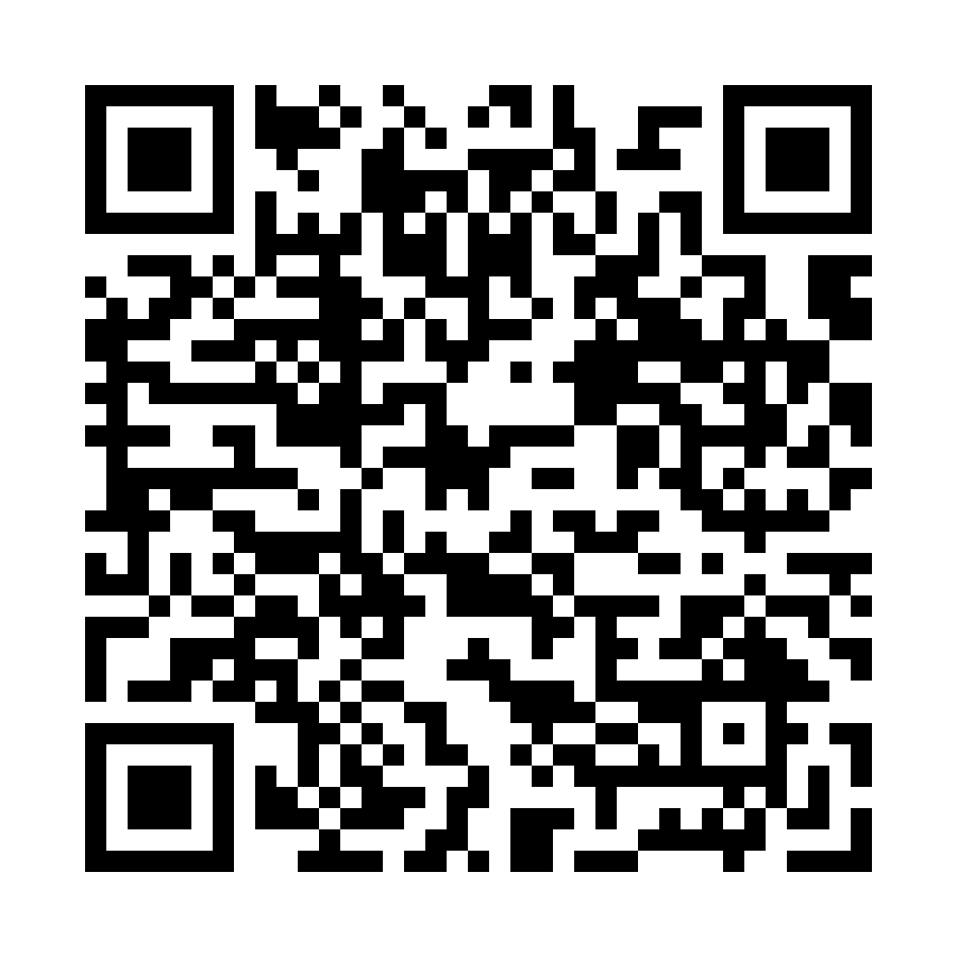
TRY IT NOW
Let's try it and see how easy it is.
Scan the code with your phone and join in under a minute.
▶ Live demo
Notes:
[~60–90s · TRY IT] But don't take my word for it. Let's try it and see how easy it is. Take out your phones and scan the code. [Pause while people scan.] While you're joining, let me show you live. [Click Live demo.] I'll ask to connect with someone who's going to the same event. On the other side, they see the request, with the event as the reason. They accept, and the chat opens. [Backup if wifi fails: play Marc's recording.]

Slide 8






THAI-FRIENDLY EVENTS
Every event checked: is it Thai-friendly?
We find the event
We email the organiser
They answer
Thais see a badge
From nomad and local platforms
Thai food?
เป็นมิตรกับคนไทย
A few quick questions
Thai translator?
TCEB endorsed?
Thai-friendly
Not Meetup, Tandem or Bumble BFF. Built for Thais, and not a dating app.
Notes:
[~40s · WHY WE'RE DIFFERENT] Now, you might ask: isn't this Meetup, or Tandem, or Bumble BFF? Those weren't built for Thai people. We have a Thai name, we work in Thai and English, and we are not a dating app. Here is the part I'm most excited about. We find events from the nomad and local platforms and translate them into Thai. Then we email every organiser a few quick questions. Is there Thai food? Is there a Thai translator, like at the Marriott? Is it TCEB endorsed? Their answers become a Thai-friendly badge, เป็นมิตรกับคนไทย. So a Thai person can see at a glance: this event is for me too. [Say "this is how it works" or "this is what we're building next" if it isn't live yet.]

Slide 9

TRANSLATED CHAT
Translation starts it. Meeting up is the point.
EXAMPLE CHAT
See you at the workshop on Saturday?
Nok sees: เจอกันที่เวิร์กช็อปวันเสาร์นะครับ?
ได้เลยค่ะ แล้วเจอกันนะคะ
Chat arrives in the reader's language, with the right polite ending (ครับ / ค่ะ). Then you meet in person, and learn each other's words.
Sam sees: Sure! See you there.
Tap any message to see the original.
Notes:
[~30s · THE MAGIC MOMENT] And here's the moment that makes it work. Sam writes in English: "See you at the workshop on Saturday?" Nok reads natural, polite Thai, with the right ending, ครับ. She replies in Thai, and he reads English. Tap the message and you see the original. Now, we could have built another translator app, but anyone can do that with ChatGPT, and Thailand already uses AI more than almost anywhere. Translation is not the point. It just gets the first conversation started. Then you meet in person, and that's where the real learning happens.

Slide 10

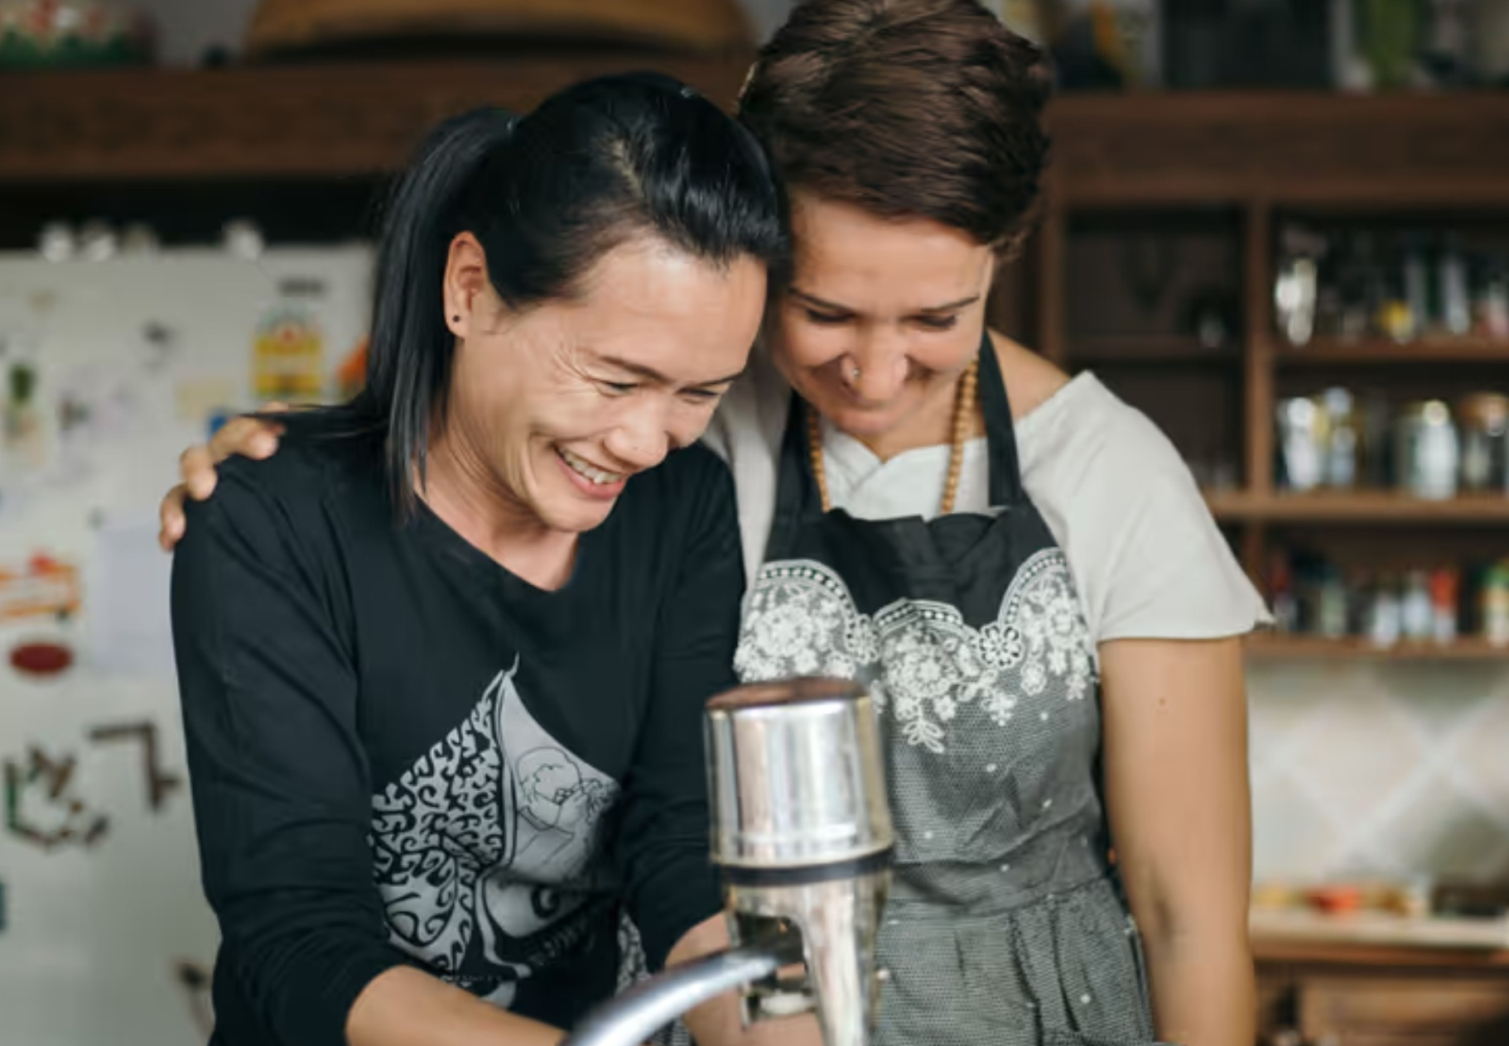
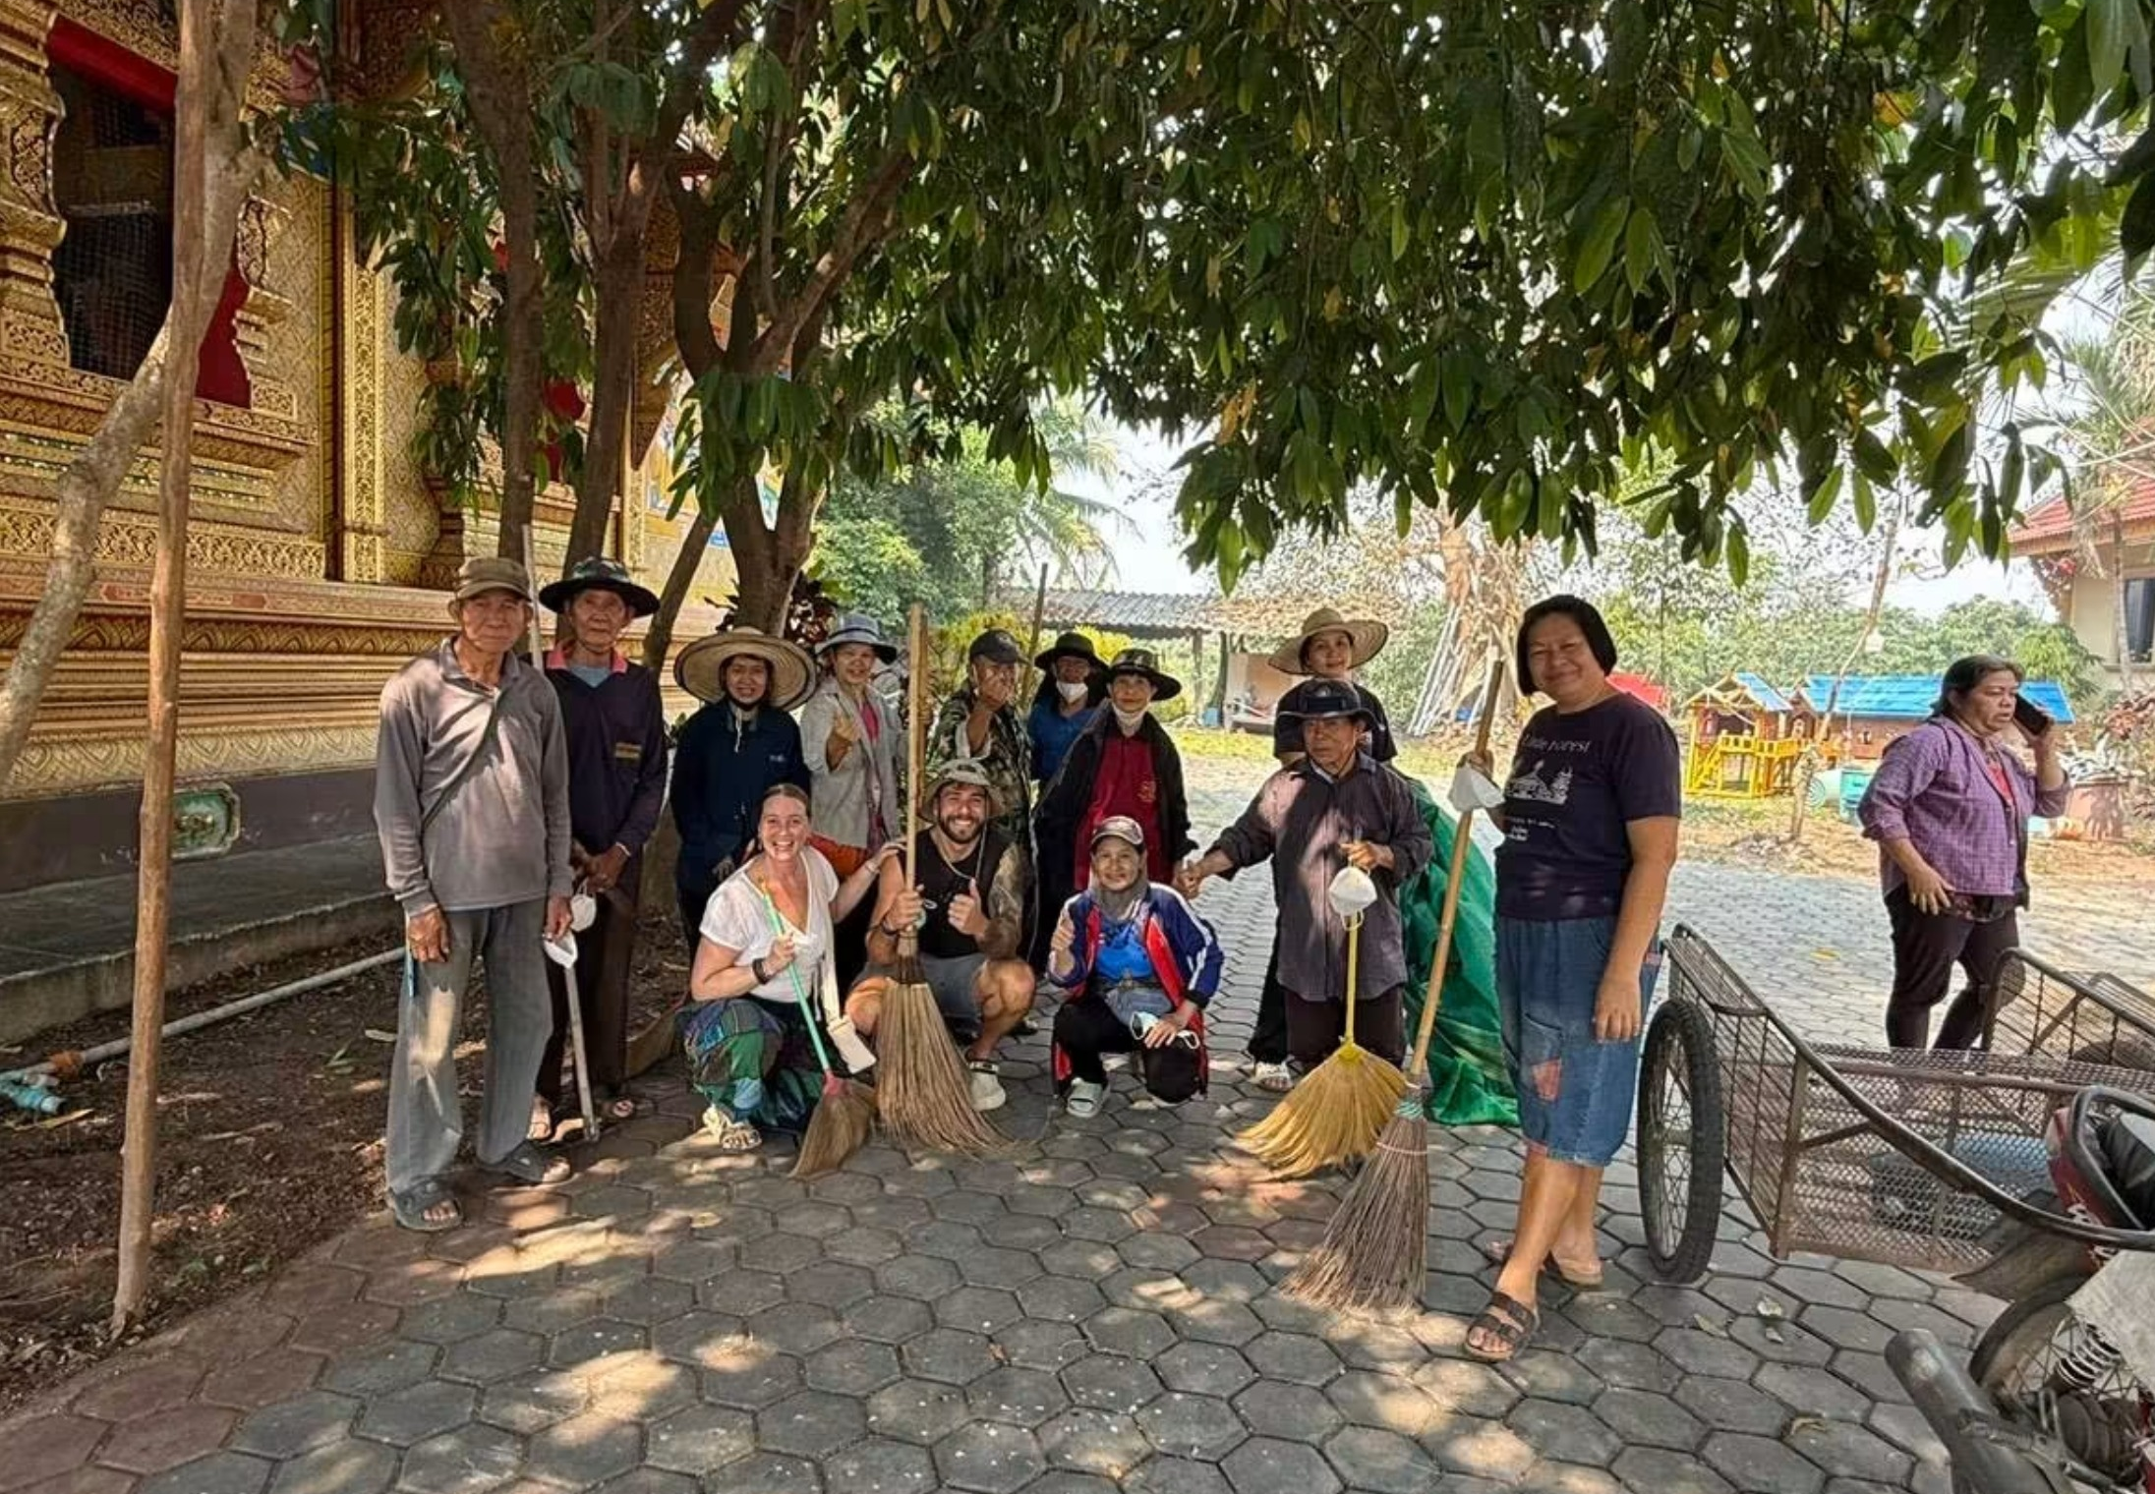

HOW THAIS WILL FIND US
LINE brings them to Bpai Duay Gan.
1
2
3
4
Attract
Add us on LINE
Tap through to the app
Feel at home
Photos of people connecting, plus this week's Thai-friendly events. All in Thai.
Scan a QR code at CMU, Payap, temples or cafés. A Thai welcome message pops up.
One tap from LINE into Bpai Duay Gan. Thai first: Thai language, Thai welcome, Thai-friendly events.
An app built to feel comfortable for Thais. Their meetup photos become next week's LINE posts.
หาเพื่อน · Find a buddy
สมัคร · Join
LINE is where Thais discover us. Bpai Duay Gan is where they feel at home.
Notes:
[~30s · GROWTH] How will Thai people find us? Through LINE, because that's where they already are. Our LINE account shares photos of real people connecting and this week's Thai-friendly events, all in Thai. Scan a QR code at the university, a temple or a café, add us on LINE, and a Thai welcome message appears: find a buddy, or join. One tap takes them into Bpai Duay Gan. And that's our real focus: the app itself is built Thai-first, Thai language, Thai-friendly events, a Thai welcome, so Thai people feel comfortable and at home using it. Their meetup photos become next week's LINE posts, and the loop feeds itself.

Slide 11
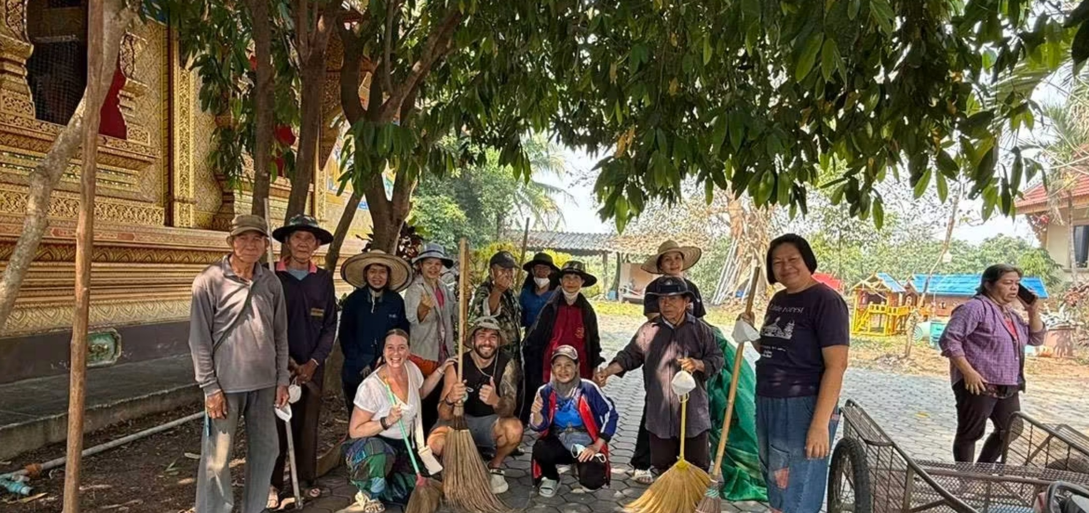
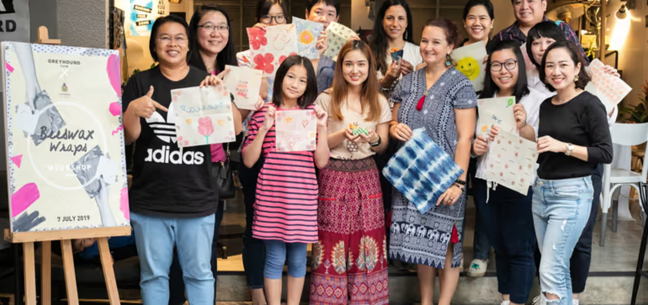
DAY-ONE IMPACT
Useful from the very first sign-up.
Works today, on any phone
Nomads join local life
Locals gain skills and friends
Just a link, no app store. Found on LINE, built to feel Thai.
Time and money spent with locals, not just around them.
Plus English practice and new income opportunities.
Launching with Chiang Mai University, Payap University and STeP
Thai students and foreign talent, learning from each other.
Notes:
[~30s · DAY-ONE IMPACT] And this works from day one. It's a link, no app store. Chiang Mai already has the people, the events and the goodwill. What's missing is the bridge. Nomads spend their time and money with locals, not just around them. Locals gain skills, English practice, new income and friends. And we know exactly where we start: I have connections at Chiang Mai University, Payap University and the STeP programme, and we'll bring Thai students and foreign talent together to learn from each other. [Say "we'll start with" unless they've already agreed.]

Slide 12
BUILT TOGETHER
Built in a weekend. Ready for any city.
The team of six
Ready for any city
Antoinette
Lutz
Self-hosted and public on GitHub. Bali, Lisbon, Medellín, Tokyo: any city where locals and newcomers want to meet can run its own.
Shivam
Richard
Oleg
Web app
Marc
github.com/richardmthompson/bpai-duay-gan
Notes:
[~15s · THE TEAM] Six of us built this in one weekend: Lutz on events, Shivam on the backend and matching, Richard on chat and translation, Oleg on the app, Marc on deployment, and me on the pitch. And it's open source on GitHub, so any city where locals and newcomers want to meet, Bali, Lisbon, Medellín, can run its own.

Slide 13

ไปด้วยกัน
"If you want to go fast, go alone.
If you want to go far, go together."
Let's go together.
ขอบคุณค่ะ · Thank you
Notes:
[~20s · CLOSE] When I was ready to give up on Chiang Mai, I didn't need a translator. I needed someone here to go with. As the saying goes: if you want to go fast, go alone. If you want to go far, go together. [Pause.] Bpai Duay Gan, ไปด้วยกัน. Let's go together. ขอบคุณค่ะ. [Optional: high-five a Thai teammate.]

