Slide 1
Single Cell RNA Sequencing Clustering Basics
IUPUI, School of Informatics and Computing
Richard Mustaklem Email: rmustak@iu.edu
11/7/2023

Slide 2

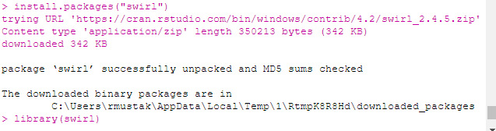
Background: Learning R
Step 1: Install R here
Step 2: Install Rstudio here
Step 3: Swirl!

Slide 3
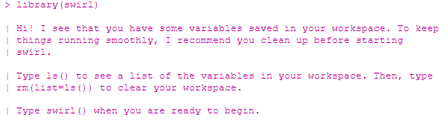
Background: Learning R
Step 1: Install R here
Step 2: Install Rstudio here
Step 3: Swirl!

Slide 4
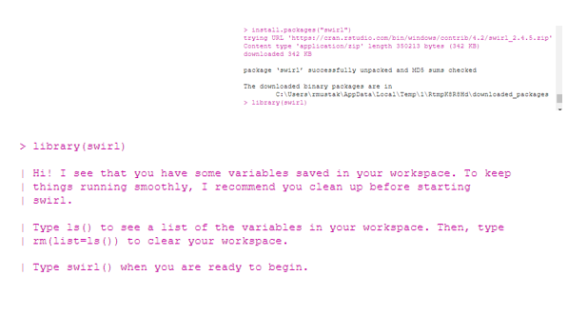

Background: Learning R
Step 1: Install R here
Step 2: Install Rstudio here
Step 3: Swirl!

Slide 5
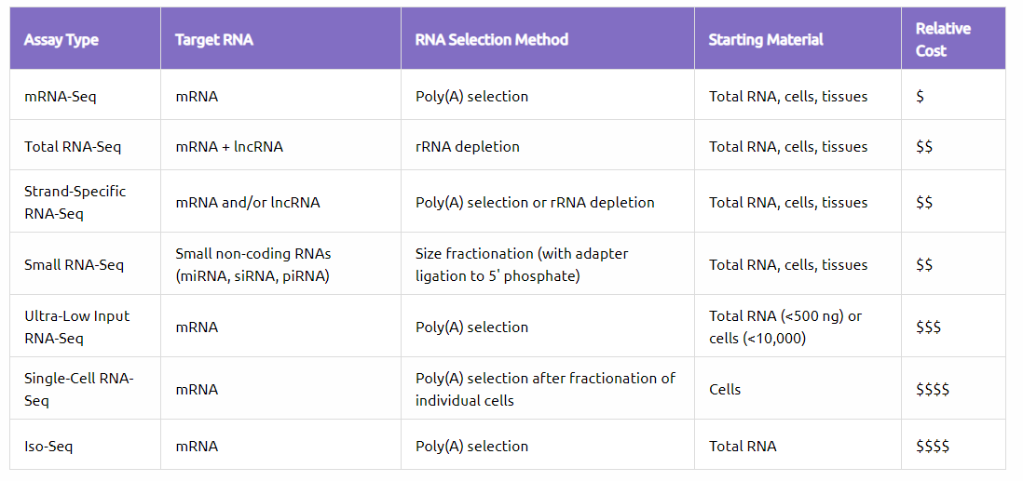
Different types of RNA-seq
https://www.azenta.com/blog/rna-seq-selection-guide-how-start-designing-your-project
Notes:
https://www.azenta.com/blog/rna-seq-selection-guide-how-start-designing-your-project
Many types of RNA-Seq are available, each providing different information about the transcriptome
Having a solid understanding of RNA-Seq and its various forms will help you make an informed decision
Defining your experimental objective is critical to understanding which RNA-Seq assay is most appropriate for your project; the more specific, the better

Slide 6
Different types of RNA-seq
https://www.azenta.com/blog/rna-seq-selection-guide-how-start-designing-your-project
Notes:
https://www.azenta.com/blog/rna-seq-selection-guide-how-start-designing-your-project
Many types of RNA-Seq are available, each providing different information about the transcriptome
Having a solid understanding of RNA-Seq and its various forms will help you make an informed decision
Defining your experimental objective is critical to understanding which RNA-Seq assay is most appropriate for your project; the more specific, the better

Slide 7
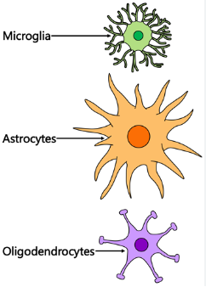
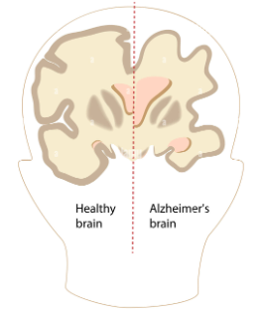
Why scRNA-seq?

Slide 8
Why scRNA-seq?
Given certain induced conditions, such as AD or PD, how does this impact our individual cell makeup?
Notes:
Credit: bioinformagician on youtube

Slide 9
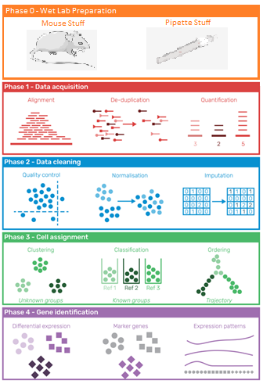
Background: scRNA-Seq
Developed in 2009 by Fuchuo Tang, University of Cambridge
Analysis of many genes at once across many cell types
Used Seurat pipeline - released 2017 but constantly updated
Notes:
https://journals.plos.org/ploscompbiol/article?id=10.1371/journal.pcbi.1006245
ScRNA sequencing was first performed in a mouse 4-cell stage blastomere in 2009. A few years later, the first multiplexed scRNA sequencing methodology was developed. In 2014, a commercial single-cell platform became available.
Single-cell RNA sequencing helps in exploring the complex systems beyond the different cell types. It enables cell-by-cell molecular as well as cellular characterization of the cells. The scRNA-Seq makes it possible to explore complex systems such as the immune system without any limitation
Bulk RNA-seq captures only an “average” of the expression profiles of thousands of cells. By contrast, single cell RNA-seq (scRNA-seq) allows the capture of individual measurements across dozens and up to thousands of single cells.

Slide 10
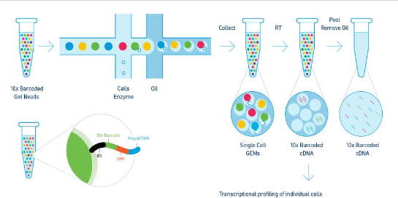
10x Genomics scRNA-seq
Notes:
Quick workflow of the 10x droplet based scRNA seq technology, there are some variations but all of them follow these guidelines more or less because of its simplicity.
Essentially how it works is you have these beads with known barcodes attached to the beads and you’re going to basically squirt them through a series of microfluidics that are very precise.
The result youll end up with are little droplets, each with their own barcoded beads. Since everything is suspended in oil, they won't recombine and then you can just process them individually in downstream workflows.
Within your library of beads and barcodes you will have two very important features, one being the 10x barcode which is literally just an identification tool and then a umi, also known as a unique molecular identifier.
In the end you will have a bunch of reads with cell barcodes, molecular barcodes, so that you can tell which cells everything came from.

Slide 11
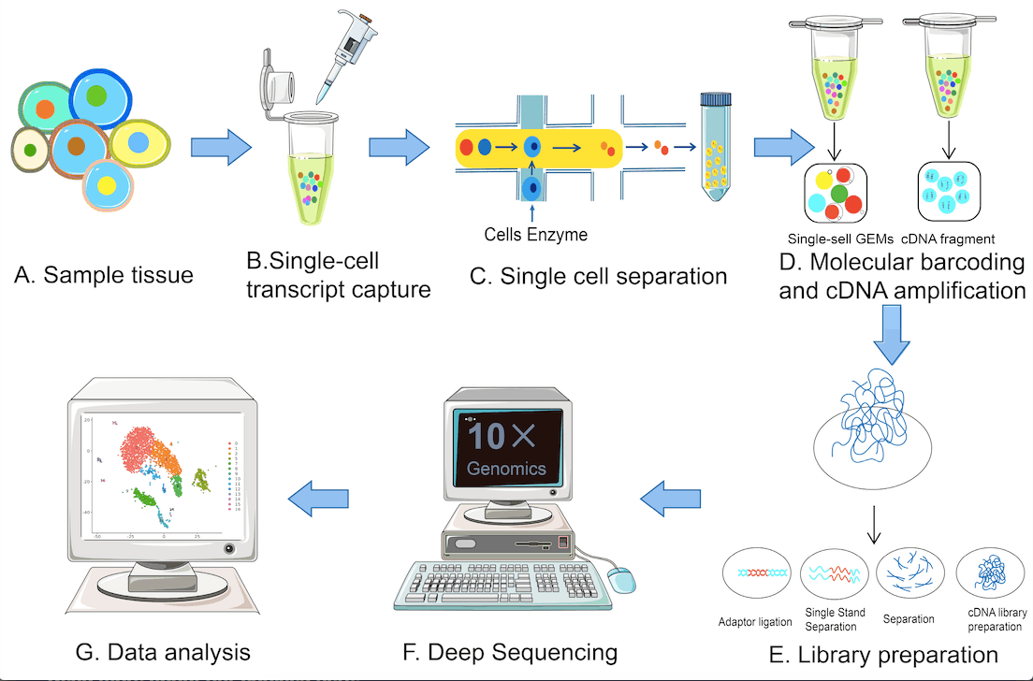
10x Genomics scRNA-seq
We want to track the most variable and expressed gene
Notes:
So afterwards once you finish all your wet lab work, you will move to the analysis portion of the experiment. All the analysis portion is, is just a count matrix that display each gene within each cell and there are programs that will cluster together similar transcriptional profiles. Depending on which pipeline you’re using or which packages you prefer, there are a multitude of different ways to analyze this type of data and it really is up to you and your data type to figure out what you want to use.
Essentially with this analysis you can look into what is happening on the individual cellular level and compare that to many other things such as cells from other samples or even just drawing conclusions of new cell types, theres many things to discover within scRNA-seq.

Slide 12
scRNA-seq Pathway
Alignment -> De-Duplication -> Quantification
Quality Control -> Normalization -> Imputation
Clustering -> Classification -> Ordering
Differential Expression -> Marker Genes -> Expression Patterns
https://journals.plos.org/ploscompbiol/article?id=10.1371/journal.pcbi.1006245

Slide 13
scRNA-seq Pathway
Alignment -> De-Duplication -> Quantification
Quality Control -> Normalization -> Imputation
Clustering -> Classification -> Ordering
Differential Expression -> Marker Genes -> Expression Patterns
https://journals.plos.org/ploscompbiol/article?id=10.1371/journal.pcbi.1006245

Slide 14

QNA + Break
Why did the single-cell RNA sequencing machine go to therapy?
Notes:
22738 features (genes), 1 assay (rna sequence)

Slide 15
QNA + Break
Why did the single-cell RNA sequencing machine go to therapy?
Because it had too many "gene"ral issues and needed to "express" itself!
Notes:
22738 features (genes), 1 assay (rna sequence)

Slide 16
Single Cell RNA Sequencing Clustering – Seurat

Slide 17
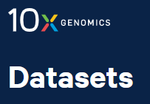
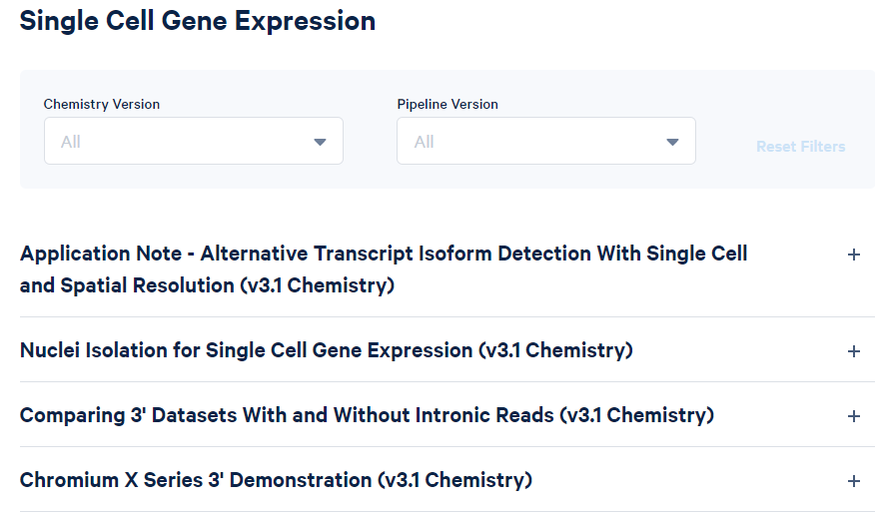
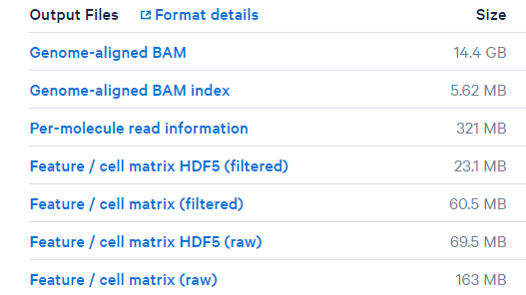
Data collection
https://www.10xgenomics.com/resources/datasets

Slide 18
Data collection
https://www.10xgenomics.com/resources/datasets

Slide 19


Starting Analysis – Reading the Data
Notes:
22738 features (genes), 1 assay (rna sequence)

Slide 20
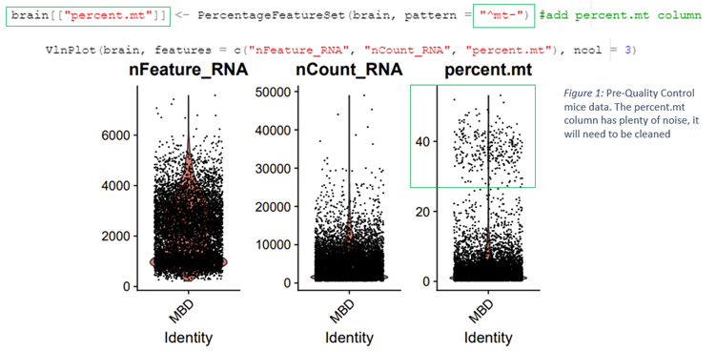
Quality Control
Notes:
Right column =The percentage of mitochondrial genes within each cell, that we are ultimately not interested in
Middle column =The counted amount of libraries within each cell
Left library = The amount of expressed genes within each cell

Slide 21
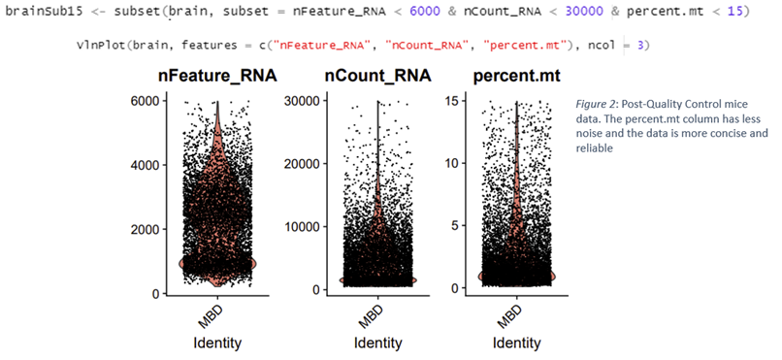
Quality Control

Slide 22
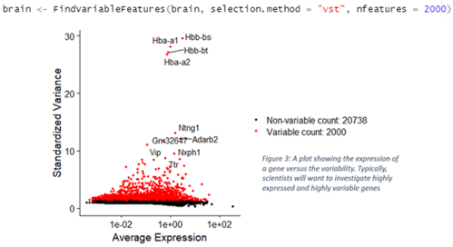
Identification of Highly Variable Features

Slide 23
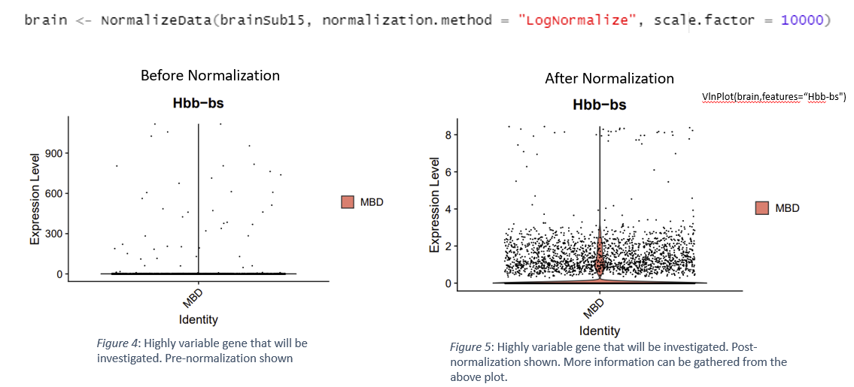
Normalization

Slide 24
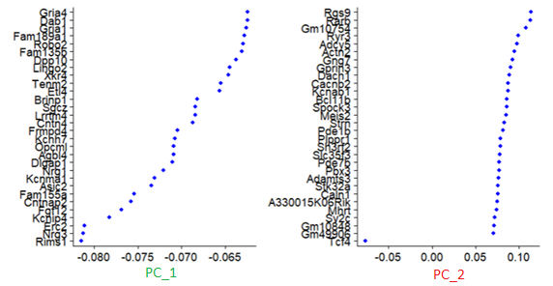
Linear Dimension Reduction
Remove redundancies,
identify relevant information,
computation time

Slide 25
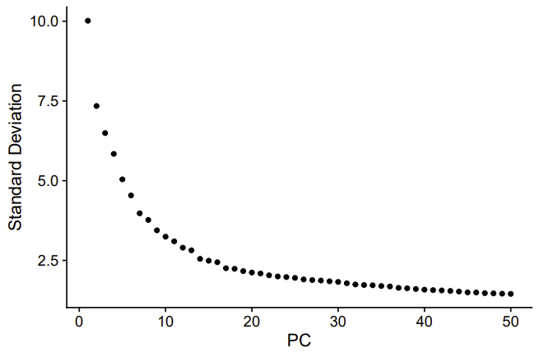
Determine Dimensionality
Look for where Principal Components start to level off
Cut your data at that point
Time and cost
Figure 6: An elbow plot showing the dimensionality of the dataset. Can test the first 25 PC for analysis.

Slide 26
Determine Dimensionality
PC_1
Look for where Principal Components start to level off
Cut your data at that point
Time and cost
PC_2
Figure 6: An elbow plot showing the dimensionality of the dataset. Can test the first 25 PC for analysis.

Slide 27
Determine Dimensionality
Look for where Principal Components start to level off
Cut your data at that point
Time and cost
Figure 6: An elbow plot showing the dimensionality of the dataset. Can test the first 25 PC for analysis.

Slide 28
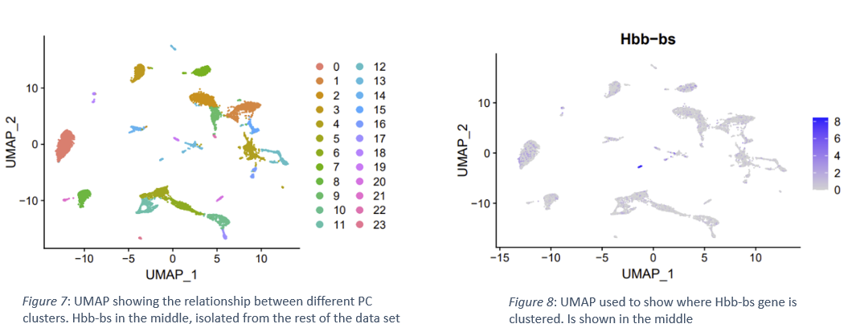
Results - Clustering
DimPlot(brain, reduction = "umap")
FeaturePlot(brain, features = c("Hbb-bs"))

Slide 29
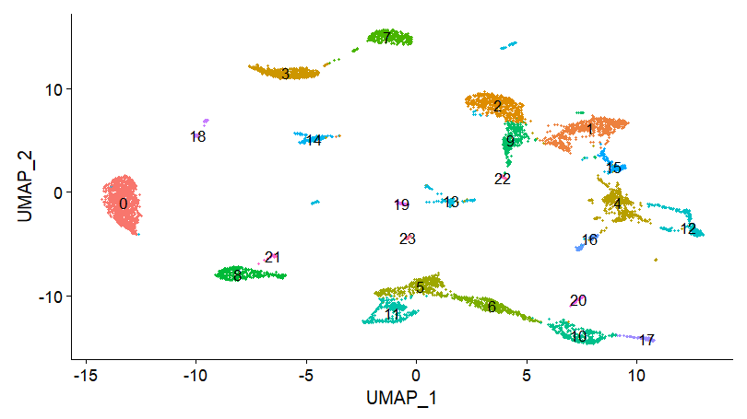
Results - Clustering
After clustering manually, annotate the clusters
Locate different clusters to correct annotation
Practice annotation example
Notes:
Pay attention to 11

Slide 30

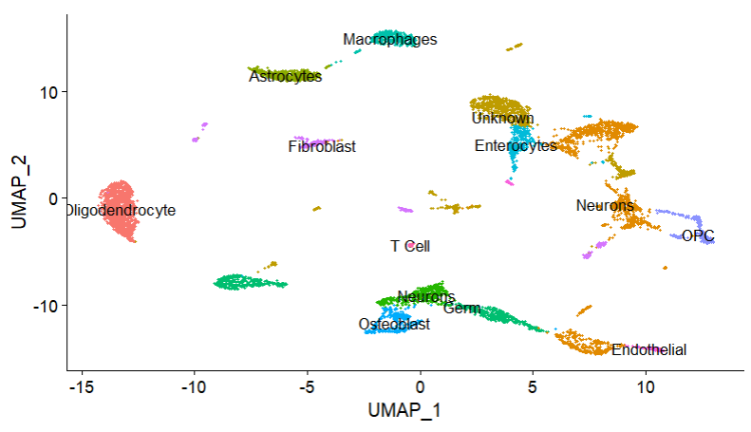
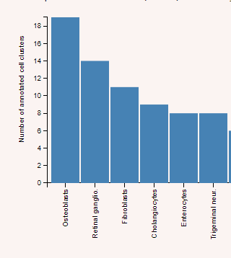
Results - Annotation
https://panglaodb.se/
Notes:
Need to add panglaodb -> look up Satb2, Hs3st2, Rspo2 results, show that cluster 11 is Tcell

Slide 31
Results - Annotation
Osteoblast, Cluster 11

Slide 32
Results - Annotation
SATB2 appears to exert diverse roles in craniofacial patterning, osteoblast differentiation and maturation, bone formation, tumor metastasis and prognosis, and neuron identification, especially in the development of the corpus callosum and pons.
Complex solution and requires more investigation

Slide 33
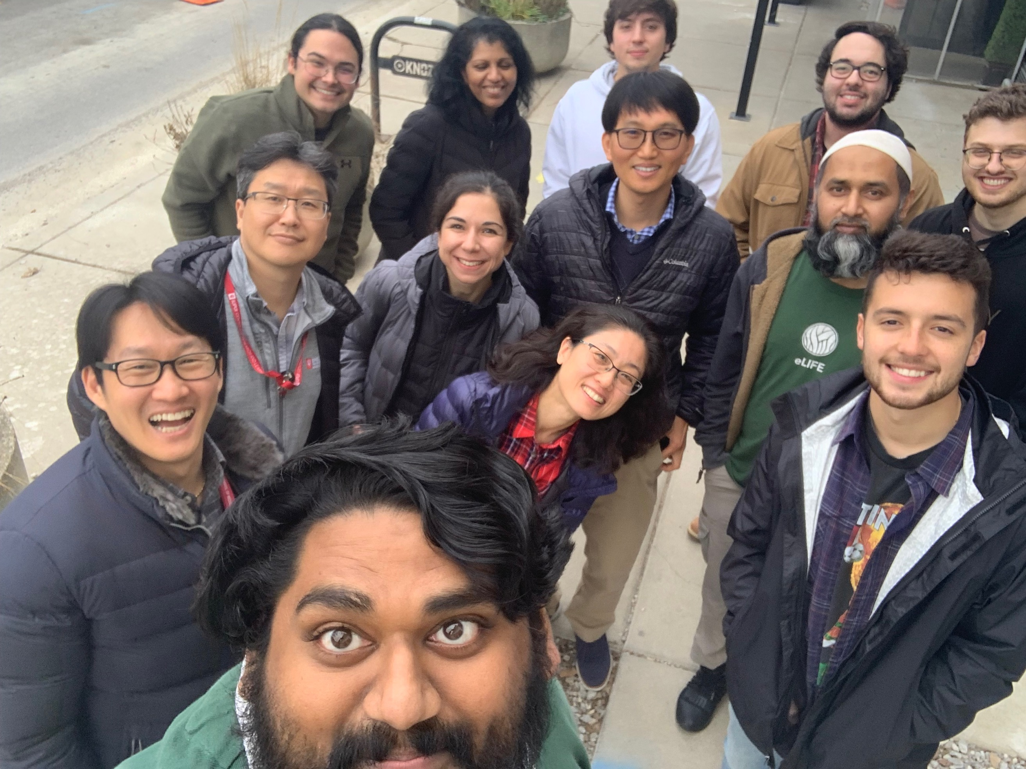
Acknowledgements
Jungsu Kim, Ph.D.
Ahmad D Sharify,
Al-Amin, Md Mamun, Ph.D.
Byungwook Kim, Ph.D.
Daniel Smith,
Dom Acri, Ph.D.
Hande Karahan, Ph.D.
Holly N Kersey
Jung Hyun Park
Kelly Hartigan
Luke Child Dabin, Ph.D.
Mason D Tate
Ryan McMullen
Sagara Wijeratne
Sam P Walsh
Sutha K John
https://www.linkedin.com/in/richard-mustaklem-34a8861a2/

