Slide 1
Risk Evaluation of ST Stocks in
Chinese Securities Exchange
Tian Boping Guo Wenming Feng Yingjun
School of Management
Harbin Institute of Technology,P.R.China 150001
Maths Department
Harbin Institute of Technology,P.R.China 150001

Slide 2
Abstract
In this paper we mainly make an
analysis of the risk level of ST sample
stocks in Chinese Securities Exchange by
calculating β coefficients.
Firstly we get different period β
coefficients’ values, using regression
analysis method and Excel Software.
then we analyze risk change law and
stability of β coefficients of ST sample
stocks, and make some conclusions:

Slide 3
(1) Pointing out the special change law of
β coefficients of ST sample stocks on fore-
and-aft period of “capped” or “uncapped”;
(2) Finding the distinct difference of risk
level of ST sample stocks’ β coefficients
between Shenzhen Securities Exchange
and Shanghai Securities Exchange;
(3) The change of most of ST sample stock
β coefficients is instability in this period.
Key word: β coefficient, risk, ST sample
stock, stability

Slide 4
1. Introduction
The young Chinese Securities Exchange
has only a few more than ten years’ history.
Lots of problems exist in this Securities
Exchange, and some of them are worth
studying. In Chinese Securities Exchange,
ST sample stocks exist all the times. With
the time going, some good performance
stocks turn to ST ones, and in the same time,
some ST stocks become execellent
performance stocks.

Slide 5
These two phenomena are separately called by
the “capped” and “uncapped”. Accounting for all to
nothing proportion of the whole stock Exchange,
there are more than one hundred ST stocks. And
ST sample stock has itself single characteristic.
“High risk, high income”, acting as an everlasting
rule, leads the investors including some ST sample
stocks zeal ones.
They certainly can benefit from ST sample
stocks, so it is necessary and significant that we
solely investigate ST sample stocks.

Slide 6
2 .β coefficient theory and method
β coefficient is one of measuring stock system
risk’s main indexes. It plays an important role in
investment theory and investment practice. β
coefficient that we investigate in the paper is
calculating by daily yield:
Daily yield = (current closing quotation –the
former closing quotation)/ the former closing
quotation.

Slide 7

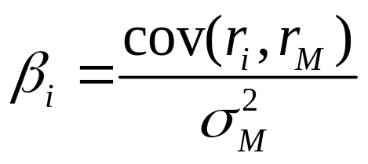

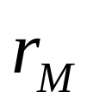
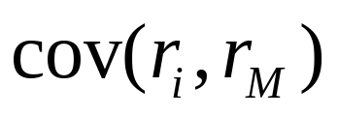
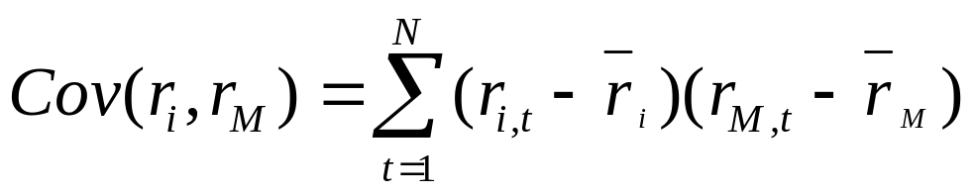
According to the formula in [1]:
(1)
In here, stocks’ yield is shown as
and exchange index yield as
Estimating covariance o f
stocks’ yield and Exchange index yield
by sample covariance:
(2)

Slide 8
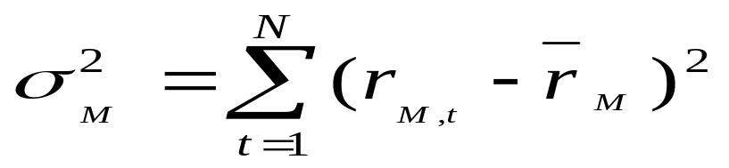

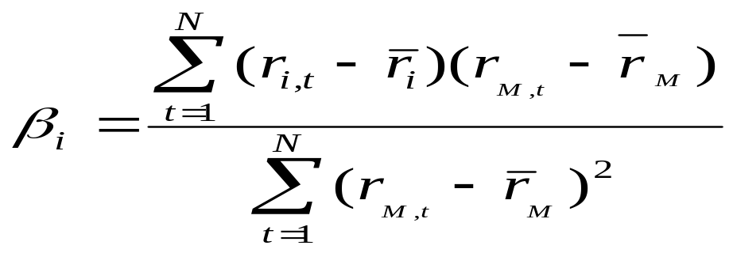
Estimating exchange index yield’s
square deviation by sample stocks:
This paper is supported by national
natural science key fund(70131010）
(3)
Therefore we get estimate of
(4)

Slide 9
Ex post facto β coefficient means that
value of β coefficient is calculated by
the really existing data of stocks or stocks
combination.
This is not a forecast but an empirical
analysis. Because of particularity of ST
sample stock, period of time that we
select must be shorter.

Slide 10
A majority of ST sample stocks can’t
exist long time at ST state: some may be
stopped after several years, and some
turn to outstanding performance stocks.
Another problem is to satisfy the normal
distribution of St stocks at computing, so
data which is necessary for calculating
every value of β coefficient must be enough
(about 50).

Slide 11
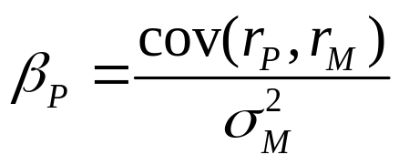


In existing stock analysis theory, there are several
meanings of β coefficient:
(1) β coefficient reflects the contribution of stocks(or
stocks combination) to the covariance combination.
and hereby gain the bonus of expectation
income, According to the formula ,
so β coefficient is used to mensurate the risk of single
stock or stocks combination in available stocks
combination

Slide 12
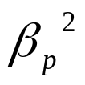

(2)Related with the first meaning, β
coefficient denotes the relationshiop of
single stock risk or stocks combination
risk
and ecumenic stock risk.
system risk= stocks combination risk

Slide 13
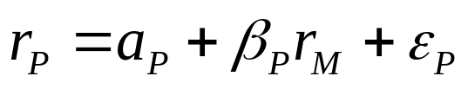

(3) as the slope of stock or stocks combination
characteristic line, β coefficient reflect the
sensitivity degree of the change of stock or
stocks combination real income to stock
market.
when >0,the change of stocks combination
yield and stock market are in the same direction,
namely, stocks combination yield rise (fall) with the
exponent of stock market rise (fall) with great
probability, thus the price forced by the market
trade with same trend of the whole market.

Slide 14
when <0, the change of stocks combination
yield and stock market are in the opposite
direction, namely, stocks combination yield rise
with the exponent of stock market fall, or stocks
combination yield fall with the exponent of stock
market rise.
when| |>1,we call the stock or stocks combination
of enterprising type, if market yield change 1%,and
the stock or stocks combination may over the 1%
change with great probability. the bigger | | is, the
more enterprise it is.

Slide 15
when | |<1, we call the stock or stocks
combination of conservative type, if market
yield change 1%, and the stock or stocks
combination may under the 1% change with
great probability. The smaller | | is, the less
sensitivity it is, thus more conservative. The
more conservative the stock is, the greater
ability to resist the influence of catastrophe.

Slide 16
3. Selecting sample and empirical analysis
Period of time of sample that we choose is
from 02/09/20 to 03/12/12. There are sixty
weeks in common (Every stock has 60×5＝
300 sample data). Reasons of selecting this
period are:
(1) The number of “uncapped” or capped”(capped*)
stocks is larger, so choice of representative sample
stocks is easier and more representative;
(2) Data to check movement rule in the period of
fore-and-aft twenty-thirty weeks of “uncapped” or
“capped” stocks are enough.

Slide 17
Then we cut these sixty weeks into six parts:
the first one is from 02/09/20 to 02/12/06; the
second one is from 02/12/09 to 03/02/21; the third
one is from 03/02/24 to 03/04/30; the forth one is
from 03/05/12 to 03/07/18; the fifth one is from
03/07/21 to 03/09/26; the last one is from 3/09/29
to 03/12/12.

Slide 18
3.1 Calculating process
(1) We calculate the six parts’ β oefficients
of twenty-five “capped” stocks, four ncapped”
ones in Shenzhen Securities Exchange and
twenty “capped” stocks, eleven “uncapped”
ones in Shanghai Securities Exchange by
data from Great Reference Software. [2],
[3](N=50) and formula(1)-(4).

Slide 19
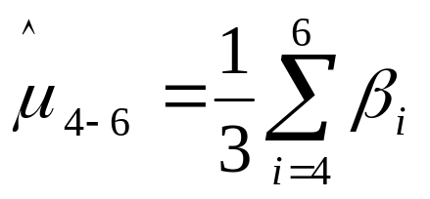
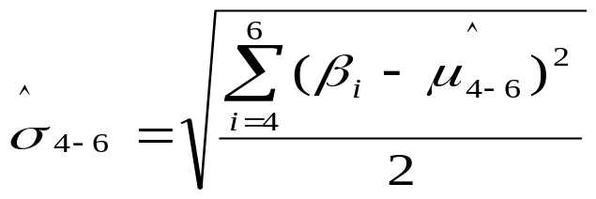
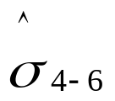
(2) Calculating average value and standard
deviation of every stock of latter three parts:
(5)
If value of is less than 0.15, β coefficient
of the stock goes to stabilization; otherwise, β
coefficient doesn’t do[3].
(3) Calculating average value and standard
deviation of every desirable standard stock of
former three parts[2]:

Slide 20

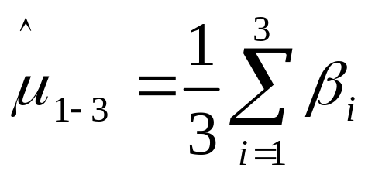
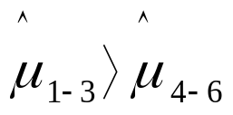
, (6)
If is right, the stock’s β coefficient
goes to reduce. Otherwise, the stock’s β
coefficient goes to add. Using Botao’s method[3],
stocks can be classified.

Slide 21
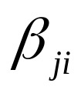
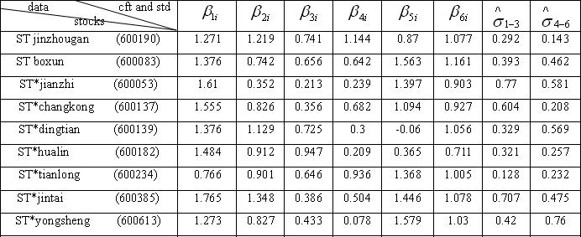
3.2 Results of β coefficients of ST stocks
Marking the th part of stock as (=1,2,3,4,5,6).The outcome is
table 1and table 2:
Table 1 stocksβ coefficients(cft) and standard deviation(std) in Shanghai stock Exchange

Slide 22
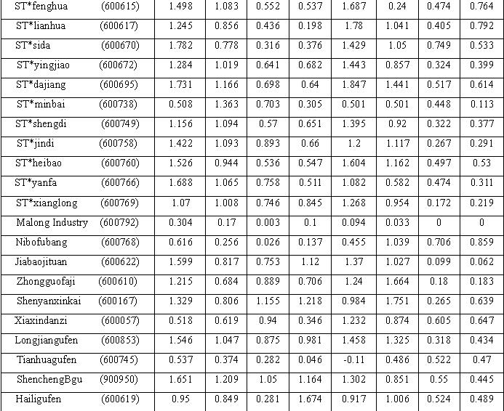

Slide 23
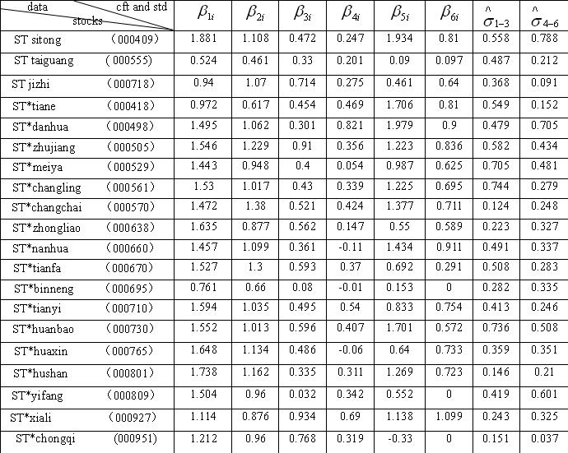
Table 2 stocks β coefficients(cft) and standard deviation(std) in Shenzhen Stock Exchange

Slide 24
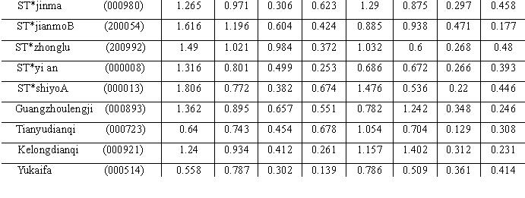
4 Conclusion
(1) The rule of ST sample stock’s β coefficients exists in the period. Values of “capped” stocks’ β coefficients are clearly less in the former four parts: 96% of all “capped” stocks of Shenzhen Exchange fulfill this rule and 85% of all “capped” stocks of Shanghai Exchange do.

Slide 25
But in the same period, only 13% of all uncapped”
ones do. 77.3% of all “capped” stocks of shenzhen
Exchange and 80% of all “capped” stocks of shanghai
Exchange fulfill the rule that values of β coefficient
markedly add in fifth part and then reduce a little in
sixth part.
(2) Difference of ST sample stock’s performance exists
between two stock exchanges: The average value of
ST sample stock’s β coefficients of all six parts is
close to 1.

Slide 26
It shows their risk level is close and harmonious
with the whole Shanghai Securities Exchange’s,
accordingly it shows the validity of government
finance management; The average of “capped ”ST
sample stock’s β coefficients in the second, third
and fourth part in Shenzhen Securities Exchange
become lesser and lesser. Especially in the fourth
part, it is only 0.34. This shows their risk level is
close and harmonious with the whole Shenzhen
Stock Exchange’s, and it differs from Shanghai
Securities Exchange distinctly. The special
phenomenon must be nearly with the development
level of this Stock Exchange

Slide 27
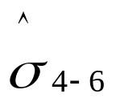
(3) The empirical analysis shows that a majority
of stocks’ β coefficients is instability. Only 6.3
percent of all (five stocks) satisfy that their
standard deviation <0.15 . For the limit of
0.15, many researchers consider that it is looser.
Movement of the five stocks is complexity, so
we make the conclusion naturally. And we think
that it is reasonable, because stability of ST
sample stocks is not better than that of general
stocks in these two Exchanges.

Slide 28
Reference
[1] Chen Shoudong. Theory and analysis of securities investment. Jilin University Press,2001:36-78. (In Chinese )
[2] Leyunhui, Lixue. An Empirical analysis of Chinese stock exchange’s β coefficients. Quantitive and Technical Economics . 1(2000) :18-23 (In Chinese)
[3] Botao. An Analysis of applicability of stocks investment theory and stocks stratagem. Beijing Economics Management Press.1999:87-89 (In Chinese)
[4] Finance Street. http://www.jrj.com.cn

Slide 29
That”s all,thank you!

