Slide 1
TITLE : AVIATION RISK ANALYSIS
SUBTITLE : PHASE 1 DATA SCIENCE PROJECT| FLIGHT DATA
DATA SOURCE : NATIONAL TRANSPORTATION SAFETY BOARD (NTSB) AVIATION ACCIDENT DATABASE, 1962–2023
RICHARD DUNCAN OKETCH

Slide 2
BUSINESS UNDERSTANDING ANALYSIS
The company must reduce the safety and financial risk of venturing into the aviation industry.
Accidents in the air have a direct impact on costs as they result in deaths, legal liability, loss of the aircraft, and insurance costs.
The various types of aircraft demonstrate a varying degree of aircraft accidents.
The patterns of increased and reduced operational risk can be realized through historical data on accidents.
The examination of deaths, the extent of damage, and the frequency of accidents contributes to the safer choice of the aircraft.
Informed investment decisions and reduction of risks in the long-term can be made through data-driven insights.

Slide 3
DATA PREPARATION ANALYSIS
        Data cleaning :
        Filter data to relevant columns
        Renaming columns
        Check for Duplicate Records
        Converting date columns
        Check fo missing values
        Converting fat(fatalities) to integer
        Check cleaned Data

Slide 4
VISUALIZATION ANALYSIS

Slide 5
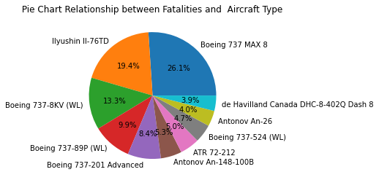
Pie chart of Aircraft type with Fatalities rate
This shows the pie chart of the relationship between the top 10 Aircraft type with the number of people who died (Fatality Rate)
Aircraft with with highest fatality rate arranged from highest to lowest are ;
Boeing 737 MAX 8 (346), Ilyushin Il- 76TD (258), Boeing 737-8KV (WL) (176), Boeing 737-89P (WL) (132), Boeing 737-201 Advanced (112), Antonov An-148-100B (71), ATR 72-212 (66),

Slide 6
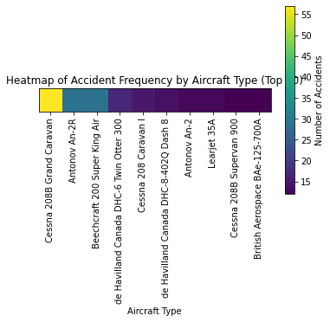
Heat map of (top 10) Aircraft type with Accident frequency
Indicates a Heat map that displays the relationship between the Aircraft type and the accident frequency
These are the top 10 type of aircraft that has a higher accident occurrence of which the investors should not consider purchasing ;
Cessna 208B Grand Caravan (57), Beechcraft 200 Super King Air (29), Antonov An-2R (29), de Havilland Canada DHC-6 Twin Otter 300 (17), Cessna 208 Caravan I (15), de Havilland Canada DHC-8-402Q Dash 8 (14), Antonov An-2 (13), Learjet 35A (13), Boeing 737-8AS (WL) (12), Cessna 208B Supervan 900 (12),

Slide 7
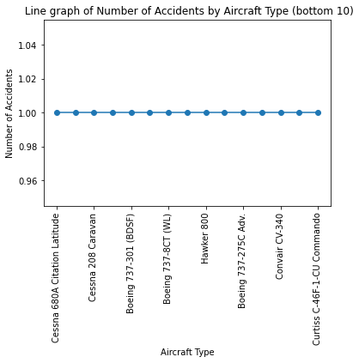
Line graph of (bottom 10) Aircraft type with Accident frequency
This shows a Line graph of (bottom 10) Aircraft type with Accident frequency
These are the sample of type of aircraft that has a lower accident occurrence of which the investors should consider purchasing ;
Grumman G-1159 Gulfstream II (1), Boeing 777-3F2ER (1), Curtiss C-46F-1-CU Commando (1), Boeing 757-223 (1), Boeing 737-800 (1), Dassault Falcon 900EX EASy (1), McDonnell Douglas MD-11F (1), Boeing 737-275C Adv. (1), Beechcraft 100 King Air (1), Lockheed WC-130H Hercules (1),

Slide 8
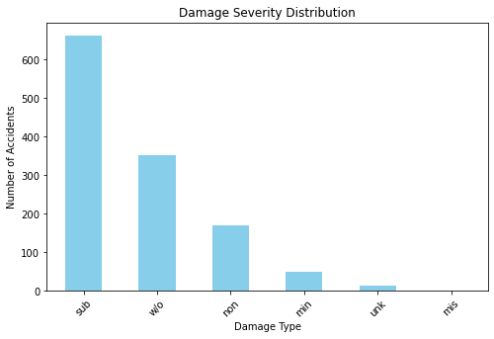
Bar graph of Damage severity Distribution
Bar graph relationship of the damage type and the number of Accidents occurred.
SUB is most common → Many accidents cause serious but repairable damage
W/O is second highest → A large number of accidents lead to total aircraft loss
MIN + NON are fewer → Fewer accidents end with light or no damage
UNK & MIS are data quality gaps

Slide 9
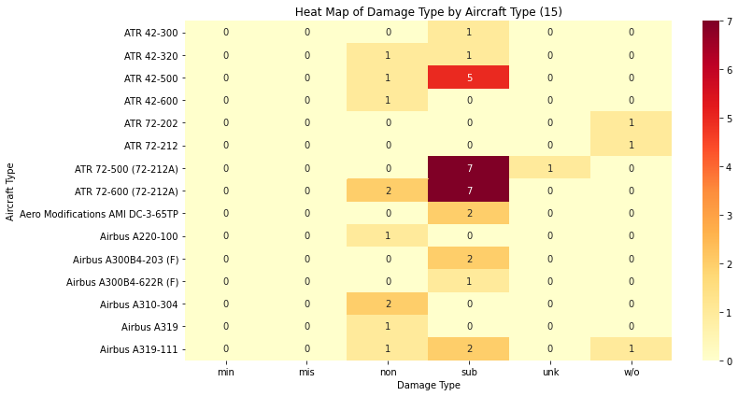
Heat map of Damage Type by (Top 15)
Aircraft Type
The Heat map demonstrates the severity of damages depending on aircrafts. The majority of aircraft record the highest number in Substantial damage (SUB) which implies that aircraft accidents usually cause severe damage which can be fixed but not destroyed. Write-off (W/O) cases are not very numerous, which means that total destruction is not very widespread in the given data. Some models, notably in the ATR 72 line, occur more within the higher damage categories, indicating that they have more operational incidents than the others.

Slide 10
INSIGHTS OF THE ANALYSIS
Fatalities by Aircraft Type
The categorization of fatalities by aircraft type indicates a significant variation in the risk of aircrafts.
The Boeing 737 MAX 8 (346 deaths) and Ilyushin Il-76TD (258 deaths) aircrafts are the ones that have the highest number of fatalities thus being involved in more serious accidents.
Conversely, the aircrafts such as Dassault Falcon 2000EX, Dornier 228-101, and ATR 42-300 have zero fatalities and this means low risk profile.
Insight: To reduce the chances of passengers and crew fatalities, investors or operators should think of aircraft types that have low fatalities in the past. Planes that have a large number of fatalities could be characterized by greater risk of operation.
Accident Frequency by Aircraft
There is a high frequency of accidents with certain types of aircraft, e.g., Cessna 208B Grand Caravan (57 accidents) and Beechcraft 200 Super King Air (29 accidents).
There are other aircraft (like Grumman G-1159 Gulfstream II and Boeing 757-223) which are represented by one flight in the dataset.
Knowledge: The frequency of accidents in different aircrafts is highly different. Planes that record more accidents might be more prone to the operational risk when compared to those with minimal accidents. To curb the number of accidents, companies ought to focus on aircrafts that have low incidences of accidents.

Slide 11
Distribution of damage
In all accidents, the majority of them are in the substantial (sub) and written-off (w/o) category; minor damage or no damage is less common.
Counts: Substantial (663), Written-off (351), None (169), Minor (49).
Insight: Most accidents are associated with a lot of damage, which brings out the concern related to the costs of repair or complete loss. By concentrating on airplanes and the conditions under which the damages are less severe, the financial consequences and asset preservation will be minimized.
Damage Intensity by Aircraft Type
Some categories of aircraft, including the Cessna 208B Grand Caravan and Antonov An-2R, are overrepresented in the severe damages categories (substantial and written-off).
Other type of aircrafts have more incidents in minor or no damage groups, which are less risky.
The appearance of heatmaps or stacked bar charts shows that there is a certain tendency to such aircraft: certain types are always followed by an increased amount of damage, and others are less dangerous.
Intuition: Aircrafts that have lower severity of damage in history should first be invested or operated because they are the aircrafts that would have lesser cost of repair and asset loss. In contrast, the types that are often engaged in the serious destruction should be closely observed or avoided to minimize the financial and operation risks.

Slide 12
RECOMMENDATION
There is no equal distribution of fatalities, accidents, and the severity of damages in the aircraft types.
High risk planes: Boeing 737 MAX 8, Ilyushin Il-76TD, Antonov An-2R, Cessna 208B Grand Caravan - these are the models with high death tolls, accidents or extreme damage.
Less dangerous aircraft: Dassault Falcon series, Dornier 228 series, ATR 42-300 of the type indicate zero or less fatalities and low accident rate with minimal damage.
Strategic Advice: The companies and investors are advised to lay emphasis on aircraft with fewer fatalities, fewer incidences of accidents, and less damage intensity to minimize operational, financial, and safety hazards.
Summary
Through death data, accident rates, and the severity of damage, the data set can help understand which aircraft models are riskier and which are less risky, leading to informed decisions based on data about which aircraft to choose and how to operate more safely.

