Slide 1
Telecom Customer Churn Prediction
presented by : Richard Oketch
5 Models
3,333
14.5%
Annual Churn Rate
Tested & Compared
Customers Analysed
Data Science Team · Moringa School · Customer Retention & Marketing

Slide 2
Business Understanding
Setting the stage — why churn matters and what we set out to solve
The Opportunity
The Challenge
Our Goal
Acquiring a new customer costs 5–7× more than retaining one
14.5% of customers leave each year (~483 annually)
Build an AI model to score every customer weekly
Even 1% churn reduction = meaningful recurring revenue gain
We only know a customer churned after it's too late
Flag high-risk customers before they decide to leave
Proactive outreach is far cheaper than win-back campaigns
No system exists to identify at-risk customers early
Give the retention team a prioritised call list

Slide 3
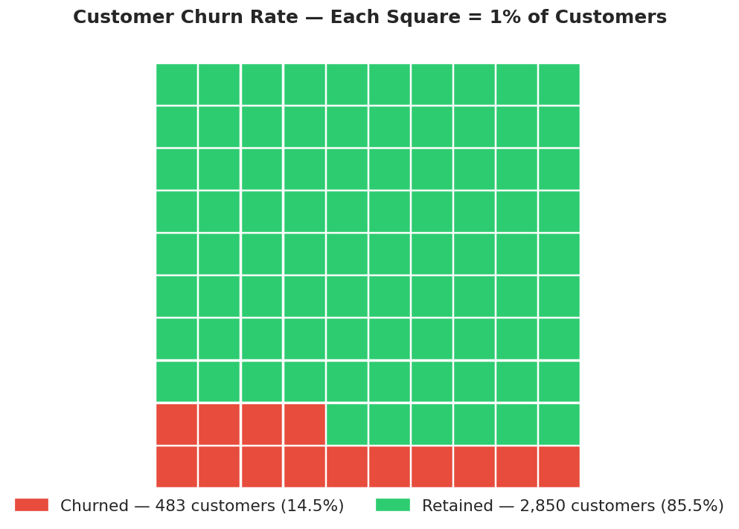
Data Understanding
3,333 customers · 21 features · one clear target: did they leave?
3,333
Total Customers
483
Churned (14.5%)
21
Features Analysed
Missing Values
0

Slide 4
Data Preparation
Cleaning and shaping the dataset — what was kept, dropped, and why
7 Columns Dropped
phone number / state / area code
Unique identifiers — no predictive signal
4 charge columns
Pearson r = 1.00 with minute columns — perfectly collinear, add no new information
21 features → 14 features
Encoding, Scaling & Split
Binary encoding
international plan, voice mail plan, churn converted to 0/1 integers
StandardScaler
Fitted on train only — prevents test data leaking into model training
80/20 stratified split
2,666 train / 667 test — 14.5% churn rate preserved in both sets
Zero missing values — no imputation needed

Slide 5
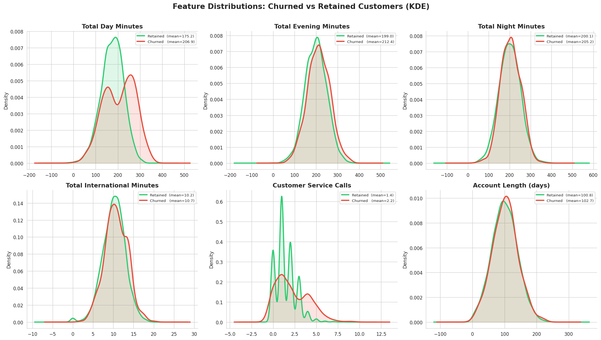

Slide 6
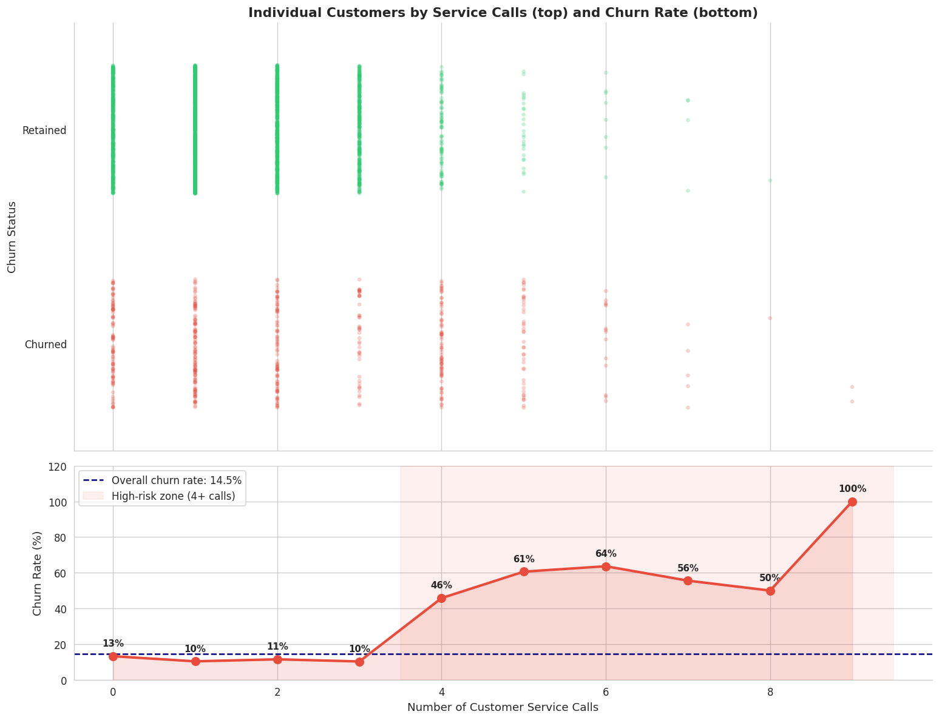
Data Finding — The Service Call Signal
The single strongest early warning sign of a customer about to leave
Key Insight
~11%
Churn rate for customers
with 0–3 service calls
46–100%
Churn rate for customers
with 4+ service calls
Business Implication
After a customer's 3rd call, route them immediately to a senior retention agent — before they decide to leave.

Slide 7
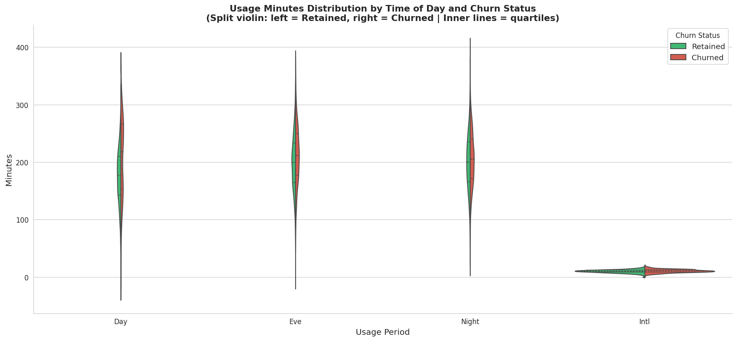
Data Finding — Usage Patterns Drive Churn
Heavy daytime callers face higher bills — and are more likely to leave
Day Minutes
Churners avg 207 min/day vs 175 for retained — higher usage = higher bills = price pressure
Night & Evening
Night and evening minutes show very similar distributions between churned and retained — these are weaker predictors.

Slide 8
Modeling Approach — Five Models Tested
We tried increasingly powerful approaches until we found the best one
M1
M2
M3
M4
M5
Random Forest
★ FINAL
Logistic Regression
(Baseline)
Logistic Regression
(Tuned)
Decision Tree
(Baseline)
Decision Tree
(Tuned)
Simple but only 25% recall — missed most churners
Better: 74% recall, but poor at precision
Memorised training data — overfit badly
74% recall, better balance — but still overfit
Best generalisation, highest AUC (0.88), most reliable

Slide 9
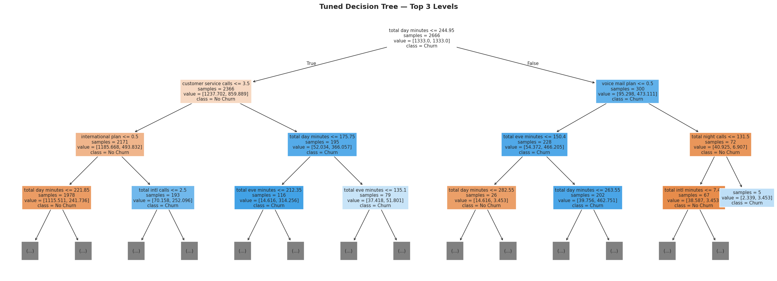
Model - Decision tree(Tuned)
Interpretation Overfitting gap shrinks from 0.351 to 0.196. Test recall rises to 74.2% matching M2, but F1 is better (0.673 vs 0.474) — same recall with far less collateral. The tree first splits on customer service calls and total day minutes, confirming the EDA insights.

Slide 10
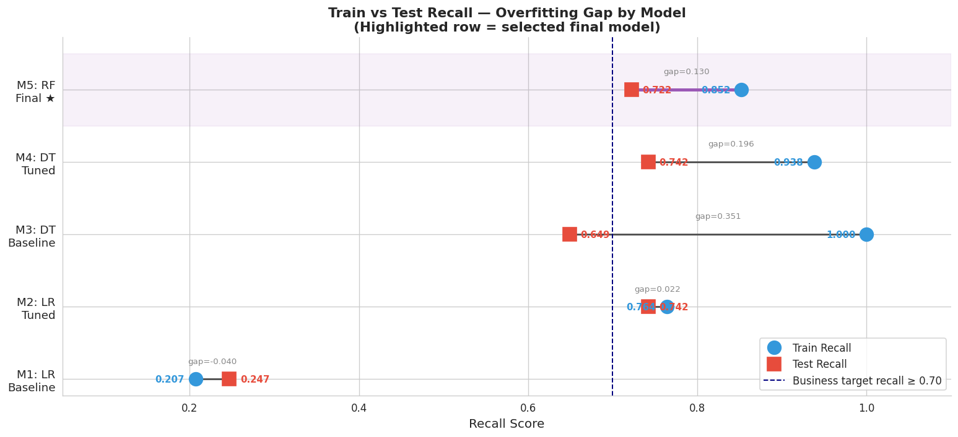
Model Evaluation — Comparing All Five Models
The Random Forest wins on the metrics that matter most for business
Train vs Test Recall — How Much Does Each Model Overfit?

Slide 11
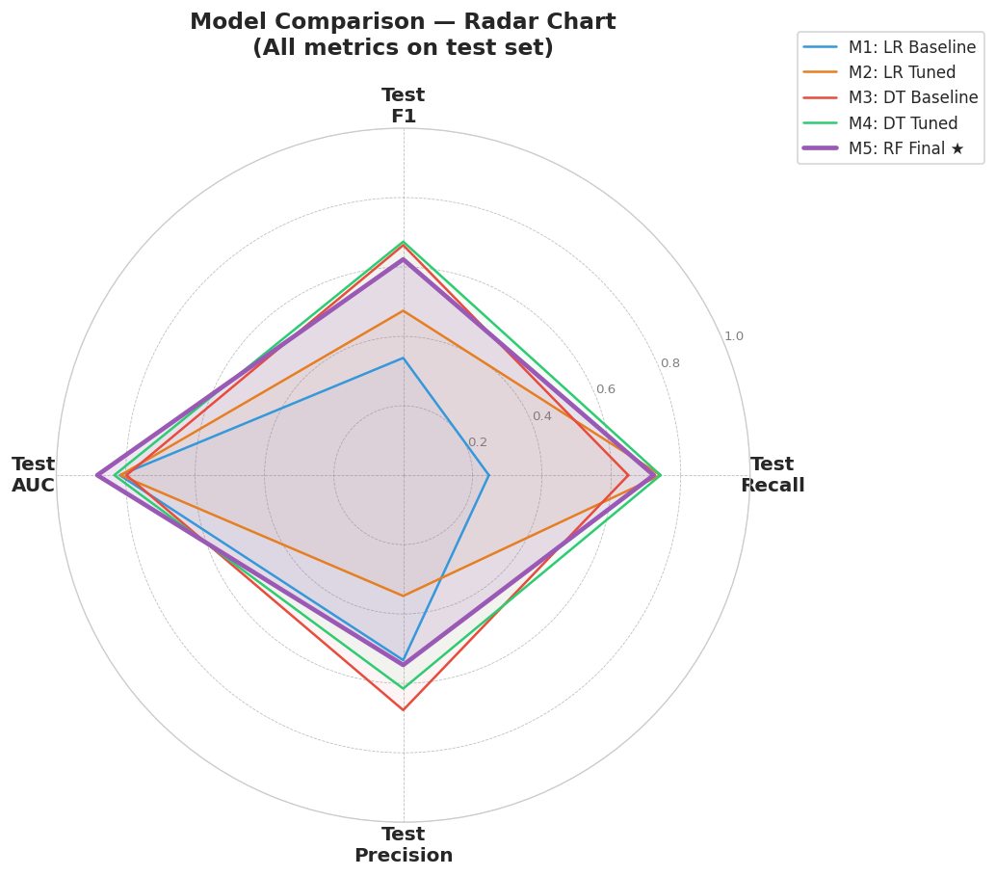
Recall
0.88
Model Evaluation — Comparing All Five Models
The Random Forest wins on the metrics that matter most for business
All Metrics at Once — Random Forest Leads
72%
55%
AUC
Precision

Slide 12
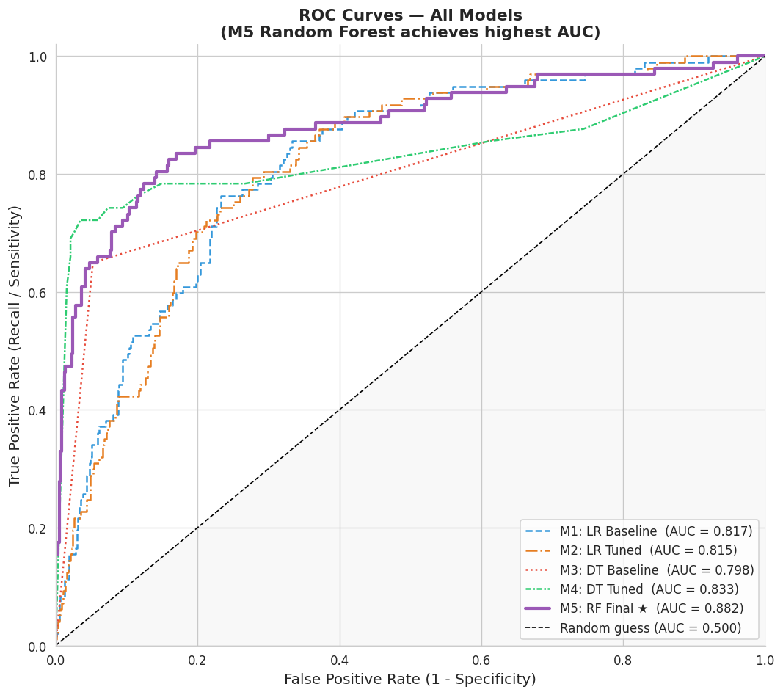
Model Evaluation — What the Numbers Actually Mean
ROC Curve — All Models
.
.

Slide 13
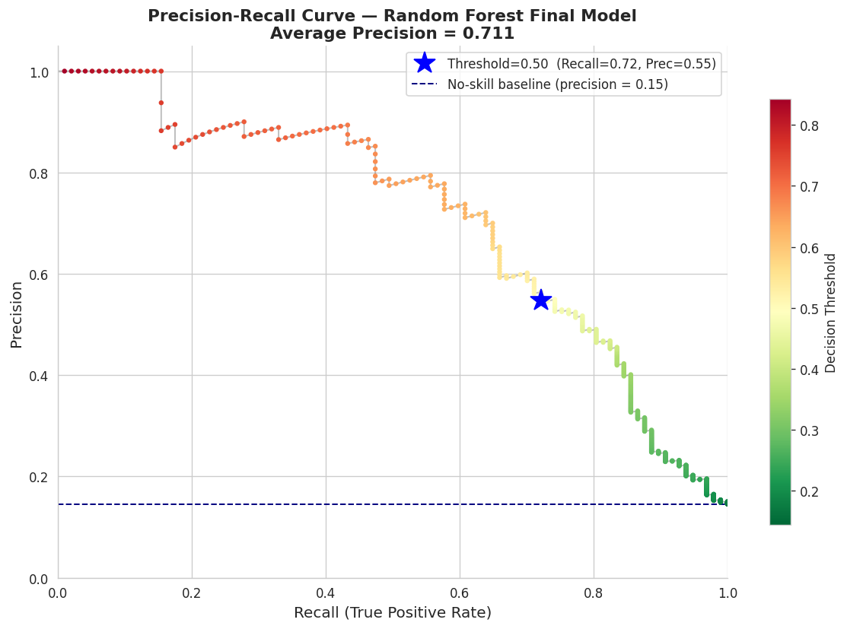
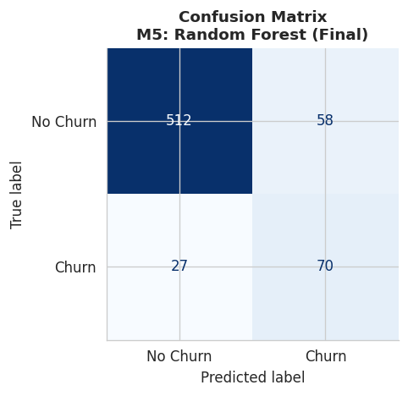
Final Model – Confusion Matrix: How Predictions Break Down
Notes:
Final model – confusion matrix

Slide 14
Model Evaluation — Explanation
Translating model performance into business outcomes
Plain-English Score Summary
Recall 72%
Of every 100 customers who would leave, we catch 72 and can intervene.
Precision 55%
Of every 100 customers we flag, roughly 55 are genuine churners.
AUC 0.88
Given any churner and non-churner pair, we rank the churner higher 88% of the time.
28% still missed
We can lower this by adjusting the threshold — trading precision for more recall.

Slide 15
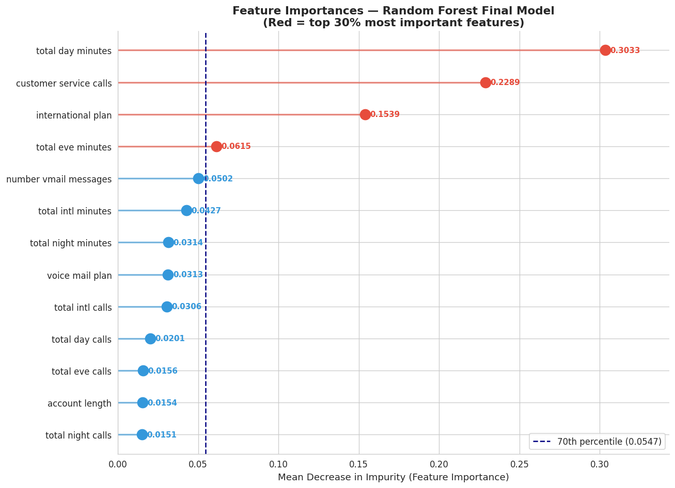
What Drives Churn? — Feature Importance
The model reveals which customer behaviours predict departure most strongly
TOP 3 FEATURES — WHAT THEY MEAN FOR US
Total Day Minutes (0.303)
Customer Svc Calls (0.229)
International Plan (0.154)

Slide 16
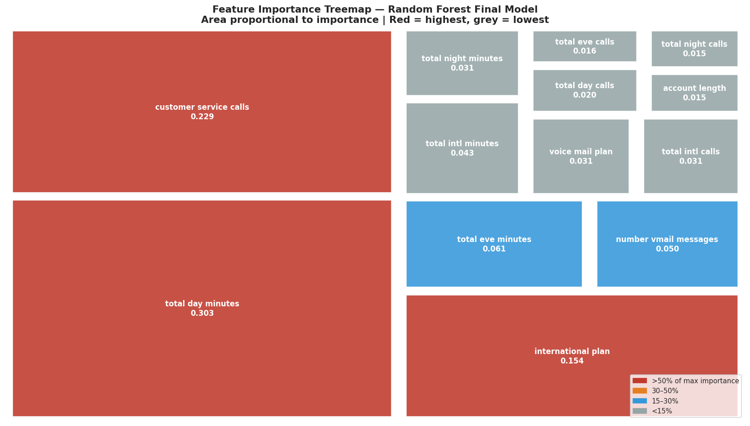
What Drives Churn? — Feature Importance
The model reveals which customer behaviours predict departure most strongly
TOP 3 FEATURES — WHAT THEY MEAN FOR US
Total Day Minutes (0.303)
Customer Svc Calls (0.229)
International Plan (0.154)

Slide 17
Our Three Recommendations
Immediate Action
01
Auto-Flag After the 3rd Service Call
Churn rate jumps from ~11% to 46%+ at 4 calls. Route to a senior retention agent before the 4th call happens. Set up a CRM trigger today.
Within 30 Days
02
Rate Cap Loyalty Offer for Heavy Daytime Users
Flag customers above the 75th percentile in day minutes (>216 min/day). Offer a price guarantee — these are your highest-value and highest-risk customers.
Within 60 Days
03
Audit the International Plan + Offer Voicemail as Incentive
42% of intl plan holders churn — review pricing vs competitors. Separately: voicemail plan holders churn at just 8.7% vs 16.7% — offer it free as a retention incentive.

Slide 18
Next Steps — Deployment Roadmap
Moving from model to measurable business impact
Phase 1
Weeks 1–2
Phase 2
Month 1–2
Phase 3
Quarterly
Deploy weekly scoring pipeline to CRM
Run A/B test: hold out control group of high-risk customers
Retrain model on newest data every quarter
Export priority-ranked at-risk customer list
Measure actual revenue retained vs outreach cost
Add contract type & demographic features
Set operating threshold with retention team
Tune threshold based on team capacity
Target: push recall above 80% with richer data
Model limitation: 27.8% of churners are still missed. Richer data and quarterly retraining will close this gap over time.

Slide 19
Model Limitations & Honest Assessment
What the model gets wrong — and how we plan to close the gaps
28% of churners still missed
Roughly 1 in 4 actual churners are not flagged. Lowering the probability threshold recovers more of these at the cost of more false alarms.
45% false positives among flagged
Nearly half of flagged customers would not have churned. Outreach cost for these must be budgeted into ROI calculations.
No demographic data
Age, income, and contract type are known churn drivers but absent from this dataset
No timestamps
Static snapshot — cannot detect seasonality or model churn as a time-to-event problem
Needs quarterly retraining
Pricing changes and market shifts erode accuracy over time — model must be refreshed regularly

Slide 20
Thank You
Questions & Discussion
72%
0.88
3
483
Churners Caught
Model AUC
Actions to Start
At-Risk / Year
Data Science Team · Moringa School

