Slide 1
Telecom Customer Churn Prediction
presented by : Richard Oketch
5 Models
3,333
14.5%
Annual Churn Rate
Tested & Compared
Customers Analysed
Data Science Team · Moringa School · Customer Retention & Marketing

Slide 2
Business Understanding
Setting the stage — why churn matters and what we set out to solve
The Opportunity
The Challenge
Our Goal
Acquiring a new customer costs 5–7× more than retaining one
14.5% of customers leave each year (~483 annually)
Build an AI model to score every customer weekly
Even 1% churn reduction = meaningful recurring revenue gain
We only know a customer churned after it's too late
Flag high-risk customers before they decide to leave
Proactive outreach is far cheaper than win-back campaigns
No system exists to identify at-risk customers early
Give the retention team a prioritised call list

Slide 3
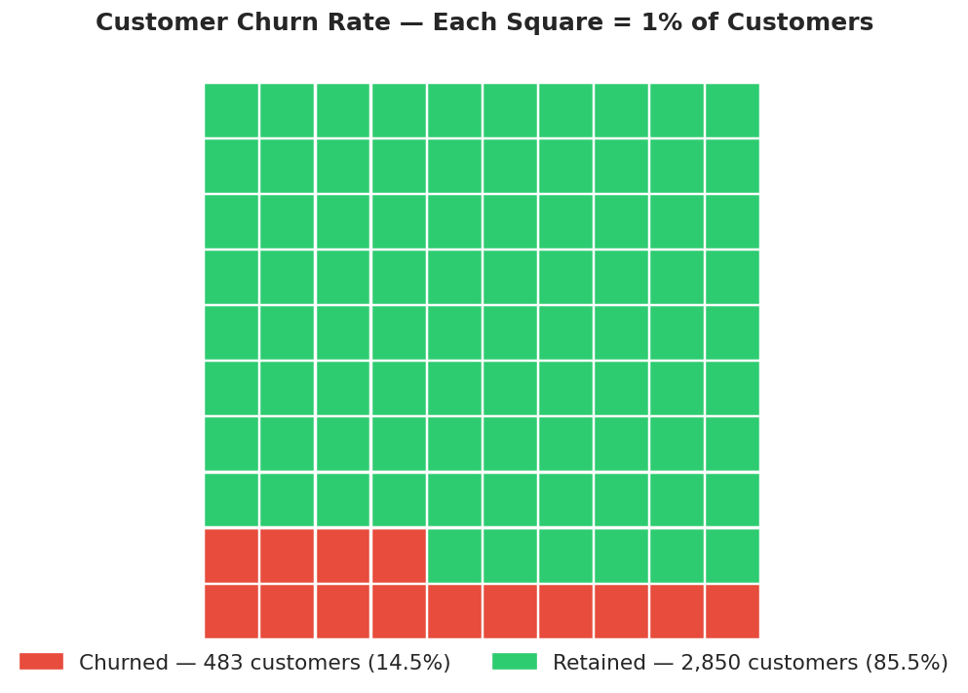
Data Understanding
3,333 customers · 21 features · one clear target: did they leave?
3,333
Total Customers
483
Churned (14.5%)
21
Features Analysed
Missing Values
0

Slide 4
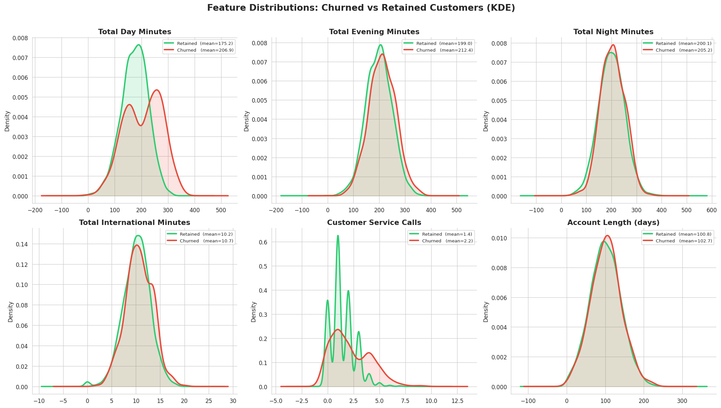

Slide 5
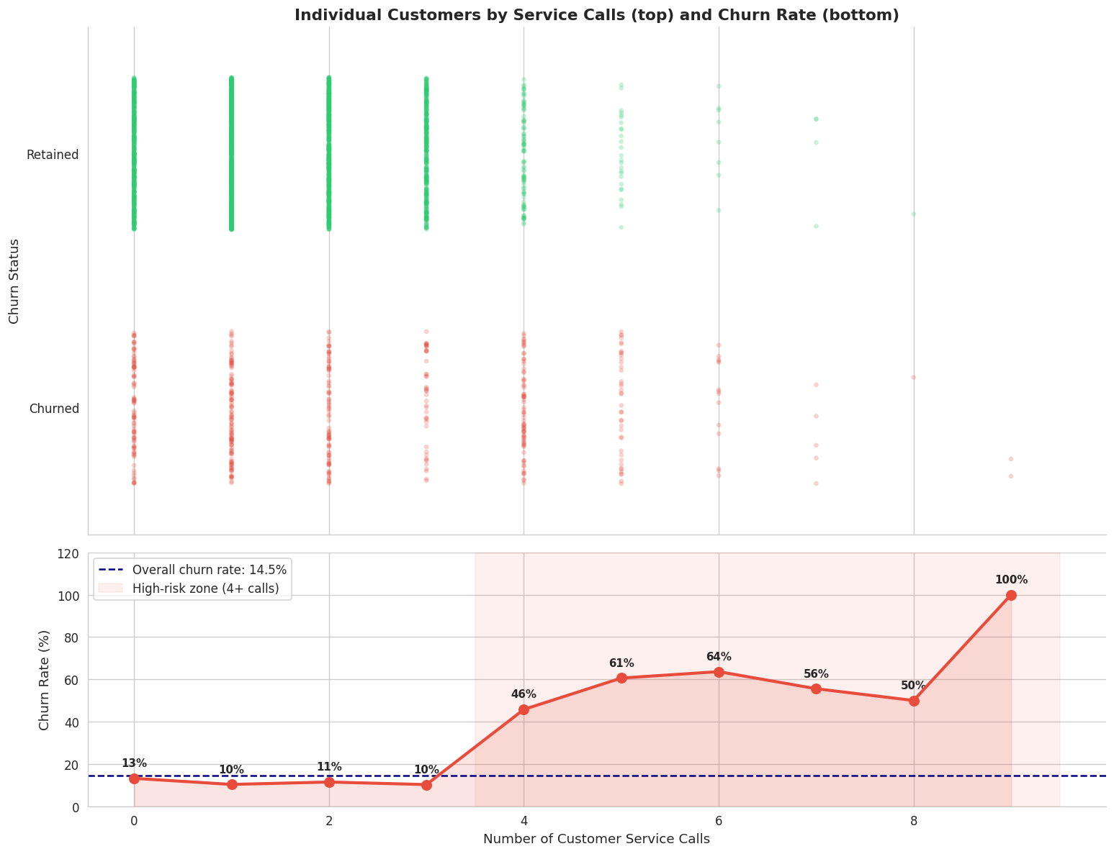
Data Finding — The Service Call Signal
The single strongest early warning sign of a customer about to leave
Key Insight
~11%
Churn rate for customers
with 0–3 service calls
46–100%
Churn rate for customers
with 4+ service calls
Business Implication
After a customer's 3rd call, route them immediately to a senior retention agent — before they decide to leave.

Slide 6
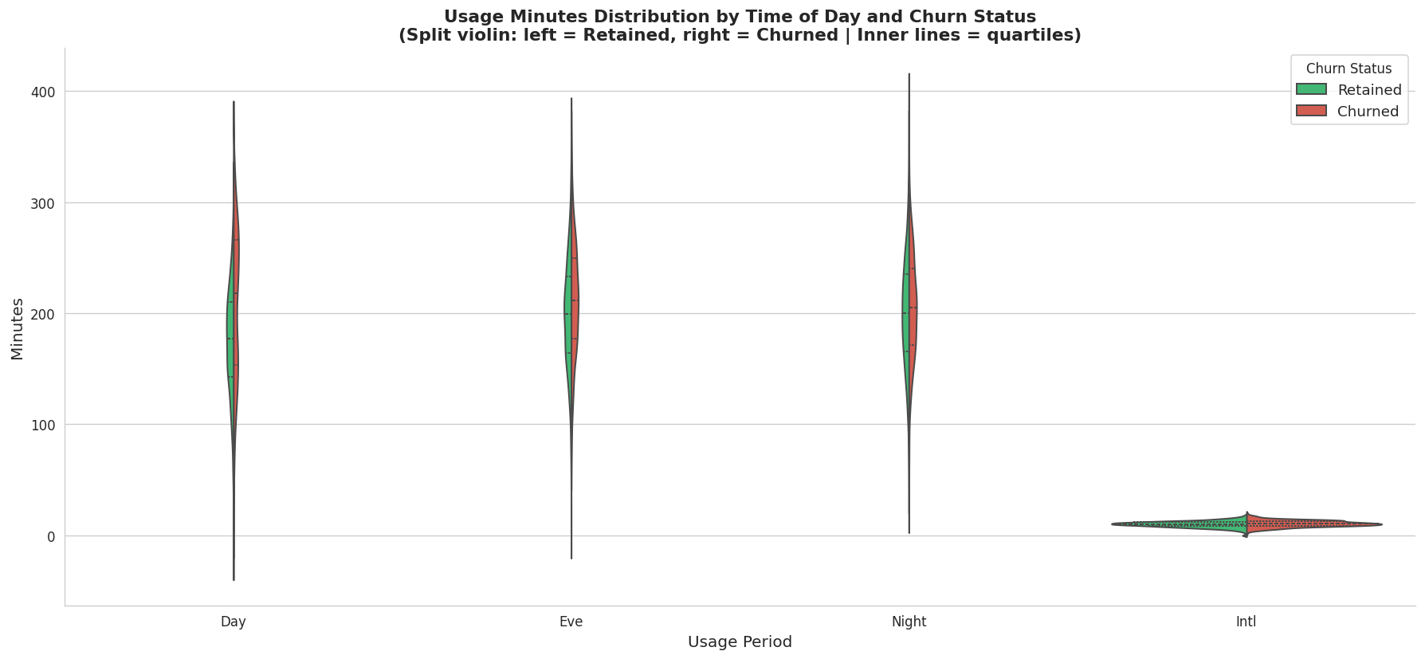
Data Finding — Usage Patterns Drive Churn
Heavy daytime callers face higher bills — and are more likely to leave
Day Minutes
Churners avg 207 min/day vs 175 for retained — higher usage = higher bills = price pressure
Night & Evening
Night and evening minutes show very similar distributions between churned and retained — these are weaker predictors.

Slide 7
Modeling Approach — Five Models Tested
We tried increasingly powerful approaches until we found the best one
M1
M2
M3
M4
M5
Random Forest
★ FINAL
Logistic Regression
(Baseline)
Logistic Regression
(Tuned)
Decision Tree
(Baseline)
Decision Tree
(Tuned)
Simple but only 25% recall — missed most churners
Better: 74% recall, but poor at precision
Memorised training data — overfit badly
74% recall, better balance — but still overfit
Best generalisation, highest AUC (0.88), most reliable

Slide 8
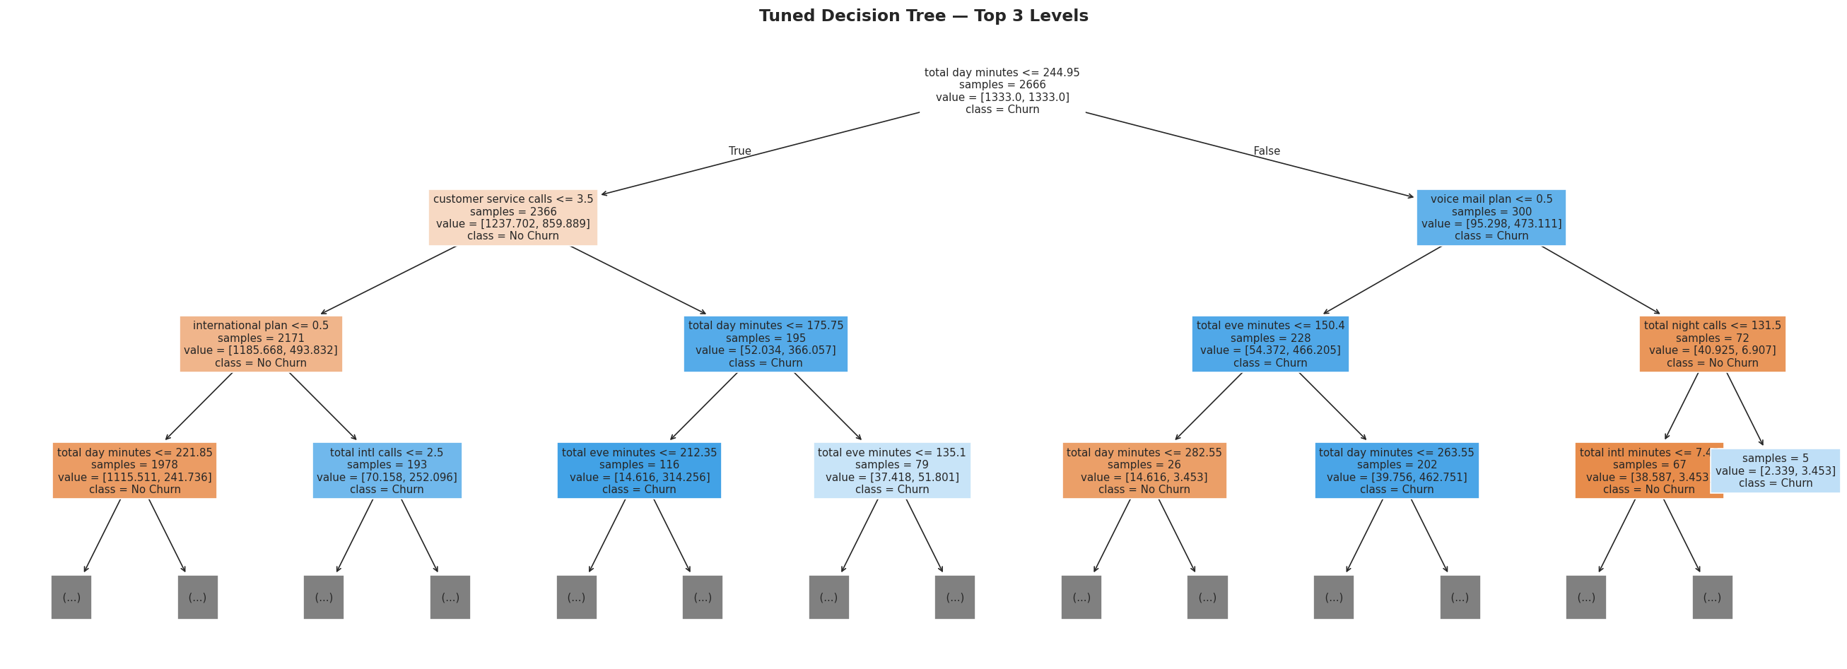
Model — Decision Tree (Tuned)
Interpretation Overfitting gap shrinks from 0.351 to 0.196. Test recall rises to 74.2% matching M2, but F1 is better (0.673 vs 0.474) — same recall with far less collateral. The tree first splits on customer service calls and total day minutes, confirming the EDA insights.

Slide 9
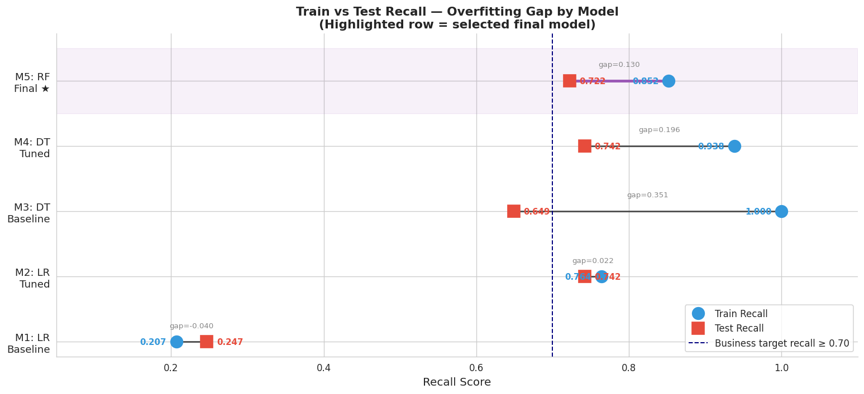
Model Evaluation — Comparing All Five Models
The Random Forest wins on the metrics that matter most for business
Train vs Test Recall — How Much Does Each Model Overfit?

Slide 10
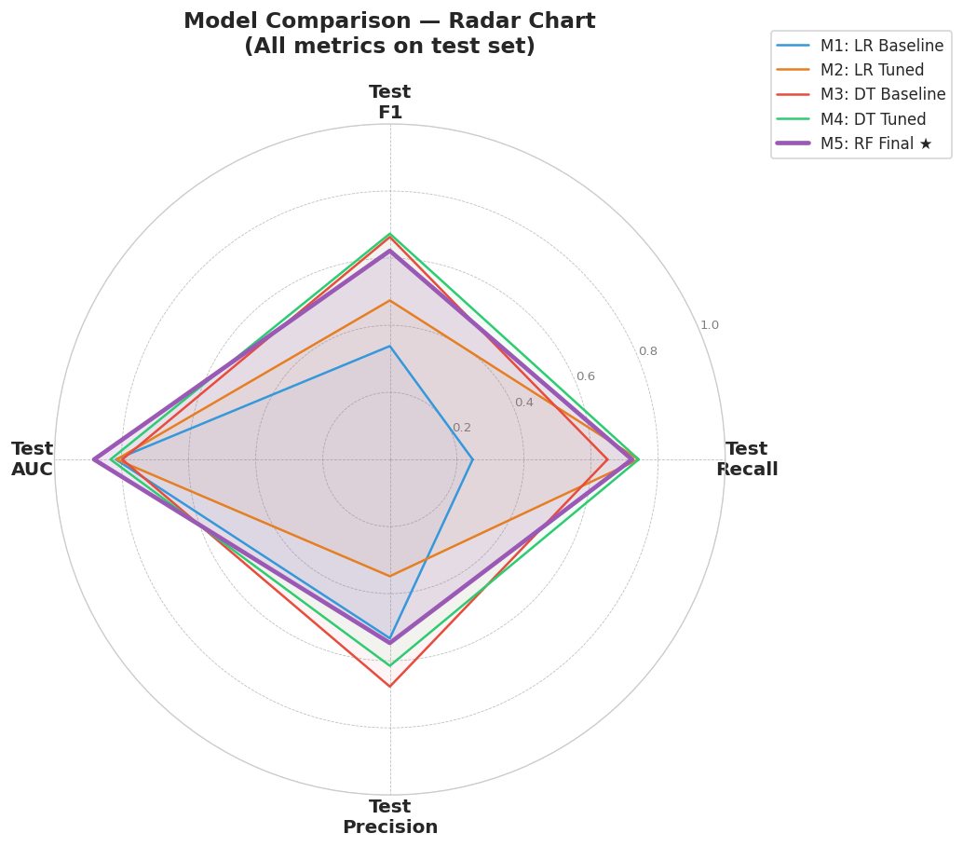
Recall
0.88
Model Evaluation — Comparing All Five Models
The Random Forest wins on the metrics that matter most for business
All Metrics at Once — Random Forest Leads
72%
55%
AUC
Precision

Slide 11
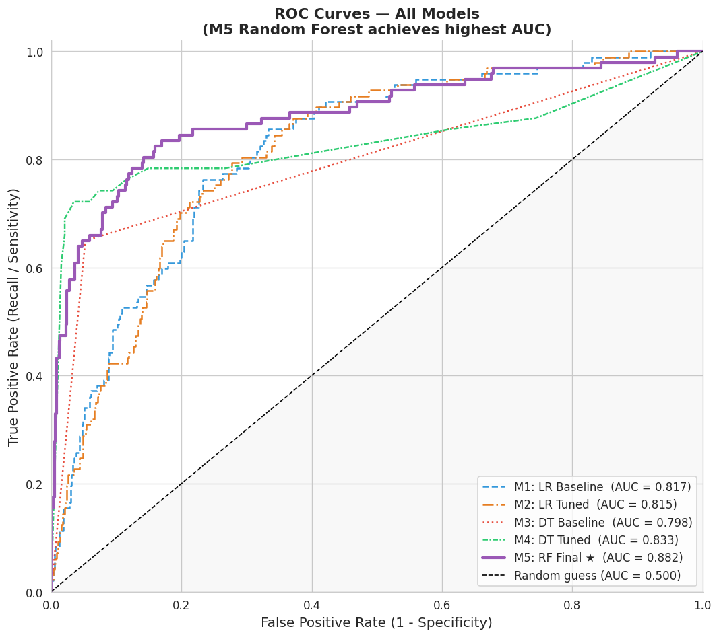
Model Evaluation — What the Numbers Actually Mean
ROC Curve — All Models
.
.

Slide 12
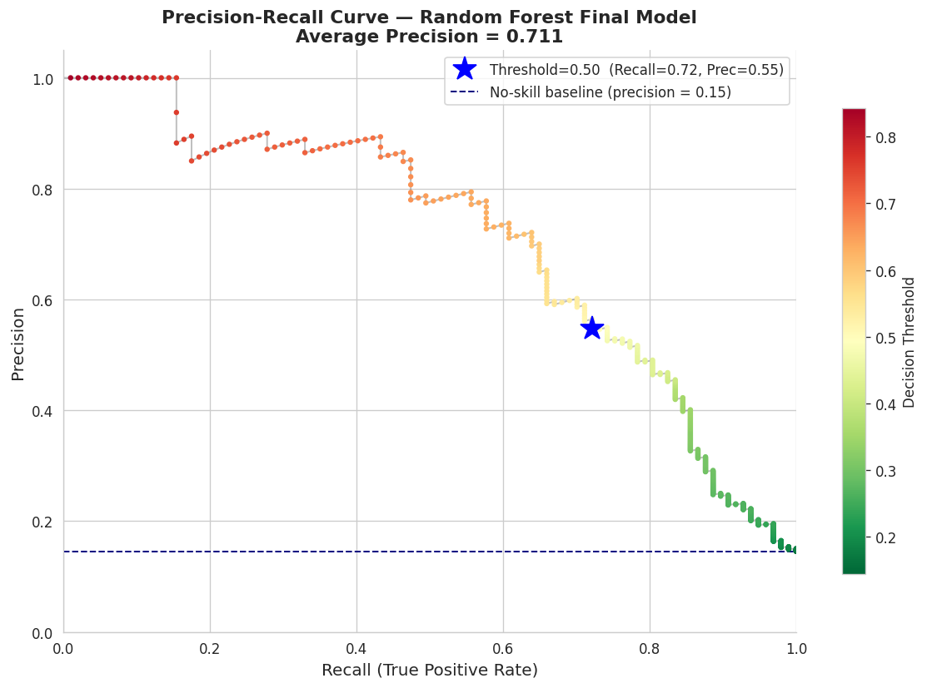
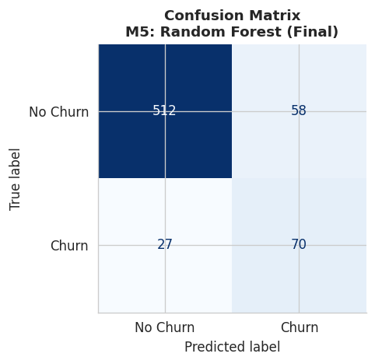
Final Model – Confusion Matrix: How Predictions Break Down
Notes:
Final model – confusion matrix

Slide 13
Model Evaluation — Explanation
Translating model performance into business outcomes
Plain-English Score Summary
Recall 72%
Of every 100 customers who would leave, we catch 72 and can intervene.
Precision 55%
Of every 100 customers we flag, roughly 55 are genuine churners.
AUC 0.88
Given any churner and non-churner pair, we rank the churner higher 88% of the time.
28% still missed
We can lower this by adjusting the threshold — trading precision for more recall.

Slide 14
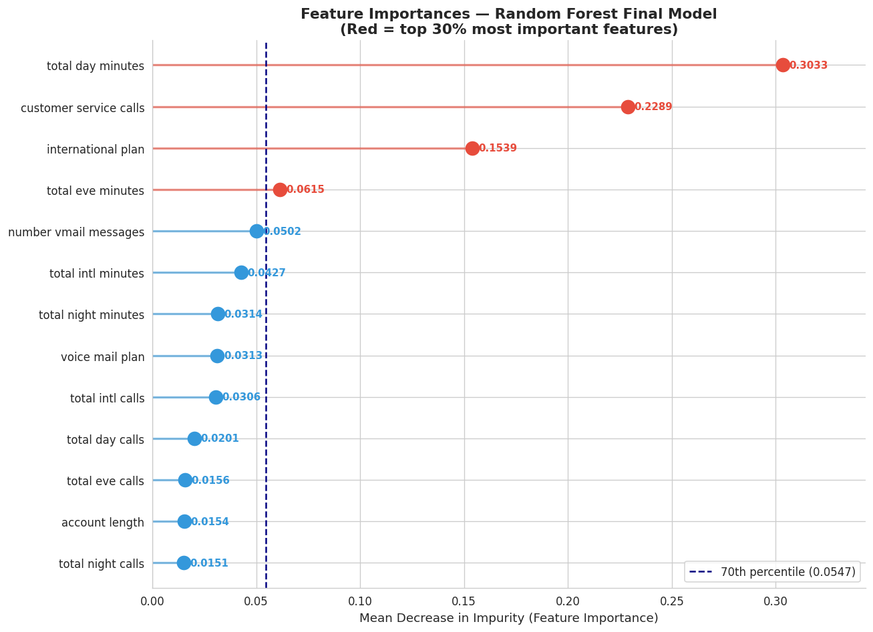
What Drives Churn? — Feature Importance
The model reveals which customer behaviours predict departure most strongly
TOP 3 FEATURES — WHAT THEY MEAN FOR US
Total Day Minutes (0.303)
Customer Svc Calls (0.229)
International Plan (0.154)

Slide 15
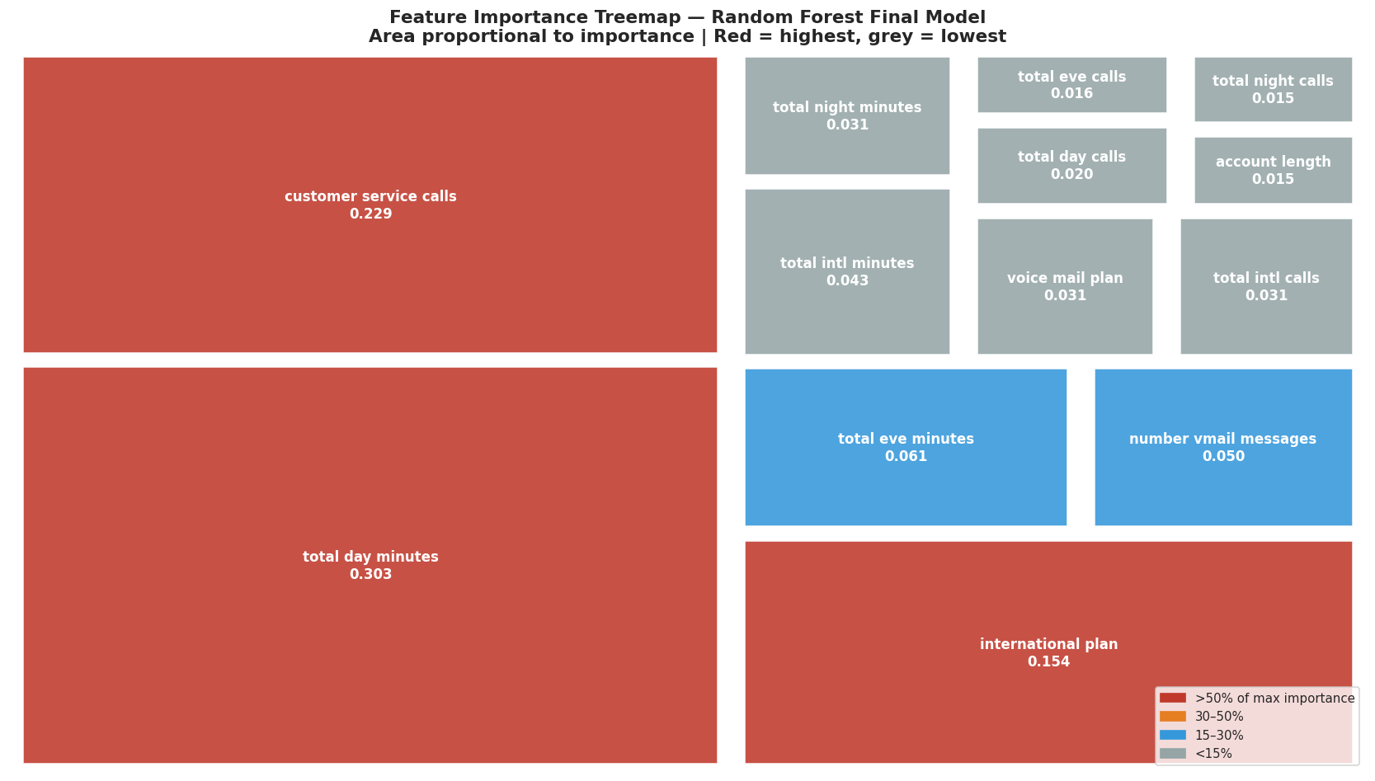
What Drives Churn? — Feature Importance
The model reveals which customer behaviours predict departure most strongly
TOP 3 FEATURES — WHAT THEY MEAN FOR US
Total Day Minutes (0.303)
Customer Svc Calls (0.229)
International Plan (0.154)

Slide 16
Our Three Recommendations
Immediate Action
01
Auto-Flag After the 3rd Service Call
Churn rate jumps from ~11% to 46%+ at 4 calls. Route to a senior retention agent before the 4th call happens. Set up a CRM trigger today.
Within 30 Days
02
Rate Cap Loyalty Offer for Heavy Daytime Users
Flag customers above the 75th percentile in day minutes (>216 min/day). Offer a price guarantee — these are your highest-value and highest-risk customers.
Within 60 Days
03
Audit the International Plan + Offer Voicemail as Incentive
42% of intl plan holders churn — review pricing vs competitors. Separately: voicemail plan holders churn at just 8.7% vs 16.7% — offer it free as a retention incentive.

Slide 17
Next Steps — Deployment Roadmap
Moving from model to measurable business impact
Phase 1
Weeks 1–2
Phase 2
Month 1–2
Phase 3
Quarterly
Deploy weekly scoring pipeline to CRM
Run A/B test: hold out control group of high-risk customers
Retrain model on newest data every quarter
Export priority-ranked at-risk customer list
Measure actual revenue retained vs outreach cost
Add contract type & demographic features
Set operating threshold with retention team
Tune threshold based on team capacity
Target: push recall above 80% with richer data
Model limitation: 27.8% of churners are still missed. Richer data and quarterly retraining will close this gap over time.

Slide 18
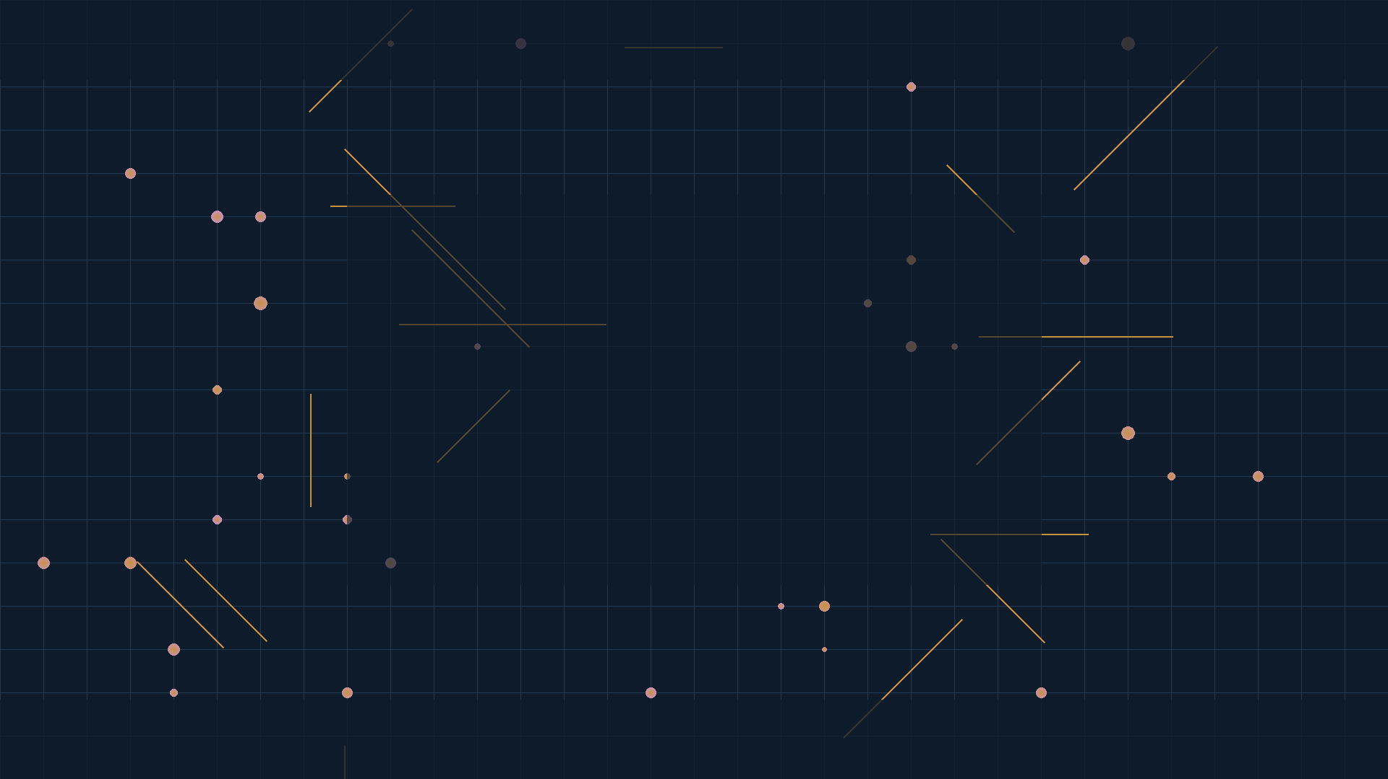
Thank You
Questions & Discussion
Data Science Team · Moringa School

