Slide 1
Rockbuster Stealth LLC
Online Transition Project
- Created by Richárd Pávay -
02-04-2023

Slide 2
AGENDA
01
02
Project Goals
Customer Habits
03
04
Geographical trends
Summary
SECTION:
SECTION:
Aim of the Project, Business Questions
Preferred Genres, Rental Duration Trends
SECTION:
SECTION:
Customer distribution, Sales distribution, Key Customers
Key Takeaways, Suggestions

Slide 3
For an effective online platform launch, understanding Rockbuster’s current customerbase is essential
Goal of the project
Key Questions
● Which movies contributed the most/least to revenue gain?
● What was the average rental duration for all videos?
● Which countries are Rockbuster customers based in?
● Where are customers with a high lifetime value based?
● Do sales figures vary between geographic regions?

Slide 4
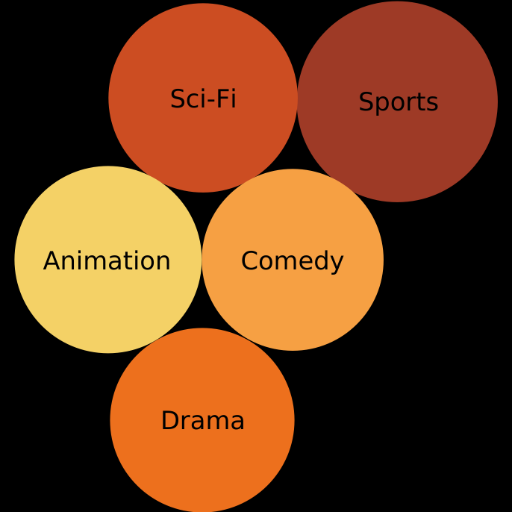
Top 5 Genres (by revenue generated)
Sports
4800 $
Sci-fi
4336 $
Animation
4245 $
Drama
4118 $
Comedy
4002 $

Slide 5
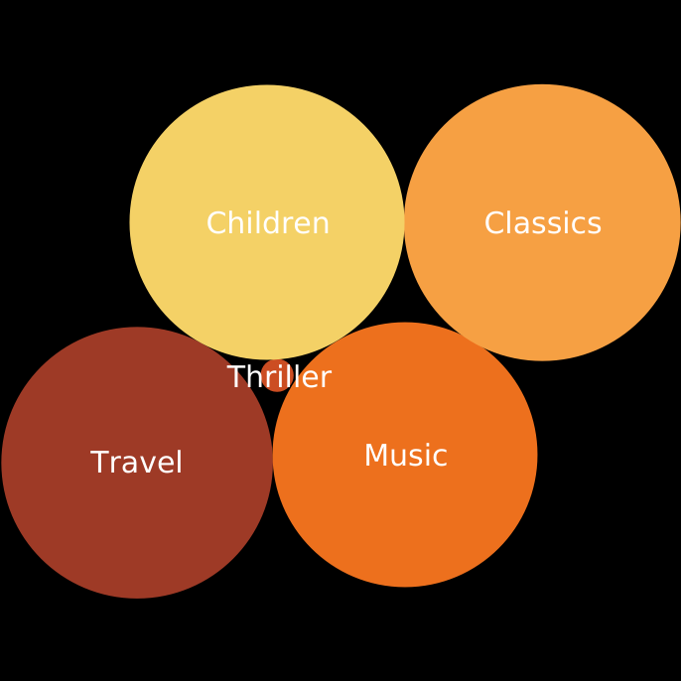
Bottom 5 Genres (by revenue generated)
Classics
3353 $
Children
3309 $
Travel
3227 $
Music
3071 $
Thriller
47 $

Slide 6
Rockbuster Rental habits
Rental duration varies between
3-7 days
Average rental duration is
5 days

Slide 7
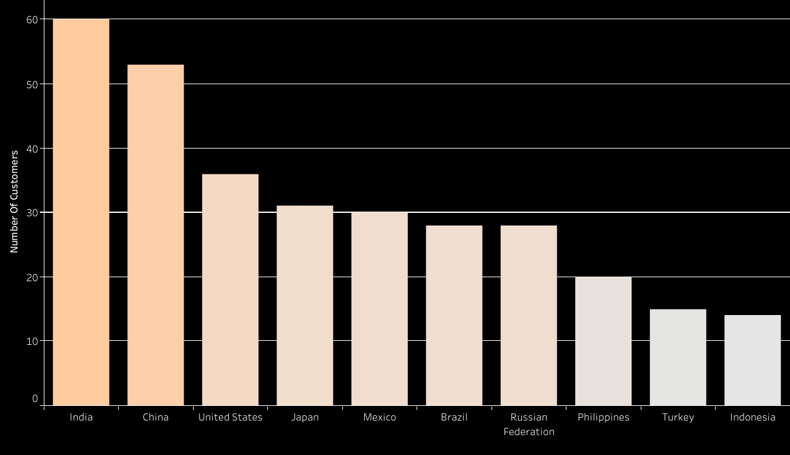
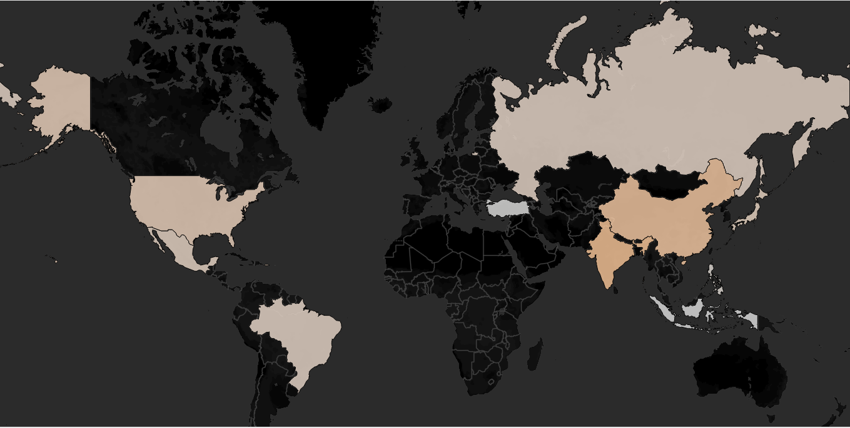
Top Countries Based on number of customers

Slide 8
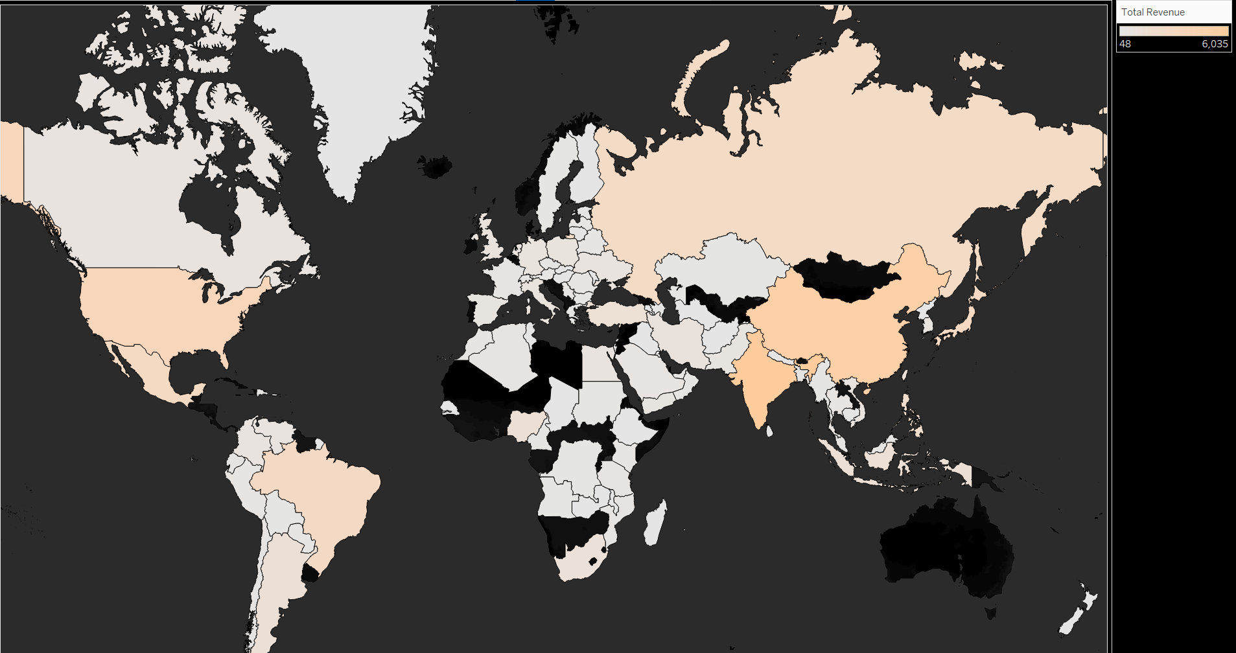
Geographic Differences by Total Revenue

Slide 9
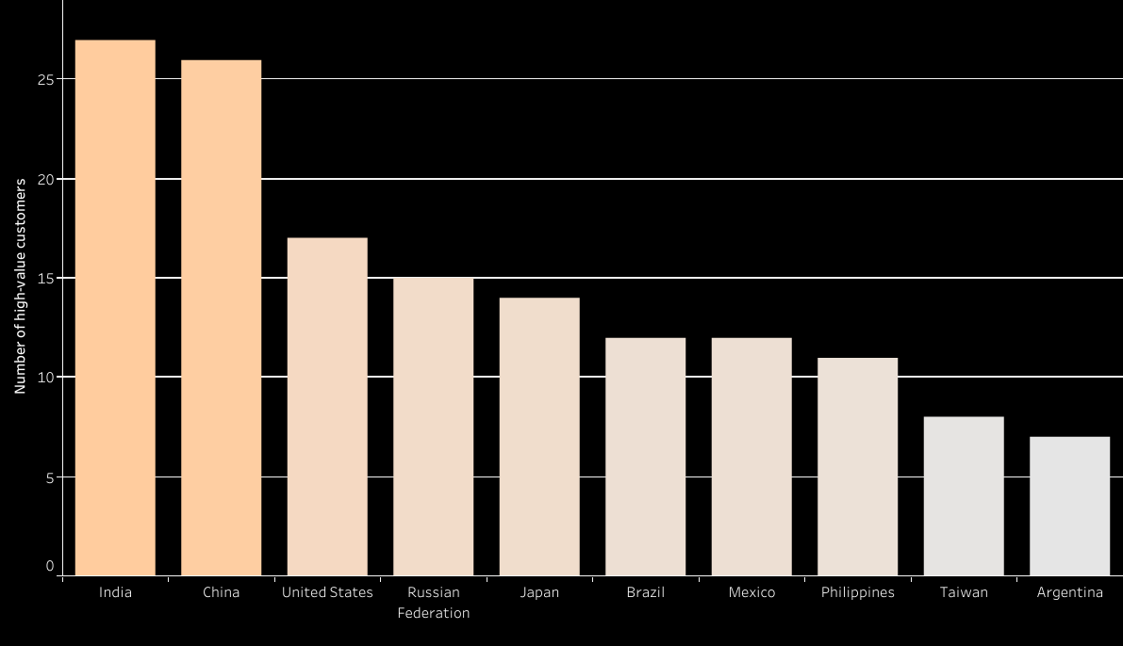
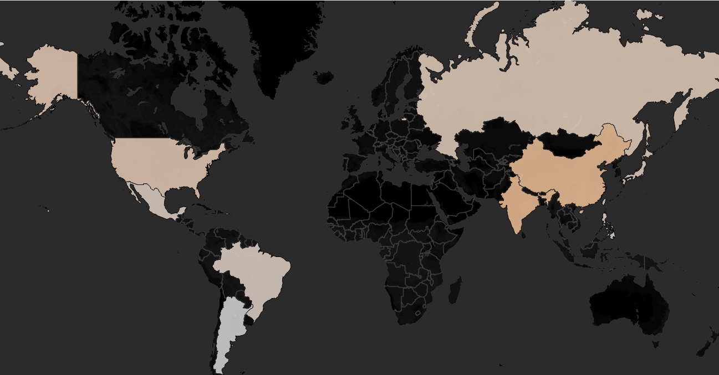
High-value customer distribution
Customers above 100$ lifetime payment were identified as high-value

Slide 10
Key Takeaways
Moovie Contribution
Rental Habits
Geographic Trends
Most profitable genres: Sports, Sci-fi, Animation
Least profitable genres: Thriller, Music, Travel
Rental duration varies between 3-7 days
Average rental duration is 5 days
Asia is the most significant market for Rockbuster LLC
India, China, and the U.S . Are the biggest source of both customers and revenue
The same countries contain the most high-value customers
For a combined visualization of customer count and revenue by geographic location, please visit: link to visualization

Slide 11
THANKS FOR YOUR ATTENTION!
DO YOU HAVE ANY QUESTIONS?

