Slide 1

Address 256
287
32 columns
24
rows
1023

Slide 2
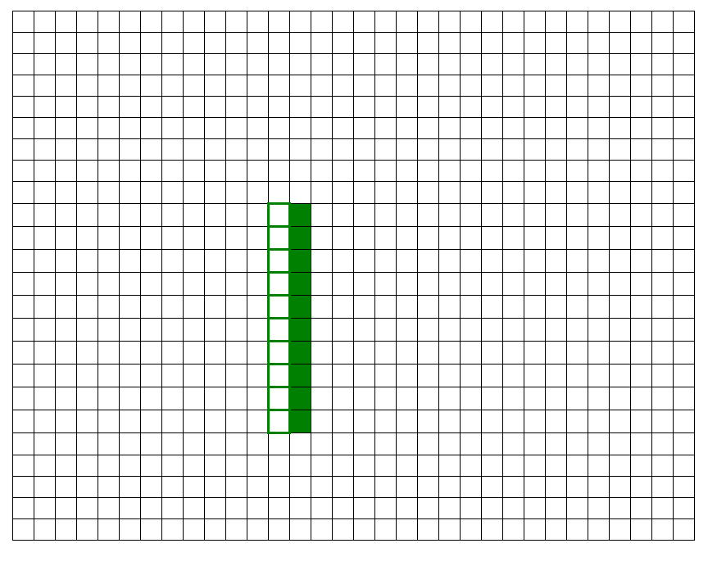

Slide 3
Front of queue
Pointer (r3)
Rear of queue
Pointer (r4)
Previous addresses (now dead data)
Screen address
of snake tail
Screen address
of snake head

Slide 4
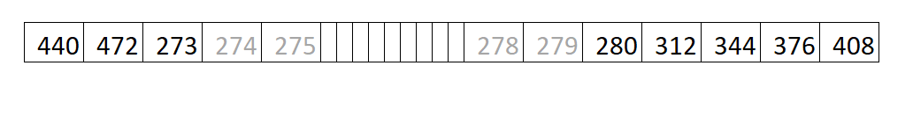
Rear of queue
Pointer (r3)
Front of queue
Pointer (r4)
Previous addresses (now dead data)
Screen address
of snake head
Screen address
of snake tail

