Slide 1
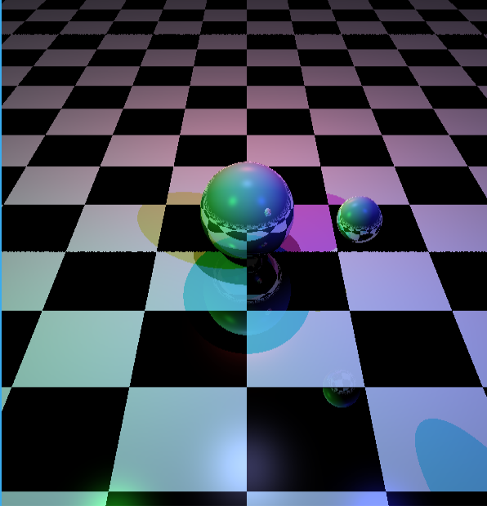
Y
new Plane(new Vector3D(0,1,0),0, StandardSurfaces.CheckerBoard),
new Sphere(new Vector3D(0,0.5,0),0.5,StandardSurfaces.Shiny),
new Sphere(new Vector3D(1,1,1),0.2,StandardSurfaces.Shiny)
new Camera(new Vector3D(6, 4, 0), new Vector3D(0, 0, 0))
Z
0,0,0
X

