Slide 1
Level 2 Employability Resources
School of Maths - Semester 1, 2026/27
Nicola Oliver, Lynn Johnson, Katie Thorley
Senior EPS Employability & Placement Officers

Slide 2
Today’s Agenda
Benefits of Work Experience
Summer Internships/Placement Year
My Career
Minerva
Where to search for Opportunities
EPS Employability Team
Next Steps

Slide 3
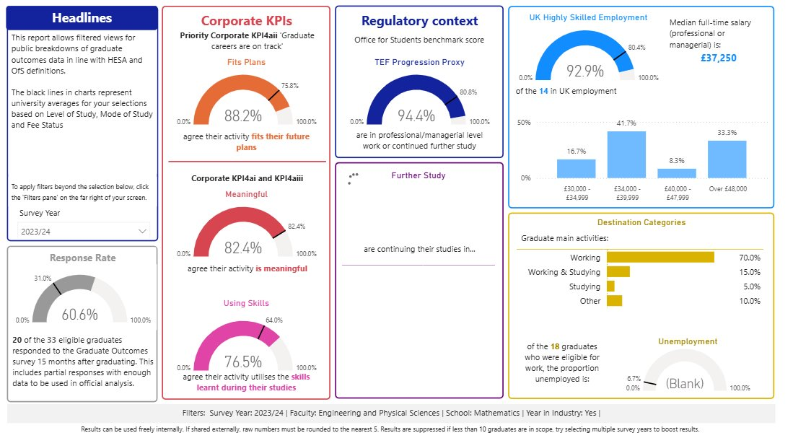
Benefits of Work Experience (Maths)
In the most recent Graduate Outcomes Survey…
92.9% of Maths Students who took a Year in Industry are now in ‘highly skilled’ Employment.
(74.4% for graduates who didn’t)
88.2% of Maths Students who took a Year in Industry say their destination fits future plans (69.0% for graduates who didn’t)

Slide 4
Paid Work Experience Opportunities
 | Summer Internship | Industrial Placement
Paid:
Length: | 8 – 12 weeks | 9 – 12 months
When: | Summer between academic years | Taken after 2nd second year (or 3rd year if on Integrated Masters)
Type of work: | Any – typically project based | Degree level, though does not need to be related to your degree**
Approval required:
International Students:
Notes:
This is the first year that some students have signed up for the YII variant of their course, so this is why it’s worth explaining about YII opportunities now. However, they will be applying at the beginning of year 2.
Explain how summer internships are not always open to first years, but to filter down to see if they are open to first years.
**
CHEM- If replacing your 3rd year, must have a laboratory focus
MATHS Must be applying skills from your degree, ie. some Maths-related content

Slide 5
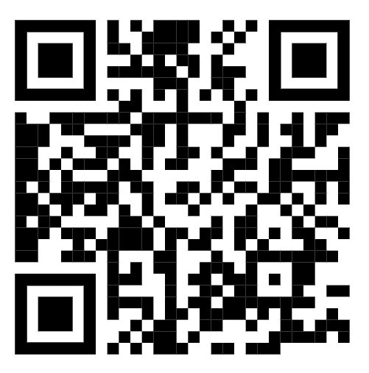
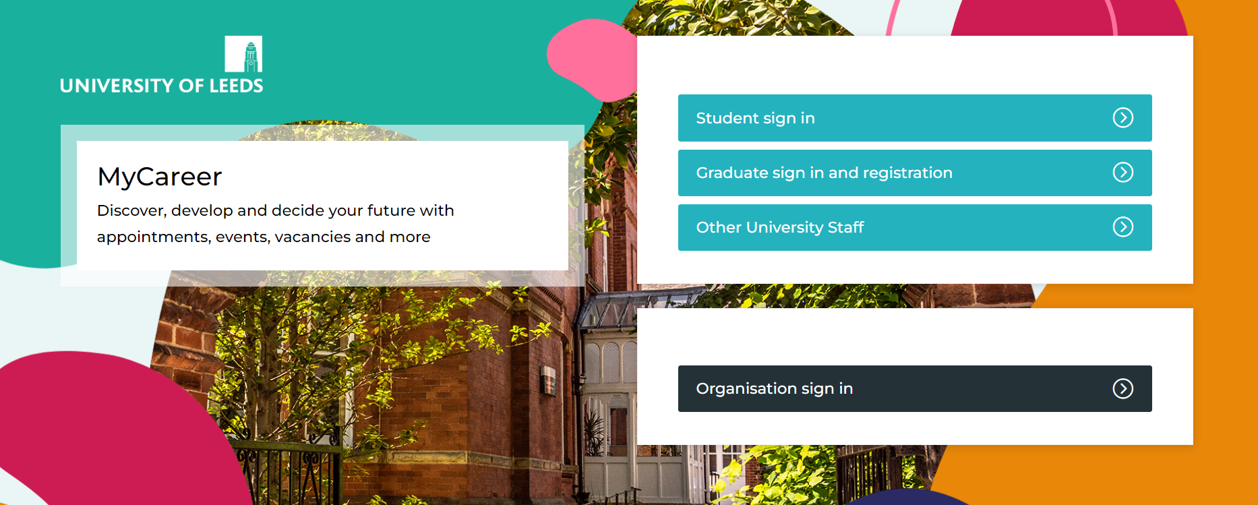
Activity: Sign into MyCareer
Once you are signed in, what services and resources on MyCareer will be useful to you?

Slide 6
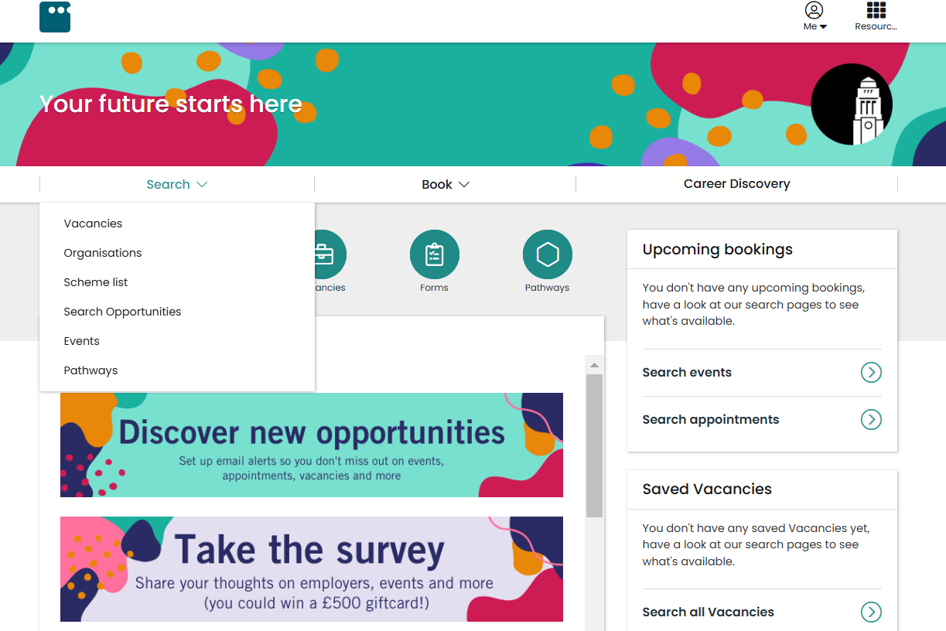
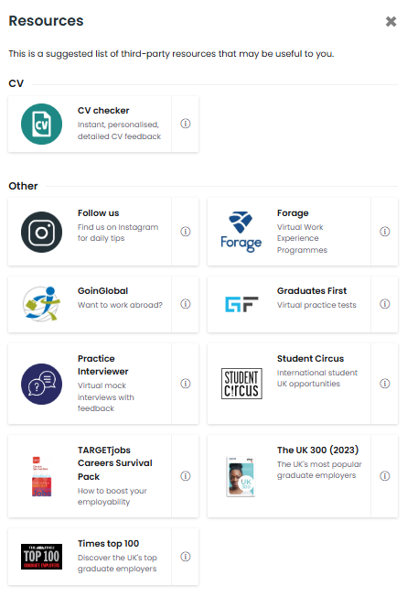
MyCareer. leeds.ac.uk
Book 1:1 appointments
Read articles related to your sector
Update your profile and preferences
Access online resources
Find Grad roles, Placements and Internships
Sign up to
EPS Exclusive Opportunities Scheme
Search & book onto Events
Notes:
Choose either to do a live demonstration to navigate MyCareer or show this slide.

Slide 7
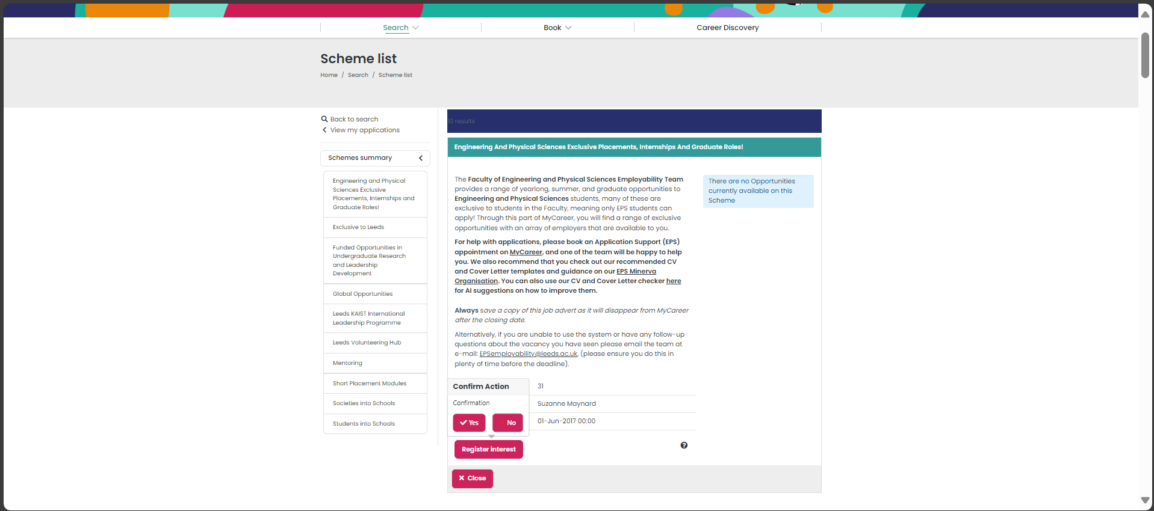
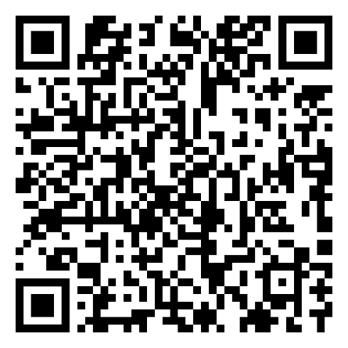
1
★ Log on / Sign up to MyCareer.leeds.ac.uk
★ Click "Search"
★ Select "Scheme List"
How to opt in to Exclusives:
OR
Scan this QR Code to open the scheme
2
★ Find scheme:
"Engineering and Physical Sciences Exclusive Placements, Internships and Graduate Roles"
3
★ Click on "Register interest"
★ Click [ ✓Yes ] to confirm

Slide 8
EPS Minerva Resources for Students
R
Resources
Application Support
CV and Cover Letter Templates
Placement / Summer Internship / Global Opportunities
FAQs and Employability Information
How to access EPS Minerva Resources:
Sign in to Minerva
On the left-hand panel, select 'Organisations'
Select – 'EPS Employability'
Notes:
Remind students of the location of the Office, based on the 1st floor of the Mech Eng building, in room 1.51 and during term time we are open to students Mon to Fri from 10-4 and outside of term-time TWT 10-4pm
You can contact us via the email address on the slide. Invite students to take a photo of the slide so they have our details.
And mentioned myCareer and Minerva in terms of booking appointments and accessing our resources.

Slide 9
Searching for Opportunities
There are 3 main Job Search Resources for Maths Students:
MyCareer
For a wide variety of jobs, some Maths related. There are also part-time vacancies and on-campus work opportunities such as research roles.
EPS Exclusive Opportunities are only open to EPS Students: refer to the video tutorial to sign up and view these.
2. GradCracker: Gradcracker - Careers for STEM Students
The job board for student and graduate level STEM roles. There are Summer Internships, Insight Days, Placement Years and Graduate Jobs.
3. BrightNetowrk: Graduate Careers For Bright Minds | Bright Network
The job board for student and graduate level STEM roles. There are Summer Internships, Insight Days, Placement Years and Graduate Jobs.
Notes:
Once you've prepared your applications, the next step is knowing where to look for opportunities. There are three key resources I'd recommend using regularly."
"The first is MyCareer, where you'll find internships, placements, graduate jobs, part-time work, research opportunities, and EPS-exclusive vacancies that are only available to students within our faculty."
"The second is Gradcracker, which is specifically designed for STEM students and advertises placement years, internships, insight days, and graduate roles from a wide range of employers."
"The third is Bright Network, another excellent platform that advertises internships, placements, graduate jobs, networking events, and employer-led opportunities across a variety of sectors. Many large employers use Bright Network as part of their recruitment process."
"I'd encourage you to check all three platforms regularly and set up job alerts so you're notified when relevant opportunities become available."

Slide 10
Other Ways to find Opportunities
LinkedIn – Groups and alumni tool
Events – bookable via MyCareer
Careers Fair – STEM Fair 20th October
Each other!
Professional Bodies
Follow companies on Linked In, make Connections, use resources on Minerva for using LinkedIn
Check out Minerva for all upcoming events
Notes:
"While job boards are a great place to start, there are lots of other ways to find opportunities and build your network."
"LinkedIn can help you connect with professionals, join industry groups, and use the alumni tool to see where Leeds graduates are working and the career paths they've taken."
"I would also encourage you to attend careers events and fairs, which can be booked through MyCareer. These are great opportunities to meet employers, ask questions, and learn about roles that may not be widely advertised."
"Don't forget your fellow students as well. Sharing opportunities, application tips, and experiences can be incredibly valuable."
"Finally, professional bodies often provide careers advice, networking opportunities, and exclusive internships, placements, and graduate vacancies, so they're well worth exploring."

Slide 11
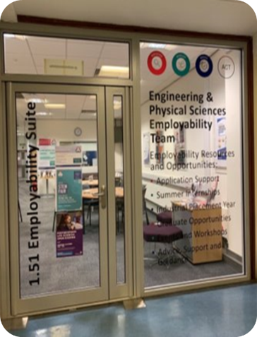
EPS Employability Team
Find Us: Visit the EPS Employability Suite, 1.51 in Mechanical Engineering​
Drop In: 12pm-2pm Wednesday and Thursday
Email Us: EPSemployability@leeds.ac.uk​
​Book Appointments, Find Events & Search for Opportunities: MyCareer ​
​Resources & Information: Available on Minerva Organisation
Senior Officers: Nicola Oliver, Lynn Johnson, Katie Thorley
Support you to enhance your employability ​
1:1 Appointments in person and via Microsoft Teams
Employer-led workshops and connecting opportunities
Opportunities newsletters
Source exclusive vacancies
Notes:
Drop in info removed for first years
Provide details of the service and explain that students with that Faculty receive a dedicated service from the EPS Employability team.
Go through the different aspect of our work and how it helps students

Slide 12
Next Steps
Log onto MyCareer
Familiarise yourself with Minerva resources
Book a 1-2-1 appointment with us
Attend the October STEM Fair

Slide 13
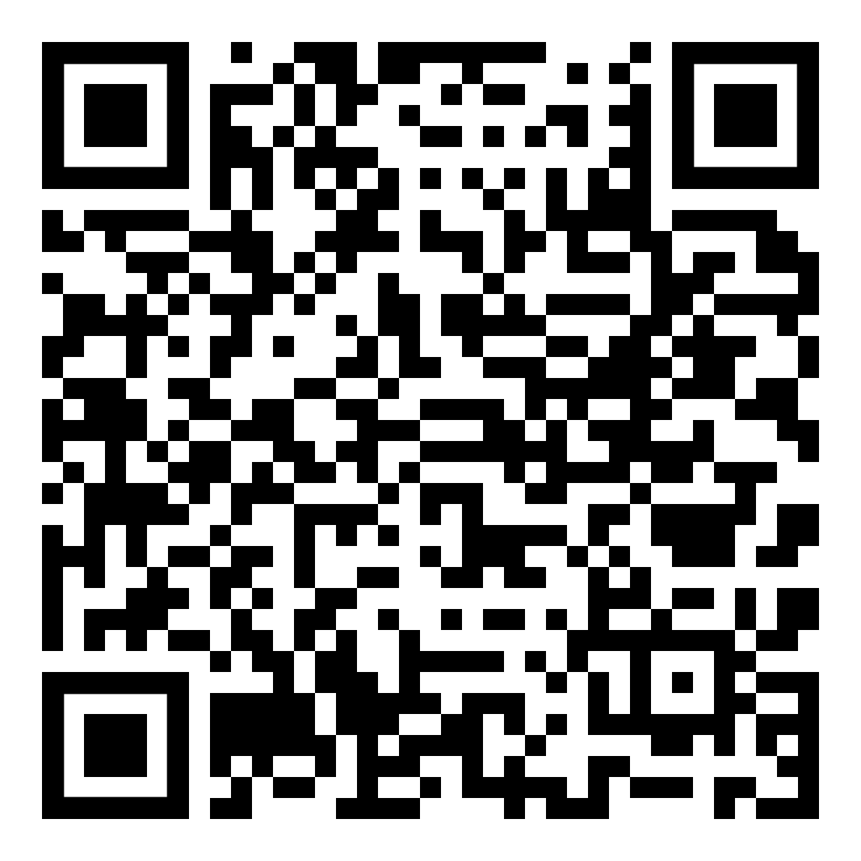
STEM FAIR 2026
20 October 2026 | 11 am – 3 pm
The Edge Sports and Exhibition Centre
This is your chance to connect with more than 100 local, national, and international STEM employers with opportunities for you!

Slide 14
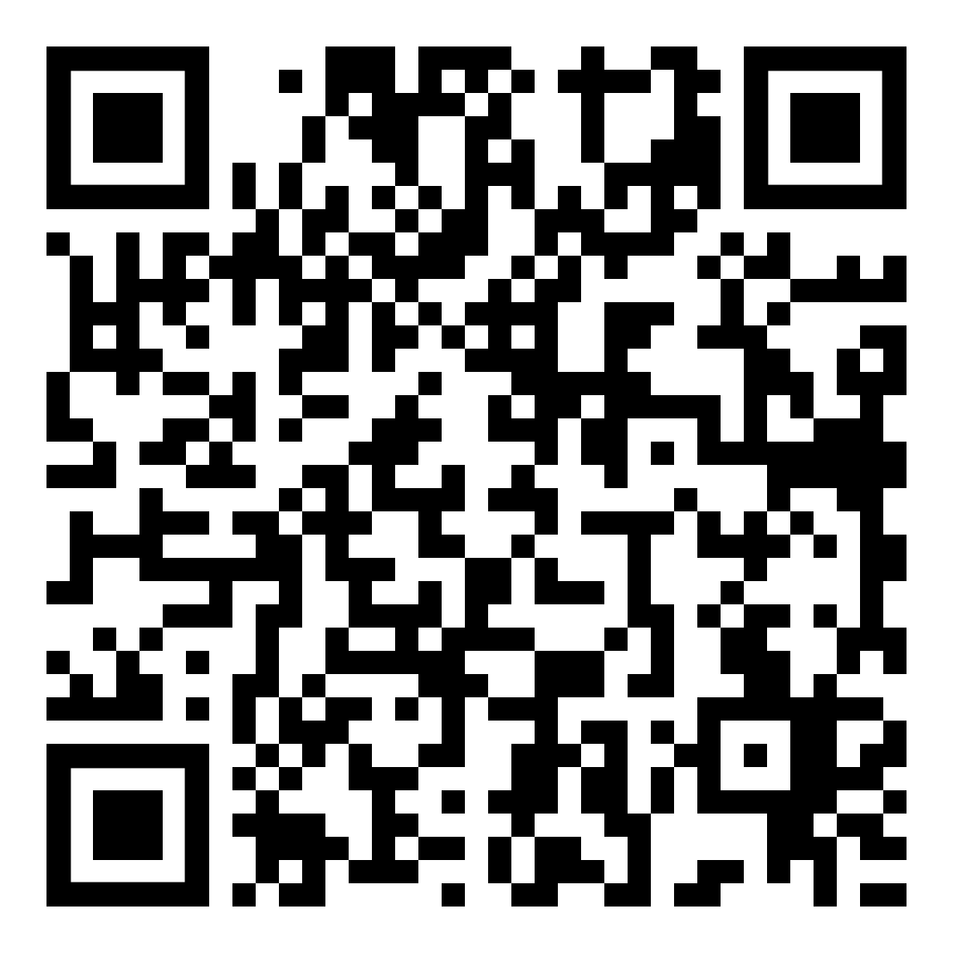
Secure Your Year in Industry or Summer Internship Session
Applications for 2027 are open now.
Book your place TODAY so you can learn how to:
Stand out to employers
Find opportunities
Access exclusive MyCareer vacancies
Use resources/support effectively
Available dates:
12 Oct, 2-3pm | 14 Oct, 11am-12noon | 16th Oct, 1-2pm

