Slide 1
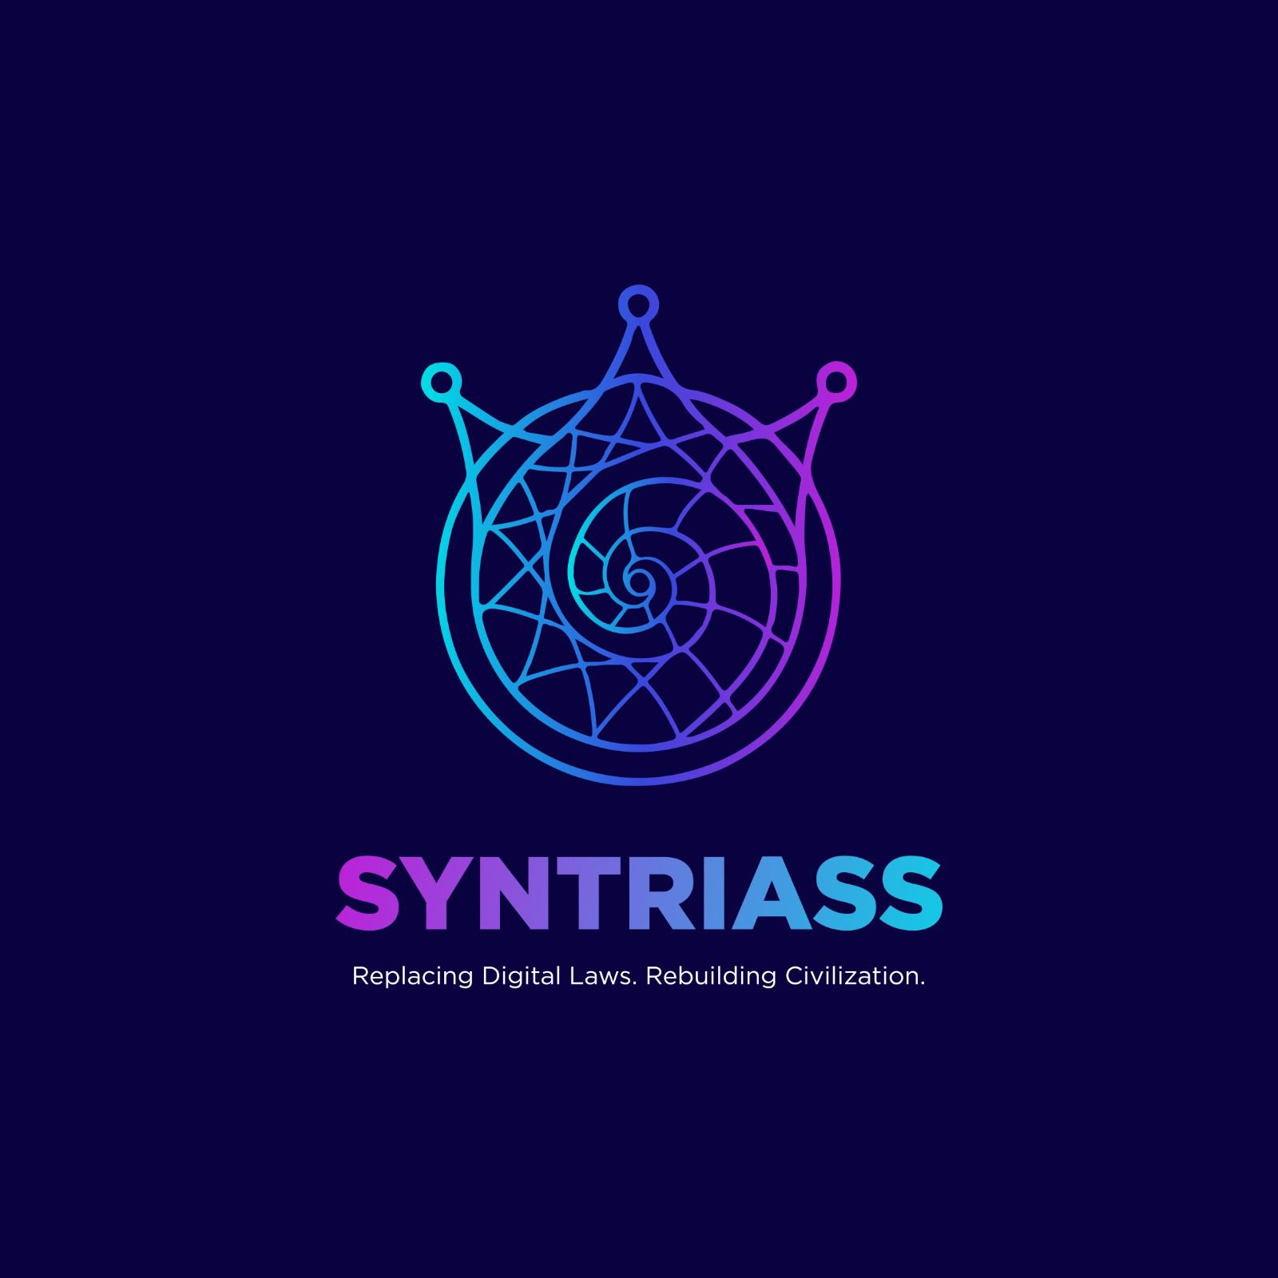
SYNTRIASS
AIRON AGENT PASSPORT
AI agents need passports before they enter regulated infrastructure.
PASS / TOXIC
Offline and online passport verification result
AIRON combines a portable Agent Passport layer with kernel-level AEGIS enforcement so autonomous agents can be identified, constrained, verified, revoked, and audited.
CI-verified
AIP service, SDK, and verifier run in GitHub Actions
AIP: passport and delegation
AEGIS: eBPF/XDP enforcement
TRL-5 pilot-ready path
TRL-4 -> 5
Lab validation complete; relevant-environment pilots are next
SYNTRIASS | AIRON pitch deck | Agent Passport + AEGIS
01

Slide 2
PROBLEM
AI agents are being deployed without an accountability boundary.
In regulated workflows, a model output is not enough. Auditors need to know which agent acted, who authorized it, what it was allowed to do, and whether that authority was still valid.
Anonymous automation
Scope creep
No court-grade trail
Liability gap
Shared API keys and service accounts hide the true actor.
->
Sub-agents inherit tools without mathematically bounded authority.
->
Logs are fragmented and cannot prove delegation lineage.
->
A breach can scale at machine speed while ownership stays unclear.
SYNTRIASS | AIRON Trust Infrastructure | Confidential pilot deck
02

Slide 3
SOLUTION
AIRON Agent Passport gives every agent a portable credential.
The passport is a signed JSON document that travels with the agent and can be verified before tool execution or during offline audit.
IDENTITY
{
header: AIP-PASSPORT,
subject: agent + keys,
issuer: AIRON root,
constraints: scopes + expiry,
lineage: signed authority,
environmental_lock: runtime,
proof: signature
}
CONSTRAINTS
Agent ID, friendly name, and public key fields.
Capability list, expiry, and max delegation depth define what the agent can do.
AUTHORITY
Issuer identity and signed lineage bind the passport to a parent AIP token.
PROOF
Ed25519 proof in Phase 1; ML-DSA field reserved for hybrid PQC upgrade.
Verify online
Verify offline
Tamper = TOXIC
SYNTRIASS | AIRON Trust Infrastructure | Confidential pilot deck
03

Slide 4
PRODUCT
Passporting an agent is now an executable workflow.
The current repo exposes issuance, verification, tamper rejection, offline audit, and Python SDK UX.
1. Issue AIP token
2. Issue passport
3. Verify before tool
4. Tamper test
POST /v1/identity/issue creates a signed agent token.
->
POST /v1/passports/issue validates the token and signs the passport body.
->
POST /v1/passports/verify returns PASS for valid authority.
->
Capability mutation returns TOXIC instead of silent acceptance.
Python: AgentPassport(config).issue(...)
CLI: airon-passport verify agent.passport.json
Developer outcome: one credential can be passed across LangChain agents, API tools, notebooks, and audit workflows.
SYNTRIASS | AIRON Trust Infrastructure | Confidential pilot deck
04

Slide 5
PLATFORM
AIP governs the actor; AEGIS enforces the boundary.
Together they create a trust gateway for regulated agent traffic: identity decisions in user space, fast containment in kernel space.
AIP CONTROL PLANE
Agent Passport
Delegation lattice
Revocation graph
EvidencePacket
Portable signed credential
Scopes cannot exceed parent
Cascade invalidation
Audit-grade trace binding
Agent request -> passport check -> policy decision -> session enforcement -> audit evidence
AEGIS ENFORCEMENT PLANE
eBPF/XDP hook
Session maps
Circuit breaker
PQC session path
Packet path interception
Kernel-resident state
Rogue-loop blocklist
Hybrid keying roadmap
SYNTRIASS | AIRON Trust Infrastructure | Confidential pilot deck
05

Slide 6
VALIDATION
The story has moved from code fragments to repeatable evidence.
AIP now has a testable passport schema, service endpoints, offline verifier, Python SDK, and Colab pilot harness.
113
25
7
PASS
CURRENT TRL
TRL-4
aip-core tests in local validation
aip-service tests including passport verifier checks
Python SDK tests covering passport UX
GitHub AIP Validation for passport implementation
Pilot evidence is next.
EVIDENCE LADDER
Schema: AgentPassport v1 fields and validation helpers
Service: /v1/passports/issue and /verify
Verifier: airon-passport offline PASS / TOXIC audit
Pilot: Colab notebook exports pilot_results.json
SYNTRIASS | AIRON Trust Infrastructure | Confidential pilot deck
06

Slide 7
MARKET WEDGE
Regulated AI needs a trust gateway before pilots become production.
AIRON starts where the cost of anonymous autonomous action is highest: financial workflows, critical operations, and defense autonomy.
WEDGE 1
WEDGE 2
WEDGE 3
BFSI and fintech
Enterprise AI teams
Defense / critical infra
AI agents reading invoices, reconciling ledgers, moving cases through payment operations.
LangChain and notebook-based agents that need portable credentials and tamper-evident tool access.
Autonomous systems requiring a black-box record of authority, runtime, and allowed action.
Trigger: auditability before agentic automation scales.
Trigger: internal controls for autonomous workflows.
Trigger: mission accountability and fail-closed behavior.
Pilot wedge
Start with Agent Passport SDK and Colab evidence. Expand to AIRON Trust Gateway once workflow authority is proven.
SYNTRIASS | AIRON Trust Infrastructure | Confidential pilot deck
07

Slide 8
BUSINESS MODEL
Land with passport pilots; expand into trust gateway infrastructure.
The product ladder starts with low-friction developer adoption and expands toward regulated infrastructure contracts.
STAGE 1
STAGE 2
STAGE 3
STAGE 4
Open SDK
Pilot license
Enterprise control plane
Trust gateway nodes
Python package, Colab notebook, LangChain / ML adapters
Private AIP service endpoint, audit exports, support
Registry, revocation, EvidencePacket vault, admin workflows
AEGIS enforcement for high-value network paths
Developer traction
Design partner validation
Annual platform contract
Capacity-priced infrastructure
Pricing can be finalized after the first design partner pilots; the immediate funding objective is validation, not premature scale claims.
SYNTRIASS | AIRON Trust Infrastructure | Confidential pilot deck
08

Slide 9
ROADMAP
Funding converts lab truth into relevant-environment evidence.
The next gate is not more claims; it is controlled pilot evidence from real agent workflows and realistic infrastructure validation.
NOW
30 DAYS
90 DAYS
180 DAYS
TRL-4
TRL-5 AIP
Hybrid PQC
AEGIS lab
Repo + CI validation, service endpoints, SDK, Colab harness
External notebook pilots, sanitized results, design partner pack
ML-DSA keyring, crypto agility, stronger CBOM evidence
Bare-metal XDP testbed, latency histograms, pilot dossier
Use of funds: deployment, pilot support, ML-DSA implementation, validation automation, and bare-metal AEGIS test infrastructure.
SYNTRIASS | AIRON Trust Infrastructure | Confidential pilot deck
09

Slide 10
USP
AIRON is the passport layer for agents, not just IAM, workload ID, or observability.
The wedge is not replacing established identity stacks. The wedge is the missing portable credential that proves an agent's authority, scope, lineage, and revocation state at the point of action.
Okta / IAM
SPIFFE / SPIRE
AIRON DIFFERENCE
Govern users, apps, NHIs, and enterprise access.
Issue workload identities and SVIDs for services.
Portable credential, cryptographic finality, enforceable boundary.
Adds passport proof.
Adds authority lineage.
Maxim AI / evals
API gateways
Travels with LangChain, notebooks, APIs, and audits.
Evaluate, simulate, and observe agent behavior.
Route APIs and enforce request-level access.
Binds human authority to agent action.
Limits scope with lattice, expiry, and revocation.
Adds verified authority.
Adds audit evidence.
Verifies offline as PASS or TOXIC.
Connects to AEGIS for network containment.
Positioning: works beside Okta and SPIFFE; competes where agent-specific proof, revocation, and forensic accountability are mandatory.
SYNTRIASS | AIRON Trust Infrastructure | Confidential pilot deck
10

Slide 11
ASK
Back the Agent Passport pilot and the AIRON Trust Gateway roadmap.
We are seeking RDI/TDB support and design partners to validate AIRON in relevant environments: agent workflows first, gateway infrastructure next.
Next step
1
Design partners
Run the Colab pilot against a deployed AIP service and return pilot_results.json.
Deploy aip-service publicly, run the Agent Passport Colab pilot, and attach generated evidence to the TDB/RDI dossier.
2
RDI support
Fund TRL-5/6 validation: deployment, cryptographic hardening, and bare-metal lab.
3
Technical diligence
Review the repo, CI artifacts, passport verifier, and validation ladder.
SYNTRIASS | AIRON pitch deck | Funding support and pilots
11

